Slide 1
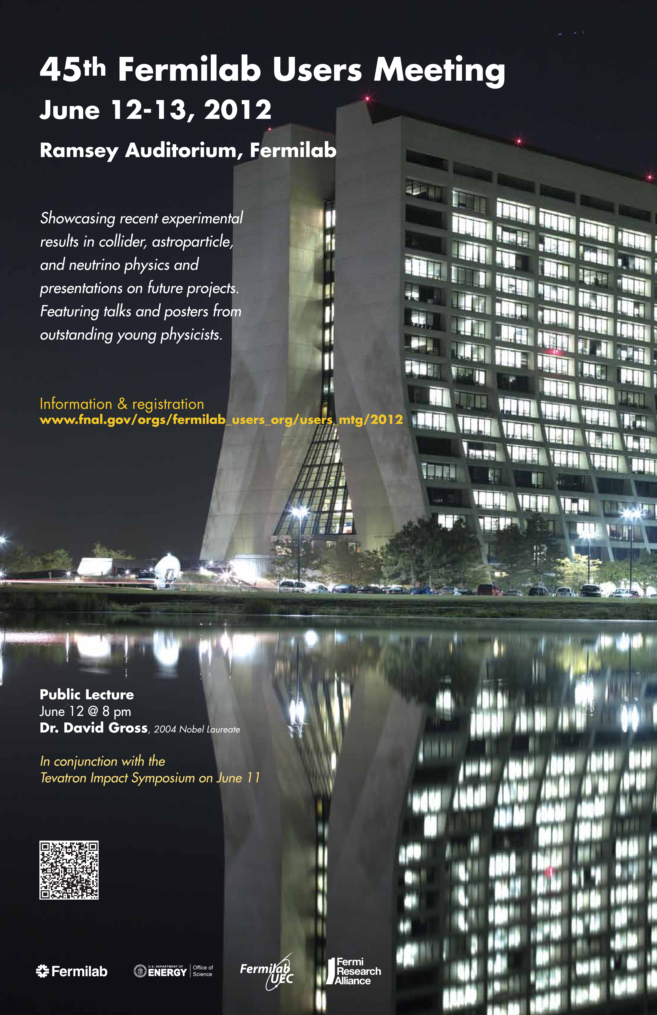
The US Muon Accelerator Program:
Goals and Challenges
Mark Palmer & Yağmur Torun
June 12, 2012
June 12-13, 2012 45th Fermilab Users Meeting

Slide 2
Outline
Introduction to MAP
The Physics Motivations
The R&D Challenges
Recent R&D Progress
Conclusion

Slide 3
Introduction to the
U.S. Muon Accelerator Program
http://map.fnal.gov

Slide 4
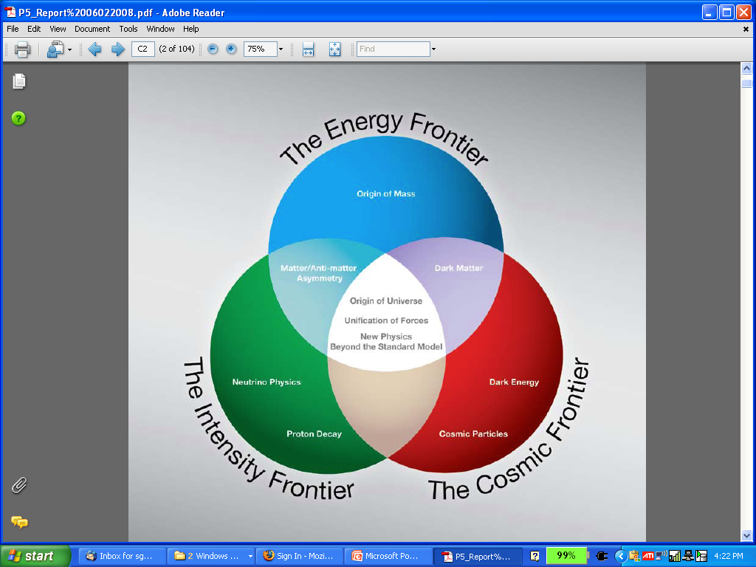
Why a Muon Accelerator Program?
High intensity μ beams have the potential to enable key measurements on 2 frontiers:
  The Intensity Frontier:
  with well-characterized ν beams for precise, high sensitivity studies
  The Energy Frontier:
  with colliders capable of reaching the multi-TeV scale

Slide 5
The U.S. Muon Accelerator Program
MAP
  Formally approved in March 2011
  A merger of the efforts of 2 groups: the NFMCC and MCTF
  It’s mission:
…to develop and demonstrate the concepts and critical technologies required to produce, capture, condition, accelerate, and store intense
beams of muons for Muon Colliders and Neutrino Factories.
The goal of MAP is to deliver results that will permit the high-energy
physics community to make an informed choice of the optimal path to a
high-energy lepton collider and/or a next-generation neutrino beam facility.
Coordination with the parallel Muon Collider Physics and Detector Study and with the International Design Study of a Neutrino Factory will ensure MAP responsiveness to physics requirements.

Slide 6
Priorities
Demonstrate the feasibility of key concepts that would allow us to build a multi-TeV collider
Continue to develop the critical elements of the NF and MC designs
Support the ongoing accelerator R&D and concept demonstration program
Establish close coordination with the detector and HEP experimental community
As able, continue to support fundamental technical development in the field that has the potential to contribute significantly to the machine design
Overarching goal during this phase of the program is to Establish Conceptual Feasibility

Slide 7
THE PHYSICS MOTIVATIONs

Slide 8
The Physics Motivations
μ – an elementary charged lepton:
  200 times heavier than the electron
  2.2 μs lifetime at rest
Physics potential for the HEP community using muon beams
  Tests of Lepton Flavor Violation
  Anomalous magnetic moment a hints of new physics (g-2)
  Can provide equal fractions of electron
  and muon neutrinos at high intensity for
  studies of neutrino oscillations –
  the Neutrino Factory concept
  Offers a large coupling to the “Higgs mechanism”
  As with an e⁺e⁻ collider, a μ⁺μ⁻ collider would offer a precision probe of fundamental interactions – in contrast to hadron colliders

Slide 9
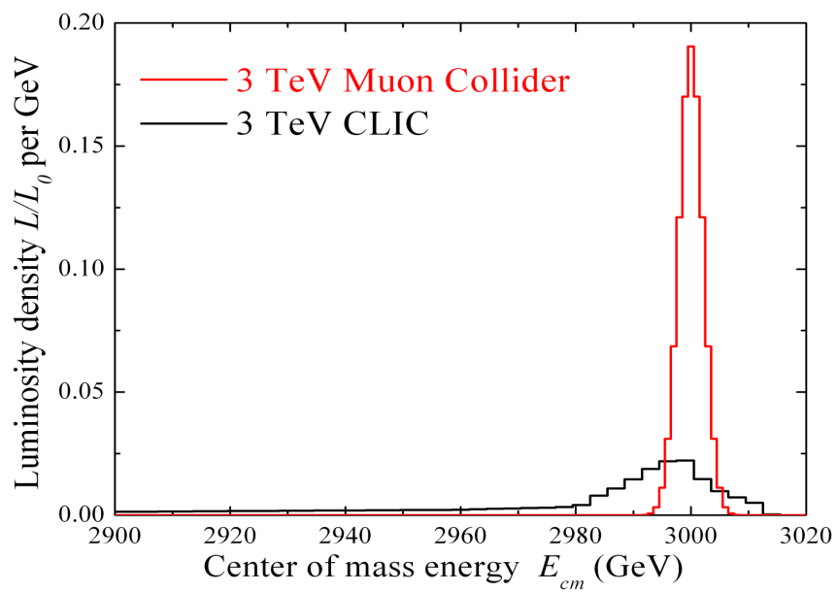
Muon Accelerator Physics
Large muon mass strongly
suppresses synchrotron
radiation
  a Muons can be accelerated and
  stored using rings at much
  higher energy than electrons
  a Colliding beams can be of
  higher quality with reduced
  beamstrahlung
Short muon lifetime has impacts as well
  Acceleration and storage time of a muon beam is limited
  Collider – a new class of decay backgrounds must be dealt with
Muon beams produced as tertiary beams:
  Offers key accelerator challenges…
Beamstrahlung in
any e+e- collider
δE/E ∝ γ²

Slide 10
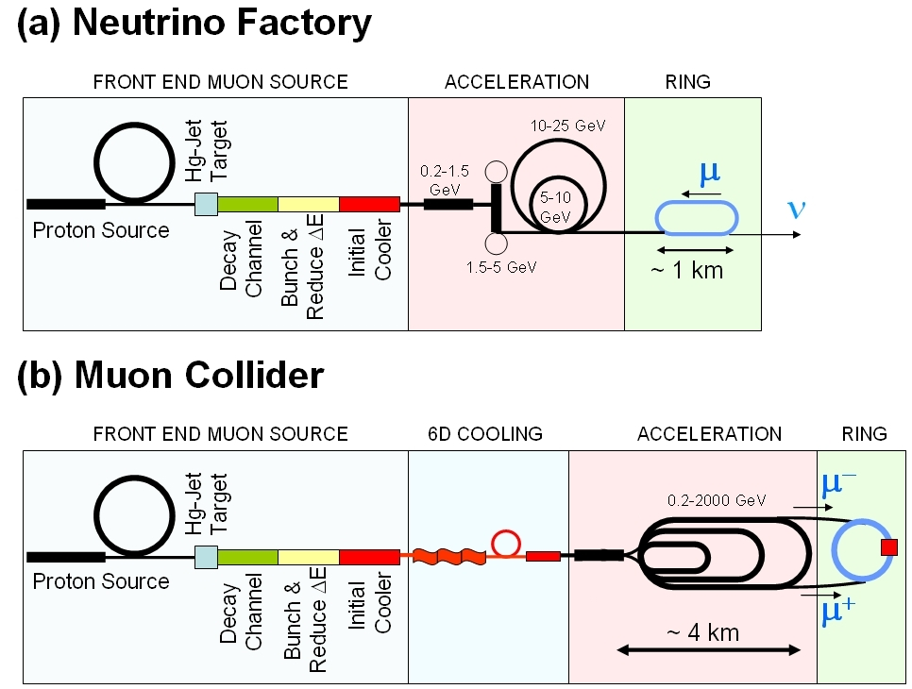
Muon Collider Concept
Proton source: For example PROJECT X at
4 MW, with 2±1 ns long bunches
Collider: √s = 3 TeV
Circumference = 4.5km
L = 3×10³⁴ cm⁻²s⁻¹
μ/bunch = 2x10¹²
σ(p)/p = 0.1%
ε_{⊥N} = 25 μm, ε_{//N}=70 mm
β* = 5mm
Rep Rate = 12Hz
10²¹ muons per year within the acceptance of an accelerator:
ε_{⊥N}=6000 μm
ε_{//N}=25 mm

Slide 11
Muon Collider - Neutrino Factory Comparison
NEUTRINO
FACTORY
MUON
COLLIDER
In present MC baseline design, Front End is same as for NF

Slide 12
THE R&D CHALLENGES

Slide 13
Major Efforts Presently Underway
Design Studies
  Proton Driver
  Front End
  Cooling
  Acceleration and Storage
  Collider
  Machine-Detector Interface
  Work closely with physics and detector efforts
Technical R&D
  RF in magnetic fields
  SCRF for acceleration chain (eg, 200 MHz cavities)
  High field magnets
    Utilizing HTS technologies
  Targets & Absorbers
  MuCool Test Area (MTA)
Major System Demonstration
  The Muon Ionization Cooling Experiment – MICE
    Major U.S. effort to provide key hardware: RF Cavities and couplers, Spectrometer Solenoids, Coupling Coils
    Experimental and Operations Support

Slide 14
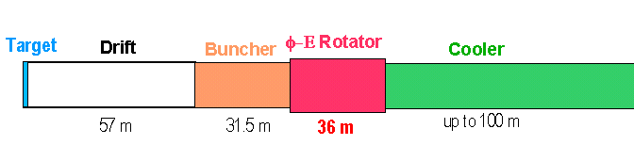
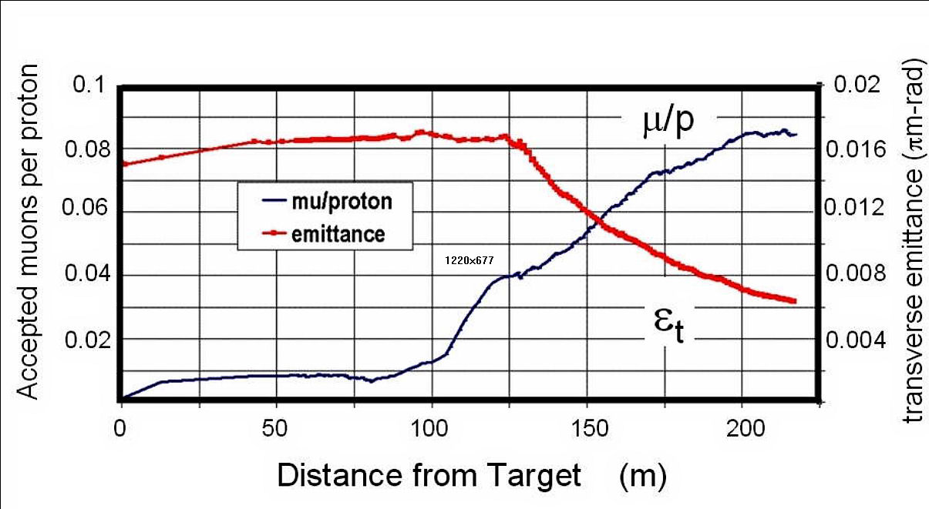
Technical Challenges – Tertiary Production
A MW-scale proton source and target facility are required
Neuffer
A multi-MW proton source, e.g., Project X, will enable
O(10²¹) muons/year to be produced, bunched and cooled to fit within the acceptance of an accelerator.

Slide 15
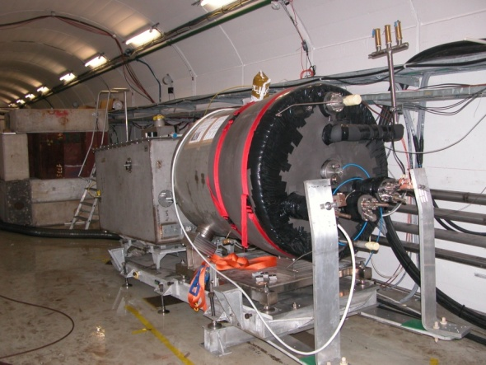
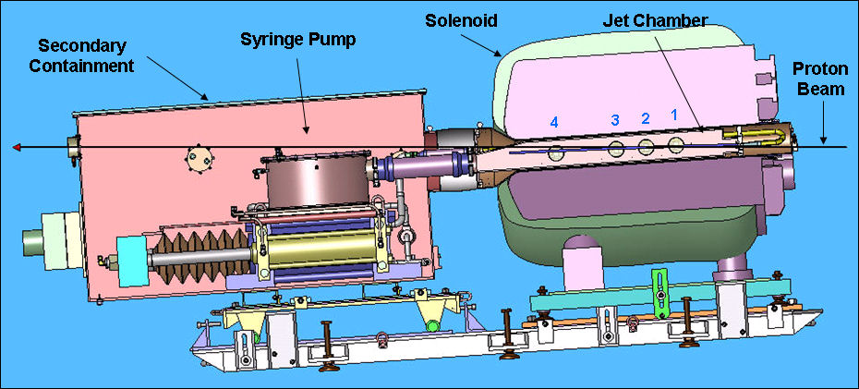

Technical Challenges - Target
The MERIT Experiment at the CERN PS
  Proof-of-principle demonstration of a liquid Hg jet target in high-field solenoid in Fall `07
  Demonstrated a 20m/s liquid Hg jet injected into a 15 T solenoid and hit with a 115 KJ/pulse beam!
  a Technology OK for beam powers up to
  8 MW with a repetition rate of 70 Hz!
1 cm
Hg jet in a 15 T solenoid
with measured disruption length ~ 28 cm

Slide 16
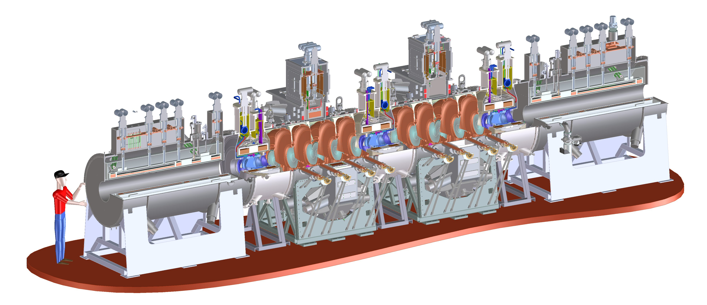
Technical Challenges - Cooling
Tertiary production of muon beams a
  Initial beam emittance intrinsically large
  Cooling mechanism required, but no radiation damping
Muon Cooling a Ionization Cooling
    dE/dx energy loss in materials
    RF to replace p_{long}
MICE
  The Muon Ionization
  Cooling Experiment:
  Demonstrate the
  method and validate
  our simulations
RF-Coupling
Coil (RFCC)
Units
Spectrometer
Solenoids

Slide 17
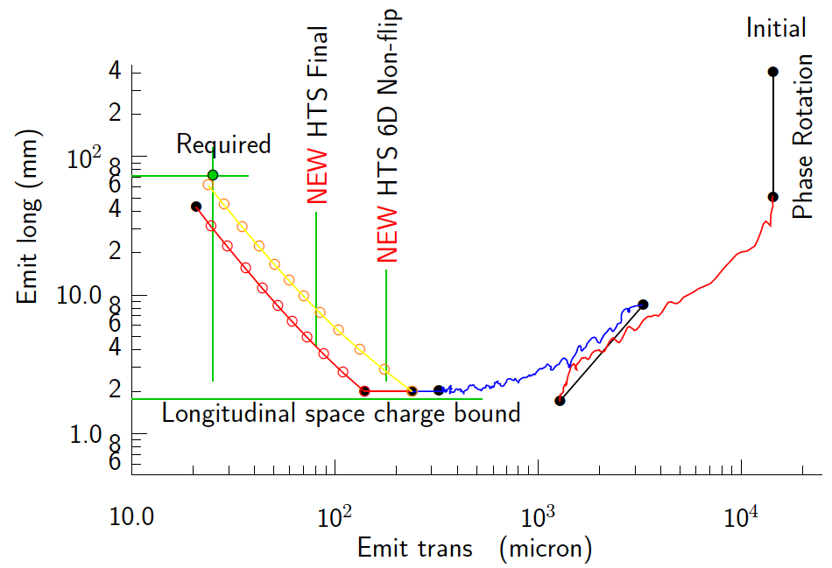
Technical Challenges - Cooling
Development of a cooling channel design to reduce the 6D phase space by a factor of O(10⁶) → luminosity of O(10³⁴) cm⁻² s⁻¹
R. Palmer
Some components beyond state-of-art:
  Very high field HTS solenoids (30-40 T)
  High gradient RF cavities operating in multi-Tesla fields
Emittance Reduction
via Ionization Cooling
for an Energy Frontier
Muon Collider
The program targets critical magnet and cooling cell technical demonstrations within its feasibility phase.

Slide 18
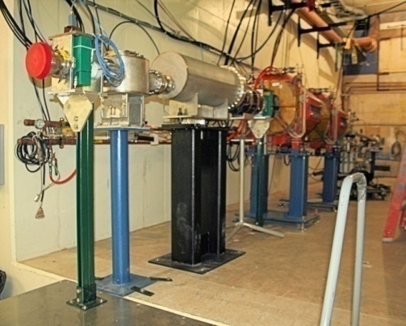
Technical Challenges – RF
A Viable Cooling Channel requires
  Strong focusing and a large accelerating gradient to compensate for the energy loss in absorbers
  a Large B- and E-fields superimposed
Operation of RF cavities in high magnetic fields is a necessary element for muon cooling
  Control RF breakdown in the presence of high magnetic fields
  The MuCool Test Area (MTA) at Fermilab is actively investigating operation of RF cavities in the relevant regimes
  Development of concepts to mitigate this problem are being actively pursued
MTA
Beamline

Slide 19
Technical Challenges - Acceleration
Muons require an ultrafast accelerator chain
a Beyond the capability of most machines
Several solutions for a muon acceleration scheme have been proposed:
  Superconducting Linacs
  Recirculating Linear Accelerators (RLAs)
    JLAB proposal for scaled electron demonstration machine
  Fixed-Field Alternating-Gradient (FFAG) Machines
        EMMA at Daresbury Lab is a test of the promising non-scaling type
  Rapid Cycling Synchrotrons (RCS/VRCS)
  Hybrid Machines
EMMA

Slide 20
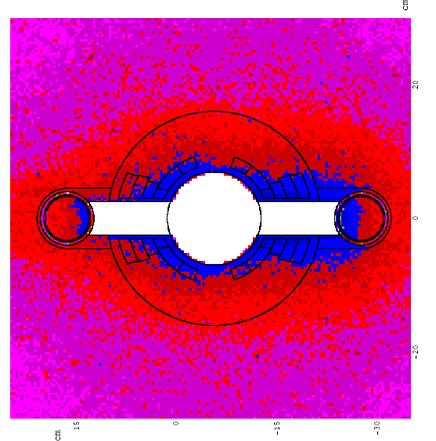
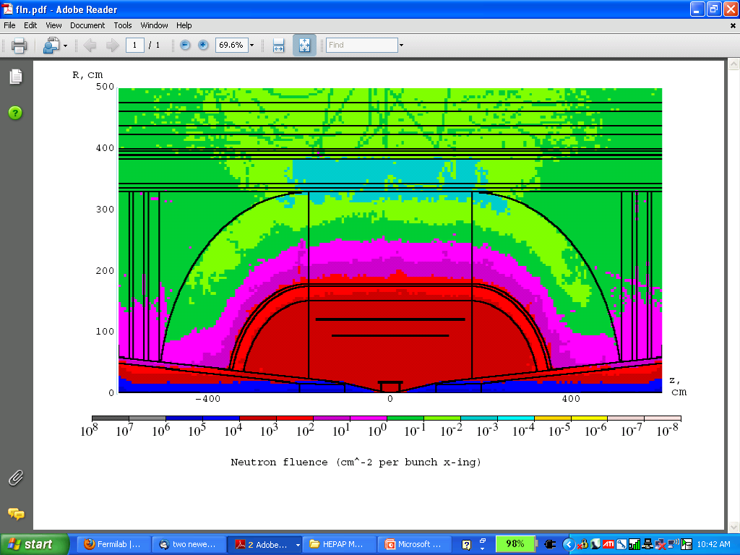
Technical Challenges – Ring, Magnets, Detector
Emittances are relatively large, but muons circulate for ~1000 turns before decaying
  Lattice studies for 1.5 TeV
  and 3 TeV CoM
High field dipoles and
quadrupoles must operate
in high-rate muon decay
backgrounds
  Magnet designs under study
Detector shielding & performance
  Initial studies for 1.5 TeV, then 3 TeV
  Shielding configuration
  MARS background simulations
Detector studies
MARS energy deposition map for 1.5 TeV collider dipole

Slide 21
Recent R&D Progress – Some Highlights

Slide 22
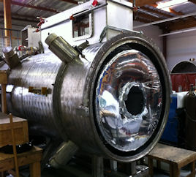
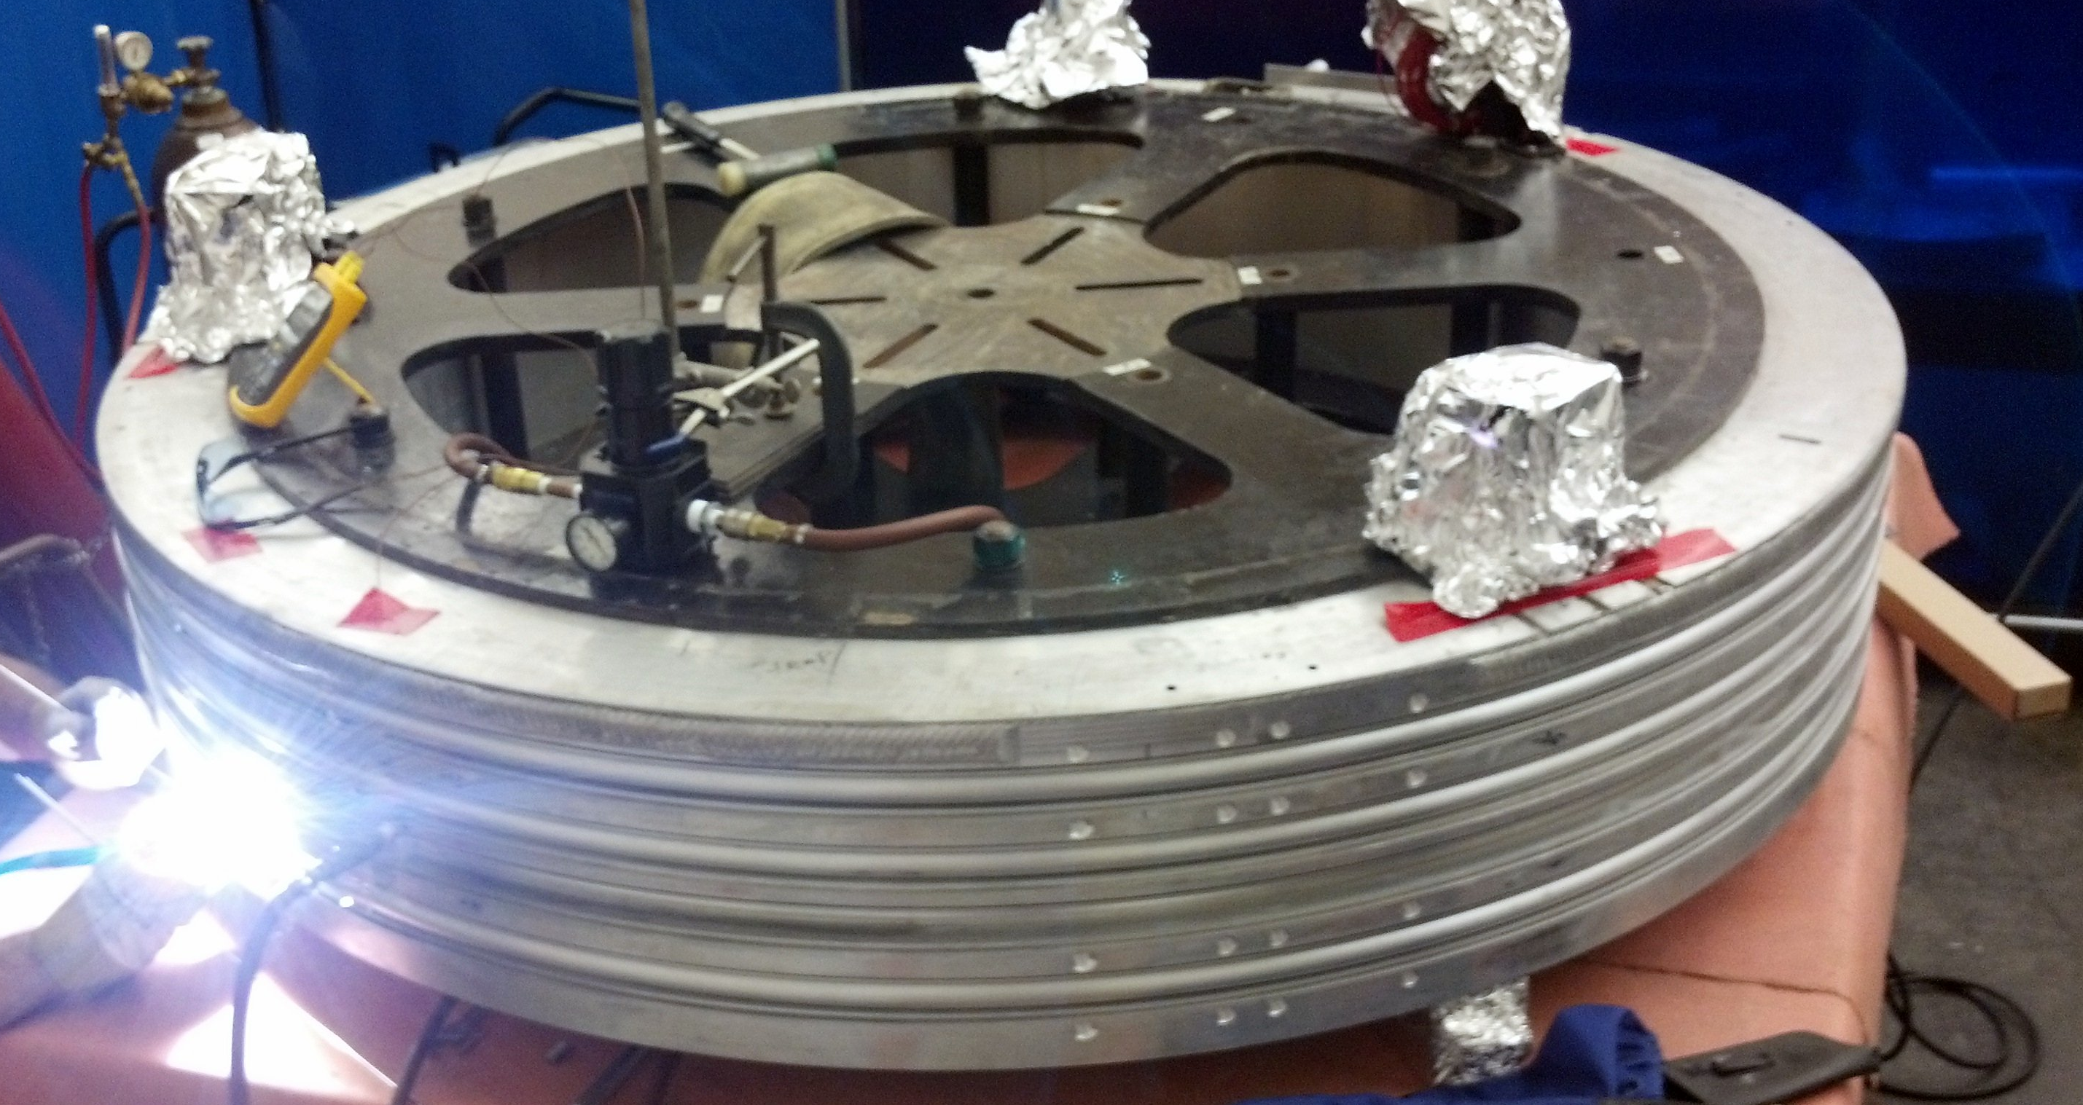
Recent Progress I –
MICE Magnets
Spectrometer Solenoids
  1st SS
  Cooldown and preliminary operational tests complete
  Ready for full current training and field mapping
  2nd SS
  Cold mass and shield being assembled into vacuum vessel
a Support MICE Step IV (2013-)
Coupling Coils
First Coupling Coil cold mass being prepared (at LBNL) for training (at FNAL) in new Solenoid Test Facility
a Support MICE Step V/VI (2016-)

Slide 23
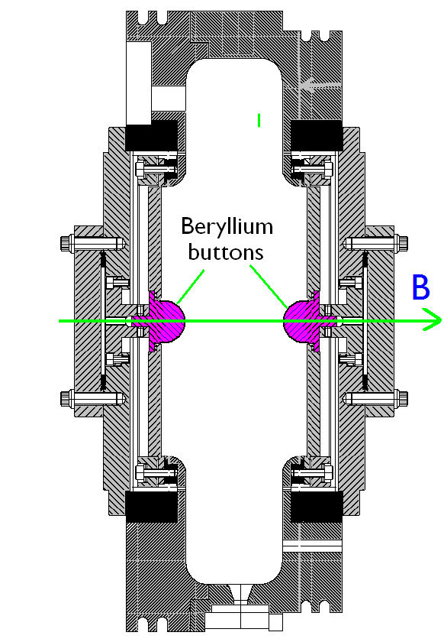
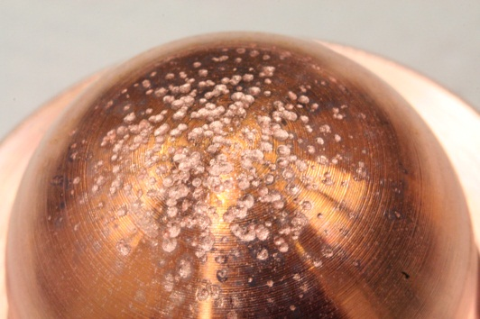
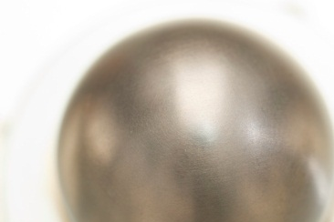
Recent Progress II – Cavity Materials
Breakdown tests with Be and Cu Buttons
Both reached ~31 MV/m
Cu button shows significant pitting
Be button shows minimal damage
a Materials choices offer the possibility of more robust operation in magnetic fields
Cu
Be

Slide 24
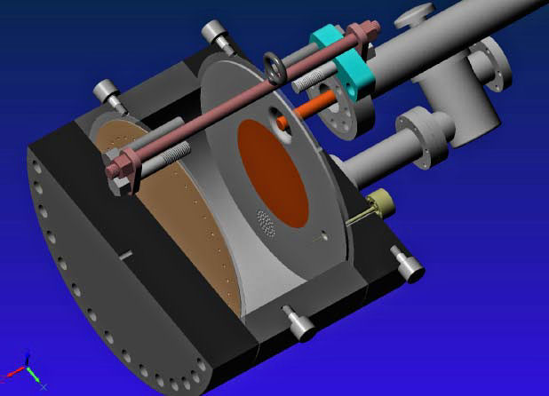
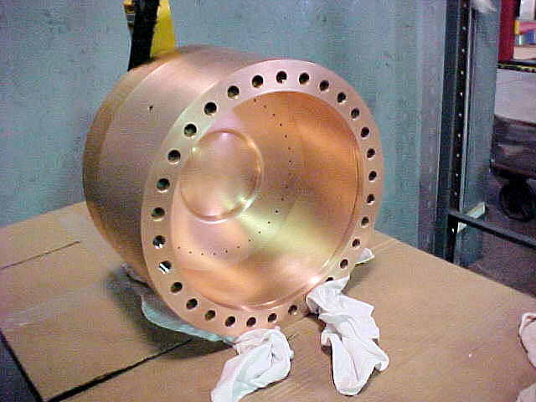
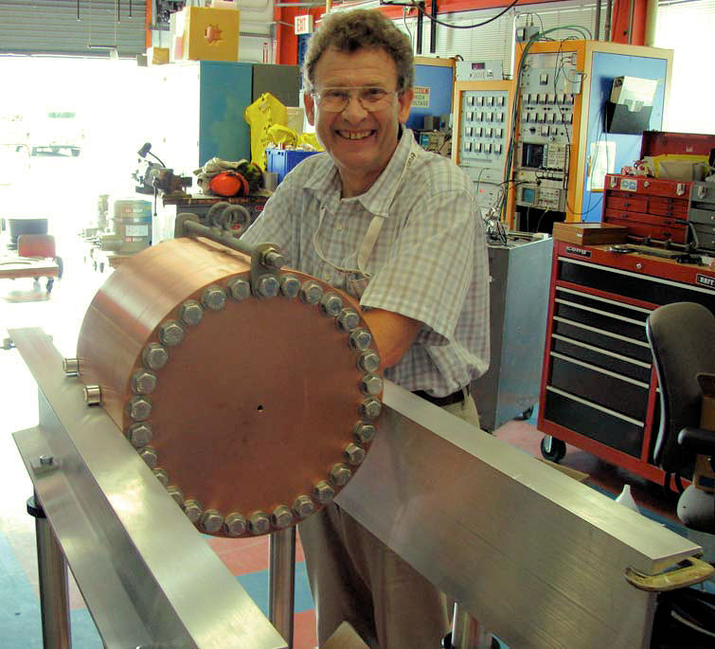
Recent Progress III – Vacuum RF
All-Seasons
Cavity
(designed for both
vacuum and high
pressure operation)
Vacuum Tests at B = 0 T & B = 3 T
  Two cycles: B₀ a B₃ a B₀ a B₃
No difference in maximum stable operating gradient
  Gradient ≈ 25 MV/m
Demonstrates possibility of successful operation of vacuum cavities in magnetic fields with careful design

Slide 25
Recent Progress IV: High Pressure RF
Gas-filled cavity
  Can moderate dark current and breakdown currents in magnetic fields
  Can contribute to cooling
  Is loaded, however, by beam-induced plasma
Electronegative Species
  Dope primary gas
  Can moderate the loading effects of beam-induced plasma by scavenging the relatively mobile electrons
1% Dry Air (0.2 % O2) in GH2
Pure GH2
1% Dry Air
(0.2 % O2)
in GH2 at
B = 3 T
Beam on
~50× change in
RF dissipation
5/22/12
E₀ = 25 MV/m
25
E₀ = 25 MV/m

Slide 26
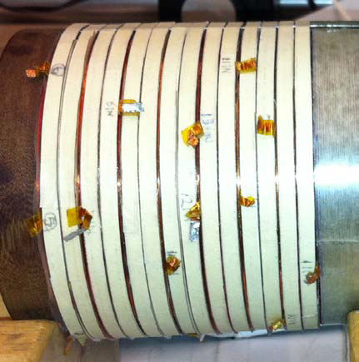
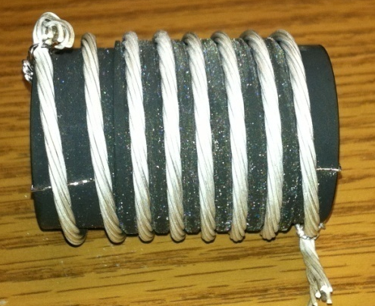
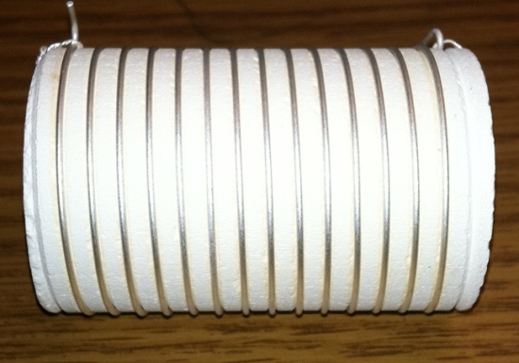
Recent Progress V: High Field Magnets
Progress towards a demonstration of a final
stage cooling solenoid:
Demonstrated 15+ T (16+ T on coil)
  ~25 mm insert HTS solenoid
  BNL/PBL YBCO Design
  Highest field ever in HTS-only solenoid (by a factor of ~1.5)
Will soon begin preparations for a test with HTS insert + mid-sert in NC solenoid at NHFML a >30 T
BSCCO-2212 Cable -
Transport measurements show that FNAL cable attains 105% J_{c} of that of the single-strand
Multi-strand cable utilizing chemically compatible alloy and oxide layer to minimize cracks

Slide 27
More Information
Have selected only some research highlights
A broader summary of the program was presented at the recent MAP Collaboration Meeting
  March 4-8 at SLAC National Accelerator Laboratory
  See presentations at:
https://indico.fnal.gov/conferenceDisplay.py?confId=5097

Slide 28
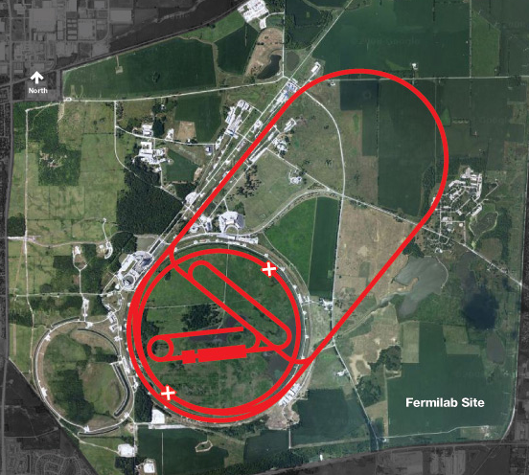
Conclusion
Over the next 6 years the primary goal of MAP is demonstrating the feasibility of key concepts needed for a neutrino factory and muon collider
a Thus enabling an informed decision on the path forward for the HEP community
Muon Collider Concept
A challenging, but promising, R&D program lies ahead!

Slide 29
BACKUP SLIDES FOLLOW

Slide 30
The Feasibility Assessment
MAP was originally proposed as a 5-7 year effort to evaluate the feasibility of Neutrino Factory and Muon Collider Technologies
  Feasibility Assessment Phase in 2 parts
    Phase I: FY13-15
    Phase II: FY16-18
  Approach
    Establish baseline concepts for each segment of the complex
      Prepare baseline design specifications that can be employed in the MAP Technical Demonstrations
      Evaluate realistic performance parameters from those baselines
      Verify feasibility
    Continue to pursue alternative options
      In particular, there exist alternative designs that hold the promise of significantly enhanced performance
      However, the capability (and funds) to implement demonstrations may well be beyond the reach of the feasibility assessment phase of the program

Slide 31
The Feasibility Assessment Phases
Feasibility Assessment: Phase I
FY13 − FY15:
Identify baseline design concepts
Identify high leverage alternative concepts
Identify key engineering paths to pursue:
  RF
  High Field Magnets
Develop critical engineering concepts (eg, 6D Cooling Cell)
Support major systems tests
  MICE Step IV
  MICE RFCC construction & testing
Feasibility Assessment: Phase II
FY16 − FY18:
Technical demonstration of critical baseline concepts
  eg, 6D Cooling cell
Pursue high leverage alternative concepts
Assess technical and cost feasibility of baseline concepts
Support major systems tests
  MICE Step V/VI
  6DICE planning
Beyond the
Feasibility Assessment
FY19 ➔
Plan contingent on the feasibility assessment!
Can we launch the design effort towards a staged implementation of a NF & MC?
Advanced systems tests
  6D ICE?
  Integrated R&D + physics program?

Slide 32
Beyond the Feasibility Evaluation Phase
Assuming that we meet our Phase I and Phase II Feasibility Goals, we hope to move forwards a full conceptual design effort including:
  Advanced systems studies may include
    A beam-based 6D ICE
    Front End concepts
    Demonstration of acceleration concepts
  Ideally this involves a staged R&D program coupled to physics needs
    Provide intensity frontier physics results during the next decade
    Support R&D towards a collider
    Develop a staged approach that takes us to the Intensity Frontier and subsequently onwards to the Energy Frontier

Slide 33
Acknowledgments
I would personally like to thank Steve Geer, Mike Zisman, Bob Palmer and the MAP L1 managers for their help in familiarizing me with the program over the last few months.
The MAP Effort -
Labs: ANL, BNL, FNAL, JLAB, LBNL, ORNL, SLAC
Universities: Chicago, Cornell, IIT, Princeton,
UC-Berkeley, UCLA, UC-Riverside, UMiss
Companies: Muons, Inc; Particle Beam Lasers

