Slide 1
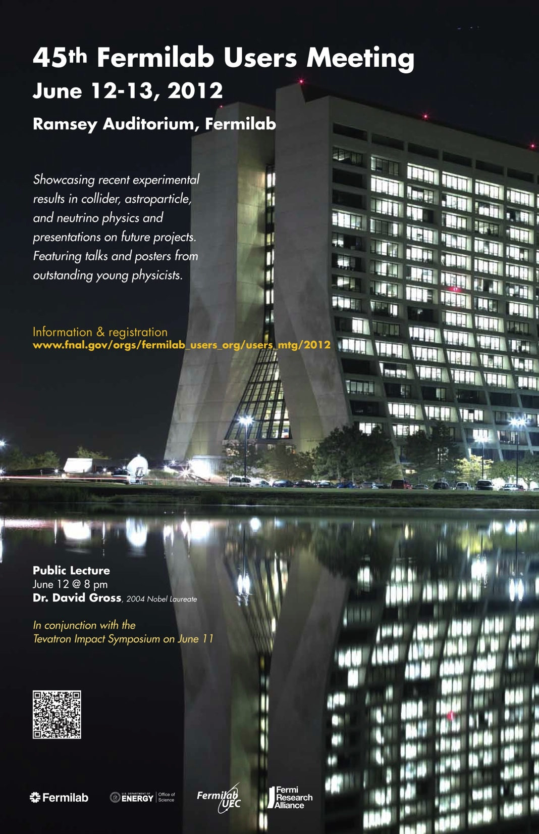
Report from the National Science Foundation
J. Cottam-Allen, K. Dienes, M. Goldberg, S. Gonzalez, J. Kotcher, R. Ruchti, J. Whitmore

Slide 2
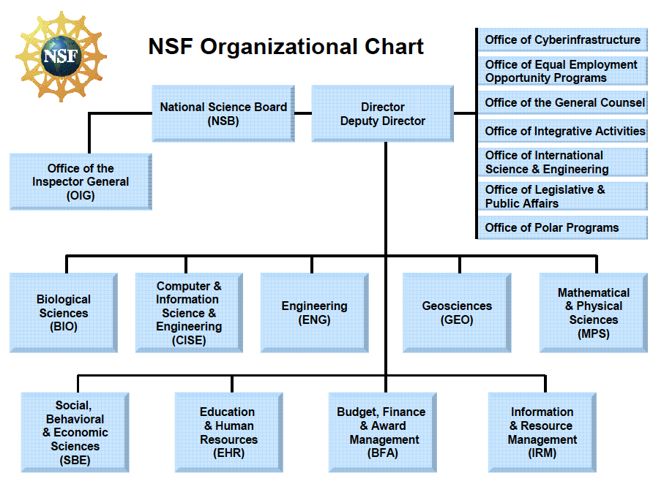

Slide 3
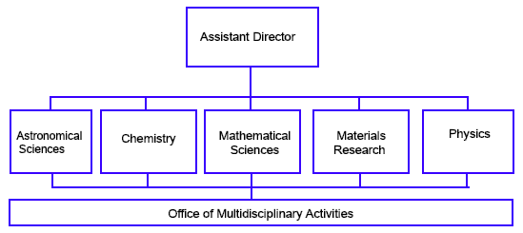
MPS Organization

Slide 4
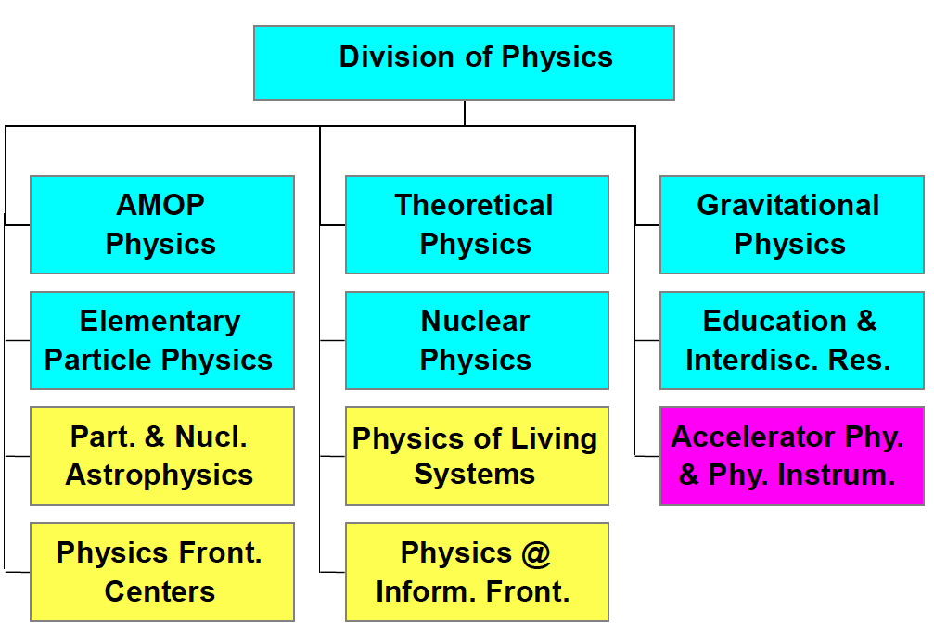
Physics Organization

Slide 5
NSF’s Mission
Public Law 81-507 (1950): “to promote the progress of science; to advance the national health, prosperity, and welfare; to secure the national defense; and for other purposes”
  Empowering university-based investigators
  Adding value through partnerships and broadening participation
Coordination
  Programs are coordinated with other U.S. and non-U.S. agencies and organizations (DOE/HEP/NP, NASA, NSF, + International)
  Solicit advice and strategic direction from advisory committees such as HEPAP, AAAC, NSAC and from the National Academy of Science
Physics Division Priorities
  Address fundamental questions in Physics – strive to transform understanding
  Cooperation across intellectual and organizational boundaries
  Recruit, train, and retain an exceptional and diverse scientific workforce

Slide 6
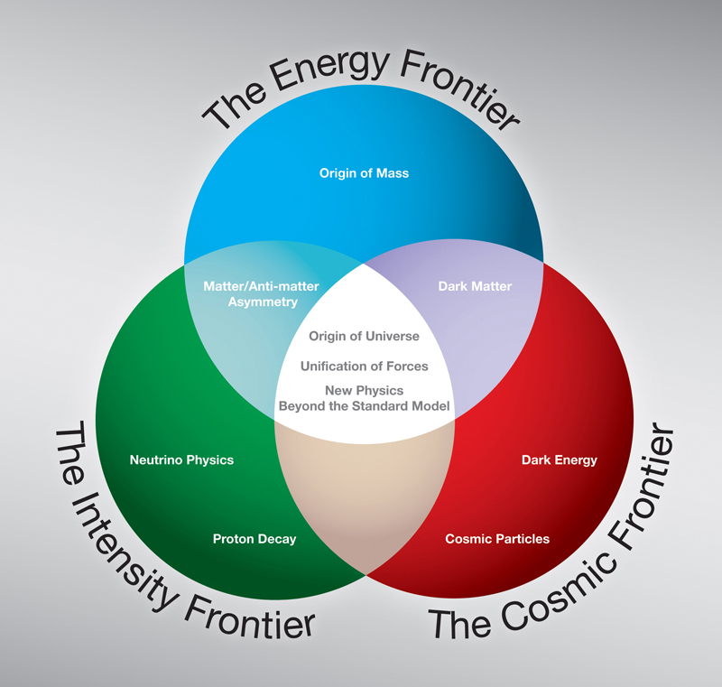
Program Scope in Particle Physics
Scientific Frontiers:
  Energy Frontier - Elementary Particle Physics (EPP)
  Intensity Frontier - Elementary Particle Physics (EPP)
  Cosmic Frontier - Particle Astrophysics (PA)
Broader Impacts:
  Accelerator R&D
  Detector R&D
  Computing
  Education and Outreach

Slide 7
Program Elements - EPP
Energy Frontier
  LHC
    ATLAS, CMS
  Tevatron
    CDF, D0
  ILC
    GDE
Intensity Frontier
  Neutrinos
    MINERvA
    MINOS/NOvA
    MiniBooNE/MicroBooNE
  BaBar
  BES-III
  LHC – LHCb
  CESR TA

Slide 8
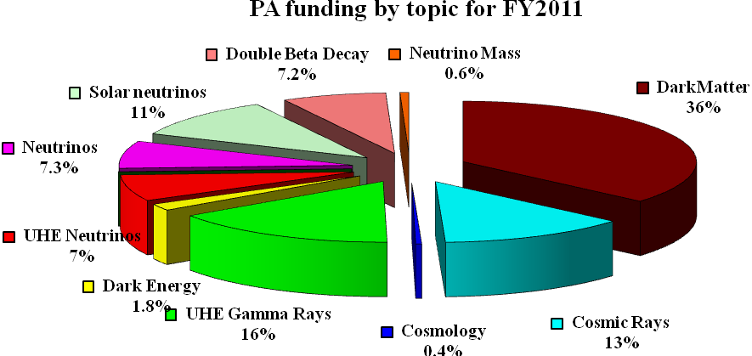
NSF Particle Astrophysics Program
Supported activities in FY11 Program:
  36% Searches for Dark Matter particles through direct detection
  36% Probing the High Energy Universe through the studies of cosmic rays, gamma-rays, and neutrinos
  26% Measurements of solar neutrinos and attempts to determine the absolute value of the mass of Neutrinos as well as some of their elusive properties.
  2.2% Studies of Dark Energy and Cosmology

Slide 9
Enabling Tools for EPP and PA Research
R&D Detectors
  LHC Detector Upgrades
  Diamond Detectors
  ILC
  LAr TPC (LBNE)
  Large Area psec PD
  Materials Developments for Underground
    Barium tagging for EXO
    Depleted Ar
    NaI in Borexino
    Ge Purification
  Airshower Microwave Bremsstrahlung Experimental Radiometer (AMBER)
  Bistatic Radio Detection in TA
  Askaryan Radio Array (ARA)
R&D Accelerators
  CESR TA
  ILC
  Muon Colliders (MuCOOL, MICE)
  Plasma Acceleration
  Project X (SRF, CESR TA)
Computing
  Open Science Grid
  Tier 2, Tier 3, UltraLight
  Anydata, Anytime, Anywhere
  iSGTW

Slide 10
Adding Value
QuarkNet
  (NSF:PHY, EIR/EHR, DOE:OHEP)
CHEPREO
  (NSF:OCI/EIR, OMA, EHR, OISE)
I2U2
  (NSF:EIR, OMA, EHR, PHY)
PIRE
  (NSF:OISE)
ISGTW, OSG
  (NSF:OCI)
Founded in EPP:
  Particle Astrophysics (PA)
  Grids for Data Intensive Science (PIF)
  QuarkNet
  I2U2

Slide 11
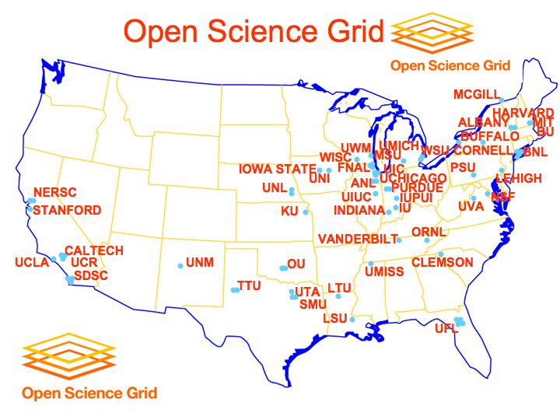
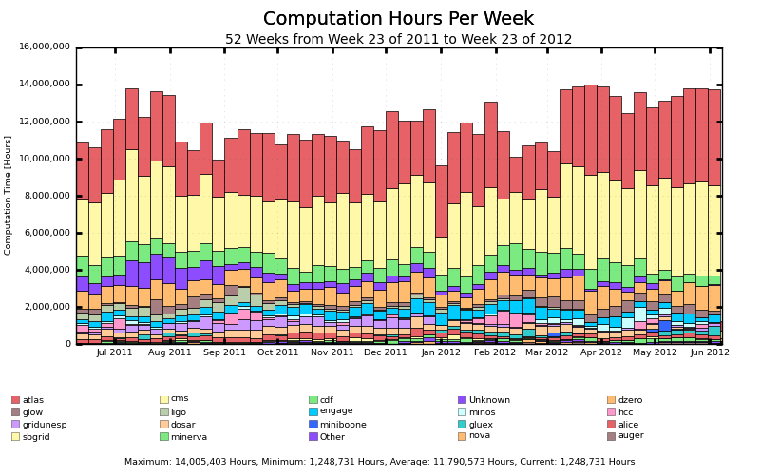
8 Tier 2s for the LHC Program
Supported through EPP and OCI (and DOE HEP)

Slide 12
QuarkNet in 2012
LHC Data: to Teachers and Students through e-Labs and Masterclasses
Research experiences and Professional Development:
  Per year 450 teachers, 100 student researchers, 100 physicists

Slide 13
Items of Interest and Opportunities
Recent MRI:
  ATLAS (3): Chicago, UCSC, Cal State Fresno
  CMS: Kansas
  LHCb/LIGO: Syracuse
  Muon Collider: Mississippi
  ARIANNA: Wisconsin
  RADAR-TA: Utah
PIRE: Kansas, KSU, UNeb, UIC, UPM
CAREERs: Two awarded in EPP and two in PA for FY’12.
Work to assist with COLA and Leadership – however funding stress makes this difficult.
Current Opportunity: Data Infrastructure Building Blocks (DIBBs):
  “Math and Physical Sciences will use DIBBs in support of existing efforts to ensure disparate data are widely interoperable; will consider proposals for efforts that are complementary to existing infrastructure; and will consider proposals that offer availability, accessibility, and broad usability to heterogeneous data sets.” http://www.nsf.gov/pubs/2012/nsf12557/nsf12557.htm

Slide 14
NSF Budget Context
MPS

Slide 15
PHY and MPS Budget Context
Physics Division
ARRA Funding

Slide 16
Recent PHY Budget Actions and Plans
Have re-directed S4 funding to a generic Underground Physics program – issued “Dear Colleague Letter” in early 2012
  Science opportunities compelling (NRC report)
  Proposals under review
  Expect coordination with upcoming DOE Dark Matter G2 FOA
Midscale Instrumentation program a priority in future budget cycles
  Capitalization fund to fabricate instrumentation that would otherwise be unaffordable by individual PHY programs (but below MREFC threshold)
Discussing possible investment in accelerator physics research program at universities
LHC Cooperative Agreements in place for CMS and ATLAS for 5 years; joint planning with OHEP for upgrades
EPP and PA are down 3% from FY11 levels (effectively 9% in spending dollars)
  Reduced support for groups spread into the out years
  Complicated by ARRA roll off

Slide 17
Important EPP/PA Dates
Now – AGEP Supplements (Alliances for Graduate Education and the Professoriate)
July 25, 2012 – Career Proposal Deadline for FY13
October 31, 2012 – Base Program Target Date for FY13
January 24, 2013 – MRI Deadline
  Limited application; universities will have pre-selection
January 2013 (late) – EPP 2013 Panel
February 2013 – PA 2013 Panel
March 2013 (or later) – NSF/MPS/EPP funding levels decided
April 2013 (or later) – Funding actions

Slide 18
Final Comments
We are in the midst of very challenging budgetary climate
We must plan, focus, and coordinate resources on excellent science with regular deliverables
  Important planning efforts ongoing (e.g. DPF)
One certainty: Many opportunities at the three frontiers
EPP and PA research are a centerpiece for NSF Physics Division
  It is an extraordinarily exciting time for Particle Physics.
  Congratulations to the Tevatron, Neutrino, and LHC programs led by the laboratory and university groups.
  You have enthusiastic support from those of us at the NSF

Slide 19
Program Elements - Particle Astrophysics
The Cosmic Frontier
  Dark Matter:
    Xenon100, Xenon1T, DarkSide-50, S-CDMS, LUX, COUPP, PICASSO, DRIFT, ADMX-HF, DMTPC
  UHE:
    Cosmic Rays: Auger, TA
    Gamma Rays: VERITAS, HAWC
    Neutrinos: IceCube
  Neutrinos:
    Reactor Neutrinos: Double Chooz, Daya Bay
    Neutrino Mass: Mare-II
    Neutrinoless Double Beta Decay: CUORE, MJD, EXO-200, NEMO-3/SuperNEMO
    Solar Neutrinos: Borexino, Mini-LENS
  Structure of the Universe:
    ACT, QUIET, LSST

