Slide 1
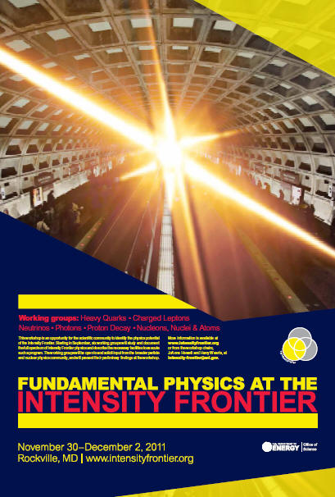
Intensity Frontier Workshop
Summary of
Fundamental Physics at the Intensity Frontier
“workshop”
J. Hewett & H.Weerts
workshop co-chairs

Slide 2
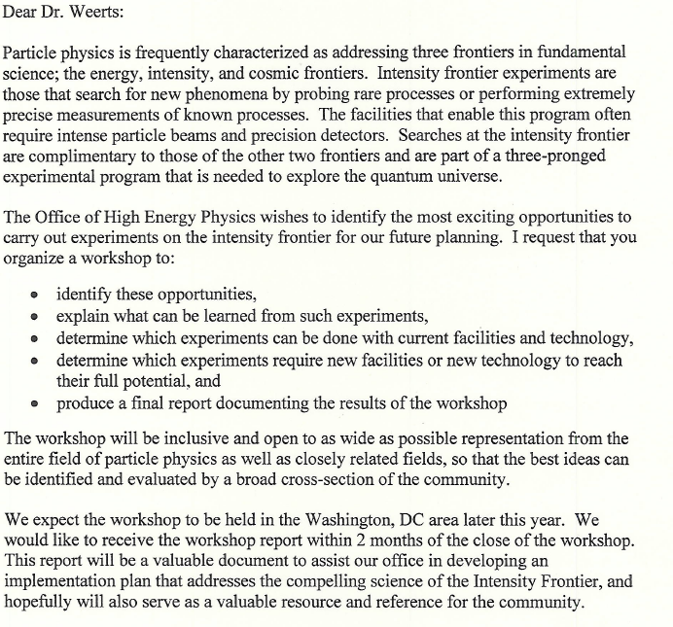
Charge to chairs of workshop
Document ( in one coherent document) the physics /science opportunities at the Intensity Frontier.
Identify experiments and facilities needed for components of program
Demonstrate that community is interested/wants to do the Intensity Frontier physics
Educate the community

Slide 3
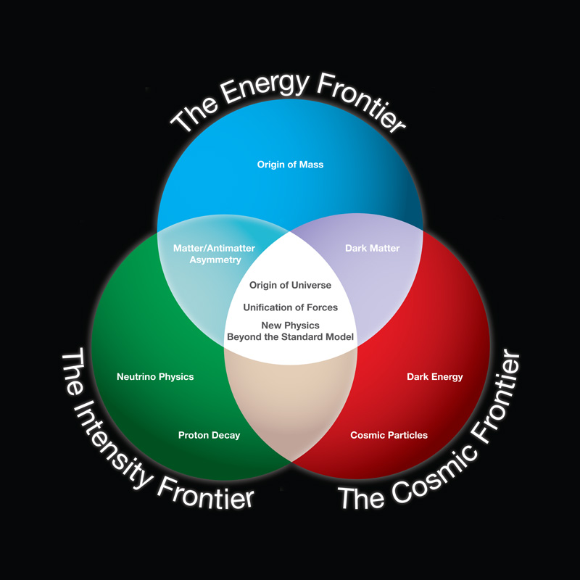
HEP and the frontiers
Good representation of HEP
Has proven to be very useful and effective in US in terms of funding and communicating HEP program to government.
Struggled with definition of Intensity Frontier & still are….
also extends into outside HEP
Energy Frontier & Cosmic frontier currently rather well defined and for foreseeable future
as long as they are all together

Slide 4
What is the Intensity Frontier?
Exploration of Fundamental Physics with high intensity beams and/or large, massive sensitive detectors
Precision measurements that indirectly probe quantum effects
Must use multi-pronged approach to search for new physics
Direct Production
Precision Measurements
Rare and Forbidden Processes
Fundamental Properties of Particles
New Physics

Slide 5
What is the Intensity Frontier?
So at outset ( without quite knowing where we were going) we set up the following areas for study
Study existing particles/ look for new ones
Heavy Quarks
Charged
Leptons
Hidden Weakly Coupled Sectors
Neutrinos
Nucleons & Atoms
Proton Decay
Mapped on to working groups

Slide 6
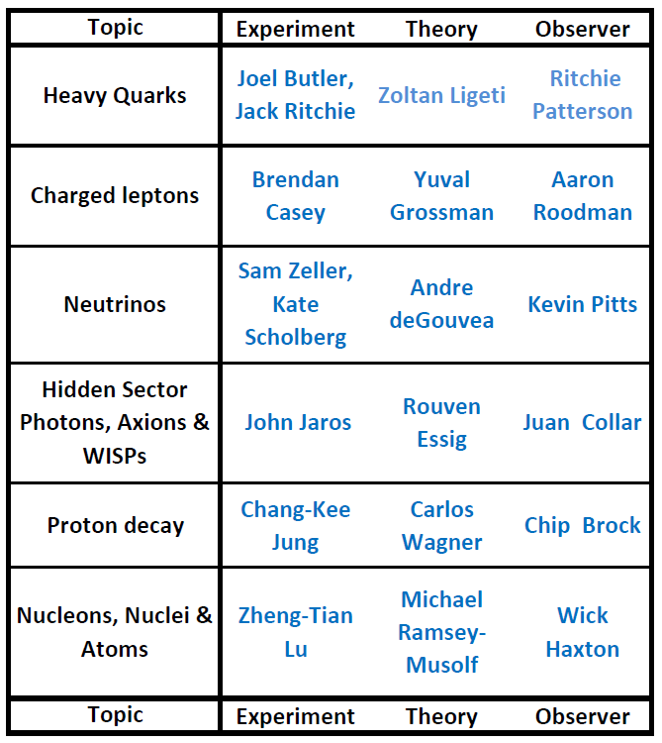
“The Intensity Frontier Workshop” exercise
Through working groups, meetings, workshops over October & November 2011 identify physics opportunities & needed facilities at the Intensity Frontier
Really:
Physics: s,c & b quarks final states
Muons, taus
All experiments for properties of neutrinos. Accelerator & non-accel.
“Dark” photons, paraphotons, axions, WISPs
Proton decay
Properties of nucleons, nuclei or atoms (EDM)
It is not just n oscillations

Slide 7
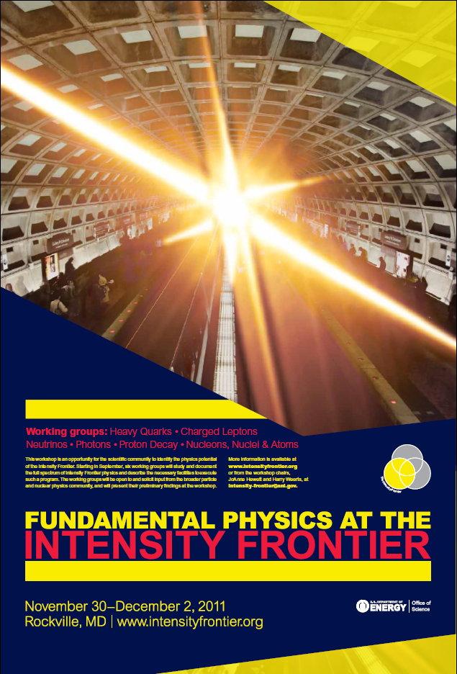
“The Intensity Frontier Workshop” exercise
Through working groups, meetings, workshops over October & November 2011 identify physics opportunities & needed facilities at the Intensity Frontier
Really:
Summarize findings, more community input & inform community at Intensity Frontier workshop: Nov 30-Dec 2, 2011, Rockville, MD
Produce a report summarizing workshop

Slide 8
The Intensity Frontier
The Intensity Frontier is a broad and diverse, but connected, overlapping , set of science opportunities.
Broad program with many connections
New sources of CPv Indirect new Physics Search
New sources of CPv -Indirect new Physics Search
Heavy Quarks
Charged leptons
NOT a priori clear which is most important. We should do them all if possible.
One outcome of workshop
Explore new weakly coupled sectors, possibly DM
WISPs
Fundamental Properties: CPv Dirac/Majorana Mass Hierarchy
Neutrinos
CPv = Charge Parity violation
New sources of CPV – Indirect new Physics Search - Fundamental measurements
Test of unification
“Neutrons”
Proton decay
LFv = Lepton Flavor number violation

Slide 9
Some outcomes of the workshop
> 500 participants
Overflowed meeting space and had to limit attendance
Exceeded our expectations ( Organizers & DOE !)
Workshop peppered with ideas and enthusiasm
> 100 Parallel session talks
Much discussion! Sessions, posters, hallways, twitter
Demonstrates a large, young community that wants to do this science
Intensity Frontier science program
Intensity Frontier is a broad set of precision measurements of properties of known particles
It is a multi pronged, inter connected program (not just one approach) AND global program
We have “only” presented the science case
Flavor of what came out of workshop and is in report ➔….

Slide 10
Physics @ Intensity Frontier: Heavy Quarks
Heavy Quark Chapter Conclusions:
Essential component of world-wide balanced
physics program
Compelling physics case not predicated on theoretical
progress
Several exp’ts underway abroad – US should be involved
US has opportunity to mount its own program in K Decays
Report shows future
sensitivities for K Decays,
as well as Charm & bottom processes at
Super-Flavor Factories
and upgraded LHCb

Slide 11
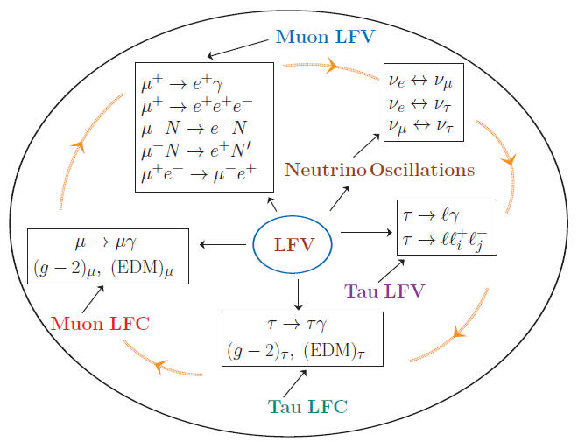
Physics @ Intensity Frontier: Charged Leptons
Charged Leptons easy to produce & detect
⇒ precise measurements are possible
Hadronic uncertainties insignificant or controlled by data
SM rates negligible in some cases so new physics stands out
Directly probe couplings of new particles to leptons
Diverse set of independent measurements

Slide 12
Physics @Intensity Frontier: Charged Leptons
95% CL limits in CLFV with muons

Slide 13
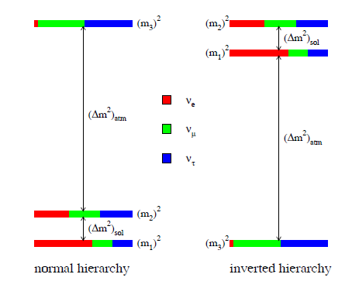
Neutrino working group
Summary of areas covered in report--- new measurements & upheaval since
Mixing matrix
State @ workshop time
Neutrino oscillations:
Daya Bay ( 3/8/2012):
Program in place to measure all
Which way ?
+
complex phase δ (CP-violation)
Not measured; only contributes if θ₁₃ is non zero
Neutrino Fundamentals:
Measure Neutrino mass
Neutrinos Majorana or Dirac
US: combination of HEP & NP
Sterile Neutrinos:
Short baseline experiment ~2σ anomalies may indicate additional sterile neutrinos
Neutrino-N scattering:
Measure neutrino interaction cross sections better and target or A dependence of them

Slide 14
Physics @ Intensity Frontier: Neutrinos
Guide to Neutrino Experiments for Dummies
Neutrinos

Slide 15
Physics @ Intensity Frontier: Neutrinos
Ability of various sources to determine neutrino properties

Slide 16
Physics @ Intensity Frontier: Proton Decay
Expected sensitivity with large underground detector
p ➔ e⁺ π⁰
p ➔ ν K⁺
Full LBNE
Future sensitivities at predicted levels for
SUSY GUT models and related to LHC SUSY

Slide 17
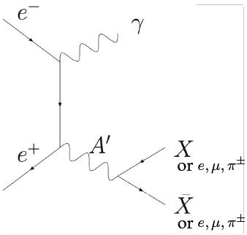
Physics @ Intensity Frontier: Ultra-weak Hidden Sectors
Collider + Fixed-Target constraints
Effective
coupling to SM
vs Mass plane
m_{A’} > 1ev

Slide 18
Nucleons, Nuclei & Atoms
Summary of areas covered in report
Neutrons
SM-theory: 10⁻³¹ e cm
Exp: <2.9x10⁻²⁶ e cm ➔ 5x10⁻²⁸ e cm
Electric dipole moments:
2018 ➔ 10⁻²⁸ e cm
Nucleus (Hg)
Sensitive probes of new physics
SM-theory: 10⁻³³ e cm
Exp: <10⁻²⁷ e cm ➔ 10⁻³² e cm
Program in place to measure all
Electrons ( cold molecules of YbF, ThO possible Fr)
SM-theory: 10⁻³⁸ e cm
Exp: <1.05x10⁻²⁷ e cm ➔ 3x10⁻³¹ e cm
Th: 1.2351 ( 2) x 10⁻⁴
Exp: 1.2300 (40) x 10⁻⁴ – 0.3% go to 0.05%
+ Kaons
Weak decays:
Nuclear β decay: precise measurement of V_{ud}, future measurement of n lifetime and decay correlations
Neutral Currents:
Polarized electron scattering from unpolarized targets & electrons ( Moeller scatter)➔ precision measurements of weak mixing angle over large Q²
Asymmetries

Slide 19
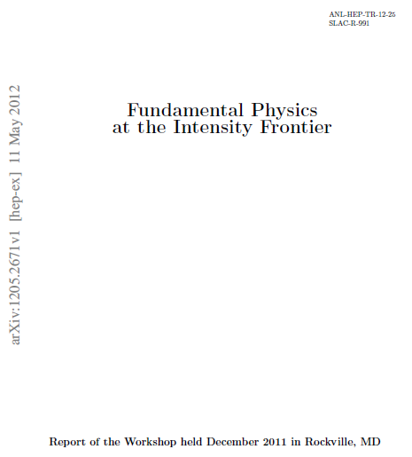
The Report
Report completed ~ mid May 2012
Total of 245 pages; 468 authors
Exec Summary
Introduction
Heavy Quarks
Charged Leptons
Neutrinos
Proton Decay
New light, weakly coupled particles
Nucleons, Nuclei & Atoms
Summary
Contents:
There is a link on the DOE HEP Website to report & to Exec summary
Report is on arXiv:1205.2671 [hep-ex]

Slide 20
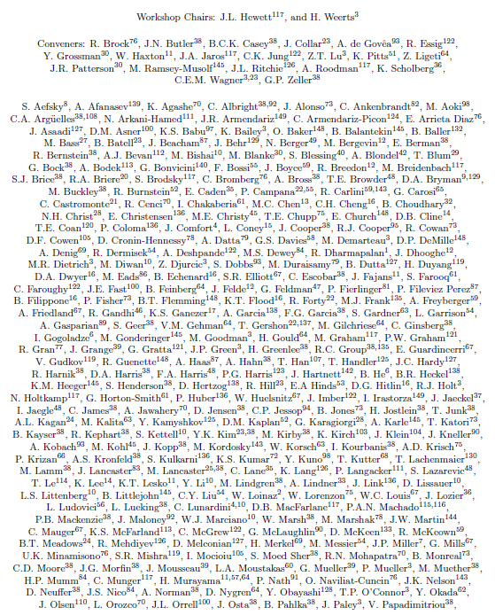
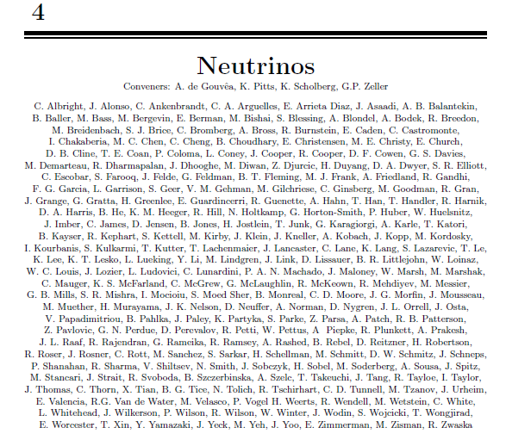
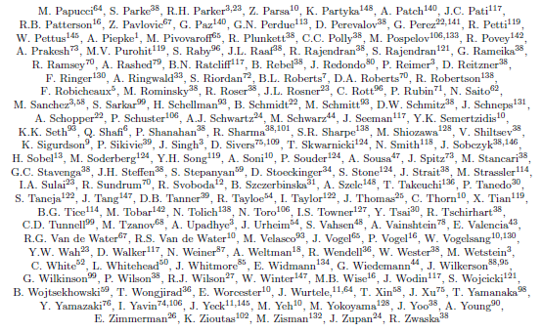
Organization of report
Each section with its own author list
List all 468 authors from 73 institutions worldwide

Slide 21
Executive summary points
Slide version of Executive Summary of Intensity Frontier:
Program directed at new physics i.e. Beyond Standard Model physics
Six working groups; three conveners each; prepare during Fall of 2011
before
Three day workshop ~Dec 2011;
large interest by community; ~500 participants; much discussion & vibrant atmosphere
after
Science is broad and diverse but interconnected
Science reach of each area documented and clear progress; this decade & next
Continue broad based science discussion of Intensity Frontier as new results arrive; future workshops
Describe science & serve as input into strategic planning; this was step 1
US has the opportunity to become a world leader in this program

Slide 22
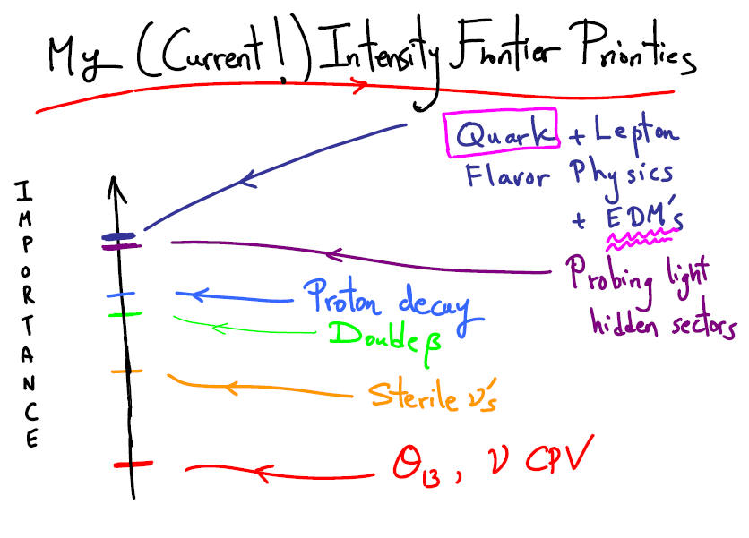
What Next?
Workshop did not address priorities…….
Proponents must engage, and make their case to, the community!
Otherwise, you may not like the resulting priorities
No consensus on science priorities yet.
Case for each will have to be made.
Also have to fold in other constrains ( $, time line, other regions)
One example, one point of view
Arkani-Hamed

Slide 23
What Next?
This workshop is just a step in the process towards making this & other programs a reality
Broad Intensity Frontier discussion must continue
Centered on science opportunities
Communities should support each other
Communities ( within HEP) must be educated
Working groups should continue in some form
DPF organizing Community planning 2013!

Slide 24
Intensity Frontier workshop
The End

Slide 25
What is the Intensity Frontier?
The Intensity Frontier addresses fundamental questions:
Are there new sources of CPV?
Is there CPV in the leptonic sector?
Are ν’s Majorana or Dirac?
Do the forces unify?
Is there a weakly coupled Hidden Sector linked to Dark Matter?
Are apparent symmetries (B,L) violated at high scales?
What is the flavor sector of LHC discoveries?
Can we expand the new physics reach of the energy frontier?

Slide 26
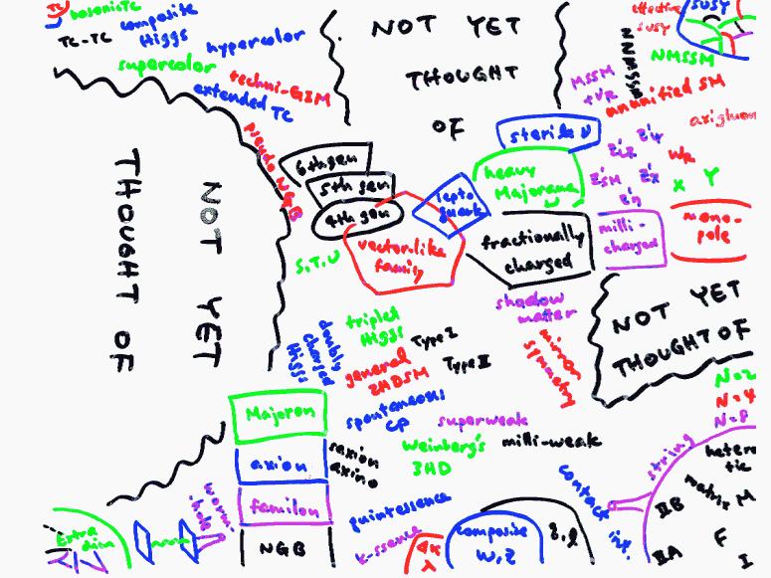
Why broad & diverse?
The Intensity Frontier is a broad and diverse set of science opportunities
Why is it important to be broad and diverse?
Anticipated discoveries at the LHC with 1st data:
SUSY!
HIGGS!
Murayama

Slide 27
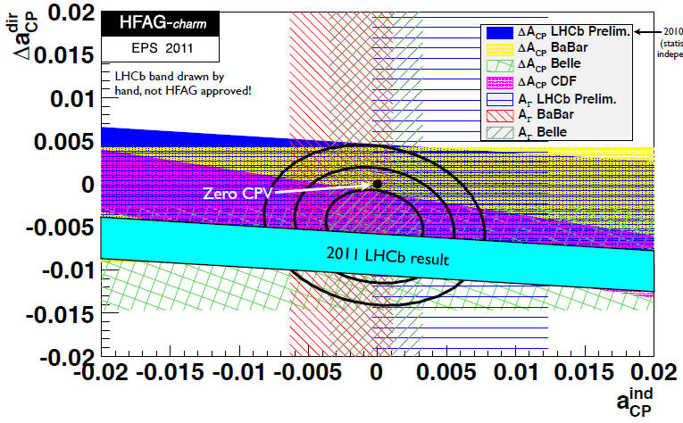
Why broad & diverse?
Expectations for LHC new physics output were high, BUT
“New physics not rolling out every week”
1st surprise from LHC: Direct CPV in Charm decays!
i.e. Intensity frontier
CPv search in
D→ππ vs D→ KK
3.5σ signal

Slide 28
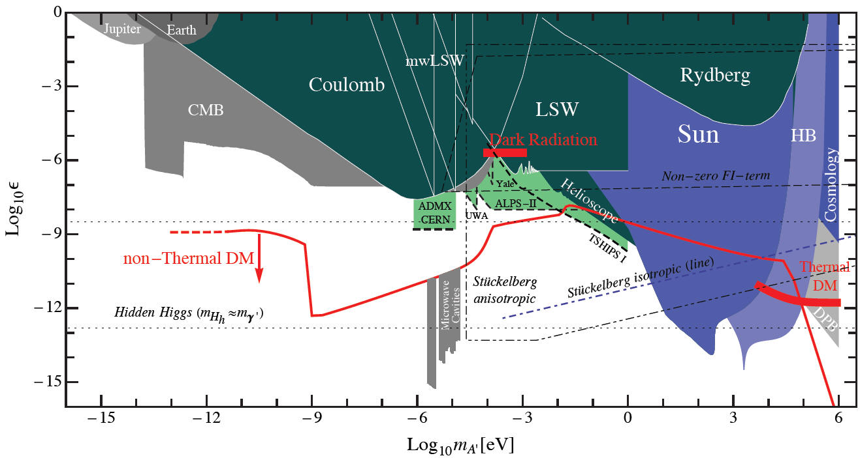
Physics @ Intensity Frontier: Ultra-weak Hidden Sectors
Hidden Sector Vector Portal/Heavy Dark Sector Photons:
Couplings to SM small enough to have missed so far, but big enough to find
Theories motivated by cosmic frontier
signatures at Intensity and (Energy) frontiers
Effective
coupling to SM
vs Mass plane
m_{A’} < 1ev

Slide 29
Physics @ Intensity Frontier: Nucleons, Nuclei and Atons
Electric Dipole Moment searches place strong constraint on
New Physics and approaching EW Baryogensis predictions

Slide 30
What is the Intensity Frontier?
The Intensity Frontier is a broad and diverse set of science opportunities
They look for, study, address following science
CP Asymmetries, Rare decays, Distributions
K’s, Charm, B’s
LFv with μ,τ
g-2
New particle searches
ν Oscillations
LFv in n’s
0νββ
EDMs
Parity Violation
Proton Decay
LFv = Lepton Flavor number violation

Slide 31
The Intensity Frontier
The Intensity Frontier is a broad and diverse set of science opportunities
They look for, study, address following science
CP Asymmetries, Rare decays, Distributions
K’s, Charm, B’s
LFv with μ,τ
g-2
Experiments planned, under construction, wishful thinking, etc
New particle searches
ν Oscillations
LFv in n’s
0νββ
EDMs
Parity Violation
Proton Decay
CPv = Charge Parity violation

Slide 32
HEP and the frontiers
progression
Struggled with definition of Intensity Frontier & still are
Others well defined and becoming more focused & defined
HEP
HEP
LHC
Energy Frontier
Cosmic Frontier
➔
Dark Matter & Dark Energy
Intensity Frontier
Intensity Frontier
Energy Frontier & Cosmic frontier currently rather well defined and for foreseeable future

