Slide 1



URA Thesis Award:
Antineutrino Oscillations in the Atmospheric Sector
Alexander Himmel
Duke University
for work done at
The California Institute of Technology
with
The MINOS Collaboration
45th FNAL User’s Meeting, June 13th, 2012

Slide 2
The Standard 3-neutrino Picture
Two mas splittings
  Large: Δm²_{atm} ≈ Δm²₂₃ = 2×10⁻³ eV²
  Small: Δm²_{sol} ≈ Δm²₁₂ = 8×10⁻⁵ eV²
Three mixing angles:
  Atmospheric: θ₂₃ ≈ 45° (maximal?)
  Solar: θ₁₂ ≈ 34°
  Reactor: θ₁₃ ≈ 9°
Atmospheric,
Accelerator
Reactor,
Accelerator
Solar,
Reactor
Notes:
We’ve known for sometime three light active neutrino flavors
More recently it was discovered that neutrinos oscillate among flavors as they propagate.
This comes about because neutrinos interact in flavor eigenstates but propagate in mass eigenstates, which are not the same.
* Matrix *
In order to have oscillations, the neutrinos need to have different, non-zero masses
* Cartoon *

Slide 3
Why study ν_{μ} and ν_{μ}?
Standard neutrino model predicts identical oscillations
  Differences would indicate new physics!
  Could manifest as different apparent mass-splittings
Antineutrino parameters are known with much less precision.
  Only the MINOS experiment that can identify ν_{μ} event-by-event
  Allows a direct measurement of antineutrino oscillations
?
?
Notes:
to effectively study we need a large, pure sample of antineutrinos

Slide 4
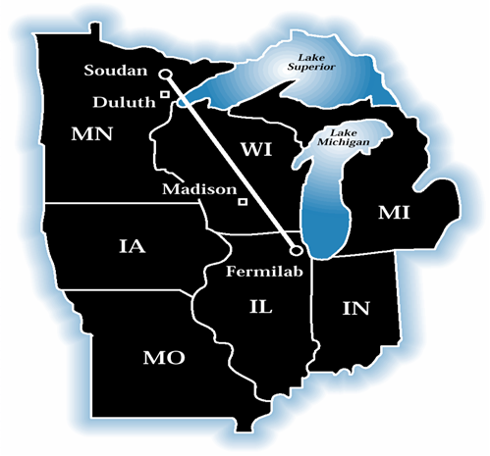
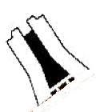
The MINOS Experiment
Fermilab
10 km
NuMI High-intensity Neutrino Beam
Notes:
Long-baseline, accelerator-neutrino oscillation experiment.
Bigger fonts on the components
Magnetized detectors – unique to MINOS among oscillation experiments

Slide 5
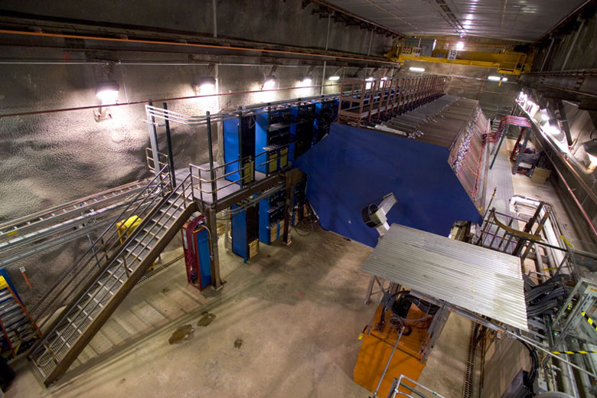
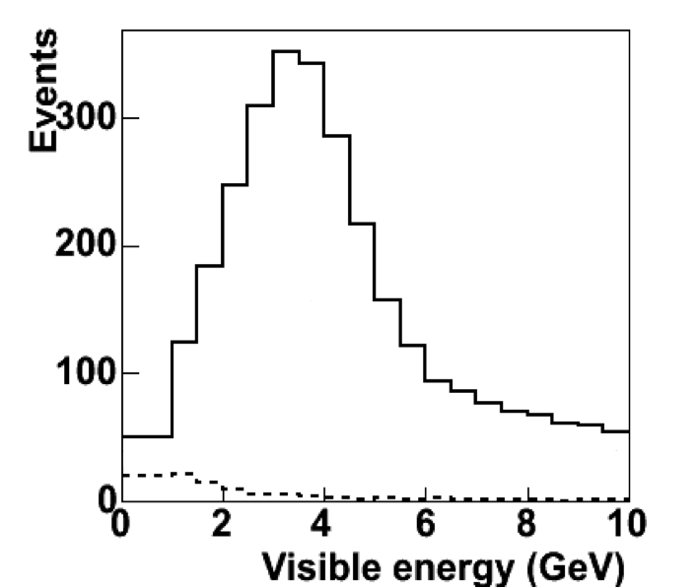
The MINOS Experiment
Fermilab
10 km
Near Detector
ν_{μ} spectrum
  Near Detector at Fermilab measures the initial
  beam composition and spectrum
Monte Carlo
Notes:
Long-baseline, accelerator-neutrino oscillation experiment.
Bigger fonts on the components
Magnetized detectors – unique to MINOS among oscillation experiments

Slide 6
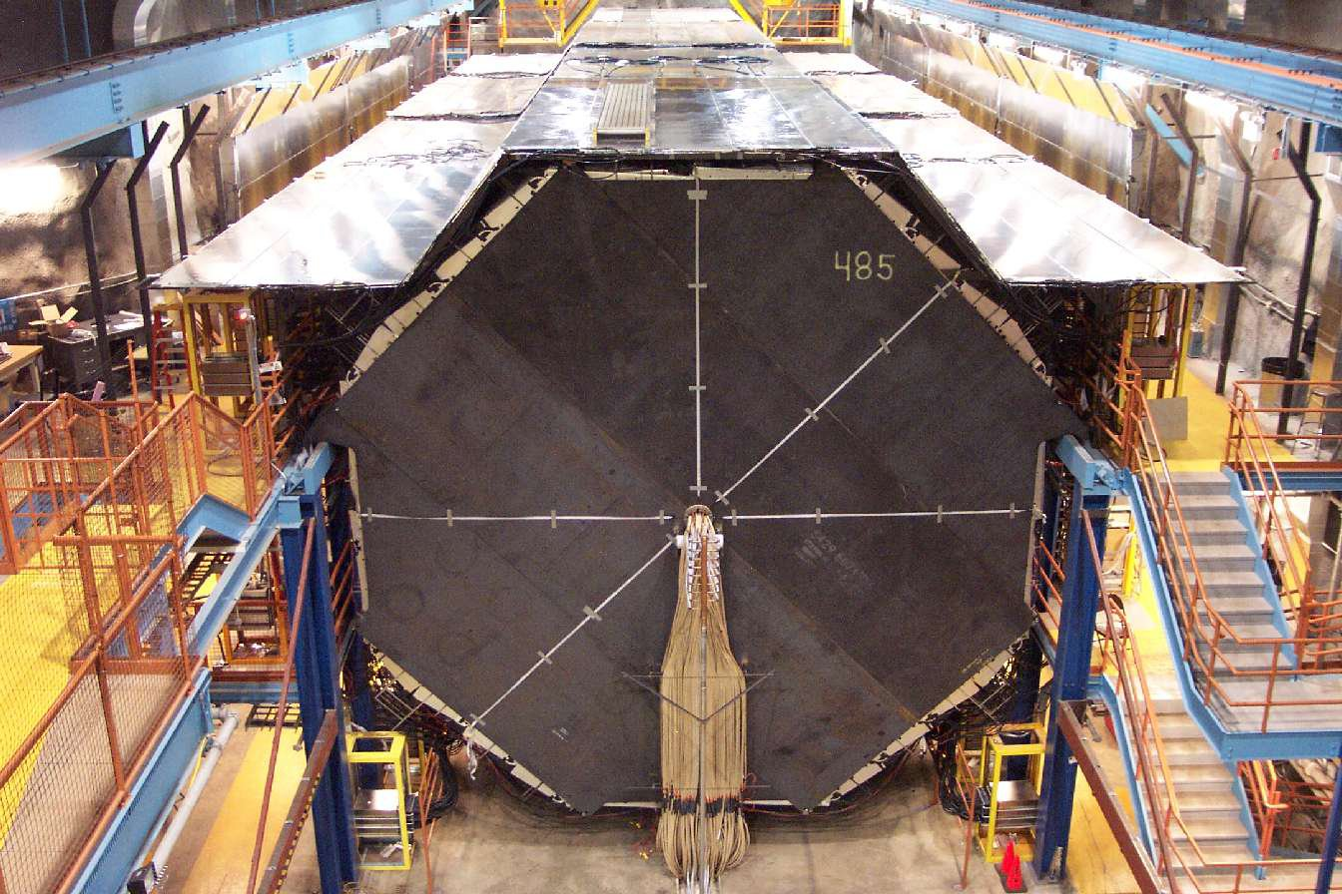
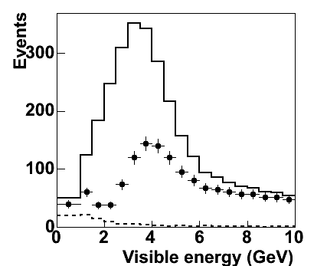
The MINOS Experiment
Fermilab
Soudan
10 km
735 km
Near Detector
Far Detector
ν_{μ} spectrum
  Far Detector in Soudan, MN measures the
  oscillated spectrum
Monte Carlo
Notes:
Long-baseline, accelerator-neutrino oscillation experiment.
Bigger fonts on the components
Magnetized detectors – unique to MINOS among oscillation experiments

Slide 7
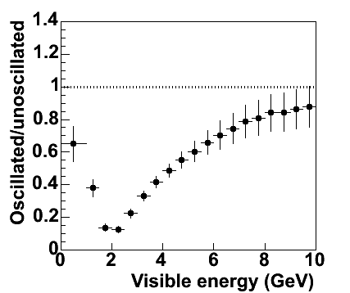
The MINOS Experiment
Fermilab
Soudan
10 km
735 km
Near Detector
Far Detector
ν_{μ} spectrum
spectrum ratio
Δm²
sin²θ
Monte Carlo
Monte Carlo
Notes:
Long-baseline, accelerator-neutrino oscillation experiment.
Bigger fonts on the components
Magnetized detectors – unique to MINOS among oscillation experiments

Slide 8
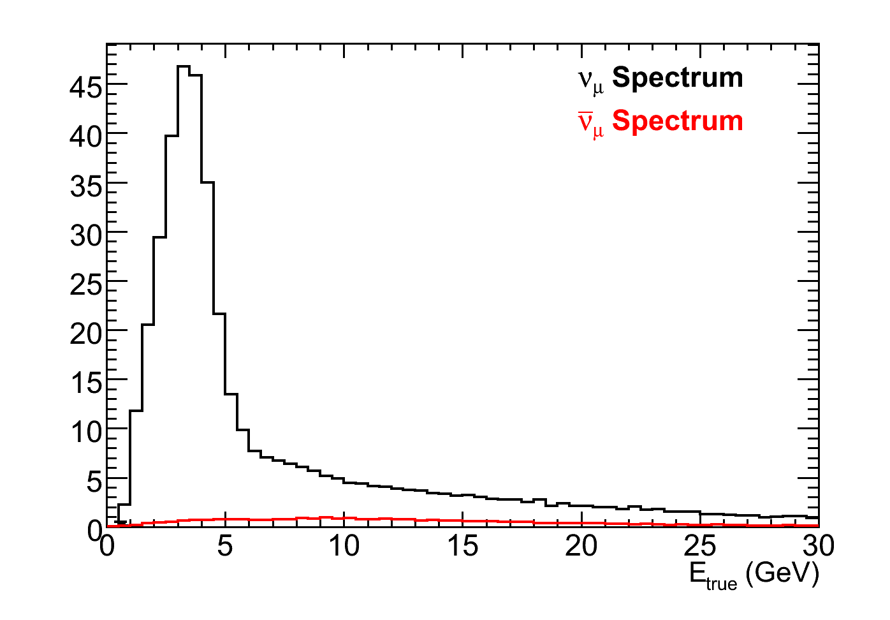

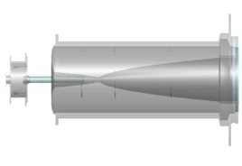
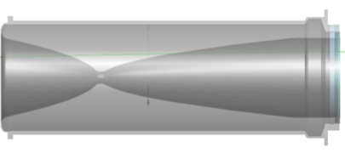
Making a Neutrino Beam
Horns focus π⁺, K⁺, which decay into ν_{μ}
Higher energy ν̄̄_{μ} from very forward π⁻
Most of MINOS beam data taken in this configuration
Monte Carlo
Neutrino mode
Horns focus π⁺, K⁺
Target
Focusing Horns
Decay Pipe
π⁻
2 m
ν_{μ}/ν_{μ}
120 GeV
MI protons
ν_{μ}
π⁺
15 m
30 m
675 m

Slide 9
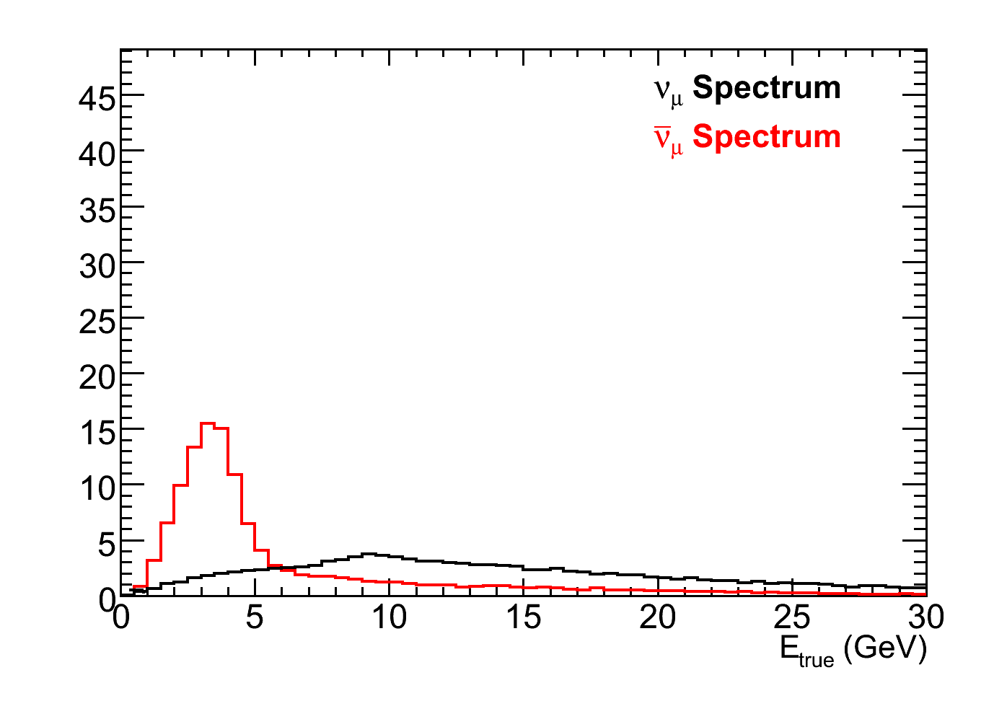
Making an Antineutrino Beam
Monte Carlo
Neutrino mode
Horns focus π⁺, K⁺
Monte Carlo
Antineutrino mode
Horns focus π⁻, K⁻
Target
Focusing Horns
Decay Pipe
π⁻
2 m
ν_{μ}
120 GeV
MI protons
ν_{μ}/ν_{μ}
π⁺
15 m
30 m
675 m
Notes:
Lower peak, higher backgrounds
High energy tail is unaffected by focusing
Mention the need for a magnetic field

Slide 10
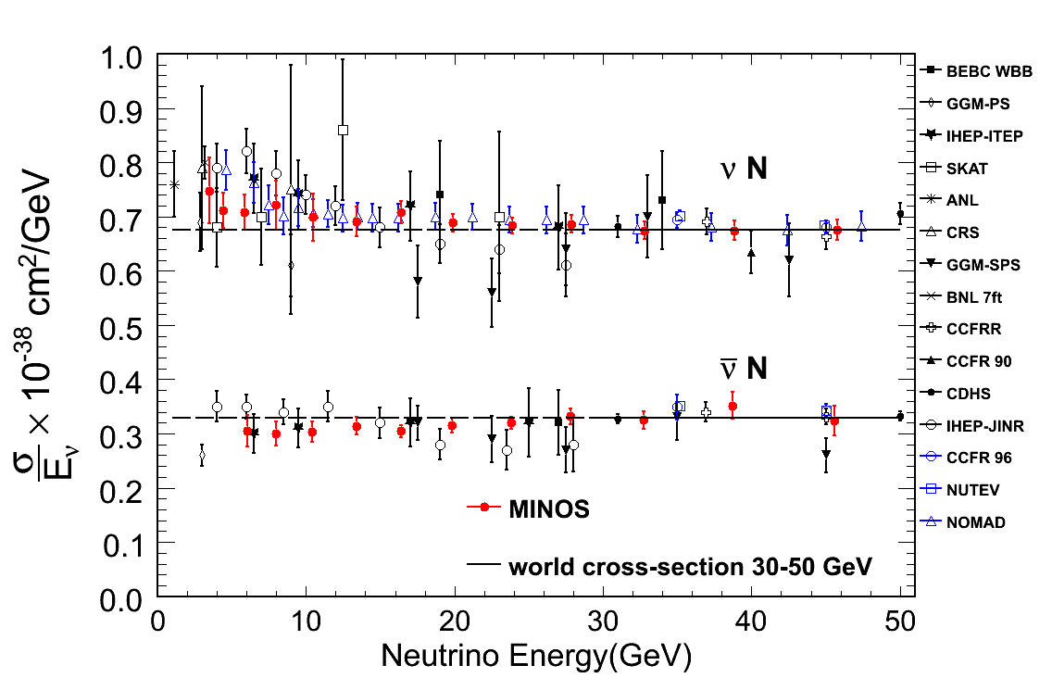
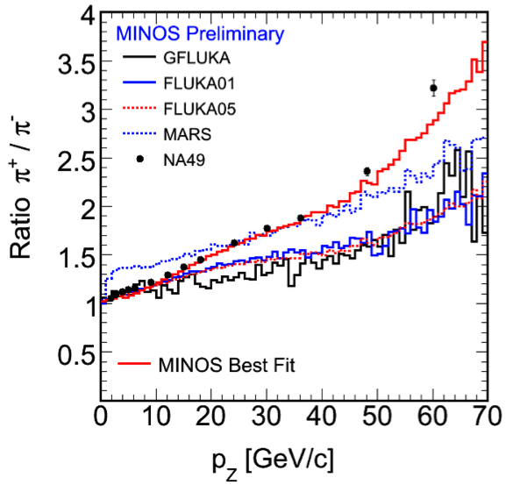
Antineutrino Cross-section
    Eur. Phys. J. C 49 897 (2007)
    Phys. Rev. D 81 072002 (2010)
Why is the peak rate ×3 lower?
  ×1.3 lower π⁻ production
  ×2.3 lower interaction cross-section
Notes:
Describe what they are, and then what they show
Describe each axis on every plot

Slide 11
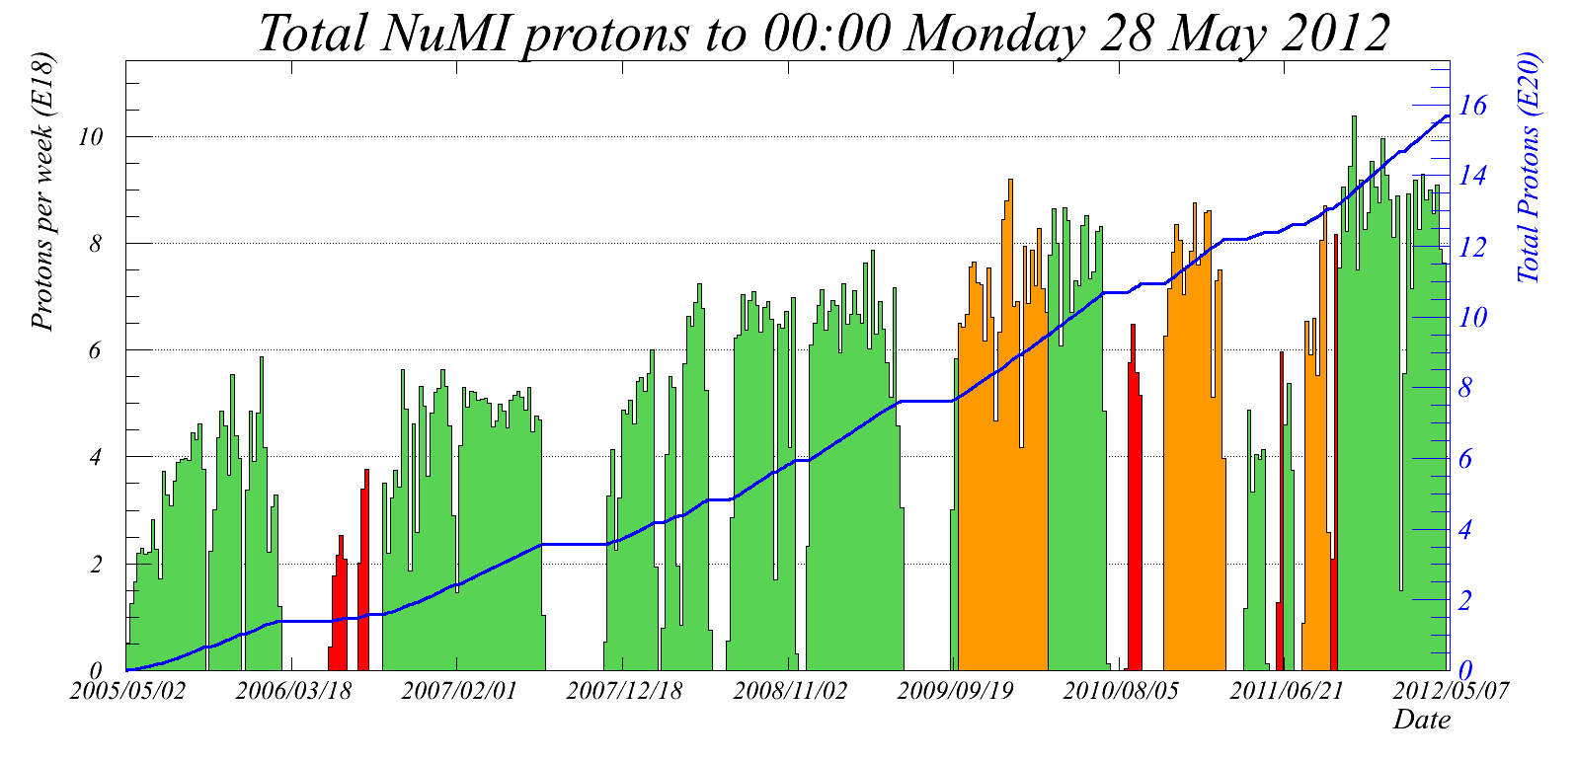
NuMI Beam Performance
My thesis
Notes:
Thank you to the accelerator folks for progressive improvement

Slide 12
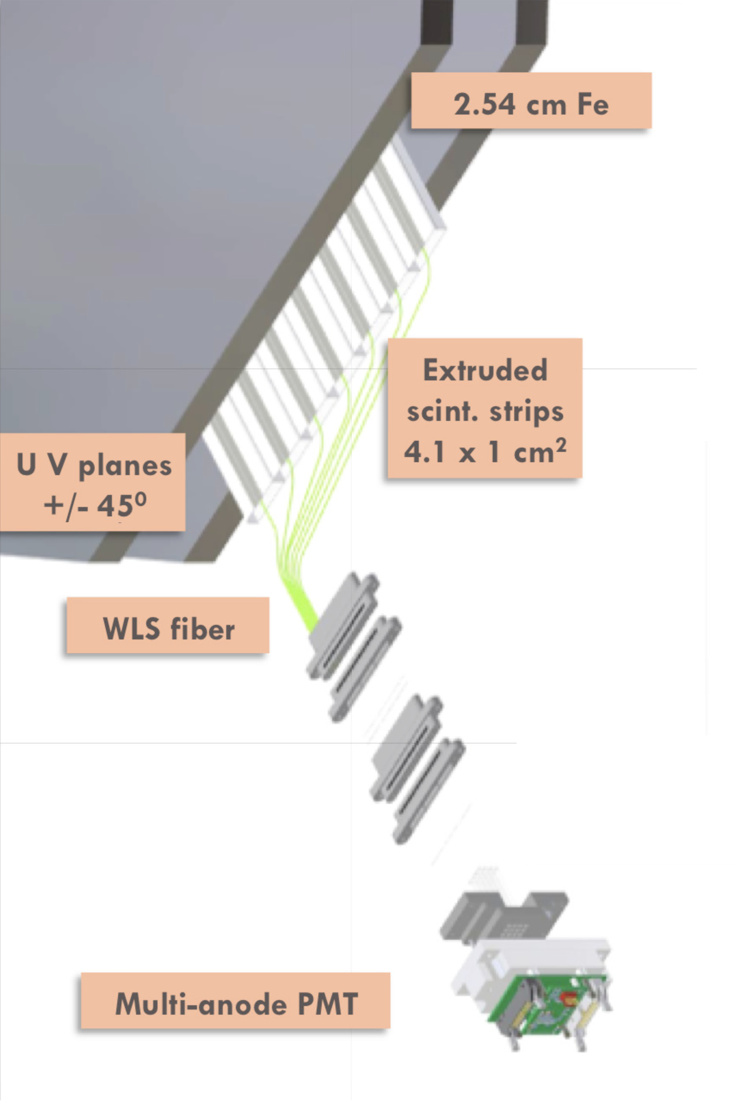
MINOS Detectors
Alternating layers of steel and plastic scintillator
Design as similar as possible to minimize systematics
Event-by-event identification of µ⁺/µ⁻ thanks to
1.3 T magnetic field
980 ton Near Detector, 5.4 kiloton Far Detector
Notes:
Point out the coil in the far detector

Slide 13
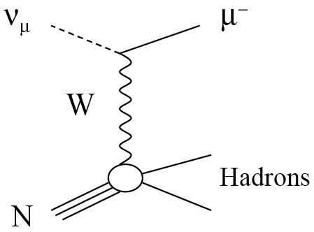
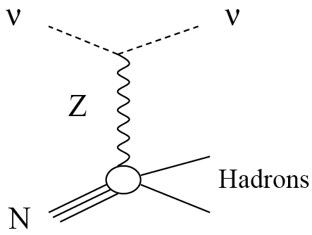
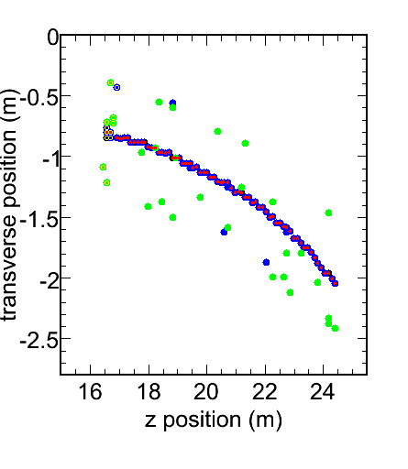
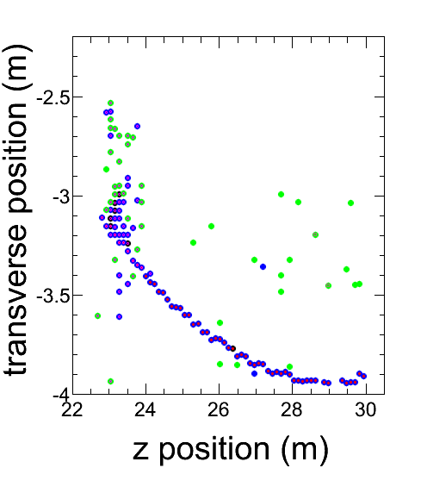
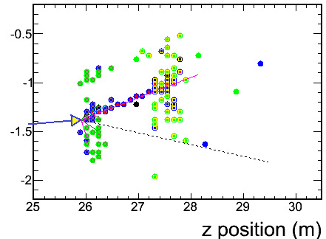

Signal
Backgrounds
ν_{μ} CC Event
ν_{μ} CC Event
NC Event
+
ν
μ⁺
μ⁻
Simulated Events
Notes:
Mention energy from track and shower

Slide 14
Signal
Backgrounds
ν_{μ} CC Event
ν_{μ} CC Event
NC Event
Positive Reconstructed Charge
+
ν
μ⁺
μ⁻
Simulated Events
Notes:
Mention energy from track and shower

Slide 15
Signal
Backgrounds
ν_{μ} CC Event
ν_{μ} CC Event
NC Event
Positive Reconstructed Charge
CC-like
Events
+
ν
μ⁺
μ⁻
Simulated Events
Notes:
Mention energy from track and shower

Slide 16
Selecting Charge Currents
CC/NC Selector
kNN Algorithm
  Measure “distance” to MC events
  Classify on fraction of closest that are signal
Input Variables
  Track Length
  Transverse energy profile
  2 dE/dx-like variables
2-Variable Example
Input Event
5 signal
1 background
kNN_{ID} = 5/6
CC
NC
Simulated Events
Notes:
Too fast – compare to monte carlo true events
Algorithm output parameter
4 dimensional knn space
How are the parameters scaled
More expalantion

Slide 17
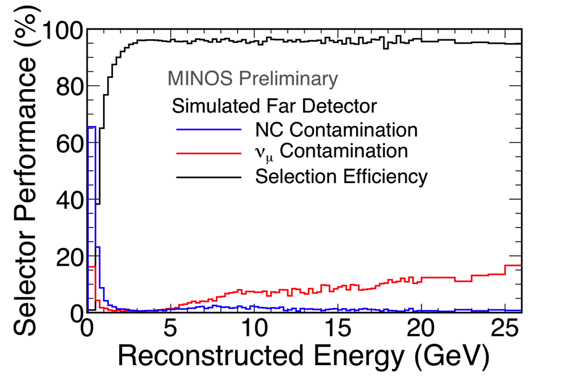
Select CC Antineutrinos
Monte Carlo
3 remaining Backgrounds:
ν_{µ}CC with a track too short to identify the charge
ν_{µ}CC with a track too straight to identify the charge
NC with a fake muon track
Notes:
Harshly removing ambiguous charge
High energy does not affect oscillation result

Slide 18
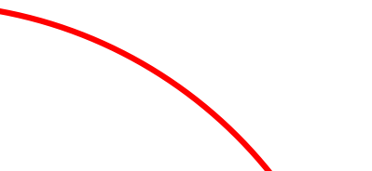
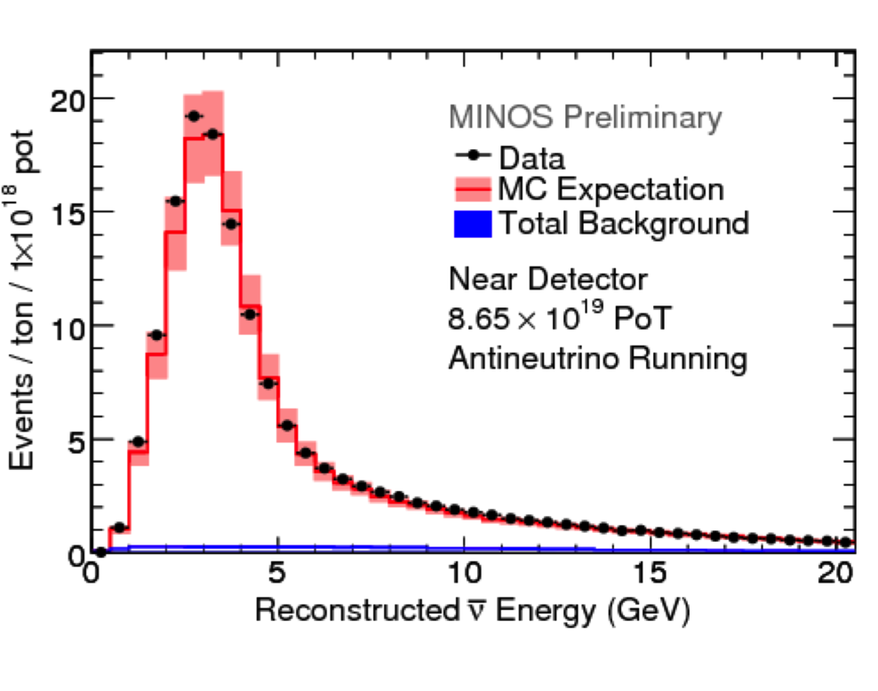
Near Detector Spectrum
Reconstruct the neutrino energy:
  Muon Track
    Range (contained)
    Curvature (exiting)
  Hadronic Shower
    Calorimetry
+
=
Notes:
Tuned target hadron production simulation
Used the neutrino-mode fit constrained by data from NA49

Slide 19
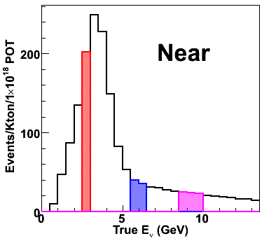
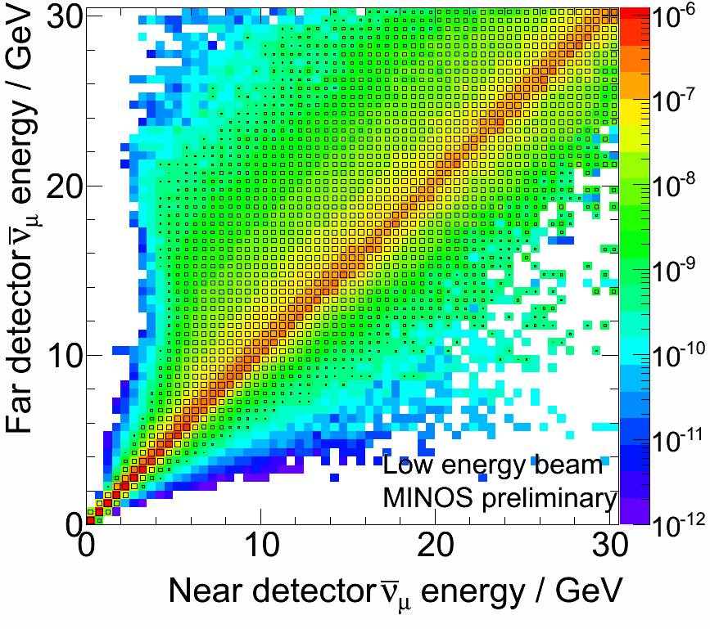
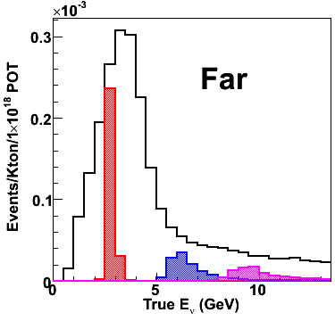
Near-to-Far Extrapolation
The Near Detector and Far Detector spectra are not identical.
Use a matrix to encode:
  beamline geometry
  decay kinematics
π
ν_{μ}
Far
Det.
Near
Det.
Monte Carlo
Monte Carlo
×
=
Notes:
Make sure to walk through the hisgtograms
Last point explains developing tails --

Slide 20
Far Detector Data
➔ 155 expected without oscillations
97 observed events
No-oscillations hypothesis is disfavored at 6.3σ

Slide 21
Neutrinos and Antineutrinos
Consistent at the 2% level assuming the same underlying parameters.
Notes:
Interesting tension. A proper combined analysis underway.
It sits right around the 95% contour and a proper combined analysis is pending.

Slide 22
New Results
  Since that time, MINOS has accumulated an additional 1.65×10²⁰ POT
New analysis incorporates
  Remove ND tracks likely to have a failed reconstruction
  Improved shower resolution
  Atmospheric neutrino samples included

Slide 23
New Results
ν_{μ} Beam+atm
ν_{μ} Beam
  Final MINOS results presented at Neutrino 2012 show no tension between neutrinos and antineutrinos
Notes:
Interesting tension. A proper combined analysis underway.
It sits right around the 95% contour and a proper combined analysis is pending.

Slide 24
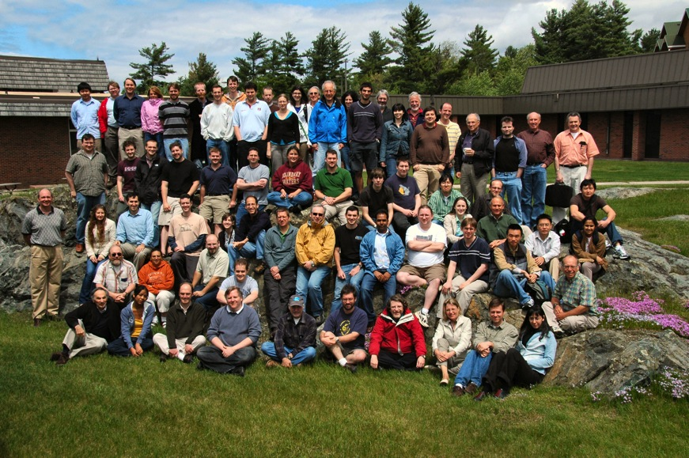
Conclusions
MINOS made the first direct, precision measurement of antineutrino oscillations using a dedicated antineutrino run
The 1.71×10²⁰ POT antineutrino measurement showed some tension with neutrinos (p=2%)
With an additional 1.65×10²⁰ POT and analysis improvements, neutrino and antineutrino parameters are no longer in tension
Thanks to all my MINOS
colleagues, my thesis advisor
Harvey Newman, and my
many unofficial advisors
The MINOS Collaboration
140 scientists
31 institutions
Notes:
“It’s very interesting, and we clearly need more antineutrino running.”
Backup slide on the cross-check of fitting without a charge sign cut

Slide 26
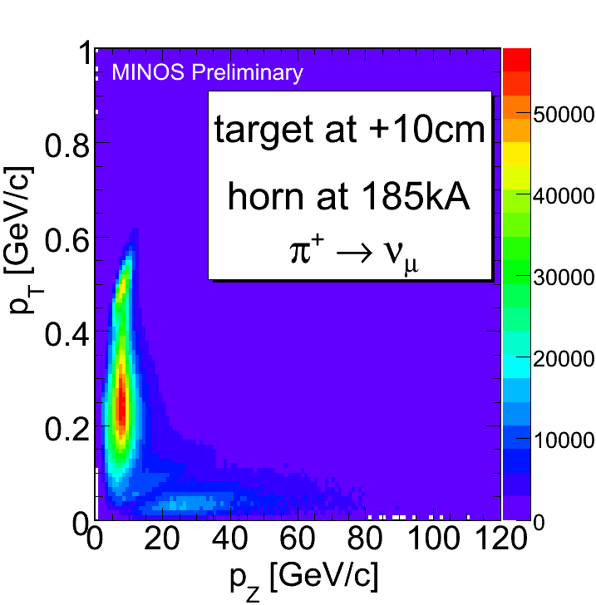
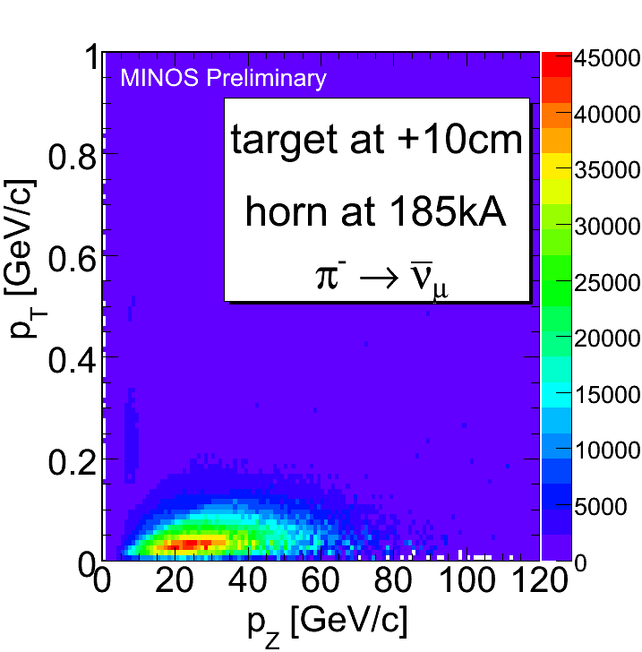
Peak vs. Tail
ν_{μ}’s from high-p_{t} π⁻’s
  Focused by horns
ν_{μ}’s from low-p_{t} π⁺’s
  Pass through horn center
Monte Carlo
Focused
Monte Carlo
Unfocused
Target
Focusing Horns
Decay Pipe
π⁺
2 m
ν_{μ}
120 GeV protons from MI
ν_{μ}
π⁻
15 m
30 m
675 m
Notes:
Where does contamination come in both beams
Take plenty of time here – the details are interesting

Slide 27
Peak vs. Tail
ν_{μ}’s from low-p_{t} π⁻’s
  Focused by horns
ν_{μ}’s from high-p_{t} π⁺’s
  Pass through horn center
Monte Carlo
Focused
Monte Carlo
Unfocused
Monte Carlo
Monte Carlo
Neutrino mode
Horns focus π⁺, K⁺
Antineutrino mode
Horns focus π⁻, K⁻
Notes:
High energy tail is unaffected by focusing

Slide 28
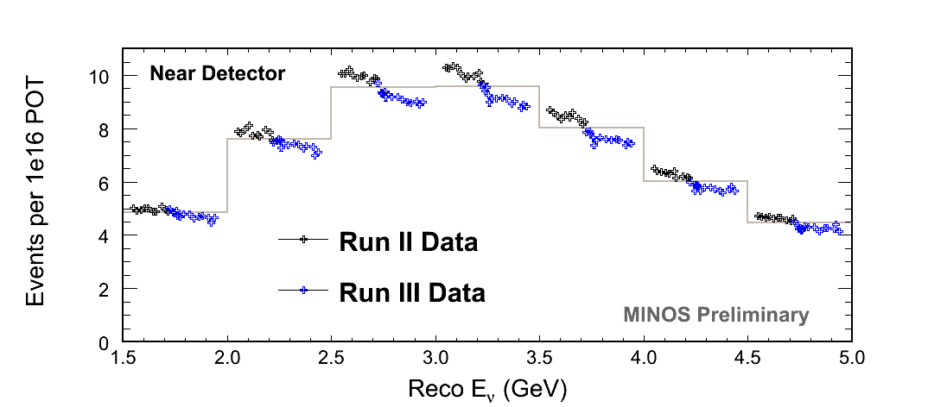
Target Degradation
Began during Run II and continued through Run III
The exact mechanism of the decay is not known
Missing fins at the shower max in the target model the energy-dependent effect
Target to undergo post-mortem later this year
Cancels between the two detector

Slide 29
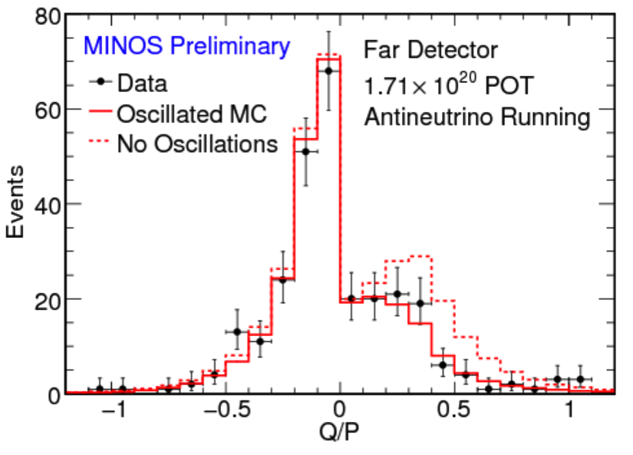
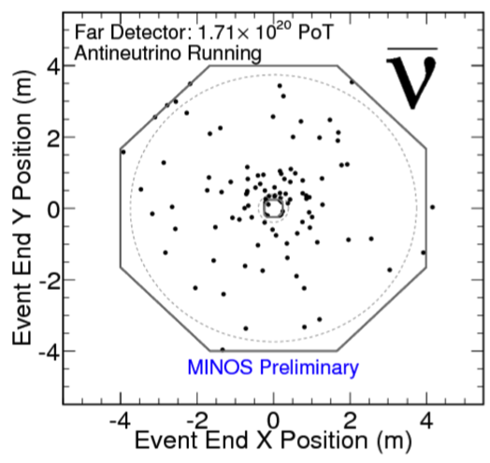
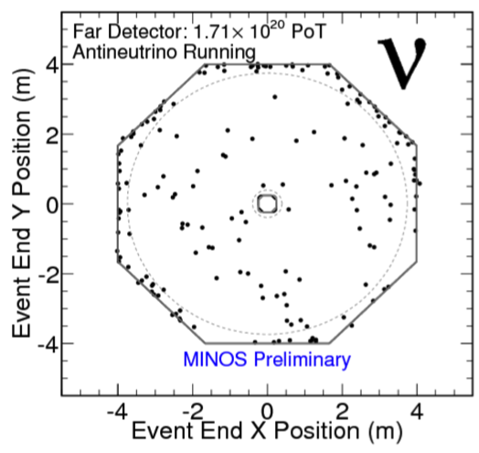
Far Detector Data
Charge/Momentum
Good data/mc agreement in
charge/momentum
Antineutrinos focused inwards
Neutrinos defocused outwards
Notes:
Antineutrinos focused towards the coil hole
Neutrinos focused away towards the edges

Slide 30
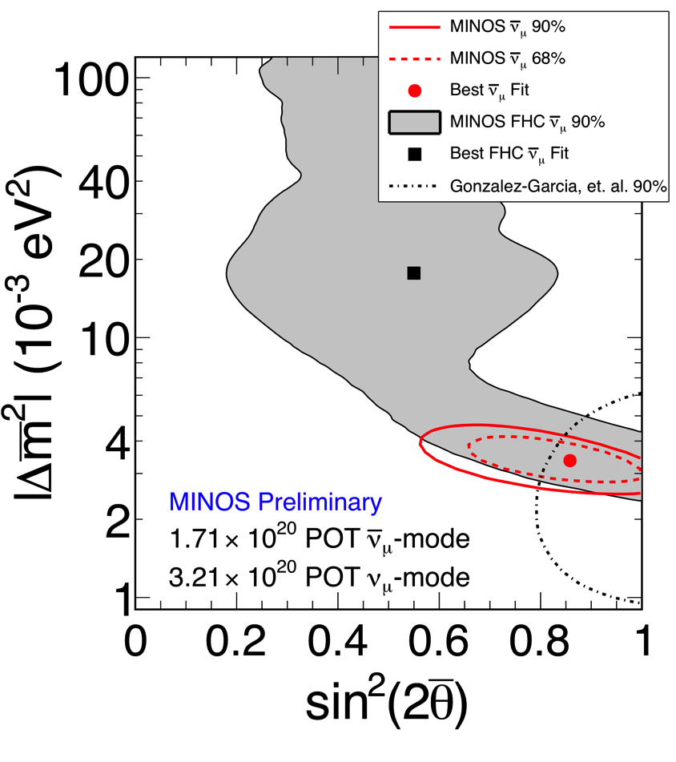
Antineutrino Contour
A combined analysis using all antineutrino data is planned.
Notes:
Add CC contour

Slide 31
Detecting Neutrinos
Cannot directly observe the neutrino
Instead, observe the charged particles after a neutrino interacts with a nucleus in the detector

Slide 32
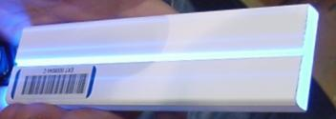
Detecting Charged Particles
4 cm x 1 cm plastic scintillator strips
Embedded wavelength-shifting fiber
Scintillation light amplified by multi-anode PMTs

Slide 33
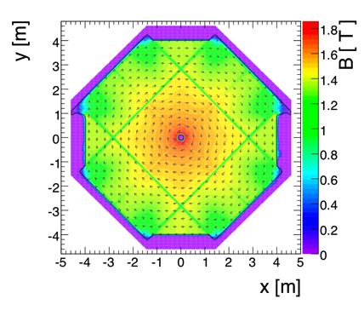
MINOS Detectors
1 cm thick, 4.1 cm wide
Plastic Scintillator
1 in thick Steel
Read out on wavelength-shifting fibre to multi-anode PMTs
1.3 T toroidal magnetic field can distinguish neutrinos and antineutrinos
B
Strips in alternating directions allow 3D event reconstruction
Notes:
Mention the field plot
Mention the reversible field
A 1 GeV muon penetrates 28 planes
Causes events to be focused inwards or outwards

Slide 34
Selecting Charged Currents
Basic selection
  In-time with the spill
  In the fiducial volume
  At least 1 reconstructed track
CC/NC separation using a kNN algorithm
  Compare to Monte Carlo events
  Fraction of signal in k most similar events is the discriminant
k-Nearest Neighbors
“kNN”
Notes:
Too fast – compare to monte carlo true events
Algorithm output parameter
4 dimensional knn space
How are the parameters scaled
More expalantion

Slide 35
Selecting Charged Currents
CC
NC
CC/NC separation using a kNN algorithm
4-parameter comparison
  Track length
  Transverse energy profile
  Energy deposited per plane
  Energy fluctuations along the track
Simulated Events
Notes:
Topology – muons tend to be longer than hadronic shower elements

Slide 36
Selecting Charged Currents
CC
NC
CC/NC separation using a kNN algorithm
4-parameter comparison
  Track length
  Transverse energy profile
  Energy deposited per plane
  Energy fluctuations along the track
Simulated Events
Notes:
Topology – muons tend to be isolated while hadronic shower elements tend to have other unrelated hits

Slide 37
Selecting Charged Currents
CC/NC separation using a kNN algorithm
4-parameter comparison
  Track length
  Transverse energy profile
  Energy deposited per plane
  Energy fluctuations along the track
Notes:
Muons – multiple coulomb scattering – lots of small energy losses – low energy per strip, relatively uniform
Hadronic shower elements – hadronic interactions tend to be more energetic and fluctuate more between low and high energy losses

Slide 38
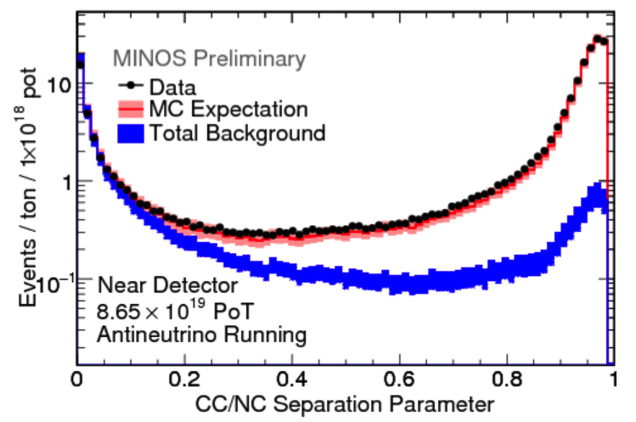
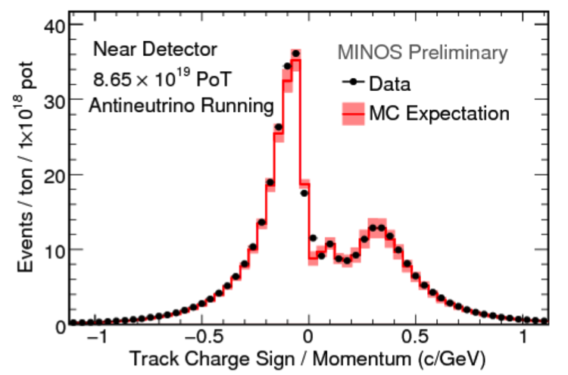
Selecting CC Antineutrinos
Use the CC/NC Selector
  Removes NC and high-y CC interactions
Accept only events with positive reconstructed charge
CC/NC Selector
Accept
Accept
Notes:
What are the 2 bumps – be ready to explain
Ready to explain modeling the peak

Slide 39
Fitting for Oscillations
Fit performed by minimizing a binned -log likelihood
For antineutrinos, a Feldman-Cousins approach is used
  Many fake experiments used create empirical χ² distributions as a function of the parameters
  Systematics included in the fake experiments

Slide 40
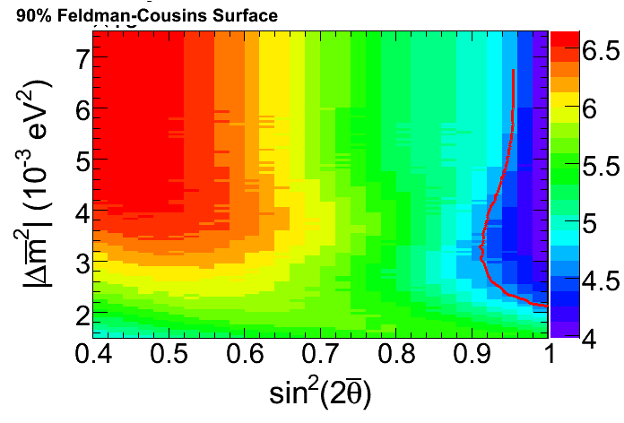
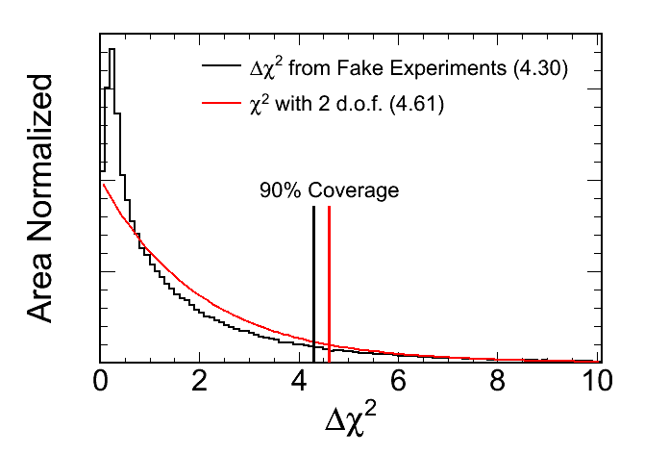
Feldman-Cousins
Each point is the Δχ² that encompasses 90% of fake experiments
  A perfectly Gaussian surface would be 4.7 everywhere.
Worse than Gaussian
Degeneracy with fast oscillations
Better than Gaussian
Physical boundary gives extra information

Slide 41
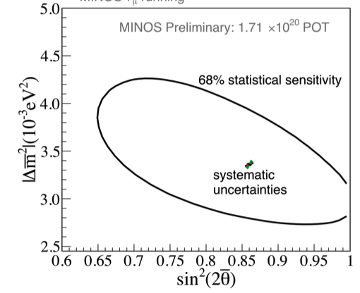
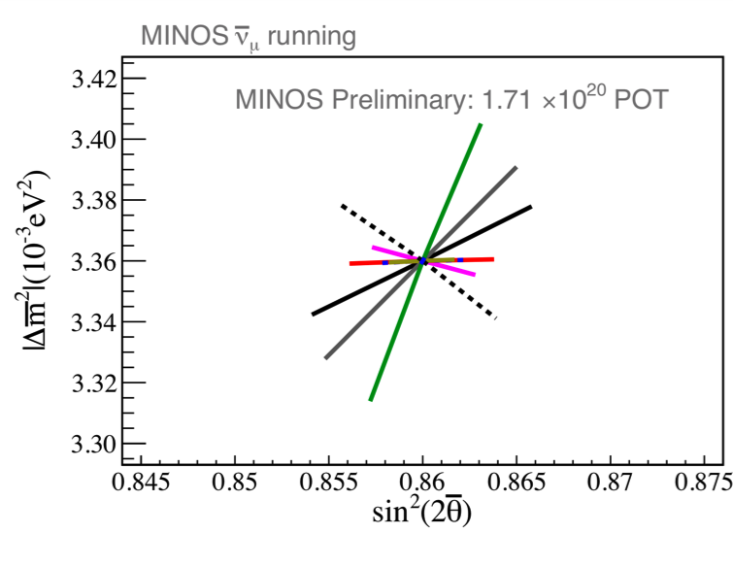
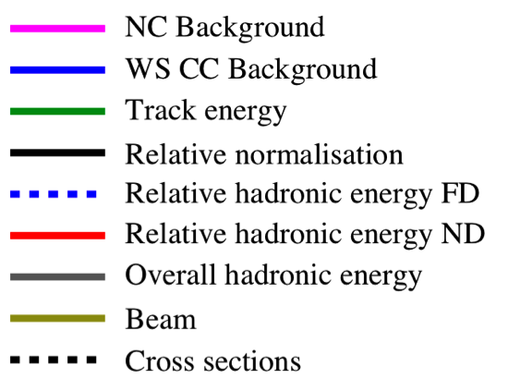
Systematics
Effect of uncertainties estimated by fitting systematically shifted MC
Systematics are very small relative to the statistical uncertainty
Monte Carlo

