Slide 1

First Beam at Fermilab SeaQuest/E906: Status and Plans
Joshua G. Rubin
Physics Division
Argonne National Laboratory
Work supported in part by the U.S. Department of Energy, Office of Nuclear Physics, contract no. DE-AC02-06CH11357

Slide 2
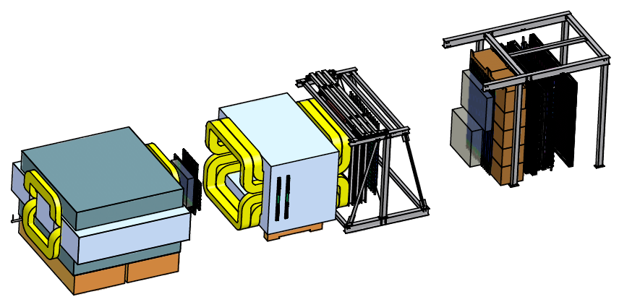
SeaQuest Apparatus
≈4000 detector channels
KMAG
Spectrometer magnet
(Δp_{t}=0.4 GeV)
FMAG
Solid iron dump & focusing magnet
(Δp_{t}=2.9 GeV)
Beam
120 GeV protons Main Injector
5s of 19ns RF/min
25m
Targets
Liquid H and D
Solid C, Fe, W
1-3 spills/targ. cycle
Mainly muons penetrate dump:
Dimuon Pairs
  Drell-Yan
  J/ψ decay
Single Muons
  hadron decay
High Rate
Low Rate

Slide 3
Fixed Target Drell-Yan Scattering:
A Laboratory for Studying Sea Quarks
q
l
q
l
Fixed target favors large x_{f} (= x_{b} – x_{t}) →
Beam antiquark densities negligible for large x_{b}
Sensitive specifically to antiquarks in the target!
Complements DIS results

Slide 4
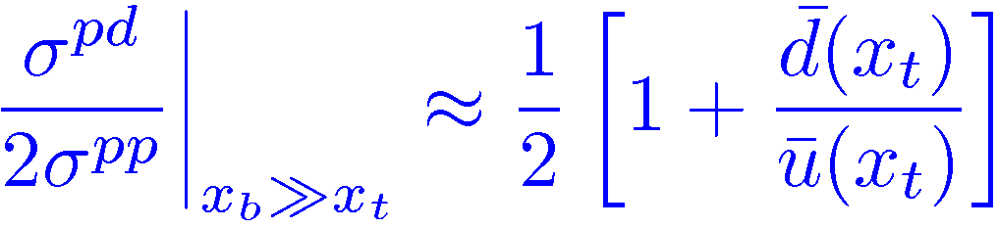
Measuring the Light Sea Asymmetry
What is the origin of the quark sea?
Naïvely expect flavor symmetry
E866 measured an asymmetric light quark sea
Caused by influence of valence quarks? Virtual mesons?

Slide 5
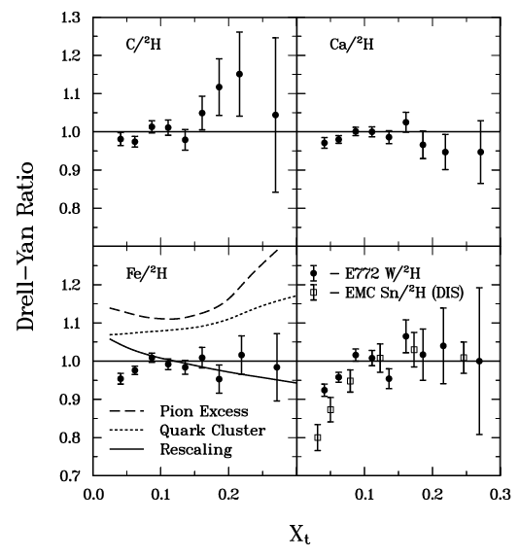
Nuclear Dependence of Drell-Yan – Exciting mysteries!
E772 produced results on several nuclear targets
No evidence of DIS-like anti-shadowing for sea-quarks. Interesting...
Where are the excess pions we expect for nuclear binding?!
x-reach limited where many models predict antiquark enhancement
DIS for comparison
Alde et al (Fermilab E772) Phys. Rev. Lett. 64 2479 (1990)

Slide 6
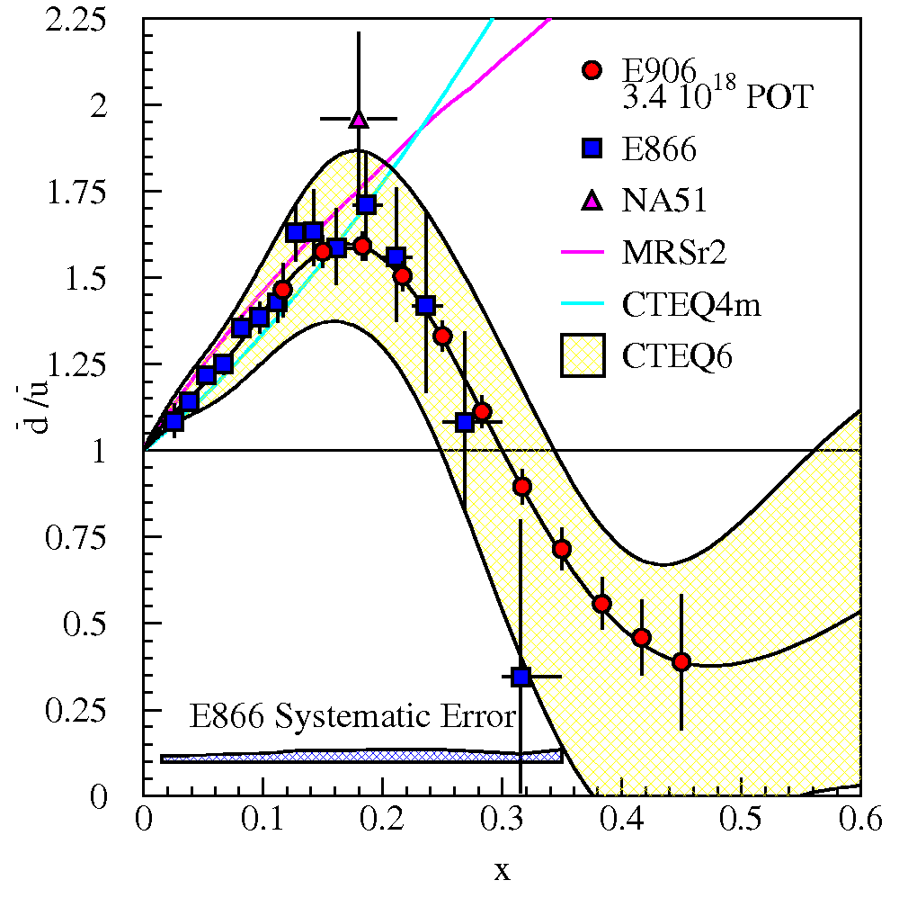
E906/SeaQuest – D-Y Comparison with E866
120 GeV protons from FNAL main injector (vs. 800GeV @ E866)
σ^{Drell-Yan} falls off as 1/s
J/ψ background proportional to s
50x relative increase in precision!
And other PDF related topics… absolute cross sections, partonic energy loss.

Slide 7
Charm at SeaQuest
J/ψ is the (large!) background for the Drell-Yan analyses
D-mesons dominate singles rate at large angles
cross section
changes rapidly
nuclear dependence
Effect of nuclear matter?
Ann.Rev.Nucl.Part.Sci. 42 (1992) 367-399
Phys.Rev.Lett. 84 (2000) 3256-3260

Slide 8
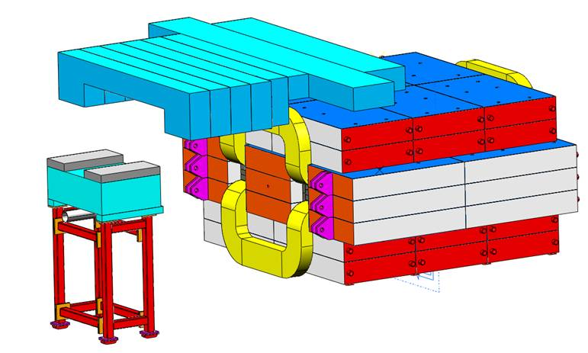
The SeaQuest Timeline – Some Unexpected Difficulties
The Fermilab Main Injector is currently shut down to upgrade intensity
 | 2010 | 2011 | 2012 | 2013
Schedule:
Actual:
Run I
Injector Upgrade
Run II
Beamline loses vacuum
Last delivered beam to KTEV
760’ pipe buried under berm
Ultimately leak controlled and reasonable vacuum was possible
Additional radiation shielding required
500 tons of concrete and steel
14 tons of steel on movable cart
Run I became a short commissioning run

Slide 9
Commissioning Run (~two months)
First protons arrived in hall on March 8, 2012
Run ended April 30, 2012 with beginning of shutdown
All systems worked!
  Typical issues with mapping and timing resolved quickly
  Some challenges with TDC microcode – modules rolled-back to a prior software version, zero-suppression moved to VME CPUs. → relatively long dead-times (>1ms)
Unexpectedly large hit multiplicities with dimuon trigger – termed “splat events”

Slide 10
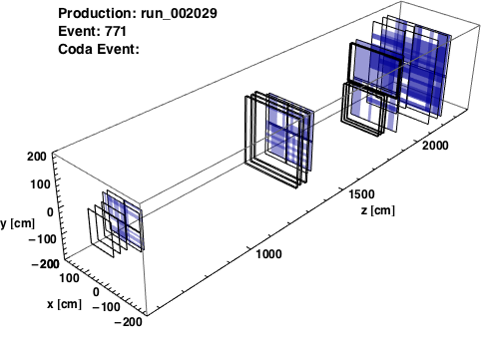
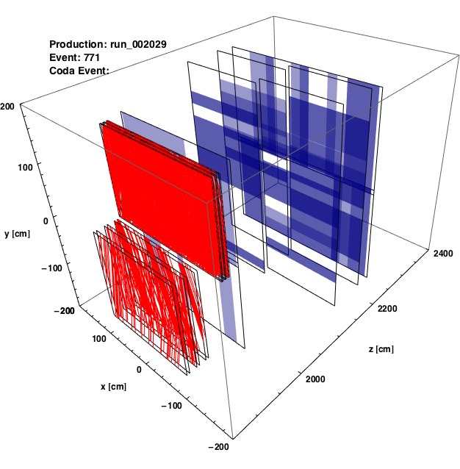
“Splat” Events
Symptoms and Clues:
Very large hit multiplicity for dimuon trigger events for both matrix and simple NIM triggers
All systems: hodoscopes, chambers, and prop. tubes swamped
Single trigger (1*2*3*4) provides clean single tracks
Average intensity normal, measured by beamline instrumentation
full detector (hodoscope hits)
Stations 3+4 (all hits)

Slide 11
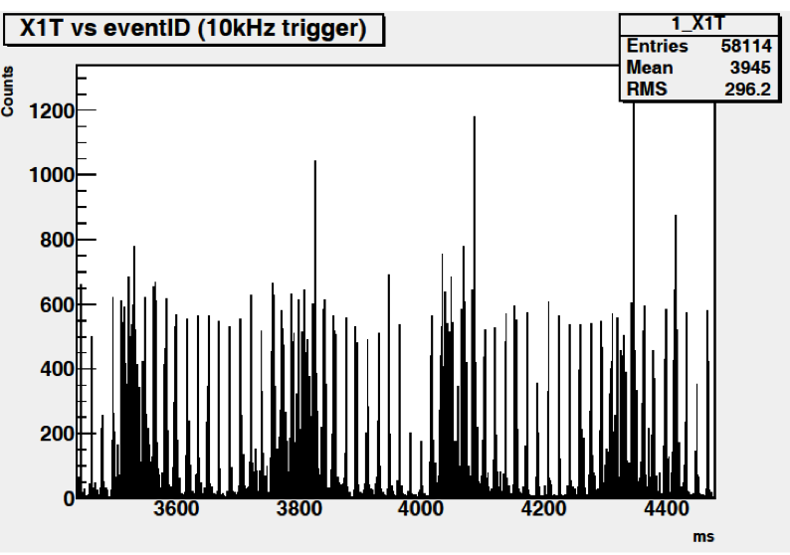
“Splat” Events – Understanding the Beam
Independent 10kHz pulsed DAQ read out raw hodoscope rates
Bins are integrated counts over 100µs (≈5000 RF buckets)
Large variation in Instantaneous intensity, duty factor very low.
Periodic structure

Slide 12
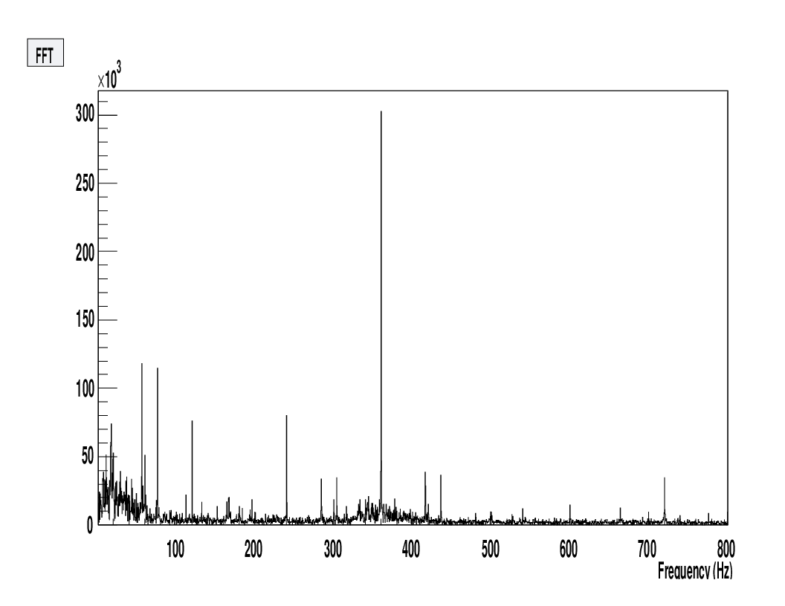
“Splat” Events – Understanding the Beam – FFT
Several clear resonances: 60Hz and harmonics, 360Hz
Fine grained feedback for the accelerator control room.
Injector power supplies? Slow extraction procedure?

Slide 13
The Splat-Block Card
A card was developed to keep a running average of the multiplicity over a 160 ns window (8 RF buckets).
If average multiplicity above threshold, raises a trigger veto
Luminosity greatly reduced, but trigger suppresses windows of time with large beam intensities.

Slide 14
Run I Summary
Short run, problems solved or understood
  The shutdown gives us the opportunity to address remaining problems properly
  Full luminosity (≈10¹⁹ POT) will still be delivered by end of Run II.
Approximately two weeks of analyzable production data taken with splat-block
Dimuon pairs observed and reconstructed!
Data taken with several target species (H, D, C, Fe, and W)
Luminosity too low to make a meaningful Drell-Yan analysis, but J/ψ cross section much larger
We expect to produce at least 120GeV relative J/ψ cross sections on nuclear targets.
Offline analysis underway… tracking, alignment, chamber calibration, data quality, etc.

Slide 15
Run II Improvements
Upgraded Stations 1 and 3- will expand acceptance to larger x_{t}
Transistorized PMT bases to address possible voltage sagging in Station 1 due to larger than expected rates
Zero suppressed TDCs – improve live time significantly.
Possible beamline Cerenkov to monitor individual bunch intensity
  Feedback to the accelerator control room
  Generate DAQ veto
  Produce accurate luminosity
And beyond!
SeaQuest with polarized Main Injector has ben proposed to study transverse-momentum dependent distributions
Special thanks for an extraordinary effort from the Fermilab team!

