Slide 1
Recent Accelerator Performance and Shutdown plans
Phil Adamson
Fermilab Accelerator Division

Slide 2
Introduction
Tevatron shut down at the end of last FY
Impact celebrated yesterday
Talks later this afternoon
Muon Accelerator Program
Yagmur Torun
FNAL Test Beam
Aria Soha
ASTA
Mike Church

Slide 3
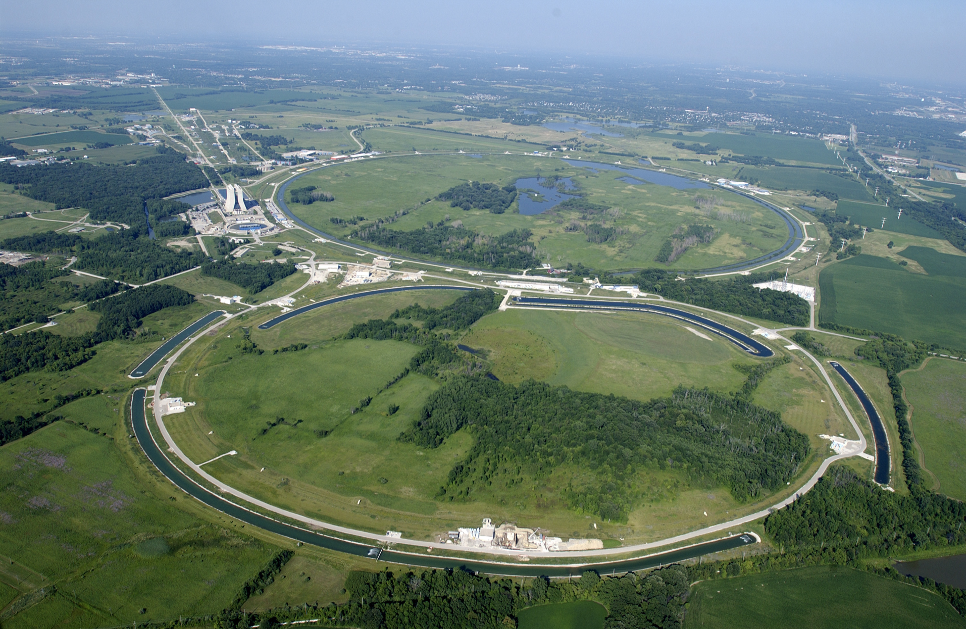
Accelerator Overview

Slide 4
Accelerator Overview
Linac:
NTF, MTA
Booster
BNB (MiniBooNE)
Main Injector/Recycler
NuMI (MINOS, Minerva)
SY120
Test Beams, SeaQuest
Muon Rings
Ex-pbar source

Slide 5
NuMI Performance
Recall NuMI target problems from last year
Water cooling lines for target redesigned
Target ran until shutdown with no problems

Slide 6
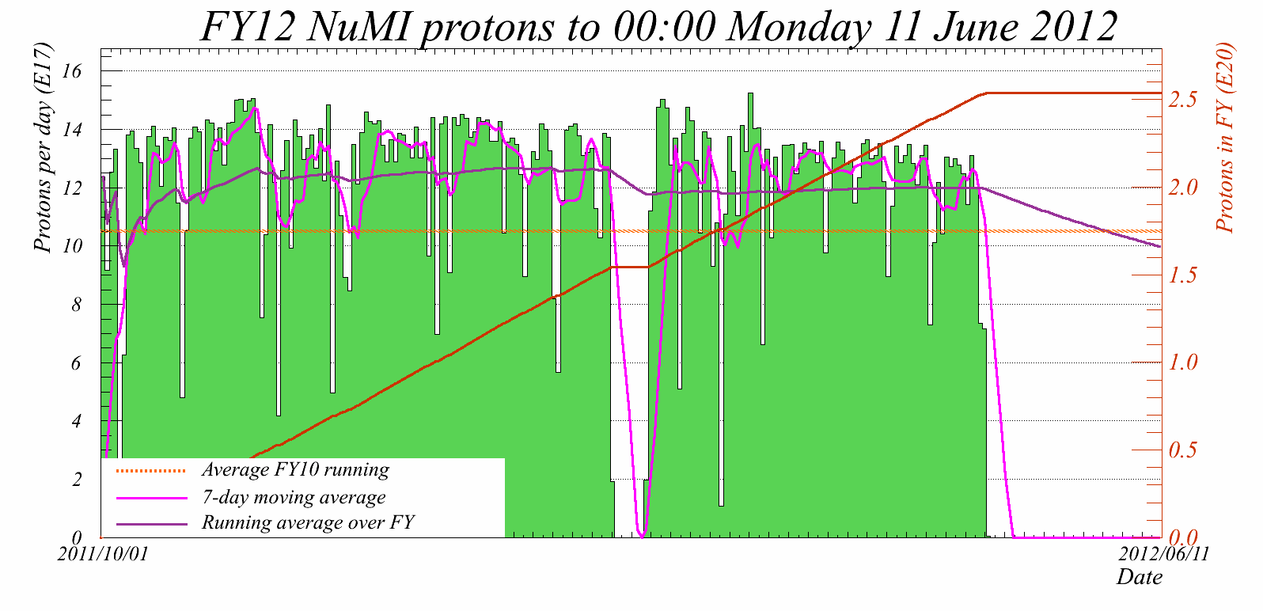
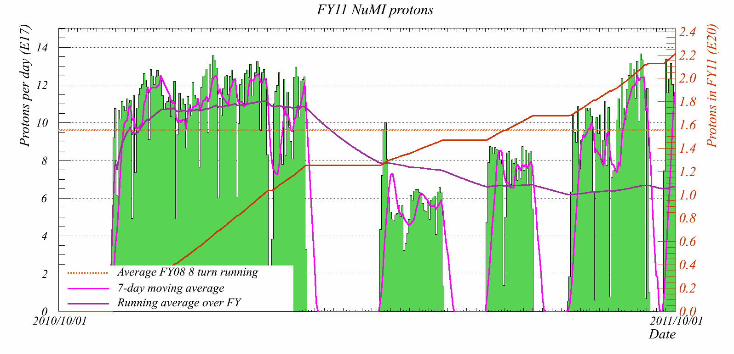
FY11: Annus Horribilis
(NT04)
NT05
NT06
NT01
NT02
Got 2.2E20 in FY11, thanks to heroic efforts from target folks (and delay to future projects)
New target NT07 installed at end of FY11
Ran without problems until shutdown

Slide 7
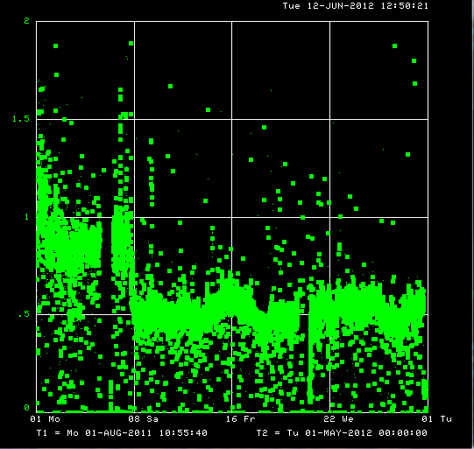
Main Injector
After Tevatron off, re-adjusted slip-stacking to fulfill request from NuMI with minimum losses
Beam loss per proton accelerated reduced by almost a factor of 2
ALARA
Retune after Tevatron off
Normalized beam loss (µJ/proton)

Slide 8
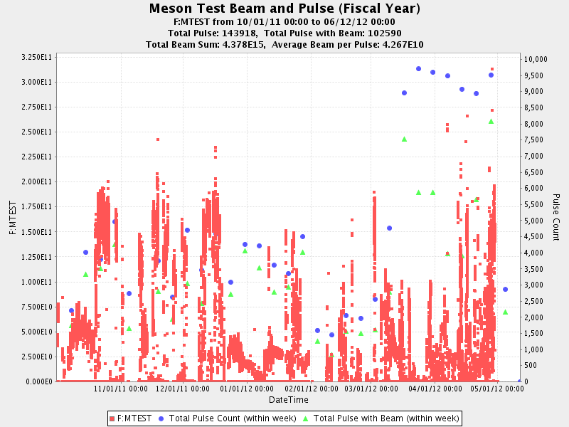
SY120
Testbeam typically runs ${10}^{11}$ protons per spill
SeaQuest started running in March
Ultimately wants 2 orders of magnitude more
Can’t afford 2 orders of magnitude more beam loss
Installed/installing instrumentation

Slide 9
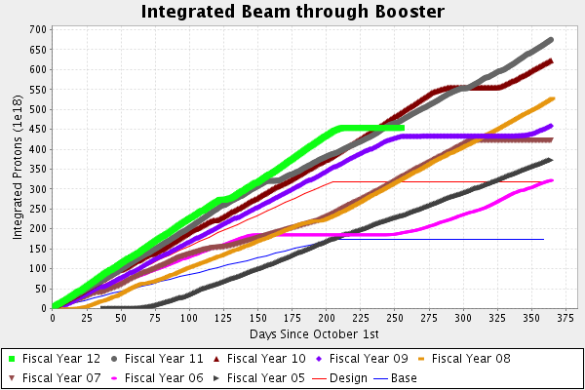
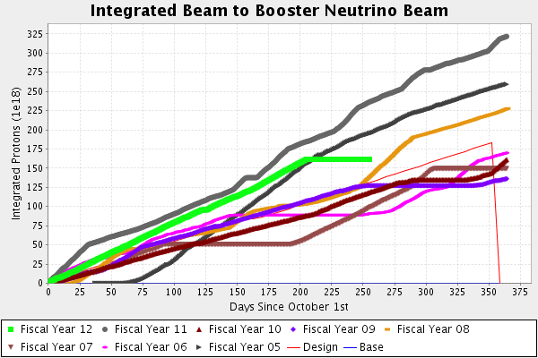
Proton Source
Steady year-on-year improvement
Lots of small gains
Need Proton Improvement Plan for future
See later in talk
BNB (MiniBooNE) good, steady performance

Slide 10
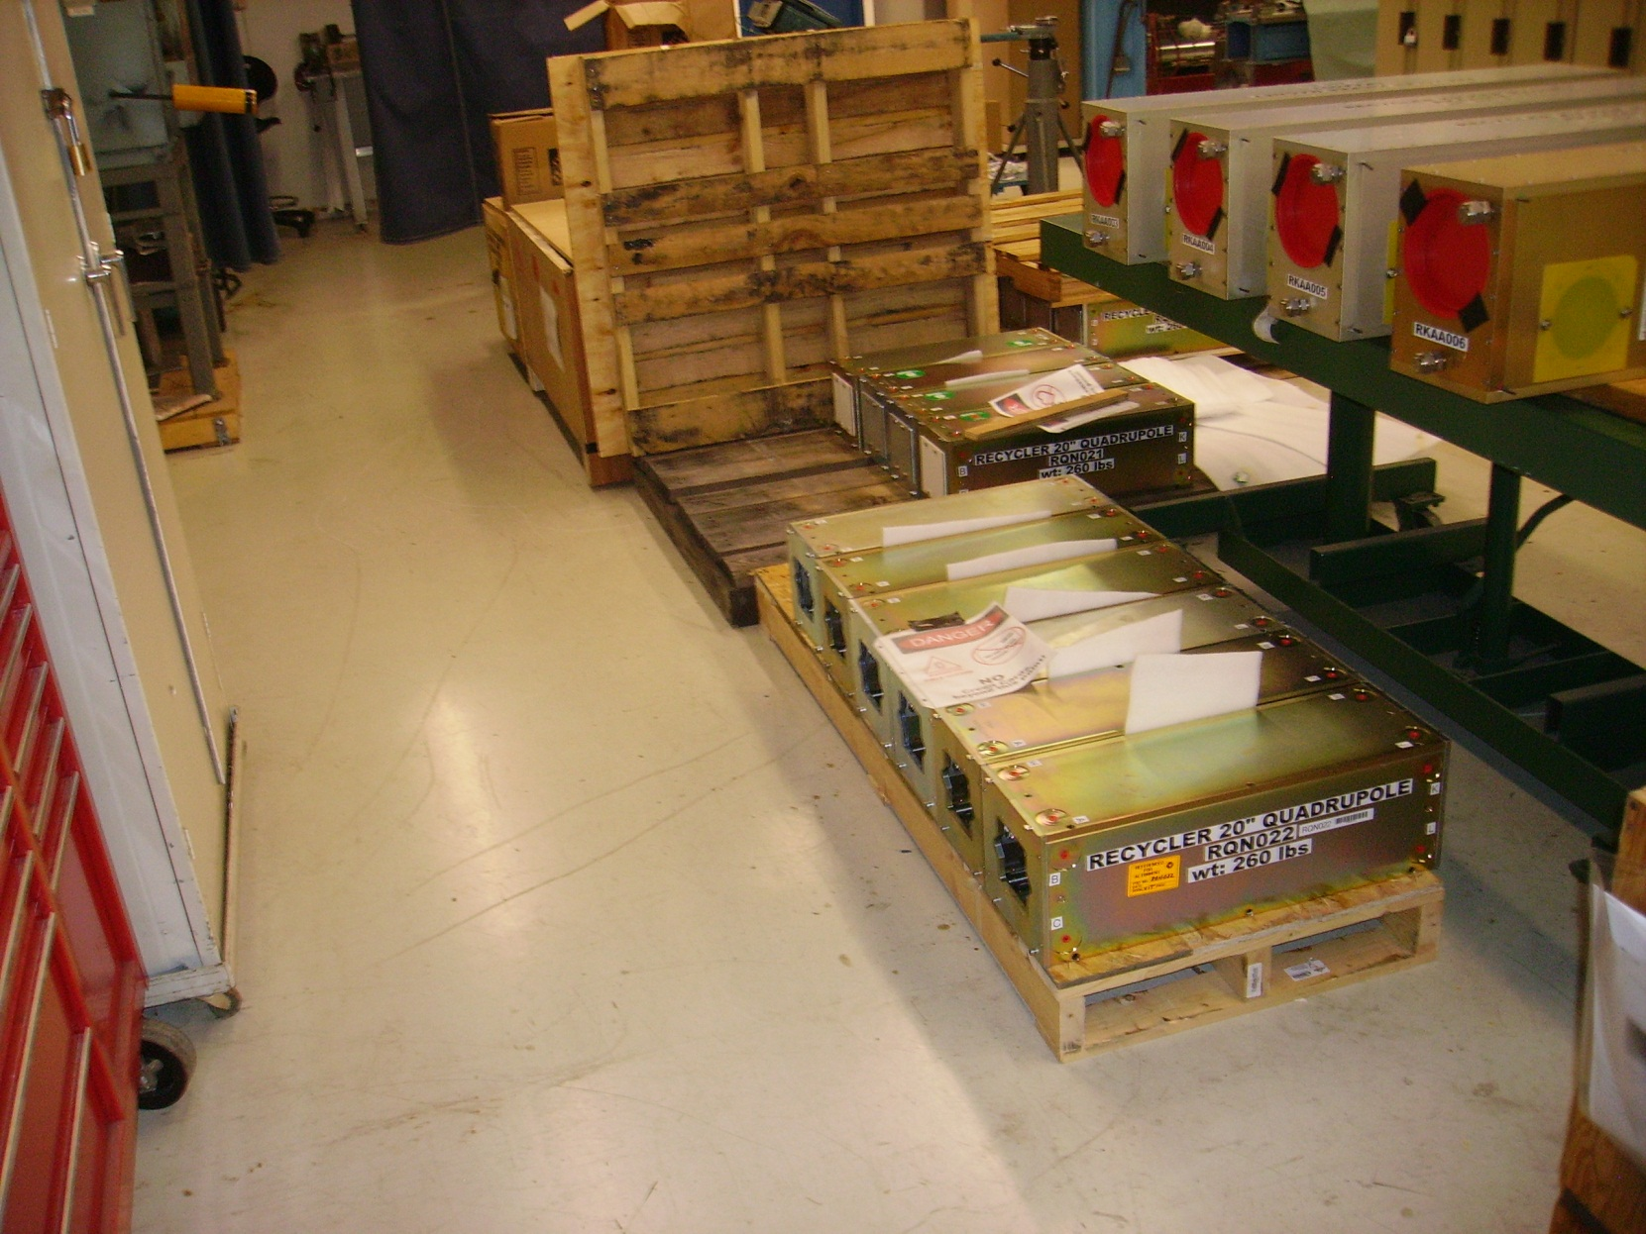
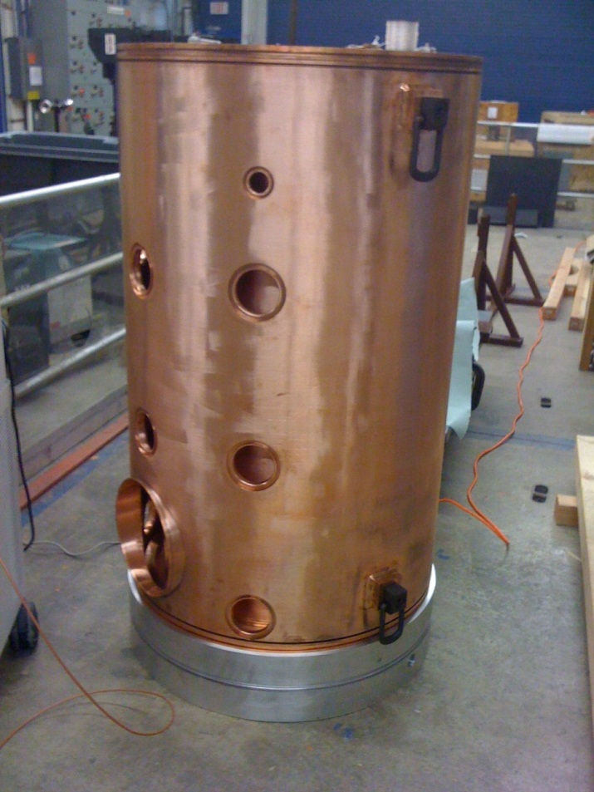
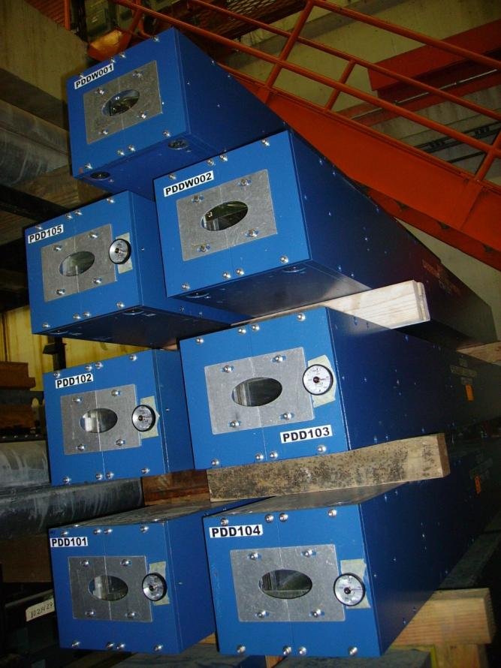
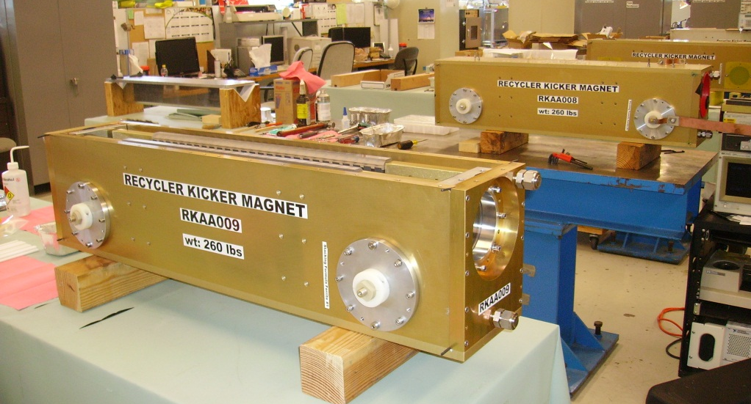
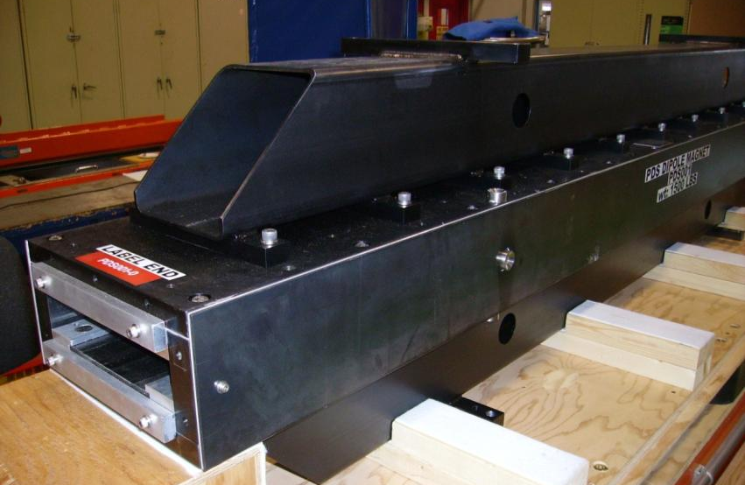
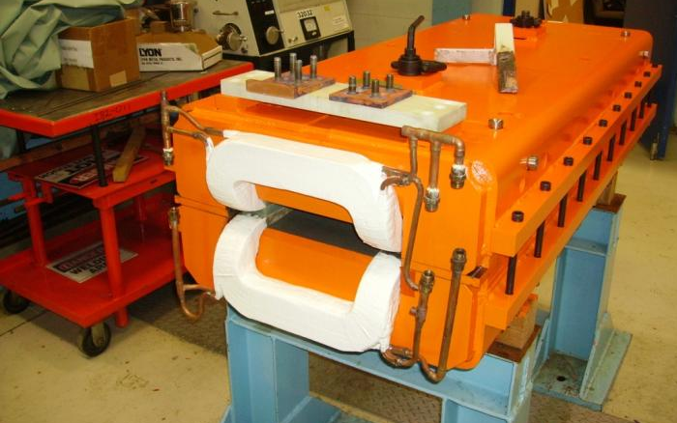
Shutdown 2012

Slide 11
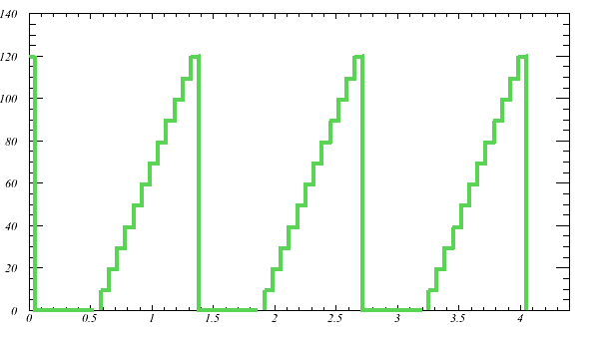
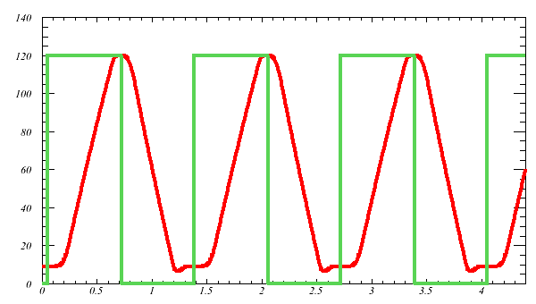
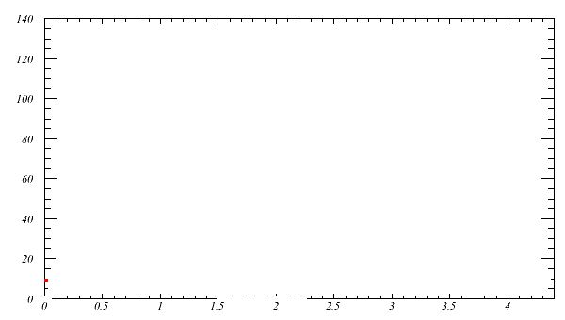
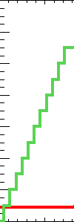
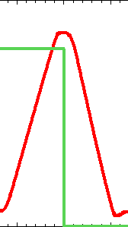
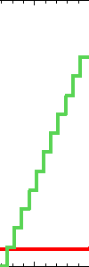
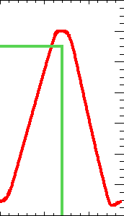
Increasing beam power
Red: MI momentum
Green: Beam current
Recycler
Move slip-stacking to recycler
11 batch -> 12 batch
Increase Main Injector ramp rate (204 GeV/s -> 240 GeV/s)
330 (380) -> 700kW with only ~10% increase in per-pulse intensity
Main Injector

Slide 12
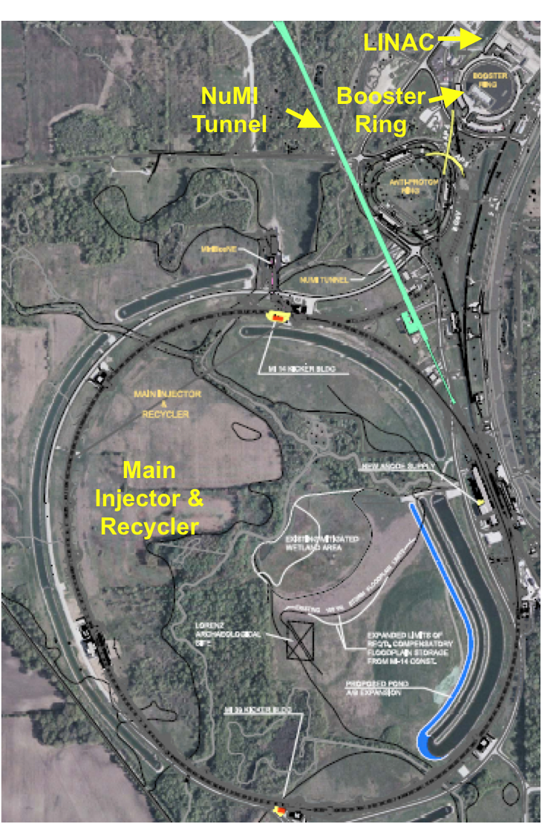
Accelerator and NuMI Upgrades
Recycler Ring, RR
New injection line into RR
New extraction line from RR
New 53 MHz RF system
Instrumentation Upgrades
New abort kickers
Decommissioning of pbar components
Main Injector
Two 53 MHz cavities
Quad Power Supply Upgrade
Low Level RF System
NuMI
Change to medium energy ν beam configuration (new target, horn, configuration)
Cooling & power supply upgrades

Slide 13
Big Picture
Crew 1
Crew 2
Crew 3
Crew4
Crew 5
Staging
Crew 6
NuMI Crew

Slide 14
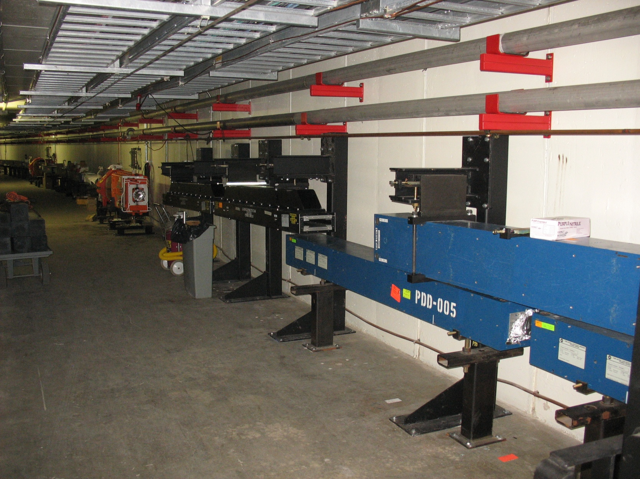
New MI8 line to recycler

Slide 15
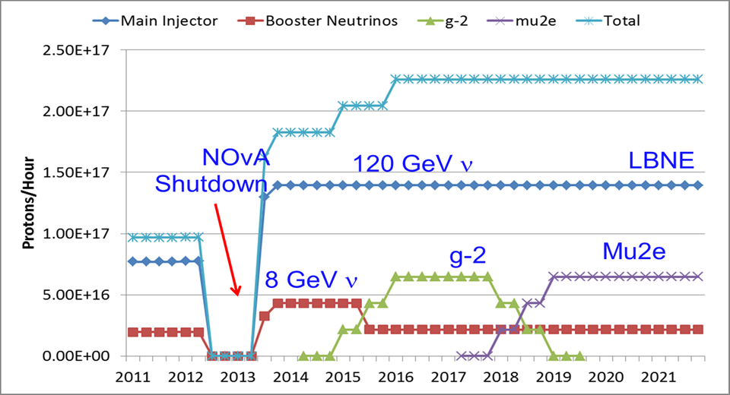
Future Proton Needs

Slide 16
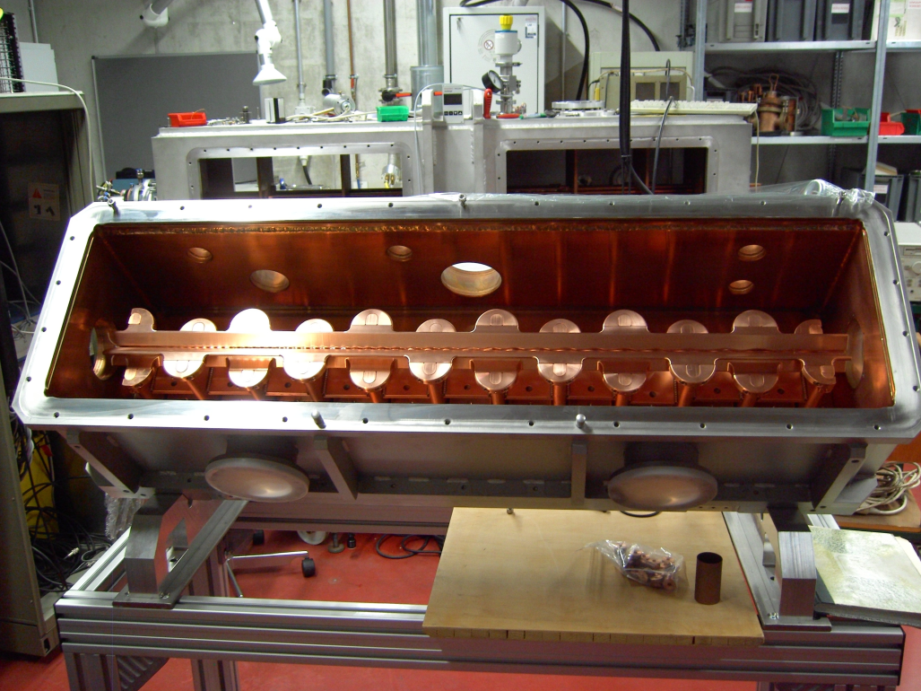
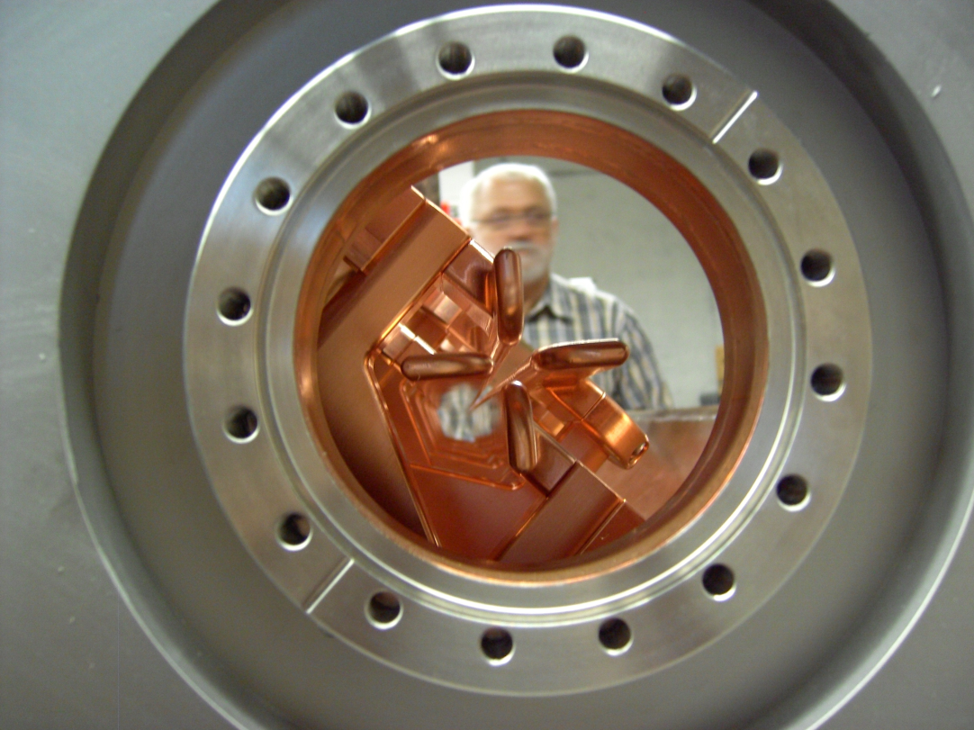
Proton Improvement Plan
Proton source is 40 years old
Must run for at least 15 more years to support lab physics program
Need upgrades to permit higher rep rate for intensity frontier
Identify weaknesses and remedy
Cockcroft-Waltons
(2009 I- off for ~ 1 year for repair)
Solution – RFQ Based Injector
Install this shutdown
Cockcroft Walton

Slide 17
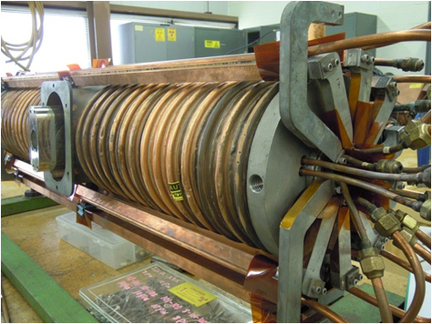
Proton Improvement Plan
Linac
Linac Dump Repair
Vacuum Upgrades
BPM Upgrade
Klystron Maintenance
Low Energy Maintenance
LE PLC Upgrade
Booster
Solid State Upgrade
Booster Cavity Refurb.
Gradient Magnet Moves
Beam Absorber Install
LCW Upgrade
Possible Shielding Changes
Booster RF cavity tuners need cooling upgrade to permit 15 Hz operation

Slide 18
Summary
Accelerators have had a good year
“11-month” shutdown has begun
Lots of work to do to upgrade complex to meet challenges of the intensity frontier
ANU (double NuMI beam power)
PIP (double+ proton source output)
SeaQuest (2 orders of magnitude increase in slow spill from MI)
We are working hard to meet these challenges
Expect a report on startup / commissioning next year

