Slide 1
The Mu2e Experiment
FNAL Users’ meeting 2012
Emma J Barnes
Boston University
June 12-13th 2012
http://mu2e.fnal.gov/

Slide 2
Summary of Talk
Charged Lepton Flavor Violation (CLFV)
Observing CLFV.
The physics of muon to electron conversion
The Mu2e experiment
Backgrounds that can limit sensitivity
Current status

Slide 3
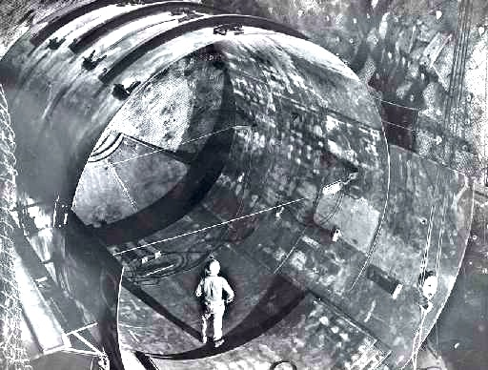
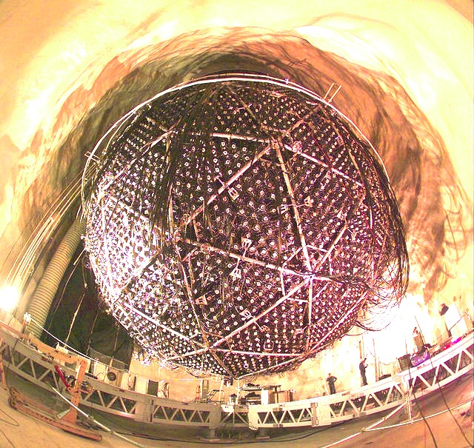
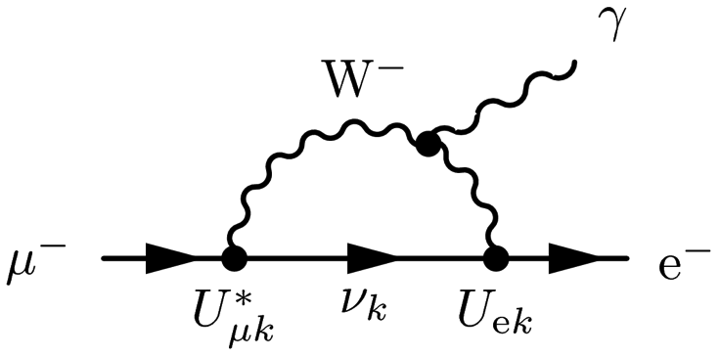
Charged Lepton Flavor violation
Homestake mine
SNOlab
Neutral lepton (neutrino) flavor violation is now an accepted fact.
Numerous experiments have confirmed many of the parameters of neutrino mixing.
CLFV in the SM can occur through the intermediate mixing of massive neutrinos.
The rate depends on the neutrino mass splitting and couplings
http://jacksonville.com/entertainment/2012-03-20/story/sky-guy-scientists-hold-fast-speed-limit-light#ixzz1v8bLlsN1
http://www.snolab.ca/content/sno-detector
No Standard model background.
So, if observed it would be unambiguous sign of New Physics

Slide 4
Searching for CLFV
3 rare muon processes stand out
MEGA, MEG, and others…
Signal is combination of final state particles.
Accidental coincidences limit usable μ rate
Br(μ⁺ →eγ) < 2.4×10⁻¹² [MEG 2011]
Br(μ⁺ → e⁺e⁻e⁺) < 1×10⁻¹² [SINDRUM-I,1988]
Signal is a monoenergetic electron.
Can take more muons/s.
Mu2e, comet, SINDRUM
R_{μe} <7×10⁻¹³ [SINDRUM-II, 2006]

Slide 5
History of CLFV searches
SINDRUM II: μ Au➔Au e⁻
MEG 2011:μ ➔e⁻ γ
Mu2e – about 4 order of magnitude improvement!
Future concepts:

Slide 6
μ-> e conversion
40 % Muon decay in orbit
60 % Muon capture
1s
Coherent recoil of nucleus
μ⁻
Muon are stopped and rapidly (ps) cascade to the 1s state producing X-Rays.
μ⁻
e⁻
X
Mono-energetic e⁻ produced
Energy depends on the Z of the material (for Al E=104.97 MeV)
Transition Energy for Al
3d→ 2p 66 keV
2p→ 1s 356 keV
3d→ 1s 423 keV
4p→ 1s 446 keV
Notes:
105.658 - BE(13)=0.48 MeV, C(27)=0.21 MeV

Slide 7
Mu2e Sensitivity
Λ: Energy scale
κ: Importance of contact term
Mu2e: Project X
Loops
Contact terms
mu2e
Supersymmetry and Heavy Neutrinos

Slide 8
Contributions to μe conversion
Rate ~ 10⁻¹⁵

Slide 9
Measuring μe conversion
Generate pulsed beam of low momentum negative muons.
Stop muons in thin foils and form muonic atoms.
  μ⁻ in aluminium: τ_{½}= 864 ns.
Wait for prompt background to decay.
  Need suitable beam repetition rate.
Then measure the electron spectrum.
  The signal: mono-energetic electrons at 105 MeV

Slide 10
Measuring μe conversion
With sensitivity to R at 90% C.L. < 5x10⁻¹⁷
  4 orders of magnitude better than current limits
  Need more than 10¹⁷ stopped muons!
  -- 3.6x10²⁰ protons on target (3 year run)
  Need to reduce any background that could affect our sensitivity.

Slide 11
Needle in a haystack?
Muon decay in orbit (DIOs)
Radiative muon/pion capture
Long transit time backgrounds (pbars, pions)
Cosmic ray induced electrons
  Muon/pion decay in flight
Beam electrons that can scatter into the target
  Need to reduce any background that could affect our sensitivity.
  Mu2e has been designed with this in mind.

Slide 12
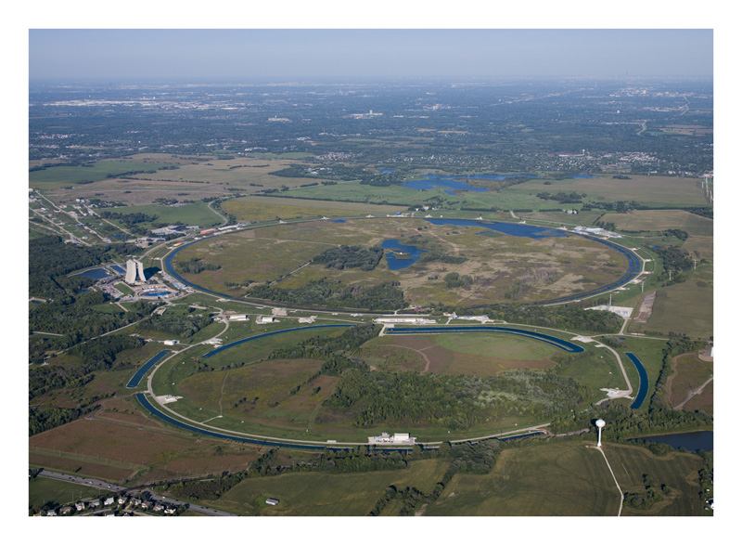

Reider Hahn

Slide 13
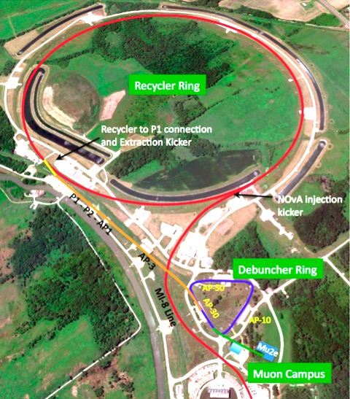
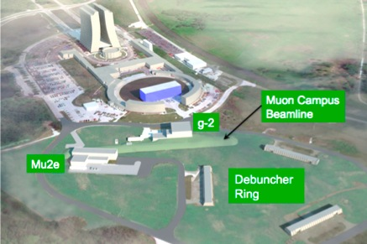
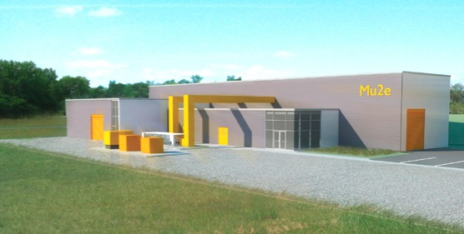
Delivery Ring
Delivery Ring
Notes:
----- Meeting Notes (5/31/12 09:16) -----
Mu2e hall

Slide 14
The mu2e Detector System
Transport: S-curve removes line of sight background and also sign-selects.
Detector: Stopping Target, Tracking and Calorimeter
Production: 8 GeV protons enter the PS and encounter a tungsten target.
Up to 8 kW beam power (6x10¹² Protons/s)
π’s are then produced which decay into accepted μ’s

Slide 15
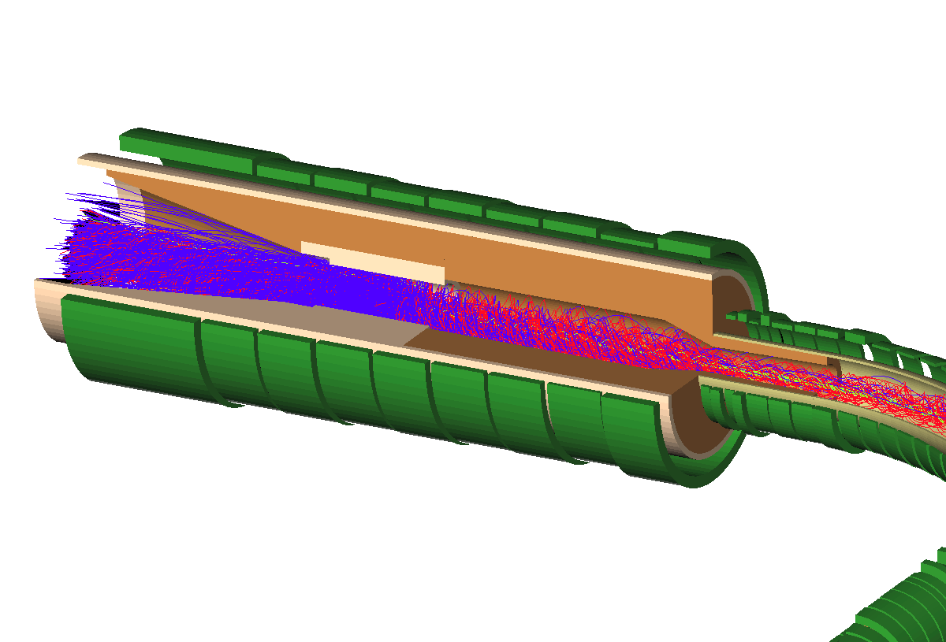
The production Solenoid (PS)
8 GeV protons strike a tungsten production target near the center of the Production Solenoid.
The PS is a high field magnet with a graded (4.6 T -> 2.5 T) solenoidal field.
The PS will be used to capture pions which can then decay into muons.
A heat and radiation shield, constructed from bronze, will line the inside of the PS to limit the heat load and radiation damage to the superconducting cable.
4.6T
Graded Solenoid Field
π’s are captured, spiral around and decay.
2.5T
1.5 m
4 m
Mu2e detector
Incident protons

Slide 16

The Transport Solenoid (TS)
S-shaped to reduced any line-of-sight photons and neutrons.
Stopping Target and
Mu2e Detector
1 m long straight section into DS
It consists of a set of superconducting solenoids and toroids that form a magnetic channel that transmits low energy negatively charged muons from the PS.
90° turn
High energy negatively charged particles, positively charged particles and line-of-sight neutral particles will nearly all be eliminated by the two 90° bends combined with a series of absorbers and collimators.
~2 m long straight section
μ beam
2nd Collimator with pbar absorber
1 m long straight section from PS
90° turn

Slide 17
The Detector Solenoid (DS)
The Detector Solenoid will provide a graded field for the muon stopping target located upstream and a uniform field downstream for the detector elements that analyze conversion electrons.
Signal events pass through tracker and produce hits, then stop in calorimeter
~11 m
The Cosmic Ray Veto
Tracker
Graded field
1 T
2 T
Calorimeter
~2 m
Al Stopping target
Calorimeter: energy, position, and timing information on tracks that have been reconstructed by the tracker.
1936 LYSO crystals arranged in four vanes
17 thin Al disks. Radii decreases from 8.3 cm upstream to 6.53 cm downstream.
17

Slide 18
Decay In Orbit (DIO)
DIOs contribute ~50% background in the signal energy region.
Most DIO e⁻s have energies below 52.8 MeV, the kinematic limit for for decay of a free muon.
For decay off a bound muon the outgoing e⁻ can recoil off the nucleus.
If the neutrinos are at rest the e⁻ can have exactly the conversion energy E_{CE}=104.97 MeV.
Small rate
~3x10⁻¹³ e⁻s >100 MeV
momentum window =103.5 to 104.7 MeV/c
tail from recoil
E_{e} (MeV)
Notes:
Intrinsic high-side resolutions: • Core: ≈ 115 keV/c • Tail: ≈ 176 keV/c
Straggling upstream =⇒ ≈ 1 MeV/c

Slide 19

The Tracker
20 μm sense wire inside a 5 mm diameter tube made of 15 μm thick metalized Mylar®.
~22,000 straws distributed into 18 measurement stations across a ~3 m length.
Planes are constructed from two layers of straws and are operated in a vacuum.
high-side resolution of σ < 180 keV
105 MeV conversion e⁻
The tracker is designed to intercept only a small fraction of the significant flux of electrons from muon decays-in-orbit (DIO) (energies < 60MeV).
e⁻ with energies < 53 MeV will curl in the field of the DS and pass unobstructed through the hole in the center of the tracker.
Michel e⁻ < 53 MeV
>53 MeV DIO e⁻
e⁻ with energies > 53 MeV (~3% total rate) will be observed in the tracker.

Slide 20
Pulsed beam structure
Proton bunch
Debuncher Cycle
Protons suppressed by a factor of 10⁻¹⁰
Delivery ring supplies a single circulating bunch where protons are resonantly extracted to the beamline.
Pulsed beam to Mu2e every cyclotron period of 1695 ns (2x muon lifetimes) for 8 GeV protons.
Muon lifetime in Al is long (864 ns) the loss of muons is acceptable if the time between pulses is not much longer than the muon lifetime and one simply waits for the pions to decay (21 ns).
Reduced 10¹¹
Wait ~700ns
Extinction level of 10⁻¹⁰ between bunches is crucial!

Slide 21
Backgrounds and sensitivities
3 years of 1.2 x10²⁰ protons/year (8 kW beam power)
Background | Background Estimate
Muon decay-in-orbit | 0.22 ± 0.06
Cosmic Rays | 0.05 ± 0.013
Radiative Pion Capture | 0.03 ± 0.007
Pion decay In-Flight | 0.003 ± 0.0015
Muon decay In-Flight | 0.01 ± 0.003
Antiproton Induced | 0.10 ± 0.05
Beam electrons | 0.0006 ± 0.0003
Radiative muon capture | < 2 x 10⁻⁶
Total (Add in quadrature) | 0.41 ± 0.08
GOAL < 2.4× 10⁻¹⁷ single event sensitivity
R_{μe}~10⁻¹⁵ 40 signal events

Slide 22
Road Map
Aim for a 4 orders of magnitude improvement compared to SINDRUM II which achieved R_{μe} <7×10^{−13.}
CD-0 approval.
Lehman review for CD-1 last week!
Start taking data in 2019
3 year running time

Slide 23
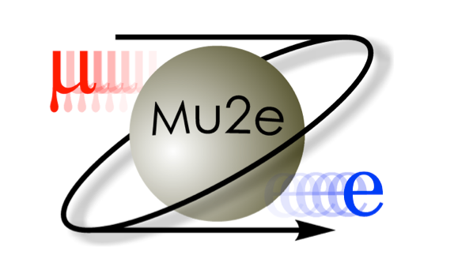
The Mu2e Collaboration
Fermi National Accelerator Laboratory
Lewis University
University of Illinois, Urbana-Champaign
Los Alamos National Laboratory
University of Massachusetts, Amherst Muons, Inc.
Northwestern University Northern Illinois University Rice University
University of Houston University of Virginia University of Washington
Boston University
Brookhaven National Laboratory
University of California, Berkeley
Lawrence Berkeley National Laboratory
University of California, Irvine
California Institute of Technology
City University of New York
Duke University
Instituto Nazionale di Fisica Nucleare Pisa Instituto
Nazionale di Fisica Nucleare, Lecce
Laboratori Nazionali di Frascati
Institute for Nuclear Research, Moscow
Joint Institute for Nuclear Research, Dubna
~130 collaborators
http://mu2e.fnal.gov/
Thanks for listening!

Slide 24
Backup Slides

Slide 25
Notes:
CE high Z< low Z
Muon radiative cature endpoint < CE Al (2.6MeV)
Muon Convertion rate increaseswith Z

Slide 26
Mu2e and the LHC

Slide 27
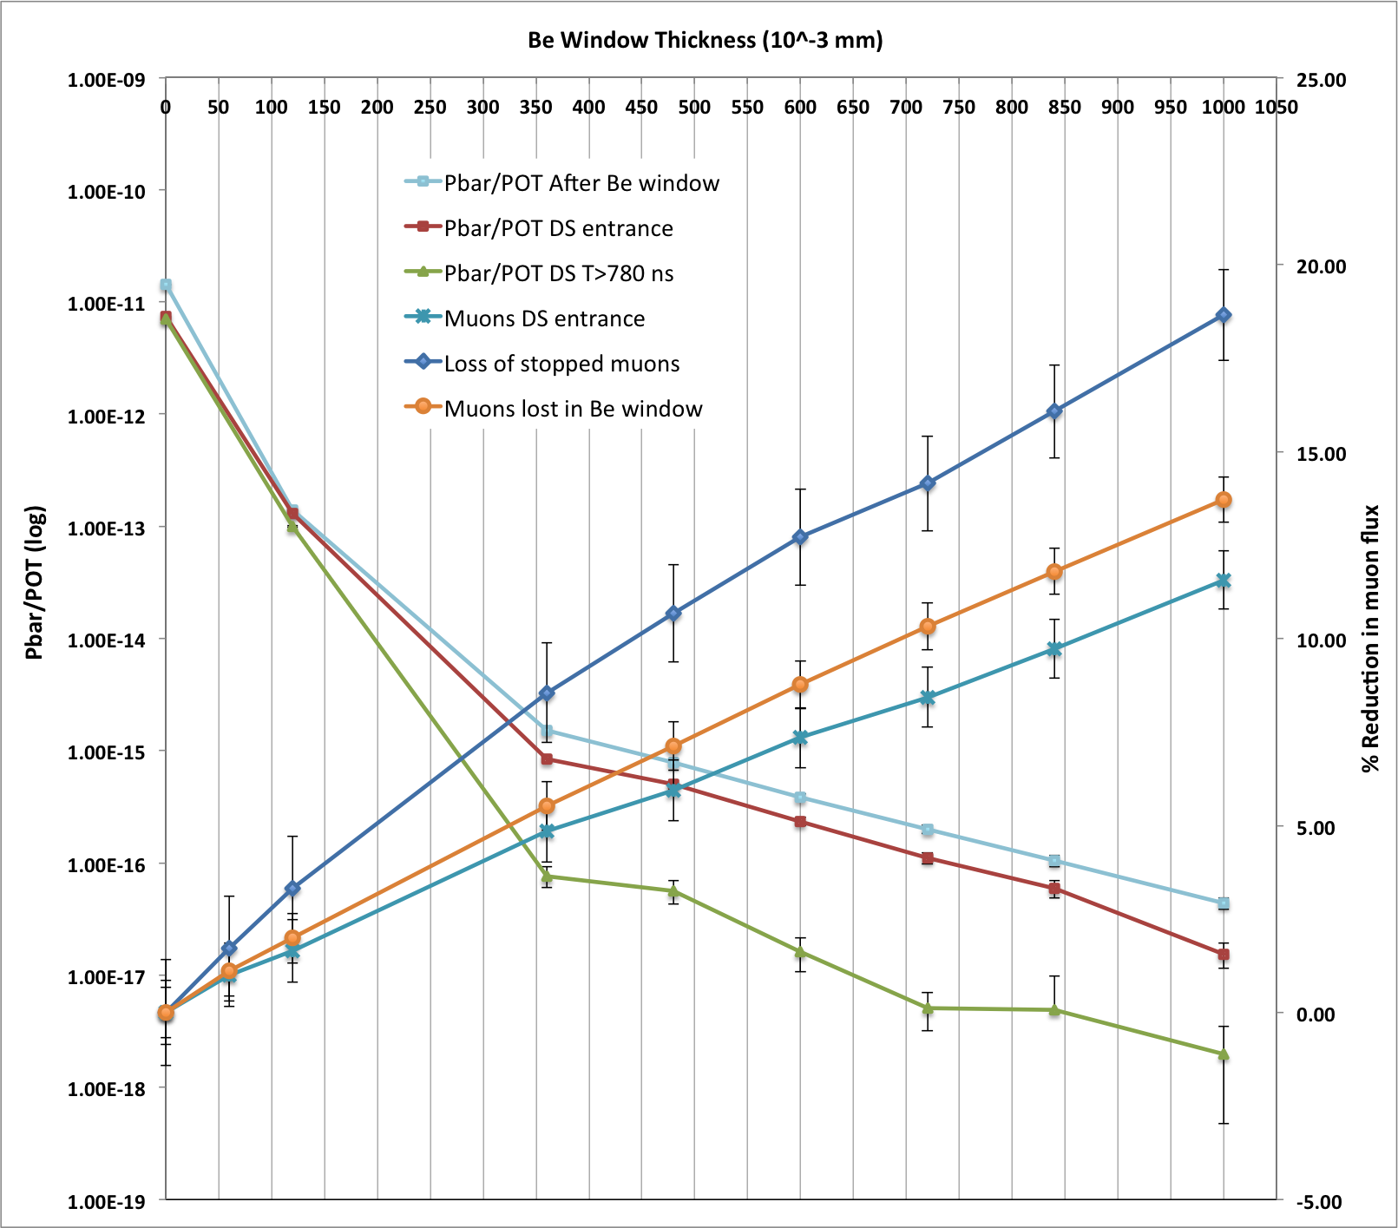
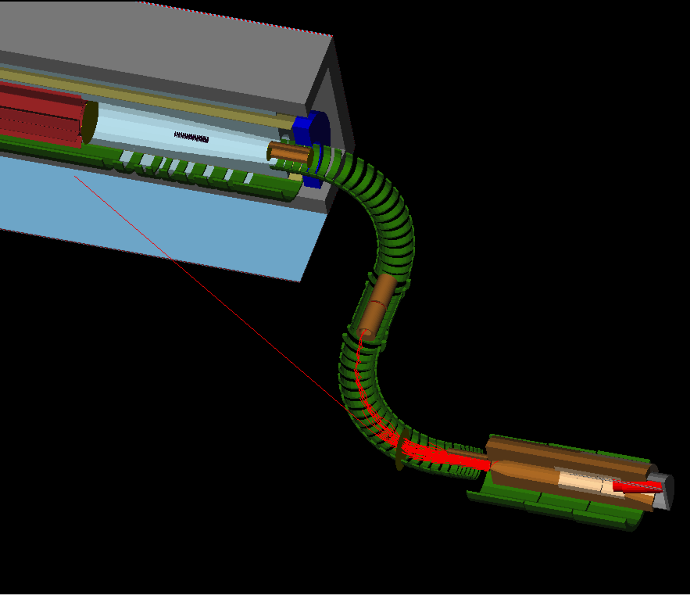
Antiprotons
The 8 GeV K.E proton beam can produce antiprotons in sufficient numbers to be a serious background.
Spiral slowly through the TS entering the DS.
They do not decay (well not that we know of!)
Annihilate on nuclei (such as in the stopping target) releasing a large number of secondaries (energetic π, γ, n and p.)
~0.9 π– and 1.2 π⁰s produced per Al nucleus.
Can reduce the Pbar flux to 533±124 Pbars throughout entire mu2e run
Only a 9 % reduction in muons (compared to no absorber) and 533±124 Pbars throughout entire mu2e run
Electrostatic sweeper field in the first collimator.
Reduction of the incident proton beam energy.
Insertion of absorber material in the beam line.
239.5 mm
0.12 mm
0.12 mm (MECO)
1.0 mm

Slide 28
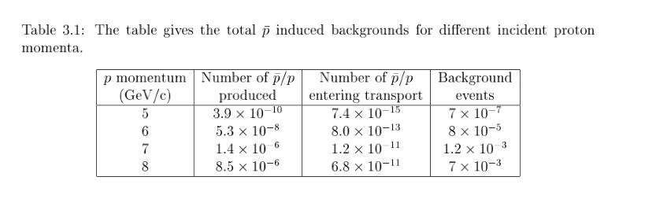

Slide 29
Beam requirements

Slide 30
Accelerator timeline

