Slide 1
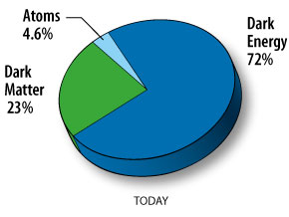
CDMS and Direct Dark Matter Searches at FNAL
Ben Loer
2012 FNAL Users’ Meeting
Jun 13, 2012

Slide 2
Outline
Introduction
The case for cold dark matter
Direct dark matter search basics
Dark matter searches at FNAL
CDMS: Cryogenic Dark Matter Search

Slide 3
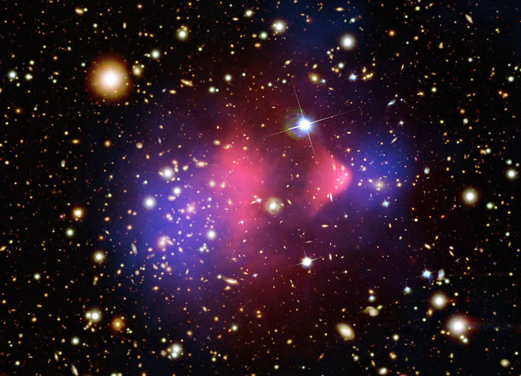
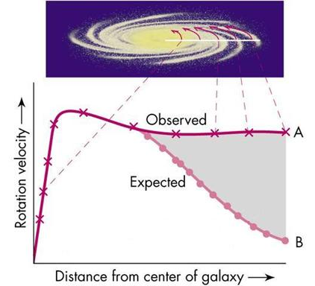
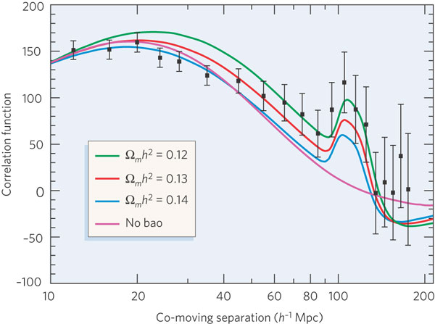
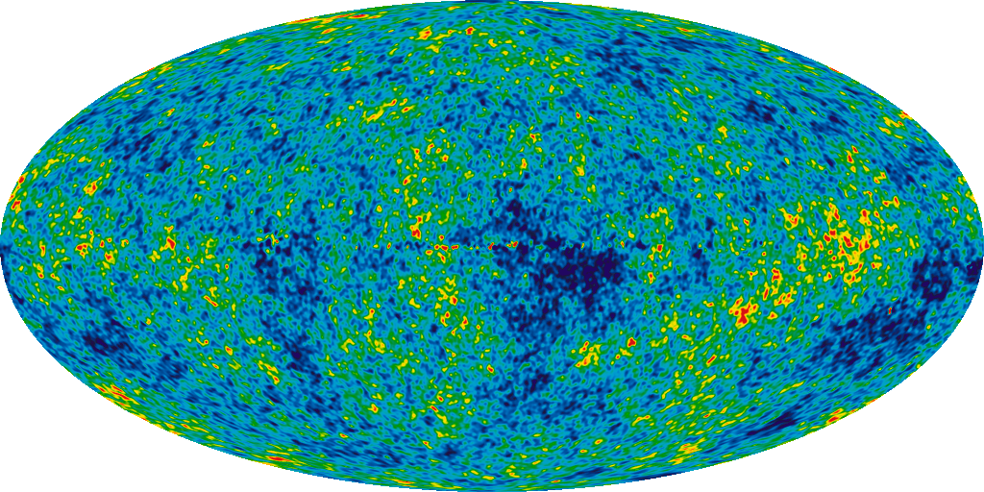
Evidence for dark matter: compelling at all scales
Single galaxies
Galaxy
clusters
The whole
observable universe

Slide 4
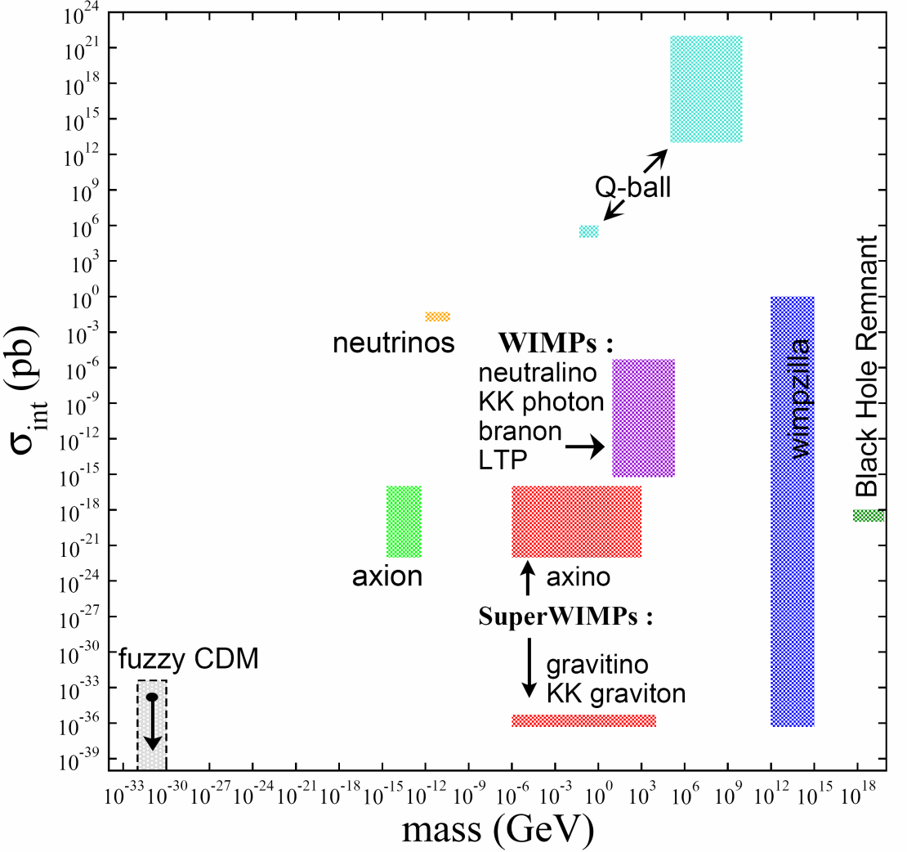
Lots of possible candidates
Most focus on WIMP: Weakly Interacting Massive Particle
Cosmological relic density naturally leads to ~GeV—TeV particle with weak-scale annihilation cross-sec
Bonus: matches neutralino in many SUSY models

Slide 5
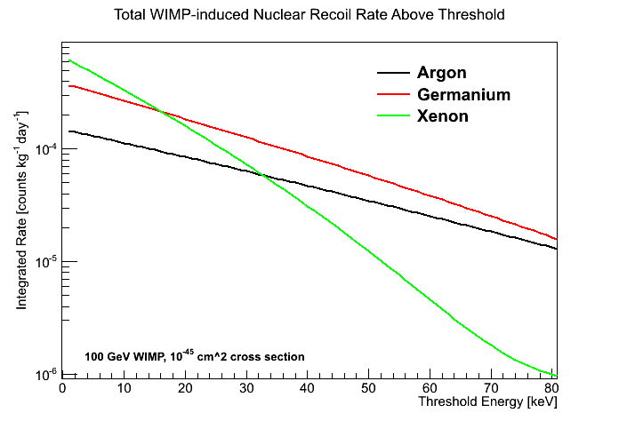
WIMP Search Challenges
Sharply falling exponential spectrum
Tiny overall rate: ~few/ton/year
Compare to “clean” copper, ~10⁷/ton/year
1 fingerprint: ~20 decays/year
Need: Low threshold, very low backgrounds

Slide 6
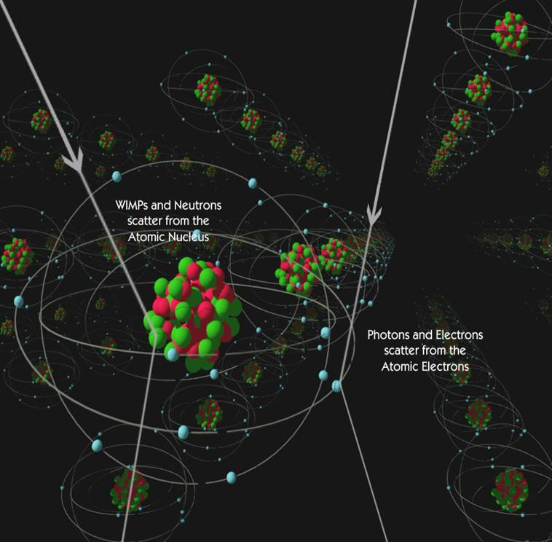
Background Rejection
Gammas are largest background, but they have different energy deposition mechanism
Alphas are usually higher energy, at surface
Neutrons mimic WIMPs; good for calibration, bad for background – need lots of shielding

Slide 7
Annual modulation
WIMP signals expected to have annual modulation
Due to motion of earth relative to sun through “WIMP wind”
“Smoking gun” dark matter signature

Slide 8
Annual modulation: Some hints
DAMA, CoGeNT, and CRESST see low-energy signals compatible with ~7 GeV WIMP
DAMA sees annual modulation at expected phase with >7 sigma
CoGeNT sees (statistically) weaker modulation

Slide 9
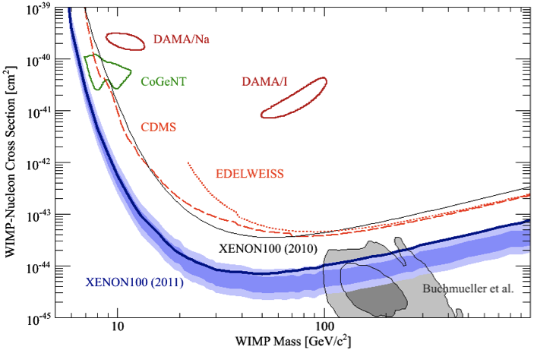
Where is the community at now*?
*For loose definitions of ‘now’
2 spin-independent fronts: Low mass (<~10 GeV)
High mass (~100s GeV)

Slide 10
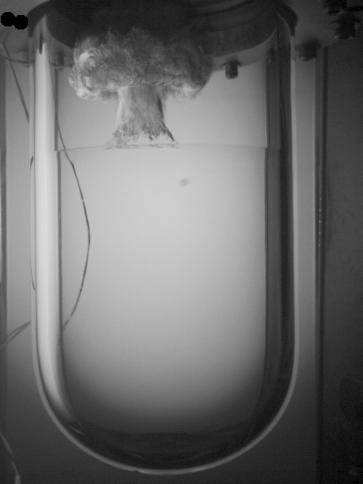
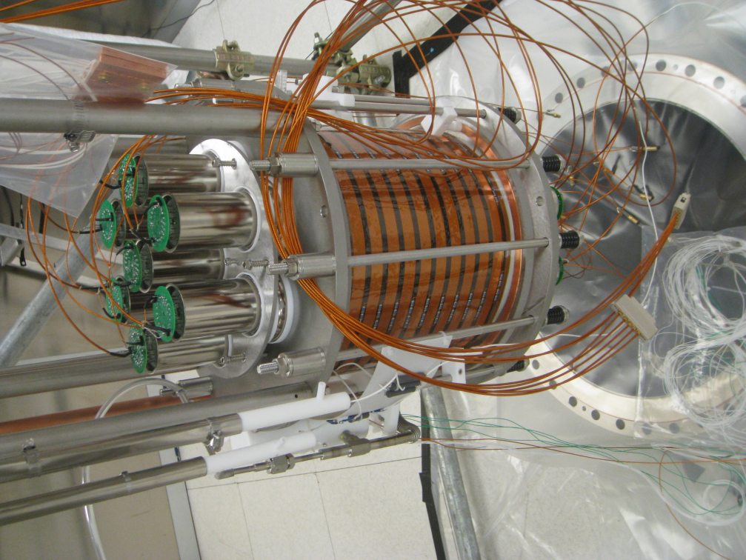
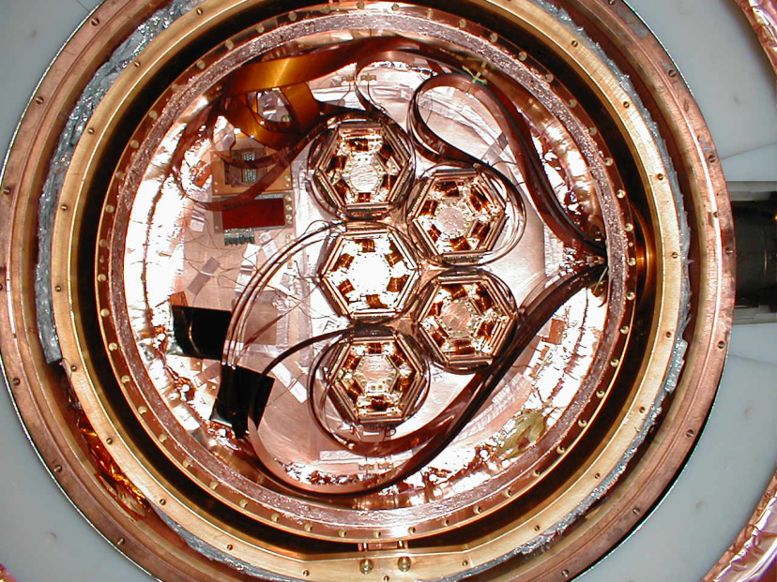
Direct WIMP Searches at FNAL
DAMIC
CCDs (from DECam)
COUPP
Bubble chamber
DarkSide
Argon TPC
CDMS
Cryogenic Ge

Slide 11
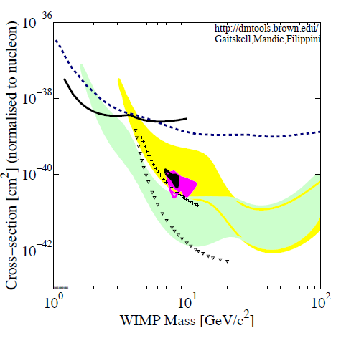
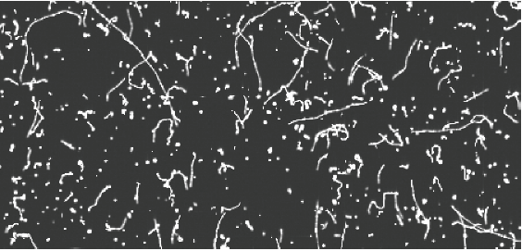
DAMIC: CCDs
Track length gives particle discrimination
Limit-holder for low-mass WIMPS
“Dots” are diffusion-limited hits (nuclear recoils)
Tracks are MIPs
Ultra low threshold (40 eV!) helps overcome small mass
DAMIC
CRESST
CDMS
XENON10
Moving to SNOLAB with 10g of CCDs and neutron shield

Slide 12
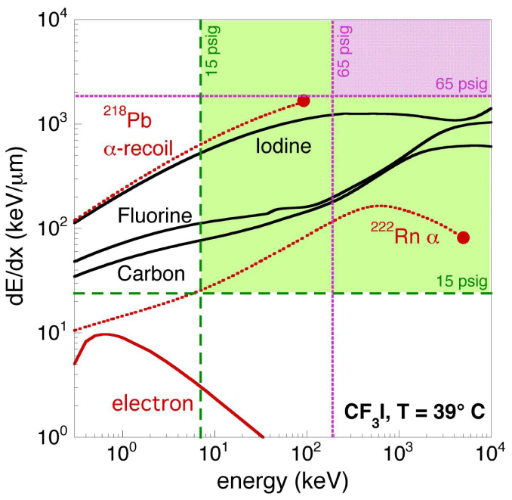
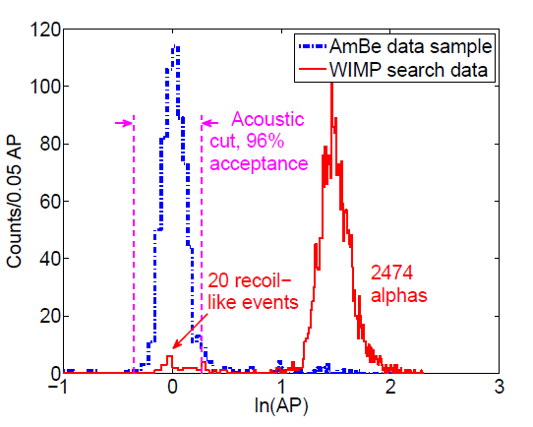
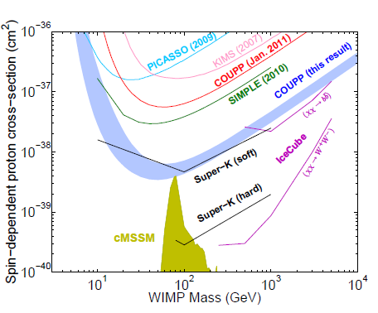
COUPP: Bubble Chamber
4kg chamber at SNOLAB leading spin-dependent result
Upgrading to 60 kg late 2012
Nucleation threshold insensitive to MIPs
Acoustic sensors provide alpha rejection

Slide 13
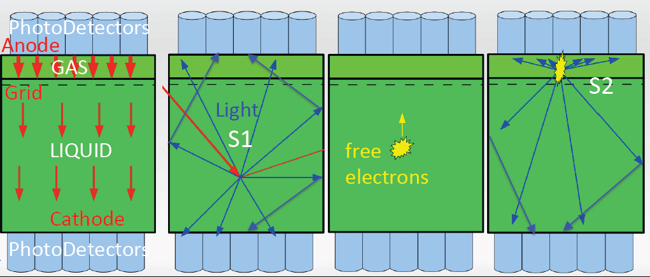
DarkSide: Dual-phase argon TPC
Liquid active volume with small drift field
Gas multiplication volume
Primary interaction creates scintillation (S1)
Ionized electrons drift toward gas region
High field in gas makes secondary scintillation (S2)
(light-gain only)

Slide 14
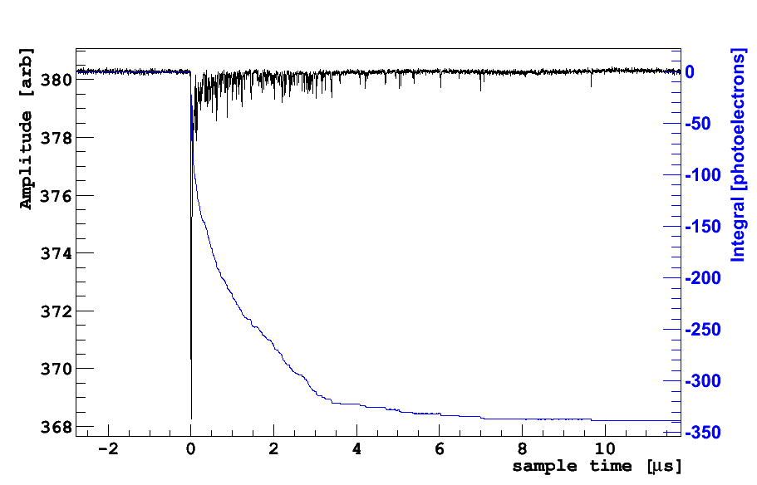
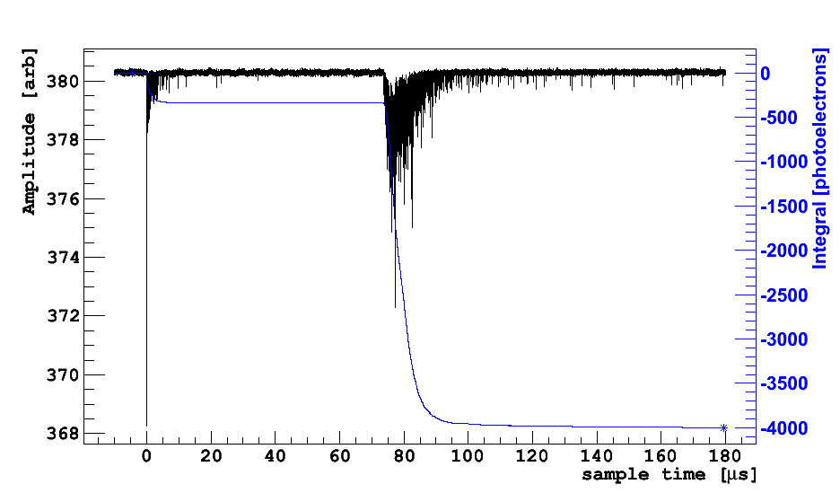
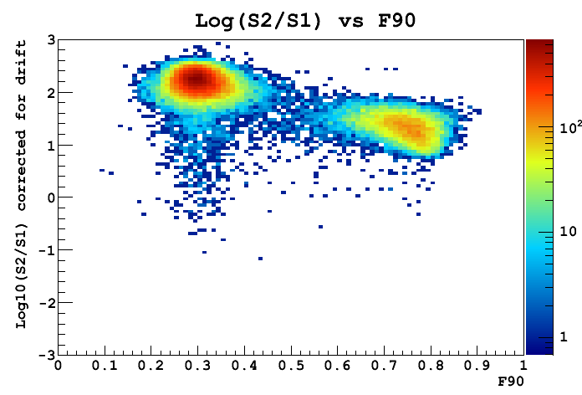
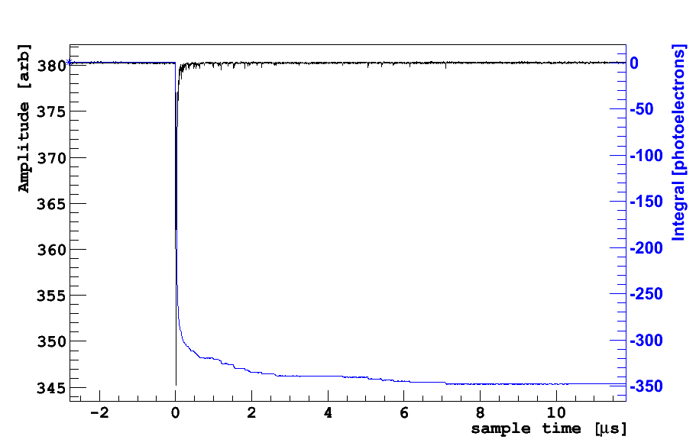
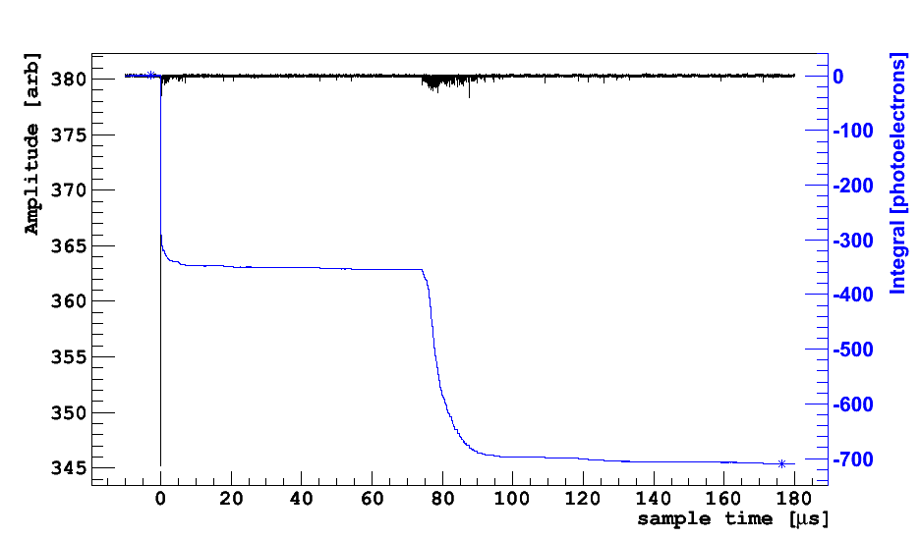
Argon TPC background rejection
Primary scintillation gives energy, PSD
Secondary scintillation gives position;
Ratio gives ionization yield (~dE/dx)
Gamma
Slow pulse
Gamma
Large S2/S1
Unshielded AmBe source at surface
Neutron
Fast pulse
Discrimination power,
sensitivity depend
exponentially on light yield!
Neutron
Small S2/S1

Slide 15
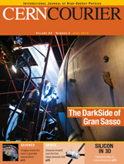
DarkSide Highlights
Underground argon reduces ³⁹Ar background > x100
DS-10 kg measured 9 p.e./keV light yield: best in field
DS-50 kg under construction now; employs high-efficiency neutron veto and huge water shield
Data incoming early 2013, plan for 3-year campaign

Slide 16
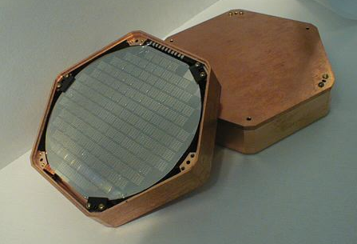
CDMS: Cold Germanium Crystals
ZIP: Z-sensitive Ion and Phonon detector
Recoil in Ge crystal ionizes electrons and excites the lattice (phonons)
Apply an electric field-> collect and measure free electrons/holes
TES measures phonons

Slide 17
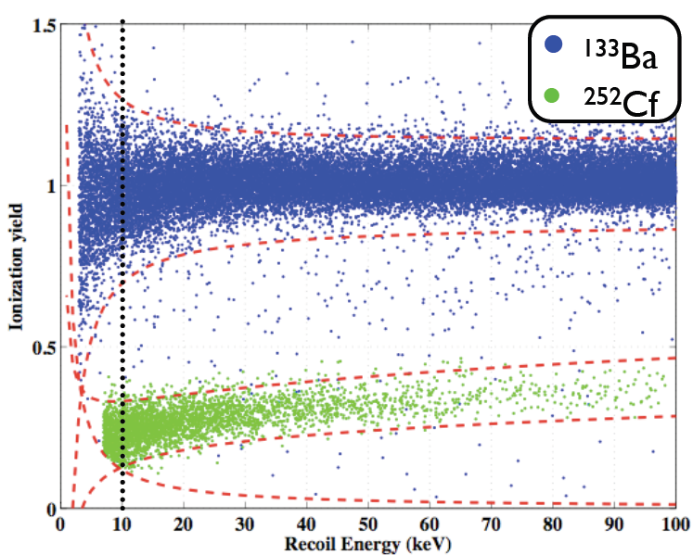
CDMS
Neutrons/WIMPs hit nucleus, excite more phonons than ions
Ratio of ionization/phonon signal removes gammas

Slide 18
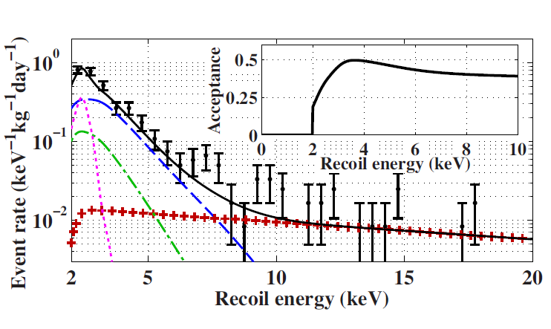
CDMS II Low Threshold Analysis - 2011
Based on 2 years of data already analyzed at 10 keV threshold
Push analysis down to 2 keV threshold
Backgrounds higher, less well understood
Net result: no evidence for WIMP signal above background.
The result (solid black) excludes most of DAMA and CoGeNT allowed regions
DAMA
CoGeNT
6 8 10 12
WIMP mass (GeV/c²)

Slide 19
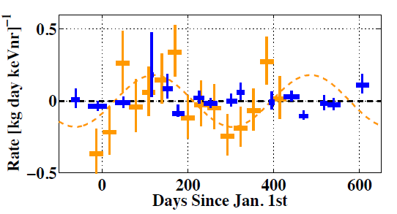
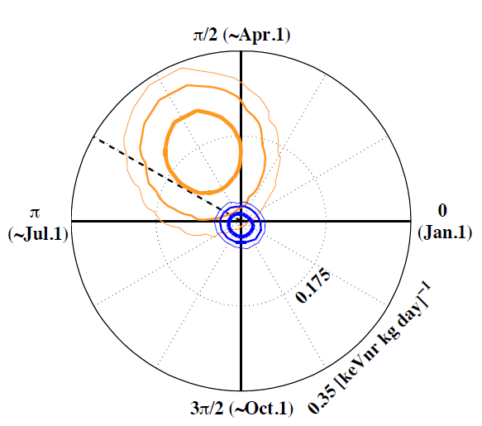
CDMS II Annual Modulation Search – 2012
No evidence for annual modulation in nuclear recoil data (blue)
Tension with CoGeNT (orange), which also uses germanium in Soudan

Slide 20
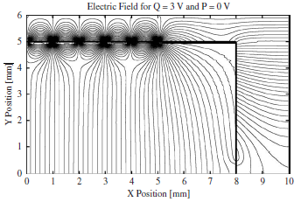
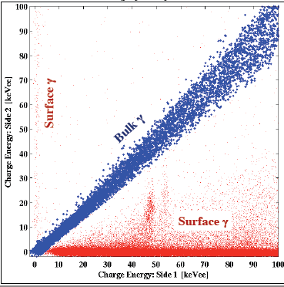
SuperCDMS: Enter the iZIP
CDMS II 10keV threshold result limited by surface events
iZIPs have Interleaved phonon and charge sensors on both sides
Surface events show up clearly on one side or the other
Reduces surface background by > x50,
Improves fiducial volume by ~x2

Slide 21
SuperCDMS Soudan: Running now
15 iZIPs: 5 towers of 3 iZIPs each, total 9kg
2 with implanted Pb210 sources to measure surface rejection
Started taking data in March, plan to run for 2 years

Slide 22
SuperCDMS SNOLAB: Coming soon!
Planned at least 100 kg total mass (72 iZIPs)
Also investigating upgrade to a liquid scintillator active neutron veto
Deeper site + better material screening + iZIPs + neutron veto = 0 background!

Slide 23
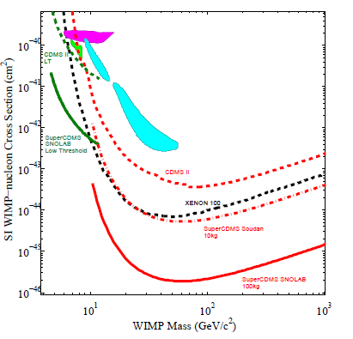
SuperCDMS SNOLAB Projected Sensitivity

Slide 24
Extra material

Slide 25
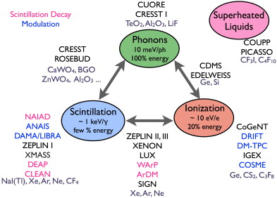
WIMP Technology Distribution
Heat
Scintillation
Ionization

Slide 26
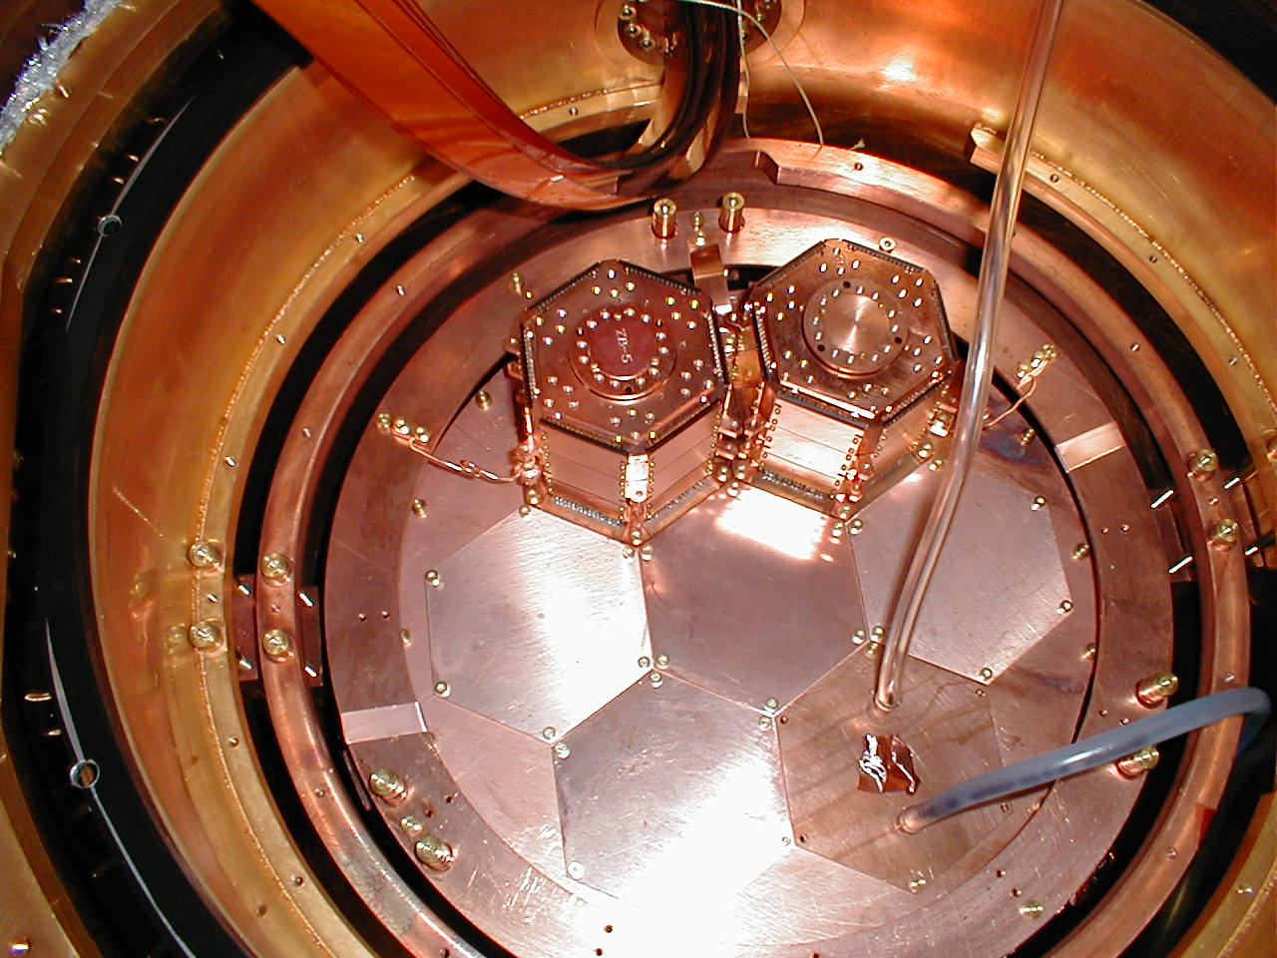
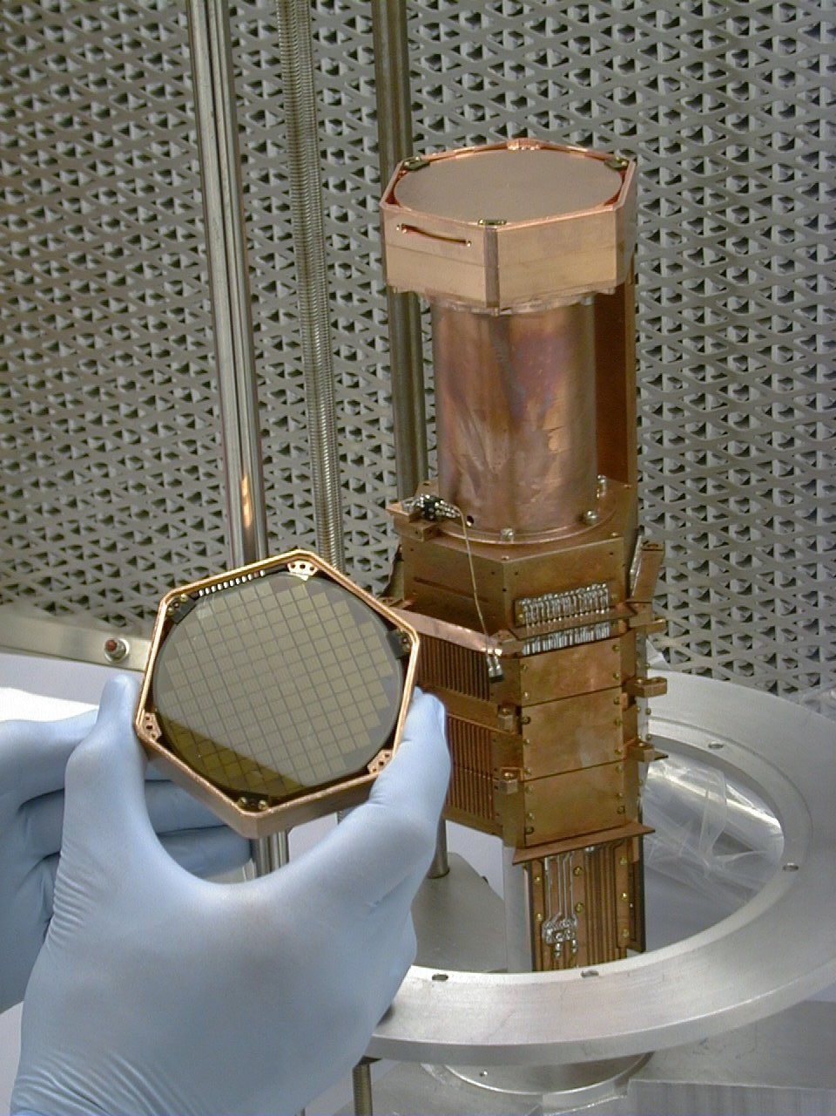
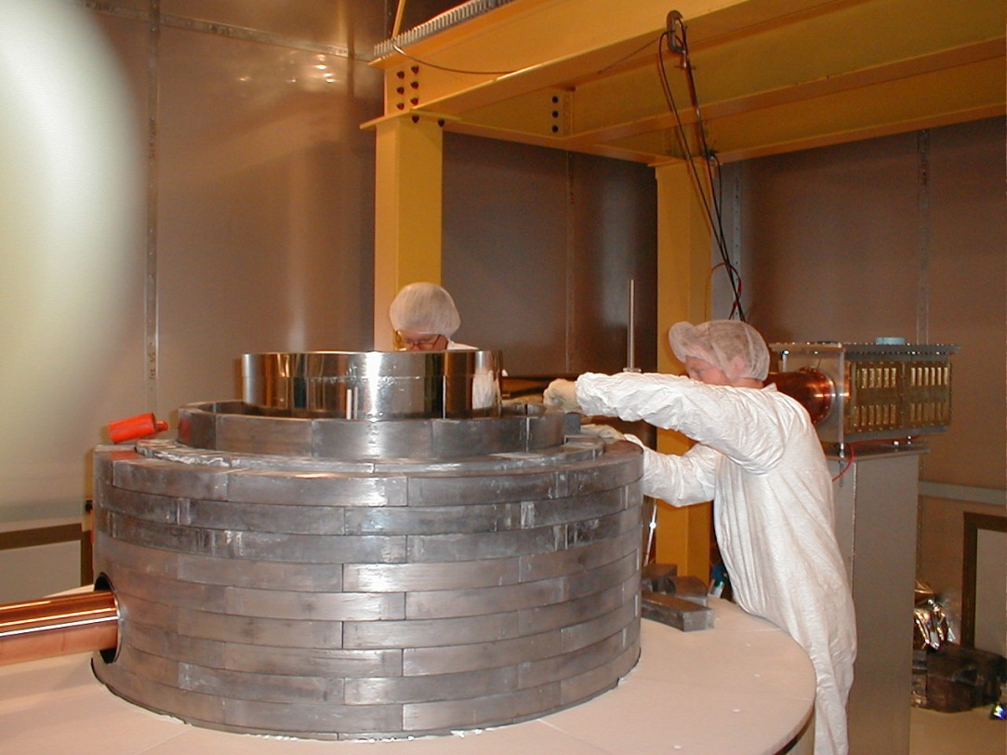
CDMS II Installation
Towers in cryostat
(2 towers campaign)
Tower assembly
Shielding assembly

Slide 27
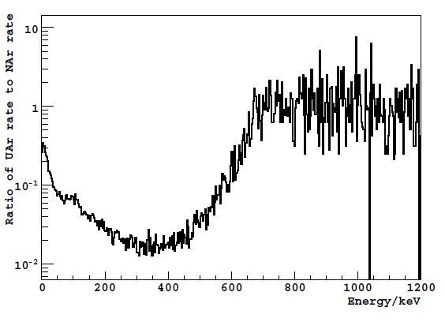
DarkSide
Use of underground argon reduces ³⁹Ar background by to <0.65% standard argon

Slide 28
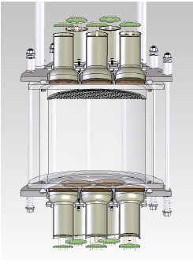
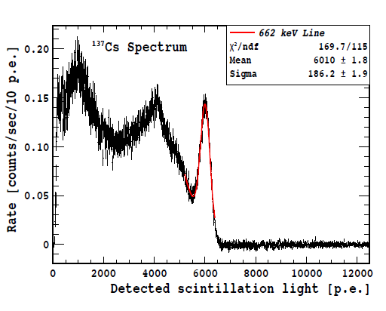
DarkSide
10 kg prototype operating at LNGS
9 p.e./keV light yield best reported for argon

Slide 29
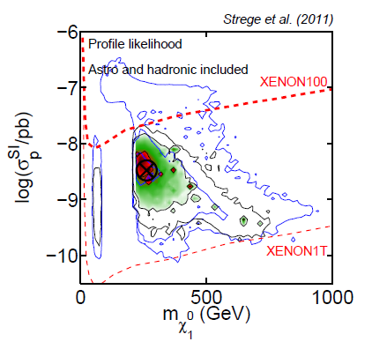
Tevatron exclusion

Slide 30
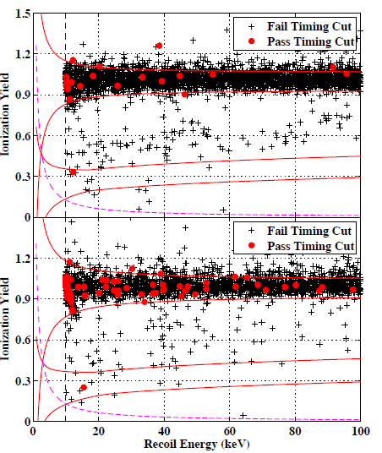
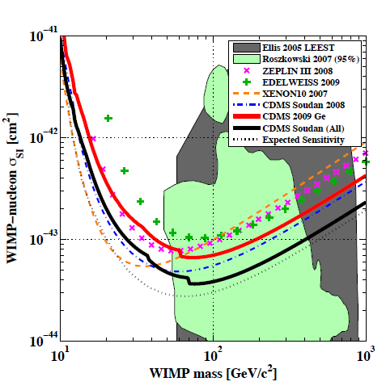
CDMS II Results - 2009
Dec 2009: then best spin-independent sensitivity
Limited by surface events

Slide 31
Surface Events in CDMS II ZIPs
Limiting background in CDMS II 10 keV threshold analysis was surface events
Free electrons/holes have some ballistic motion
Some is lost for events near surface
Pushes yield down into WIMP search box

