Slide 1
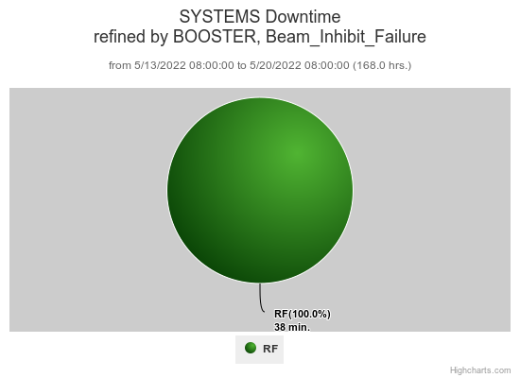
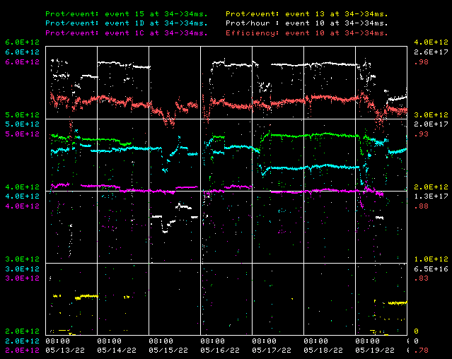
Booster Operations 5/13/22 – 5/20/22
Downtime: ~38min total
BRF Misc trips
Several BRF4 Bias supply trips
Studies this week:
New Damper testing on $17.
Bunch Rotation studies on $17.
This week:
Currently 94-95% eff. on cycles. $15 ~4.6 E12 p/p, 95%eff to NuMI, $1C ~4.0E12 p/p to Muon(off now), $1D @ ~4.6 E12 p/p to BNB, @5Hz, SY120 ~4.6E11 p/p. ~3.38E19 protons total for the week
General tuning over week with variations in injected beam stability causing elevated losses. Tuning continues across the proton source machines to improve beam quality into Booster gradually improving. Thanks to PreAcc and Linac folks.
Thanks to Controls for looking into our IRM node BLML3 data acquisition problems which seemed to only be an issue with data through DPM02.
Thanks to Operations for tuning efforts over week.
Requests/Plans:
Open request for brief periods (2)$17 cycles in time-line.
2hrs opportunistic down time to replace BRF2 Modulator
Days shift studies planned for Tuesday 5/24

