Slide 1









LBNF Target and Associated Equipment
Phase 2 Project: Construction
4th July 2022
Chris Densham (PI), Peter Loveridge (PM), Joe O’Dell, Tristan Davenne, Mike Fitton, Eric Harvey-Fishenden, Dan Wilcox, Mike Parkin, Phil Jeffery, Joe Bennett
(STFC Rutherford Appleton Laboratory)
John Back (University of Warwick)
Biao Cai (University of Birmingham)
Dong Liu (University of Bristol)

Slide 2
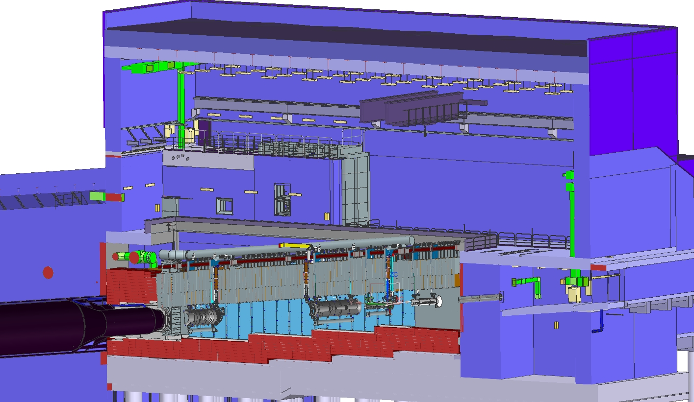
LBNF Target Complex – Target Hall
Work-Cell
Work Cell
Target
Hall
Decay
Vessel
Primary
Beamline
←Beam

Slide 3
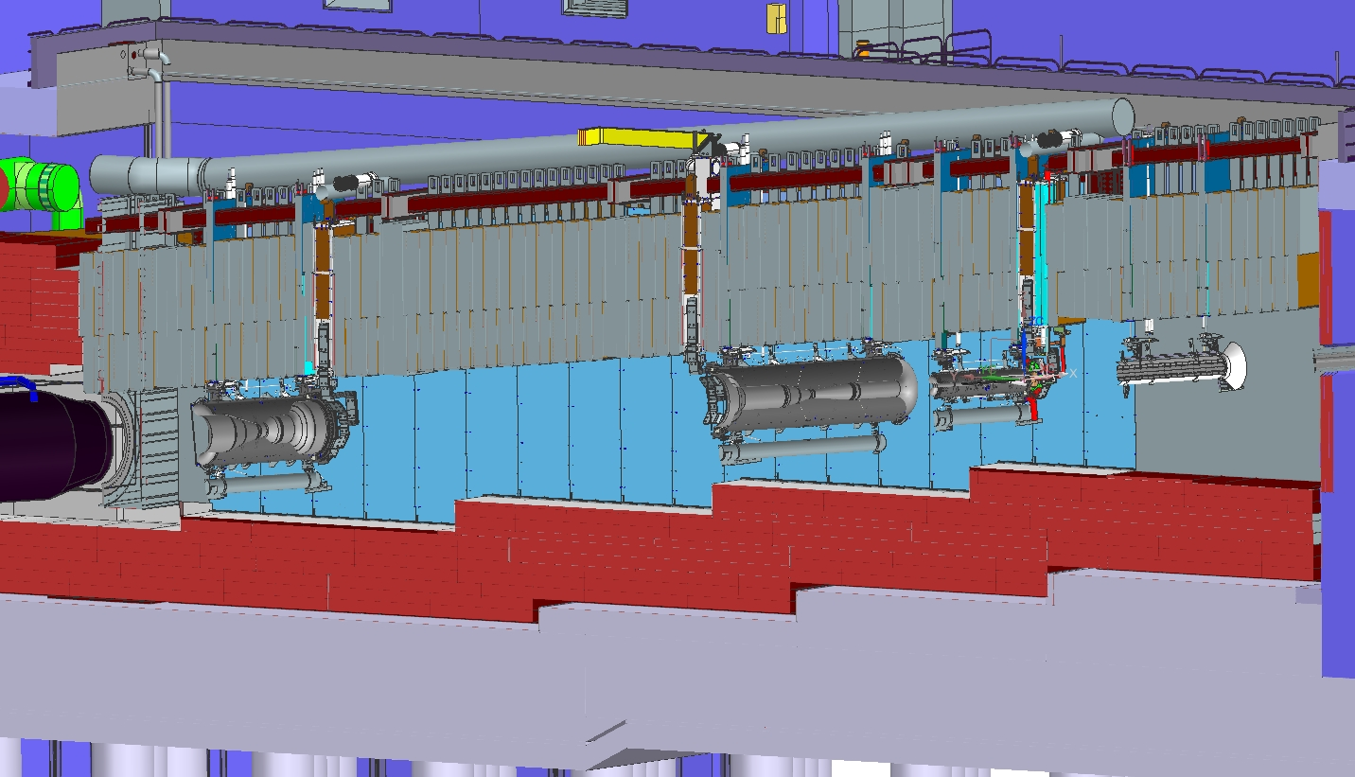
Target Station
Work Cell
Target Hall
Decay
Vessel
←Beam
N₂ Gas
He Gas
Decay Pipe Upstream Window
Horn C
Steel Shielding
Horn A with Target
Baffle
Primary Beam Window
Horn B

Slide 4
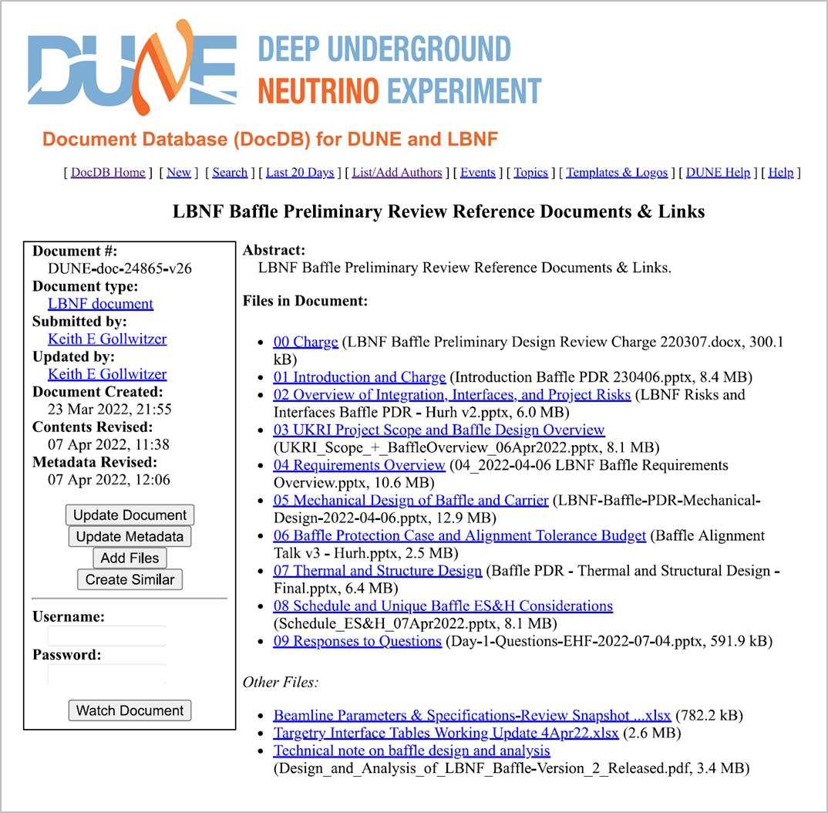
Baffle/Collimator PDR
Completion of UK Phase 1 project with successful Preliminary Design Review of the baffle collimator
Eight presentations by joint UK/US team over two half-days Apr 6-7
Review committee members from Fermilab (Ammigan, Hartsell), Oak Ridge National Laboratory (Winder)
https://indico.fnal.gov/event/53872/
“Yes, the preliminary design demonstrates the capability of meeting the functional requirements. The reviewers compliment the team on their excellent work, presentations, and willingness to answer questions during the review.”

Slide 5
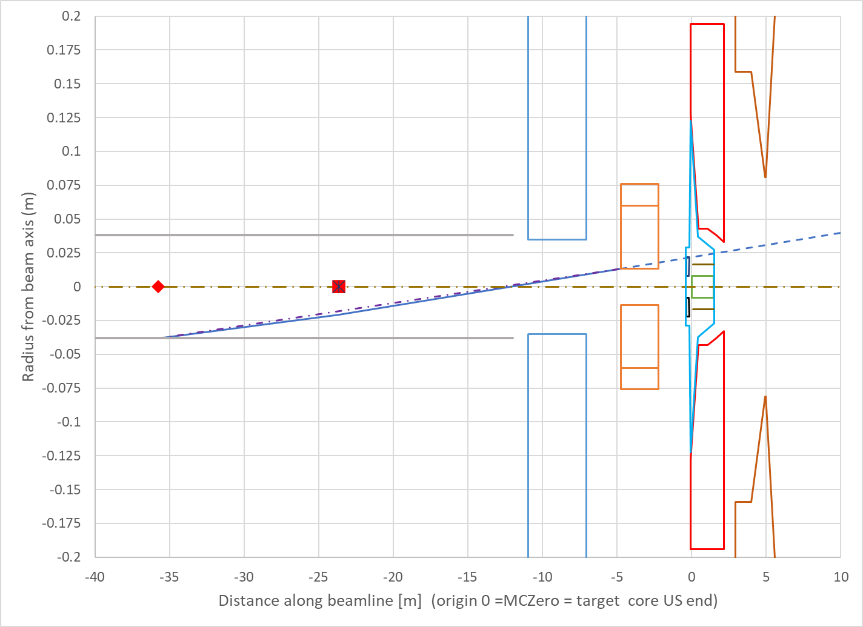
Layout expanded around baffle, and largest radius/angle where proton beam does not go through entire baffle length
Baffle PDR: Many meetings & exchanges with Fermilab
Horn
A
Shield
wall
Baffle
Formalized technical requirements & specification + conceptual design as per:
Target core
Target
Helium
containment
Bafflette
Last trim magnet
and maximum beam kick
Baffle
internal
support
rings
Last Quad magnet and aperture

Slide 6
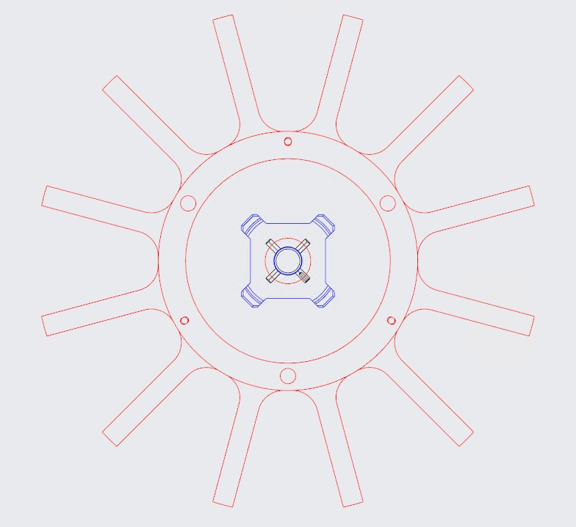
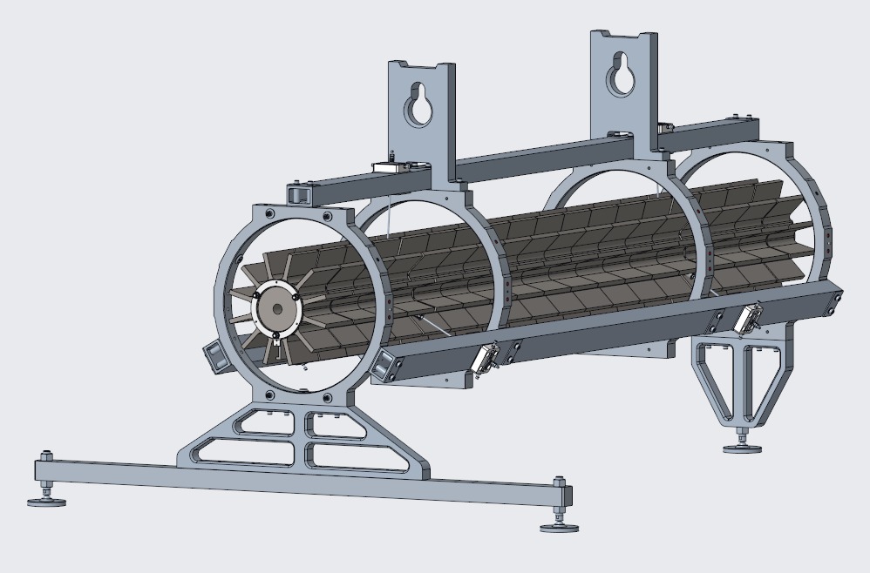
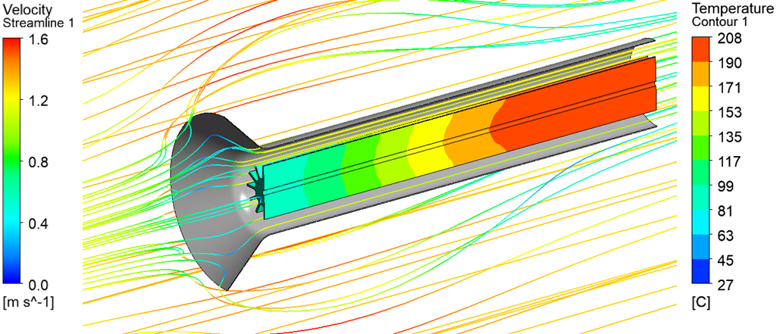
Baffle Collimator Thermal Design Overview
Titanium spider supports thermally isolates graphite core from aluminium carrier
Heating from i) beam-tails and ii) backscatter
Passively cooled by flowing chase nitrogen
Finned core segments to optimise convection heat transfer
Outer duct funnels additional nitrogen flow over core
Spider support ensures graphite baffle core is thermally well isolated from carrier
Baffle CAD (with Duct hidden)
Finned baffle core geometry optimized for convection heat-transfer using ANSYS/CFX

Slide 7
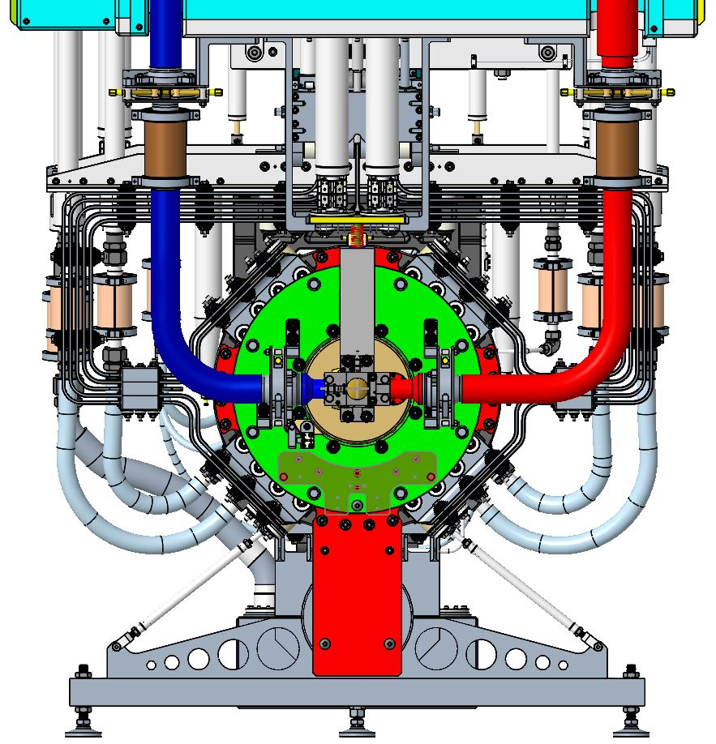
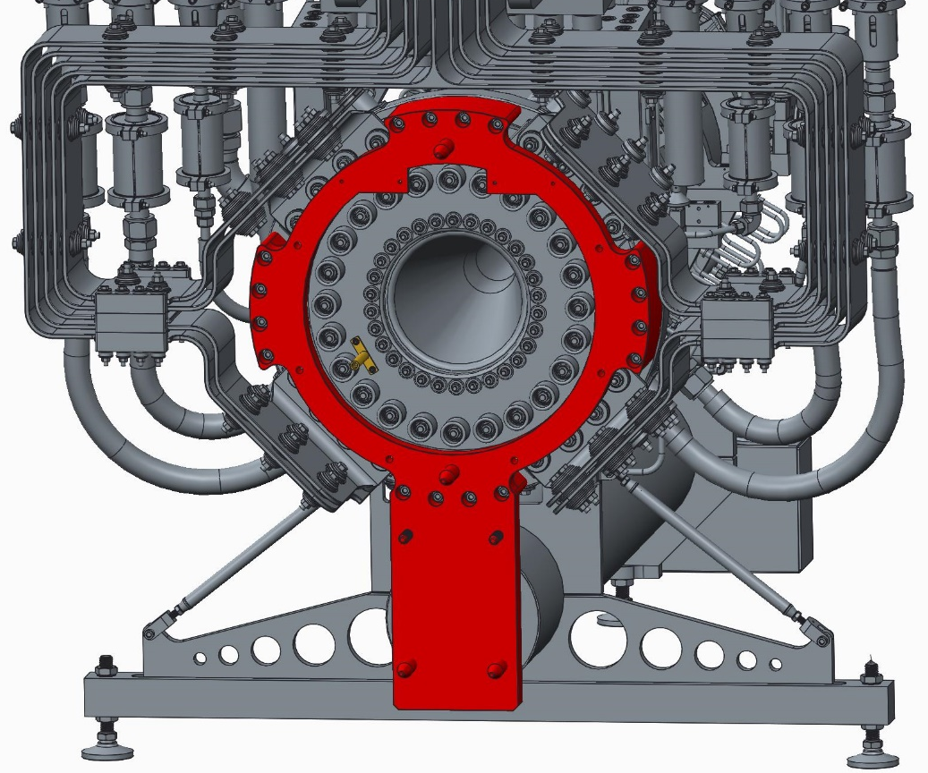
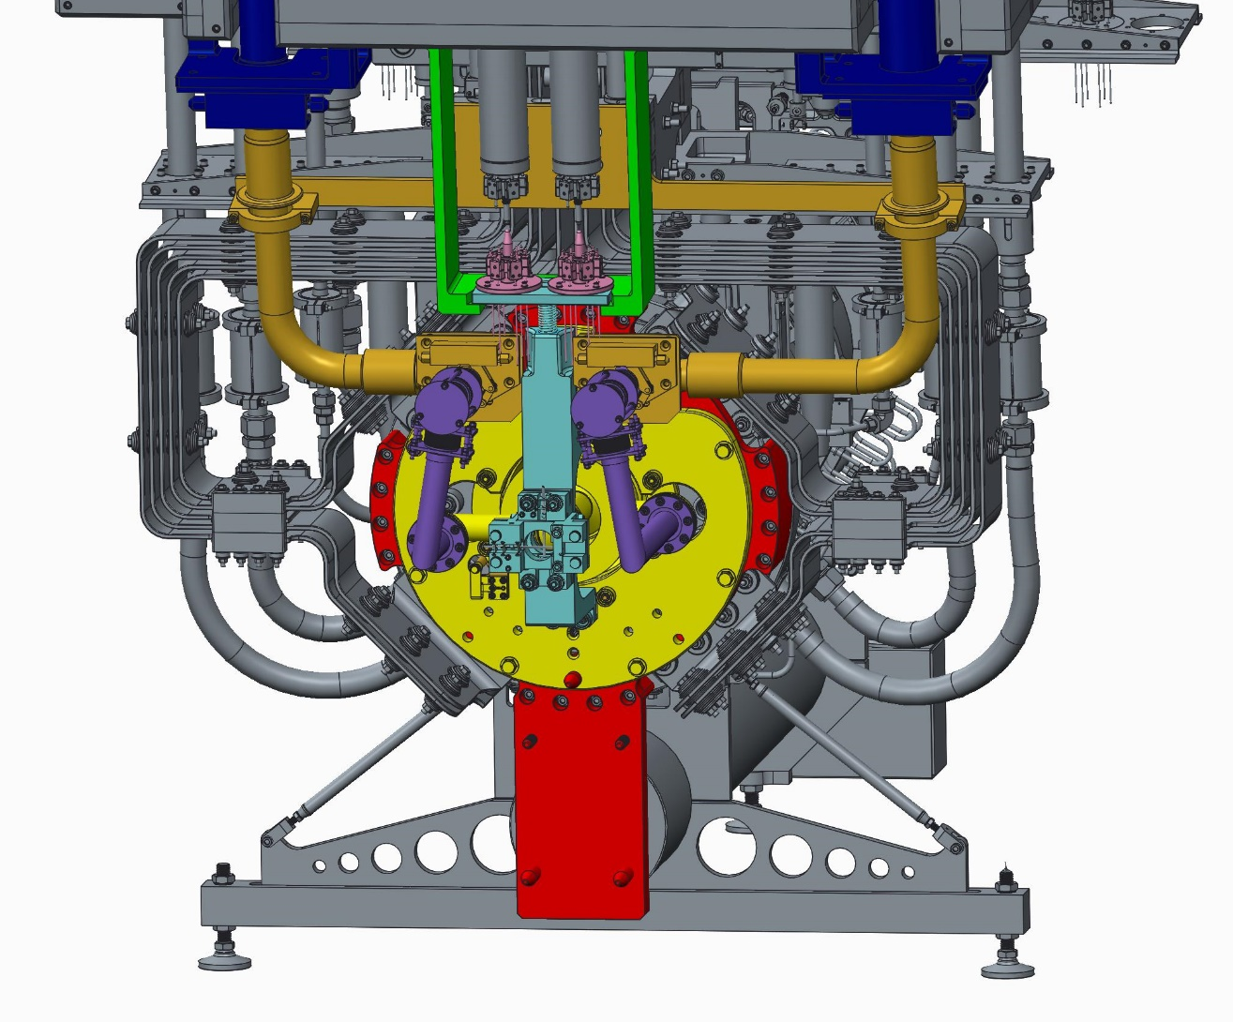
Target & horn integration
Magnetic horn ready for target installation
Target installed with preliminary design of ‘T2K’-like helium lines
Towards final design – simpler, path to 2.4 MW, but extra tooling required

Slide 8
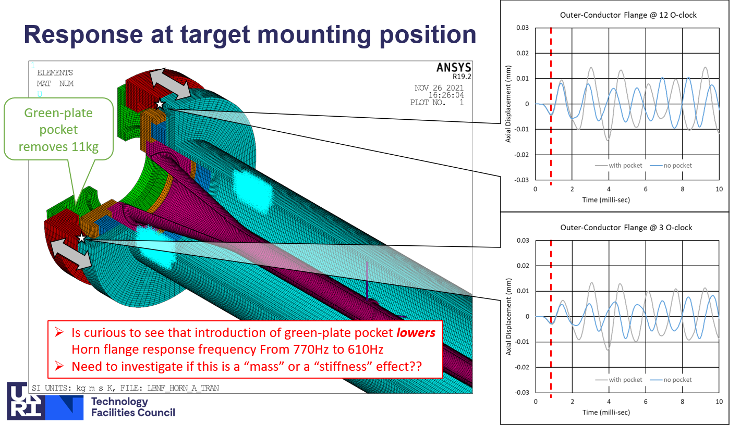
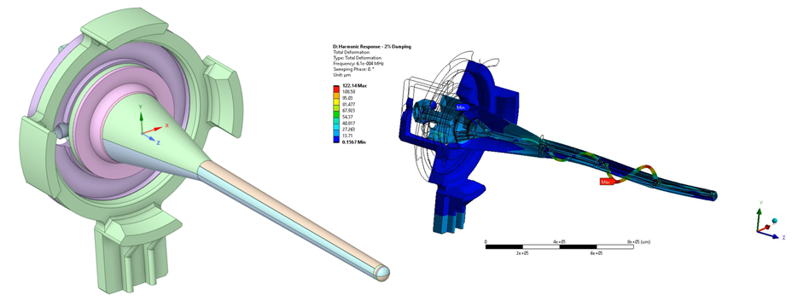
Lorentz force induced vibrations of horn and target
Peter Loveridge Horn A simulation of Horn A target mount vibrations
  Simplified to a sine wave with constant amplitude and frequency
  Applied as BCs to a separate model of the 1.5 m target by Dan Wilcox
    Sine sweep with varying frequency, constant 10μm displacement to study sensitivity to input assumptions
Simplified results at outer flange:
Case | Frequency (Hz) | Displacement (μm) | Acceleration (g)
Horn only | 1000 | 20 | 79
Horn and solid green plate | 732 | 10 | 21
Horn and pocketed green plate | 641 | 10 | 16

Slide 9
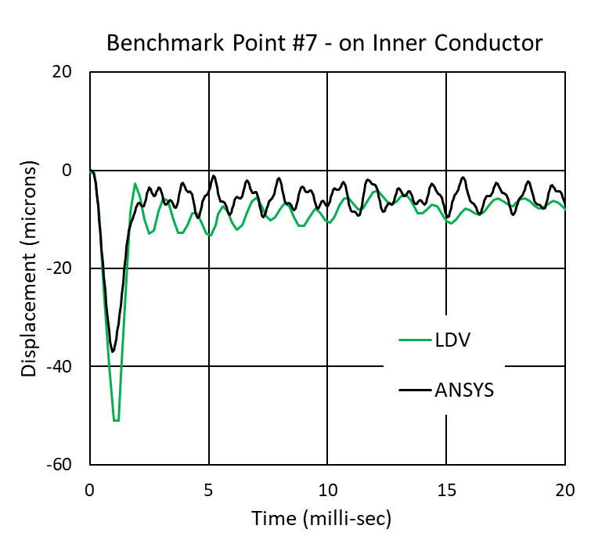
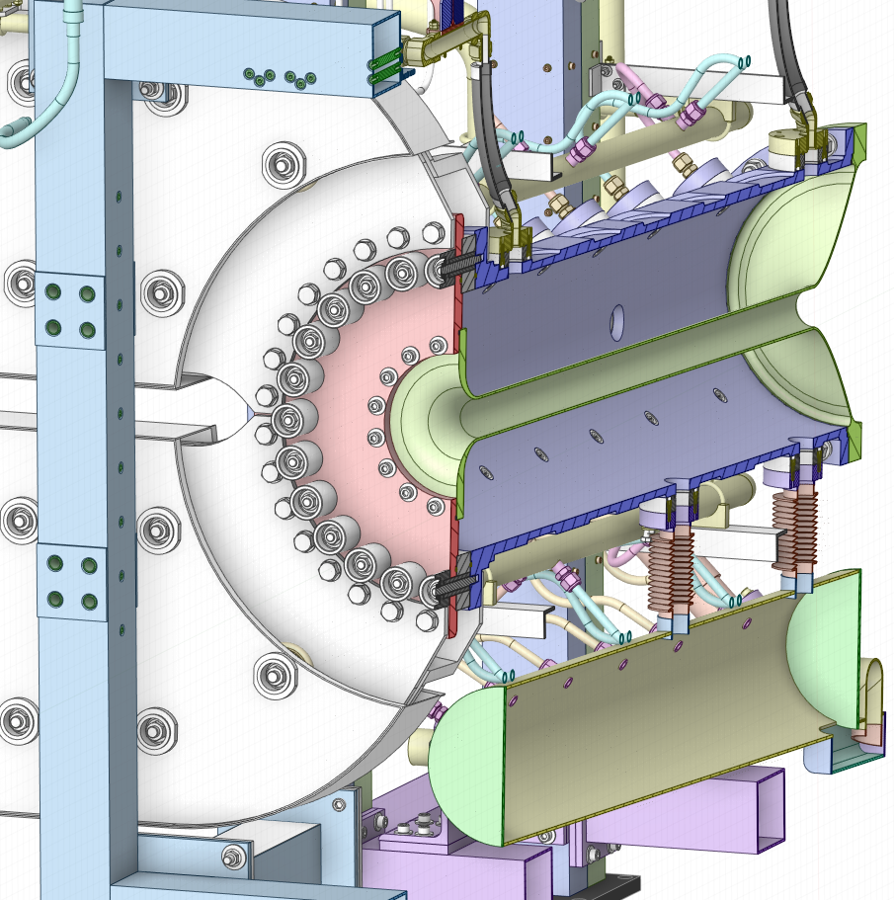
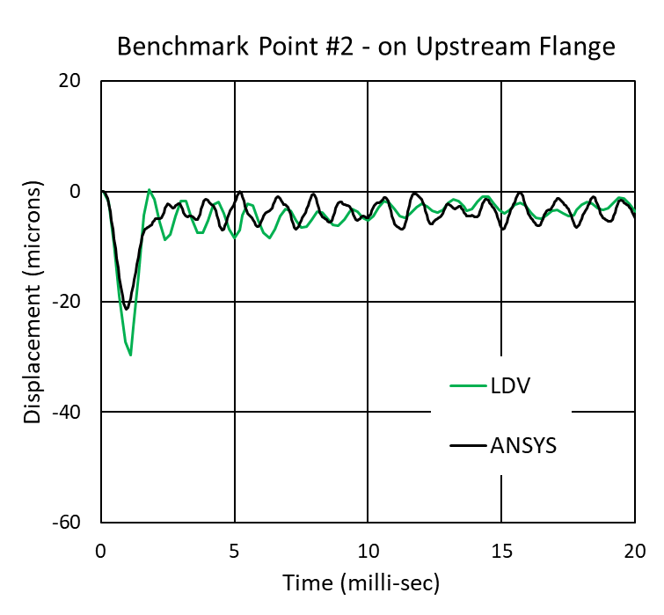
Benchmark of simulation technique using LDV data from T2K horn
Max vibration amplitude at various locations
Point #7
Point #2
LDV data from T. Sekiguchi, KEK.
FEA analysis by Peter Loveridge, RAL

Slide 10
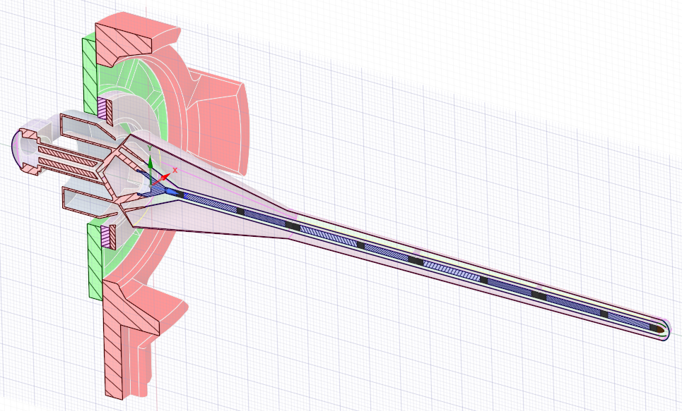
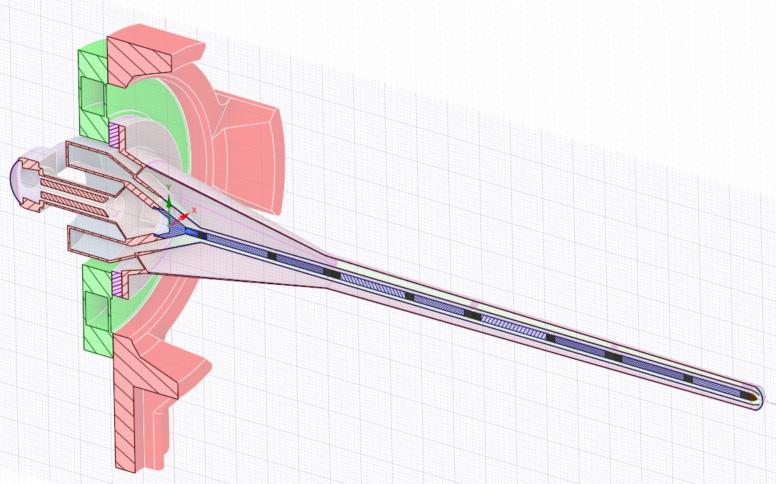
Geometry Changes for Vibration Reduction
Two options investigated to mitigate vibrations of target expected from pulsed magnetic horn current induced Lorentz forces:
  Make the support plate stiffer, while also reducing the driving frequency below the first plate frequency (e.g. by adding mass)
    Implemented as a ribbed stainless steel 316L plate
  Make the support plate axially compliant (low f), so driving frequency is not transmitted
    Implemented as two thin aluminium plates, axially separated to prevent gravity sag
Al6061-T6
2 x axially compliant support plates
SS 316L
Al6061-T6
Al6061-T6
Increased stiffness of (green) support plate
Gravity sag (μm)
Baseline | 226
Reinforced | 224
2 Thin Plates | 224
Steel Plate | 223
2x 6mm thick plates, with 58mm spacing between

Slide 11
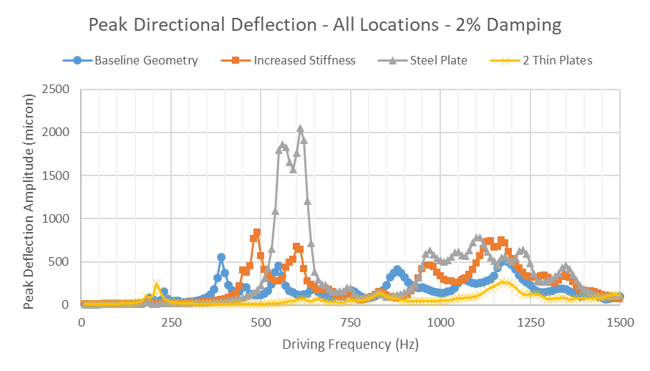
Changes to Vibration Response of 1.5 m target
1st mode of “green” support plate in each case
Sine sweep with varying frequency
10 µm amplitude applied
2% damping (typ. from T2K horn data)
Conclusion: reducing the axial stiffness of the mounting plate can reduce vibration amplitudes

Slide 12
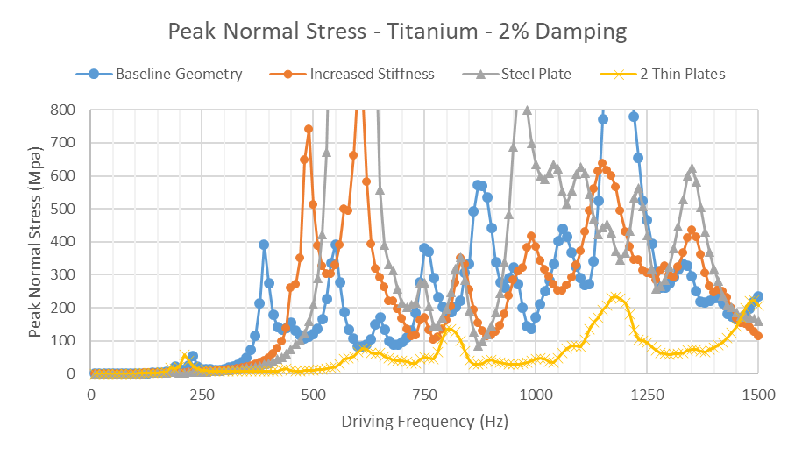
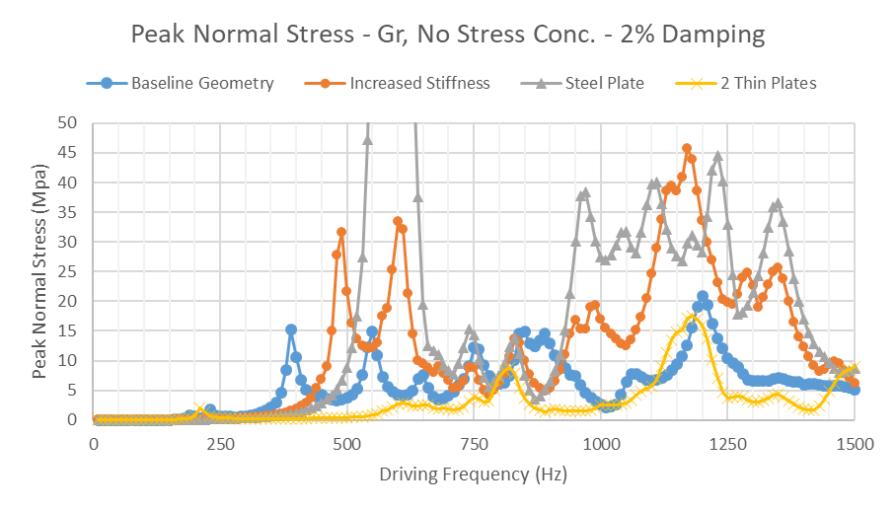
Vibration induced stresses in target Ti & graphite
Axially compliant support geometry (2 thin plates) gives a large frequency range where fatigue response looks acceptable (and (de-)tunable)
Baseline plan for prototype target support
Titanium target container
Graphite target
1.5E9 cycle endurance limits
Horn 1st mode
Horn 1st mode

Slide 13
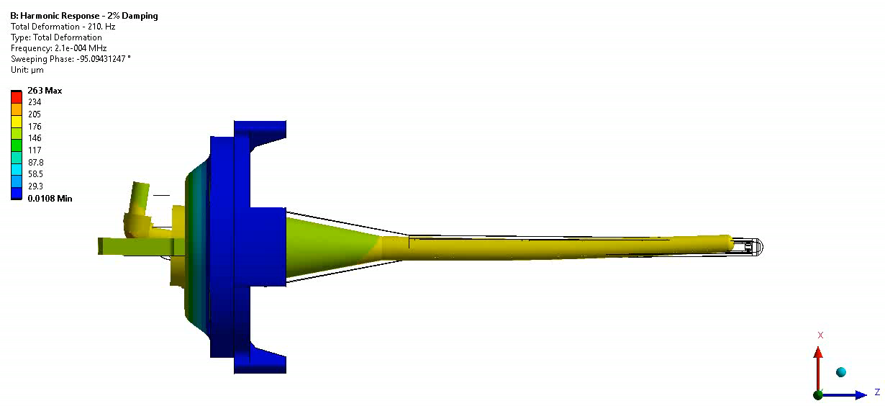
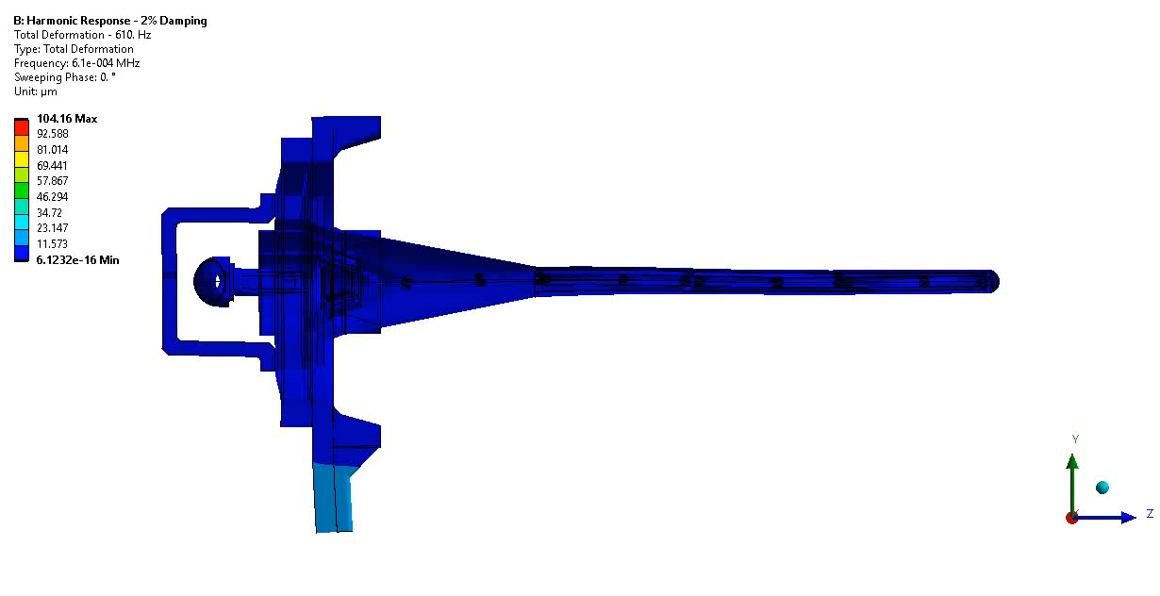
Modes of Concern – 2 Thin Plate support
Peak at 210Hz
210Hz
Peak at 610Hz
610Hz
Double plate natural frequency ≈237Hz with dummy target mass attached
2nd natural frequency ≈633Hz
Target can (in principle) be ‘tuned’ by changing (increasing) thickness of outer container

Slide 14
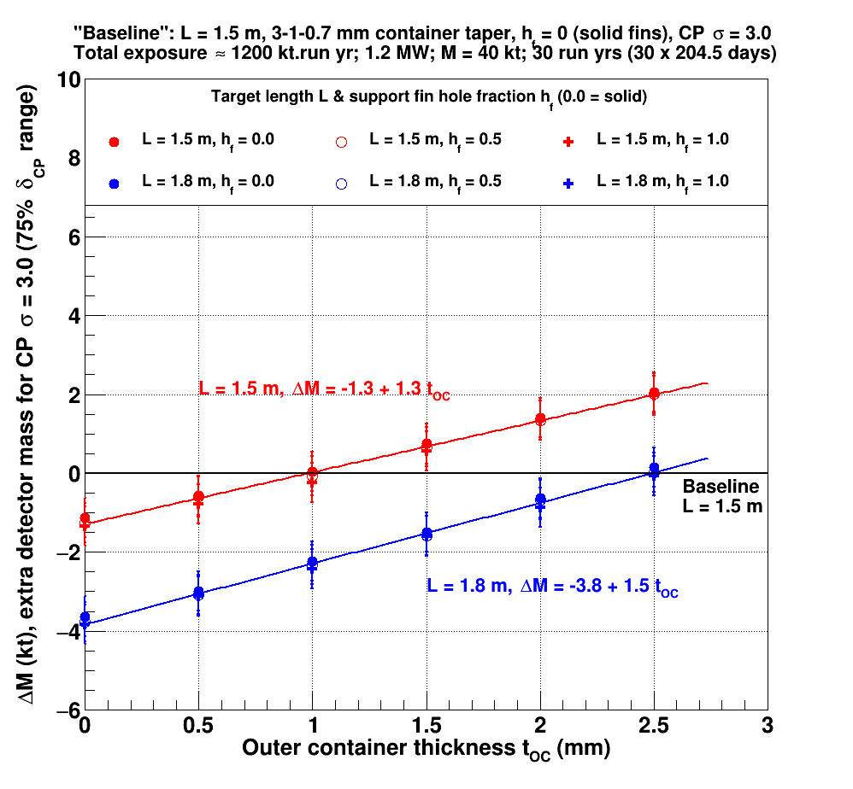
Physics impact of LBNF target outer container thickness variations
John Back presentation to BIWG docdb 25880
Increasing target length from 1.5 to 1.8 m has similar effect to extra 2 kT detector mass
‘Lose’ c. 2 kT if double target container thickness from 1 mm to 2 mm
Detailed GEANT4 model
Unoscillated nsignal & background fluxes extrapolated to far detector

Slide 15
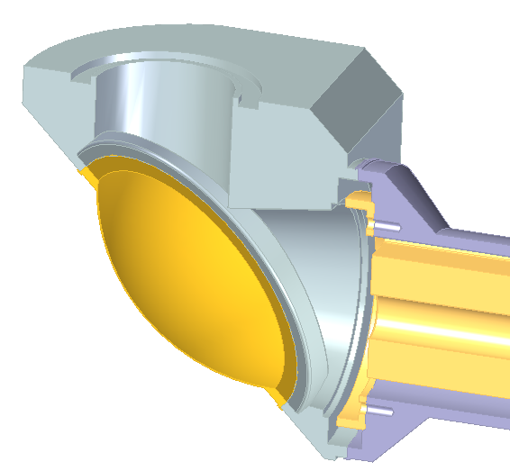
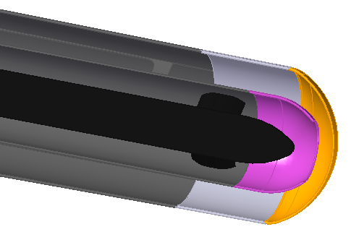
Beam Window Material Selection
Windows have higher temperature, radiation damage and fatigue than the container
Available radiation damage data: up to 0.24 dpa, mostly for grades 5 and 23
Peak dose: 0.14 dpa/yr in container, 2.5 dpa/yr in upstream window
Downstream Window
t_{min} = 0.4mm
Dose = 0.7dpa/yr
T_{max} = 150°C steady state, 175°C peak
ΔT = 55°C/pulse
Upstream Window
t_{min} = 0.3mm
Dose = 2.5dpa/yr
T_{max} = 115°C steady state, 150°C peak
ΔT = 70°C/pulse
p

Slide 16
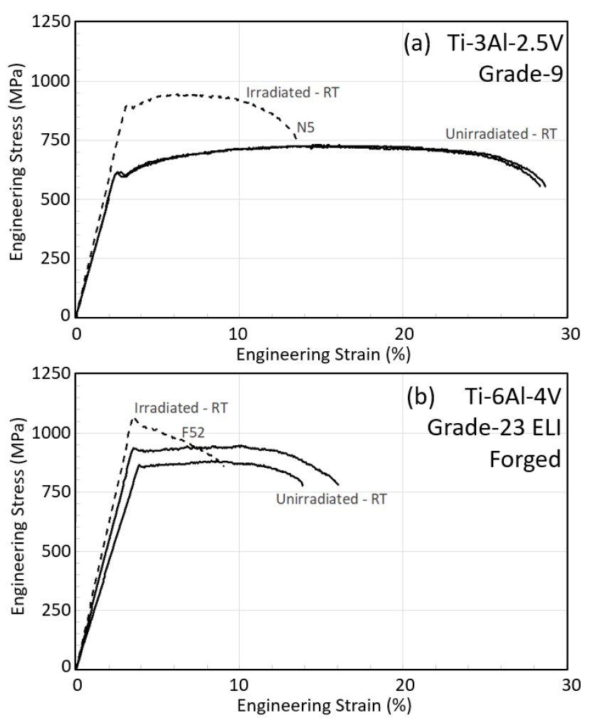
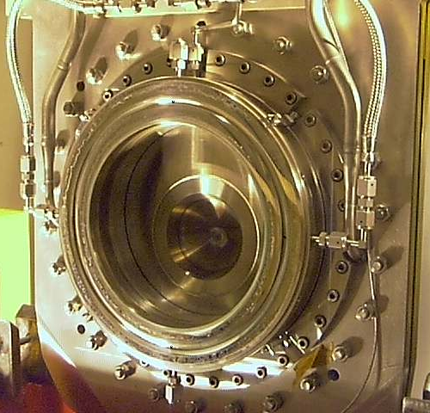
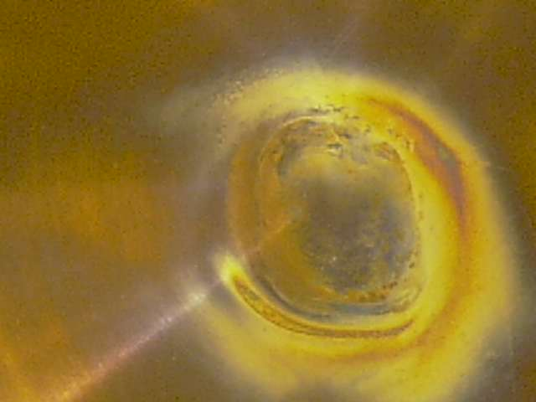
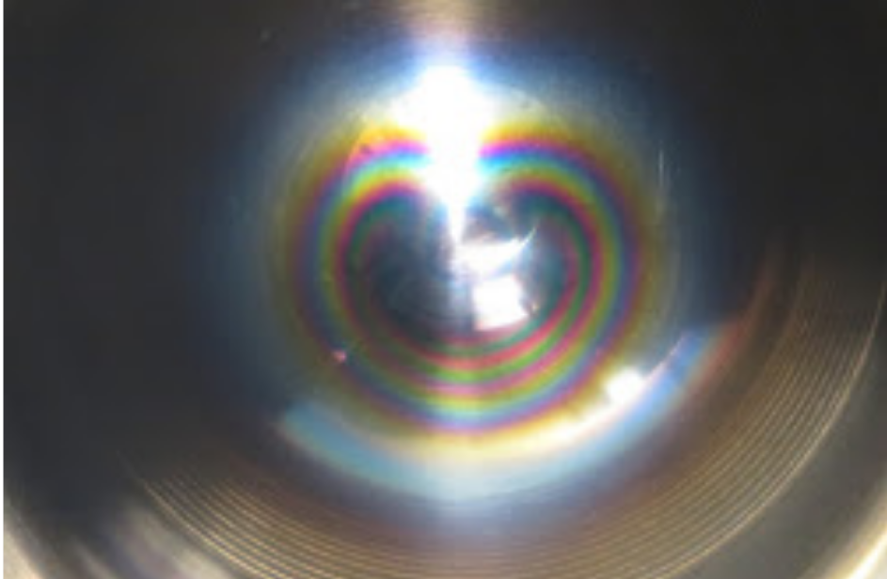
Radiation Damage of T2K Titanium Windows
Visible inspection permissible only
T2K beam window #1 (DS) after 2.2e21 POT, c.1.4 DPA
Tensile properties of titanium irradiated with 180 MeV protons at up to 0.23 DPA at BLIP, BNL
N5=0.22 dpa @112°C
Grade 5 Ti-6Al-4V
T2K beam window #2 (US) after c.1.6e21 POT, C. 1 DPA
F52=0.22 dpa @112°C
T. Ishida et al., Journal of Nuclear Materials, 2020

Slide 17
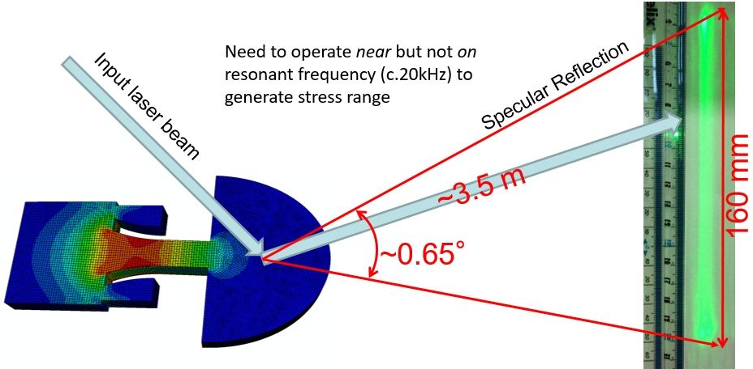

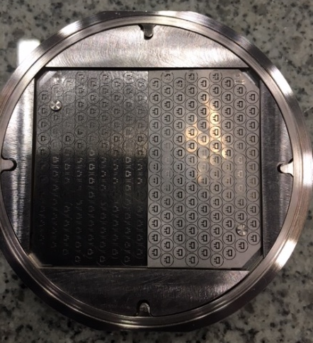
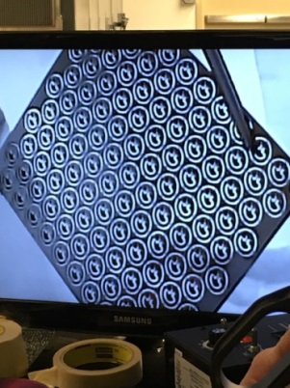
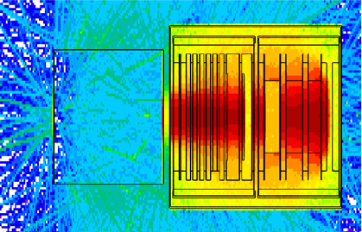
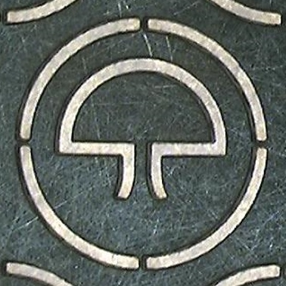

Legacy from HyperK-UK project:
Irradiated mesoscale fatigue samples of Ti-6Al-4V titanium alloy
Mesoscale ultrasonic fatigue samples prepared by RAL and Oxford and irradiated at BLIP, Brookhaven National Lab
1st phase irradiation (2017)
  Samples at c.0.23 DPA
2nd phase irradiation(Jan-Mar 2018)
  Samples at c.1 DPA
Fatigue test results will inform selection of target window material candidates for irradiation at B’ham
Applied vibration
Samples irradiated to 0.23 DPA extracted from capsule
Accumulated Damage in Ti samples
Mesoscale-Fatigue samples in BLIP capsule
3.4mm
RaDIATE
Collaboration

Slide 18
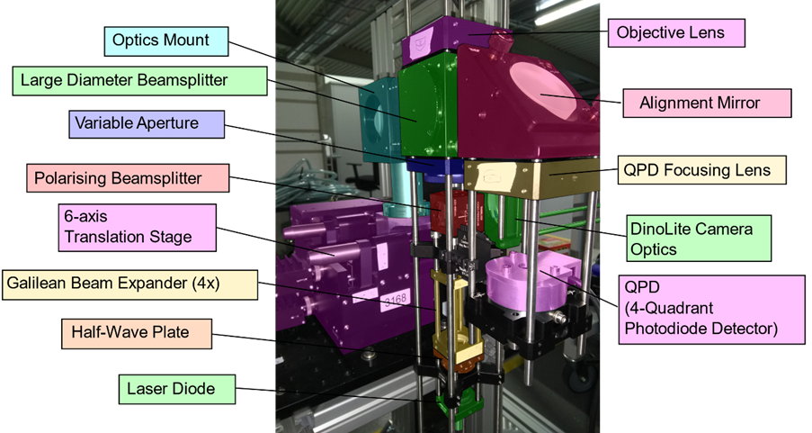
Ultrasonic Fatigue Rig for active sample testing at Culham
Ultrasonic Fatigue Rig (UFR) diagnostics by STFC Innovations PDRA
RAL Graduate Engineer placement planned to assist in commissioning and testing control samples in shielded research room at Culham
Active sample testing and microscopy of fracture surfaces by Oxford at Culham
Diagnostic optics for UFR

Slide 19
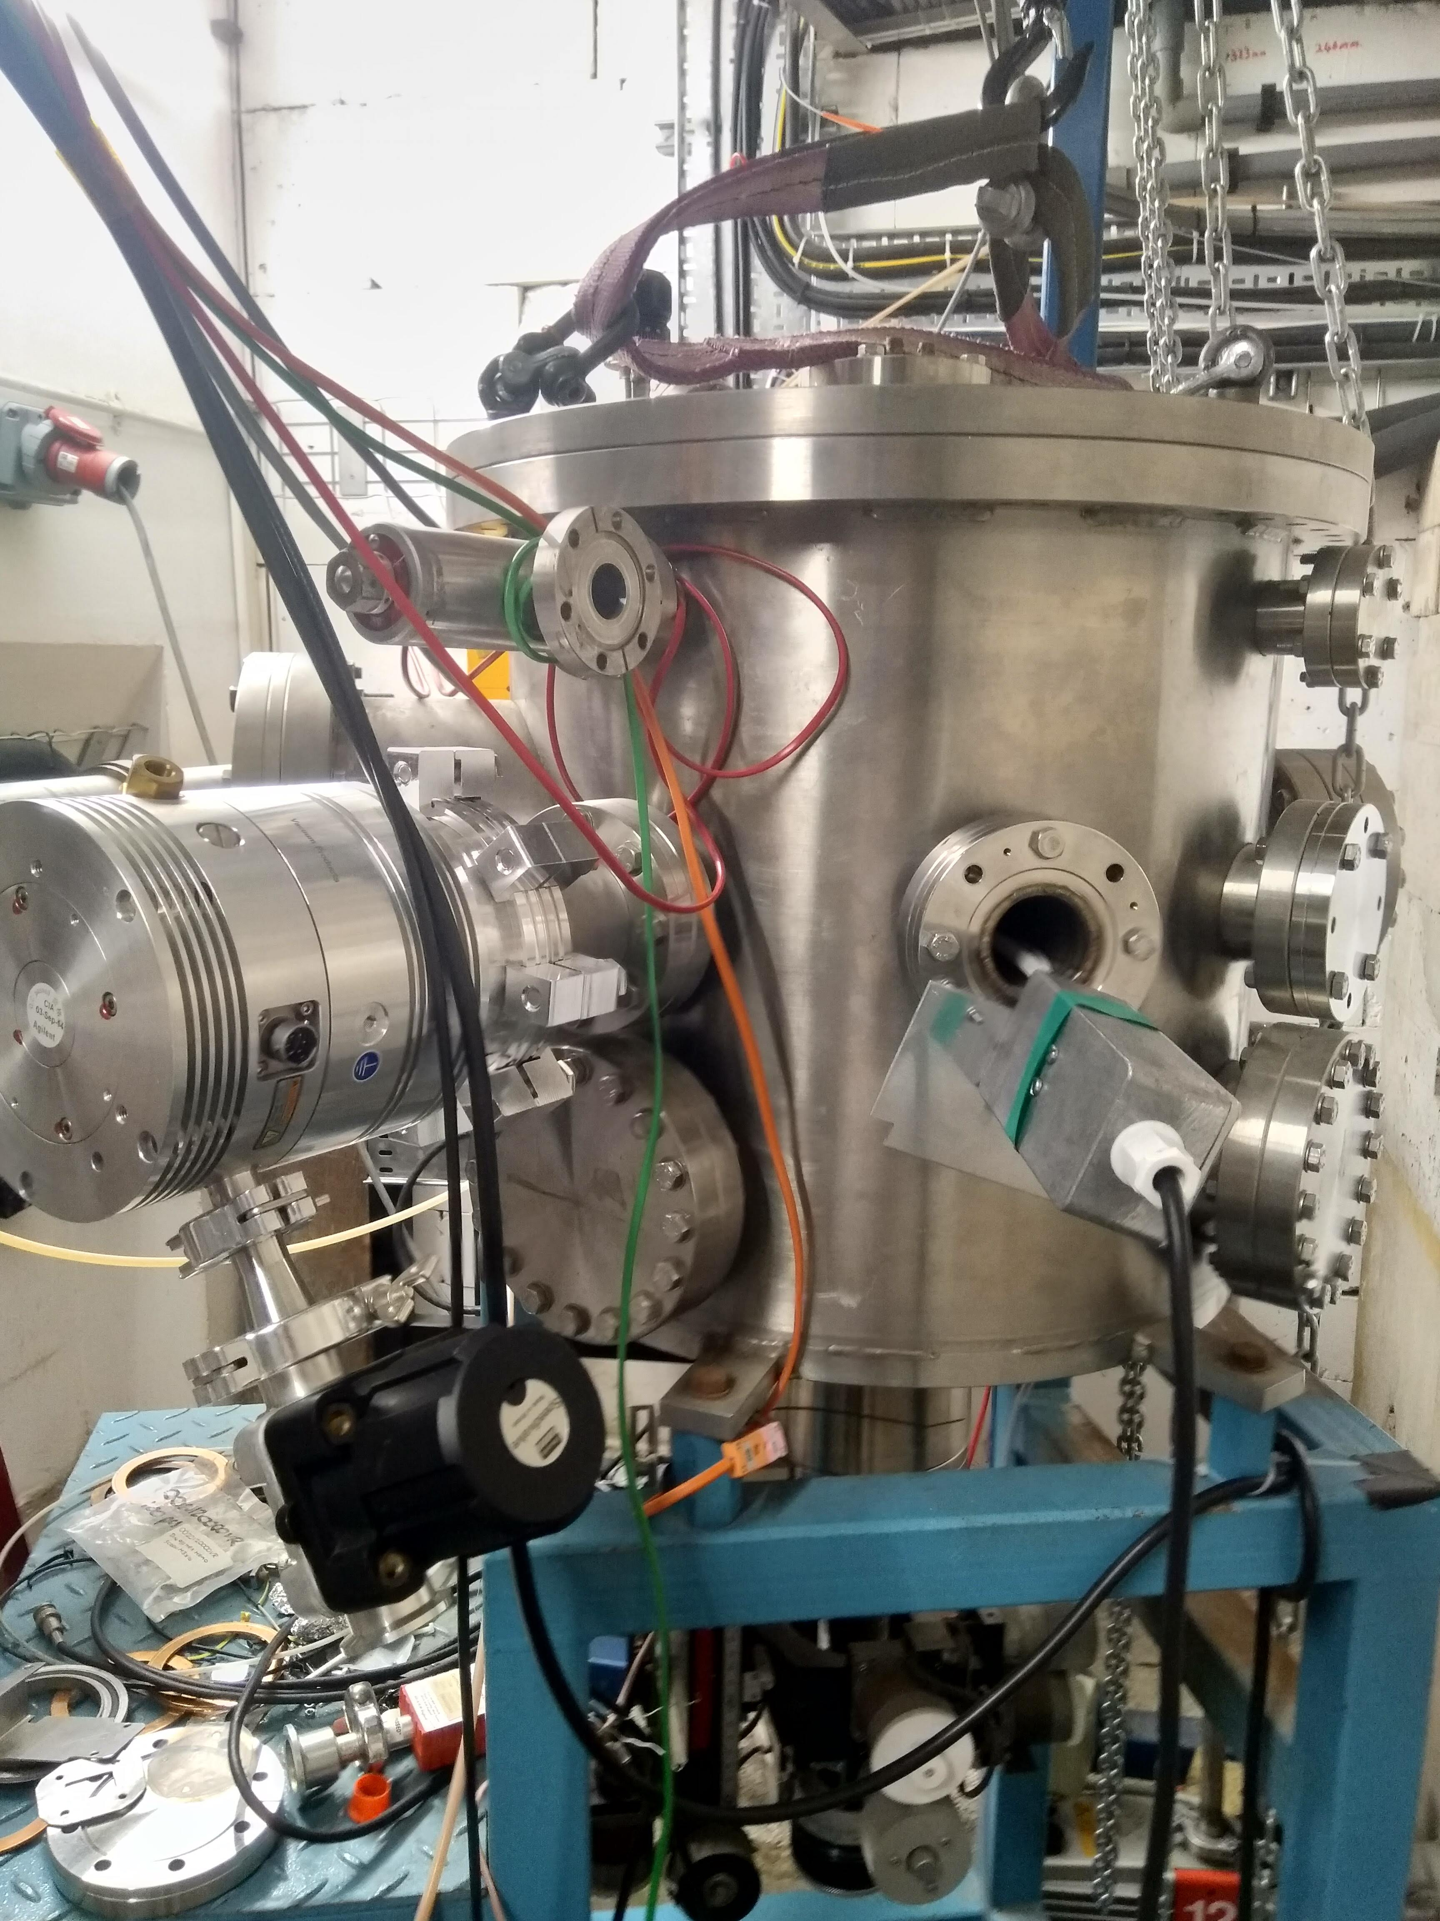

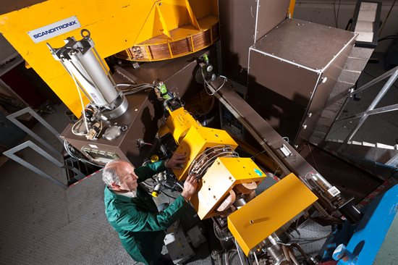
Birmingham University MC40 Materials Irradiation & PIE plans
Sample environment (RAL)
MC40 irradiation (B’ham)
PIE (Culham)
Micro/nano indentation
Micromechanical tests
TEM/XRD
Control the sample temperature e.g. 160 °C
Proton and He irradiation at high energy to 2 dpa
T-6Al-4V (α+β)
Ti-15V-3Cr-3Sn-3Al (β)??
Hardening
Ductility
Fatigue
Post-doc (16 Months)
PhD on Ti irradiation fully funded by EPSRC-CDT Topological Design at Univ. Birm. (4 years)
PhD on Fe-Cr irradiation funded by UKAEA (3.5-4 years)

Slide 20
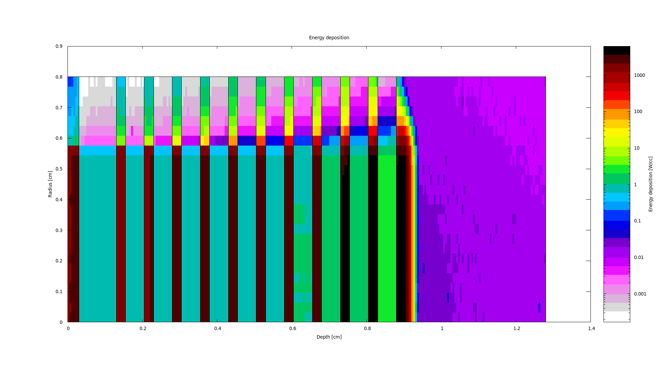
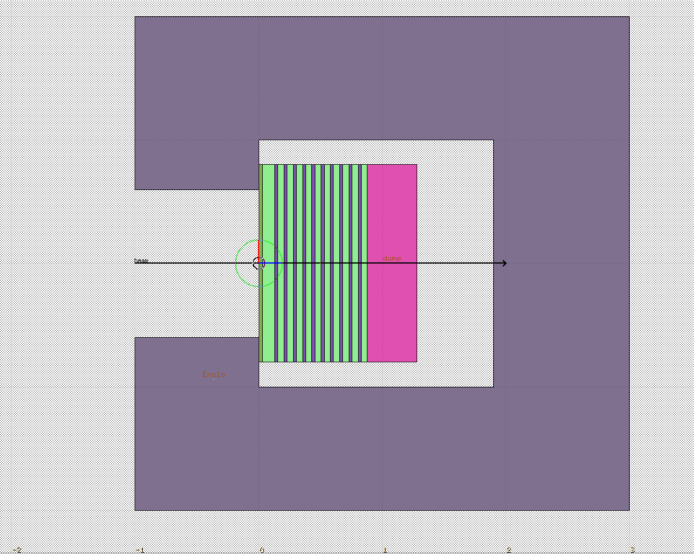
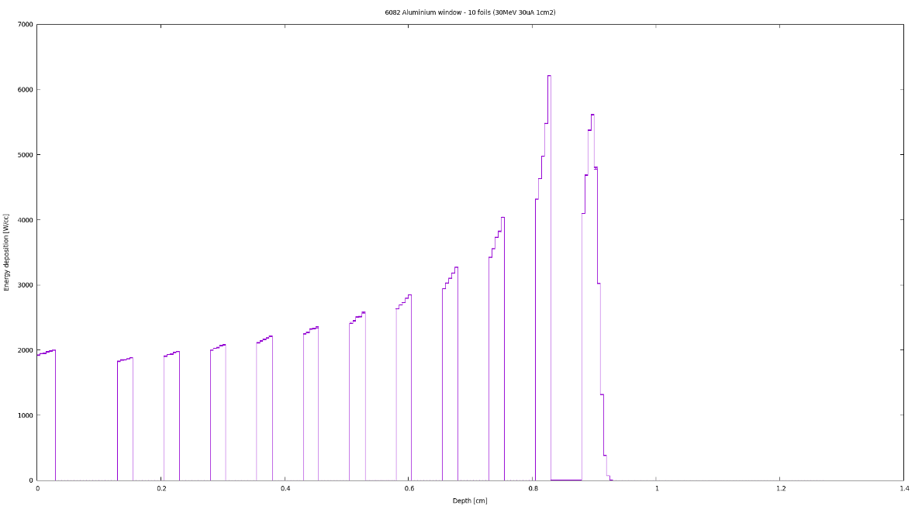
Birmingham MC40 cyclotron irradiation plan
– sample environment outline design at RAL
FLUKA model
Stainless steel enclosure
30 MeV proton beam
0.564cm radius
Graphite beam dump / samples for Bristol
Bragg peak in graphite beam stop
6082 Aluminium window
Titanium foil ‘mesoscale’ fatigue samples
Nitrogen gas
Example energy deposition used for engineering design

Slide 21
Summary
Phase 1 Project closed-out with final PDR passed
Phase 2 Construction Project underway – 1.5 m long target is baseline¹
Potential mitigation of Lorentz force driven horn/target vibration issue
  Axially compliant supports comprising two thin Aluminium plates and a spacer has significantly improved vibration response in simulations
  Plate geometry can be tuned, and multiple plate options can be physically tested
Materials Science sub-project underway via RaDIATE Collaboration
  Exploitation of legacy samples from HyperK
  Design of sample environment from B’ham MC40 cyclotron underway
  Planning underway for Post-Irradiation Examination of titanium and graphite samples at Culham
¹As per STFC funding recommendation

Slide 22




