Slide 1
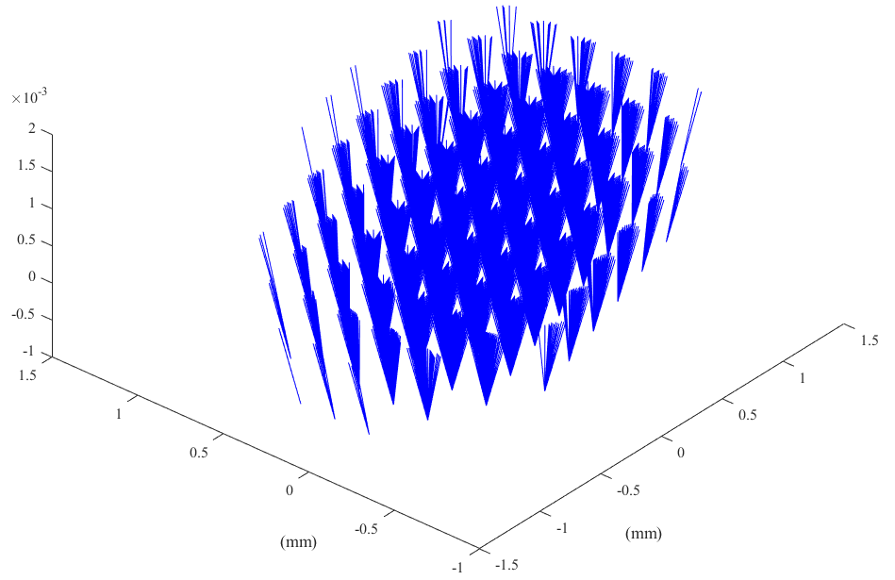
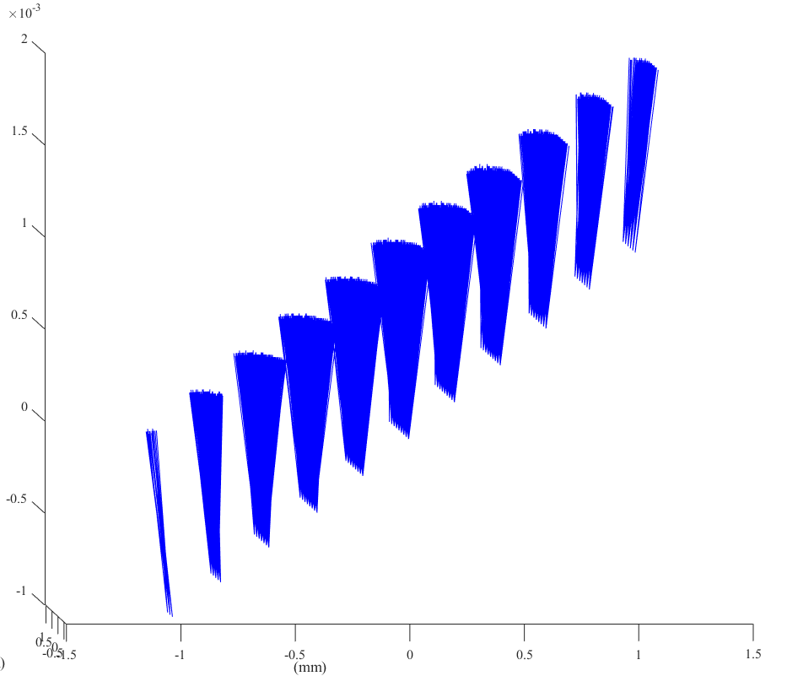
Geometric Acceptance
Rays originate from grid +/- 1 mm with 0.2 mm spacing (projected back onto OTR screen), a polar angle grid of 5 to 105 mradians with 10 mradian spacing, and an azimuthal grid of 2*pi mradians with pi/10 mradian spacing
OTR Screen

Slide 2
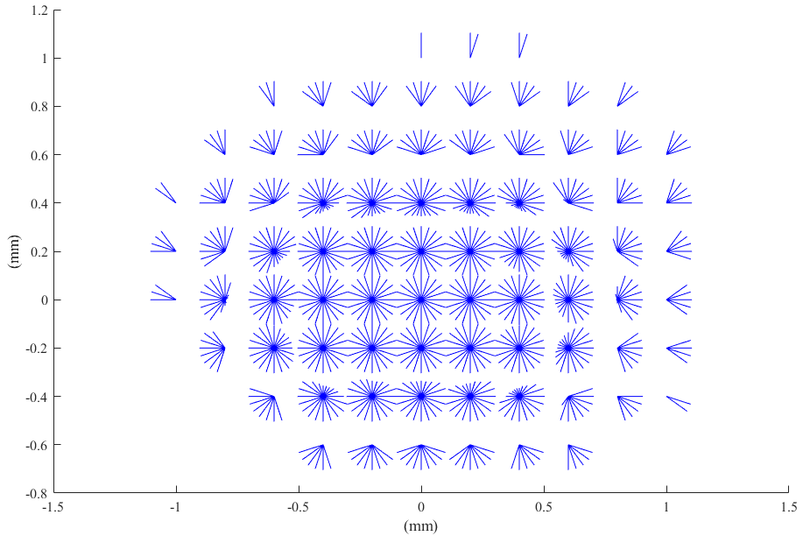
Geometric Acceptance
Looking at the outgoing rays from source points
Rays are the ones that make it into the Streak Camera hut

Slide 3
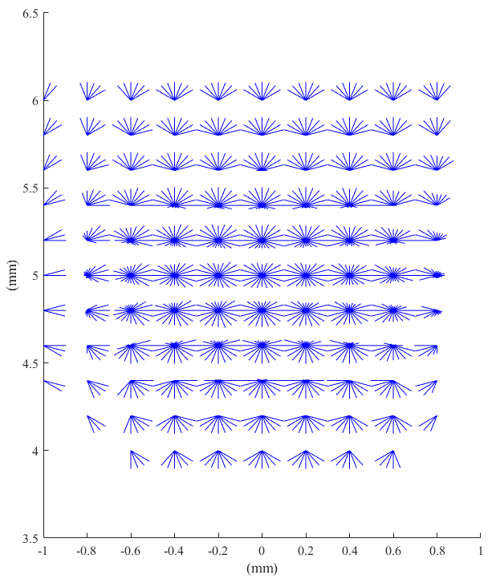
Geometric Acceptance
Now with central location moved +5 mm vertically and collimating mirror rotated 12.8 mradians to compensate

