Slide 1
Survey of ion sources

Slide 2
H+ ion sources
Surface plasma H- production
Volume H- production
H- ion source types

Slide 3
There are basically 2 styles of H+ sources that are used in most labs
Electron Cyclotron Resonance (ECR)
ESS, SPIRAL2,FAIR
Duoplasmatron
INR RAS, FNAL HINS,

Slide 4
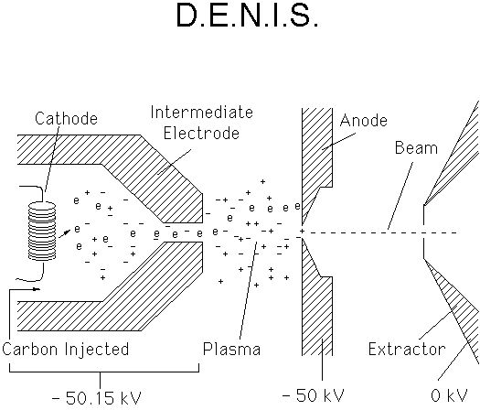
H+ sources
Duoplasmatrons
Low plasma density region
A cathode is heated, giving off electrons they are attracted to the “intermediate electrode”. As they travel towards the electrode they collide with the surrounding gas (H₂ in this case)
These collisions free additional electrons which collide with other particles
The intermediate electrode squeezes down the electrons giving a dense plasma
Low density plasma in the chamber/high density plasma outside the chamber gives the name duo-plasmatron
The high negative potential on the anode pulls H+ out of the source
H+
Filament
(cathode)
H₂
High plasma density region

Slide 5
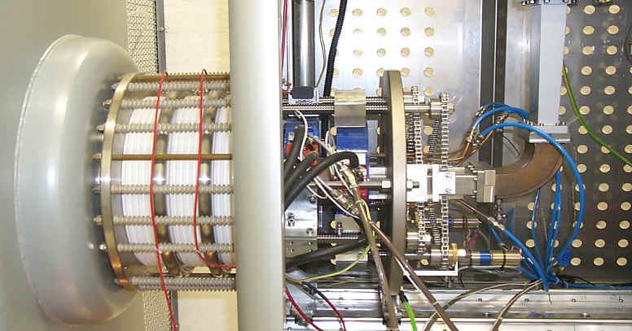
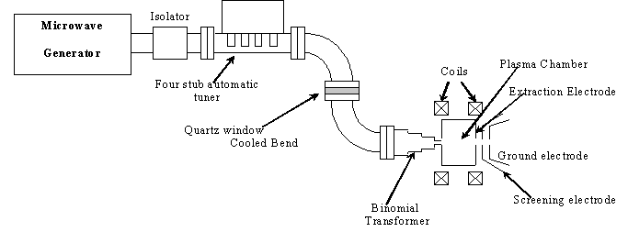
Microwave ECR sources
2.45GHz microwaves , which correspond to the electron cyclotron frequency are injected into the source volume which ionizes a low pressure gas into a plasma.

Slide 6
H+ sources
 | Source type | Beam current | Pulse width | Rep rate
FAIR | ECR | 70mA |  | 4Hz
PEFP | Duoplasmatron | 20mA | 2ms | 120Hz
ESS | ECR | 60mA | 2ms | 20Hz
SPIRAL2 | ECR | 5mA |  | DC
IFMIF |  | 140mA |  | DC
INR RAS | Duoplasmatron | 50-120mA | 200us | 50Hz

Slide 7
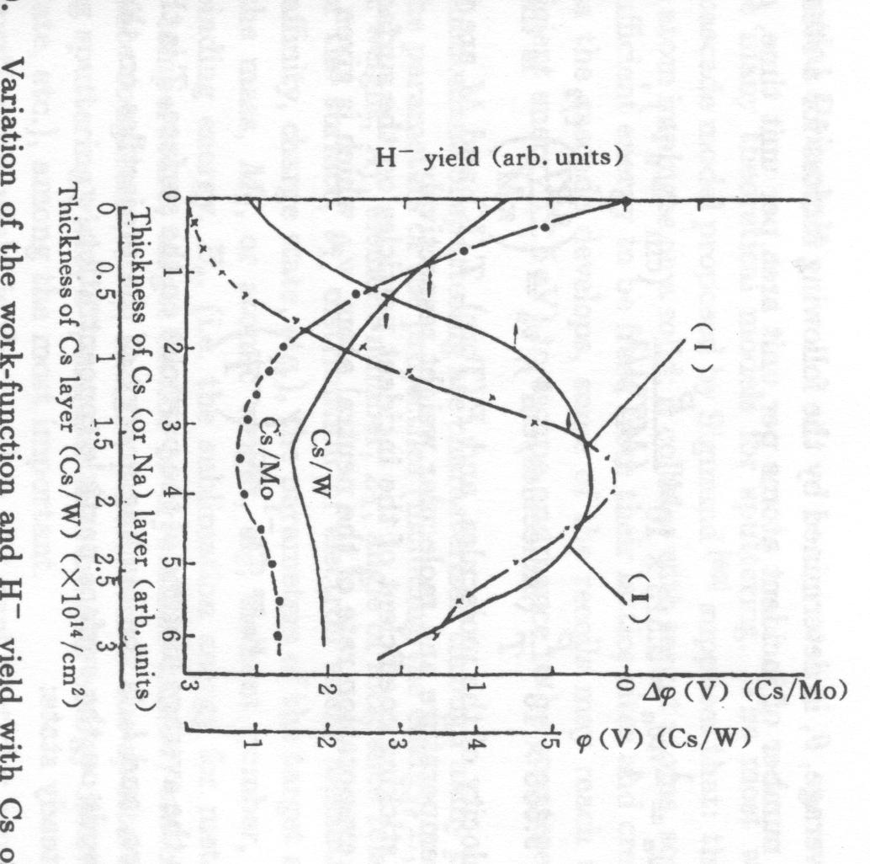
Surface production Sources (SPS)
Mo
Cs
Cathode (-)
e⁻
~1 mm
H⁺
H₂⁺
e⁻
Anode (+)
B
Cs
H⁻
Figure from Stockli USPAS June 2007
e⁻
Cs
Mo has a host of loosely bound e- that take about 4.6eV to remove
Cs lowers the surface work function to about 1.8eV with 0.6 mono-layer thickness
Hydrogen affinity is about 0.75eV so most of the hydrogen particle leave the surface as neutrals, however a few leave the surface as H- ions
This is why we use cesiated sources
Cs
P
H
H
Figure from ZHANG Ion Sources
Figure from Stockli USPAS June 2007

Slide 8
Volume H- production
For volume sources, H- ion production relies on increased cross section for dissociative-attachment reaction (in the plasma volume) when molecules are excited to high vibrational states (v”>2).
Primary ionization chamber
H- formation region
e⁻ (cold)
e⁻ (hot)
e⁻
H₂(ν>0)
H⁻
ions
H₂(ν=0)
H
H₂(ν>0)
e⁻ (hot)
Figure from Stockli USPAS June 2007
Filter B-field

Slide 9
There are basically 5 proven H- ion sources in use at major labs:
Magnetron
(FNAL, BNL, ANL, DESY)
Surface conversion
(LANL, KEK)
Filament-driven volume
(TRIUMF, Jyväskylä)
Penning
(RAL, INR)
RF-driven volume
(DESY, SNS)

Slide 10
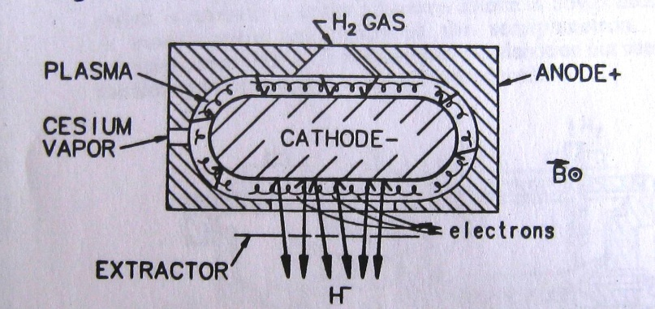
Magnetron sources
magnetron
FNAL magnetron H- sources are used
In Cockcroft-Walton
New source for Preinjector upgrade (RFQ project)
N
cathode
H-
6cm
S
e-
Plasma is generated by ExB motion of electrons
H-
H- are produced at the cathode surface then extracted (SPS Source)
They are then pulled out of the source by the extractor

Slide 11
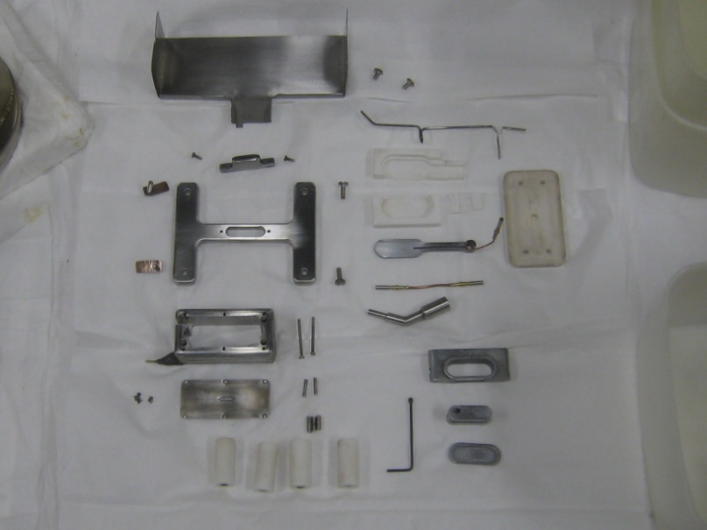
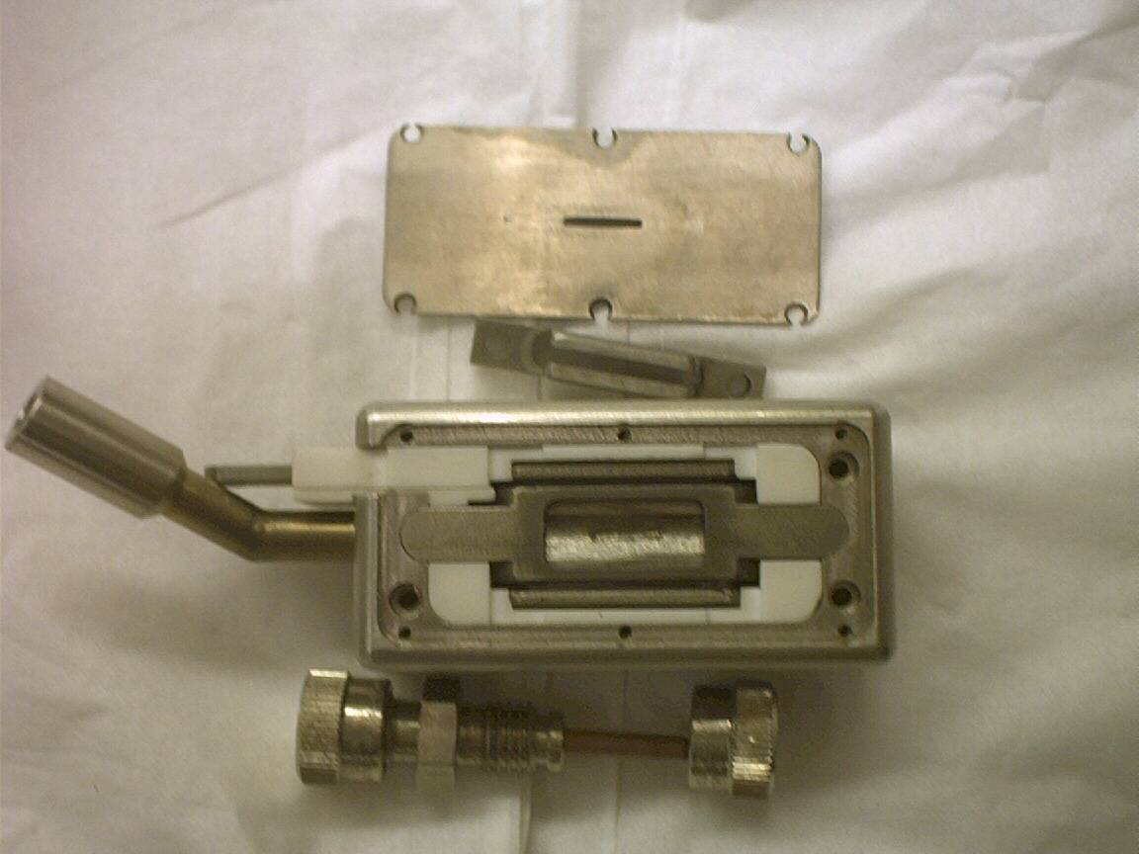
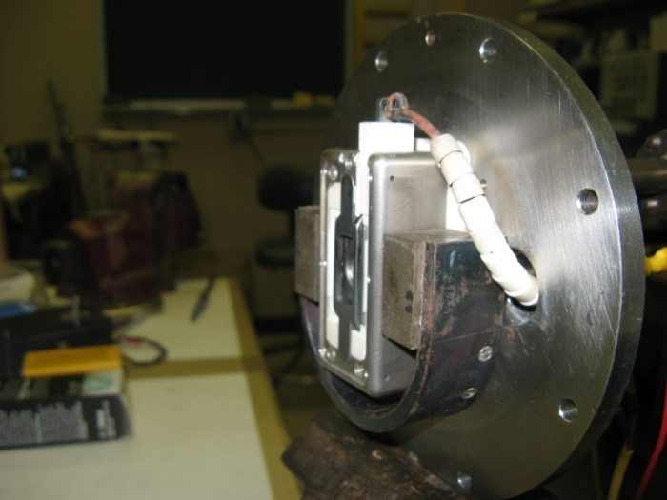
Magnetron sources
FNAL
BNL
Parameter | Value
H- beam current | 50 - 60mA
Arc current | 45 - 55A
Arc Voltage | 115 – 145V
Extractor Voltage | 15 – 18kV
Pulse width | 80 usec
Rep Rate | 15Hz
Duty factor | 0.12%
Power efficiency | 9mA/kW
Average lifetime | 3.5 months
Parameter | Value
H- beam current | 100mA
Arc current | 10A
Arc Voltage | 150V
Extractor Voltage | 35kV
Pulse width | 700 usec
Rep Rate | 7.5Hz
Duty factor | 0.5%
Power efficiency | 67mA/kW !
Average lifetime | 9 months

Slide 12
Penning sources
Cs
Anode (+)
e⁻
Mo
B
H⁺
H⁻(fast)
B
H (chr. ex.)
e⁻
Anode (+)
Cathode
(-)
Cathode
(-)
Extractor
H⁻
Figure from Stockli USPAS June 2007
H⁻(fast)+H(slow) H(fast)+H⁻(slow)
H- ions produced on the cathode similar to magnetron
Relies on charge exchange to produce slow H- ions for extraction
One benefit: easy access to cathode allows cooling which in turn allows higher duty factors (possibly DC)

Slide 13
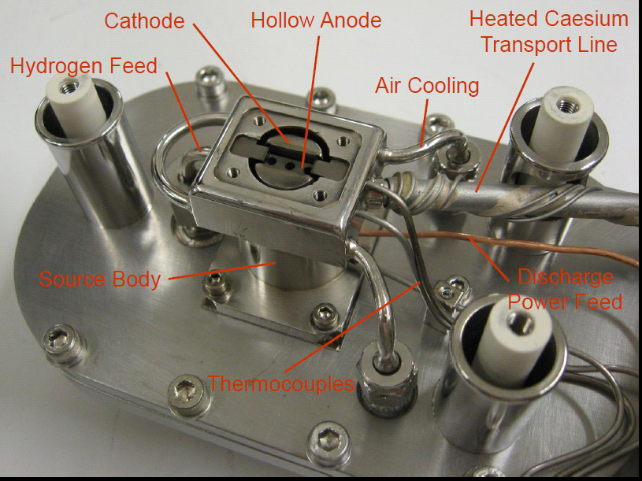
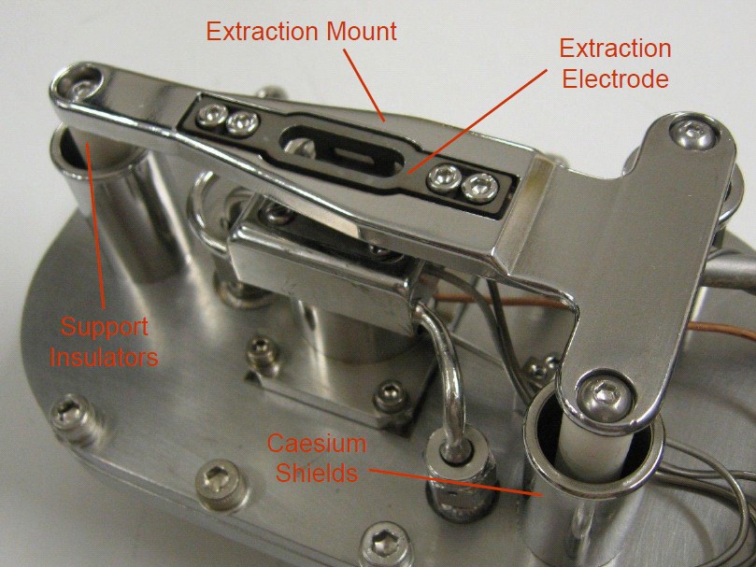
Penning sources
RAL ISIS penning source
Dan Faircloth 2012
Dan Faircloth 2012
Parameter | Value
H- beam current | 70mA
Arc current | 50A
Extractor Voltage | 17kV
Pulse width | 2 msec
Rep Rate | 50Hz
Duty factor | 10%
Average lifetime | 20 days
Dan Faircloth 2012

Slide 14
Mulit- cusp converter ion source
Multicusp magnets
Cs
H⁺
Cathode
(-)
H⁻
Anode
(+)
Converter
(H⁻ production surface)
Multicusp B field
Figure from Stockli USPAS June 2007
Large volume, low pressure plasma
Cusp field minimizes electron loss to walls/confines plasma to center or source
H+ ions created in plasma strike converter plate to produce H⁻ ions

Slide 15
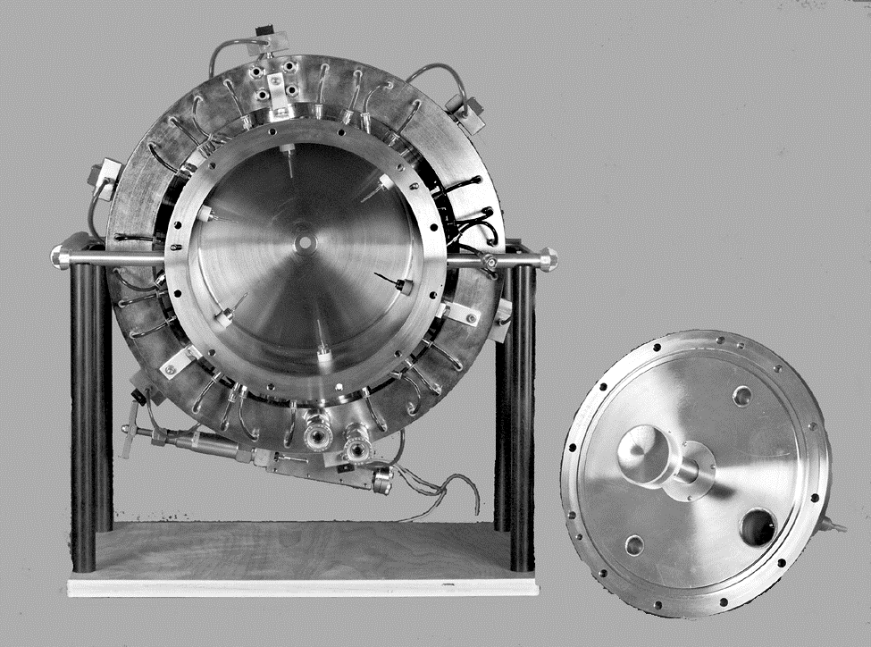
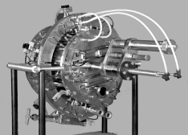
Mulit- cusp converter ion source
Parameter | Value
H- beam current | 20mA
Arc current | 60A
Arc Voltage | 100V
Extractor Voltage | 80kV
Pulse width | 1 msec
Rep Rate | 120Hz
Duty factor | 12%
Average lifetime | 4 weeks
Power efficiency | 3mA/kW

Slide 16
Filament driven volume source
e⁻ (hot)
H₂(ν>0)
Filter magnets
H₂(ν=0)
e⁻ (hot)
H₂(ν>0)
ions
e⁻
H⁻
filament
e⁻ (cold)
26 cm
Figure from Stockli USPAS June 2007
Filaments biased to create electrons with sufficient energy to excite hydrogen to high vibrational states
Small volume area separated from larger volume by magnetic field to stop energetic e- from destroying the H- ions once they are produced
Typically low current sources, but high duty factors (DC)

Slide 17
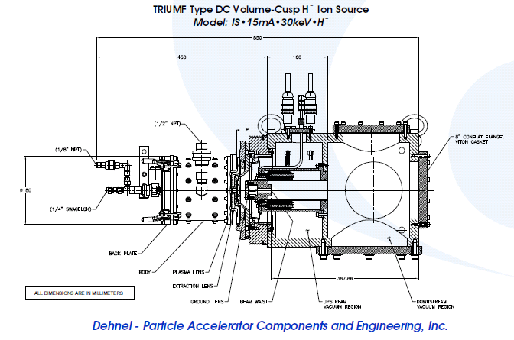
Filament driven volume source
Company called D-Pace manufactures filament driven volume sources ranging from 5mA to 15mA
Parameter | Value
H- beam current | 15mA
Arc current | 45A
Arc Voltage | 150V
Extractor Voltage | 20 – 30kV
Rep Rate | DC
Duty factor | - -
Average lifetime | 350hrs

Slide 18
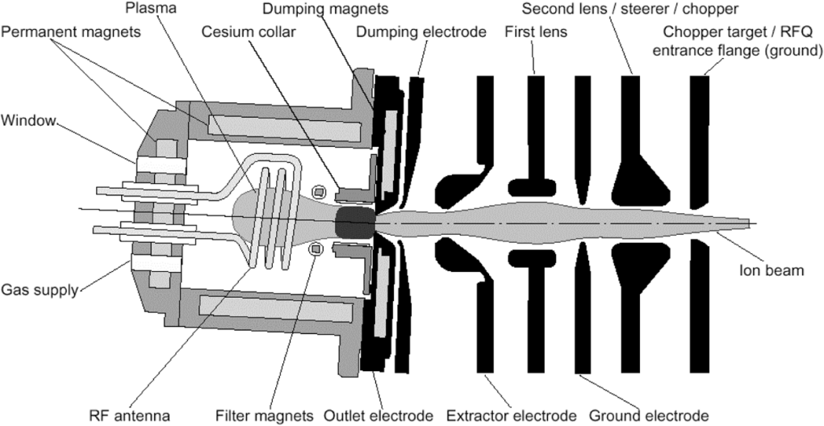
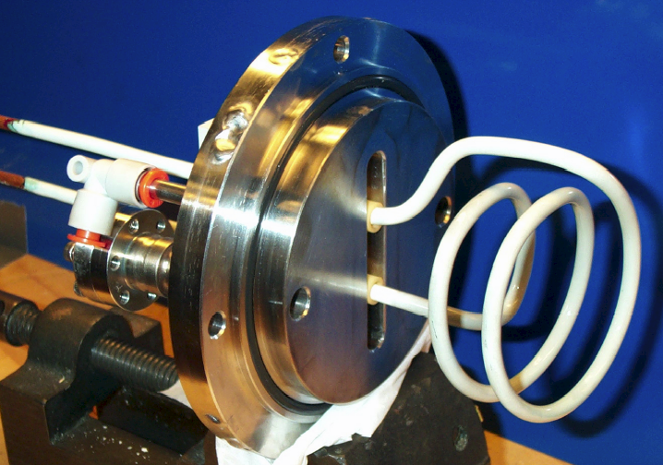
RF driven volume source
B_{RF}(2 MHz)
ions
E_{RF}(2 MHz)
RF antenna
SNS multicusp RF ion source and LEBT
Filler magnet region
Parameter | Value
H- beam current | 67mA
Pulse Width | 1.23 ms
Beam Energy | 65keV
Rep Rate | 60Hz
Duty factor | 100%
Average lifetime | ~11 weeks

Slide 19
H- ion source parameters for different types of sources
Facility | Source type | LEBT type | Cs | Curr-ent (mA) | Pulse length (ms) | Rep Rate (Hz) | Extrac Aperat ∅(mm) | Normalized Emittance (rms) | Emittance Location | Life-time (weeks) | Energy (keV)
DESY (RF) | Multicusp ext. RF | 2 solenoids | No | 30 40 | 0.15 | 8 | 6.5 | 0.26 (90%) 0.43 (90%) | LEBT | >150 | 38
Fermi | magnetron | Dipole | Yes | ~60 | 0.1 | 15 | 0.9x10 | 0.2/0.3 | 750 keV | ~30 | ~20
BNL | magnetron | 2 solenoids | Yes | ~100 | 0.6 | 6.66 10 | 2 | ~0.4 | LEBT | ~30 | 35
ISIS | Penning | Dipole | Yes | ~60 ~35 | 0.5 | 50 | 0.6x10 | ~1 ~0.15/0.29 | Dipole exit 665 keV | ~3 | 35
LANSCE | Surface converter | 2 solenoids | Yes | ~18 {40} | 1 | 120 | 10 {8} | ~0.14 (98%) {~0.3 (98%)} | LEBT | >4 - | 80
J-PARC | Multicusp LaB₆ filam. | 2 solenoids | No | 20 35 | 0.5 | 25 | 9 | 0.15/0.18 (9?%) - | LEBT | >3 | 50
SNS Frontend | Multicusp int. RF | 2 Einzel lenses | Yes | ~20 41 | < 1 | 1-5 | 7 | 0.12/0.14 (100%) 0.25/0.31 (100%) | Test LEBT exit | >11 - | 65
SNS Teststand | Multicusp int. RF | 2 Einzel lenses | Yes | 33 41 | 1.23 | 60 10 | 7 | 0.18/0.26 (100%) 0.25/0.31 (100%) | Test LEBT exit | 2.3 - | 65
JAERI | Multicusp W-filament | NA | Yes | 60 72 | 1 | 50 | 8 | ~0.21 (100%) - | Source exit | ~0.5 | 70
Sumy | Inverse magnetron | NA | No | ~50 | 0.1-1 | 1-10 | 5.4 | - | - | <10⁶ p | 10-100
Figure from Stockli USPAS June 2007

