Slide 1
Organization and Logistics
Allan Rowe, IKC Technical Manager
2nd PIP-II Technical Meeting
July 12-14, 2022

Slide 2
Local Safety Information
Fermilab COVID Page
  Current Fermilab Site COVID Protocols
  Send questions to: covid19@fnal.gov
WG Chairs should inform participants of nearby tornado shelters and fire escape/gathering point information
Fermilab Site Map

Slide 3
Daily Agenda
8:00 a.m. Central Start time
  Coffee Service: Hermitage, IARC 2nd floor kitchen, Wilson Hall Atrium
12:00 p.m. Session Close
Lunch – on your own
  Wilson Hall has limited options
  Nearby Batavia or Warrenville options are plentiful
Satellite meetings in the afternoons
  Separately organized
Due to COVID rules, no workshop-wide organized social events
Working Groups can self-organize, if desired
Note: There will be no closing Close Plenary Session this week
  Closing Plenary Session to be convened after Partners return home
PIP-II Technical Meeting Indico Site Link

Slide 4
Working Groups, Links and Locations
Plenary Session and Working Groups | Teams Meeting Links | Meeting Location | Working Group Contacts
Opening Plenary | Click here to join the meeting | Remote Only | Allan Rowe: arowe@fnal.gov
Cryogenics Distribution System | Click here to join the meeting | Confessional – Wilson Hall 5th Floor East | Ram Dhuley: rdhuley@fnal.gov
650 MHz Cavity Processing and Testing | Click here to join the meeting | Floating Point – IARC 3rd Floor East | HyeKyoung Park: hkpark2@fnal.gov
RF Power Coupler Production | Click here to join the meeting | Innovare – IARC 3rd Floor Center | Josh Helsper: jhelser@fnal.gov
650 MHz Cryomodule Production | Click here to join the meeting | Hermitage – ICB 2nd Floor East | Joe Ozelis: ozelis@fnal.gov
Managing Tech. Obsolescence | Click here to join the meeting | Dungeon – Cross Gallery – Adjacent to Control Room | Victor Grzelak: vgrzelak@fnal.gov
If you experience any logistical issues, please contact:
Traci Langford: tracil@fnal.gov
Allan Rowe: arowe@fnal.gov

Slide 5
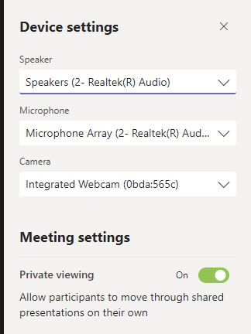
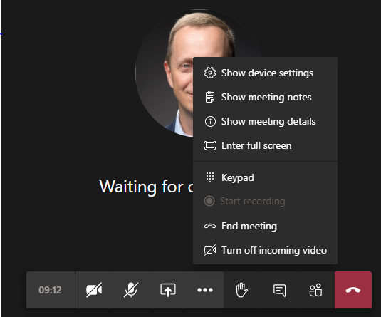

Microsoft Teams Navigation and Control
Access Teams meetings these ways:
Best Option: Teams Application
  https://www.microsoft.com/en-us/microsoft-365/microsoft-teams/download-app
2nd Best: Microsoft Edge Browser
  https://www.microsoft.com/en-us/edge
3rd Best: Google Chrome
  https://www.google.com/chrome/
Make Changes Here
Navigation Ribbon
Audio/Device Settings
Notes:
Teams necessary for all Partners to access Workshop
Mute when entering meeting
Raise hand to speak
Use Chat to ask/answer questions or record observations for the benefit of the session
Audio controls
Share Screen control – highlight desktop

Slide 6
Working Group/Meeting organization
Please identify a note-taker who can log action items, open issues, etc.
Questions and Answers can be logged using the in the Teams chat function.
If audio is difficult for remote participants, please repeat questions or answers near the microphone in the room.
After the morning meetings, please schedule afternoon meetings with your local technical points of contact.
Additional ad hoc facility tours may also be possible if requested.

Slide 7
Working Group Overviews
Cryogenics Distribution System
  Review of CDS risks design challenges
  Detailed look at PIP-II interfaces and analysis
  EN vs ASME code comparison
650 MHz Cavity Processing and Testing
  650 MHz cavity processing and test results to date
  Procurement experience and plans
  Performance requirements, lessons from other Projects

Slide 8
Working Group Overviews – cont…
RF Power Coupler Production
  PIP-II RF coupler production experience and lessons learned
  Other project RF coupler production experience
  PIP-II requirements, acceptance criteria, specification details
HB650 Cryomodule Production
  Status and review of pCM assembly and lessons learned
  Nonconformance review
  Open issues in the 650 MHz CM designs
  Partner preparedness for CM integration

Slide 9
Open Issues and Lessons Learned from 1st Workshop
Uploaded to Indico for review
Key Lessons Learned uploaded to PIP-II Lessons Learned Database
Open Issues should be reviewed for relevance and status
  Catalyst for discussion during this week’s meetings
  Many can be closed due to the maturity of the designs/prototyping and overall Project Status
  Others still need to be addressed – too many to review in this talk

Slide 10
Questions?

Slide 11








Enjoy the Discussions!
Notes:
Time for questions?
Disconnect and head to the WG sessions

