Slide 1
Plenary – Requirements, Interface, and Performance Verification & Acceptance
Lidija Kokoska
PIP-II Technical Workshop
7/12/2022

Slide 2
Agenda
Tuesday July 12th (8:15-9:15am CDT)
Required Document Deliverables & Overview of Verification Planning Tools (20 min)
Verification Examples in the Project Life Cycle (20 min)
HB650 Production Coupler
HB650 Production Cryomodule
Questions & Open Discussion (20 min)

Slide 3
Required Document Deliverables
&
Overview of Verification Planning Tools

Slide 4
Product Verification Process Overview
Inputs
Outputs
Product Verification
(planning, conducting verification plans, results & reports)
Requirements & Interface Specifications (FRS, TRS, ISD, etc.)
Closed Discrepancy Reports and identified corrective actions
Quality Control Plans
Verification Results & Reports (traveler results, test reports)
Design Specifications (Design Drawings, Fabrication Specs)
Product/System Acceptance Approvals & Certifications (ACLs)
Product to be Verified
Verified End Product to Integration

Slide 5
Verification vs Acceptance
Verification is the formal process using the method of analysis, inspection, test, or demonstration to confirm that a device or system satisfy all specified requirements.
The verification program is performed once (as long as the design doesn’t change).
Acceptance is a smaller subset of the verification program that is selected as criteria for the device or system’s acceptance program.
The selected Acceptance activities are performed on each device/sub-system as they are manufactured and readied for installation or integration.
An Acceptance Data Package is prepared and shipped with each device/sub-system
Requirements Verifications
Acceptance Criteria Lists
Interface Verifications
Fabrication Verifications

Slide 6
Verification Document Deliverables & Reference Documents
PIP-II document deliverables by project phase are identified in ED0008163 PIP-II Technical Review Plan
Key Document Deliverables related to verification (or verification inputs) include:
Final Design Review (FDR)
Functional (FRS) & Technical Requirements Specifications (TRS)
Interface Specification Documents (ISD)
Quality Control (QC) Plan
Draft Acceptance Criteria Document Template
Procurement Readiness Review (PRR)
Approved & Released Acceptance Criteria Document Template
Draft Verification Test Plans & Procedures
Draft Inspection Procedures & Travelers
Draft Manufacturing Inspection Plans (MIPs)
Manufacturing Readiness Review (MRR)
Final MIPs
Vendor QC Plan
Final/Updated Acceptance Criteria Document
Final Verification Test Plan & Procedures
System Acceptance Review 1 (SAR1)
(tailored by deliverable)
Approved & released baseline specs, plans, and procedures (noted above)
Completed & Approved Acceptance Criteria Lists (ACLs)
Closed travelers, Discrepancy Reports, etc.

Slide 7
Verification Planning Tools
Requirements Verification section of FRS, TRS, & ISD metadata sheets:
Meta-data sheets include columns to facilitate acceptance planning activities
Verification Methods identified to assist with QC planning efforts
1
2
3
4
5
6
Specific traveler description/title should be added for requirements with Inspection or Test verification methods.
Separate verification documents should be referenced if a traveler will NOT be used.
Final document #’s can be added to this meta-data sheet and corresponding QC plan once the document is developed.
Verification plan status is closed once the Verification/Traveler Document or Acceptance Criteria Document has been developed.

Slide 8
Verification Planning Tools
Requirements Verification section of FRS, TRS, & ISD metadata sheets:
Identify the Verification Method for each requirement (Analysis, Inspection, Test, or Demonstration)
Identify the Verification Document # or a traveler title/description which will provide the verification procedure details and results (i.e. component final design report, incoming inspection traveler, acceptance test traveler, etc.)
Provide a brief description of the specific verification actions to be taken and the required verification environment conditions.
Identify the Verification and/or Acceptance Success Criteria with tolerances
Note if the verification step is a device/system Acceptance Parameter
Identify when each requirement verification step will occur in the Verification Timeframe column by project phase or milestone (i.e. incoming inspection, SAR1, etc.) and the institution responsible for the verification (i.e. vendor, partner, FNAL, etc.).

Slide 9
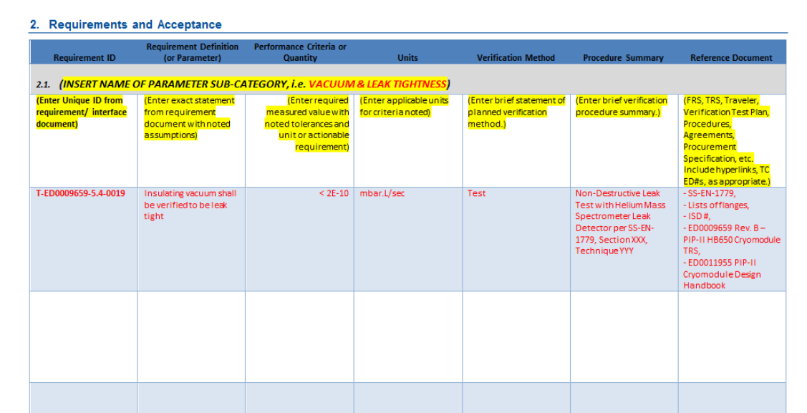
Verification Planning Tools
Acceptance Criteria Lists (ACL’s) Template:
PIP-II Acceptance Criteria Template Link
ACL’s provide an advanced formal approval process with IKC stakeholders which includes the actual details of the test procedures used for inspection and/or test. This could vary slightly between what the partner does and what FNAL does to test a performance criteria.
ACL’s will include ALL verifications needed for acceptance, including those which may be tied to interfaces and fabrication and may not be captured in the requirements metadata sheets.

Slide 10
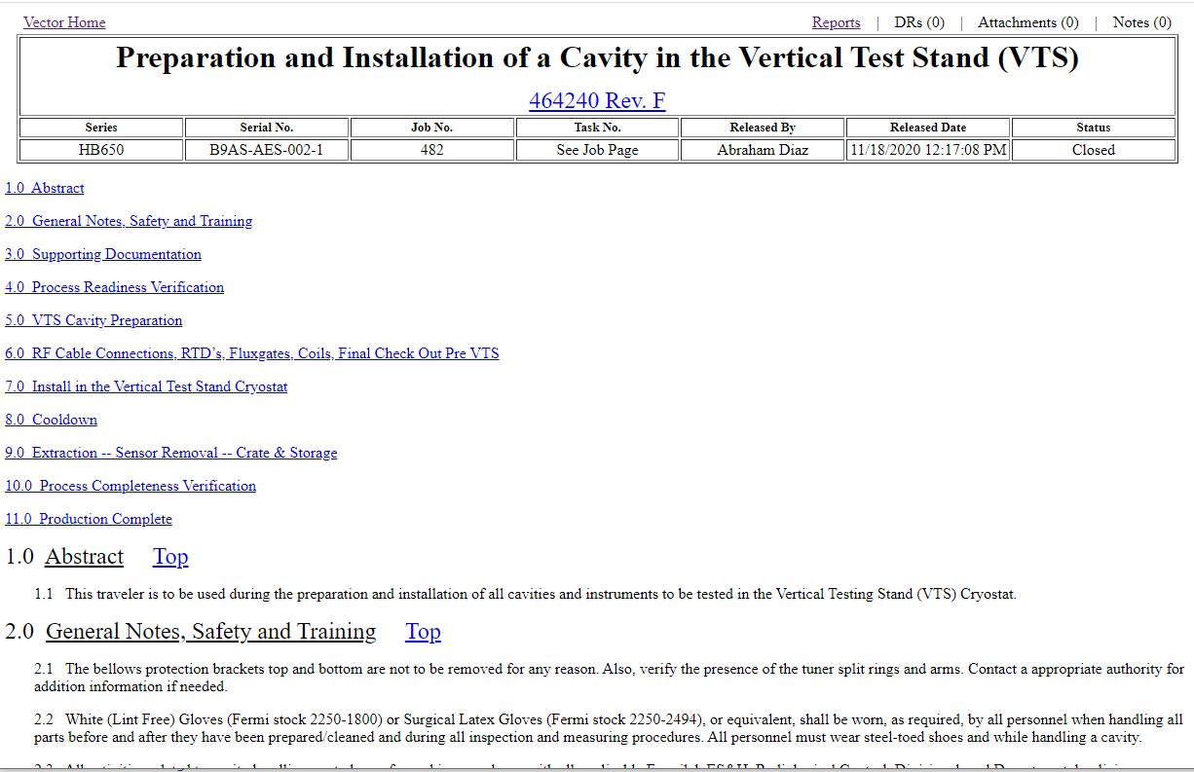
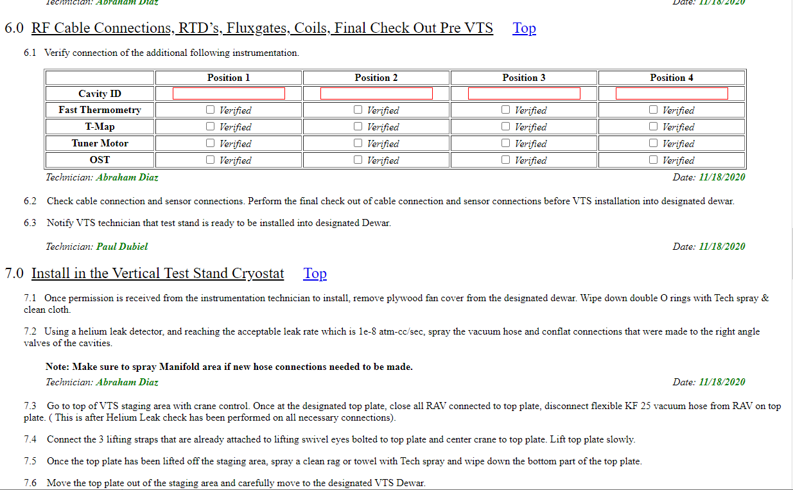
Verification Planning Tools
Traveler Templates & Vector Traveler System:
Travelers will be used to detail out the steps, procedures, or results of:
Fabrication, Assembly, and Installation
Inspections
Testing
Non-conformances and their associated Discrepancy Reports (DRs)

Slide 11
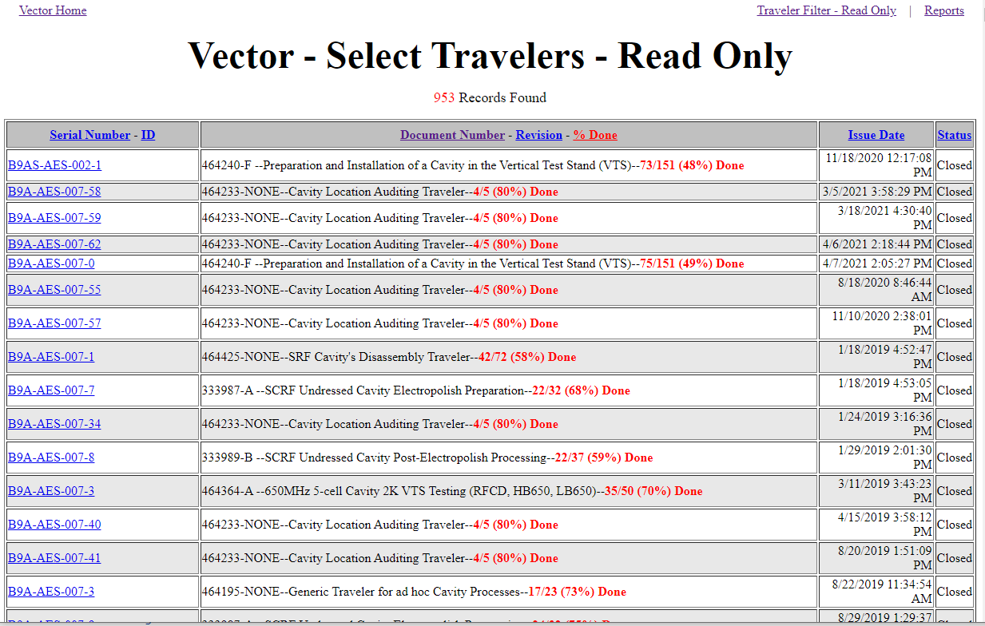
Verification Planning Tools
Traveler Templates & Vector Traveler System:
The Fermilab Vector Traveler System will be used for internal Fermilab PIP-II work and will import or upload all vendor and partner traveler information.

Slide 12
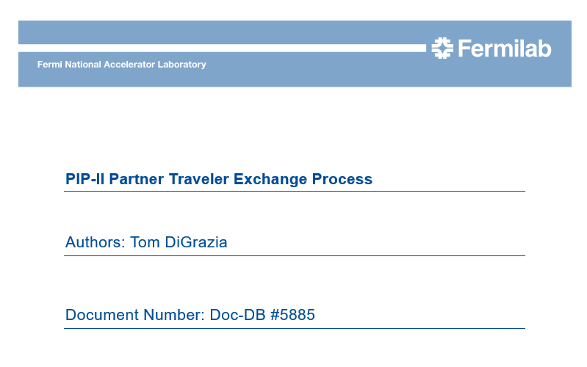
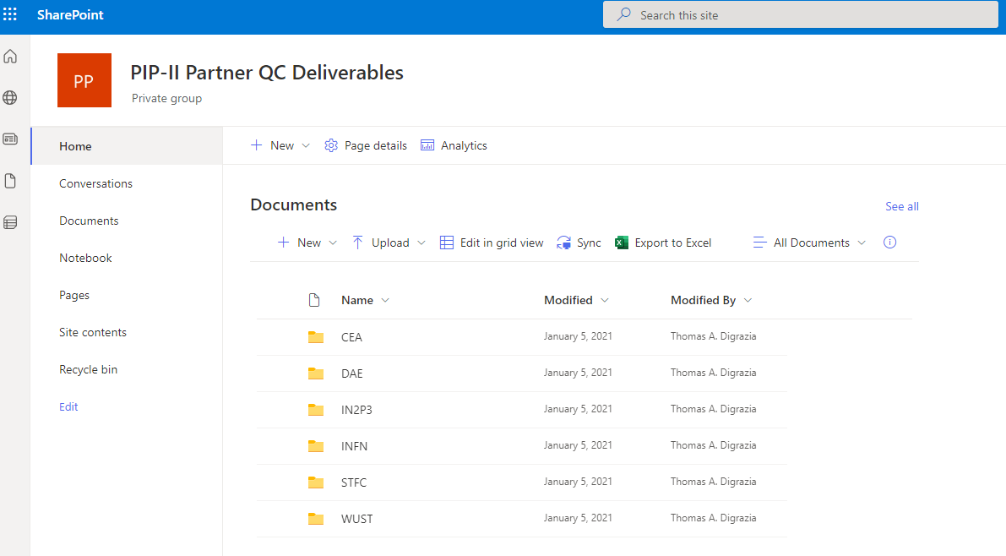
Verification Planning Tools
Partner Traveler Exchange:
Partner Travelers are uploaded to the SharePoint Online Site by the partners directly.
PIP-II Quality Engineer uploads the completed traveler to a corresponding Interface Traveler in the Fermilab Vector System & notifies the L3M & SPM.
DRAFT
Partner Traveler Exchange Process is expected to be used for the transfer of partner developed traveler information to FNAL. Working draft of this is available as PIP-II-doc-5885.

Slide 13
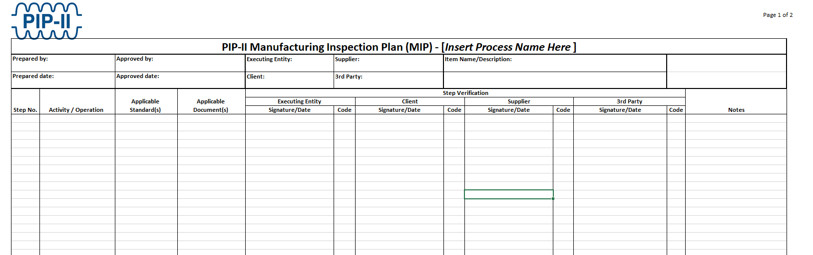
Verification Planning Tools
Manufacturing & Inspection Plans (MIPs):
MIPs are developed to ensure that inspection requirements are properly incorporated into fabrication processes. Some in-process inspections or verifications may be identified as acceptance criteria.

Slide 14
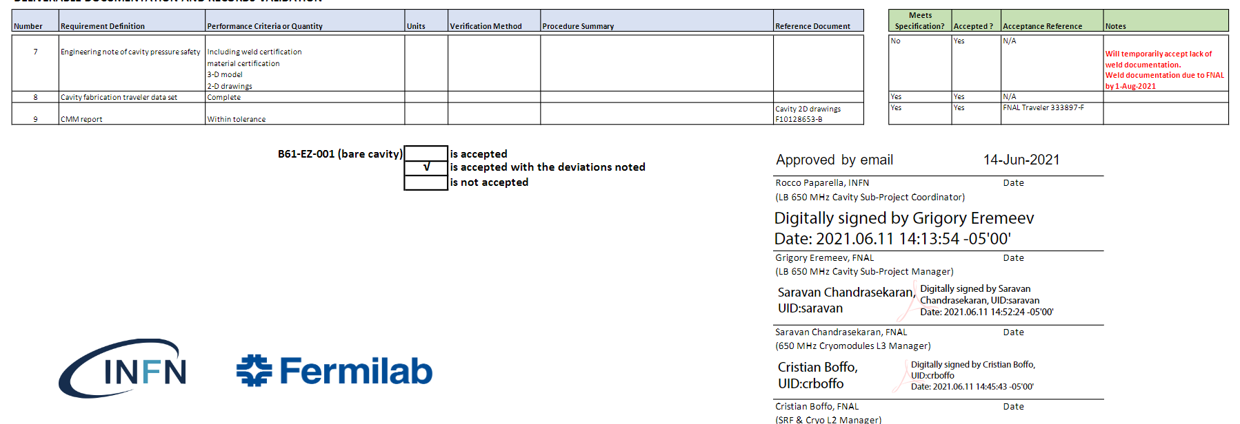
Acceptance Plans, Acceptance Criteria Templates, and ACLs
Acceptance Plan highlights critical stages, roles, & responsibilities of each institution.
Acceptance Criteria Document template identifies criteria details for acceptance. Requires approval and agreement by both institutions.
Acceptance Criteria Listing (ACL) collects results of the verifications specific to each serialized deliverable into a document format. ACL is the governing document facilitating equipment transfer.

Slide 15
Travelers vs. ACLs
Travelers:
Used to document information needed to identify processes related to inspection, testing, and fabrication, as well as to identify, report, correct, and trend nonconformances or situations adverse to quality performance. Also contain hold points for the SME/L3M to review and a handoff section for SME/L3M to review before the next step.
Acceptance Criteria List (ACL):
Governing document which identifies the acceptance criteria agreed upon between FNAL and the partner institution, the necessary verification procedures and processes, and the applicable verification results of the noted serialized component (as noted in the referenced traveler). The ACL facilitates acceptance of the final deliverable and certifies the serialized deliverable for higher level integration.

Slide 16
Verification Examples in the Project Life Cycle

Slide 17
All traveler template document #’s, verification doc #’s, and Acceptance Criteria doc #’s for all levels of production (prototype, First Article, or production units) are indexed in QC Plan.
FDR
PRR
MRR
IRR
L3/L4 System Final QC Plan
SAR 1,2
(Partner Deliverables)
L3 System FRS Requirement Verification Plan (FRS metadata sheet)
*FAI = First Article Inspection Unit
L3/L4 System TRS Requirement Verification Plan (TRS metadata sheet)
L3/L4 System FAI* Traveler Templates
L3/L4 FAI Unit Fabrication
L3/L4 FAI Testing & QC
L3/L4 System Interface Verification Plans
(ISD metadata sheet)
FAI Travelers
FAI Travelers
L3/L4 System Repeat Production Item Traveler Templates
L3/L4 Production Item Fabrication
L3/L4 Production Item Testing & QC
L3/L4 Production Item Fabrication
L3/L4 Production Item Testing & QC
L3/L4 System Fabrication Verification Plans
(MIP information or informal plans)
L3/L4 Production Item Fabrication
L3/L4 Production Item Testing & QC
Some information carried over for repeat production verifications
L3/L4 Production Item Fabrication
L3/L4 Production Item Testing & QC
L3/L4 Production Item Fabrication
L3/L4 Production Item Testing & QC
Production Travelers
Production Travelers
Production Travelers
Production Travelers
Production Travelers
Production Travelers
Acceptance Criteria Document provides template for ACL’s used with serialized component deliverables.
ACL consolidates Multi-Traveler results into single document for approval;
ACL = Governing Document which certifies deliverable for higher level integration or acceptance
Production Travelers
Production Travelers
Production Travelers
Production Travelers
L3/L4 Acceptance Criteria Document
Installation Deliverable List Document (IDL)

Slide 18
All traveler template document #’s, verification doc #’s, and Acceptance Criteria doc #’s for all levels of production (prototype, First Article, or production units) are indexed in QC Plan.
FDR
PRR
MRR
IRR
L3/L4 System Final QC Plan
SAR 1,2
(Partner Deliverables)
L3 System FRS Requirement Verification Plan (FRS metadata sheet)
*FAI = First Article Inspection Unit
FAI or prototype travelers will typically contain all the test/inspection/demonstration steps necessary to verify and qualify DESIGN and FABRICATION quality. If a prototype or FAI Unit is qualified, then some inspections/tests/demonstration may be deemed to be unnecessary to repeat (i.e. flow tests, thermal measurements, pressure rate of rise, etc.)
L3/L4 System TRS Requirement Verification Plan (TRS metadata sheet)
L3/L4 System FAI* Traveler Templates
L3/L4 FAI Unit Fabrication
L3/L4 FAI Testing & QC
L3/L4 System Interface Verification Plans
(ISD metadata sheet)
FAI Travelers
FAI Travelers
Production travelers will typically contain only the test/inspection/demonstration steps necessary to verify FABRICATION quality. These are a subset of verifications performed on the prototype or FAI unit.
L3/L4 System Repeat Production Item Traveler Templates
L3/L4 Production Item Fabrication
L3/L4 Production Item Testing & QC
L3/L4 Production Item Fabrication
L3/L4 Production Item Testing & QC
L3/L4 System Fabrication Verification Plans
(MIP information or informal plans)
L3/L4 Production Item Fabrication
L3/L4 Production Item Testing & QC
Some information carried over for repeat production verifications
L3/L4 Production Item Fabrication
L3/L4 Production Item Testing & QC
L3/L4 Production Item Fabrication
L3/L4 Production Item Testing & QC
Production Travelers
Production Travelers
Production Travelers
Production Travelers
Production Travelers
Production Travelers
Acceptance Criteria Document provides template for ACL’s used with serialized component deliverables.
ACL consolidates Multi-Traveler results into single document for approval;
ACL = Governing Document which certifies deliverable for higher level integration or acceptance
Production Travelers
Production Travelers
Production Travelers
Production Travelers
L3/L4 Acceptance Criteria Document
Installation Deliverable List Document (IDL)

Slide 19
Verification, Acceptance, & Handoff
CF Deliverables:
90% CCR
(FDR)
Submittal Review (MRR)
Product Fabrication, Verification, Acceptance, and Integration
AUP
(IRR)
PRR
IKC Deliverables:
Product Fabrication, Verification, Acceptance, and Integration
SAR 1,2
(Partner Deliverables)
FDR
PRR
MRR
IRR
LINAC Deliverables:
Product Fabrication, Verification, Acceptance, and Integration
FDR
PRR
MRR
IRR
Other Project Deliverables (AccU):
Product Fabrication, Verification, Acceptance, and Integration
System Integration
FDR
PRR
MRR

Slide 20
Verification, Acceptance, & Handoff - IKC Coupler Example
Draft process shown. Details of acceptance process still being finalized by Working Groups.
Partner Activities & Milestones
Product Fabrication, Verification, Acceptance, and Integration
SAR 1,2
(for CM assembly)
CM Integration & Linac Install Prep Steps
FDR
PRR
MRR
IRR
FDR for B.92 HB Coupler Before Production Procedure
PRR for HB650 Production Power Couplers (STFC/Fermilab)
MRR for HB650 Production Power Couplers (STFC/Fermilab)
Qty 20 (18 for CM #2-4 + 2 spares)
Coupler Phase 1
Coupler Phase 2
Coupler Phase 3
Coupler Phase 4

Slide 21
Verification, Acceptance, & Handoff - IKC Coupler Example
FDR for B.92 HB Coupler Before Production Procedure
ACL = Acceptance Criteria List
FDR
Draft process shown. Details of acceptance process still being finalized by Working Groups.
PRR for HB650 Production Power Couplers (STFC/Fermilab)
PRR
MRR for HB650 Production Power Couplers (STFC/Fermilab)
MRR
Phase 1 – Vendor Fabrication & ship
Phase 2 – FNAL QC & Ship
Phase 3 – STFC Incoming Inspection & QC
Production Coupler Fabrication (Qty 20?)
Production Coupler FNAL Incoming QC Inspection & Testing
L3M & Partner SPC approval of deliverables to ship
L3M & Partner SPC approval of deliverables for install
Production Coupler STFC Incoming QC Inspection & Testing
Approval to begin fabrication
Vendor Fabrication in-process QC (S/N 1-20)
FNAL Incoming Inspection Travelers (S/N 1-20)
STFC Incoming Inspection Travelers (S/N 1-20)
FNAL Conditioning Travelers (S/N 1-20)
L3M/SPC Approval Signoffs
STFC Insp & Test Travelers (S/N 1-20)
Report/Traveler Results
L3M/SPC Approval Signoffs
FNAL Test/Msmt. & Ship Prep Travelers (S/N 1-20)
L3/L4/SPC ACLs EDxxxx1-EDxxxx20
Results & Signoffs (S/N 1-20)
Traveler Results
L3/L4/SPC ACLs EDxxxx1-EDxxxx20
Results & Signoffs (S/N 1-20)
L3/L4/SPC ACLs EDxxxx1-EDxxxx20
Results & Signoffs (S/N 1-20)
Traveler Results
Traveler Results
Traveler Results
Traveler Results

Slide 22
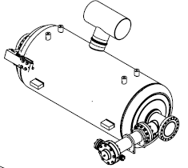
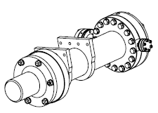
Verification, Acceptance, & Handoff - IKC Coupler Example
FDR for B.92 HB Coupler Before Production Procedure
ACL = Acceptance Criteria List
FDR
Draft process shown. Details of acceptance process still being finalized by Working Groups.
PRR for HB650 Production Power Couplers (STFC/Fermilab)
PRR
Realized product to higher level assembly
MRR for HB650 Production Power Couplers (STFC/Fermilab)
MRR
Phase 3 – STFC Incoming Inspection & QC
Phase 4 – STFC Installation QC
Coupler Phase 1
Coupler Phase 2
L3M & Partner SPC approval of deliverables for install
L3M & Partner SPC approval of installation
Production Coupler STFC Incoming QC Inspection & Testing
Production Coupler STFC Installation QC
STFC Incoming Inspection Travelers (S/N 1-20)
STFC Installation Travelers (S/N 1-20)
STFC Insp & Test Travelers (S/N 1-20)
L3M/SPC Approval Signoffs
L3M/SPC Approval Signoffs
Archive Documentation
Completed and approved ACLs submitted in TC repository for final approval workflows.
Traveler #’s and TC Documents to be indexed into HB650 CM 2-4 SAR1 packages.
L3/L4/SPC ACLs EDxxxx1-EDxxxx20
Results & Signoffs (S/N 1-20)
L3/L4/SPC ACLs EDxxxx1-EDxxxx20
Results & Signoffs (S/N 1-20)
Traveler Results
Traveler Results
Traveler Results
Completed ACL = Component Certification

Slide 23
Verification, Acceptance, & Handoff – IKC CM Example
Draft process shown. Details of acceptance process still being finalized by Working Groups.
Partner Activities & Milestones
Product Fabrication/Assembly, Verification, Acceptance, and Integration
SAR 1,2
(CM1)
Integration & Install Prep Steps
FDR
PRRs
MRRs
IRR
FDR for CM Before Production Procedure
Partner PRRs for HB650 Production CM Components (STFC/Fermilab)
Partner MRRs for HB650 Production CM Components (STFC/Fermilab)
Qty 3
CM1 Phase 1a-c (Beamline & Comp. Assy)
CM1 Phase 2
(Coldmass Assembly)
CM1 Phase 3 (Coldmass Insertion)
CM1 Phase 4 (Final CM Assembly)

Slide 24
Verification, Acceptance, & Handoff – IKC CM Example
ACL = Acceptance Criteria List
FDR for CM Before Production Procedure
Draft process shown. Details of acceptance process still being finalized by Working Groups.
FDR
Partner PRRs for HB650 Production CM Components (STFC/Fermilab)
PRRs
MRRs
Partner MRRs for HB650 Production CM Components (STFC/Fermilab)
Phase 1a-c – Partner Beamline & Component Assembly
Phase 2 – Partner Coldmass Assembly
Phase 3 – Partner Coldmass Insertion
Phase 4 – Partner Final CM Assembly
Production CM STFC Assembly & QC
Production CM STFC Coldmass Assembly & QC
Production CM STFC Coldmass Insertion & QC
Production CM STFC Final Assembly & QC
Approval to begin assembly
STFC BL Assy in-process QC
STFC Coldmass Assy & in-process QC
STFC Coldmass Insertion & in-process QC
STFC Assembly & in-process QC
Report/Traveler Results
SPC/SPM/L3M ACL EDxxxCM1
Results
SPC/SPM/L3M ACL EDxxxCM1
Results
SPC/SPM/L3M ACL EDxxxCM1
Results
SPC/SPM/L3M ACL EDxxxCM1
Results
Traveler Results
Traveler Results
Traveler Results

Slide 25
Verification, Acceptance, & Handoff – IKC CM Example
ACL = Acceptance Criteria List
FDR for CM Before Production Procedure
Draft process shown. Details of acceptance process still being finalized by Working Groups.
FDR
Partner PRRs for HB650 Production CM Components (STFC/Fermilab)
PRRs
MRRs
Partner MRRs for HB650 Production CM Components (STFC/Fermilab)
CM Phase 1
CM Phase 2
SAR 1
(CM1)
SAR 2
(CM1)
Integration & Install Prep Steps
CM Phase 3
L3M & Partner SPC approval to test at STFC
L3M & Partner SPC approval to ship to FNAL
L3M & Partner SPC final acceptance & title transfer
CM Phase 4
Production CM STFC Acceptance Testing
Production CM FNAL Incoming Inspection & Acceptance Testing
IRR
STFC Acceptance Testing & QC
FNAL Incoming Inspection Travelers
L3M/SPC Approval Signoffs
L3M/SPC Approval Signoffs
L3M/SPC Approval Signoffs
FNAL Final Acceptance Testing & QC
Archive Documentation
Completed and approved ACLs submitted in TC repository for final approval workflows.
Traveler #’s and TC Documents to be indexed into HB650 CM 2-4 SAR1 packages.
SPC/SPM/L3M ACL EDxxxCM1
Results & Signoffs (ACL1)
SPC/SPM/L3M ACL EDxxxCM1
Final Results & Signoffs (ACL 2 & 3)
SPC/SPM/L3M ACL EDxxxCM1
Results & Signoffs
Traveler Results
Completed ACL = Component Certification

Slide 26
Acceptance Documentation – Summary & Path Forward
Specifications: Partner SPCs to send email concurrence notice for each Technical Requirement Specification & Interface Specification Document for their deliverable to Fermilab SPMs. Concurrence uploaded to Teamcenter item.
Acceptance Plans: Finalize all Partner Acceptance Plans by the next DOE Independent Project Review in Q2 FY2023 (Feb/Mar 2023)
Final means: Approved/signed by Project Director and Partner Technical Coordinator
Acceptance Criteria: Partner SPMs work with SPCs and other technical stakeholders to align acceptance criteria and verification methods to Technical Requirement Specifications and other specification documents. There’s significant effort to prepare these documents based on recent history with the UKRI and CEA cryomodules.
Traveler Templates: PIIP-II Quality Engineers will work with partners to finalize details of Traveler exchange process. Partner travelers should flag acceptance criteria results for integration into the FNAL PIP-II Vector Traveler System DB.

Slide 27
Questions & Open Discussion

Slide 28
Questions to Partners
Immediate questions from audience
Discussion Questions:
Do SPCs know how to find documents?
Are the document deliverables achievable for the noted milestones?
Are there any gaps in the process? (i.e. missing stakeholders, missing information, etc.)

Slide 29
Partner Reference Documentation

Slide 30
CEA Relevant Documents
All Documents not under development are Released in Team Center as of 7/12/2022
LB650 Pre-Production Cyromodule
PIP-II LB650 Cryomodule FRS Rev. C (ED0001830)
LB650 Cryomodule TRS Rev. C (ED0009658)
Order Form: Assembly 1.5 Cell 650 MHz Rev. - (ED0007561)
Cryomodule: 650 MHz B 0.61 4-Cavity EPDM Rev. - (ED0001254)
PIP-II LB650 CM Acceptance Plan Rev. – (Under Development) (ED0011981)
PIP-II LB650 CM Acceptance Criteria Rev. – (Under Development) (ED0011982)
LB650 Cryomodule
PIP-II LB650 Cryomodule FRS Rev. C (ED0001830)
LB650 Cryomodule TRS Rev. C (ED0009658)
Order Form: Assembly 1.5 Cell 650 MHz Rev. - (ED0007561)
Production Cryomodule EPDM (Under Development)
PIP-II LB650 CM Acceptance Plan Rev. – (Under Development) (ED0011981)
PIP-II LB650 CM Acceptance Criteria Rev. – (Under Development) (ED0011982)

Slide 31
INFN Relevant Documents
All Documents not under development are Released in Team Center as of 7/12/2022
LB650 Pre-Production Cyromodule Cavities
PIP-II LB650 Cryomodule FRS Rev. C (ED0001830)
LB650 Cryomodule TRS Rev. C (ED0009658)
LB650 Internal ICD and ISD Rev. - (ED0011092)
PIP-II LB650 MHz Bare Cavity Manufacturing Specification Rev. A (ED0011699)
PIP-II 650 MHz Beta=0.61 Cavity and Helium Vessel Integration Specification Rev. - (ED0011869)
PIP-II SRF LB650 Jcav Acceptance Plan Rev. - (Under Development) (ED0011871)
PIP-II SRF LB650 Jcav Acceptance Criteria Rev. - (ED0011872)
PIP-II LB650 Jacketed Cavity Acceptance Criteria (Under Development) (ED0013428)
LB650 Cryomodule Jacketed Cavities
PIP-II LB650 Cryomodule FRS Rev. C (ED0001830)
LB650 Cryomodule TRS Rev. C (ED0009658)
LB650 Internal ICD and ISD Rev. - (ED0011092)
PIP-II 650 MHz Beta=0.61 Cavity and Helium Vessel Integration Specification Rev. - (ED0011869)
PIP-II SRF LB650 Jcav Acceptance Plan Rev. - (Under Development) (ED0011871)
PIP-II SRF LB650 Jcav Acceptance Criteria Rev. - (ED0011872)

Slide 32
UKRI Relevant Documents All Documents not under development are Released in Team Center as of 7/12/2022
HB650 Cryomodules
650 MHz, Beta .92 Cryomodule FRS Rev D (ED0001322)
PIP-II HB650 Cryomodule TRS Rev B (ED0009659)
ISD Prototype HB650 Cryomodule Rev A (ED0007562)
Production Cryomodule EPDM (Under Development)
PIP-II HB650 Cryomodule Acceptance Plan Rev. - (ED0010601)
PIP-II HB650 CM Acceptance Criteria (Under Development) (ED0011978)
HB650 Jacketed Cavities
650 MHz, Beta .92 Cryomodule FRS Rev D (ED0001322)
PIP-II HB650 Dressed Cavity TRS Rev. - (ED00013631)
PIP-II-L3 Internal Interfaces HB650 Rev. - (ED0011227)
PIP-II HB650 Cryomodule Acceptance Plan – UKRI Rev. -(ED0010601)
UKRI HB650 CM Acceptance Criteria Rev. – (Under Development) (ED0011978)
HB650 Couplers
650 MHz, Beta .92 Cryomodule FRS Rev D (ED0001322)
PIP-II HB650 Dressed Cavity TRS Rev. - (ED00013631)
PIP-II-L3 Internal Interfaces HB650 Rev. - (ED0011227)
PIP-II HB650 Cryomodule Acceptance Plan – UKRI Rev. -(ED0010601)
PIP-II HB650 prod RF coupler Acceptance Criteria Rev. – (Under Development) (ED0011990)
HB650 Tuners
650 MHz, Beta .92 Cryomodule FRS Rev D (ED0001322)
PIP-II HB650 Dressed Cavity TRS Rev. - (ED00013631)
PIP-II-L3 Internal Interfaces HB650 Rev. - (ED0011227)
PIP-II HB650 Cryomodule Acceptance Plan – UKRI Rev. -(ED0010601)
UKRI HB650 CM Acceptance Criteria Rev. – (Under Development) (ED0011978)

Slide 33
CNRS Relevant Documents
All Documents not under development are Released in Team Center as of 7/12/2022
SSR2 Pre-Production Jacketed Cavities/Couplers/Tuners
PIP-II SSR2 Cryomodule FRS Rev D (Under Development) (ED0001829)
PIP-II SSR2 Cavity Coupler and Tuner TRS Rev B (ED0009784)
PIP-II Pre-production SSR2 Cryomodule, Internal ISD Rev. – (ED0011023)
Proto SSR2 Cryomodule 325 MHz B .47 EPDM Rev – (Under Development) (ED0001257)
PIP-II Prod SSR2 Acceptance Plan Rev – (Under Development) (ED0011963)
PIP-II SRF SSR2 Production Acceptance Criteria – IN2P3 Rev – (Under Development) (ED0011898)
SSR2 Jacketed Cavities/Couplers/Tuners
PIP-II SSR2 Cryomodule FRS Rev D (Under Development) (ED0001829)
PIP-II Production SSR2 Cavity Coupler and Tuner TRS Rev - (ED0013795)
PIP-II Pre-production SSR2 Cryomodule, Internal ISD Rev. – (ED0011023)
PIP-II Production SSR2 EPDM Rev – (Under Development) (ED0011912)
PIP-II Prod SSR2 Acceptance Plan Rev – (Under Development) (ED0011963)
PIP-II Prod SSR2 Acceptance Criteria – IN2P3 Rev – (Under Development) (ED0011964)

Slide 34
DAE – BARC Relevant Documents All Documents not under development are Released in Team Center as of 7/12/2022
Cryoplant
PIP-II Cryogenic Plant FRS Rev. C (ED0003531)
PIP-II Cryogenic Plant TRS Rev. A (ED0010521)
Cryo Plant Specifications Rev. A (ED0005493)
PIP- II Cryoplant ISD Rev. A (ED0011884)
PIP-II DAE Deliverables Acceptance Plan Rev. – (Under Development) (ED0011957)
PIP-II Cryoplant Acceptance Criteria Rev. – (Under Development) (ED0011886)
SSR1 Prototype Cavity and He Vessel
PIP-II SSR1 325 MHz Cryomodule FRS Rev C (ED0001316)
PIP-II SSR1 Prototype Cryomodule TRS Rev. -(ED0009534)
Manufacturing Specification for SSR1 Superconducting Single Spoke Resonators Rev. C (ED0371029)
SSR1 Prototype Tuner
PIP-II SSR1 325 MHz Cryomodule FRS Rev. C (ED0001316)
PIP-II SSR1 Prototype Cryomodule TRS Rev. -(ED0009534)
SSR1 Cryomodule 325 MHz B .22 EPDM Rev. - (ED0001256)
SSR1 Jacketed Cavities
PIP-II Production SSR1 FRS Rev. - (ED0011838)
PIP-II Production SSR1 Cavity, Coupler, Tuner TRS Rev. – (ED0011909)
PIP II SSR1 Internal ICD and ISD Rev. – (Under Development) (ED0011405)
PIP-II SSR1 Production Cryomodule EPDM Rev. – (Under Development) (ED0011856)
PIP-II SSR1 Production Cavity Acceptance Plan Rev. – (Under Development) (ED0012002)
PIP-II SSR1 Production Cavity Acceptance Criteria Rev. – (Under Development) (ED0012003)
SSR1 Tuner
PIP-II Production SSR1 FRS Rev. - (ED0011838)
PIP-II Production SSR1 Cavity, Coupler, Tuner TRS Rev. – (ED0011909)
PIP II SSR1 Internal ICD and ISD Rev. – (Under Development) (ED0011405)
PIP-II SSR1 Production Cryomodule EPDM Rev. – (Under Development) (ED0011856)
PIP-II 650 MHz 70 kW SSA Acceptance Criteria – DAE/RRCAT Rev. – (Under Development) (ED0011961)
PIP-II Prod SSR2 Cryomodule Acceptance Criteria – DAE/BARC Rev. – (Under Development) (ED0011962)

Slide 35
DAE – BARC Relevant Documents cont. All Documents not under development are Released in Team Center as of 7/12/2022
SSR1 SC Solenoids
PIP-II Production SSR1 FRS Rev. - (ED0011838)
PIP-II TRS SSR1 SSR2 Production Focusing Lens and Current Leads Rev. – (ED0013800)
PIP-II SSR2 Solenoid ISD – DAE/BARC Rev. – (Under Development) (ED0011960)
PIP-II Production SSR2 Solenoid Fab Spec (Under Development) (ED0011935)
PIP-II 650 MHz 70 kW SSA Acceptance Criteria – DAE/RRCAT Rev. – (Under Development) (ED0011961)
PIP-II Prod SSR2 Cryomodule Acceptance Criteria – DAE/BARC Rev. – (Under Development) (ED0011962)
SSR2 Pre-Production Jacketed Caveties/Couplers/Tuners
PIP-II SSR2 Cryomodule FRS Rev D (Under Development) (ED0001829)
PIP-II SSR2 Cavity Coupler and Tuner TRS Rev B (ED0009784)
PIP-II Pre-production SSR2 Cryomodule, Internal ISD Rev. – (ED0011023)
Proto SSR2 Cryomodule 325 MHz B .47 EPDM Rev – (Under Development) (ED0001257)
PIP-II DAE Deliverables Acceptance Plan Rev - (Under Development) (ED0011957)
PIP-II Pre-Prod SSR2 Acceptance Criteria Rev – (Under Development) (ED0011958)
SSR2 Pre-Production SC Solenoids
PIP-II SSR2 Cryomodule FRS Rev D (Under Development) (ED0001829)
Focusing Lens for SSR1 and SSR2 Rev. – (ED0011214)
PIP-II Pre-Production SSR2 Cryomodule Internal ISD Rev. – (ED0011023)
PIP-II Production SSR2 Solenoid Fab Spec (Under Development) (ED0011935)
PIP-II DAE Deliverables Acceptance Plan Rev - (Under Development) (ED0011957)
PIP-II Pre-Prod SSR2 Acceptance Criteria Rev – (Under Development) (ED0011958)
SSR2 Cryomodule
PIP-II SSR2 Cryomodule FRS Rev D (Under Development) (ED0001829)
PIP-II Production SSR2 Cryomodule TRS Rev – (ED0011910)
PIP-II Production SSR2 – External ISD (Under Development) (ED0011911)
PIP-II Production SSR2 EPDM (Under Development) (ED0011912)
PIP-II DAE Deliverables Acceptance Plan Rev - (Under Development) (ED0011957)
PIP-II Pre-Prod SSR2 Acceptance Criteria Rev – (Under Development) (ED0011958

Slide 36
DAE – BARC Relevant Documents cont. All Documents not under development are Released in Team Center as of 7/12/2022
SSR2 Jacketed Cavities/Couplers/Tuners
PIP-II SSR2 Cryomodule FRS Rev D (Under Development) (ED0001829)
PIP-II Production SSR2 Cavity Coupler and Tuner TRS Rev – (ED0013795)
PIP-II Pre-production SSR2 Cryomodule Internal ISD Rev – (ED0011023)
PIP-II Production SSR2 EPDM Rev - (Under Development) (ED0011912)
PIP-II DAE Deliverables Acceptance Plan Rev - (Under Development) (ED0011957)
SSR2 SC Solenoids
PIP-II SSR2 Cryomodule FRS Rev D (Under Development) (ED0001829)
PIP-II TRS SSR1 SSR2 Production Focusing Lens and Current Leads Rev -(ED0013800)
PIP-II Pre-production SSR2 Cryomodule Internal ISD Rev – (ED0011023)
PIP-II Production SSR2 Solenoid Fab Spec Rev – (ED0011935)
PIP-II DAE Deliverables Acceptance Plan Rev - (Under Development) (ED0011957)
PIP-II Prod SSR2 Cryomodule Acceptance Criteria – DAE/BARC (Under Development) (ED0011962)
LB650 Pre-Production Couplers
650 MHz Coupler FRS Rev A (ED0003645)
PIP-II LB650 Dressed Cavity TRS Rev – (ED0013630)
PIP-II LB650 Internal ICD and ISD Rev – (ED0011092)
PIP-II 650 MHz RF Coupler Fabrication Specification Rev – (Under Development) (ED0011984)
PIP-II DAE Deliverables Acceptance Plan Rev - (Under Development) (ED0011957)
PIP-II LB650 prod DCAV Acceptance Criteria DAE Rev – (Under Development) (ED0011986)
LB650 Couplers
650 MHz, Beta .61 Cryomodule, 4 Cavities, FRS Rev C (ED0001830)
PIP-II LB650 Dressed Cavity TRS Rev – (ED0013630)
PIP-II LB650 Internal ICD and ISD Rev – (ED0011092)
PIP-II 650 MHz RF Coupler Fabrication Specification Rev – (Under Development) (ED0011984)
PIP-II DAE Deliverables Acceptance Plan Rev - (Under Development) (ED0011957)
PIP-II LB650 prod DCAV Acceptance Criteria DAE Rev – (Under Development) (ED0011986)

Slide 37
DAE – BARC Relevant Documents cont. All Documents not under development are Released in Team Center as of 7/12/2022
LB650 Tuners
650 MHz, Beta .61 Cryomodule, 4 Cavities, FRS Rev C (ED0001830)
PIP-II LB650 Dressed Cavity TRS Rev – (ED0013630)
PIP-II LB650 Internal ICD and ISD Rev – (ED0011092)
PIP-II LB650 Tuner Fabrication Specification Rev – (Under Development) (ED0011983)
PIP-II DAE Deliverables Acceptance Plan Rev - (Under Development) (ED0011957)
PIP-II LB650 prod DCAV Acceptance Criteria DAE Rev – (Under Development) (ED0011986)
HB650 Couplers
PIP-II HB650 Cryomodule FRS Rev D (Under Development) (ED0001322)
PIP-II HB650 Dressed Cavity TRS Rev – (ED0013631)
PIP-II L3 Internal Interfaces HB650 Rev – (ED00112277)
PIP2IT Magnets
MEBT Quad Magnet FRS Rev – (ED0001312)
PXIE MEBT and HEBT Quadrupoles and Dipole Correctors TRS Rev – (ED0003467)
HPRF 325 MHz-7kW SSAs (SSR1)
PIP-II RF Power Systems L3 FRS Rev A (Under Development) (ED0008023)
325 MHz Solid State 7kW Amplifier FRS Rev B (ED0003408)
7 kW RF Power Amplifier TRS Rev E (ED0004290)
325 MHz 7kW Solid State RFPA ISD Rev A (ED0006356)
PIP-II DAE Deliverables Acceptance Plan Rev - (Under Development) (ED0011957)
PIP-II 325 MHz 7kW SSA Acceptance Criteria Rev - (Under Development) (ED0012006)
HPRF 325 MHz-20kW SSAs (SSR2)
PIP-II RF Power Systems L3 FRS Rev A (Under Development) (ED0008023)
325 MHz Solid State 20 kW Amplifier FRS Rev – (ED0003669)
PIP-II 325 MHz 20 kW RF Power Amplifier TRS Rev B (ED0010994)
PIP-II 325 MHz 20 kW RF Power Amplifier ISD Rev - (Under Development) (ED0010992)
PIP-II DAE Deliverables Acceptance Plan Rev - (Under Development) (ED0011957)
PIP-II 650 MHz 20 kW SSA Acceptance Criteria Rev – (Under Development) (ED0011889)

Slide 38
DAE – BARC Relevant Documents cont. All Documents not under development are Released in Team Center as of 7/12/2022
PIP-II Magnets
MEBT Quad Magnet FRS Rev – (ED0001312)
PXIE MEBT and HEBT Quadrupoles and Dipole Correctors TRS Rev – (ED0003467)
PIP-II DAE Deliverables Acceptance Plan Rev - (Under Development) (ED0011957)
PIP-II Magnets Acceptance Criteria Rev – (Under Development) (ED0011888)
650 MHz Warm Unit Magnets (Quads + Correctors)
PIP-II Warm Magnets: FRS Rev - (ED0003403)
PIP-II Warm Magnets: TRS Rev A (ED0003441)
PIP-II Linac Warm Magnet ISD Rev – (ED0013224)
ICD Warm Unit Model/Drawing (F10105038)
PIP-II DAE Deliverables Acceptance Plan Rev - (Under Development) (ED0011957)
PIP-II 650 MHz Warm Magnet Acceptance Criteria Rev – (Under Development) (ED0011961)
RFPI – STC
RF Protection Interlocks Document FRS Rev A (ED0005729)
RF Interlocks TRS Rev B (Under Development) (ED0006125)
RFPI Software Requirements Rev – (ED0011255)
RFPI Firmware Requirements Rev – (ED0011250)
PIP-II RFPI ISD for STC Rev – (Under Development) (ED0011991)
PIP-II DAE Deliverables Acceptance Plan Rev - (Under Development) (ED0011957)
PIP-II LLRF and RFPI Acceptance Criteria Rev – (Under Development) (ED0012007)
RFPI SSR1 CM
RF Protection Interlocks Document FRS Rev A (ED0005729)
RF Interlocks TRS Rev B (Under Development) (ED0006125)
RFPI Software Requirements Rev – (ED0011255)
RFPI Firmware Requirements Rev – (ED0011250)
RFPI ISD for SSR1 CM Rev – (Under Development) (ED0011992)
PIP-II DAE Deliverables Acceptance Plan Rev - (Under Development) (ED0011957)
PIP-II LLRF and RFPI Acceptance Criteria Rev – (Under Development) (ED0012007)

Slide 39
DAE – BARC Relevant Documents cont. All Documents not under development are Released in Team Center as of 7/12/2022
RFPI SSR2 CM
RF Protection Interlocks Document FRS Rev A (ED0005729)
RF Interlocks TRS Rev B (Under Development) (ED0006125)
RFPI Software Requirements Rev – (ED0011255)
RFPI Firmware Requirements Rev – (ED0011250)
PIP-II RFPI ISD for SSR2 CM Rev – (Under Development) (ED0011993)
PIP-II DAE Deliverables Acceptance Plan Rev - (Under Development) (ED0011957)
PIP-II LLRF and RFPI Acceptance Criteria Rev – (Under Development) (ED0012007)
RFPI HB650 CM
RF Protection Interlocks Document FRS Rev A (ED0005729)
RF Interlocks TRS Rev B (Under Development) (ED0006125)
RFPI Software Requirements Rev – (ED0011255)
RFPI Firmware Requirements Rev – (ED0011250)
PIP-II RFPI ISD for HB650 CM Rev – (Under Development) (ED0011997)
PIP-II DAE Deliverables Acceptance Plan Rev - (Under Development) (ED0011957)
PIP-II LLRF and RFPI Acceptance Criteria Rev – (Under Development) (ED0012007)
LLRF STC/SSR1 CM/SSR2 CM/HB650 CM
PIP-II LLRF L3 FRS Rev B (Under Development) (ED0004194)
LLRF PIP-II FRS Firmware Rev – (Under Development) (ED0005198)
LLRF PIP-II TRS Software Rev – (Under Development) (ED0005199)
LLRF PIP-II TRS Master Oscillator and Precision Reference Rev – (ED0005164)
LLRF PIP-II TRS Controller Chassis Rev – (ED0005793)
LLRF PIP-II TRS SRF Resonance Control Rev - (Under Development) (ED0005782)
LLRF PIP-II TRS 4-Channel Upconverter Rev – (ED0005163)
LLRF PIP-II TRS 8-Channel Downconverter Rev – (ED0005166)
LLRF PIP-II TRS ADC DAC Mezzanine Board Rev – (Under Development) (ED0011279)
LLRF PIP-II TRS FPGA Board Rev- (Under Development) (ED0011278)
PIP-II LLRF Station ISD Rev – (Under Development) (ED0012004)
PIP-II DAE Deliverables Acceptance Plan Rev - (Under Development) (ED0011957)
PIP-II LLRF and RFPI Acceptance Criteria Rev – (Under Development) (ED0012007

Slide 40
DAE – BARC Relevant Documents cont. All Documents not under development are Released in Team Center as of 7/12/2022
Resonance Control STC/SSR1 CM/SSR2 CM/ HB650 CM
PIP-II LLRF L3 FRS Rev B (Under Development) (ED0004194)
LLRF PIP-II TRS Master Oscillator and Precision Reference Rev – (ED0005164)
LLRF PIP-II TRS Controller Chassis Rev – (ED0005793)
LLRF PIP-II TRS SRF Resonance Control Rev - (Under Development) (ED0005782)
LLRF PIP-II TRS 4-Channel Upconverter Rev – (ED0005163)
LLRF PIP-II TRS 8-Channel Downconverter Rev – (ED0005166)
LLRF PIP-II TRS ADC DAC Mezzanine Board Rev – (Under Development) (ED0011279)
LLRF PIP-II TRS FPGA Board Rev- (Under Development) (ED0011278)
PIP-II LLRF Resonance Control ISD Rev – (Under Development) (ED0012005)
PIP-II DAE Deliverables Acceptance Plan Rev - (Under Development) (ED0011957)
PIP-II LLRF and RFPI Acceptance Criteria Rev – (Under Development) (ED0012007

Slide 41
DAE VECC Relevant Documents All Documents not under development are Released in Team Center as of 7/12/2022
LB650 Pre-Production Jacketed Caveties
PIP-II LB650 Cryomodule FRS Rev. C (ED0001830)
PIP-II LB650 Dressed Cavity TRS Rev – (ED0013630)
LB650 Internal ICD and ISD Rev. - (ED0011092)
PIP-II LB650 MHz Bare Cavity Manufacturing Specification Rev. A (ED0011699)
PIP-II LB650 Jacketed Cavity Fabrication Spec – DAE Rev – (Under Development) (ED0011985)
PIP-II DAE Deliverables Acceptance Plan Rev - (Under Development) (ED0011957)
PIP-II LB650 prod DCAV Acceptance Criteria – DAE Rev – (Under Development) (ED0011986)
LB650 Pre-Production Tuners
PIP-II LB650 Cryomodule FRS Rev. C (ED0001830)
PIP-II LB650 Dressed Cavity TRS Rev – (ED0013630)
LB650 Internal ICD and ISD Rev. - (ED0011092)
PIP-II HB650 Tuner Fabrication Specification Rev – (Under Development) (ED0011989)
PIP-II LB650 Tuner Fabrication Specification –DAE Rev – (Under Development) (ED0011983)
PIP-II DAE Deliverables Acceptance Plan Rev - (Under Development) (ED0011957)
PIP-II LB650 prod DCAV Acceptance Criteria – DAE Rev – (Under Development) (ED0011986)
LB650 Jacketed Cavities
PIP-II LB650 Cryomodule FRS Rev. C (ED0001830)
PIP-II LB650 Dressed Cavity TRS Rev – (ED0013630)
LB650 Internal ICD and ISD Rev. - (ED0011092)
PIP-II LB650 Jacketed Cavity Fabrication Spec – DAE Rev – (Under Development) (ED0011985)
PIP-II DAE Deliverables Acceptance Plan Rev - (Under Development) (ED0011957)
PIP-II LB650 prod DCAV Acceptance Criteria – DAE Rev – (Under Development) (ED0011986)

Slide 42
DAE RRCAT Relevant Documents All Documents not under development are Released in Team Center as of 7/12/2022
HB650 Proto Jacketed Cavities/ Tuners
650 MHz Beta .92 Cryomodule FRS Rev D (Under Development) (ED0001322)
PIP-II HB650 Dressed Cavity TRS Rev – (ED0013631)
PIP-II – L3 Internal Interfaces HB650 Rev – (ED0011227)
HB650 Cryomodule
650 MHz Beta .92 Cryomodule FRS Rev D (Under Development) (ED0001322)
PIP-II HB650 Cryomodule TRS Rev B (ED0009659)
ISD Prototype HB650 Cryomodule Rev A (ED0007562)
PIP-II DAE Deliverables Acceptance Plan Rev - (Under Development) (ED0011957)
PIP-II HB650 prod CM Acceptance Criteria – DAE Rev – (Under Development) (ED0011988)
HB 650 Cavities/ Couplers/ Tuners
650 MHz Beta .92 Cryomodule FRS Rev D (Under Development) (ED0001322)
PIP-II HB650 Dressed Cavity TRS Rev – (ED0013631)
PIP-II L3 Internal Interfaces HB650 Rev – (ED0011227)
PIP-II DAE Deliverables Acceptance Plan Rev - (Under Development) (ED0011957)
PIP-II HB650 prod CM Acceptance Criteria – DAE Rev – (Under Development) (ED0011988)
650 MHz – 40 kW TI Test Stand SSAs/ 40 kW SSAs
PIP-II RF Power Systems FRS Rev A (Under Development) (ED0008023)
650 MHz Solid State 40 kW Amplifier FRS Rev B (ED0003413)
TRS 40 kW 650 MHz Solid State RF Power Amplifier System Rev C (ED0005489)
650 MHz 40 kW RFPA ICD Rev A (Under Development) (ED0006360)
PIP-II DAE Deliverables Acceptance Plan Rev - (Under Development) (ED0011957)
PIP-II 650 MHz 40 kW SSA Acceptance Criteria Rev – (Under Development) (ED0011887)
650 MHz – 70 kW SSAs
PIP-II RF Power Systems FRS Rev A (Under Development) (ED0008023)
650 MHz Solid State 70 kW Amplifier FRS Rev - (ED0003680)
PIP-II 650 MHz 70 kW RF Power Amplifier TRS Rev B (ED0010996)
PIP-II 650 MHz 70 kW RF Power Amplifier ISD Rev – (Under Development) (ED0010997)
PIP-II DAE Deliverables Acceptance Plan Rev - (Under Development) (ED0011957)
PIP-II 650 MHz 70 kW SSA Acceptance Criteria Rev – (Under Development) (ED0011961)
Cryostat
Neutron Veto P&ID Rev – (ED0001375)
HTS-2 TRS Rev A (Under Development) (ED0002154)

Slide 43
WUST Relevant Documents All Documents not under development are Released in Team Center as of 7/12/2022
CDS Distribution Valve Box
PIP-II Cryogenics Distribution System FRS Rev – (ED0008022)
PIP-II CDS DVB Deliverable Specification Rev – (Under Development) (ED0011878)
PIP-II Cryogenics Distribution System ISD Rev B (ED0007572)
PIP-II CDS TTL DVB Acceptance Plan Rev – (Under Development) (ED0011881)
PIP-II CDS –DVB Acceptance Criteria Rev – (Under Development) (ED0011980)
CDS Tunnel Transfer Line Modules
PIP-II Cryogenics Distribution System FRS Rev – (ED0008022)
CDS – TTL Deliverables Specification Rev – (Under Development) (ED0011879)
PIP-II Cryogenics Distribution System ISD Rev B (ED0007572)
PIP-II CDS TTL DVB Acceptance Plan Rev – (Under Development) (ED0011881)
PIP-II – CDS TTL Acceptance Criteria Rev – (Under Development) (ED0012415)

