Slide 1
STFC HB650 Coupler procurement status
Anna Shabalina
2nd PIP-II Technical workshop
14 July 2022

Slide 2
Task | Scheduled date PPD | Scheduled date NOW
FDR | October 2021 Originally part of the cavity/cryomodule FDR | July-August 2022
PRR | November 2021 | September - October 2022
MRR | May 2022 | February 2023
Delivery of batch 1 | March 2023 | January 2024
Acceptance of batch 1 | April 2023 | February 2024
Delivery of batch 2 | July 2023 | May 2024
Acceptance of batch 2 | August 2023 | June 2024
Delivery of batch 3 | November 2023 | August 2024
Acceptance of batch 3 | November 2023 | September 2024
FDR delay from February 2022– 115 days
Drafting STFC document – 10 days
FNAL review – 5 days
Finalizing documents – 15 days
FNAL

Slide 3
String assembly needs
Task | Scheduled date PPD | Scheduled date NOW | Needed by
Testing complete batch 1 |  | May 2024
Delivered to STFC batch 1 | November 2023 | June 2024 | June 2024
Testing complete batch 2 |  | September 2024
Delivered to STFC batch 2 | March 2024 | October 2024 | October 2024
Testing complete batch 3 |  | November 2024
Delivered to STFC batch 3 | May 2024 | January 2025 | January 2025
String 1 | December 2023
String 2 | April 2024
String 3 | June 2024
New dates are strangely aligned,
Thanks to the cavity delays.
PRELIMINARY

Slide 4
Market Survey?
(Discussion)

Slide 5
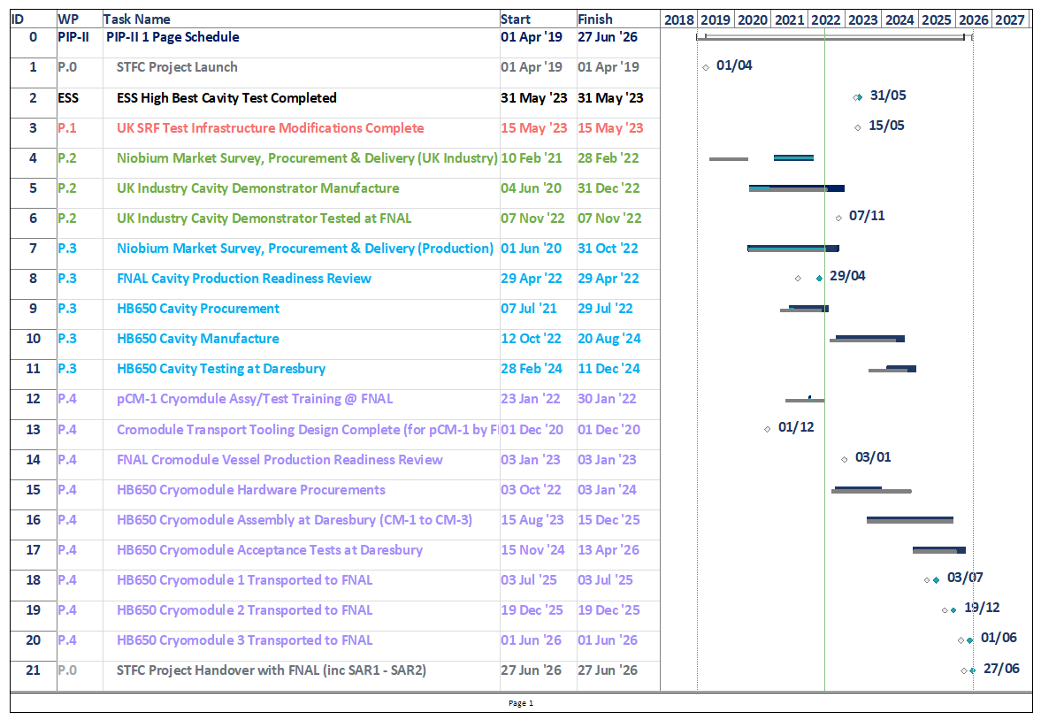
PIP-II Cryomodule Delivery Plan
Grey bars = Jan 22 Plan
Dark blue bars = Jun 22 Plan
White diamonds = Jan 22 m/s
Green diamonds = Jun 22 m/s
Key messages
Aggregate delay > 6 months
Primary drivers:
Nb material quality (12-mo) – OTIC (China).
Cavity Production Readiness Review (6-mo) - FNAL.
5

