Slide 1
PIP-II 2nd Technical Workshop, WG#1
Welcome, Introduction
Joe Ozelis, Olivier Napoly
Fermilab
12-14 July, 2022

Slide 2
Welcome to the 2nd PIP-II Technical Workshop !
  Working Group #1 – HB650 Cryomodule Production
    42 participants (most of all WGs!), 17 in-person, 25 remote, 2:1 ratio partners:FNAL
Workshop details – logistics
  Mornings will be devoted to talks and guided discussions, for remote and in-person participants, using MS-Teams
  On-site participants will meet here in the Hermitage Conference room, ICB 2nd floor, east side.
  We will also have this room available for afternoon ad-hoc or informal discussions/meetings
  Afternoons are also available to visit facilities and observe activities taking place (e.g., MP9 for CM assy)
  Agenda, etc on Indico
    https://indico.fnal.gov/event/54738/

Slide 3
Working Group #1 – HB650 Cryomodule Production
Topics :
  Status of prototype HB CM assembly – how are we doing
  Lessons learned, issues, non-conformances – how aren’t we doing (!)
  Potential design changes due to the above
  And since virtually identical – LB650 CM design status/issues, DAE HB CM design status
  And of course – how do we build them (HB & LB) – infrastructure
  And then get them here – transport
Do not feel that topics are set in stone – this is a workshop intended to provide a forum for informal and ad-hoc discussion of relevant issues, within the framework defined above.
  Feel free to bring up relevant questions, problems, uncertainties that could benefit from a broader discussion amongst all of us

Slide 4
Agenda:

Slide 5
Agenda
You can see from the agenda, that there is dedicated discussion time for each presentation, on average 50% of the presentation time… active participation is encouraged!
  We will try to stick to the advertised schedule, but productive discussion will not be terminated if we can accommodate any delays, move talks if need be (presuming speakers are available at other times)
    This might eat into open discussion time on Thursday
We will have breaks ~ mid-way through the mornings. Coffee will be available.
On Thursday we have a substantial time slot available for additional discussions, ad-hoc presentations, etc. Or “field trips” to other WGs :
  Plans for FNAL cavities, cavity test harmonization (incl FE comparison) – WG2
  Coupler progress at DAE/discussion – WG3
  Or WG Summary talk (could be ether email or new virtual meeting next week…)
Moring sessions typically end ~ 12:00, Lunch on own afterwards
After lunch we can re-convene in Hermitage for open or targeted discussions, or facility visits, discussion with other WGs, etc.

Slide 6
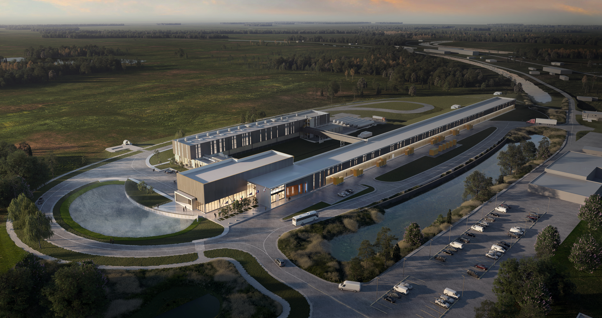
Have a Productive Workshop
&
Thank You!

