Slide 1
PIP-II 2nd Technical Workshop, WG#1
Status of HB650 Prototype CM Assembly
Chuck Grimm
Fermilab
12-14 July 2022

Slide 2
Outline
Team Background
Roles
Support Teams
Cavity String Details
Phase Assembly Overview
Phase 1A – Beam Line Assembly (F10152132) - Complete
Phase 1B – Strongback Fitment and Assembly (F10152150) – In Progress
Phase 1C – Strongback and Beamline Merger (F10152201)
Phase 2 – Coldmass Assembly (F10152230)
Phase 3 – Insertion of Coldmass into Vacuum Vessel (F10152239)
Phase 4 – Final Cryomodule Assembly (F10152255)
Look Ahead
Misc. Work
Thermal Shield Assembly
Titanium Cavity Support Fabrication

Slide 3
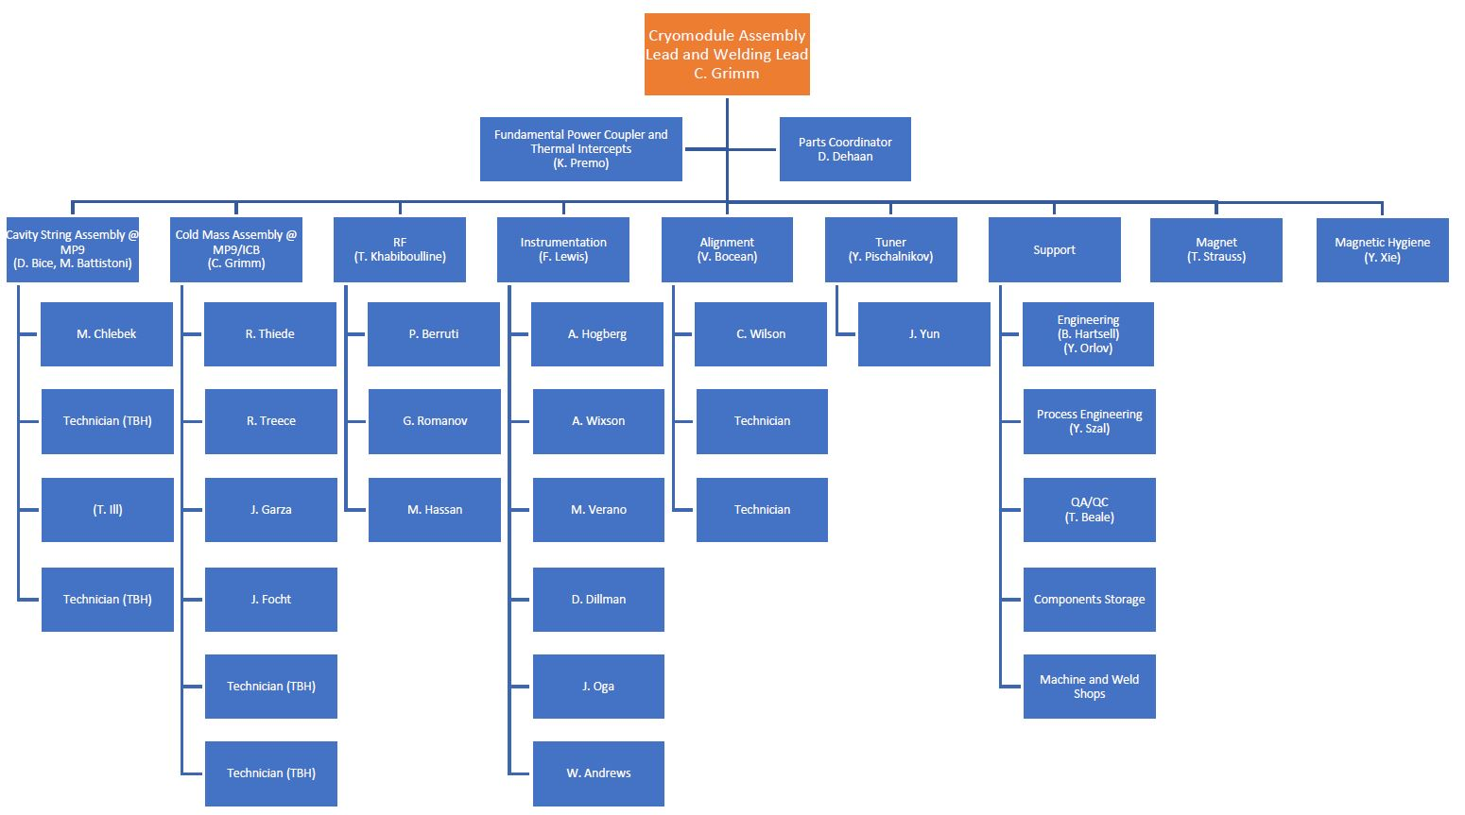
Team Background
Experienced teams with over 30 cryomodules built to date. **
Consisting of 3.9 GHz, 1.3 GHz, 650MHz, 325 MHz (SSR1) modules
**Some minor changes for PIP-II modules

Slide 4
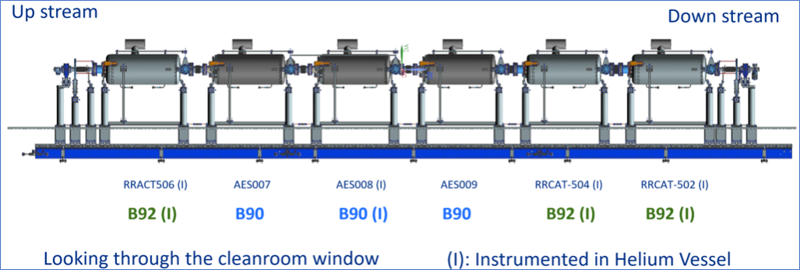
String Details
Mixture of B92 and B90 cavities
Four cavities with internal instrumentation
All Cavities dressed at FNAL

Slide 5
Phase 1A: Beam Line Assembly
Reference Drawing: F10152132
Traveler: 464613
Main Tasks
Assemble beamline in the cleanroom - complete
Receive beamline from cleanroom - complete
Connect beamline to the lifting tooling - complete
Install B92 tuners - complete
Install B90 tuners - complete
Install local magnetic shields - complete
Weld cooldown line – complete
Traveler will be closed once all DR’s are dispositioned

Slide 6
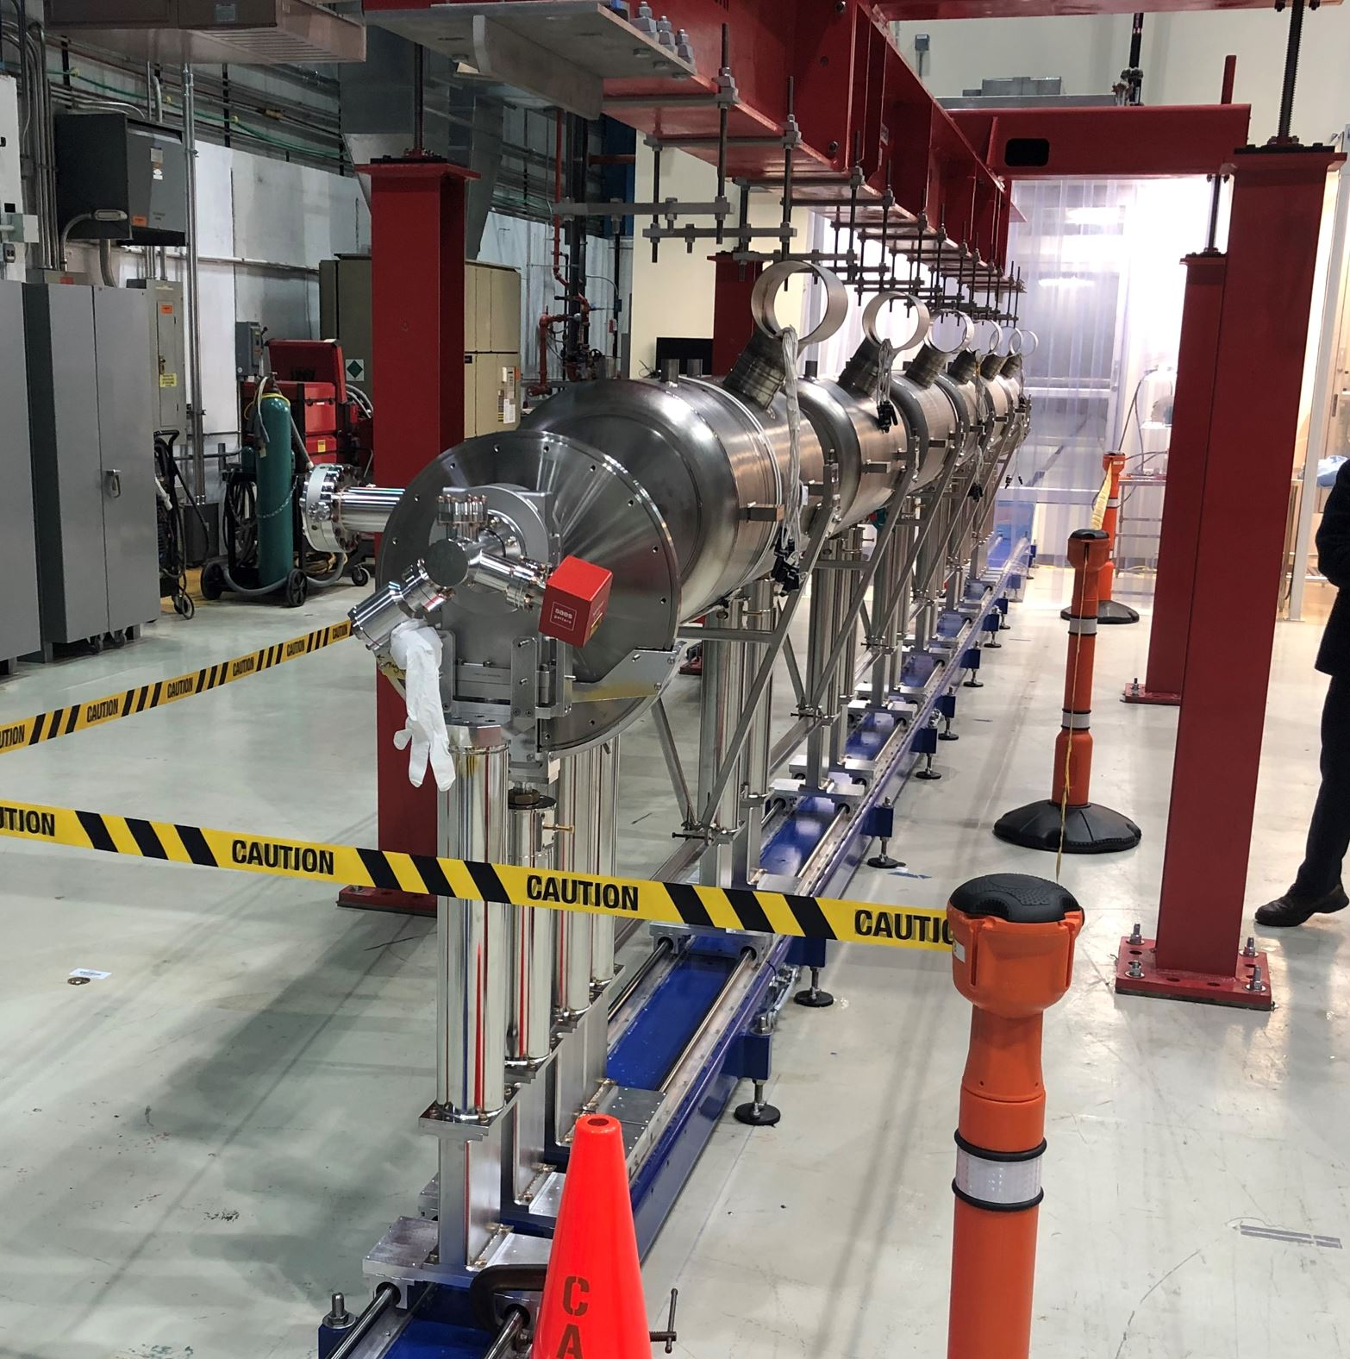
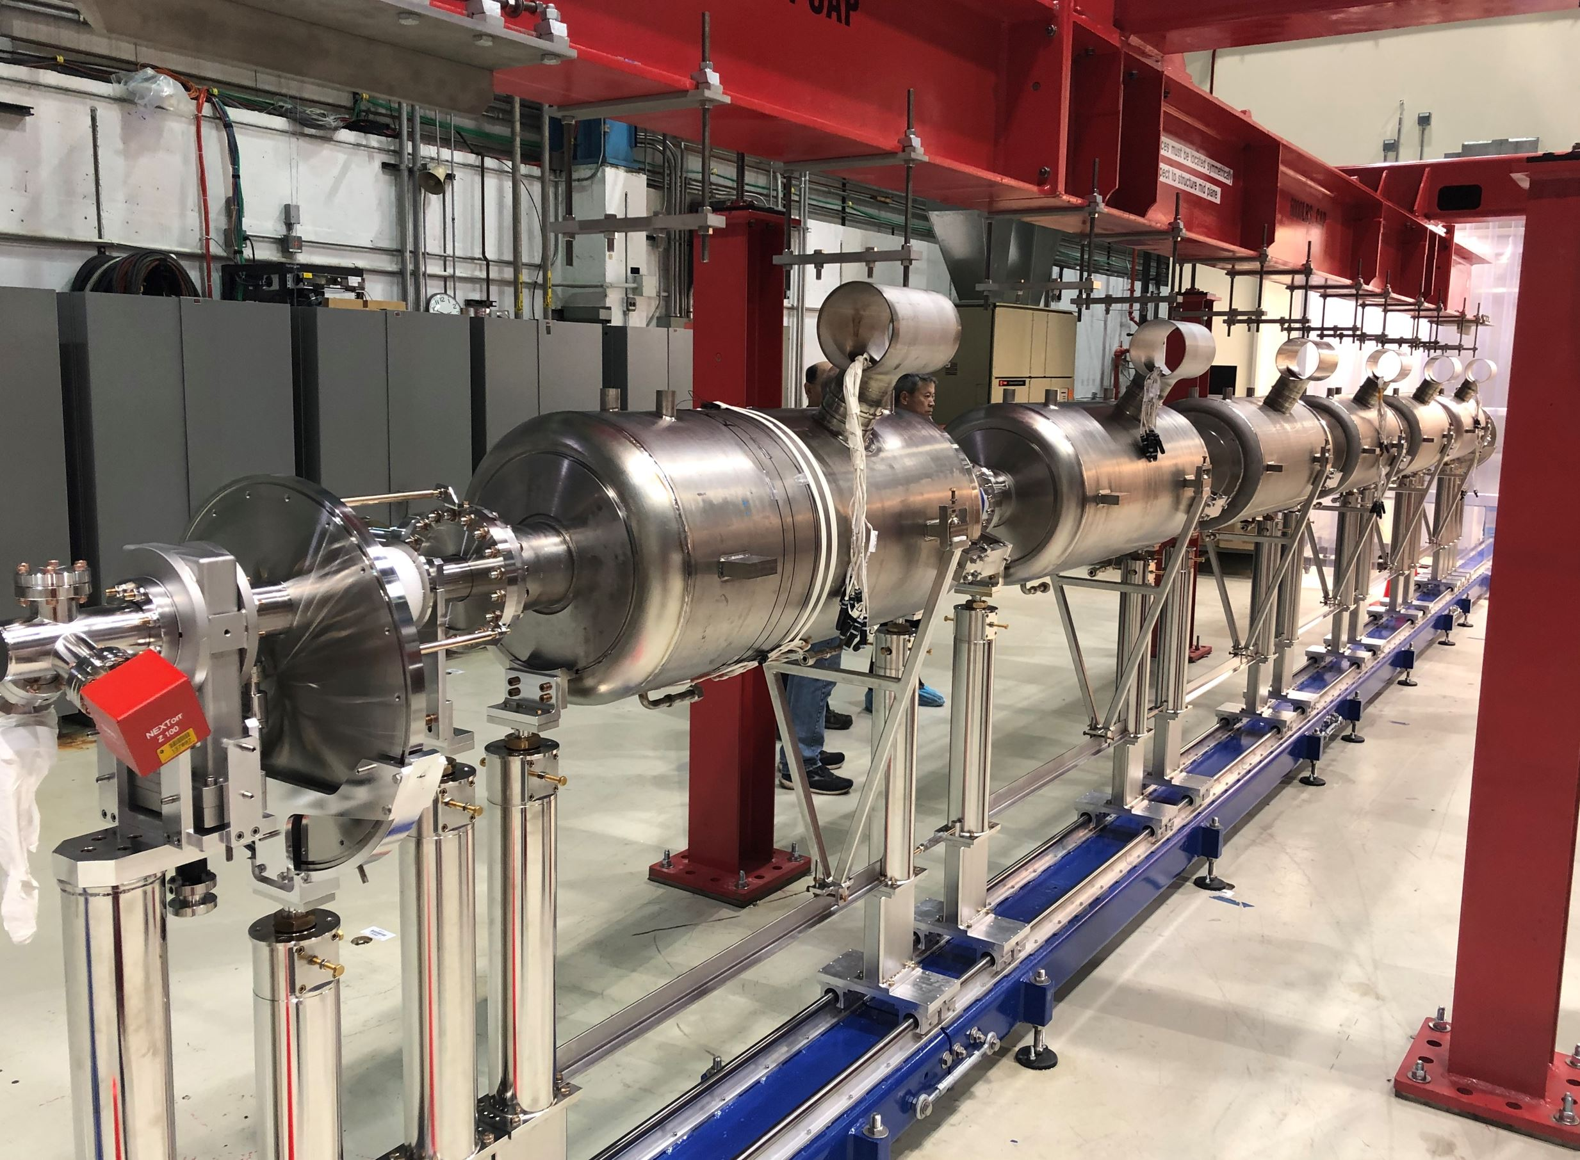
Phase 1A: Beam Line Assembly
Roll out was easy, glided smooth on the rails
RRCAT-502
View Downstream Looking Upstream

Slide 7
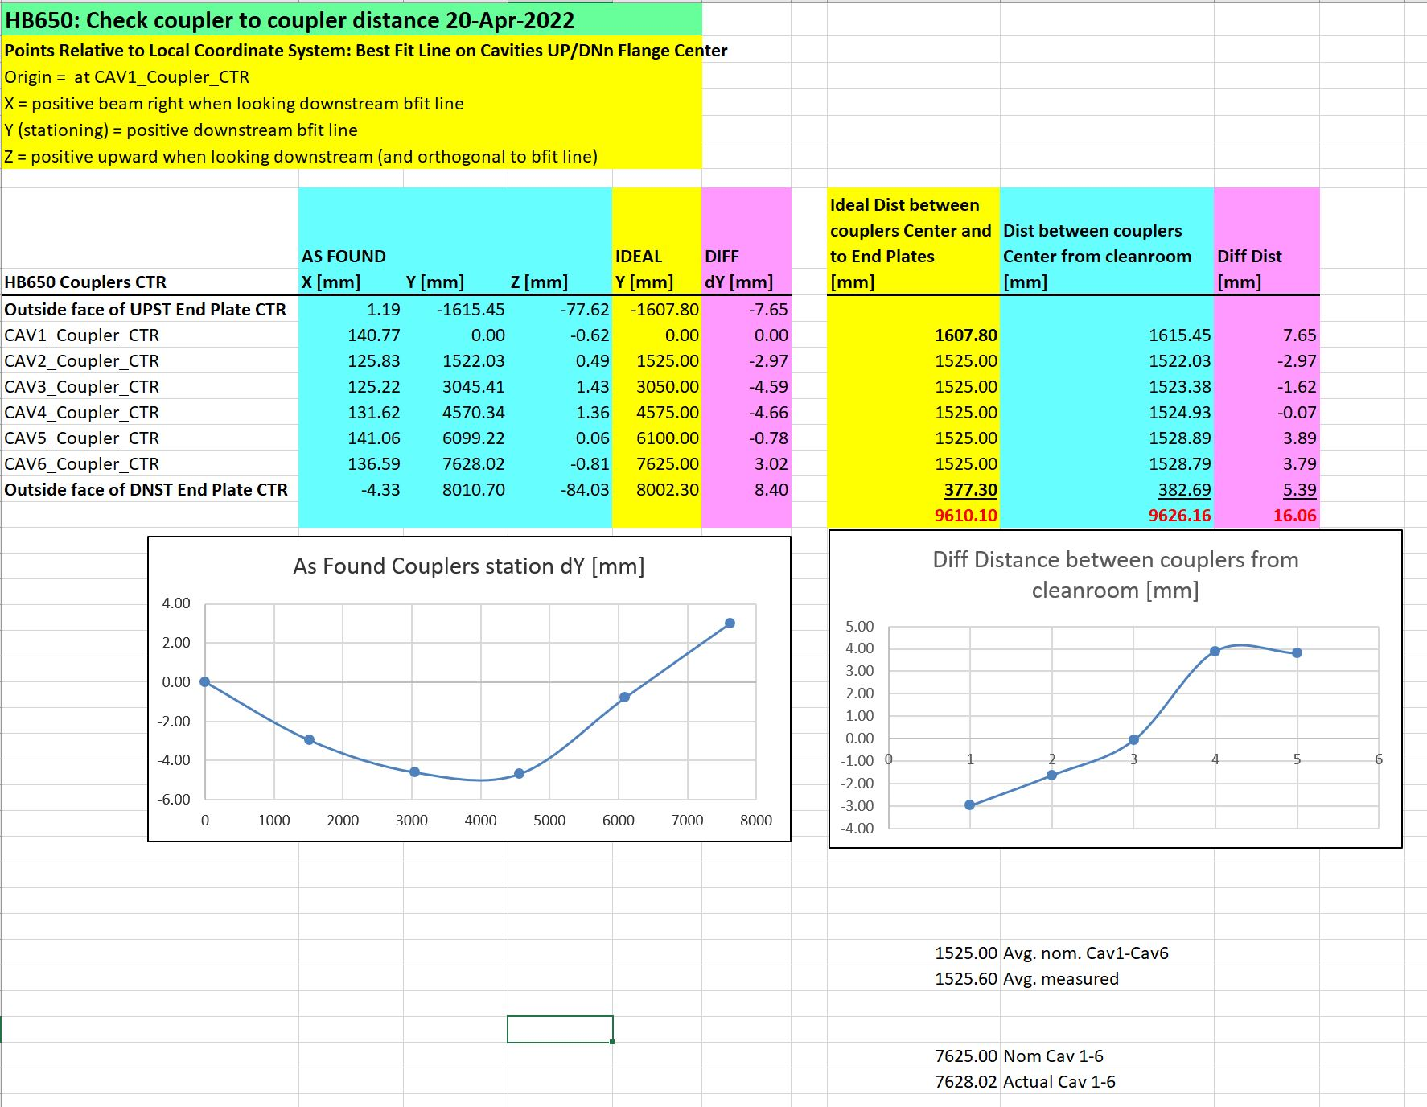
Phase 1A: Beam Line Assembly
Post cleanroom alignment check
Coupler-to-coupler spacing could have been a little better
Overall length of string, end plate to end plate 16mm too long, needed minor adjustment to correct spacing
Data Courtesy of Virgil Bocean

Slide 8
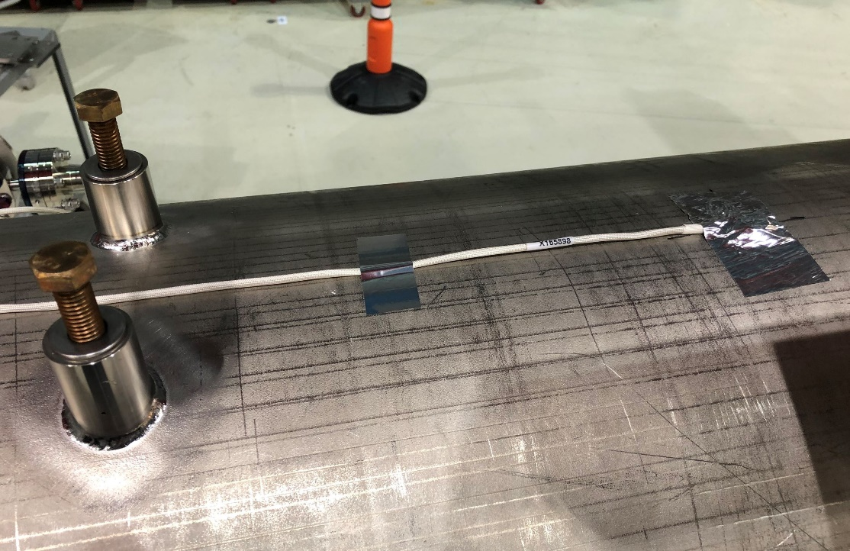
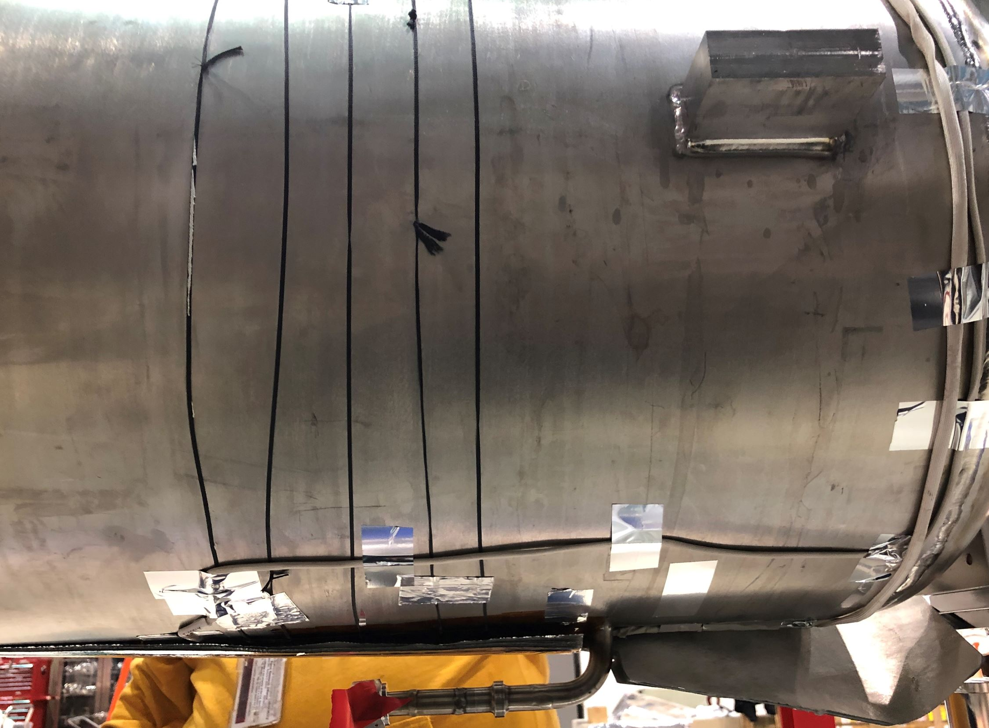
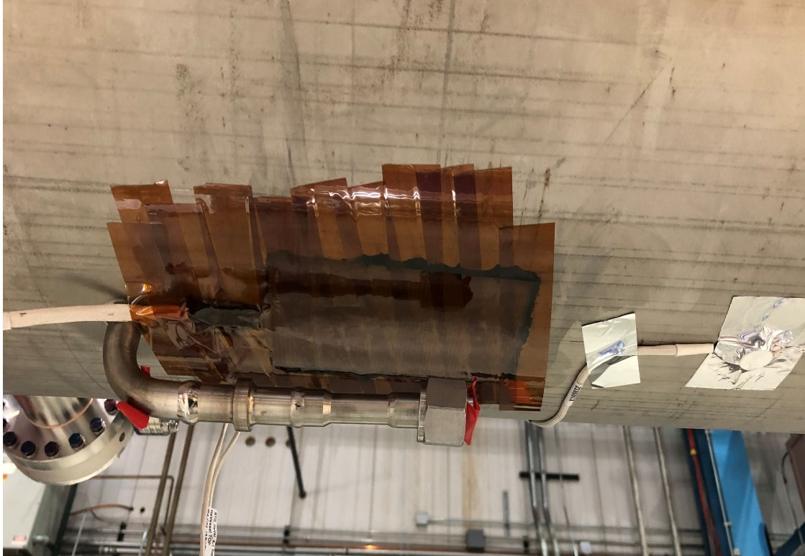
Phase 1A: Beam Line Assembly
Temperature Sensors and Heaters
25W heater installed under vessel secured with Stycast and G-10 cover
Two temp. sensors installed on each tank, one on top and bottom, secured with Stycast and G-10 “Garage”

Slide 9
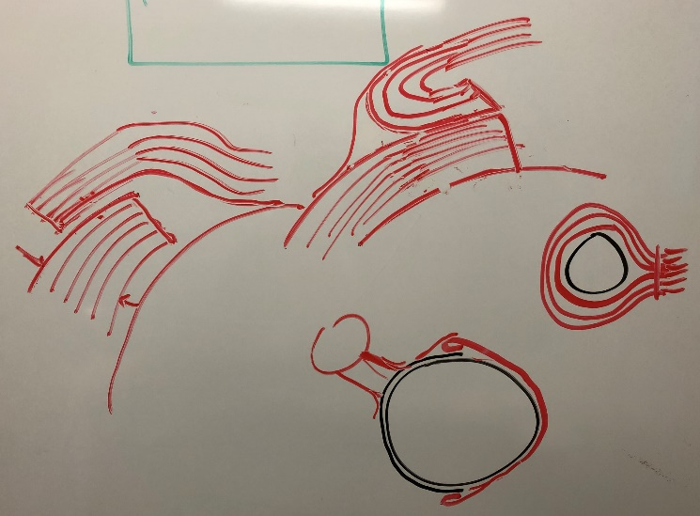
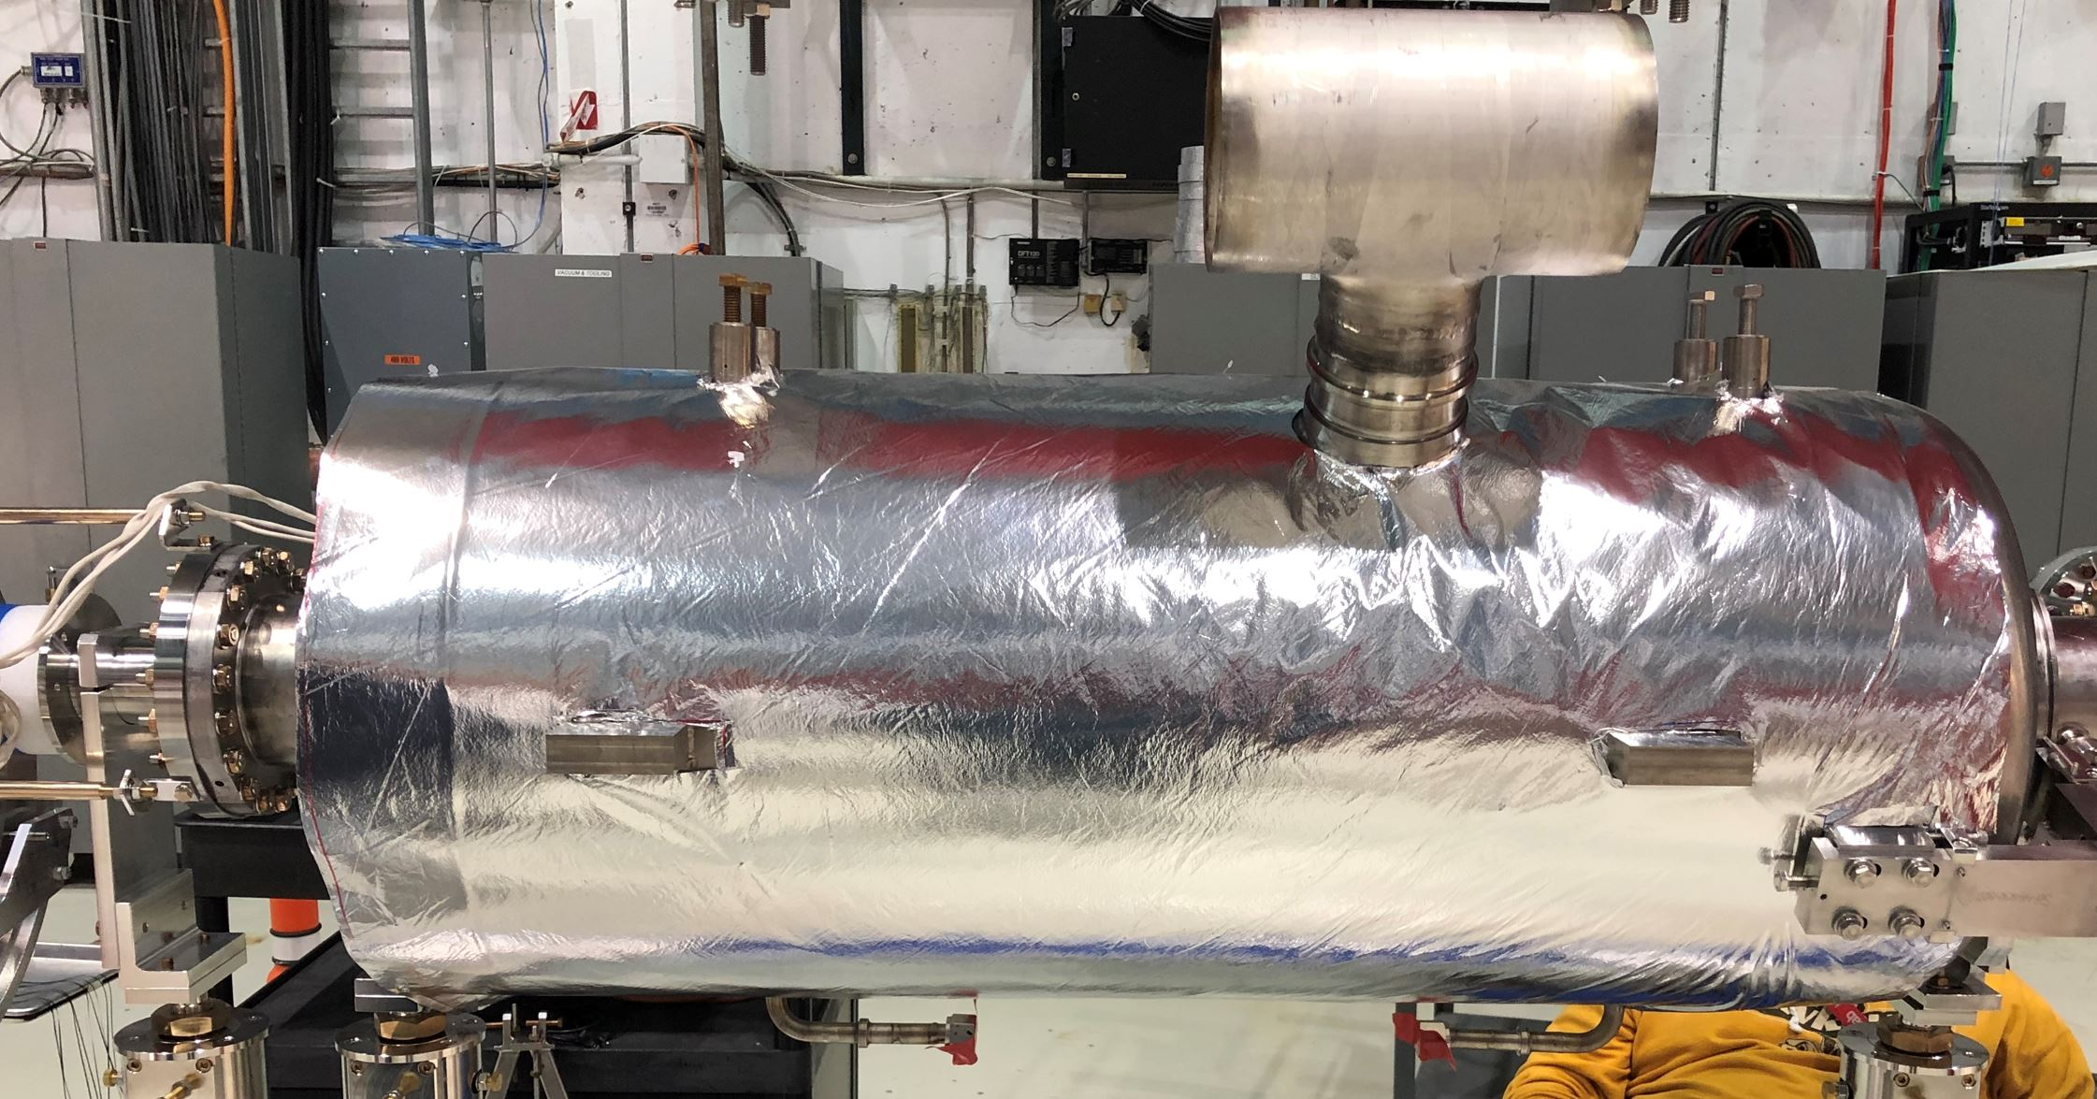
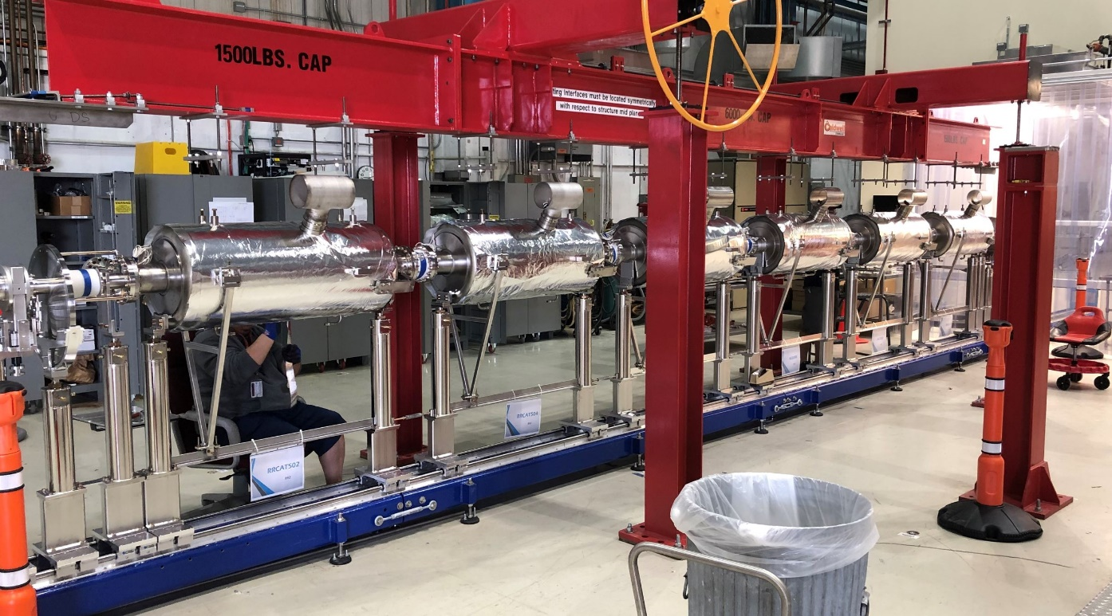
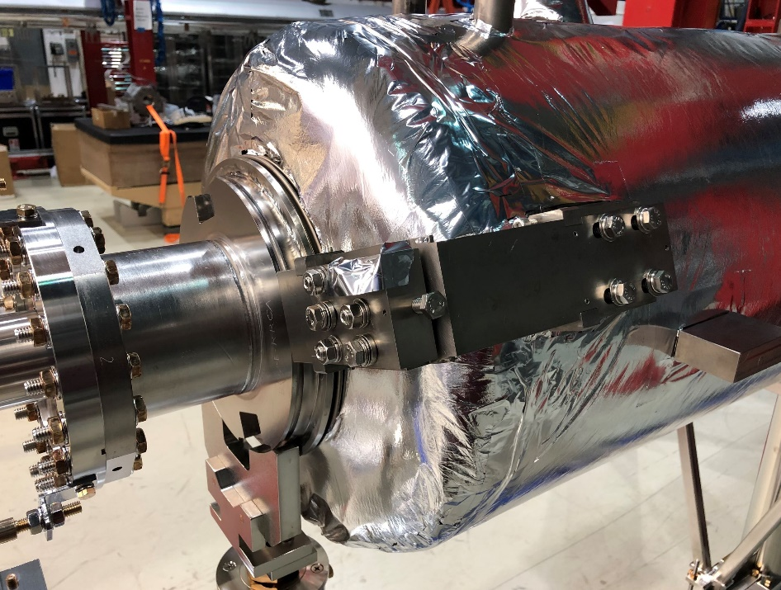
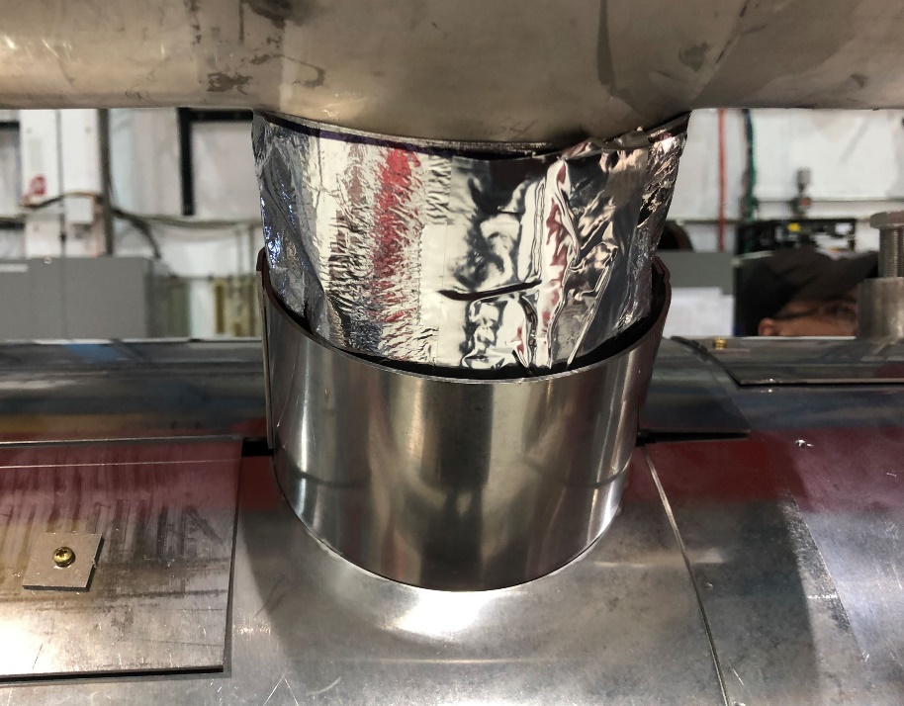
Phase 1A: Beam Line Assembly
MLI Blanket Installation
10-Layer blankets – hand made
Folded at joints to avoid thermal shorts, “best practice”

Slide 10
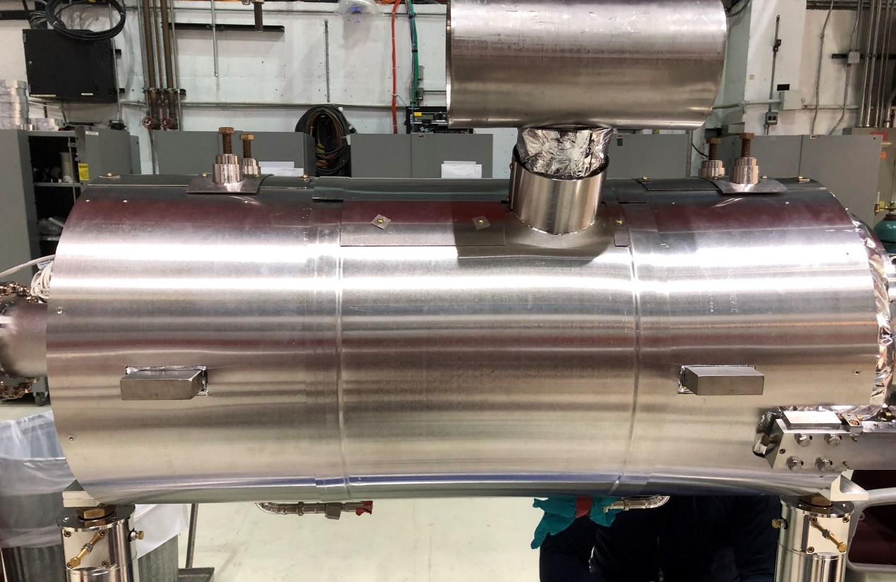
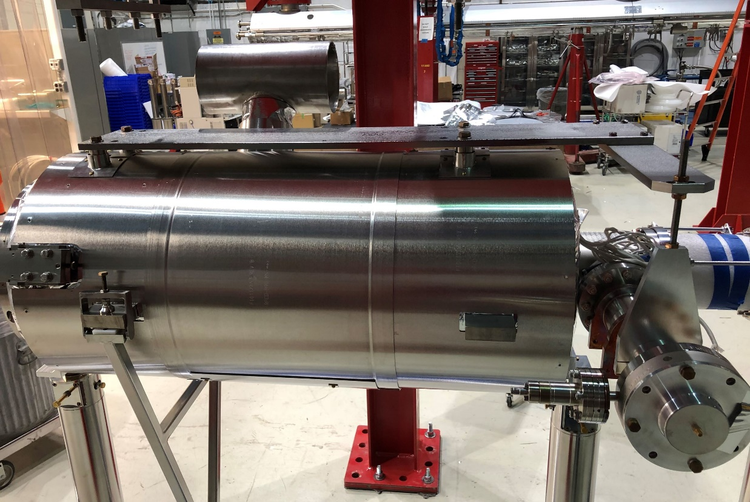
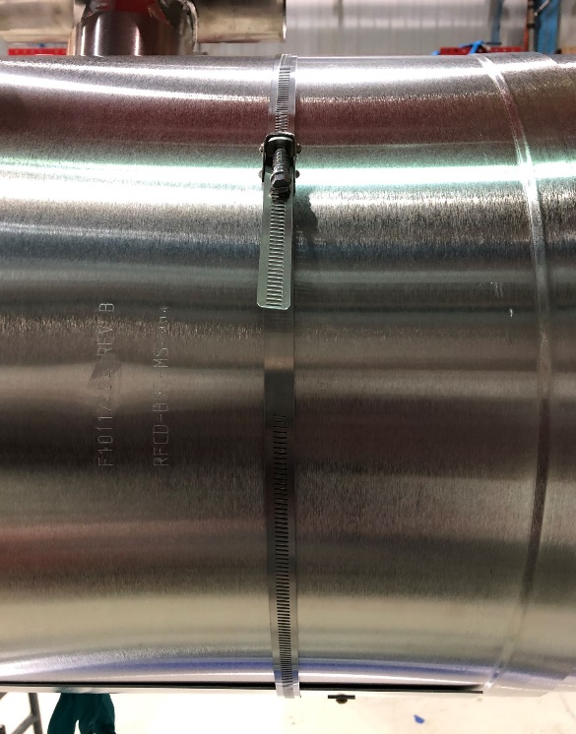
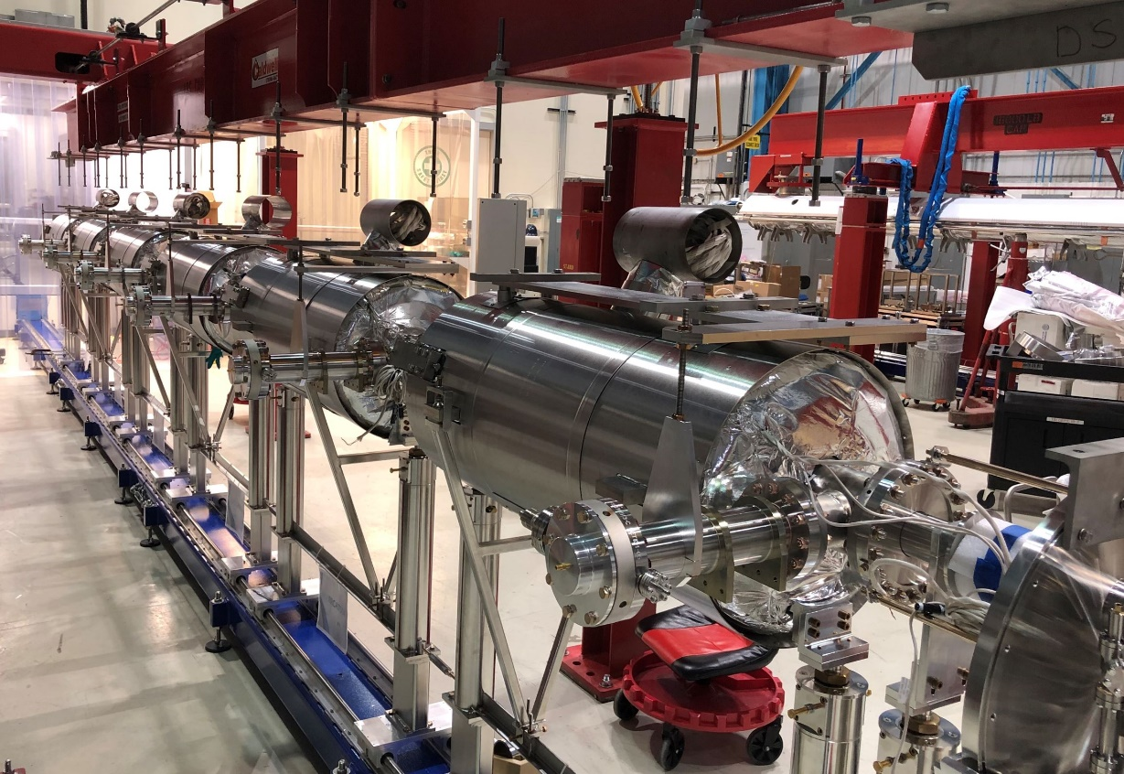
Phase 1A: Beam Line Assembly
Magnetic Shield and Lifting Plate/Coupler Support

Slide 11
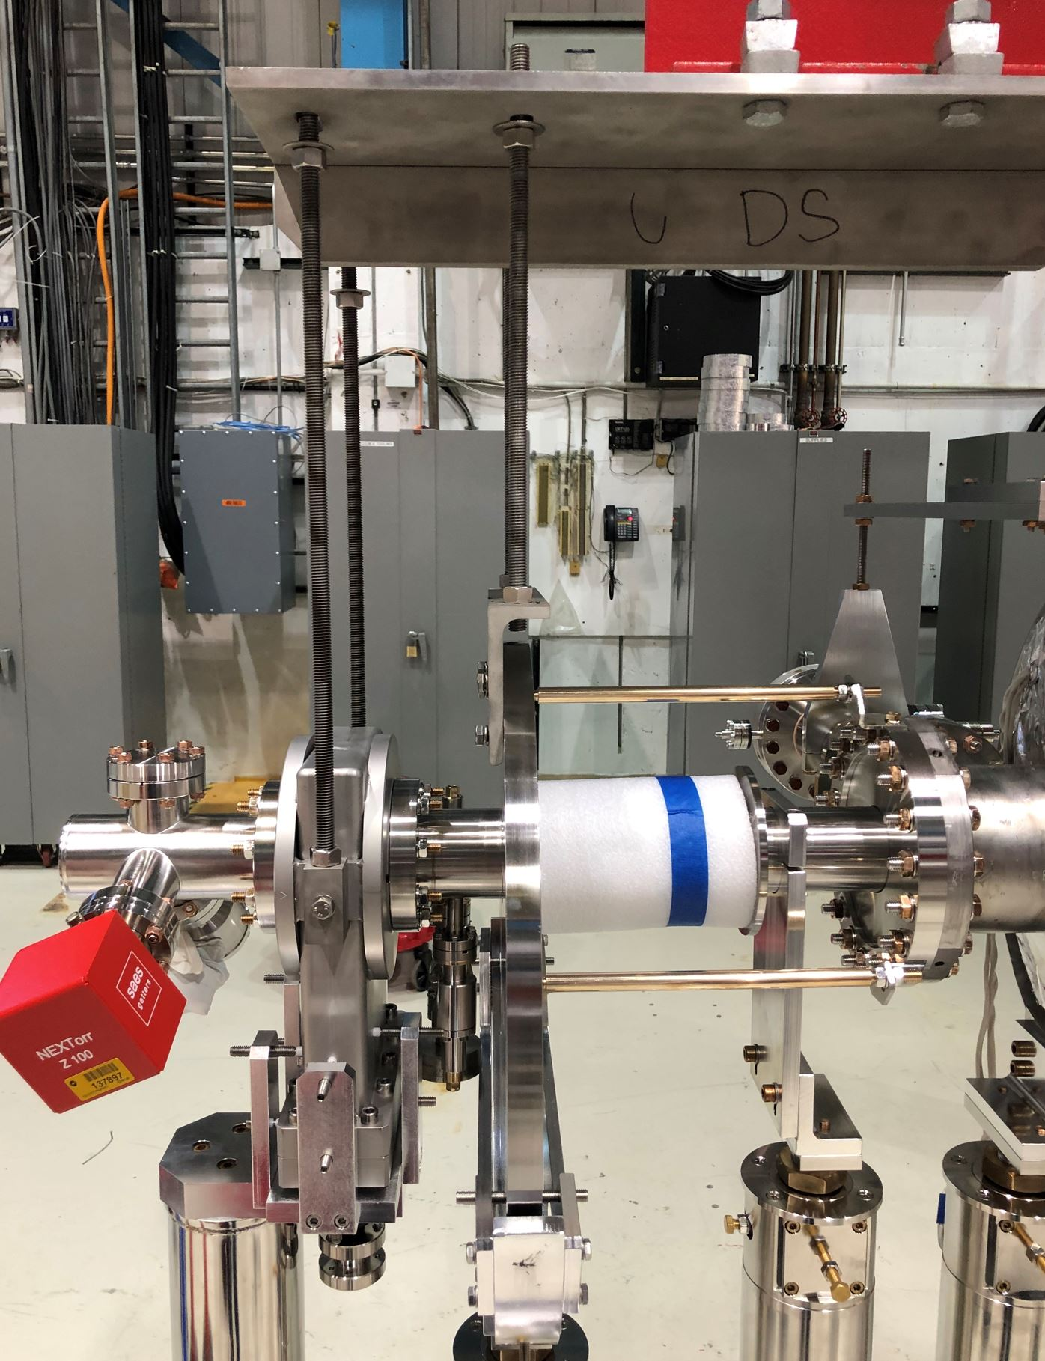
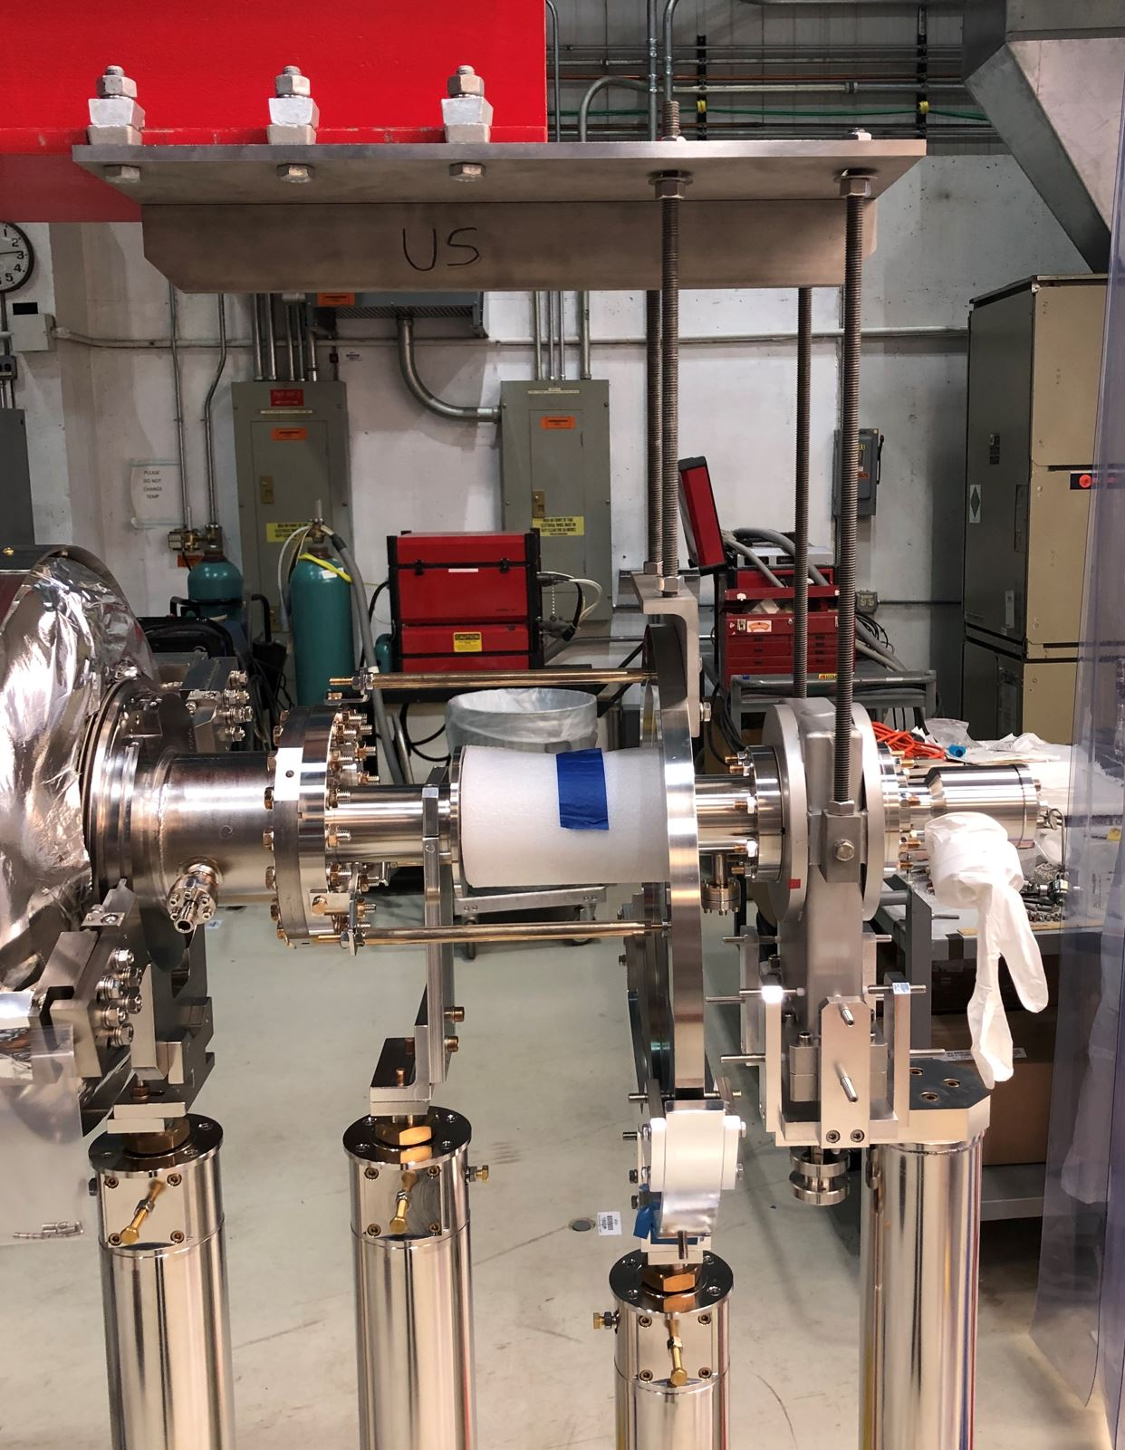
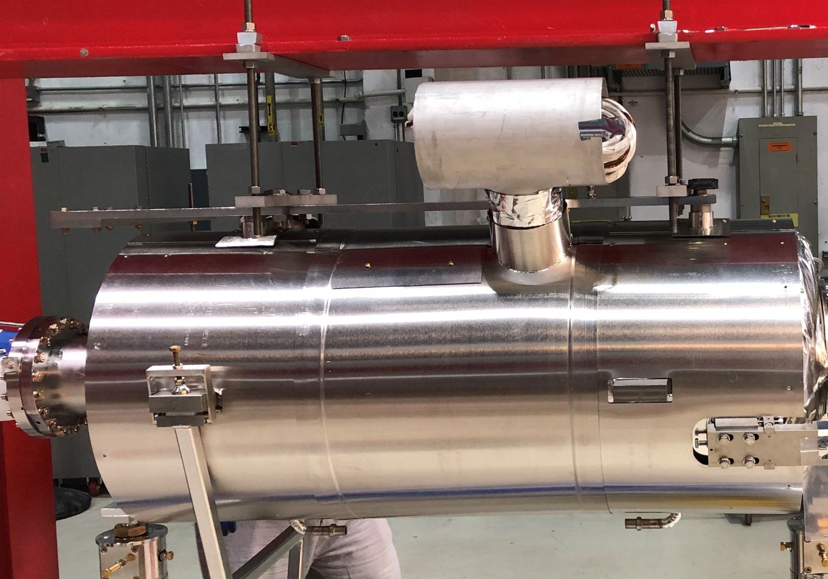
Phase 1A: Beam Line Assembly
Install Lifting Fixture to the String
Position string centered under to the lifting fixture
Install threaded rod connections and torque all hardware
Cavity Supports
DS End Supports
US End Supports

Slide 12
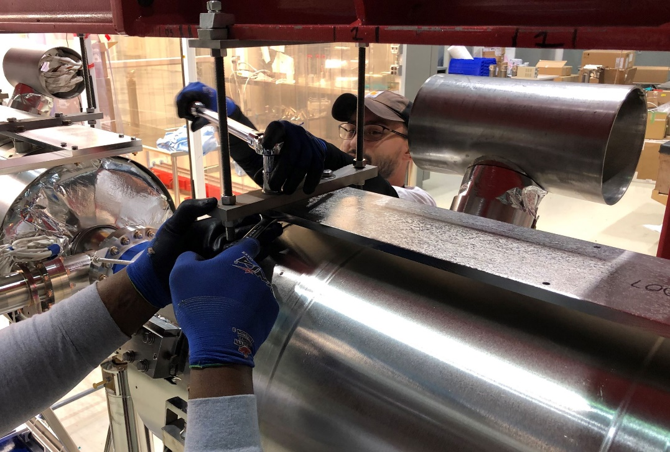
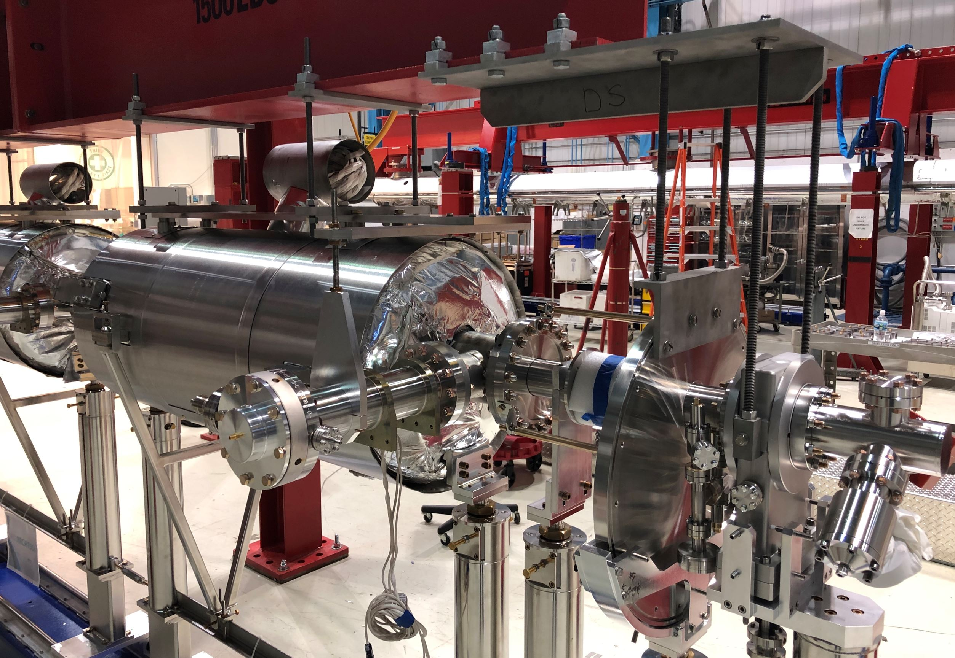
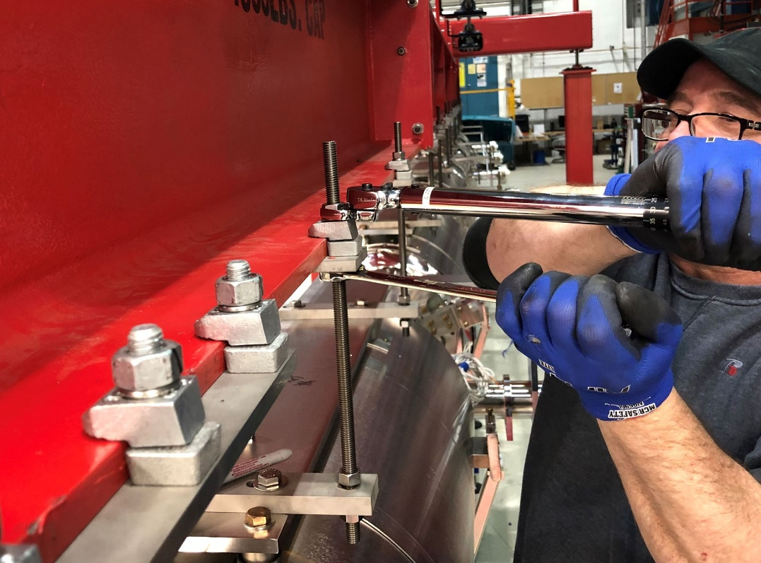
Phase 1A: Beam Line Assembly
Install Lifting Fixture to the String
Torque all connections to proper values
Check all connections in preparation for lift
Final View Attached to Lifting Fixture and Cleanroom Posts

Slide 13
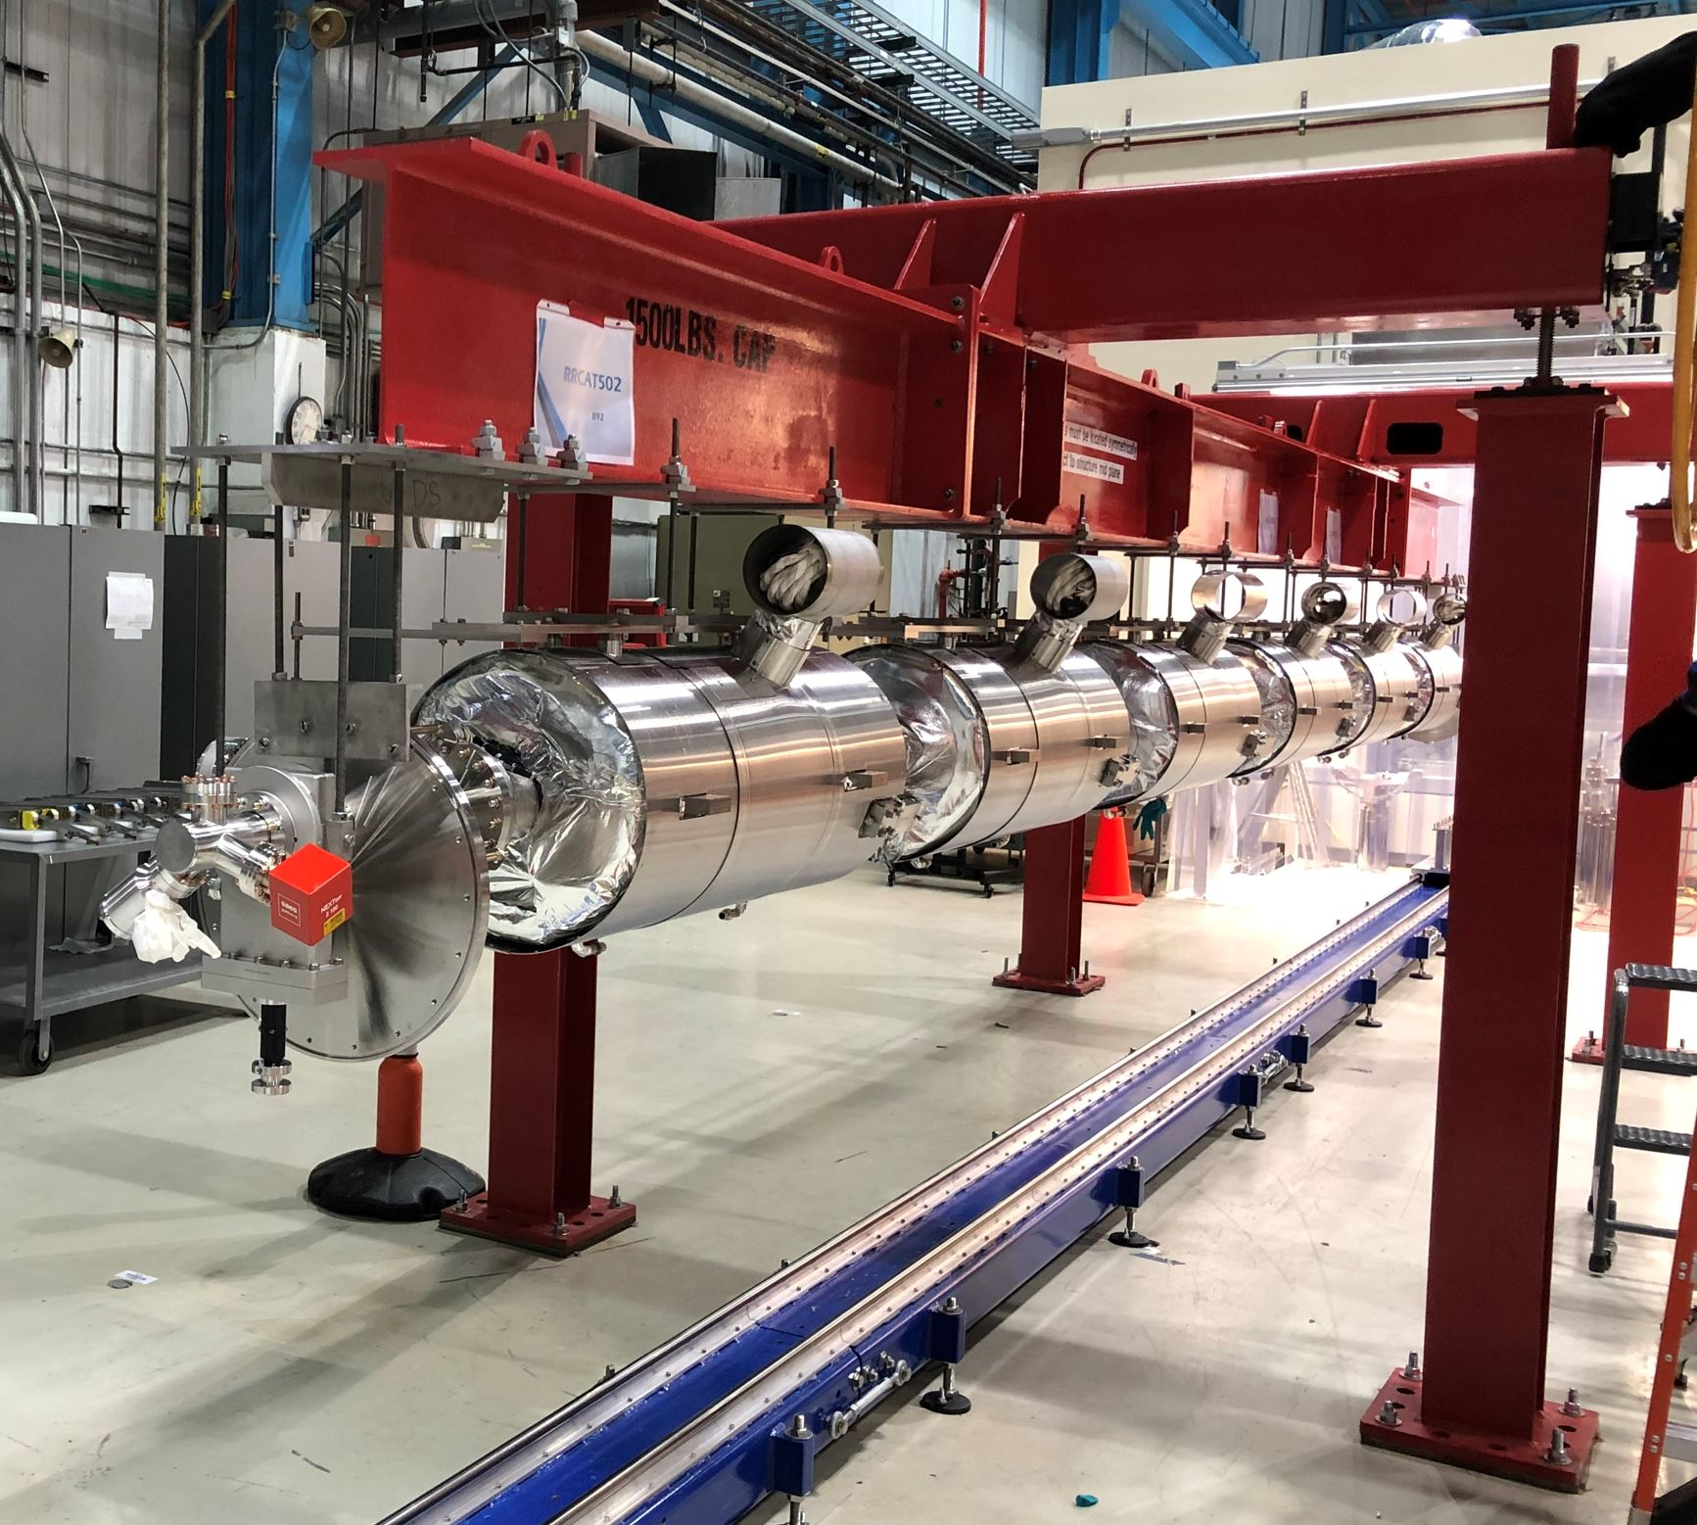
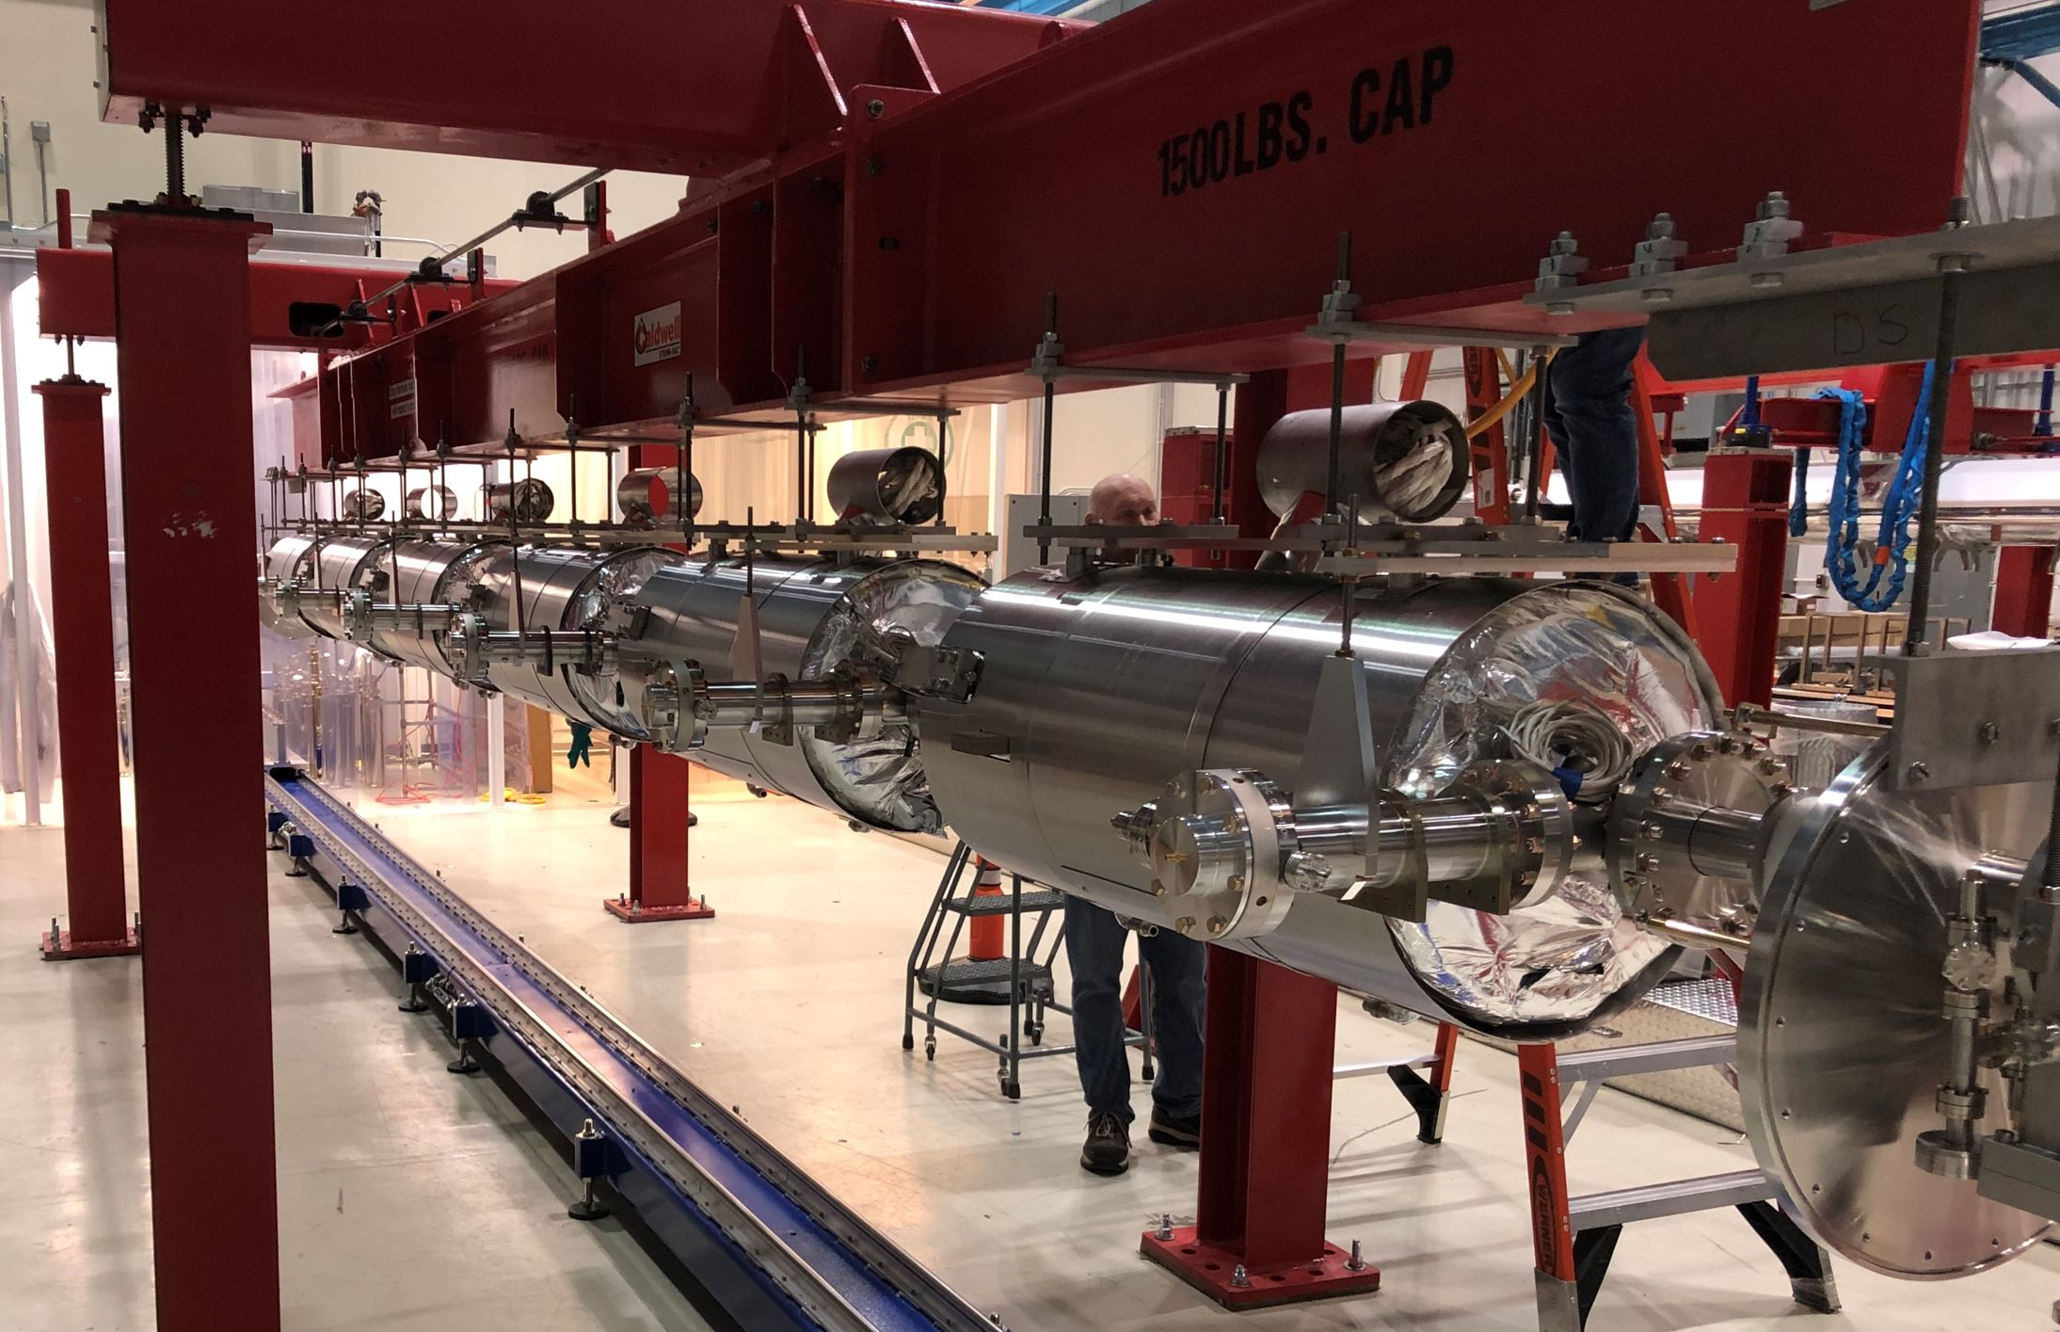
Phase 1A: Beam Line Assembly
Lift String From the Cleanroom Stands
Disconnect connections of cleanroom stands and back off alignment screws
Slowly lift until loose from cleanroom stands
Move stands back into the cleanroom

Slide 14
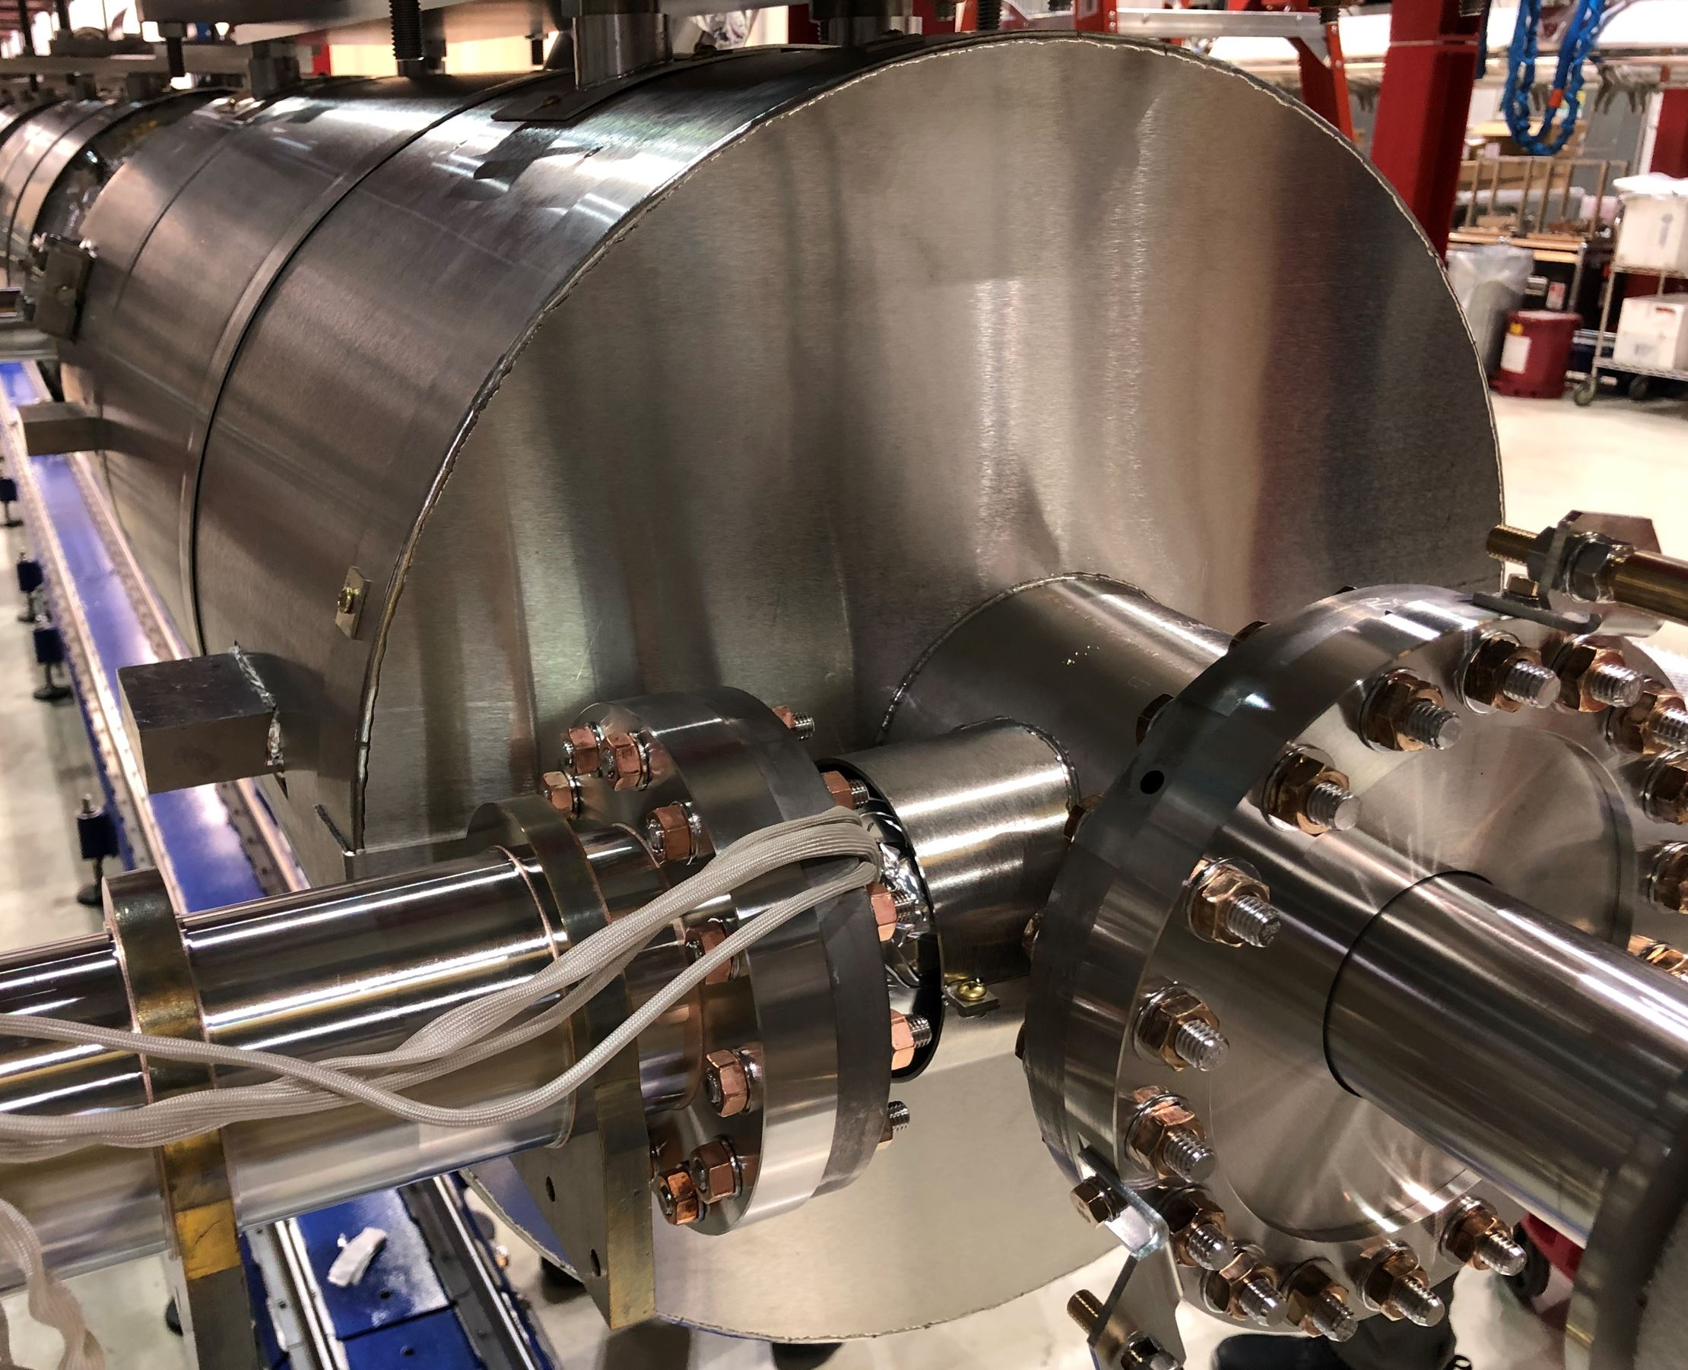
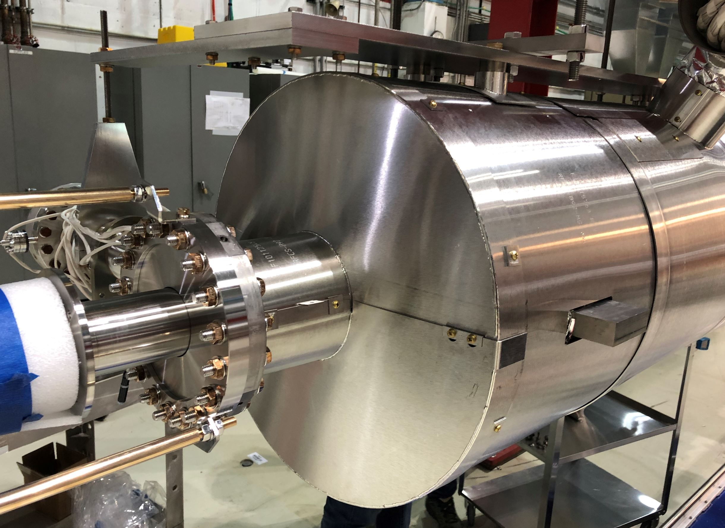
Phase 1A: Beam Line Assembly
Install all Downstream Magnetic Shield Endcaps
Must have cleanroom posts removed for this step
Upstream endcaps are part of tuner installation
RRCAT-502 Assembly

Slide 15
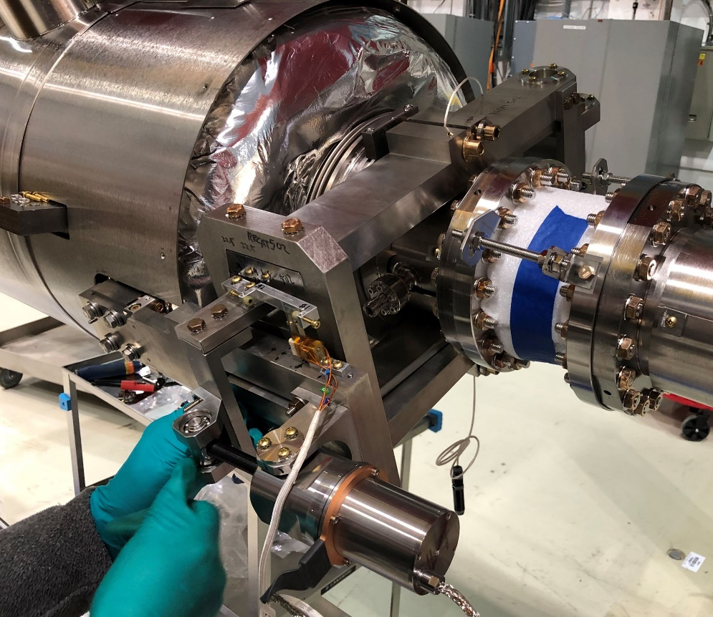
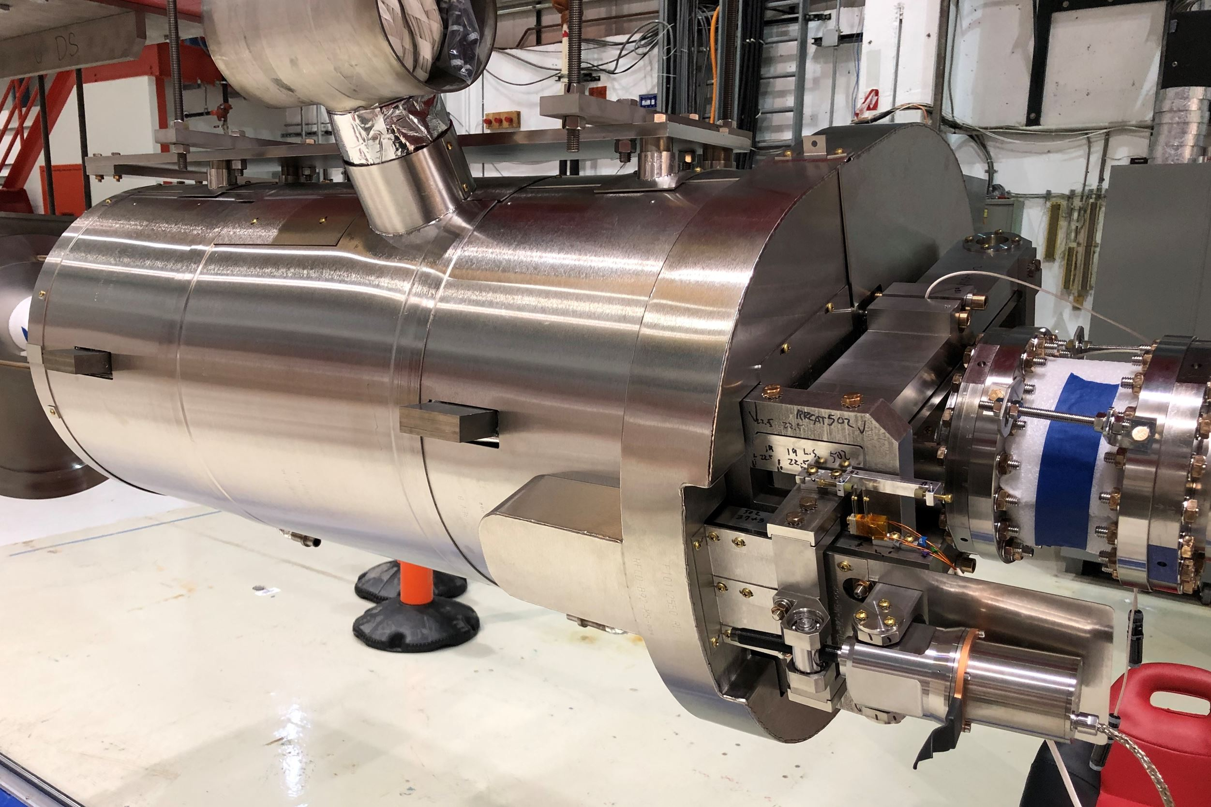
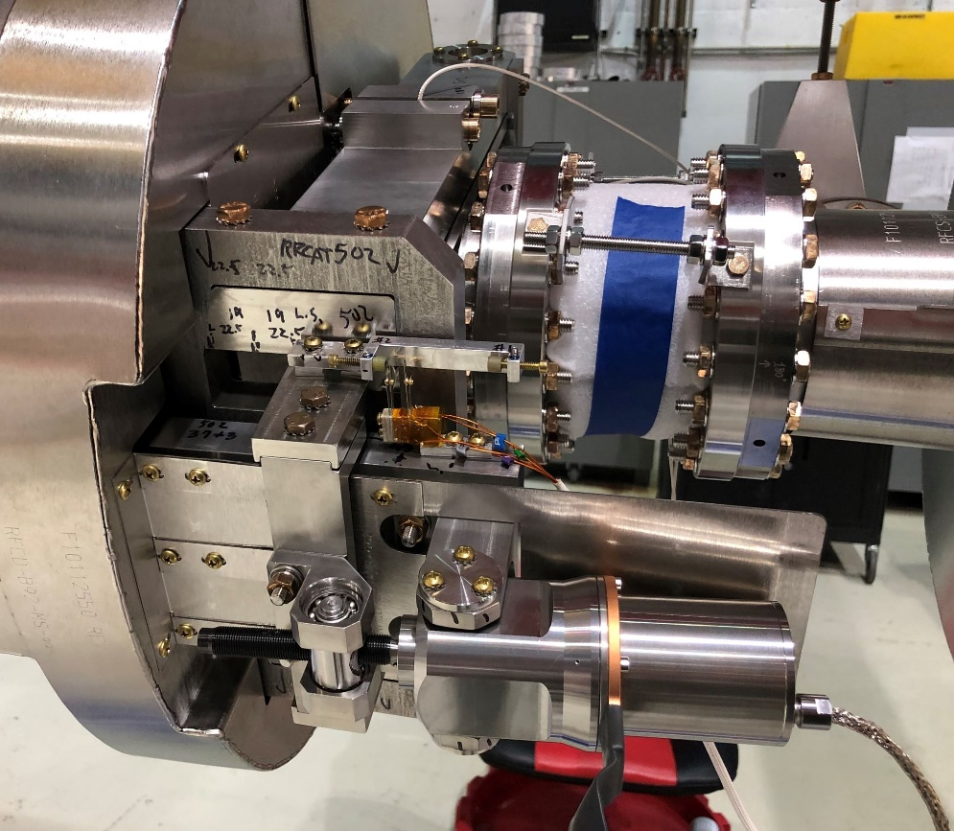
Phase 1A: Beam Line Assembly
Install B92 Lever Tuners
Upstream endcaps are part of tuner installation
RRCAT-502 Assembly

Slide 16
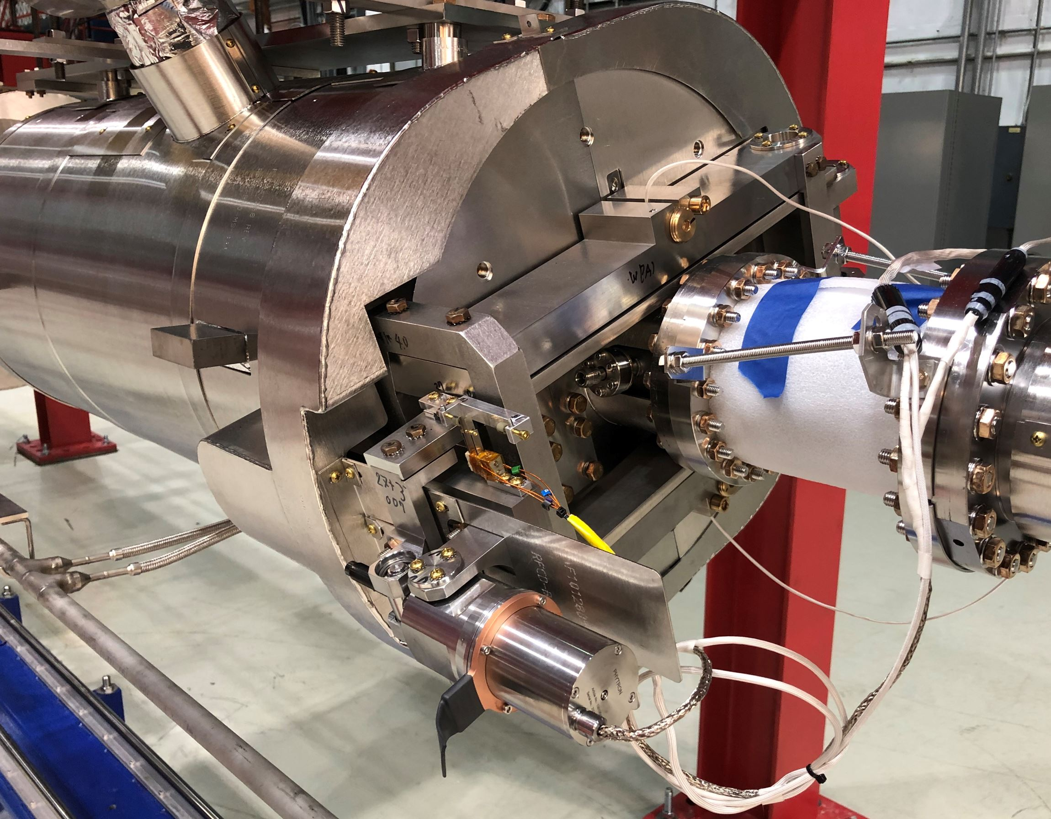
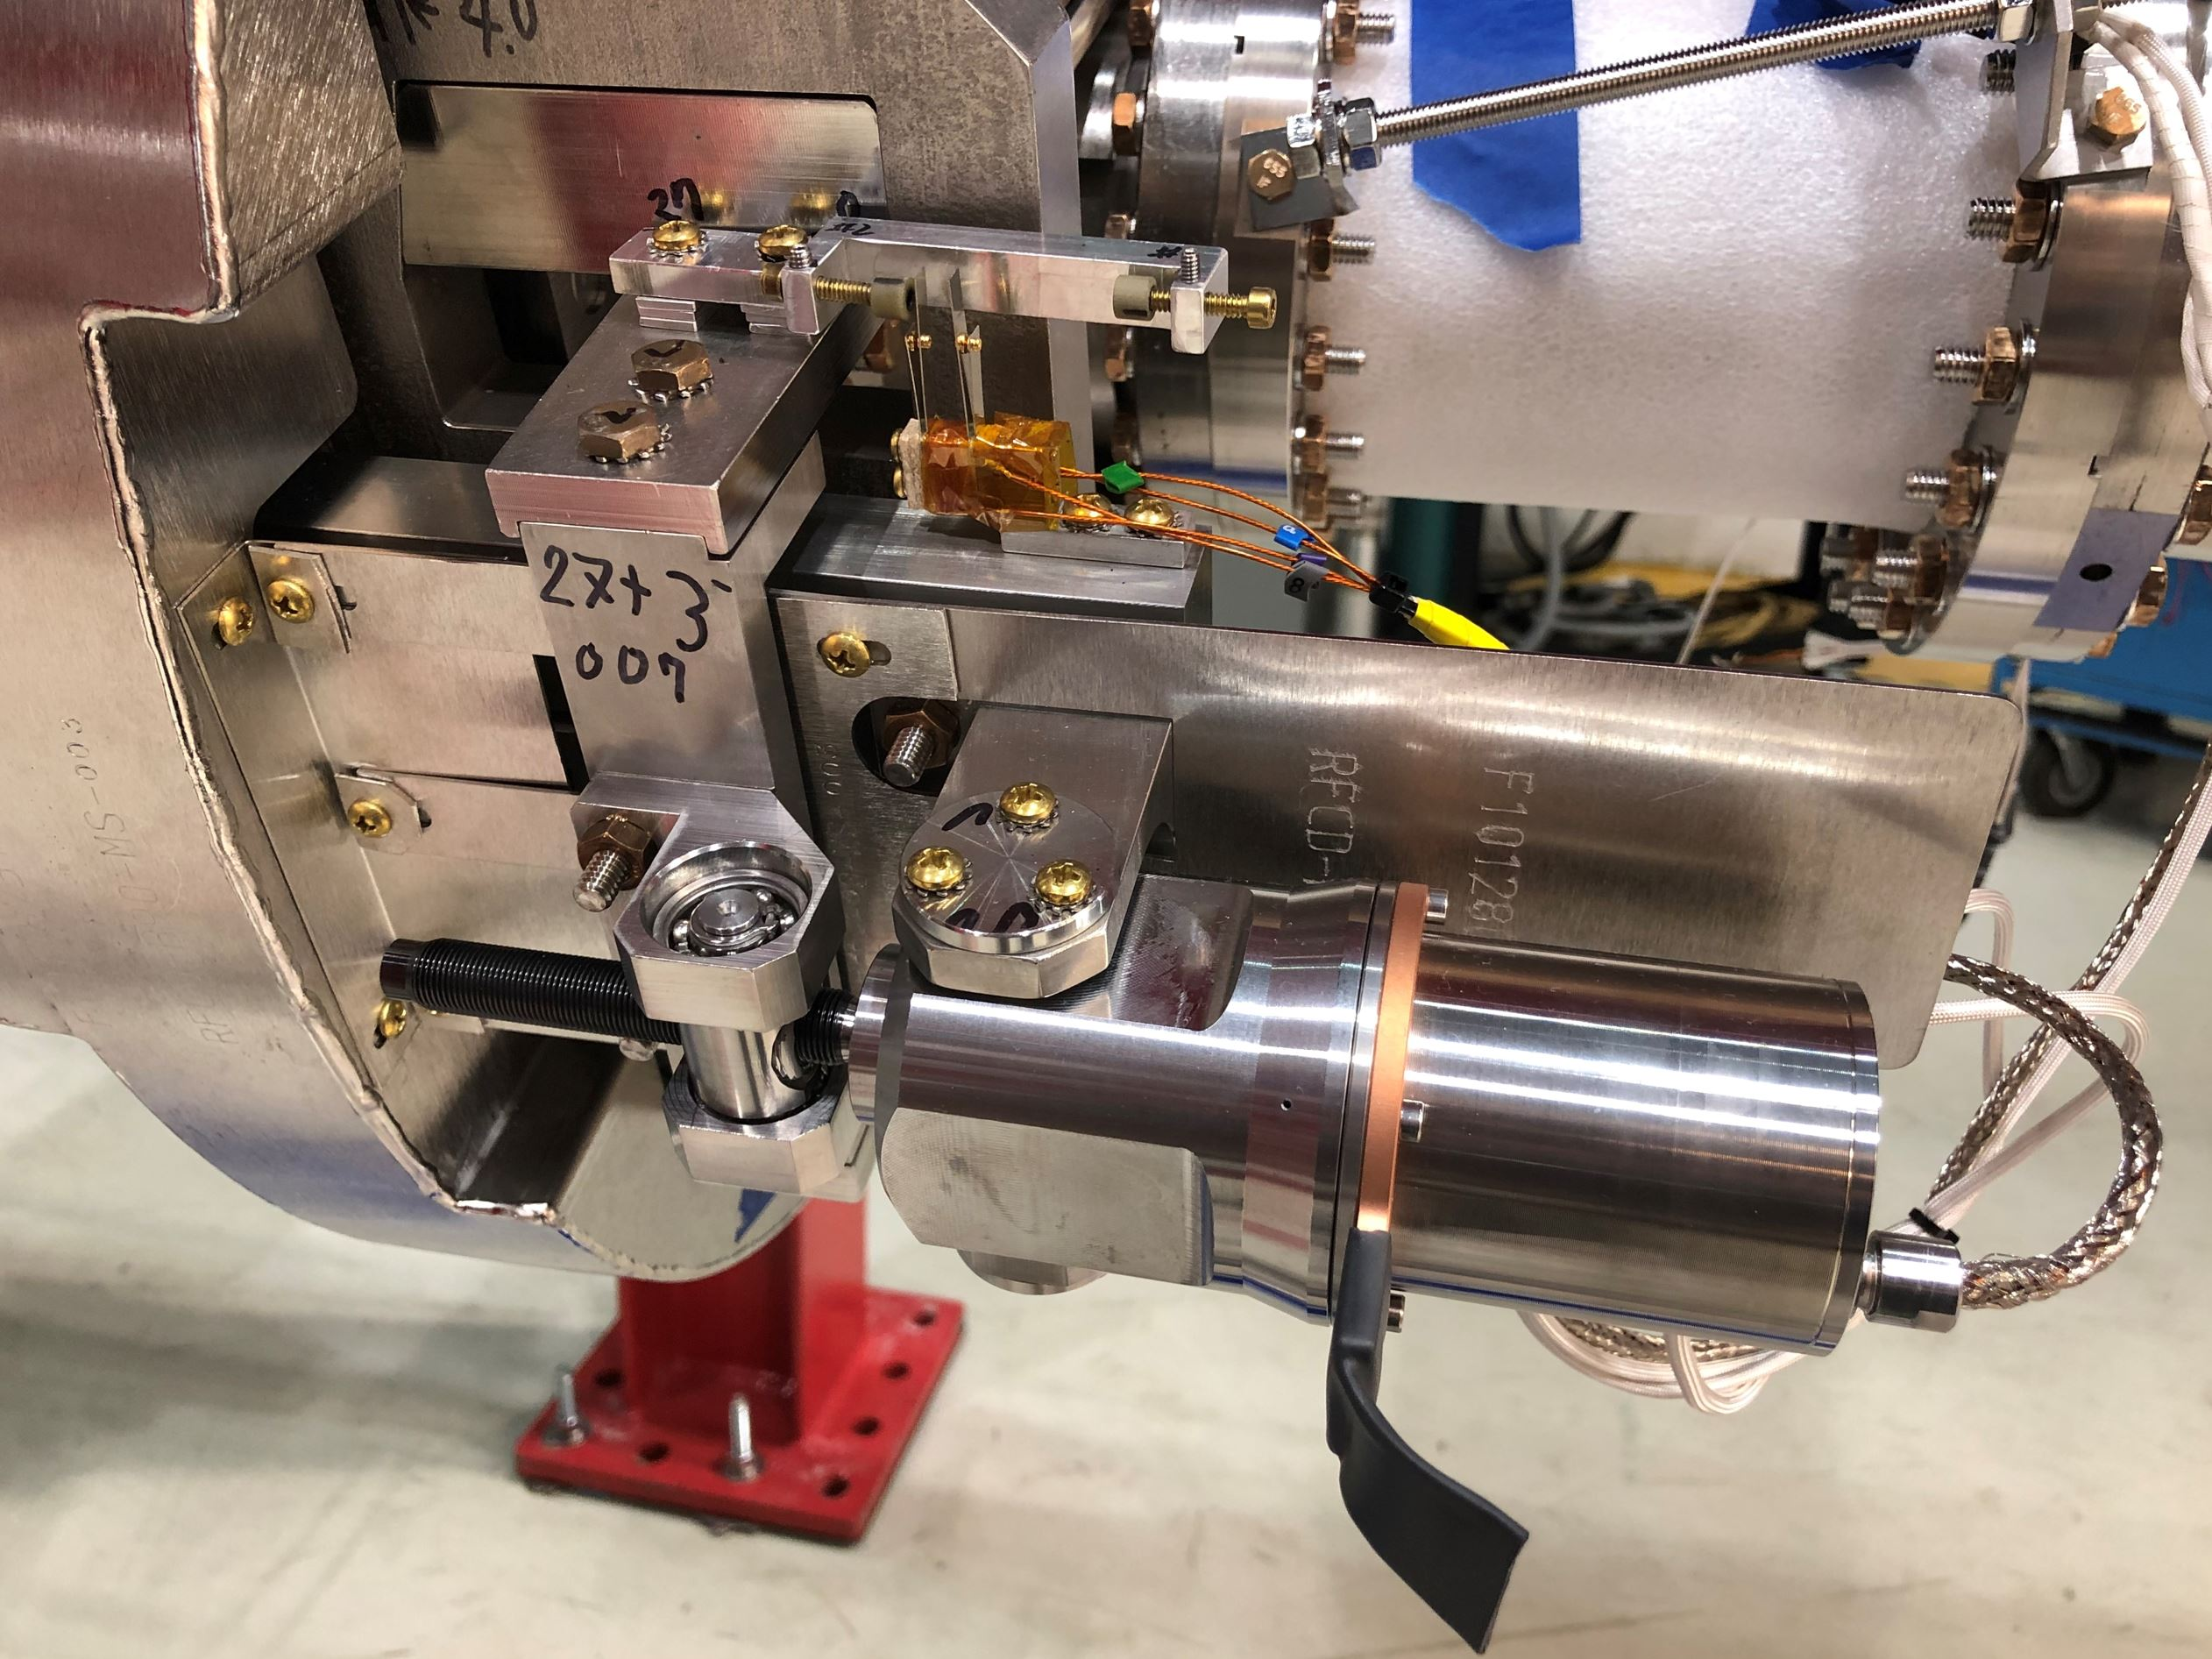
Phase 1A: Beam Line Assembly
Install B90 Lever Tuners
Upstream endcaps are part of tuner installation
AES-007 Assembly

Slide 17
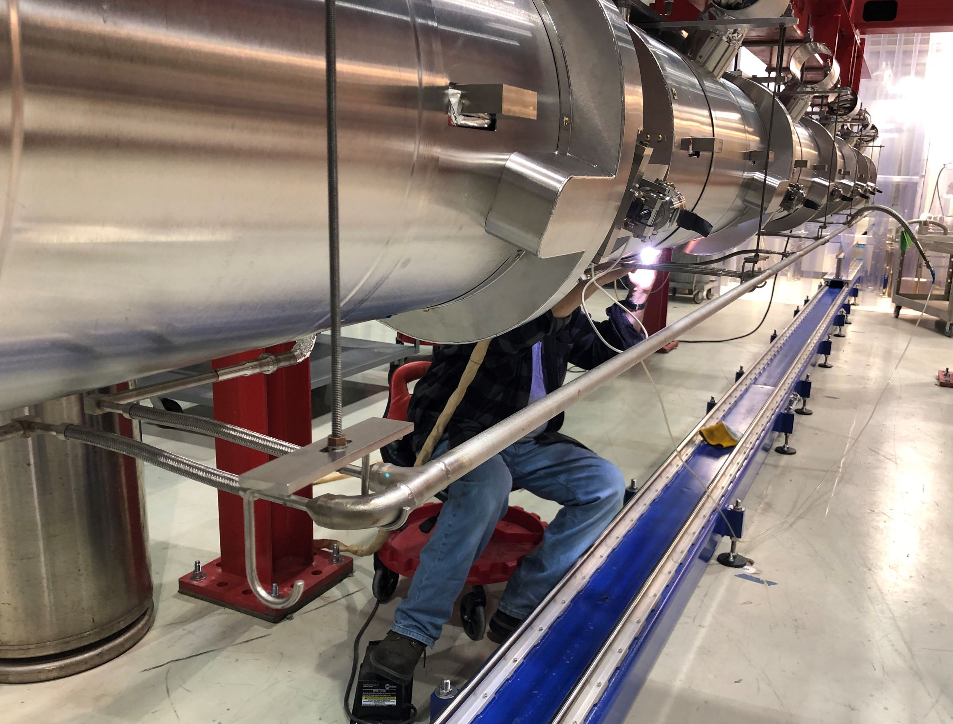
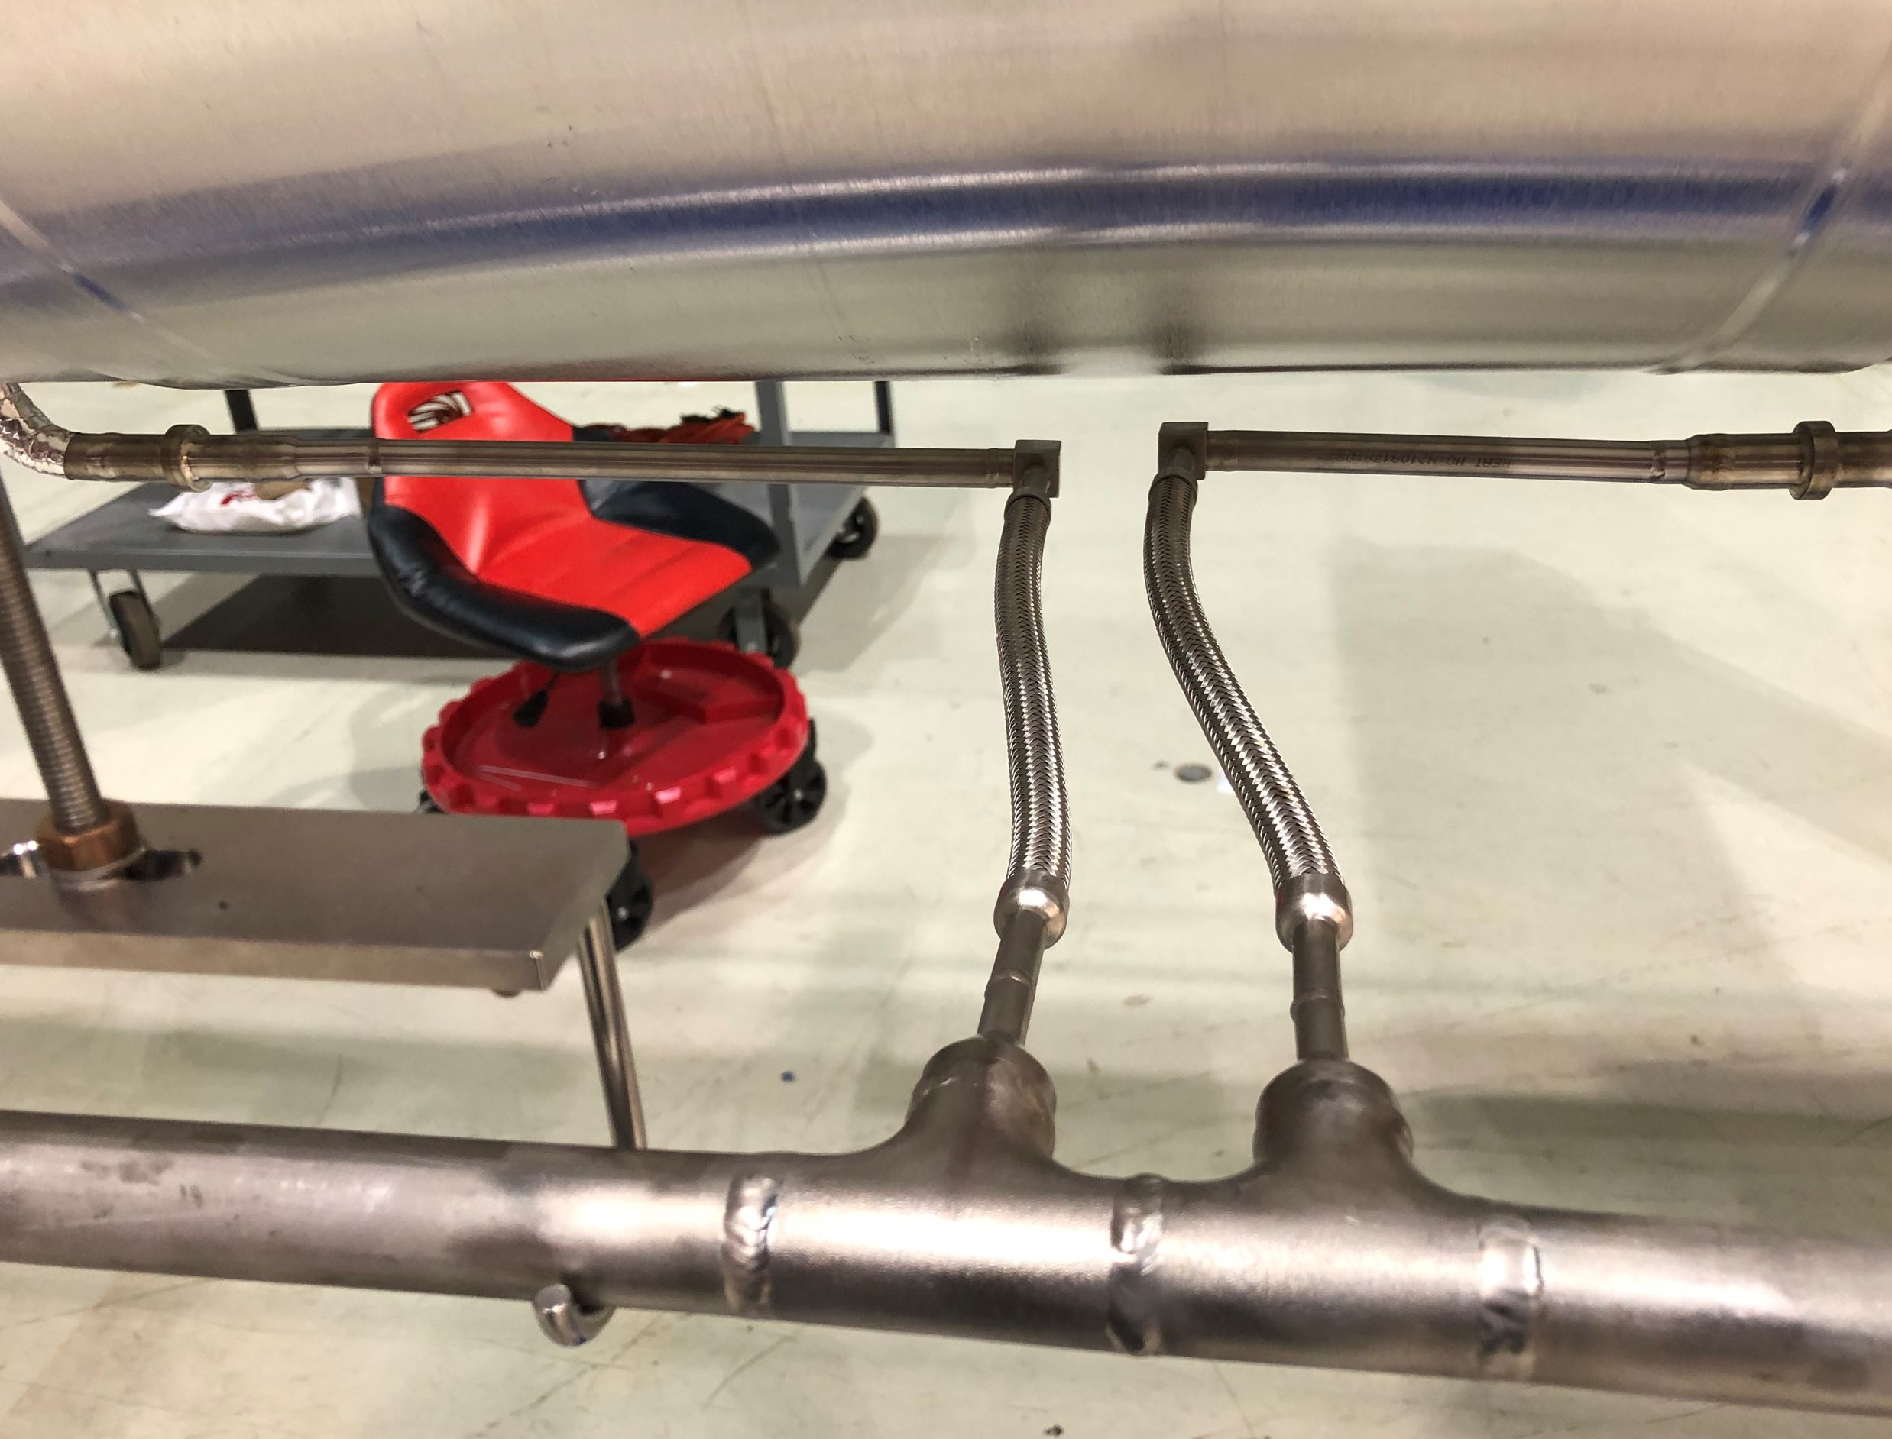
Phase 1A: Beam Line Assembly
Weld Cooldown Line
Line fabricated at FNAL, pressure tested, and leak checked before installation
This activity completes Phase 1A assembly
Offsets in CD Line to Compensate for Pipe Shrinkage

Slide 18
Phase 1B: Strongback Fitment and Assembly
Reference Drawing: F10152150
Traveler: 464613
Main Tasks
Set up vacuum vessel
Install global magnetic shields - complete
Assemble strongback on rail - complete
Strongback fitment in vessel – in progress
Install strongback magnetic shields and MLI
Install G-11 posts
Install lower thermal shield weldment
Install 5K line and cavity supports
Demagnetize strongback assembly – not required

Slide 19
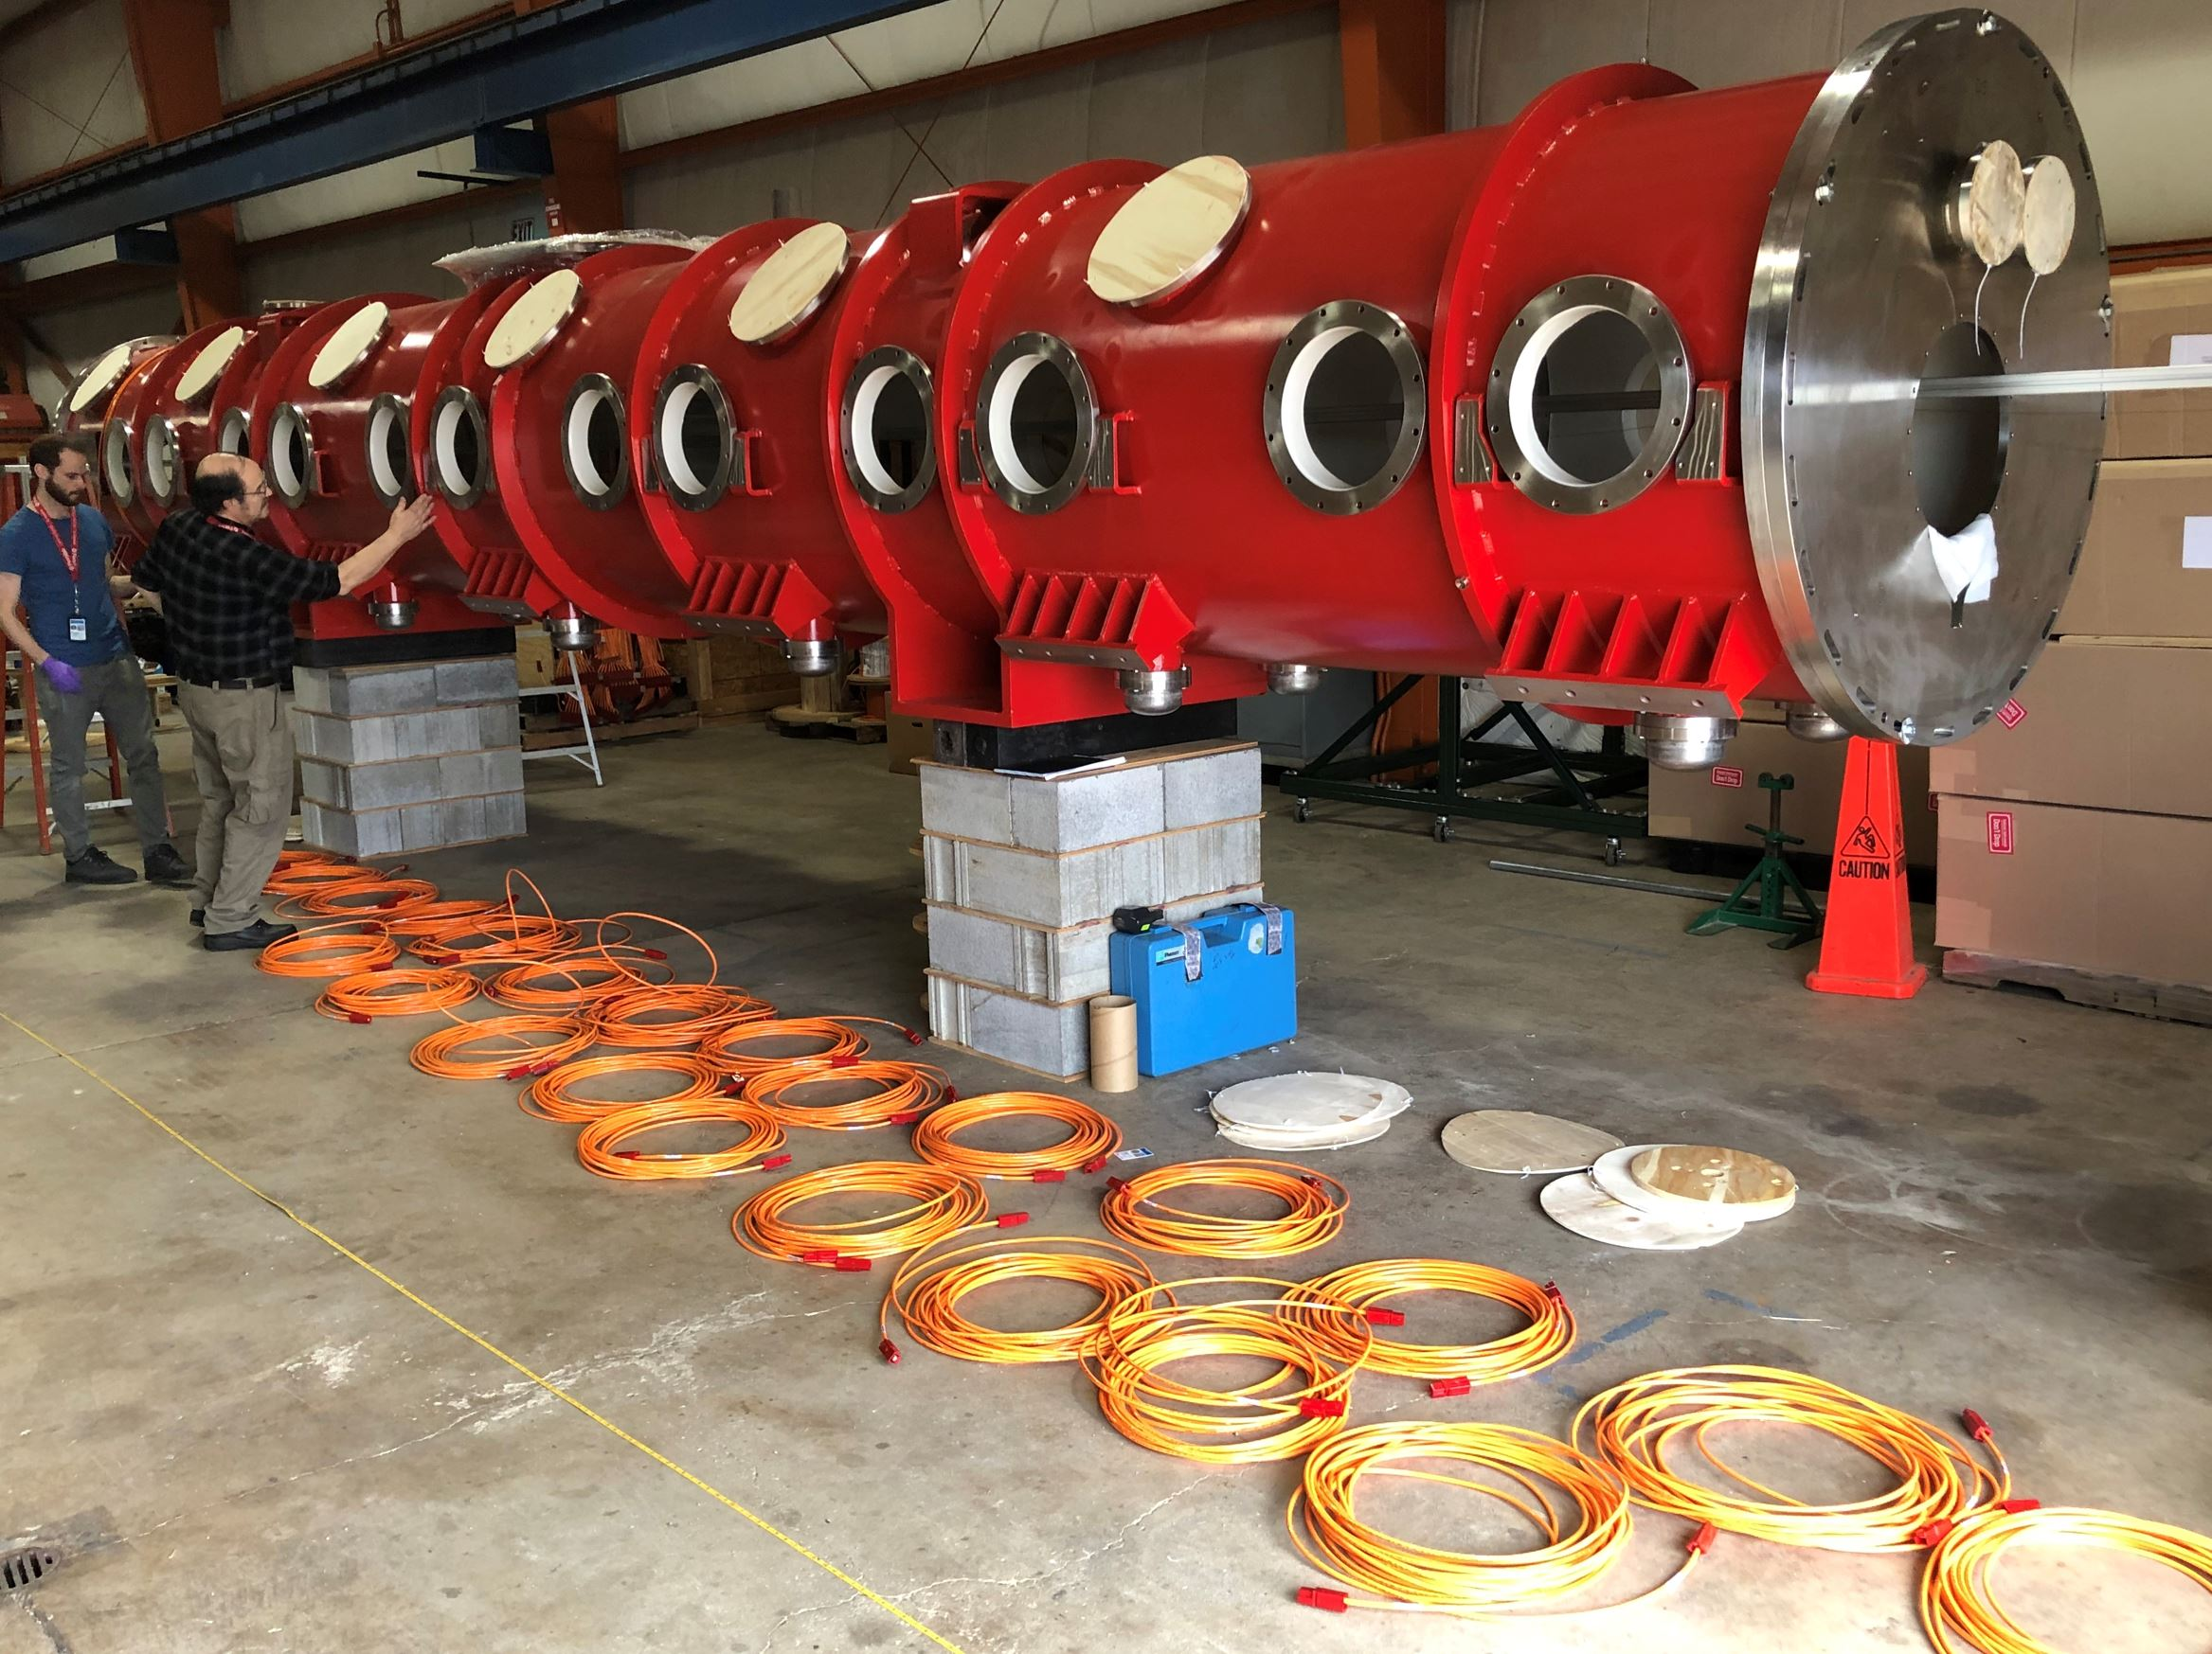
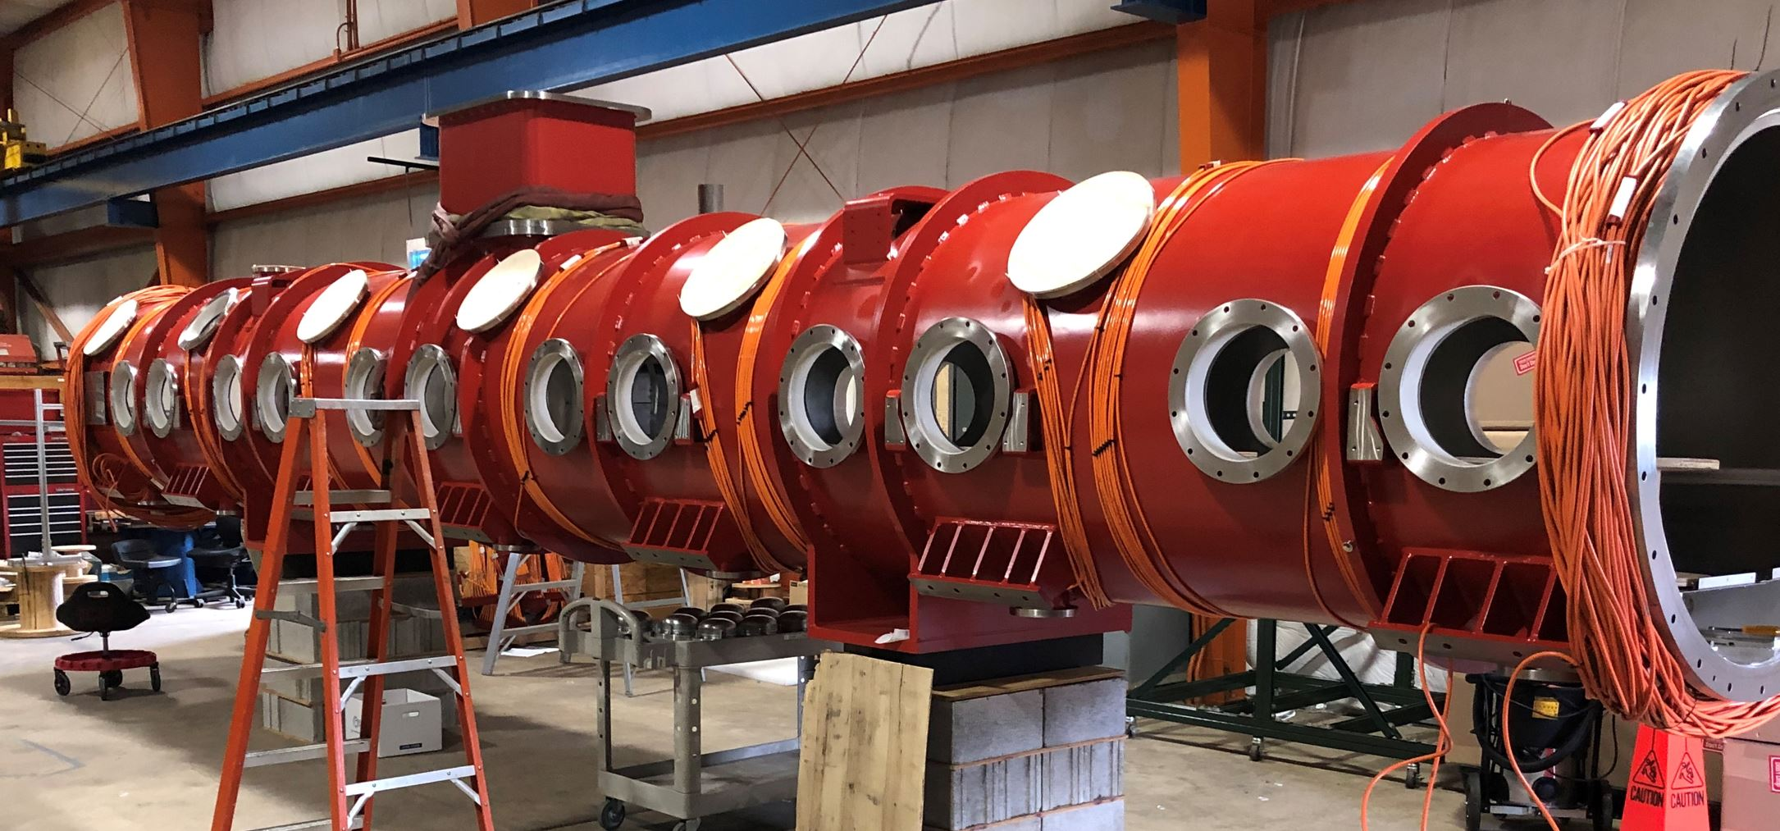
Phase 1B: Strongback Fitment and Assembly
Setup Vacuum Vessel
Permeability measurements on bare vessel
Demag vacuum vessel
Before and after demag coil installation

Slide 20
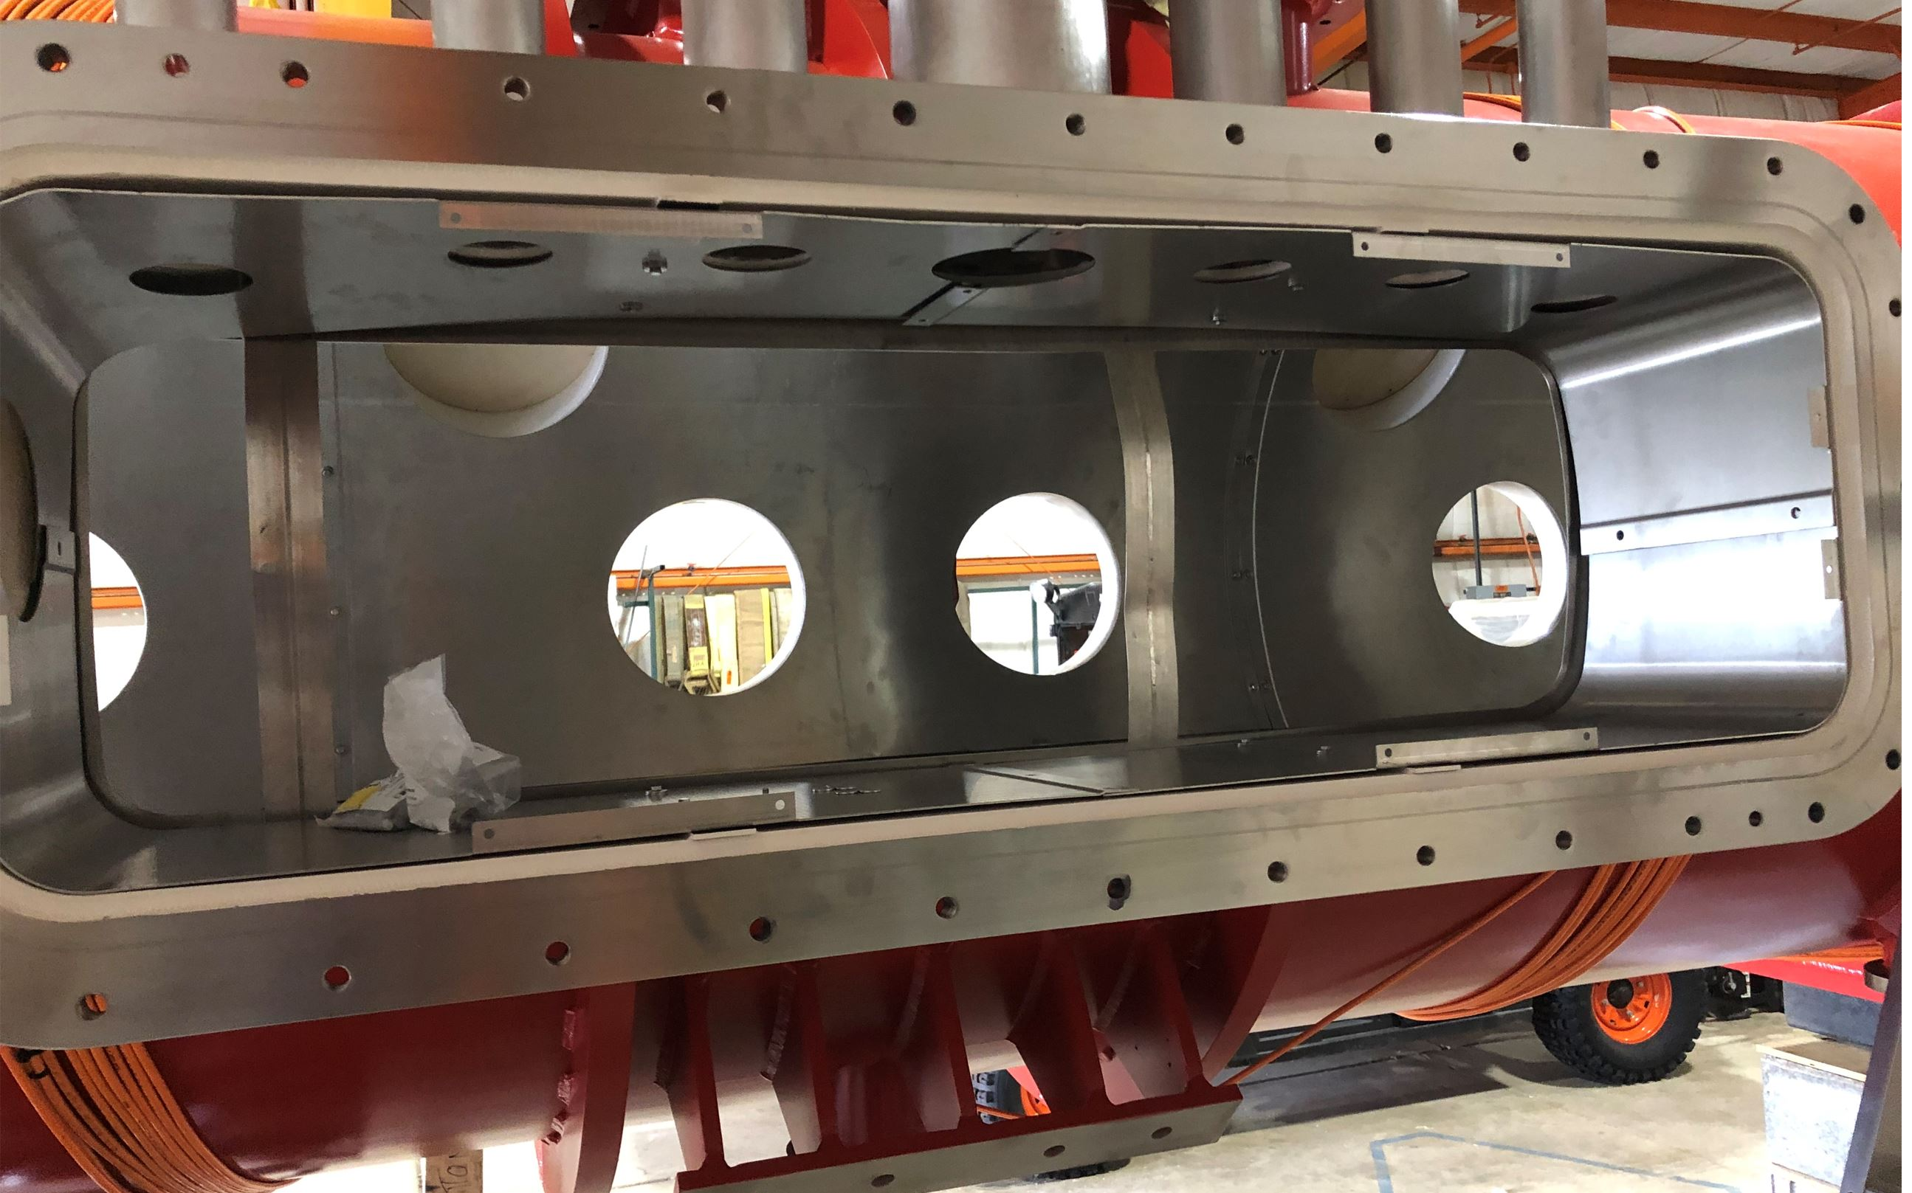
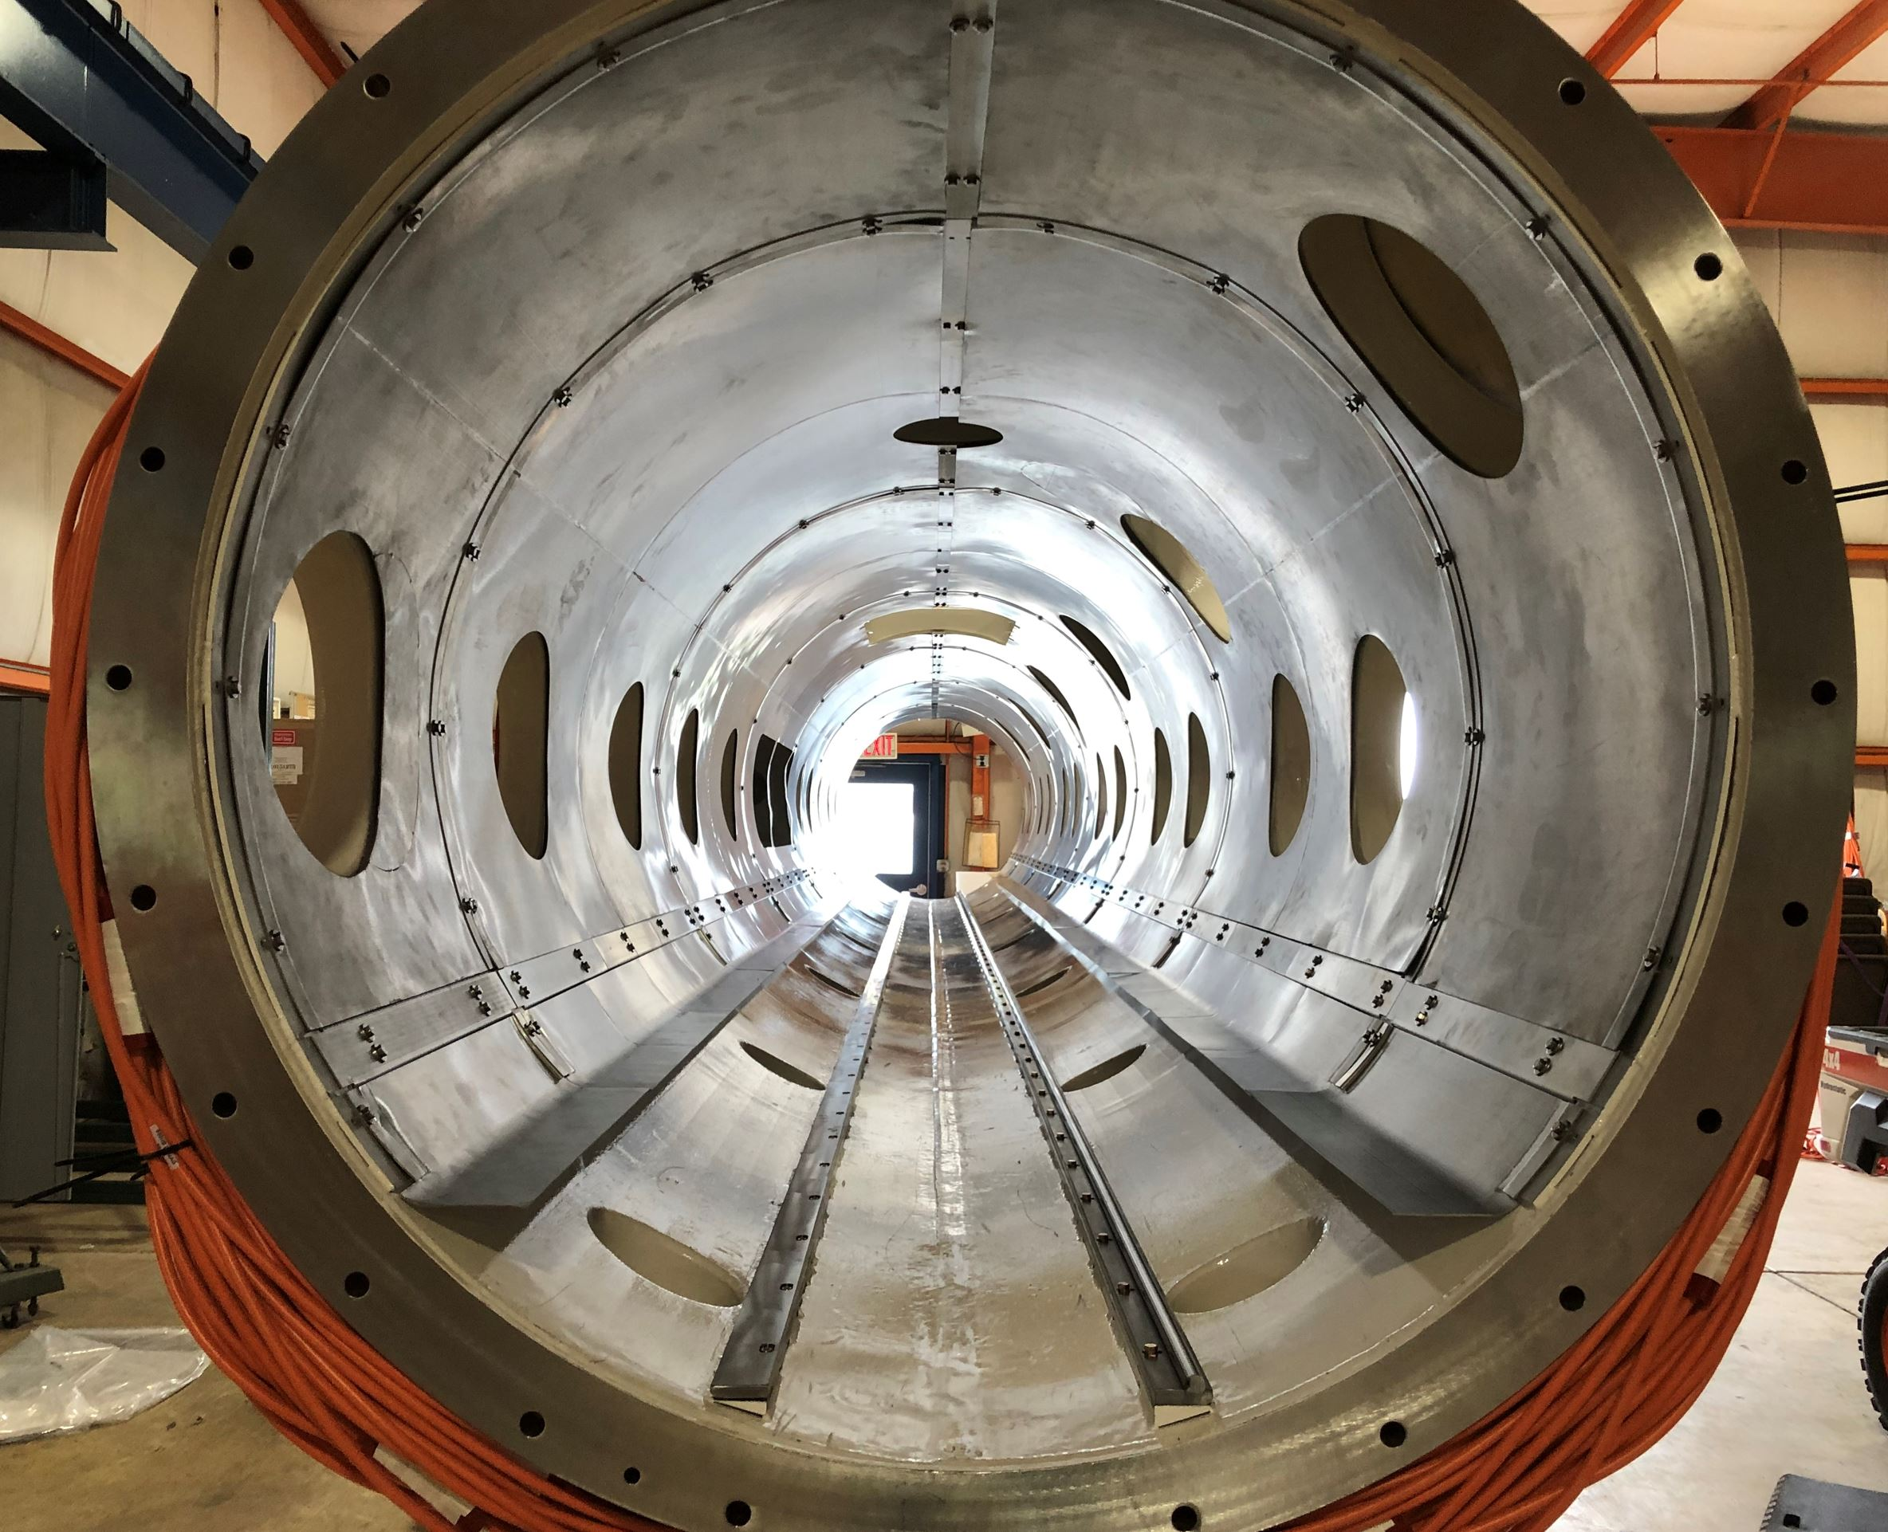
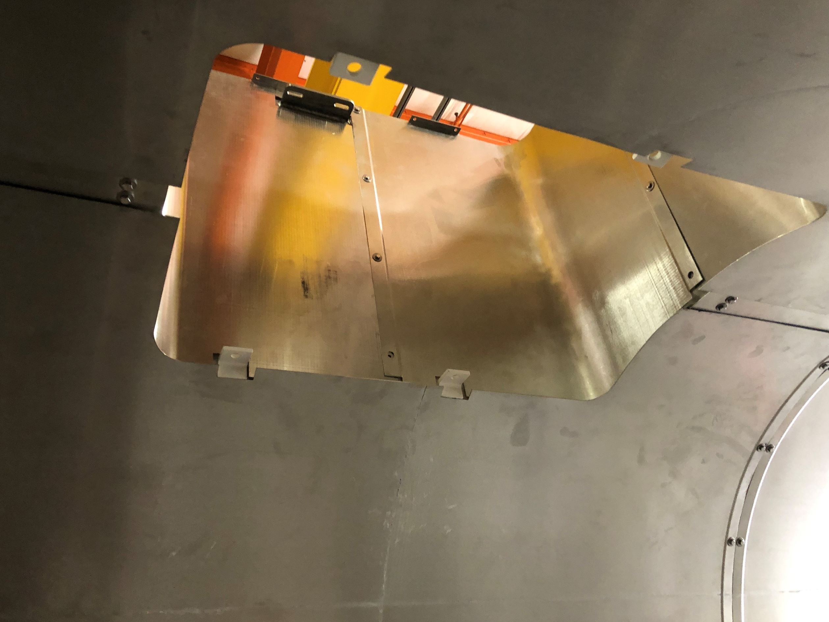
Phase 1B: Strongback Fitment and Assembly
Setup Vacuum Vessel
Install global magnetic shields

Slide 21
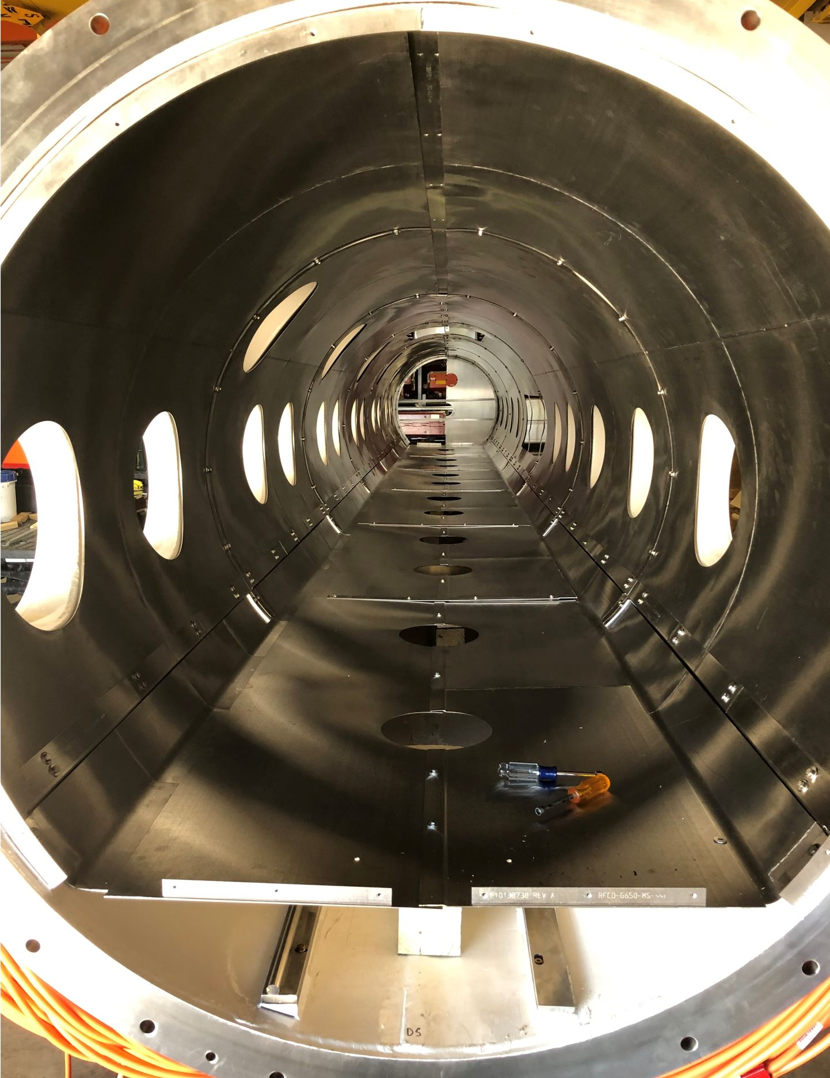
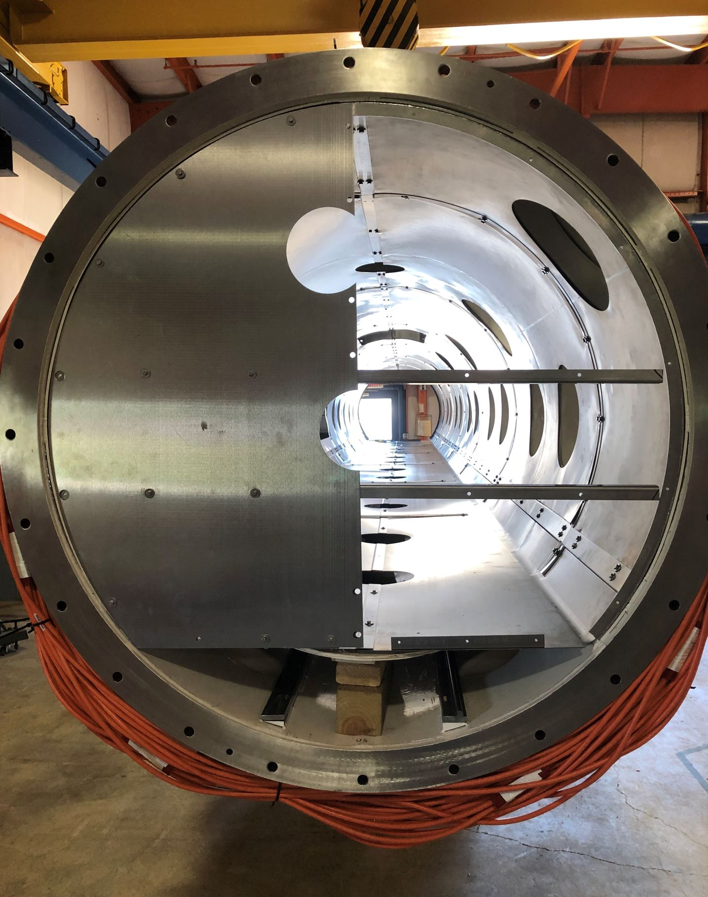
Phase 1B: Strongback Fitment and Assembly
Setup Vacuum Vessel
Install global magnetic shields

Slide 22
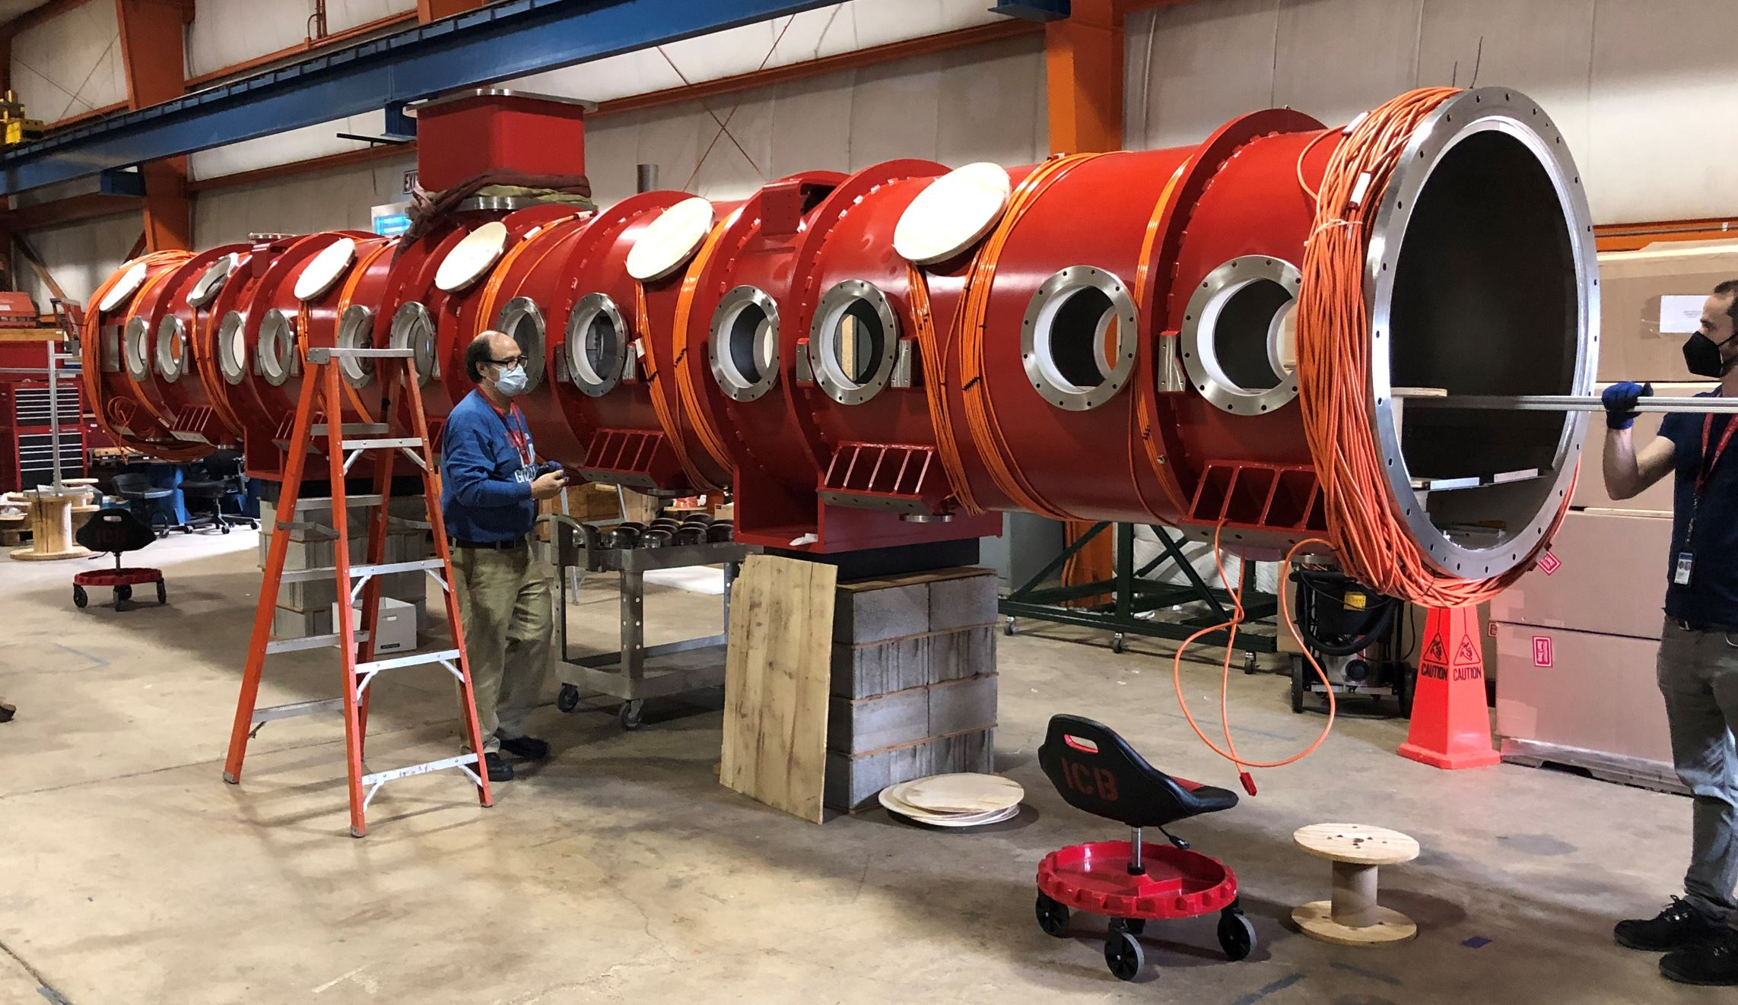
Phase 1B: Strongback Fitment and Assembly
Setup Vacuum Vessel
Permeability measurements

Slide 23
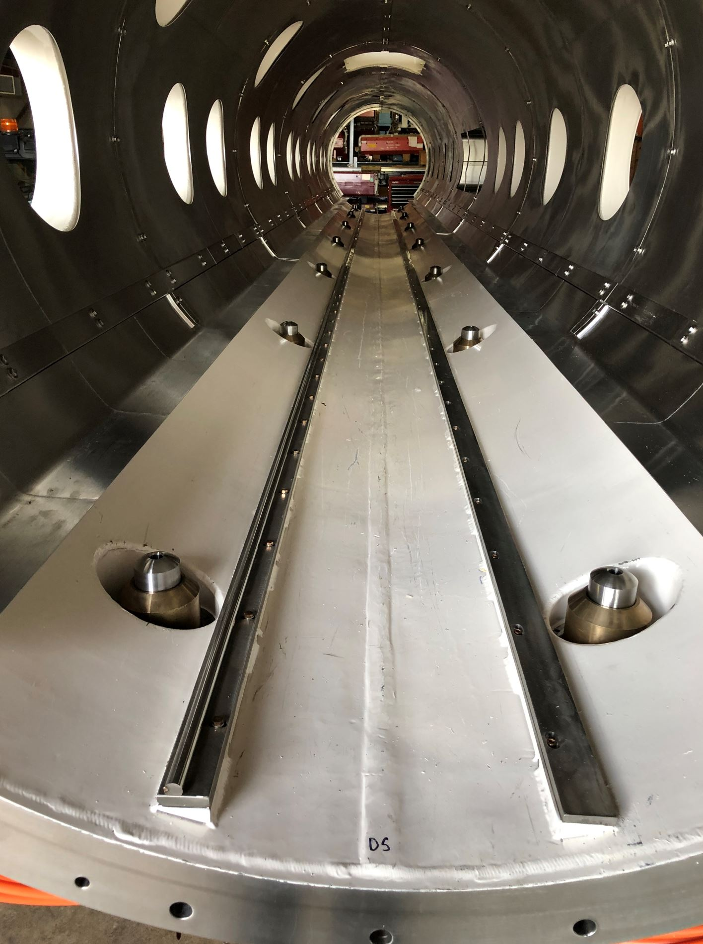
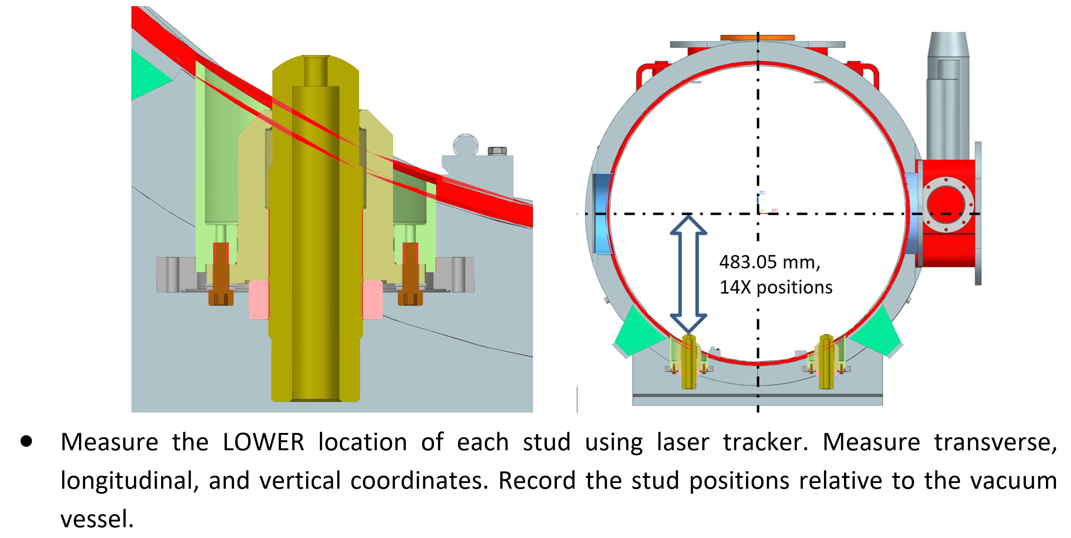
Phase 1B: Strongback Fitment and Assembly
Set and Capture Alignment Data for Strongback Supports
Set pin height to final height and measure bottom of pins via laser tracker

Slide 24
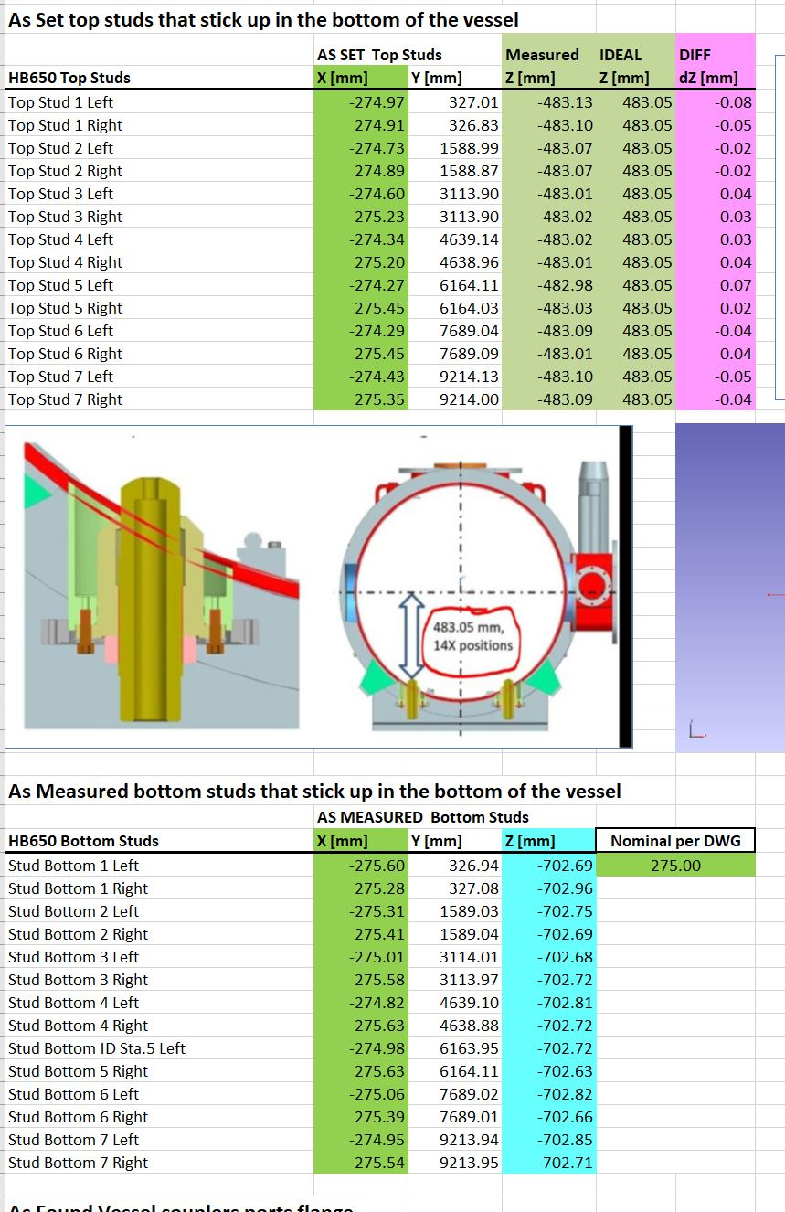
Phase 1B: Strongback Fitment and Assembly
Set and Capture Alignment Data for Strongback Supports
Set pin height to final height and measure bottom of pins via laser tracker
Data used for final coldmass alignment inside the vacuum vessel

Slide 25
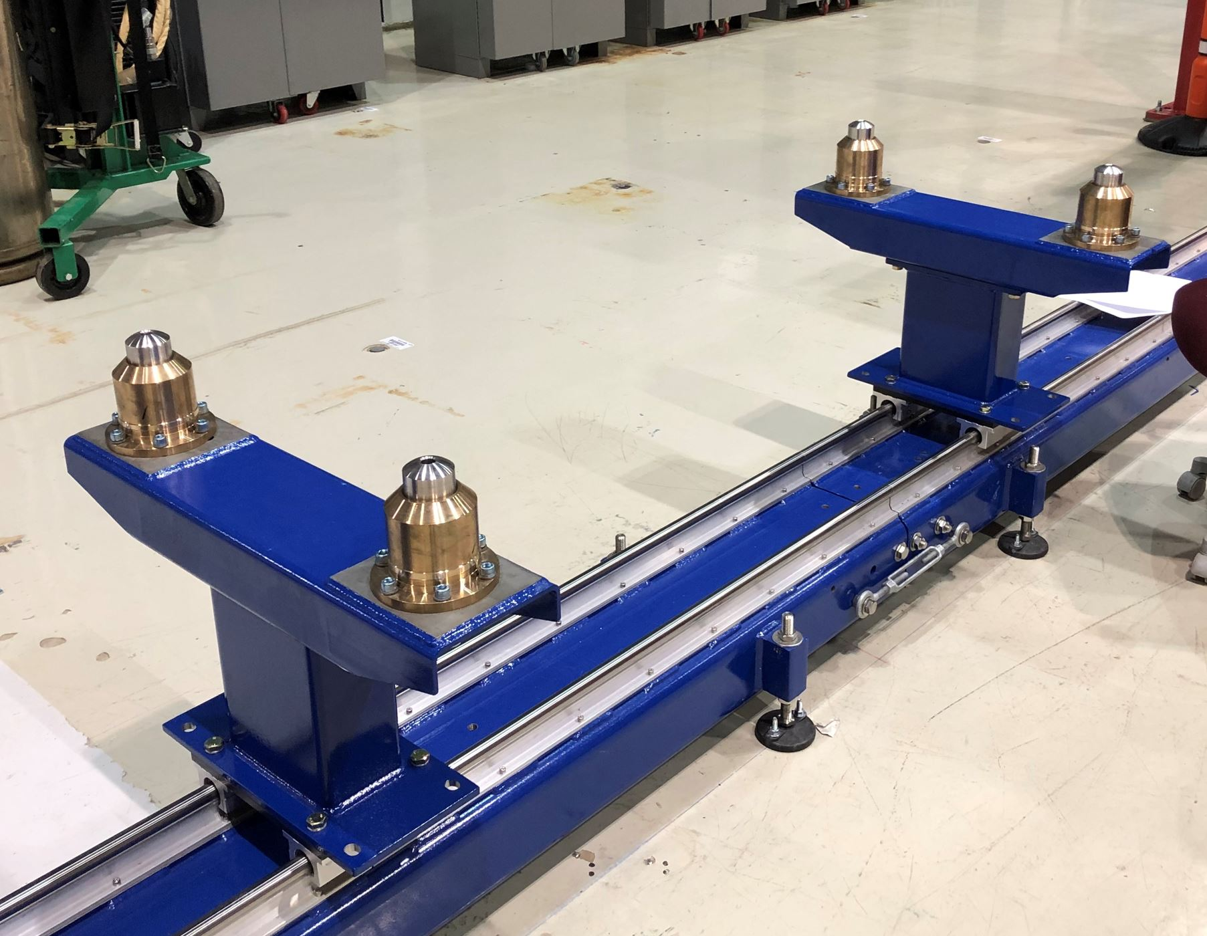
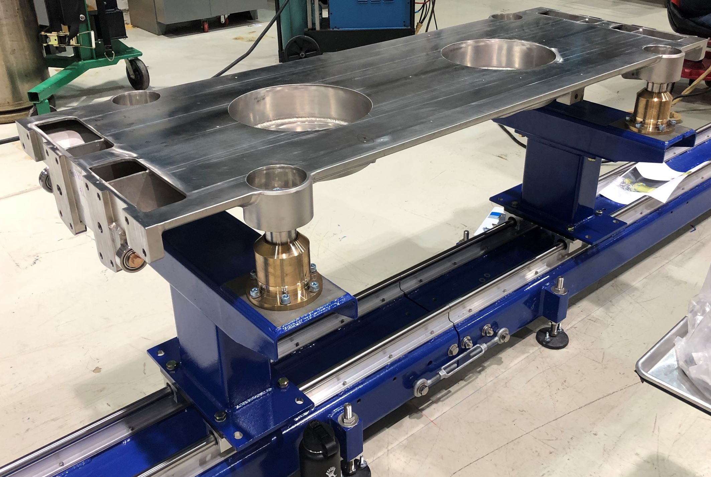
Phase 1B: Strongback Fitment and Assembly
Assemble Strongback on Rail
Six sections comprise strongback, pinned and bolted together
Remove the 14 supports from vacuum vessel and mount to rail supports
Upstream End Must be Assembled First

Slide 26
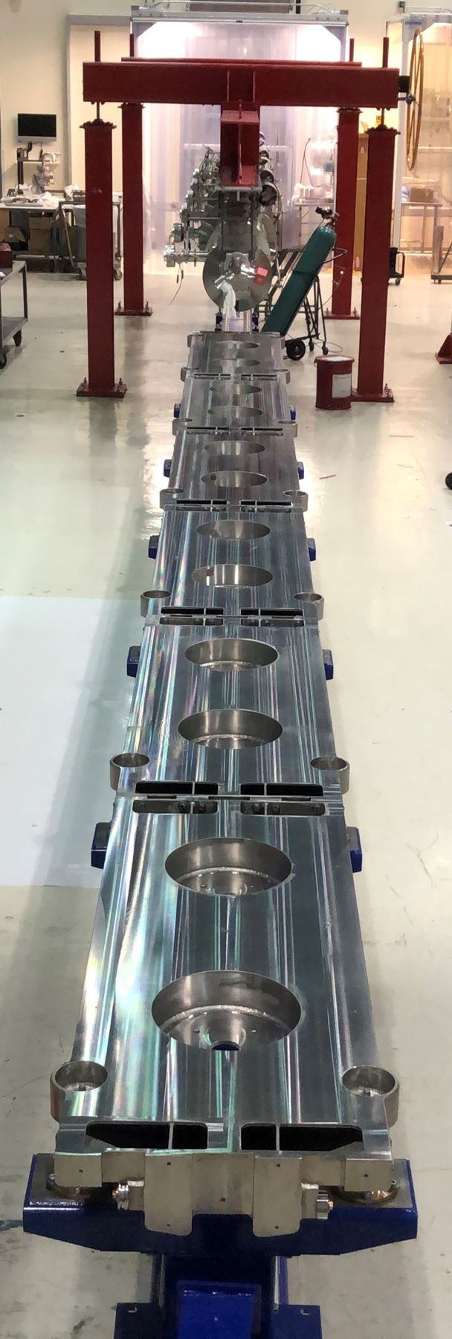
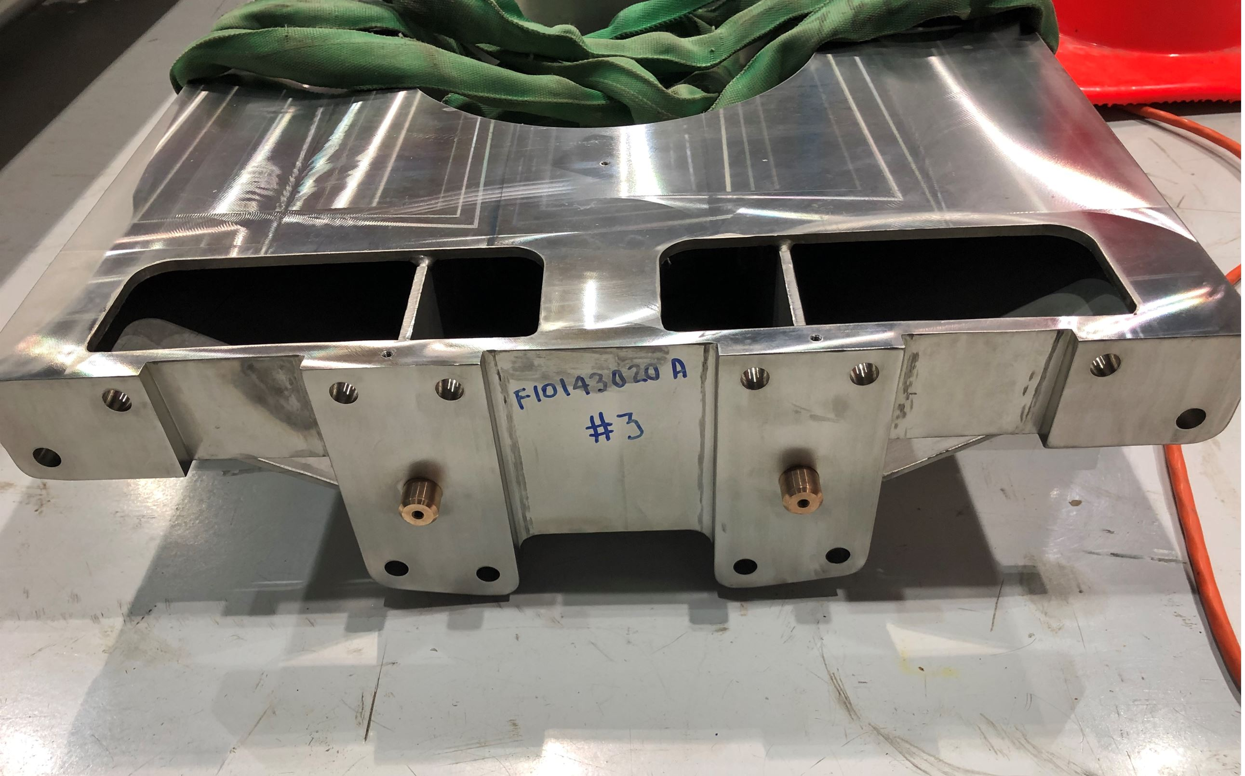
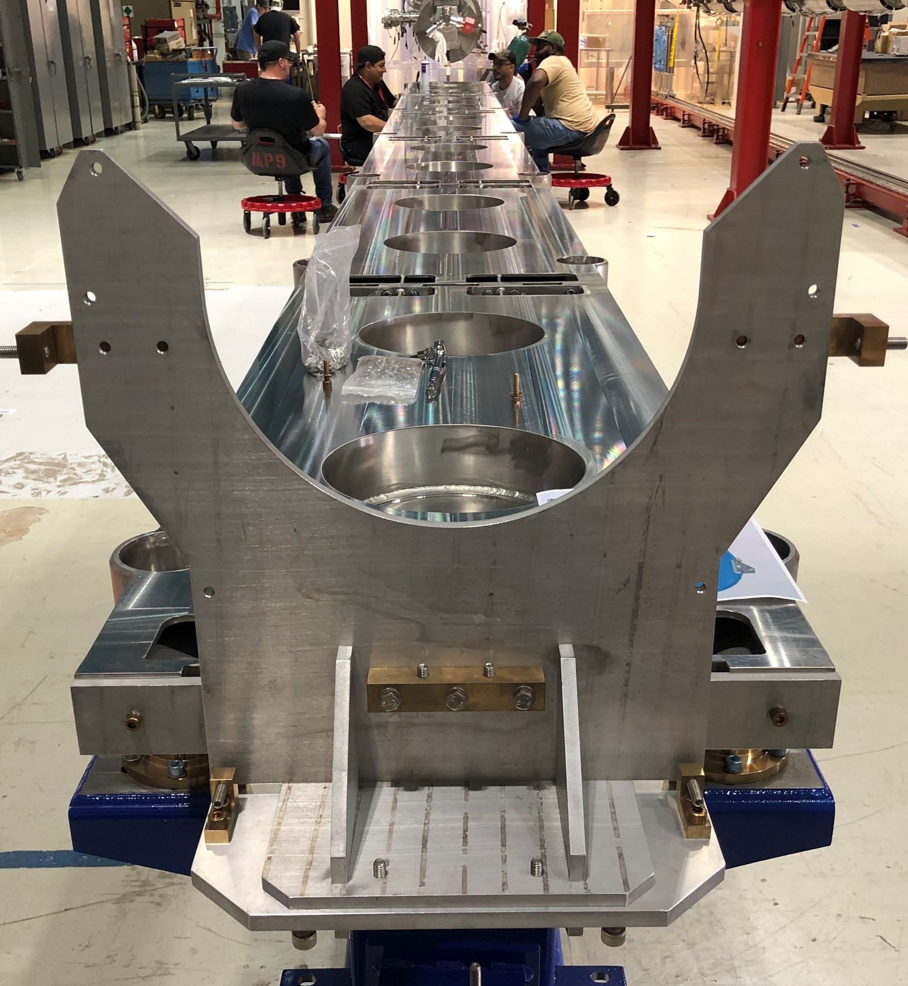
Phase 1B: Strongback Fitment and Assembly
Assemble Strongback on Rail
Six sections comprise strongback, pinned and bolted

Slide 27
Phase 1B: Strongback Fitment and Assembly
Straddle Vacuum Vessel over Rails
Align and level vacuum vessel over rails to except strongback for fitment test
Vessel resting on eight 6 ton leveling jacks
Four used for leveling
Four used for additional stability

Slide 28
Phase 1B: Strongback Fitment and Assembly
Strongback fitment test/alignment
Insert strongback and transfer loads to support pins

Slide 29
Phase 1B: Strongback Fitment and Assembly
Strongback fitment test/alignment
Set up “dummy” endplates and align positions to capture “real” plates

Slide 30
Phase 1B: Strongback Fitment and Assembly
Strongback removed from vacuum vessel
Pin the conical plate to the strongback

Slide 31
Look Ahead
Complete final Phase 1B steps
Install strongback magnetic shields and MLI blanket
Install G-11 posts
Install lower thermal shields
Install 5K line and cavity supports
Close Phase 1B
Prepare for Phase 1C assembly
Strongback and Beamline Merger

Slide 32
Misc. Work
Thermal Shield Assembly

Slide 33
Misc. Work
Titanium Cavity Support Fabrication

Slide 34
Misc. Work
Titanium Cavity Support Fabrication
Completed Cavity Supports

Slide 35
Thank you!

