Slide 1
PIP-II 2nd Technical Workshop – WG1
HB650 pCM String Assembly
Lessons Learned
J. Ozelis
12-July-2022

Slide 2
Introduction
String assembly for the HB650 prototype cryomodule commenced in early December 2021 and was completed by April 8th, 2022, with rollout of the string from the cleanroom
Progress was initially slow as infrastructure and tooling (and sometimes hardware) were available only in a just-in time (or sometimes not) basis
  Tooling was often, but not always, fully tested in a “mock-up” assembly, therefore some tooling operation/use was only tested out for the first time in the cleanroom during actual assembly
  Additionally, setbacks in timely qualification of cavities (vertical testing) due to FE were experienced.
    Cavity found to have bad vacuum required re-HPR and VTS test (2x).
  Incorrect procedure for coupler installation, precipitated by tooling problems, on two cavities required their re-processing/re-qualification
Many opportunities for lessons learned and improvements in tooling, processes, procedures, infrastructure, etc..
  Some of this captured in formal Discrepancy Reporting mechanism
  Most captured by “After Action” survey circulated among CR and engineering/scientific staff
    Resulting from something other than a non-conformance with a spec…

Slide 3
“After Action” survey – how we captured Lessons Learned opportunities that were not part of DRs, how we will track mitigation or solutions

Slide 4
Lessons Learned - Discussion of Individual Issues
Overall Strategy
  Presented relevant topics from the official Discrepancy Reports (9 issued related to string assembly)
    Nature of the discrepancy
    Resolution
    Corrective action
  Discussed other “Lessons Learned” items individually, covering the following :
    The issue/difficulty encountered
    Root cause of the issue (bad tooling, incomplete procedure, sub-optimal component design, facility issue)
    Proposed or agreed upon solution/mitigation
    Status of the mitigation
    Verification plan for mitigation
  Summarize any common or general Lessons Learned – any overarching themes
  In the following slides are described some lessons learned of particular note. Full set is discussed in slides on the LL Indico page (https://indico.fnal.gov/event/55032/)

Slide 5
Discrepancy Reports
12667 : Cavity internal pressure too high
12775 : Two cavities had bent fill lines
12726 : Inactive purging during coupler/bellows installation
12709, 12710 : Improper coupler installation
12750 : Inactive purge during coupler installation
12790 : Coupler-Coupler distances out of spec
12760 : Threaded stud in wrong orientation
12806 : String overall length too long by 16mm
12726, 12709, 12710, 12750, 12760,12790, 12806 to be covered as part of larger group of lessons learned from “After Action” survey.

Slide 6
Lessons Learned - Discussion of Individual Issues
DR 12667
Issue : Cavity internal pressure found to be too high when attempting to backfill in preparation for coupler installation – suspect a leak which cold have led to contamination
Resolution : Cavity was removed from cleanroom, underwent HPR/VTS cycle to be requalified
Root Cause : Leaking Right Angle Valve (cavity had been under vacuum, coming straight from previous VTS test). It has been FNAL (and other) experience that these VAT RAV’s can begin to leak after a certain number of (thermal : 300K → 2K → 300K) cycles
Corrective Action : Develop a tracking mechanism (traveler based?) to record how many times a particular RAV has been used on an assembly, and prohibit use (remove from service/inventory) after X times.
Status of Mitigation : In progress

Slide 7
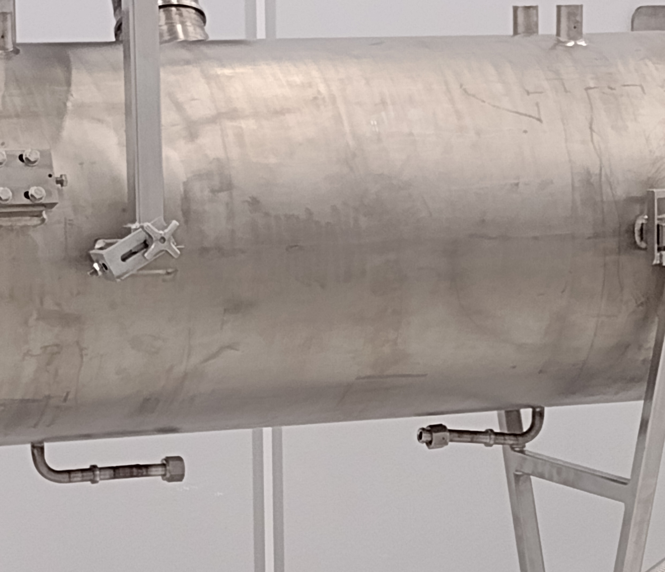
Lessons Learned - Discussion of Individual Issues
DR 12775
Issue : Once in the cleanroom and readied for assembly, it was found that two cavities had bent He fill lines. These may have prevented further assembly on the coldmass with the cooldown line.

Slide 8
Lessons Learned - Discussion of Individual Issues
DR 12775
Issue : Once in the cleanroom and readied for assembly, it was found that two cavities had bent He fill lines. These may have prevented further assembly on the coldmass with the cooldown line.
Resolution : Cavities (sealed) were removed from cleanroom, HeV fill lines repaired. (cavities then underwent HPR/VTS cycle to be requalified for other reason)
Root Cause : Interference with structural member of shipping crate. Shipping crate was originally modified to allow space for fill line, but this required careful placement in crate, which was not always easily accomplished (observable).
Corrective Action : Modified crates to provide clearance regardless of how cavity is positioned in the crate
Status of Mitigation : Complete

Slide 9
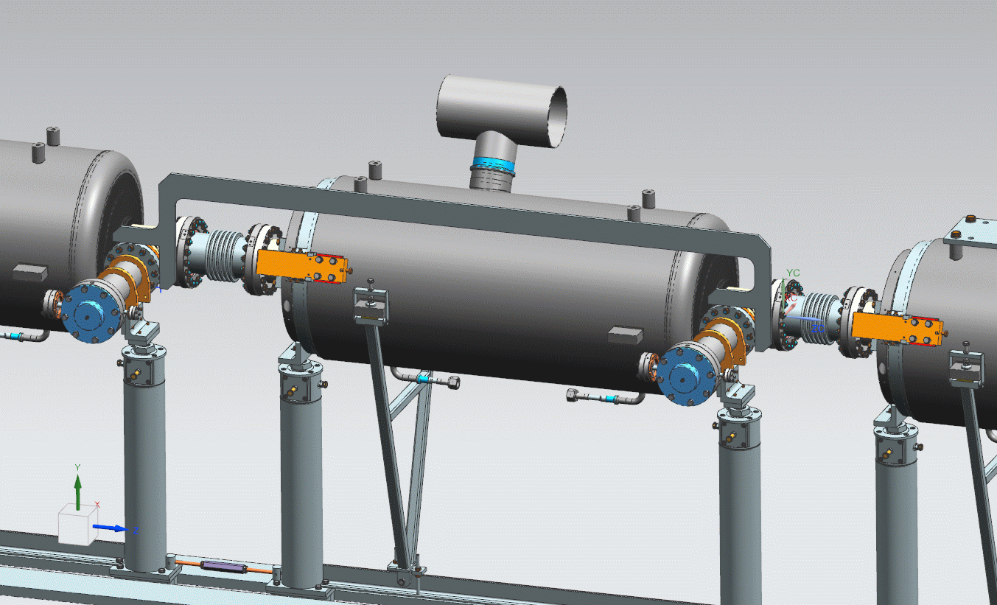
Lessons Learned - Coupler to Coupler Measurements and Adjustments
Issue #1
  “Coupler-to-Coupler spacing adjustment not clearly described”
Proposed Mitigation
  Redesign measurement “Caliper”
    Interface with Coupler flats
  Revise Traveler 464612
Status of Mitigation
  Design Complete
    F10181970
  Fabrication Next
  464612 being revised to
  appropriately detail process.

Slide 10
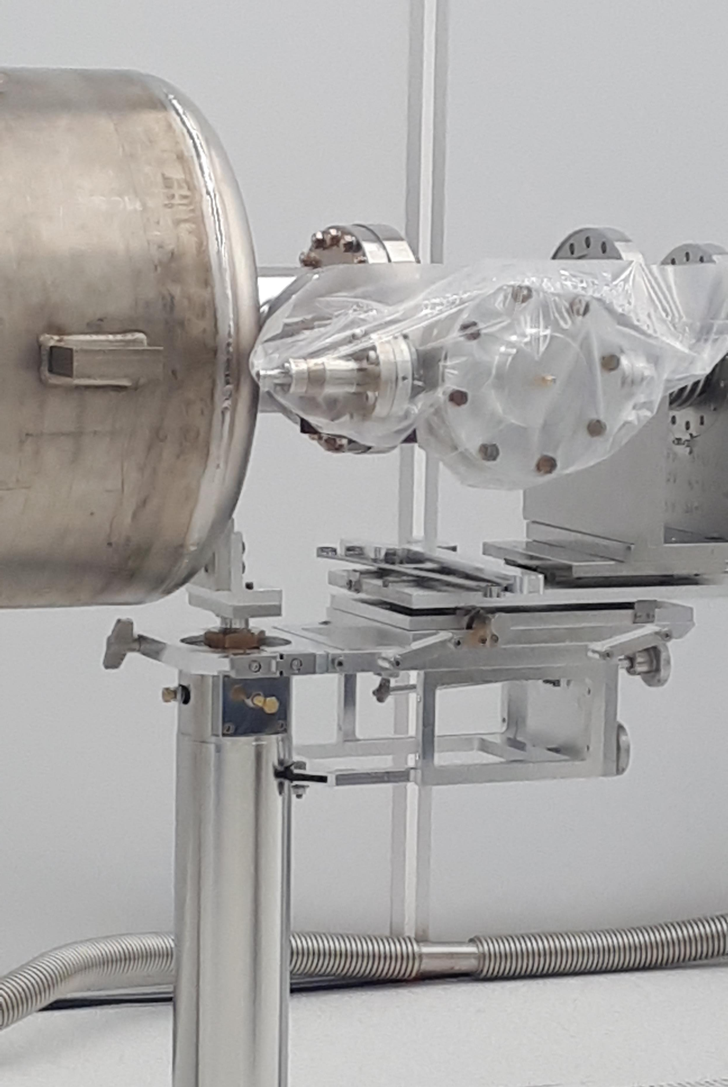
Issue #2: Coupler table not robust enough to hold higher weight of 650 couplers. Broke during use.
More context: this table was used for 3 couplers and 2 bellows assemblies. One knob broke at 4th coupler assembly.
Root Causes:
  Table located too low in 3D model, hence table is barely useable at its lowest level
  Mock-up failed to identify this problem
  Table is copy/paste from LCLS-II table, but not adapted to the weight of PIP-II bellows and couplers
  Knob thread is SS on SS
Resolution: the knob was replaced with SiBr thread, the table became useable but still facing instability problems.

Slide 11
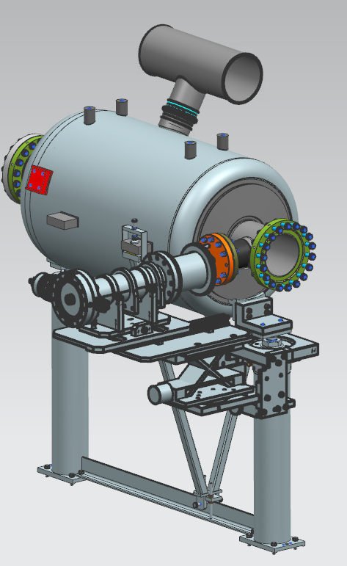
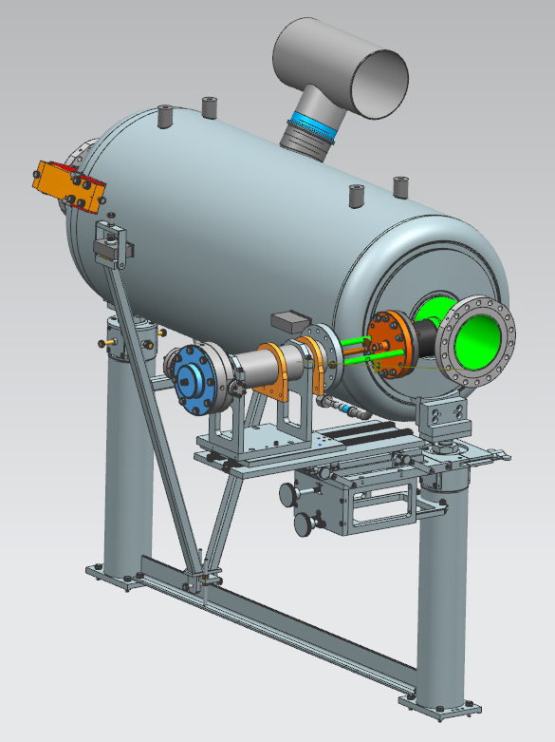
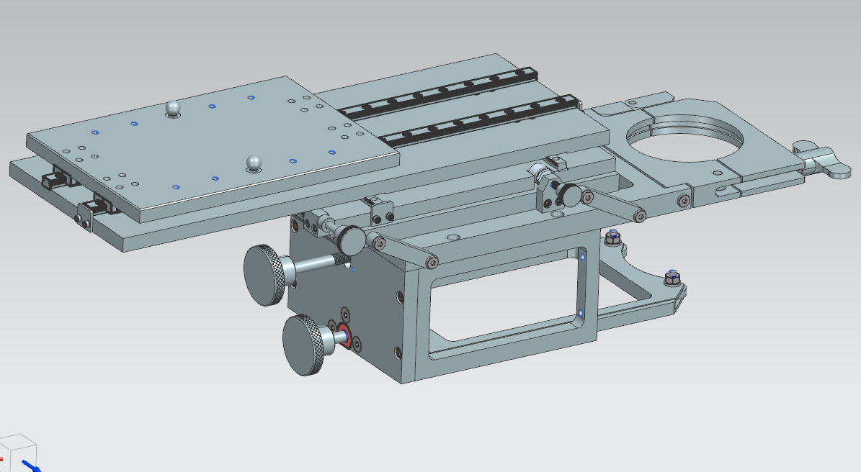
Corrective Action: two options described below
Status of Mitigation: assessment is ongoing. Anticipated completion date: 31-Aug-22
1
2
F10167419-B, revised
1. Upper plate longer (25 cm, was 15cm)
2. Silicone Br.-Threaded insert
Option #2
Use CEA Installation tool
More information to be obtained from CEA
Option #1
Use FNAL revised Installation table

Slide 12
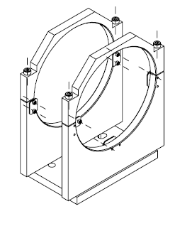
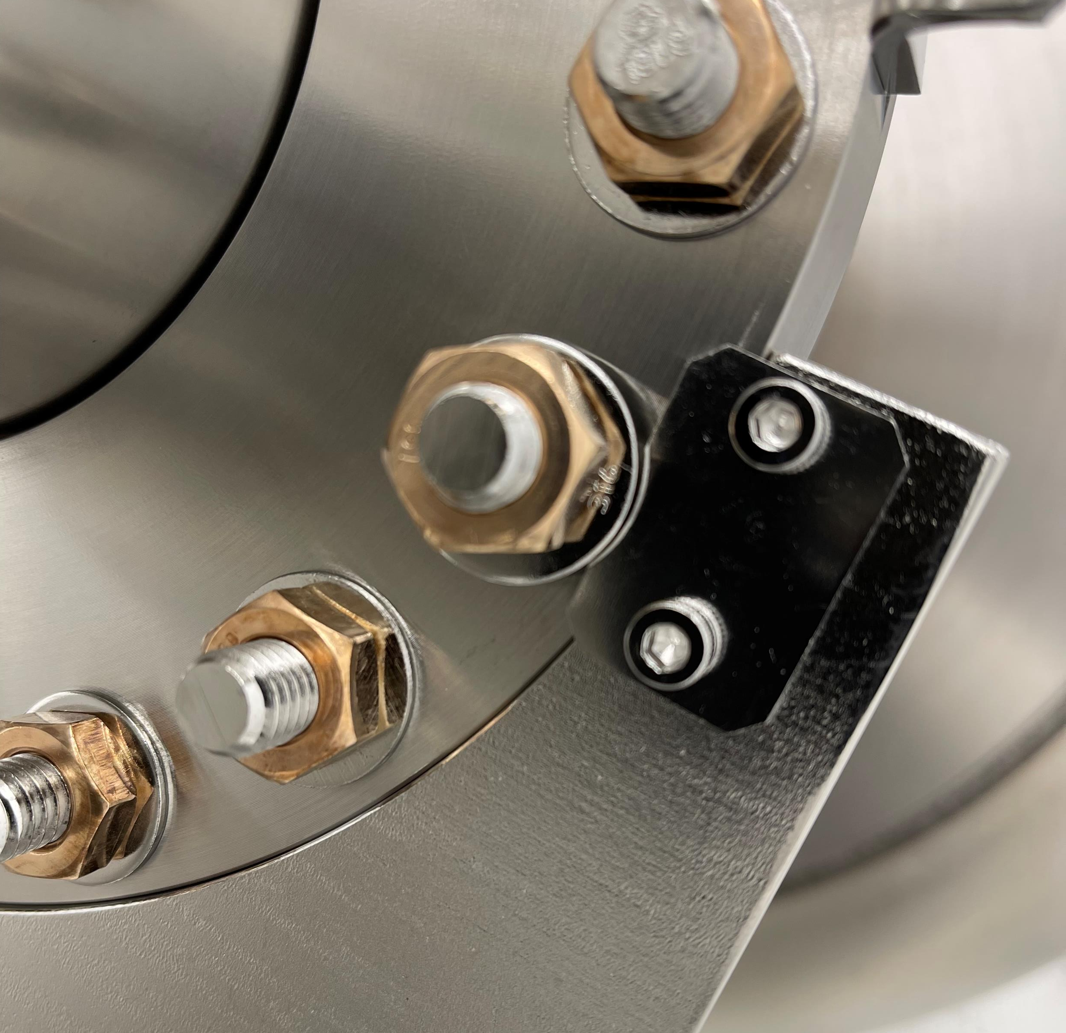
Issue #3: Bellows holders are too heavy. Awkward positioning doesn't easily allow for 2-person handling. Holders are steel.
Root Cause: new design, issue with weight identified during mock-up assembly​
Corrective Action: bellows holder drawings were revised. Holder material was changed to Aluminum with anodizing.
Resolution: the holders were used as is.
Status of Mitigation:
B92 bellows holder already at MP9.
Additional interference problem:
Not worked out yet.
Anticipated completion date: 10-July-22
F10143573-C

Slide 13
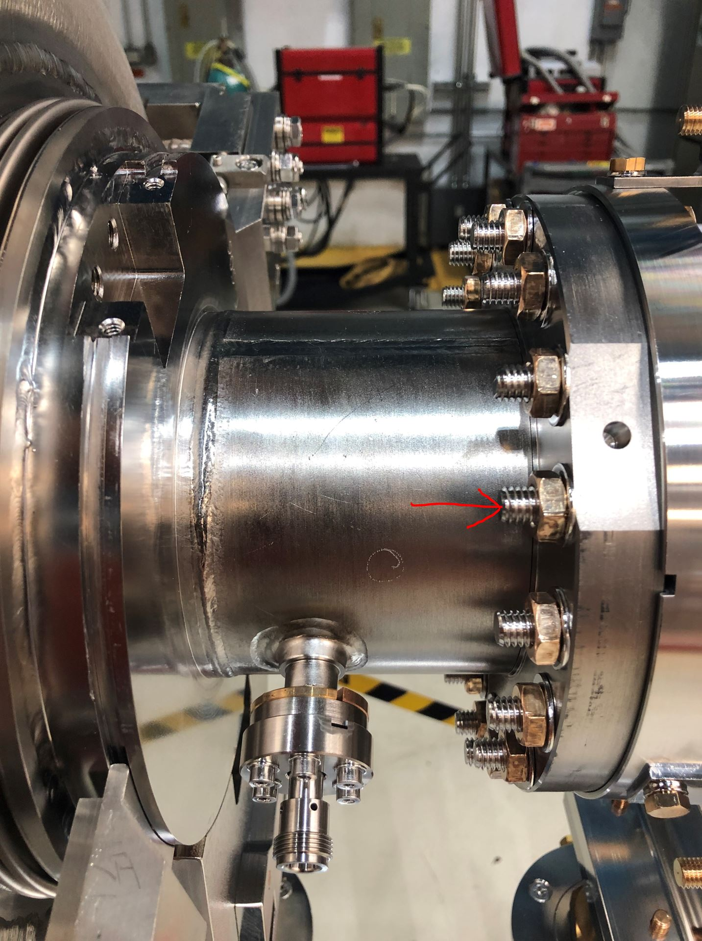
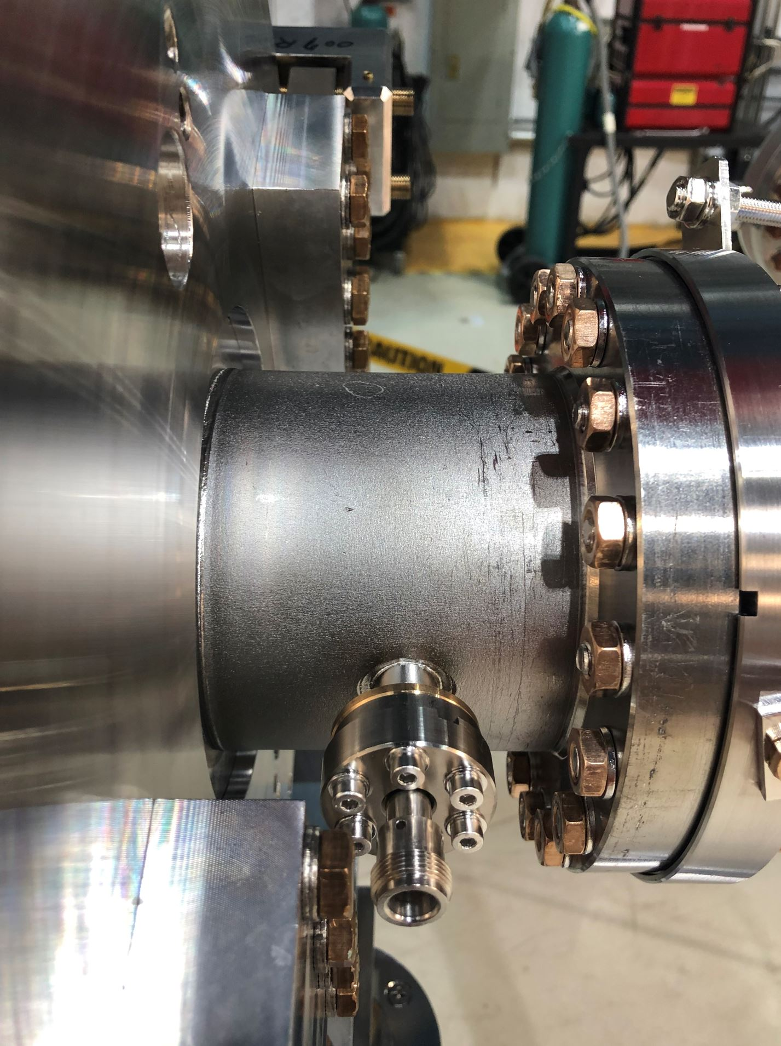
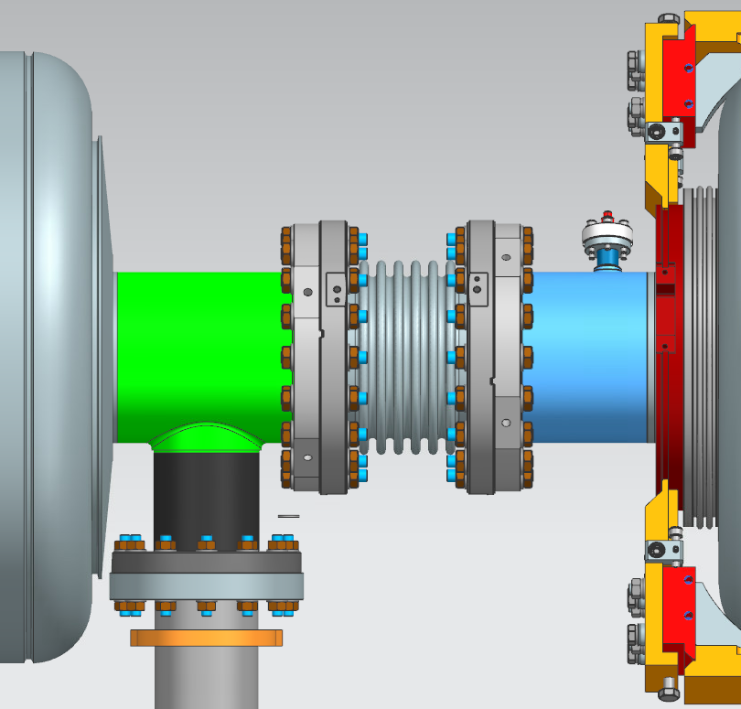
Issue #4: Studs need to have the extra length on one side, with the nuts flush on the other to accommodate tuner and magnetic shielding.
Root Cause: DR / procedure
Resolution: the studs of BPE-RRCAT506 flange connection were flushed one by one.
Corrective Actions:
For HB605 and LB650 production, drawings will include short M10 studs.
Status of Mitigation: ongoing.
Drawings will be revised.
Anticipated completion date: 10-Jul-22
B92-B92
bellows

Slide 14
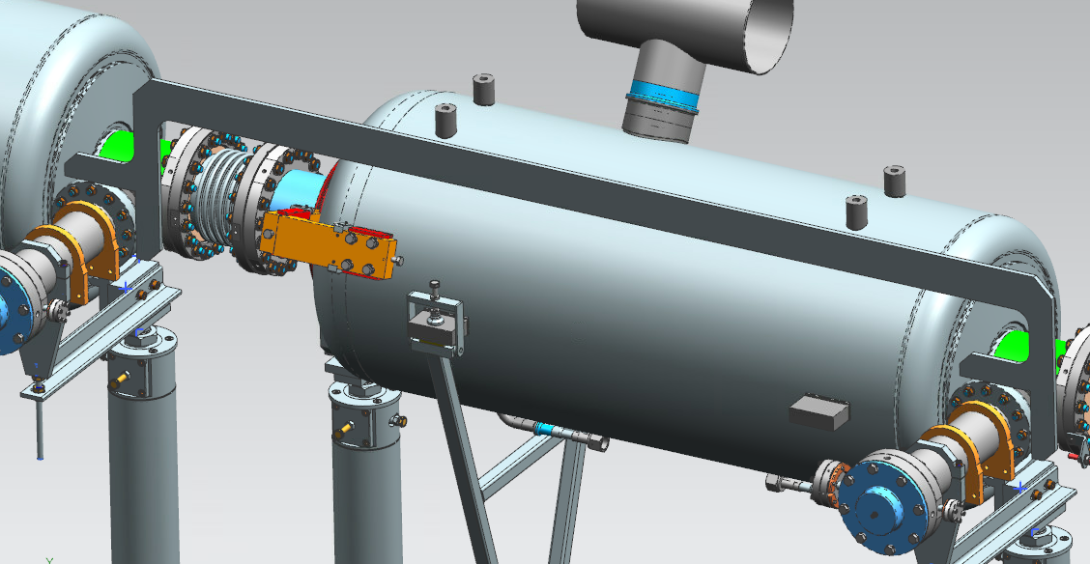
Issue #5: Coupler to Coupler distance tooling
Root Cause: new design, issue with rigidity identified during mock-up assembly.​
Resolution: the current caliper was used, with deviations on the distances
Corrective Actions:
  Coupler to coupler caliper was redesigned, F10181970, Al 8 mm thickness.
Status of Mitigation: drawing released.
  Fabrication process not started yet.
  Anticipated completion date: 31-Aug-22
F10181970--;1-HB650 CALIPER, XFEL STYLE

Slide 15
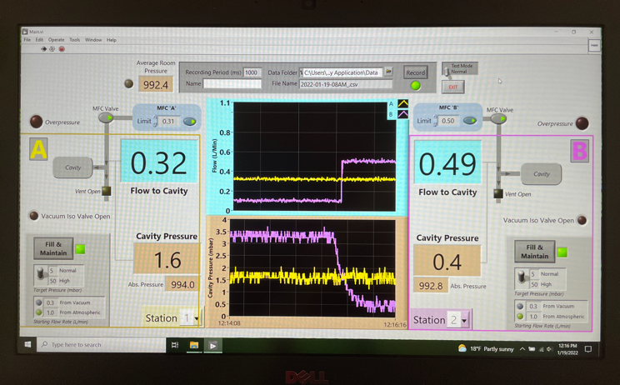
Lessons Learned - Purging System Not Robust
Issue #6
  Purge system doesn't seem to work in the same way consistently. Sometimes the flow indicator turns on and the valve click was audible, sometimes the flow indicator would not turn on and the click was audible, sometimes the flow indicator turns on but there is no audible click of the valve opening. Demonstration that the valve is not always opening or closing when the flow indicator is on or off. Particulates could be entered into the cavity during flange hole purging.
Root Cause
  Software was not tested early enough. Mock-up was not conducted due the o tight schedule and the lack of a spare cavity.
  Staff not fully trained.

Slide 16
Lessons Learned - Purging System Not Robust
Issue #6
Proposed Mitigation
  Improve the software and provide a visible/audible signal inside the cleanroom.
    Bring a display inside the cleanroom or viewable through the cleanroom window.
  Train the staff and incorporate the feedback from the end users.
Status of Mitigation
  Complete by 12/31/2022

Slide 17
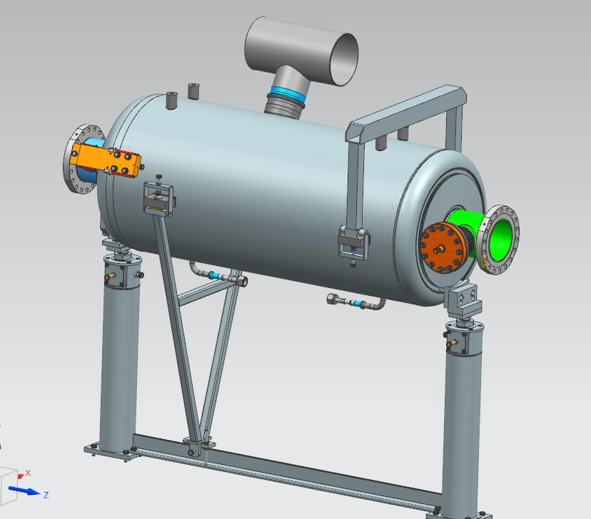
Issue #7: Leveling Bridge made of steel. Too heavy to easily handle in the cleanroom, no locking mechanism.
Root Cause: new design, issues with weight and locking identified during mock-up assembly.
Resolution: locking mechanism was implemented, then used as is.
Corrective Actions:
Leveling Bridge was revised, F10169274-B, material- Al.
Weight is 3 times smaller.
Status of Mitigation: drawing released.
Locking mechanism yet to be included.
Fabrication process not started yet.
Anticipated completion date: 31-Aug-22

Slide 18
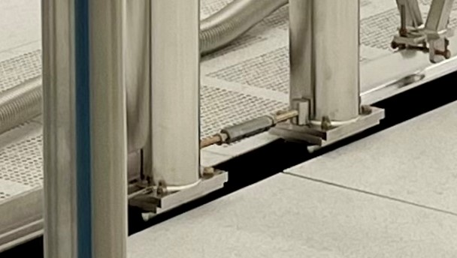
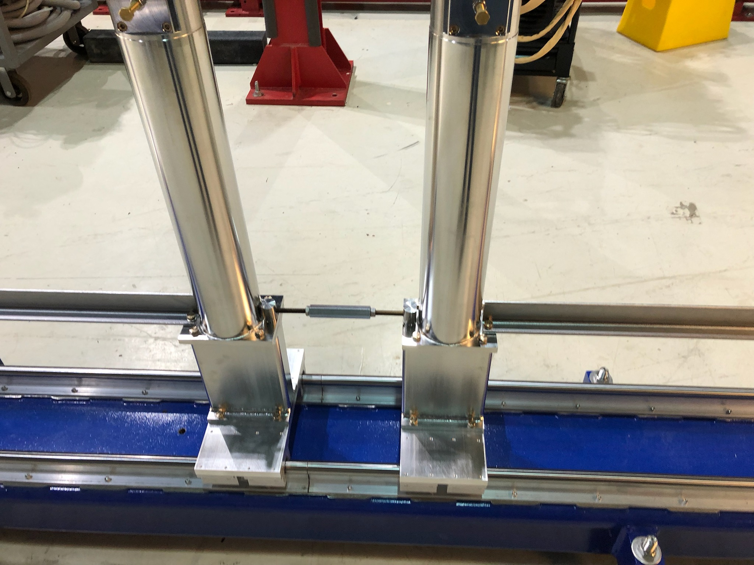
Issue #8: Turnbuckle assemblies did not fit into receptacles on cleanroom posts, they therefore could not be used when adjusting cavity-cavity spacing in the cleanroom.
Root Cause: Turnbuckles pins conformed to specs, but holes in the post bases needed rework. Only partial QC of the done rework resulting in one turnbuckle that did not fit and could not be removed, in the clean room.
Resolution: this turnbuckle was removed outside of the clean room.
Corrective Actions:
None, all parts should have 100% QC, including QC of repair work.
Status of Mitigation: QC yet to be done.
Anticipated completion date: 10-Jul-22

Slide 19
Issue #11
Studs for beamline and coupler flanges are too long. The extra length on the beamlines have to be put on one specific side, and screwing nut extra distance of stud creates more particles, and makes sliding stud through hole more unwieldy.
-See Issue #4, also needs cavity string drawing for production HB650

Slide 20
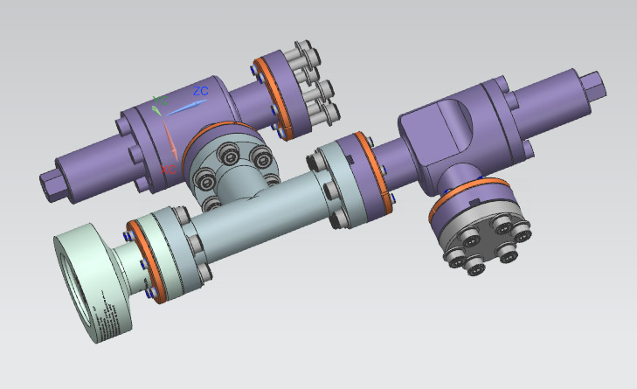
Issue #13: Beam line burst disk sub-assembly used the hex head screws
Root Cause: new design, issue with assembly identified early on by techs.
Resolution: used as is.
Corrective Actions:
Drawing is revised, F10150129-A.
Hex-head screws changed to socket head-cap screws, everywhere.
Custom Allen key to be used
M4 screws are tighten by hand.
Status of Mitigation: drawing released

Slide 21
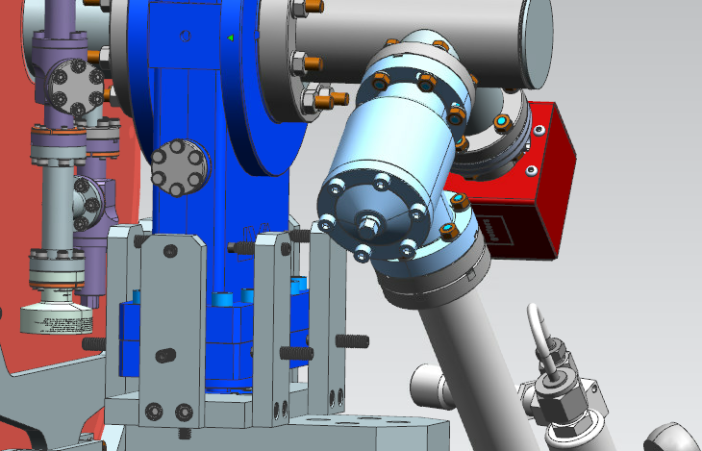
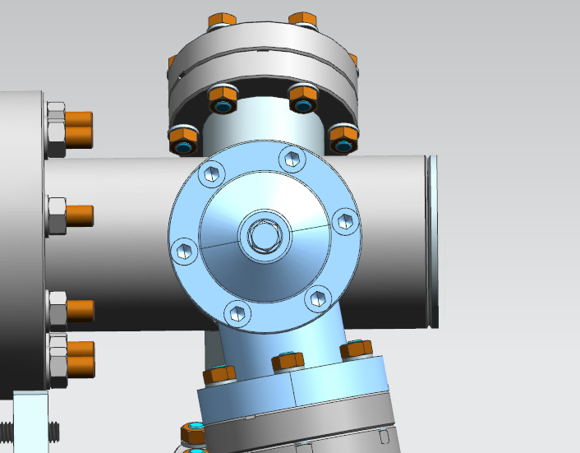
Issue #14: The DS RAV is tricky to install at the right orientation
Root Cause: interference of spool piece with gate valve support not anticipated.
Resolution: gate valve rotated, but angle needs to be small enough to avoid interference with end cap tooling
Corrective Actions: use 2 upper bolts for digital level location for turning DS RAV on the needed angle.
Status of Mitigation: completed
Use 2 bolts OD and
Digital level to Control 10° angle
10°

Slide 22
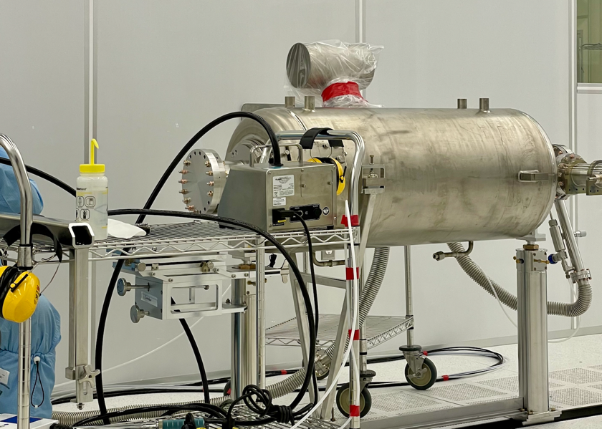
Lessons Learned - Beamline Studs Removal
Issue #15
  The cavity beamline flange studs removal in anticipation of bellows connection or coupler installation caused the early seal breaking. The holes could not be blown cleaned by ionized nitrogen, which increases the risk that some particulates could enter the cavity when the flange is removed at the later steps.
Root Cause
  Procedure was not developed early enough. Mock-up was not conducted due to tight schedule and the lack of a spare cavity.

Slide 23
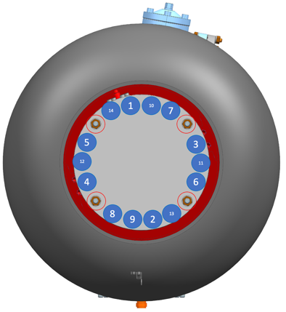
Lessons Learned - Beamline Studs Removal
Issue #15
Proposed Mitigation
  The previous procedure removes the studs sequentially which may cause uneven force by the remaining studs. Develop a new procedure that is similar to the “star” pattern of the cavity flange attachment, and test it separately.
Status of Mitigation
  New procedure was tested with an LB650 cavity and again on the last two cavities of PHB650 string assembly. It was an off-normal procedure for the string assembly.
  Update the traveler procedure using the off-normal procedure by 6/30/2022
PFFA clean the 4 flange holes that were used for alignment
Then install 4 new, clean studs of the size 3/8”, 8 washers and 8 nuts. Tighten them up to 500 in.lbs.
Perform PFFA on Cav1 flange by removing studs according to the following “star” pattern, leaving the 4 clean studs installed in step 2 above. Blow clean each hole immediately after the stud is removed until all 14 studs are removed, or the seal opens.

Slide 24
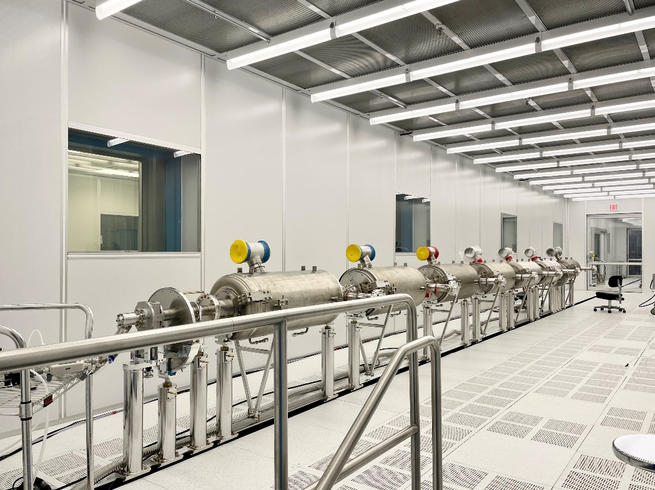
Lessons Learned - Room pressure difference > 5 mbar.
Issue #16
  The room pressure difference was larger than the 5 mbar. When the cavity pressure at the center of the room was 5-mbar higher than the corner pressure, it tricked the control software to stop purging. The purging will not activate if the cavity pressure is >5mbar above the ambient.
Root Cause
  No prewarning about the pressure difference. The design did not consider that. A mock-up test may not capture the failure.
Cavity pressure was measured near the center of the cleanroom
Ambient pressure was measured near the corner of the cleanroom

Slide 25
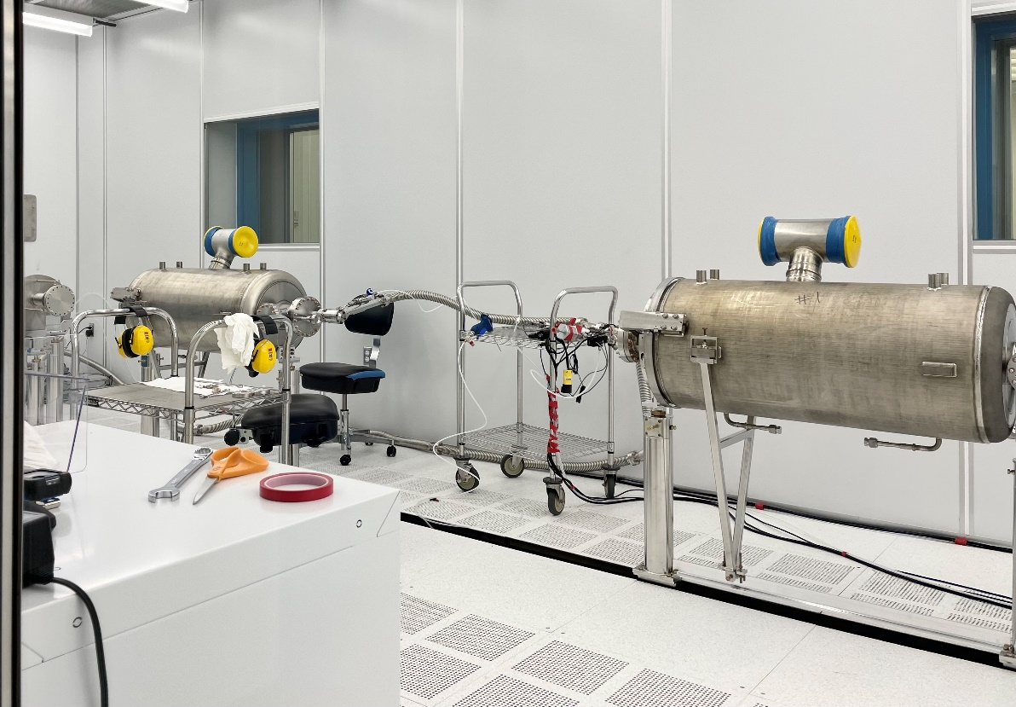
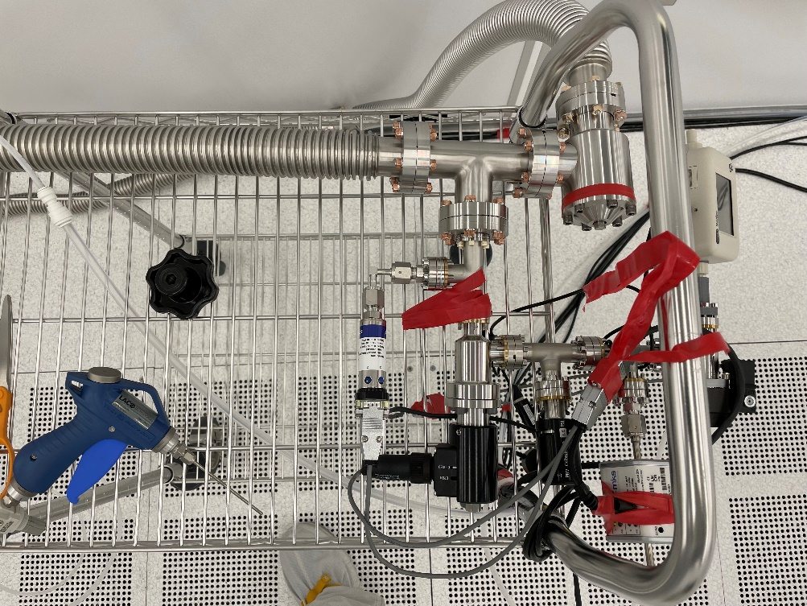
Lessons Learned - Room pressure difference > 5 mbar.
Issue #16
Proposed Mitigation
  Add a sensor to the purging head assembly which would be next to the cavity.
Status of Mitigation
  Update the design by 12/31/2022
Potential location for the local pressure sensor

Slide 26
Lessons Learned - pressure and temperature recording after string backfill
Issue #17
  There was no pressure and temperature recording in the backfill section of traveler.
    This would help to establish the known condition of the string pressure, where temperature and ambient pressure could change.
    Without this knowledge, the pressure differential between the cavity string and the ambient pressure could be large and may cause the particulate migration when the valve is opened during the follow-up procedure.
Root Cause
  Not applicable.
Proposed Mitigation
  Revise the string assembly traveler.
Status of Mitigation
  Revised the traveler.
  Release the traveler after this workshop.

Slide 27
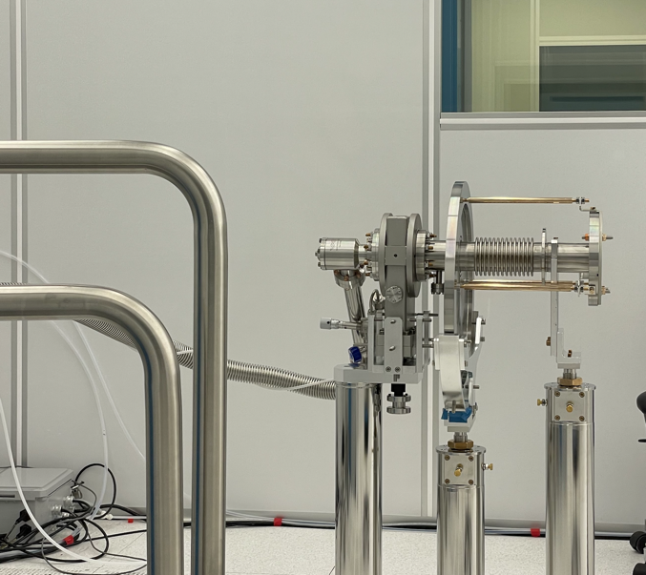
Lessons Learned - Beampipe End Assemblies
Issue #19,21
  BPE clocking/alignment requires a revised procedure. Otherwise there might be unnecessary rotation of the mating flange since the cavity flange is fixed. The unnecessary rotation could cause particulate movement into the cavity.
  The beam pipe end (qty 2) is a weldment which is interfaced with the cryomodule endcap on one side, and, through a rotatable flange, to the cavity flange on the other side. Therefore its roll angle needs to be tuned accurately to match the endcap side, before the rotatable flange is locked in rotation to the cavity flange, and brackets are installed on that flange to lock the BPE bellows longitudinally.
  Similar to the cavity lugs used to adjust cavity roll angle, an accurate fiducialized interface needs to be defined and machined on the BPE, for the clocking operation in the clean room using a bubble or digital level to adjust its roll angle.
  BPE length needs to be adjusted during the sub-assembly procedure. The BPE length is preferred to be controlled while it is in a clean room.
Root Cause
  Procedure was not developed early enough. Mock-up was not conducted sufficiently due to limited resources.

Slide 28
Lessons Learned - Beampipe End Assemblies
Issue #19,21
Proposed Mitigation
  Develop a new procedure, as well as a design revision similar to the cavity lugs used to adjust cavity roll angle, an accurate fiducialized interface needs to be defined and machined on the BPE, for the clocking operation in the clean room using a bubble or digital level to adjust its roll angle.
Status of Mitigation
  Pending design update related to issue #18.
  Update the traveler procedure by 12/31/2022

Slide 29
Lessons Learned - Beampipe End Assemblies
Issue #19,21
Proposed Mitigation
  Develop a new procedure.
Status of Mitigation
  Pending design update related to issue #18.
  Update the traveler procedure by 12/31/2022

Slide 30
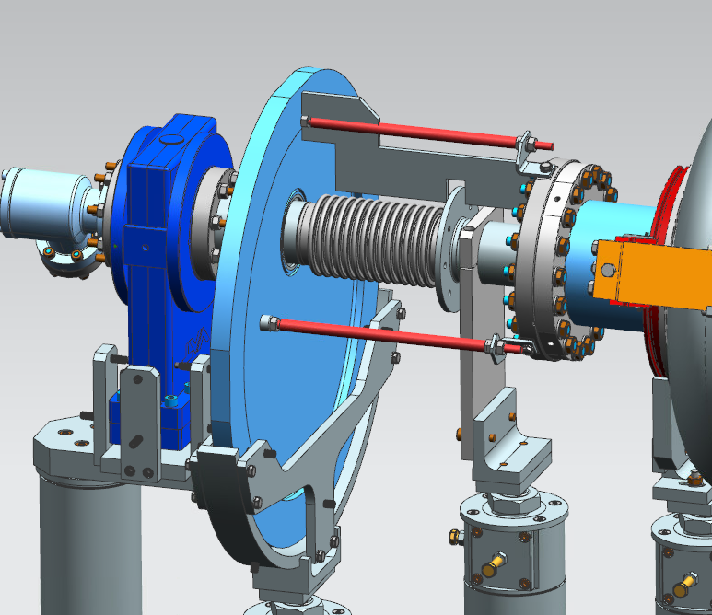
Issues #5 & #20: BPE length needs to be adjusted in the clean room
Root Cause: Beam pipe end (BPE) length precise adjustment was overlooked.
Resolution: length of both BPEs were adjusted after roll-out.
Corrective Actions:
a new caliper is designed F10182105
Material: Aluminum.
will look into white teflon and user-friendly handle ‘à la ESS’, for bellows protection.
Status of Mitigation: design optimization ongoing.
Fabrication process not started yet.
Anticipated completion date: 31-Aug-22

Slide 31
Lessons Learned - Cavity Vertical Measurements
Issue #22
  “Check that cavity string height is within the comfort range of the bellows and coupler adjustable table operation.”
    One cavity in pCM found to be out of tolerance upon string roll out.
Root Cause
  Cavity height was adjusted in the cleanroom as a consequence of a .92 to .9 connection.
    Not Deemed something that can re-occur. Travelers
    specify to not adjust heights once initial post heights are
    set outside cleanroom
Proposed Mitigation
  Develop a “quick check” technique for cavity heights
  Incorporate laser level
  Wire stretched along support tabs
Status of Mitigation
  Discussion Phase / Determining potential for recurrence if procedures are carefully followed

Slide 32
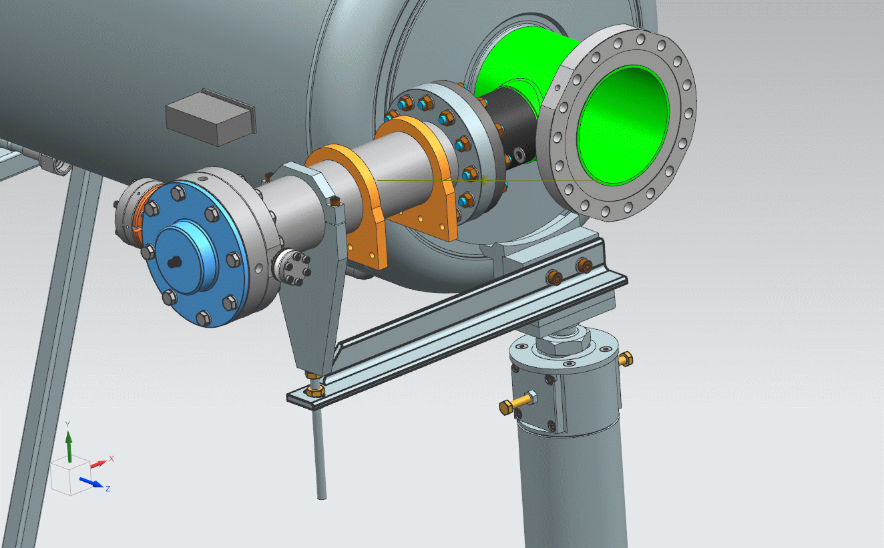
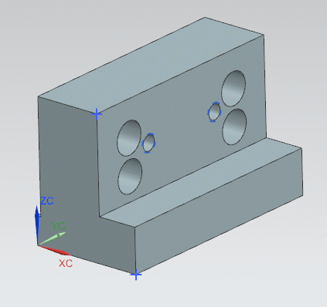
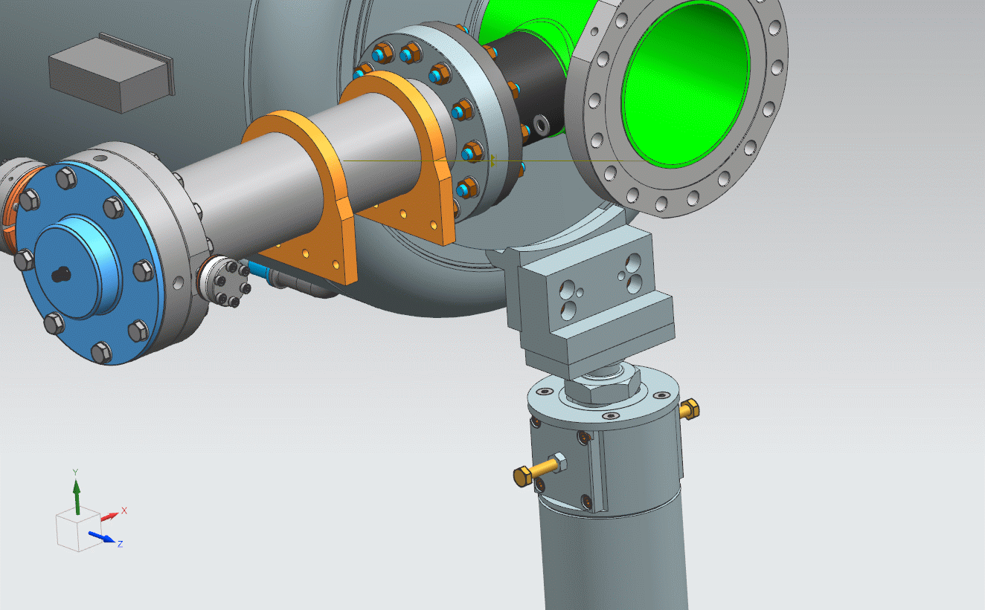
Issue #23: Clean room coupler support.
Root Cause: current upper plates too heavy and invasive for clean room installation
Resolution: couplers were not supported until 2 weeks after roll-out, including tuner and magnetic shielding installation.
Corrective Actions: new ‘light’ support was created, F10182276, to be use in Clean Room and outside Clean room, before connection to lifting tool in Phase 1a.
Status of Mitigation: drawing released,
with new cavity L-bracket. Fabrication process not started yet.
Anticipated completion date: 31-Aug-22
New part F10182276
New part - F10182244

Slide 33
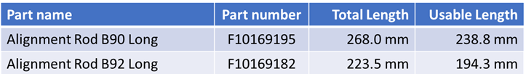
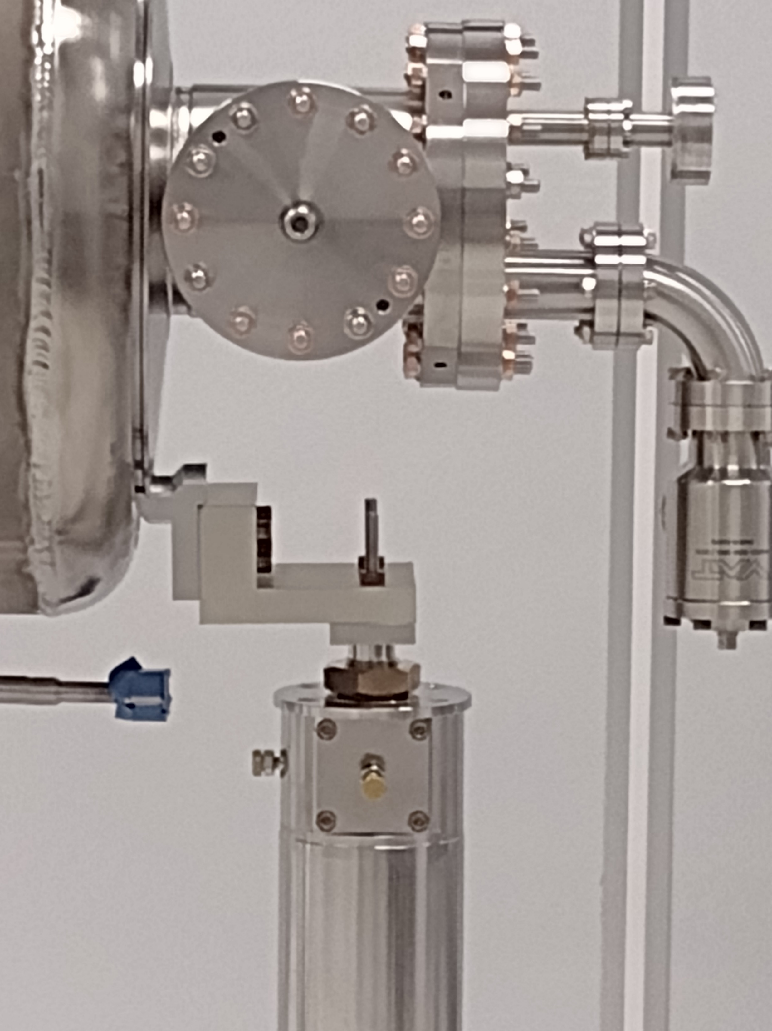
Issue #24: B92 flange alignment long-rods to short to be used with RAV straight spool piece.
Root Cause: new design
Resolution: RAV elbow connection were used for B92 cavities
Corrective Actions: either design of longer rods or continue with elbow connection
Status of Mitigation: pending on decision.
Anticipated completion date: 10-Jul-22

Slide 34
Summary
A number of common elements come to the fore when considering these lessons learned, that are generally applicable:
  More thorough “mock-up” assemblies
    Almost every aspect of the assembly process should be tested out – even if similar to previous projects
      Verifies procedures are adequately detailed
      Verifies tooling functions as required
      Actual assembly staff need to be involved, along with engineers, etc
      Follow the existing procedures at first
    Make time for this in the schedule
      Human resources available
      Tooling, components, HW available
        Consider impact of unexpectedly long lead times for tooling fabrications, hardware deliveries, etc.
      Include time for modification of tooling, etc. and a re-test
      Verify changes and improvements outside the CR – they may not be sufficient, or there could be other (new) impacts

Slide 35
Summary
  Fully commission any new facilities/infrastructure
    Pumping systems, purging systems, controls, DAQ
    Verify not only functionality but cleanliness
      E.g., verification testing in vertical test stand
      Certification of the clean room(s) is a given…
  QC of components
    Do not shortcut QC inspection of components & tooling, especially interfaces
    Don’t use the mock-up activities as the time for discovering that things don’t fit together.
      Verify fit-up and address any issues beforehand

Slide 36
Summary
  Do not be overly-aggressive with scheduling
    Procurements (tooling, HW) are taking (in some cases much) longer than expected
      This can reduce or eliminate time for mock-ups, re-work, etc.
    QC take longer than you think, especially if comprehensive
    Re-work of tooling can take longer
      On-site shop turn-around time, workload, priorities
      Local machine shops turnaround time
      Procurement processes
        Revised, reviewed, approved, released drawings
    The mock-up activities will take longer than what is expected for production
  We are presently working on completing the design/tooling/procedure changes and verifying their effectiveness.
    Each issue has a mitigation “due date”

Slide 37
Summary
  Thanks to the many people involved in the HB650 pCM String Assembly activity who provided input/feedback that contributed to these Lessons Learned:
        Marco Battistoni
        Damon Bice
        Saravan Chandrasekaran
        Mark Chlebek
        Ted Ill
        Olivier Napoly
        Yuriy Orlov
        Valeri Poloubotko
        Tim Ring
        Vincent Roger
        Genfa Wu

