Slide 1
HB650 pCM – Current non conformance & lessons learned
Vincent Roger

Slide 2
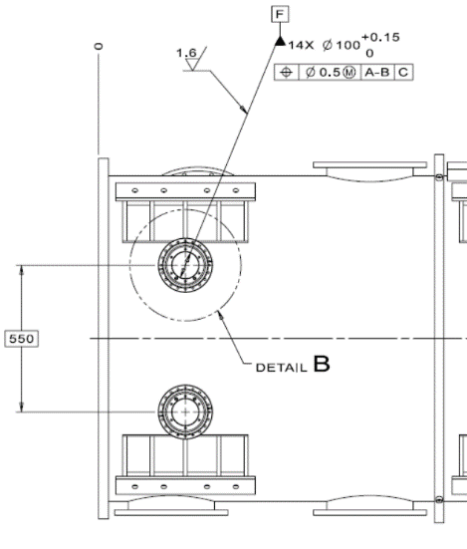
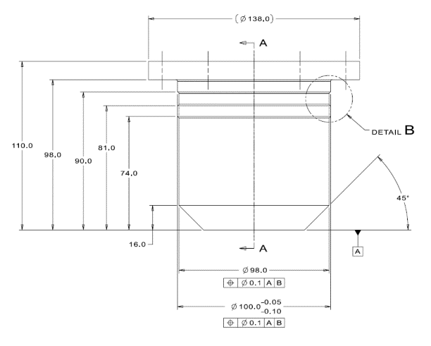
Vacuum vessel
The overall quality of the vacuum vessel is very good but several non conformance and lessons learned have been found out.
On the final machining drawing F10137478 100 mm holes on the stud ports needed be machined after welding. This was not done by the manufacturer, and the hole shapes were not perfectly circular anymore which led to interference with the housing. Thus, remachining of the housing was needed at Fermilab. For production cryomodule this point need to be discussed with the vacuum vessel manufacturer to make sure they understand that this is a critical point. Also, clearance has been slightly increased.

Slide 3
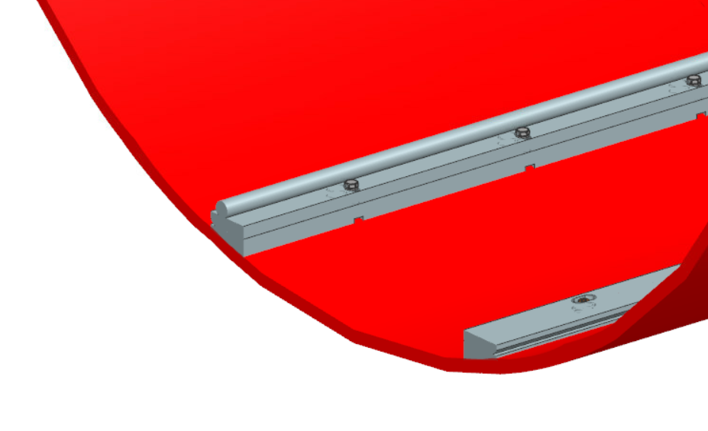
Vacuum vessel
The overall quality of the vacuum vessel is very good but several non conformance and lessons learned have been found out.
Laser tracker data have been provided by the manufacturer. Measurements met requirements, and this was confirmed by FNAL laser tracker measurement. However, we should have included rail tolerance directly on the top assembly drawings to make sure that the rail was positioned at the good location.

Slide 4
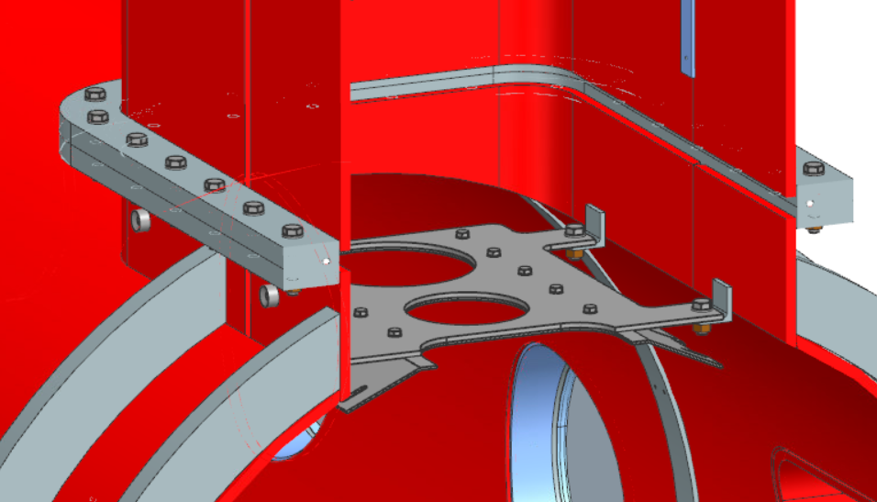
Vacuum vessel
The overall quality of the vacuum vessel is very good but several non conformance and lessons learned have been found out.
This bracket has been mounted upside/down. This has a low impact since we just use this bracket to lock the HTTS to the vacuum vessel during overseas transportation. Shims and longer screws will be needed. For production CM this should be checked during a visit of the manufacturer facility.

Slide 5
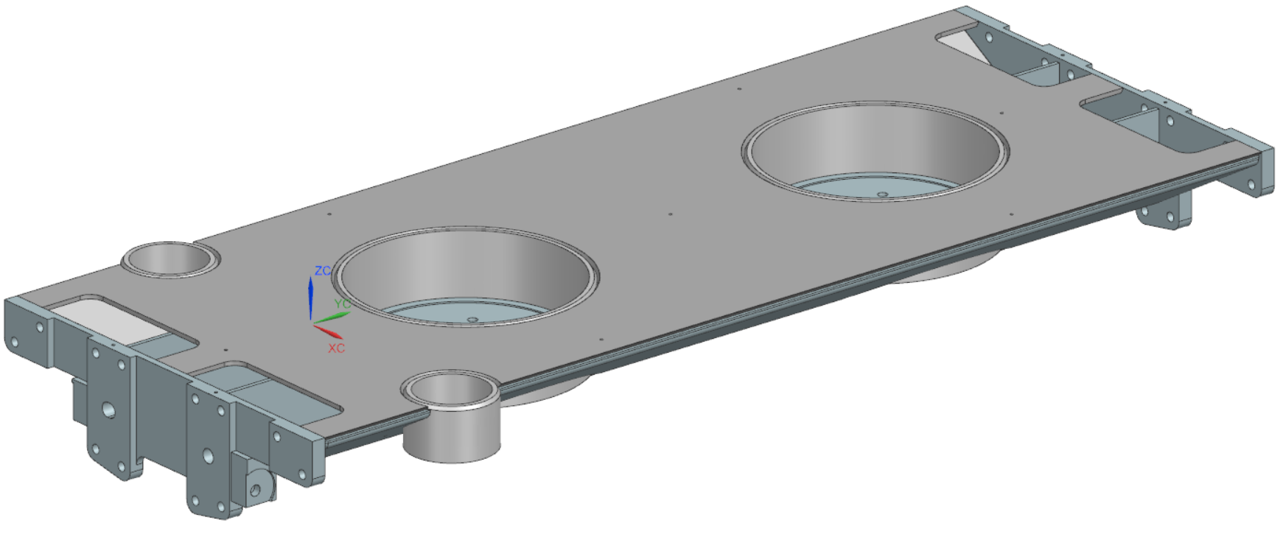
Strongback
The overall quality of the strongback is good. However, the pin location were out of tolerance. This point should be discussed with the manufacturer since these locations are our reference to assemble the strongback.

Slide 6
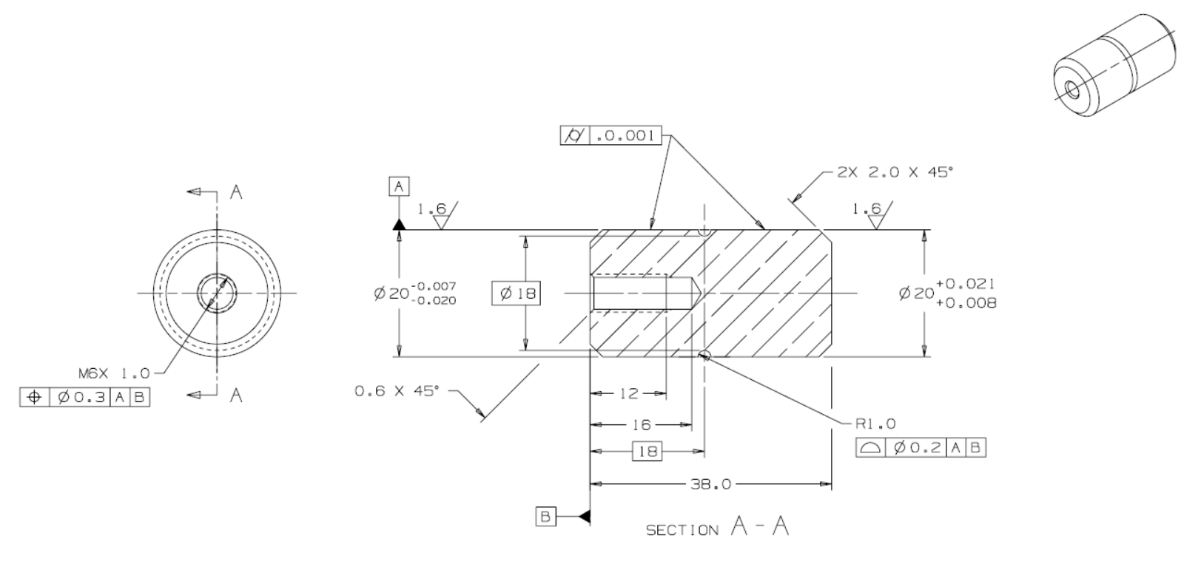
Strongback
Each pin has two different ends. One side is a shrink fit assembly, and the other side slides. There was no instruction on drawings or spec for the manufacturer to assemble these pins. To make the assembly process easier, we will ask the manufacturer to provide the strongback modules with the pins already assembled on the shrink fit side.

Slide 7
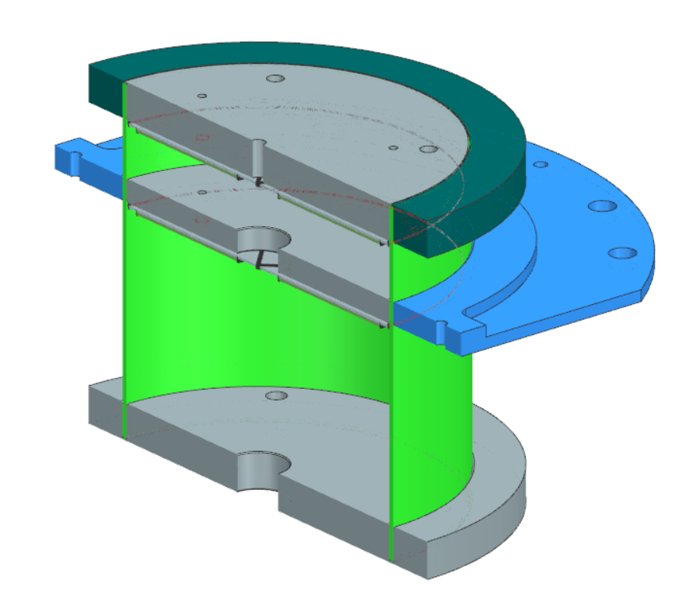
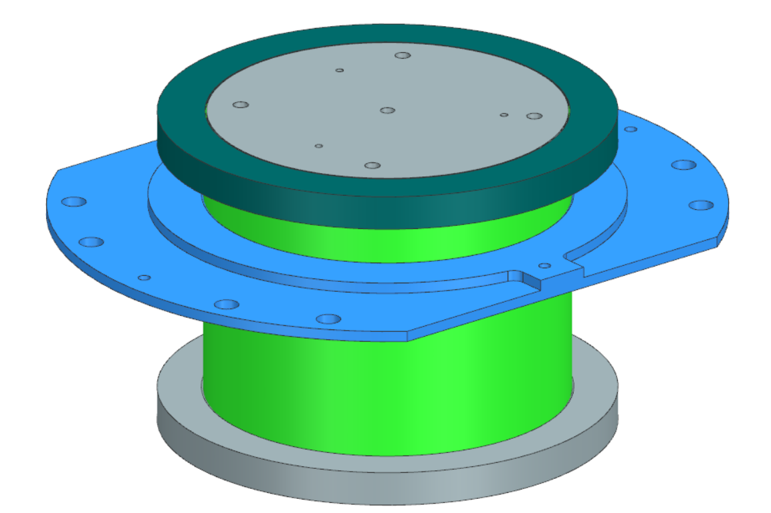
G11 post
The assembly procedure is clear that jigs are needed in order to position each ring and disk. However, the manufacturer decided to perform final machining instead. This lead to chips and oil trapped inside the G11 post. This point needs to be clear and discussed with the manufacturer just after awarding the PO.
In addition, the sequence of the assembly process has been changed in order to avoid putting MLI into liquid nitrogen. Assembly process document has been updated.

Slide 8
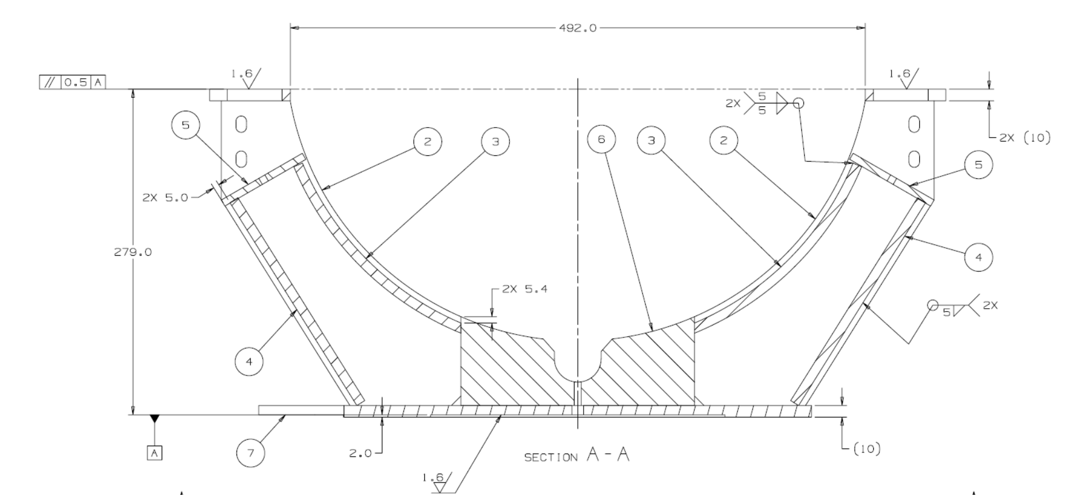
Cavity support
Drawing updates of some support posts were necessary. Datum A was not correct. Drawings have been updated.

Slide 9
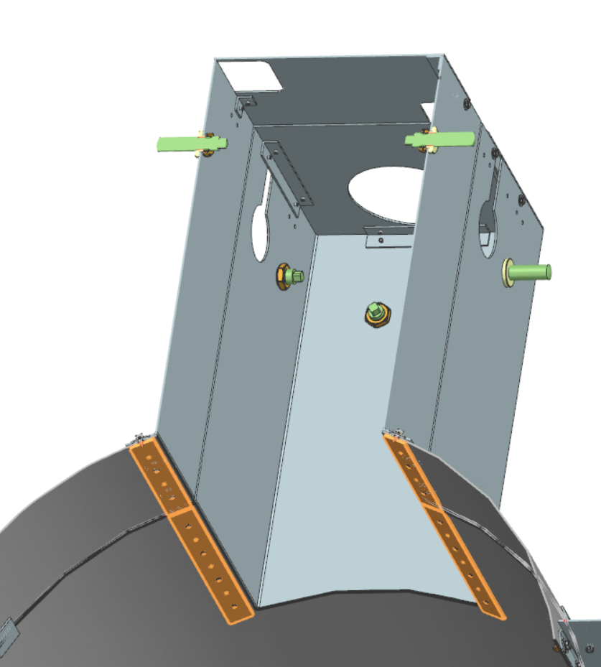
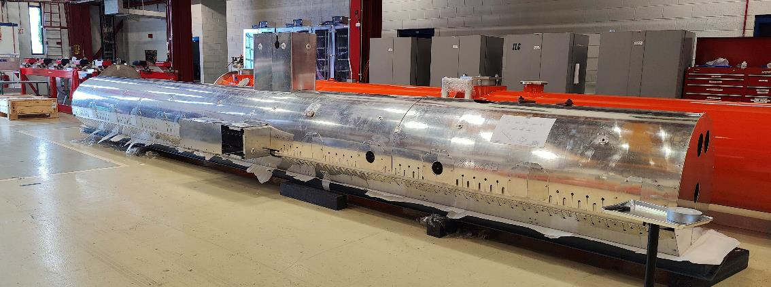
HTTS
All parts have been connected together, and fit well. However, these plates were not welded to the main part of the shield despite it was specified on the drawings. This will need to be done during the assembly process instead. This point need to be clear and discussed with the manufacturer just after awarding the PO.

Slide 10
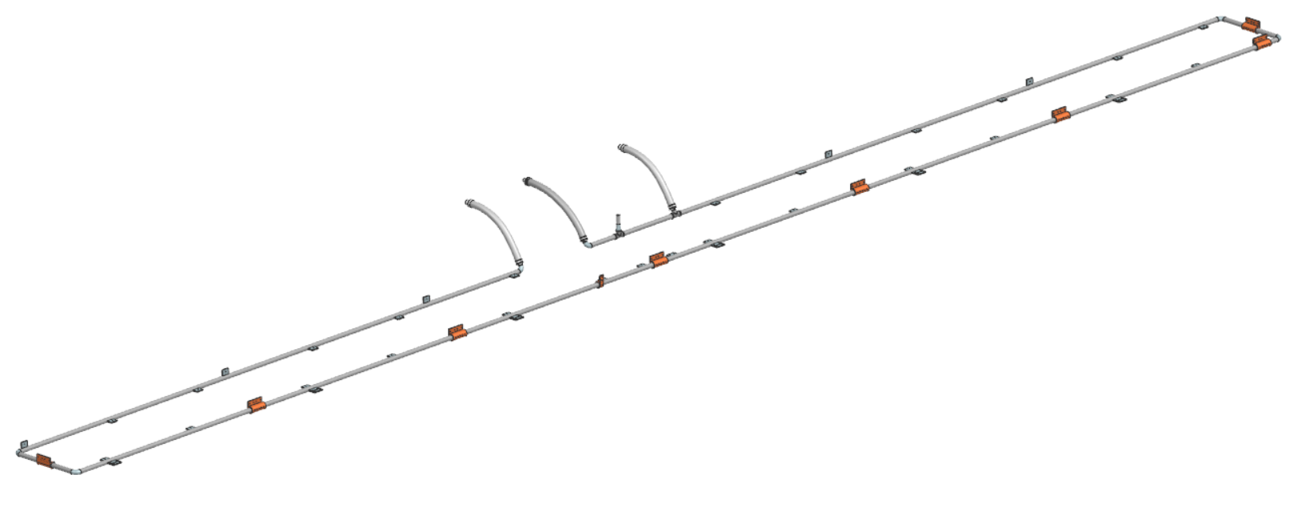
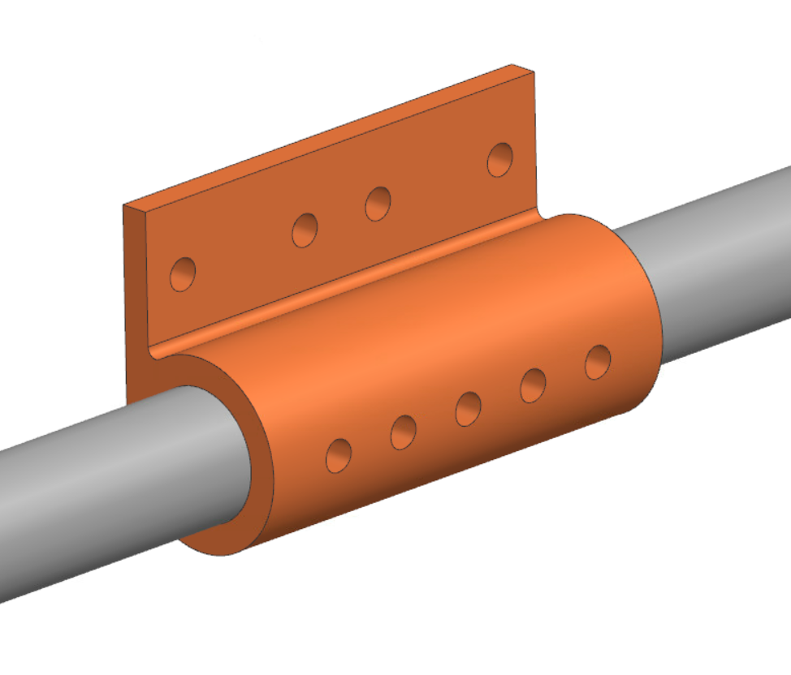
LTTS
Drawings specify furnace brazing, but this line is too long to fit inside any oven. In addition, holes have been added to check the quality of the brazed joint. Drawings have been updated.

