Slide 1
PIP-II 2nd Technical Workshop, WG#1
Nonconformance / Discrepancy Reporting Process
Matt Luedke
FNAL
12-14 July, 2022

Slide 2
Introduction
Vector
Travelers
Discrepancy Reports (DR)
DR Tracker

Slide 3
Vector
Location for all travelers to reside
Can run reports to see how many travelers are open vs closed.
Capable of sorting by series or even down to a specific component.
Also same for DRs.
Allows for revision history.
Repository of other supporting procedures to be located and linked into related travelers.

Slide 4
Travelers
PIP-II HB650 pCM Travelers | ID #
PIP-II HB650 String Assembly | 464612
HB 650 pCM Assembly Phase 1a – Beamline Assembly | 464613
HB 650 pCM Assembly Phase 1b – Strongback Fitment and Assembly | 464614
HB 650 pCM Assembly Phase 1c – Strongback and Beamline Merger | 464616
HB 650 pCM Assembly Phase 2 – Coldmass Assembly | 464617
HB 650 pCM Assembly Phase 3 – Insertion of Coldmass into Vacuum Vessel | 464618
HB 650 pCM Assembly Phase 4 – Final Cryomodule Assembly | 464708

Slide 5
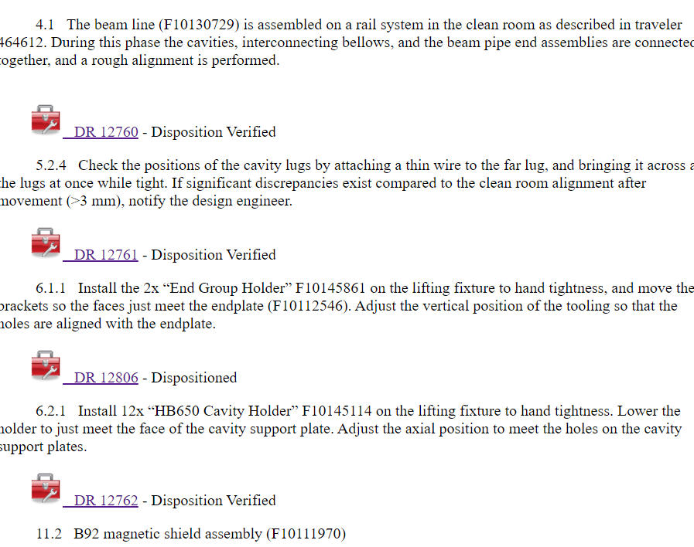
HB 650 pCM Assembly Phase 1a – Beamline Assembly
DRs issued against travelers are located in top right header of traveler
Open or Past Due DRs will now allow a traveler to be closed.
Click on link to see all DRs associated with traveler.
Identifies step the DR was issued against.
Shows the current status of each DR

Slide 6
Discrepancy Reports
Provides a narrative of the discrepancy.
Identifies Risk Assessment level:
Critical, Moderate, Minor
Identifies Cause, Disposition, and Corrective Action.
Provides a method to verify.
Utilizes a workflow.
Allows for Attachments.

Slide 7
DR Tracker
Provides method to easily view snapshot of related traveler DRs.
Reviewed during weekly meetings with 650MHz prototype cryomodule team.
Can link in Travelers and DRs for quick edits or updates.

Slide 8
Summary
Vector houses all our Travelers and related DRs.
Workflows help provide a method of DR completing and verification.
Simple excel spreadsheet helps to track all related Travelers and DRs.

Slide 9
References
PIP-II Nonconformance Handling Procedure, DocDB 3100
Vector
650 DR Tracker

Slide 10
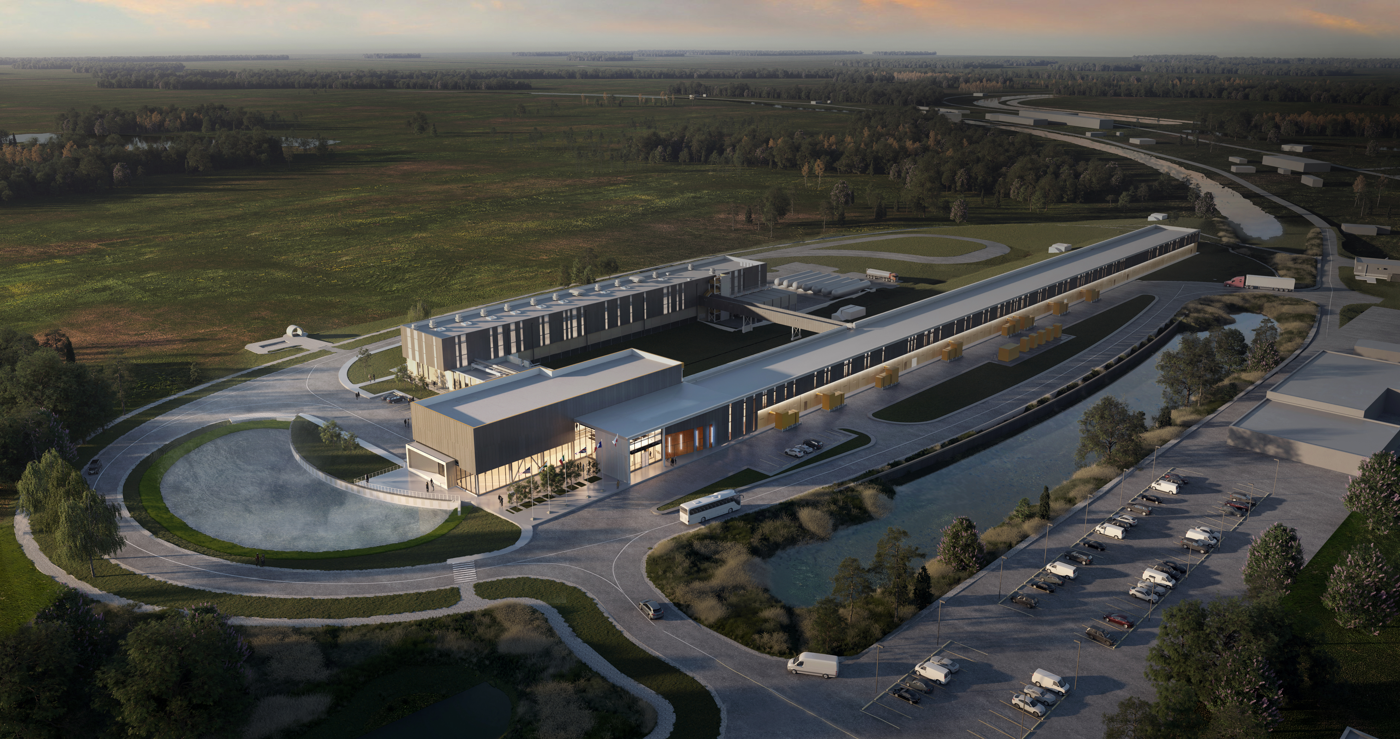
Thank You!

