Slide 1
HB650 CM - Design optimization
Vincent Roger

Slide 2
Vacuum vessel
The HB650 production vacuum vessel will be made of carbon steel and SS304L. No parts will be made from SS316L. (This change was already implemented for LB650 & SSR2 vacuum vessel). Cost reduction.
Side port flanges and top port flanges need to be the same as LB650 & SSR2 CM. Standardization.
The number and location of the alignment targets need to be changed to comply with the TRS. (This change was already implemented for SSR2 & LB650 vacuum vessel). Compliance with TRS.
The drawings of the vacuum vessel need to be updated showing all the parts that need final machining for example the lifting lugs of the vacuum vessel. Tolerances will need to be reviewed. Drawing/Design update to match expectations.

Slide 3
Vacuum vessel
Pins should be added in between the main part of the vacuum vessel and top part, and in between the top part and the top part cover. This is to make sure that the interface with CDS doesn’t change. Drawing/Design update to match expectations.
Pins on the endcaps and side ports will be removed, they are not needed for the assembly process. Cost reduction.
No epoxy on the flange and nozzle of the 14 ports. Update Technical specifications to meet our requirements.

Slide 4
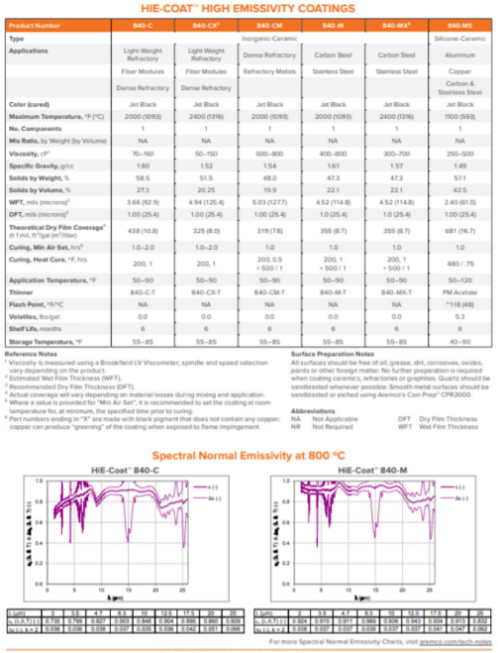
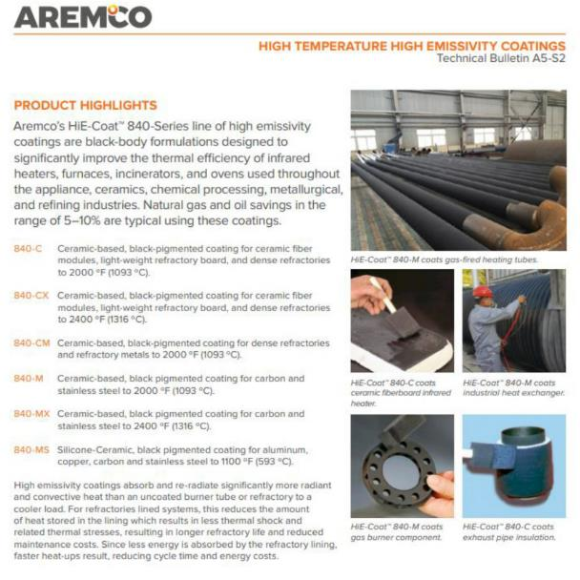
Strongback
In addition to the sandblasting a coating will be applied on the lower faces of the strongback in order to increase emissivity from 0.4 to 0.9 (this optimization is already designed for SSR2 ppCM): Aremco HiE-Coat_840-M. Heat curing up to 500 K for 60 minutes is required after the coating is applied to dry off chemically retained water. Better performance.

Slide 5
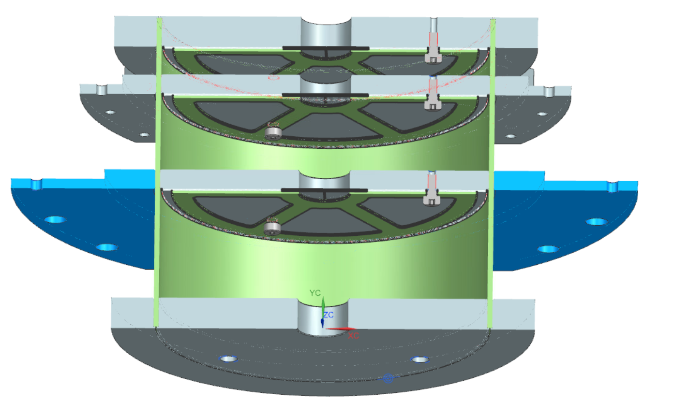
G11 posts
The MLI retainer will be redesigned to reduce radiation. Better performance – Heat loads.
SSR2 G11 post
F10142469

Slide 6
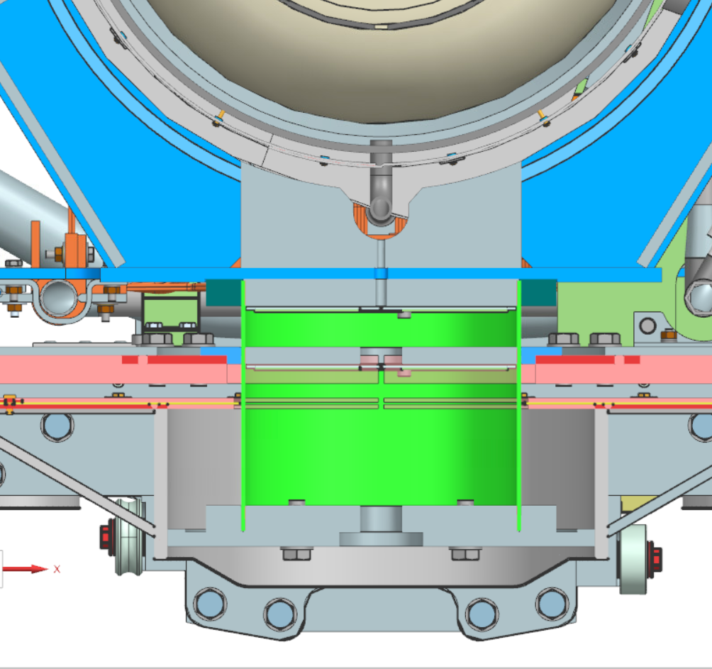
G11 support post & cavity support
Increase hole diameter to make sure that vacuum is done inside the support post: 30 mm in upper disk of the G11 post and 10 mm in the cavity post. Better performance – Heat loads.

Slide 7
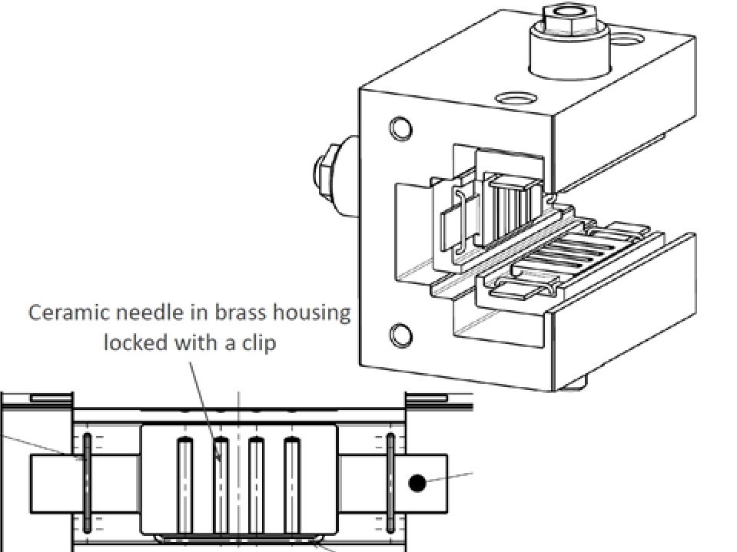
C-Brackets & cavity support
The C-Brackets design should be optimized based on CEA design on the LB650 CM. Better magnetic hygiene & easier assembly process.
The cavity support design should be optimized to allow more flexibility if the helium inlets on the cavity are out of tolerance. Reduce risk that the cavity support will interfere with the cavity during the assembly process.

Slide 8
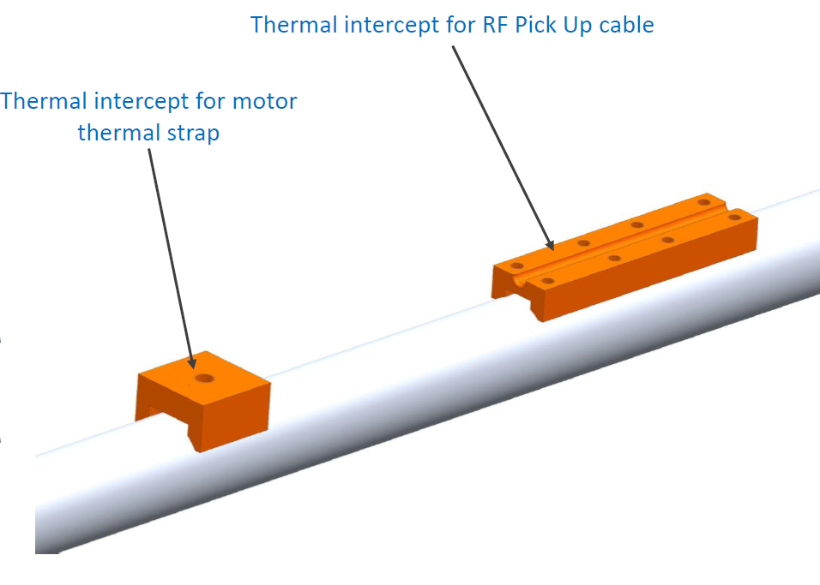
LTTS
Thermal intercept may be improved based on CEA design. Better performance – Heat loads.

Slide 9
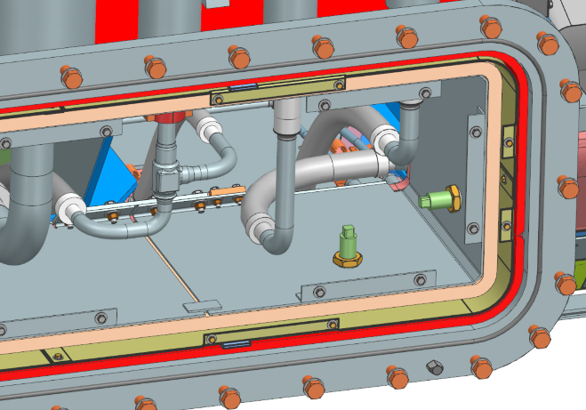
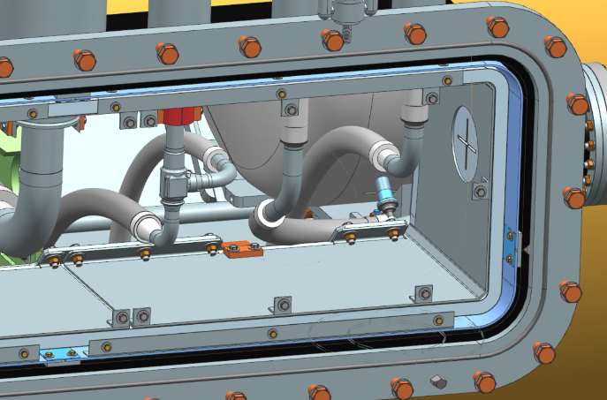
HTTS
The location of the thermal strap connecting the main part of the HTTS to the side part will change to improve the thermal contact (this optimization is already designed for SSR2 ppCM). Better performance – Heat loads.
HB650 CM
SSR2 CM

Slide 10
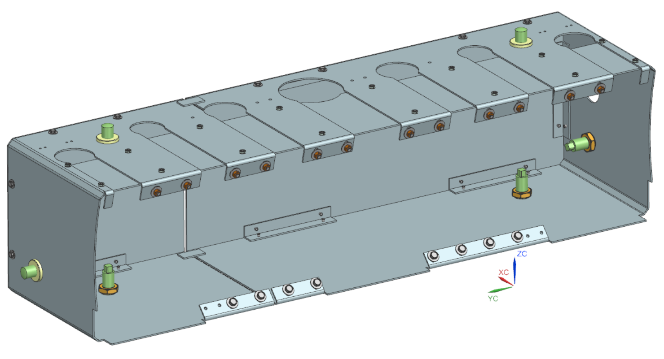
HTTS
These two bends on the side part of the HTTS are not needed. Reduce design complexity.

Slide 11
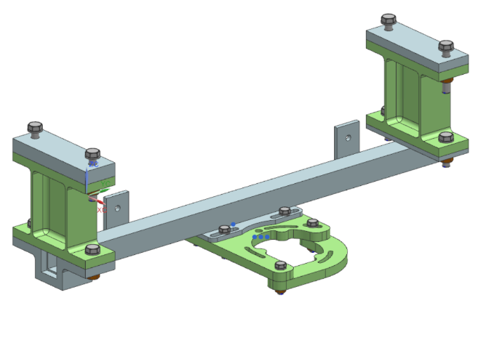
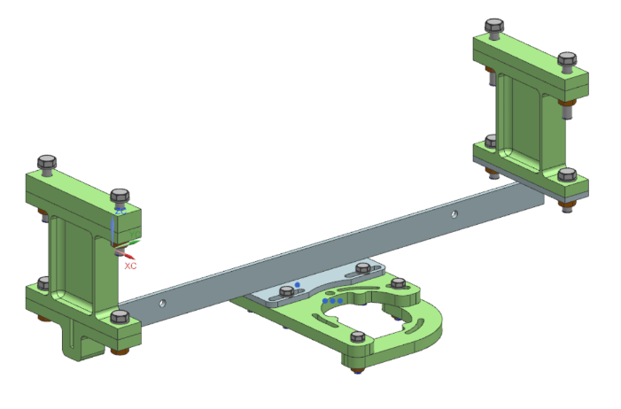
HX support
Heat exchanger support. Based on calculations performed on SSR2 ppCM, it seems the HX support is too stiff. Design optimization was performed for SSR2 ppCM. During the optimization phase we will check if it works as well for the HB650 CM. Better performance – Heat loads & Structural.
HB650 CM
F10130853
SSR2 CM
F10171047

Slide 12
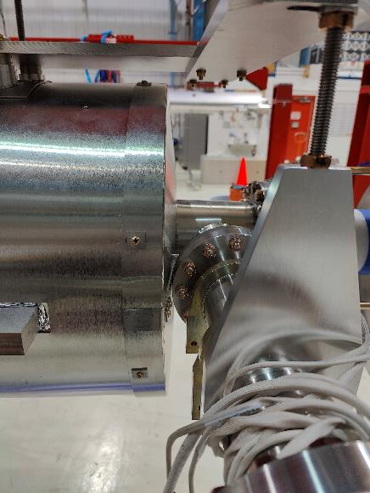
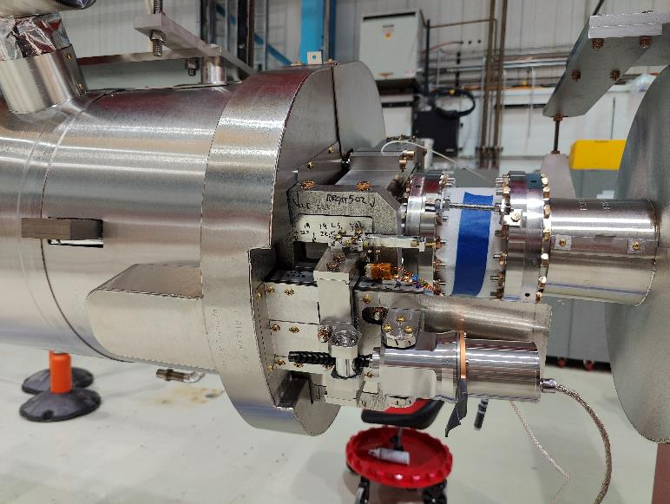
Local magnetic shield
The design of the 650 cavity magnetic shields needs to be optimized in order to manage with non conformance of the 650 cavities. This activity is on going. Ease assembly process.

Slide 13
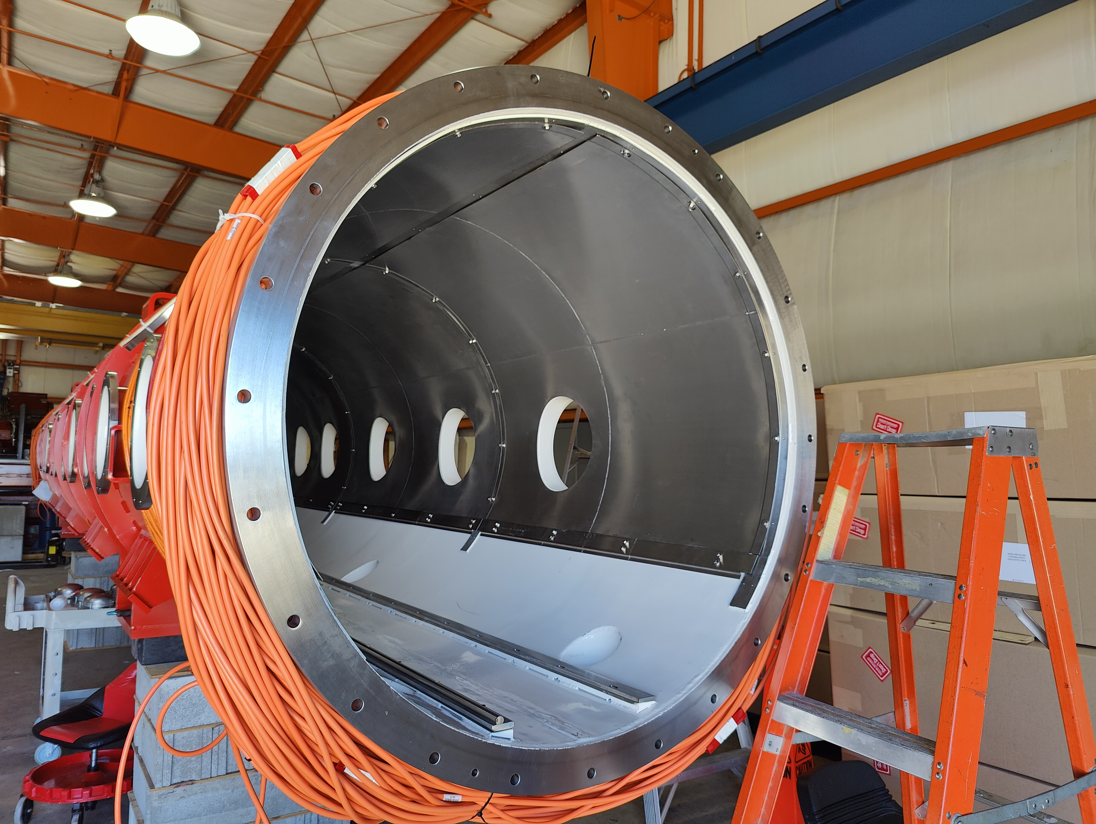
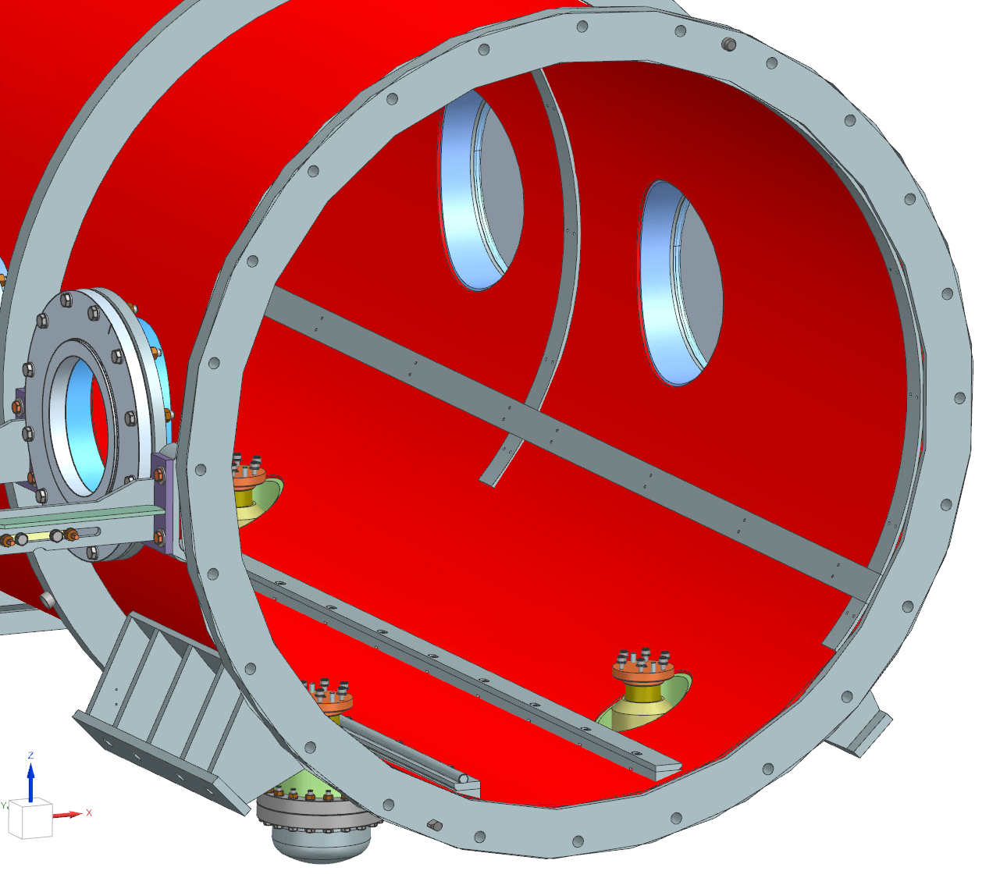
Global magnetic shield
The HB650 global magnetic shield design needs to be redesigned based on the lessons learned gathered during the assembly process and based on the SSR2 global magnetic shield design. Some holes were around 10-15 mm off mainly due to the fact that the bending radius of the inner frame is smaller than expected. Ease assembly process

Slide 14
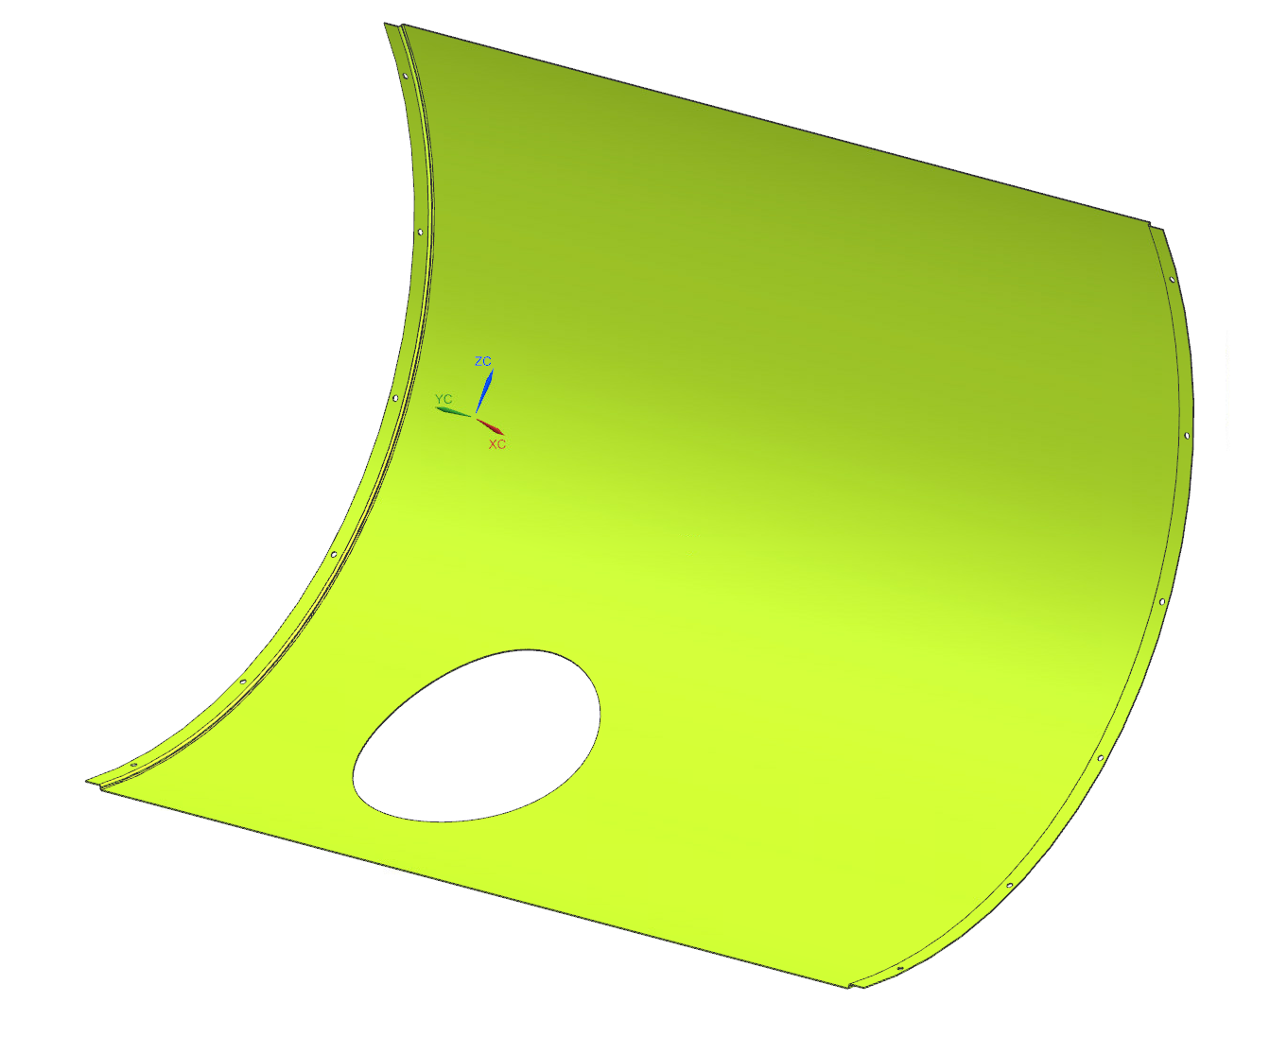
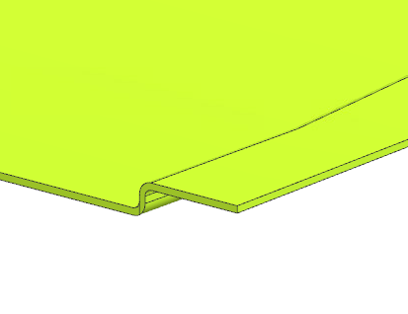
Global magnetic shield
S shape can be removed. (already done for SSR2 CM). Reduce cost.

Slide 15
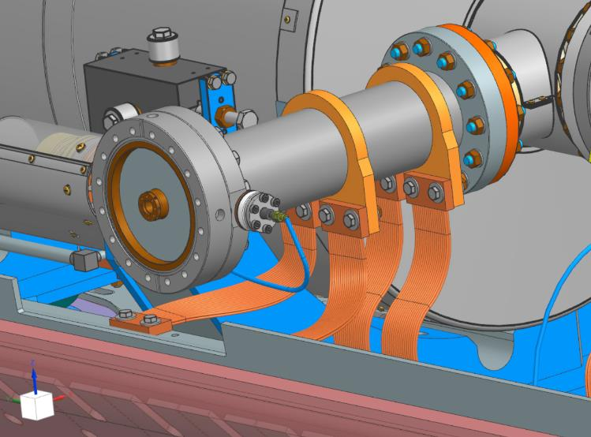
Thermal straps
Thermal straps on the coupler intercepts will have a M3 holes to mount a temperature sensor if needed (Only for LB650 ppCM). Better accuracy.
M3 holes

Slide 16
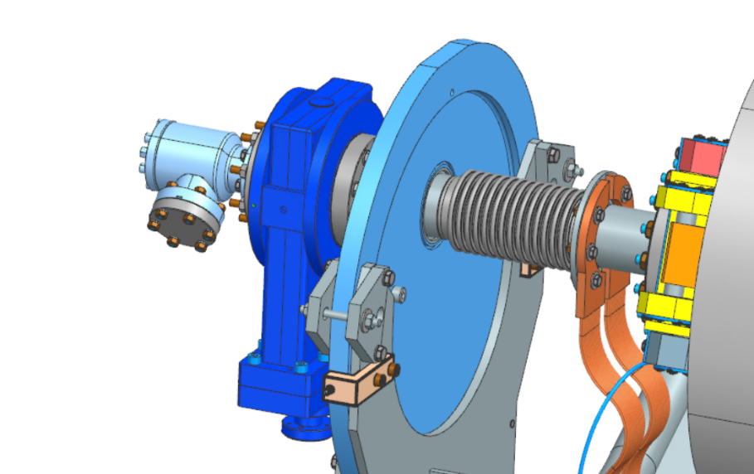
Thermal straps
The design of the thermal straps on the beam line will be optimized to reduce weight.
Reduce weight.
This length can be reduced

Slide 17
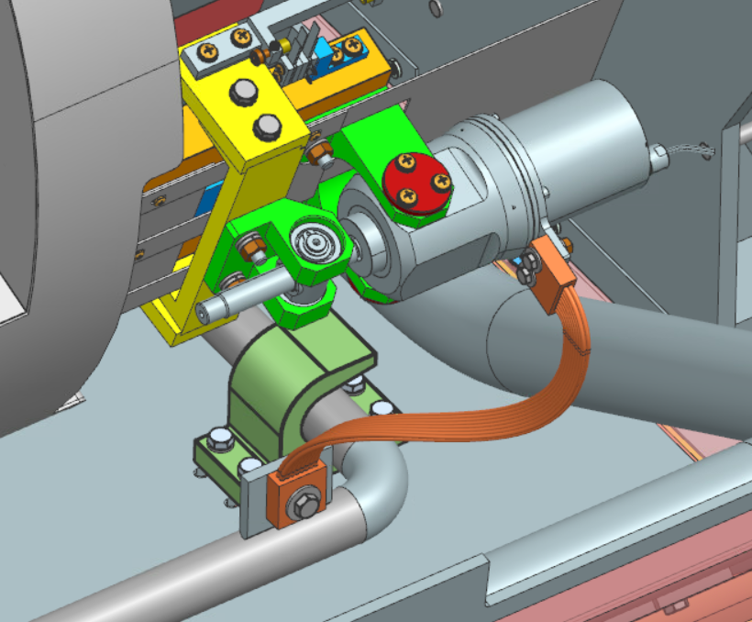
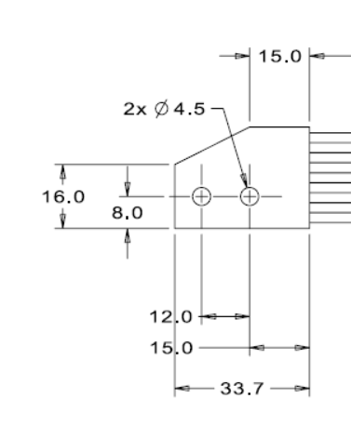
Thermal straps
The design of the tuner thermal straps can be shorter by changing the design of the thermal straps end on the tuner side. (This optimization is already designed for SSR2 ppCM). Better performance.

Slide 18
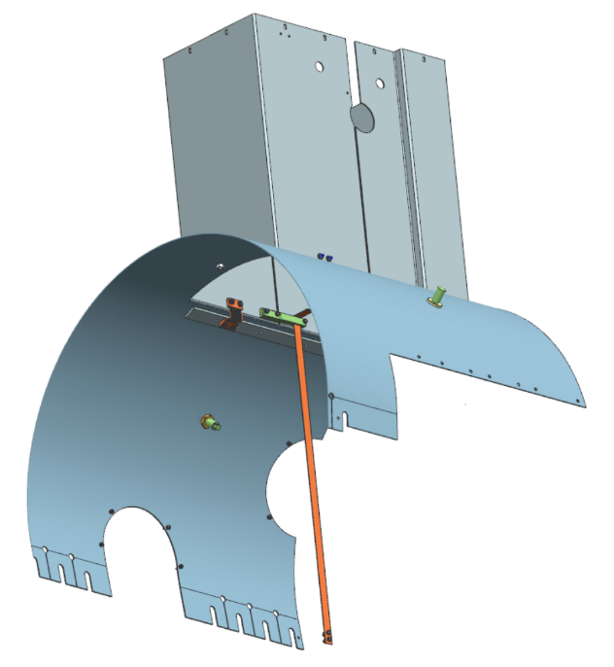
Thermal straps
A thermal strap will be added connecting the main part of the thermal shield to the top hat (this optimization is already designed for SSR2 ppCM). Better performance.

Slide 19
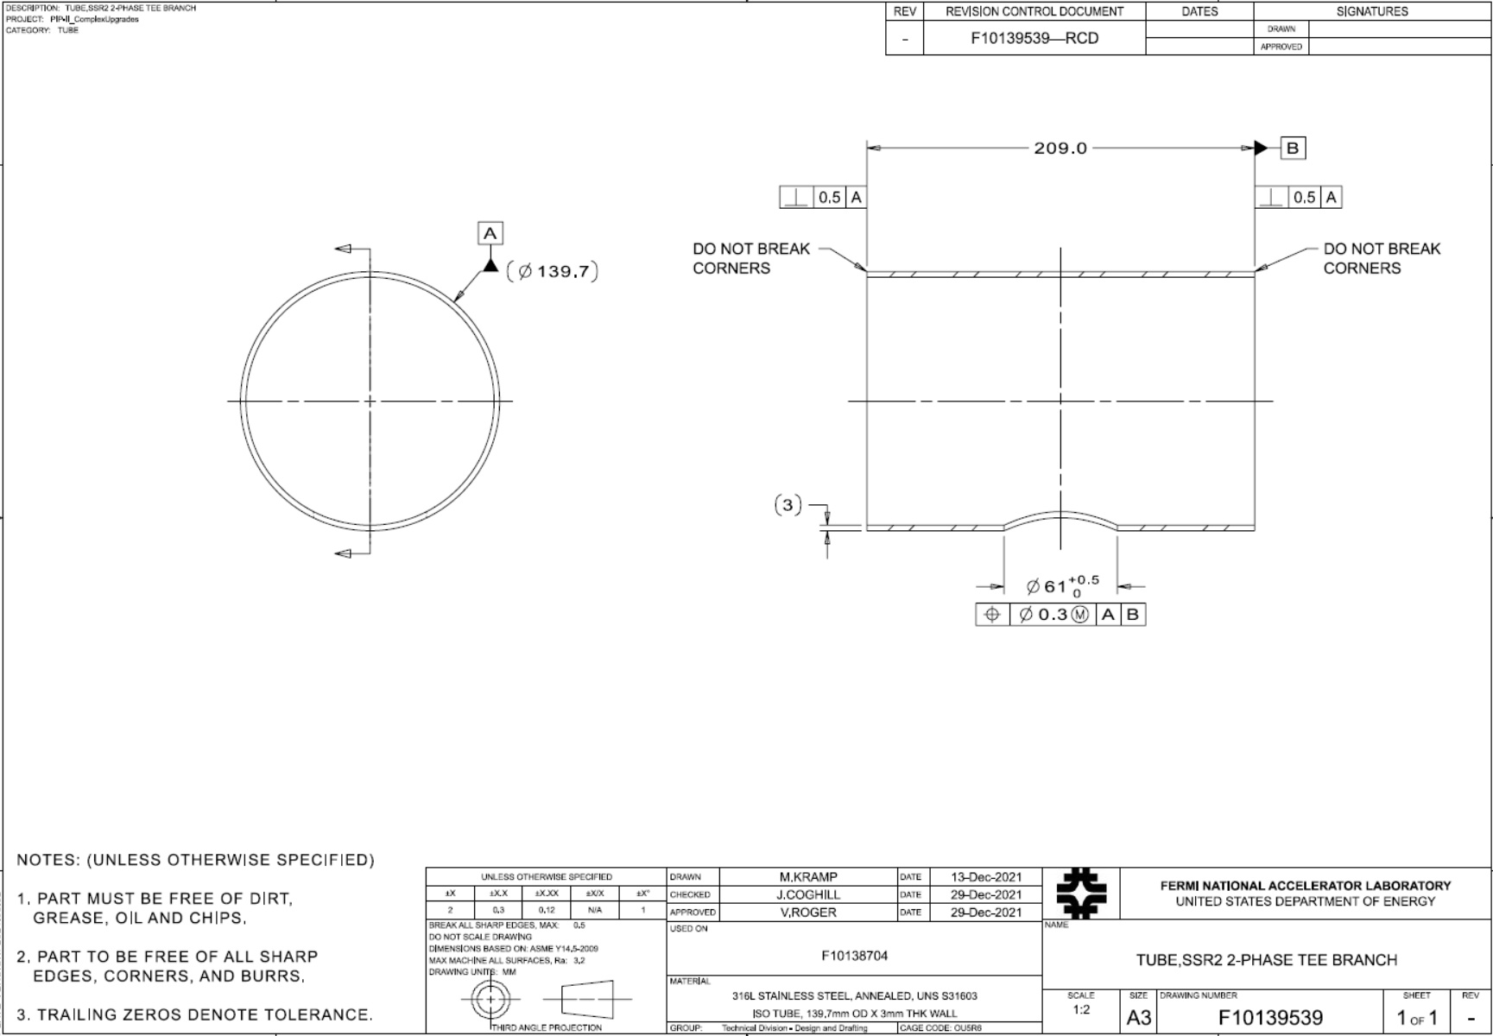
Parts in Stainless steel
Measurements during the assembly process of the HB650 pCM will be done to determine if it is required to have all parts in stainless steel located on the inside of the global magnetic shield annealed. (This has been already applied for SSR2 ppCM for which the requirements are more severe). Better performance.

Slide 20
Two phase helium pipe & pressure transducer line
The two-phase pipe diameter will change because the tee of the production cavity design is different that the one on the prototype cavity. This design will be based on the one used for the SSR2 ppCM. Different requirements prototype / production.
The design of the pressure transducer line will change because there will be no instrumentation inside the helium vessel of the production cavities. This design will be based on the one used for the SSR2 ppCM. Different requirements prototype / production.

Slide 21
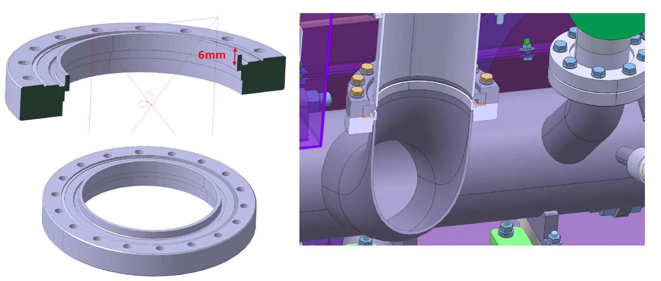
Cryogenic lines - Top part
The relief line and pumping line design will be modified based on the CEA design. This will avoid grinding welds after receiving the cryomodules from STFC. Ease assembly process.
Concerning the high pressure HX inlet and outlet, the design may be modified. This is not decided yet. Ease assembly process.

Slide 22
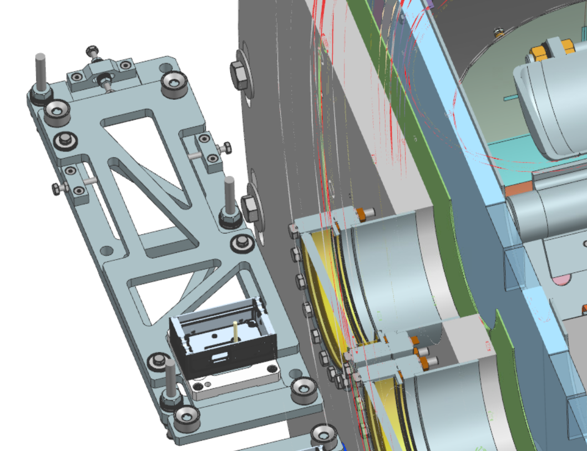
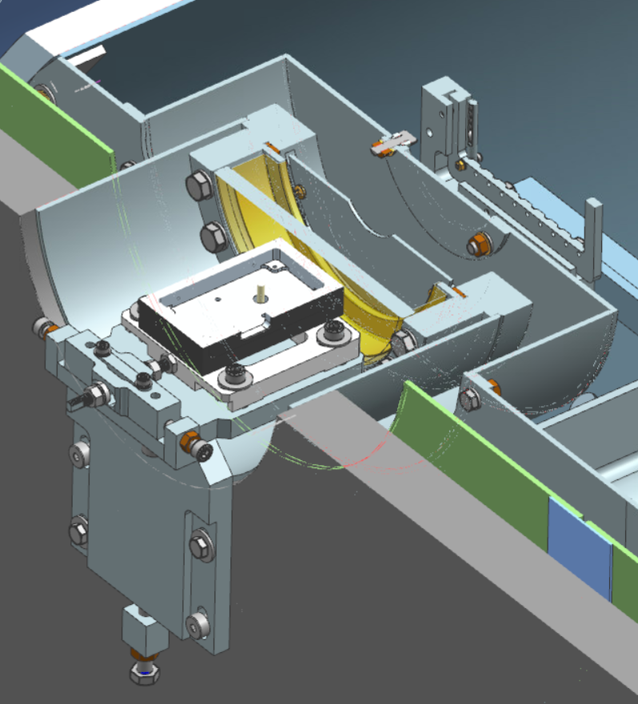
HBCAM supports and interfaces
Reduce heat loads from the view ports, adding a shield on the CF flange. In addition, a cover on the HTTS need to be added if the HBCAM are not used. Better performance – Reduce heat loads.
The design of the HB650 HBCAM support may changed based on the SSR2 design. No need to dismount the HBCAM supports during transportation.
Shield
Cover
HB650 CM
SSR2 CM

Slide 23
Beam line
Beam line hardware shall be 100% metric. As agreed by the Project.
The burst disk assembly need be re-designed. Ease assembly process & code compliance.
Tooling need be redesigned (see June 2022 workshop). Ease assembly process.

