Slide 1
Status of CM Assembly Infrastructure at CEA
PIP-II Technical Workshop - WG#1 HB650 Cryomodule Assembly
J. Drant A. Raut
S. Berry A. Moreau

Slide 2
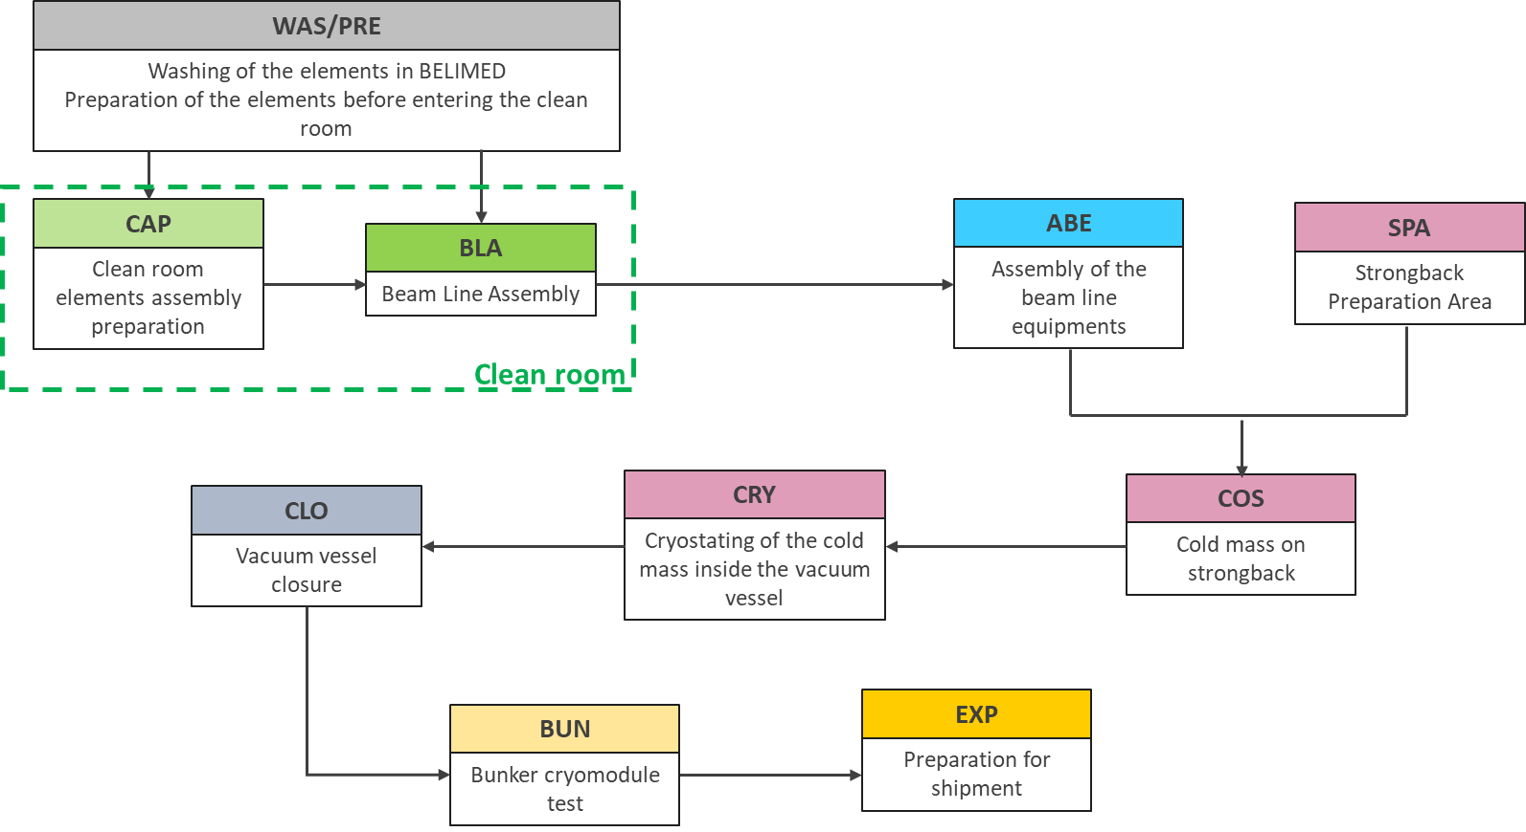
Status of LB650 CM Assembly
General workflow of workstations
Geographical location of the assembly workstations in CEA infrastructure
Overview of the main steps of each workstation
A detailed assembly step example
The use of mock-ups
The use of robot assistance for flange cleaning
Assembly tooling

Slide 3
Status of LB650 CM Assembly
General workflow of workstations
Geographical location of the assembly workstations in CEA infrastructure
Overview of the main steps of each workstation
A detailed assembly step example
The use of mock-ups
The use of robot assistance for flange cleaning
Assembly tooling

Slide 4
General workflow of workstations
WAS/PRE
Washing of the elements in BELIMED
Preparation of the elements before entering the clean room
CAP
ABE
SPA
BLA
Clean room elements assembly preparation
Assembly of the beam line equipments
Strongback Preparation Area
Beam Line Assembly
Clean room
CLO
CRY
COS
Vacuum vessel closure
Cryostating of the cold mass inside the vacuum vessel
Cold mass on strongback
BUN
EXP
Bunker cryomodule test
Preparation for shipment
Notes:
WAS : WAShing of elements
PRE : PREparation of elements before clean room
CAP : in Clean room Assembly Preparation
BLA : Beam Line Assembly
ABE : Assembly of Beam line Equipments
SPA : Strongback Preparation Area
COS : Coldmass On Strongback
CRY : CRYostating
CLO : Closure of cryomodule
EXP : EXPedition

Slide 5
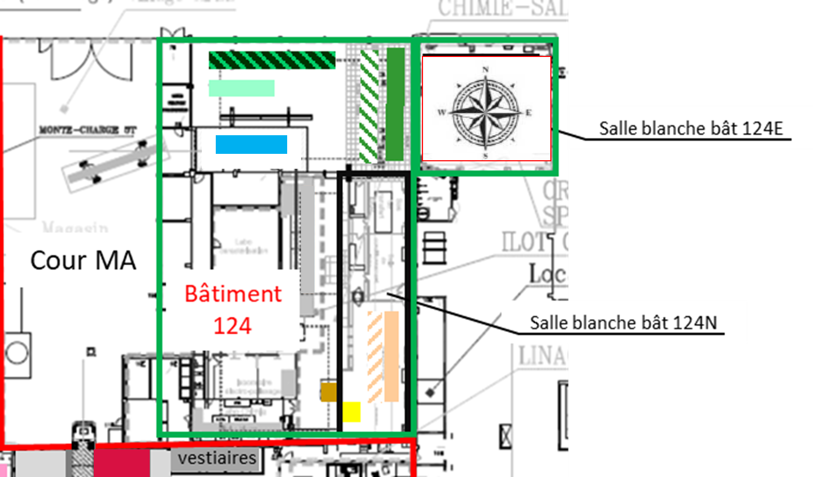
Geographical location of the assembly workstations
General view of the layout of the various assembly workstations based on the layout of the ESS project
Workstation LAV/PREP
Workstation COS
Workstation CAP
Workstation CRY
Workstation BLA
Workstation CLO
Workstation ABE
Waiting area for Workstation BUN
Workstation SPA
Workstation EXP
Notes:
WAS : WAShing of elements
PRE : PREparation of elements before clean room
CAP : in Clean room Assembly Preparation
BLA : Beam Line Assembly
ABE : Assembly of Beam line Equipments
SPA : Strongback Preparation Area
COS : Coldmass On Strongback
CRY : CRYostating
CLO : Closure of cryomodule
EXP : EXPedition

Slide 6
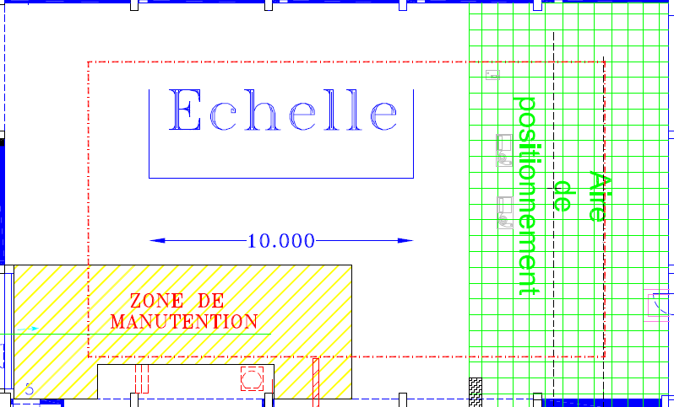




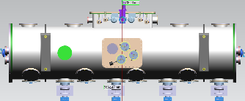
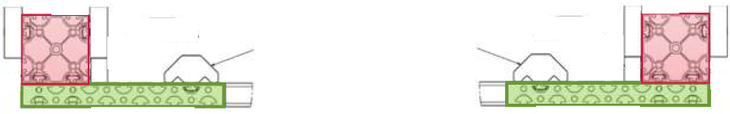

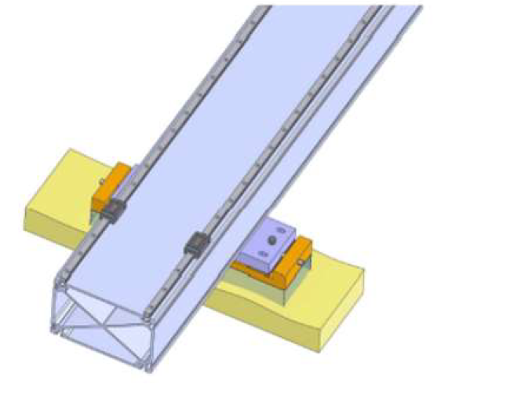
Geographical location of the assembly workstations
Detailed view of the layout of the various assembly stations within the assembly hall, based on the layout of the ESS project
CRY
SPA
1,35
1,15
15,00
COS
CLO
ABE
East to west rails (15m)
Strongback and vacuum vessel
Cryomodule
Waiting
Area
South to North rail
(46m) for the beam line
TEST & SHIPPING
(BUN & EXP)
CLEAN ROOM
(WAS/PRE/CAP/BLA)
Notes:
WAS : WAShing of elements
PRE : PREparation of elements before clean room
CAP : in Clean room Assembly Preparation
BLA : Beam Line Assembly
ABE : Assembly of Beam line Equipments
SPA : Strongback Preparation Area
COS : Coldmass On Strongback
CRY : CRYostating
CLO : Closure of cryomodule
EXP : EXPedition

Slide 7
Status of LB650 CM Assembly
General workflow of workstations
Geographical location of the assembly workstations in CEA infrastructure
Overview of the main steps of each workstation
A detailed assembly step example
The use of mock-ups
The use of robot assistance for flange cleaning
Assembly tooling
Notes:
Adapt the assembly step workflow with design modification, HB650 REX, mockup assemblies

Slide 8
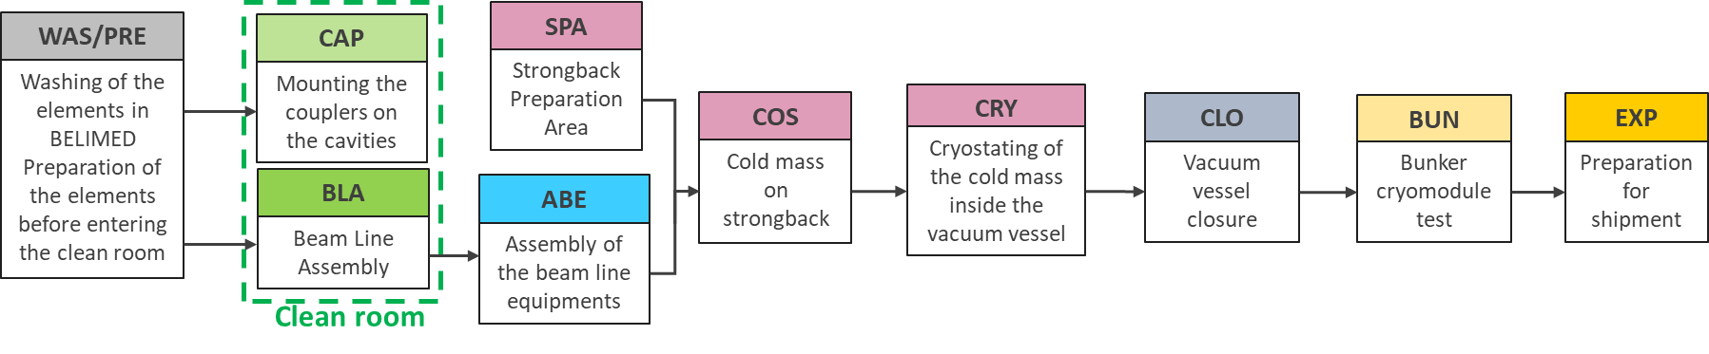
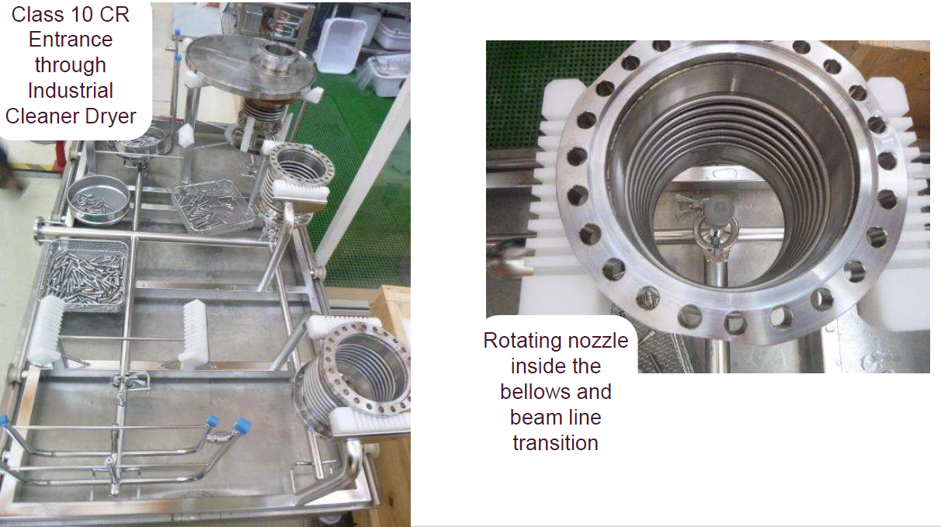
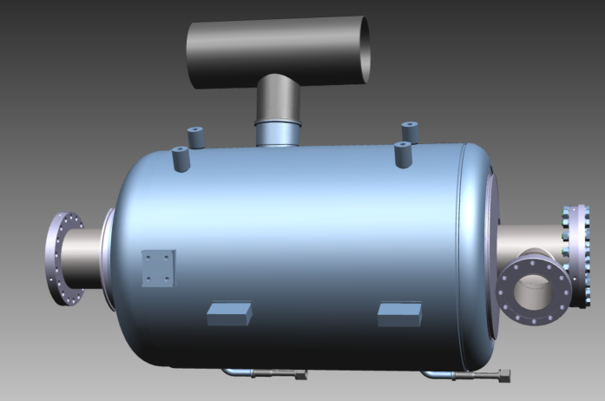
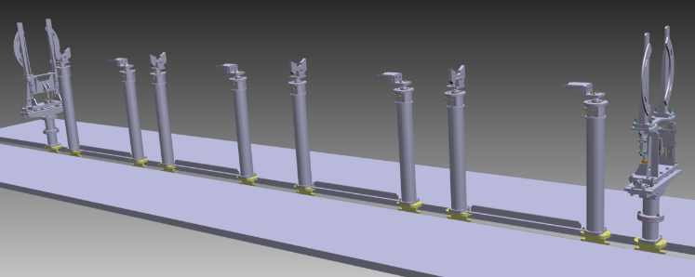
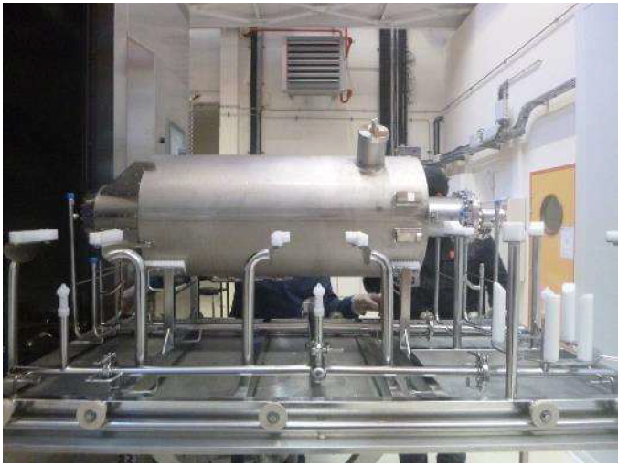
Workstation WAS/PRE
Pictures from ESS
A - PRE
Reception and QC of components (cavities, couplers, bellows,…)
Plugs mounted
1 - PRE
2 - PRE
Preparation of components before washing steps (installation, mounting of plugs…)
Alignment and setting of cavities posts and clean room assembly tooling
1 - WAS
2 - WAS
3 - WAS
Cleaning of cavities, bellows, couplers manifold and beam pipe end
Cleaning of cavities posts, tooling
Cleaning of all clean room parts (valves, screws, …)

Slide 9
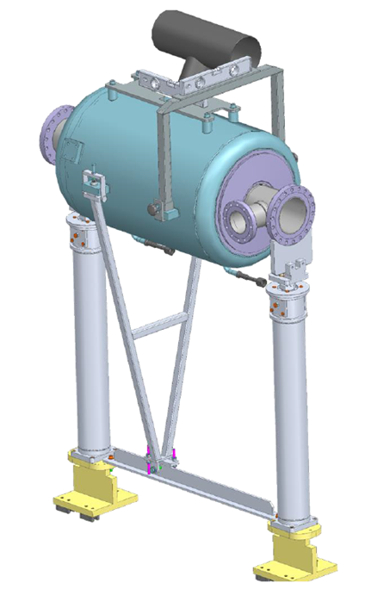
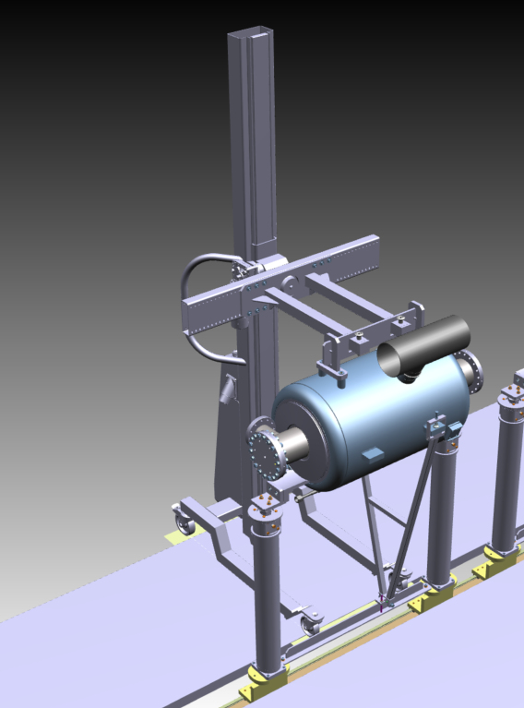
Workstation CAP
1 - WAS
2 - WAS
3 - WAS
Cleaning of cavities, bellows, couplers manifold and beam pipe ends
Cleaning of cavities posts, tooling
Cleaning of all clean room parts (valves, screws, …)
1 - CAP
3 - CAP
Transfer of the coupler manifold to the coupler test station
Transfer and installation of a cavity on posts
2 - CAP
4 - CAP
Leak test of the pumping group connection and RGA of the coupler manifold and slow venting
Cavity alignment settings
5 - CAP
Leak test of the pumping group connection and the cavity by spraying and slow venting

Slide 10
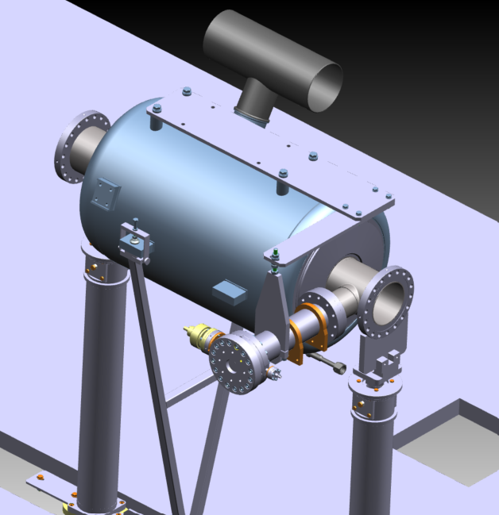
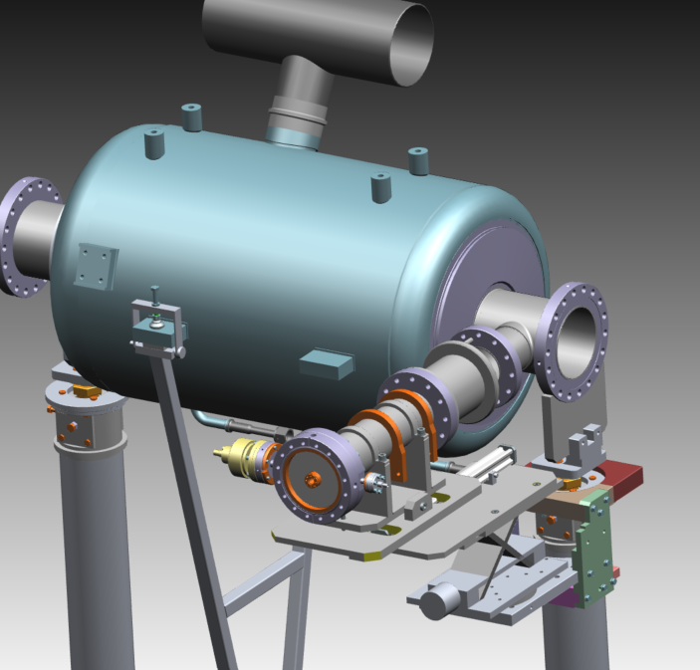
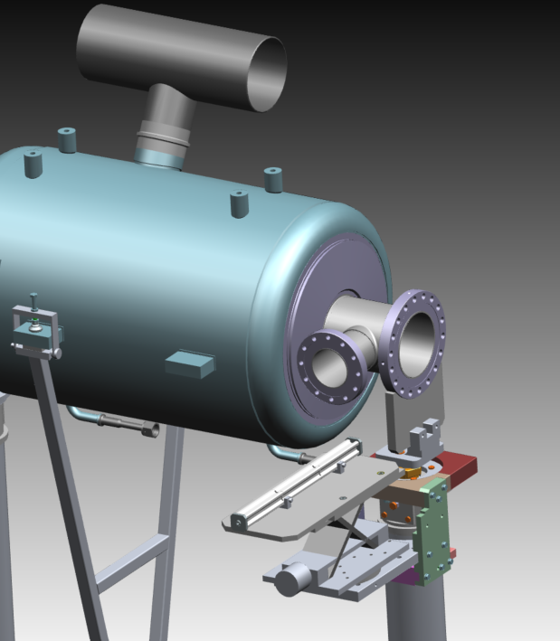
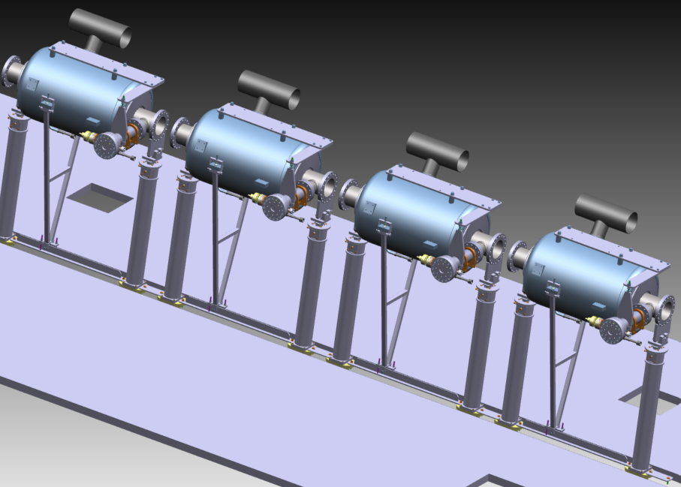
Workstation BLA
2 - CAP
5 - CAP
Leak test of the pumping group connection and RGA of the coupler manifold
Leak test of the pumping group connection and the cavity by spraying
1 - BLA
2 - BLA
Coupler manifold disconnection and mounting on coupler tooling + pre-positioning of coupler/cavity
Cleaning the holes of the cavity coupler flange
3 - BLA
Cavity/coupler final connection and installation of holding coupler tooling
4 - BLA
5 - BLA
Leak test of the connection and slow venting
Repetitions of previous steps to obtain 4 aligned leak tight cavities/couplers

Slide 11
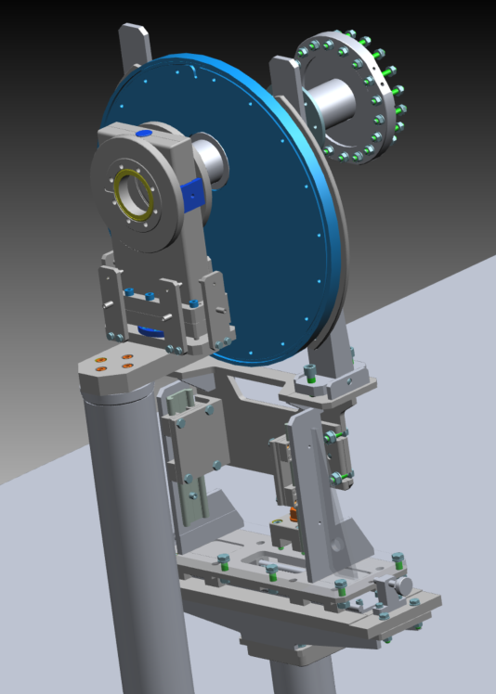
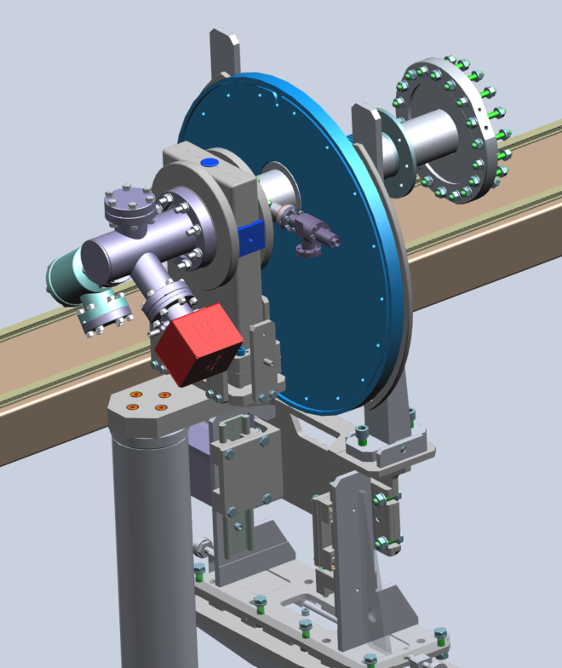
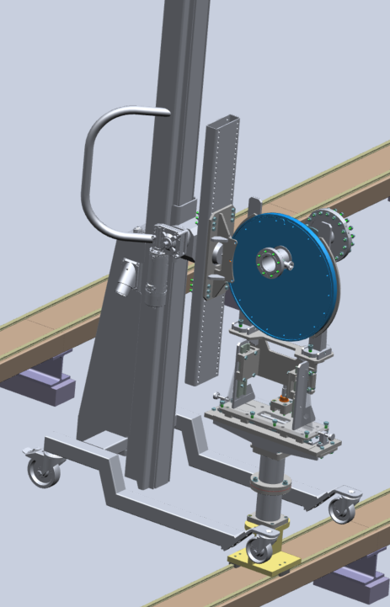
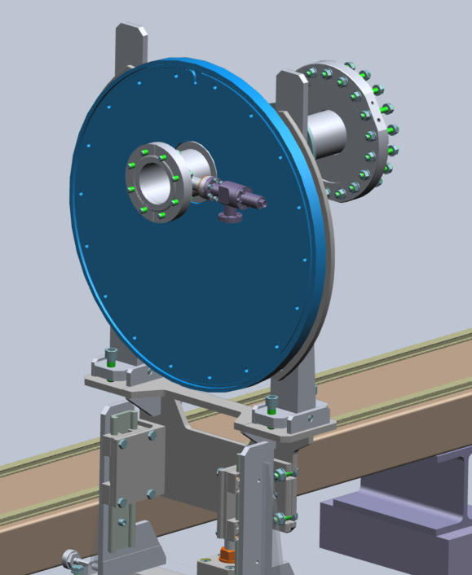
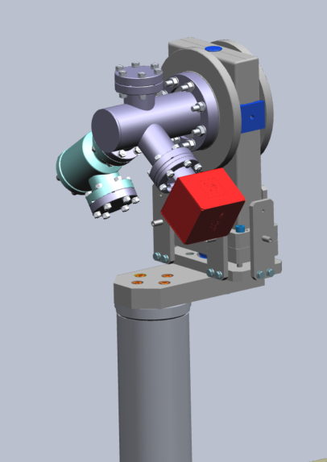
Workstation BLA
6 - BLA
11 - BLA
Setting up beam pipe ends on posts
Assembly of flushing system on US gate valve
7 - BLA
12 - BLA
Assembly of extremity devices (ion pum, valves, flushing system…) on DS gate valve
US gate valve/ US beam pipe end assembly
13 - BLA
8 - BLA
Leak check of flushing device/US gate valve/ US beam pipe end connections and slow venting
Burst disk system first RAV/ DS beam pipe end connection
9 - BLA
DS gate valve/ DS beam pipe end assembly
10 - BLA
Leak check of extremity devices/DS gate valve/ DS beam pipe end connections and slow venting

Slide 12
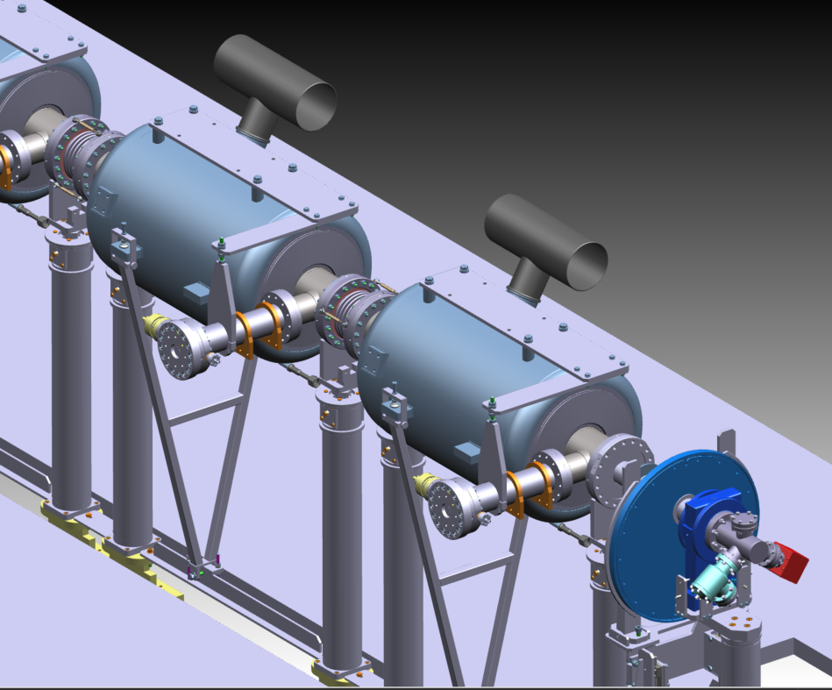
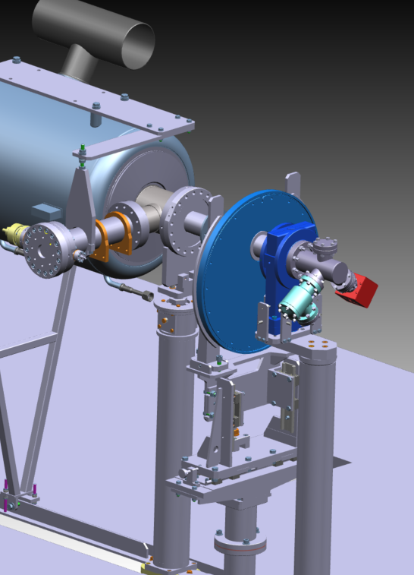
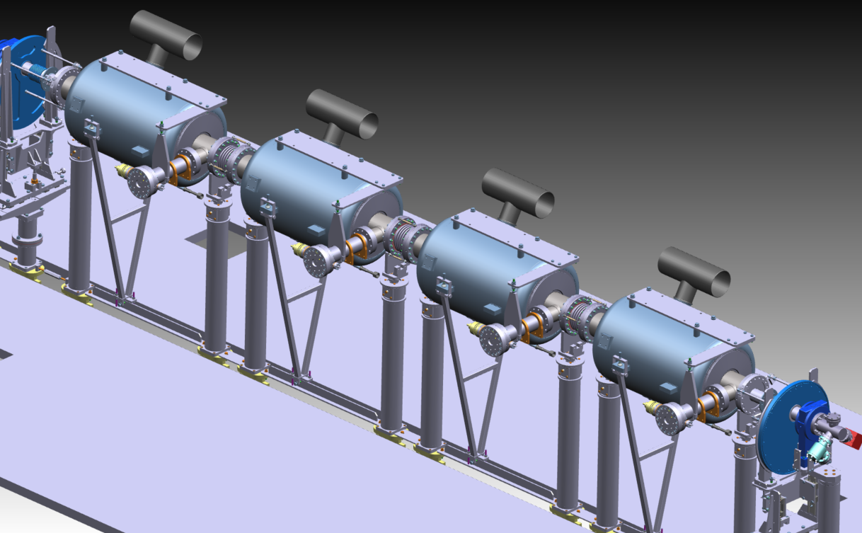
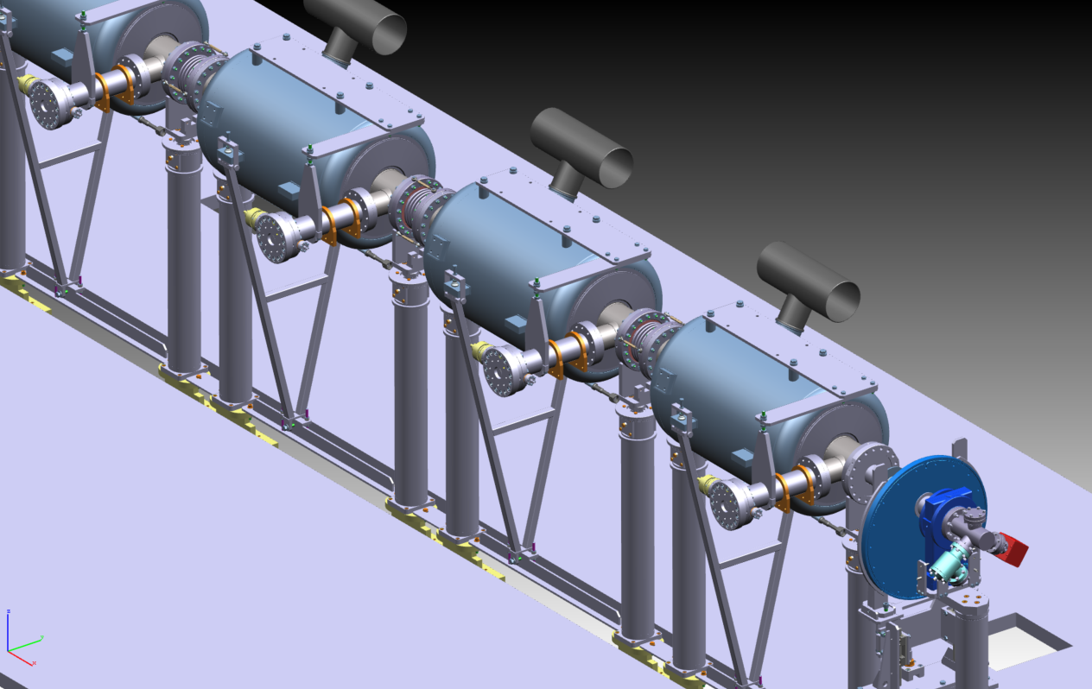
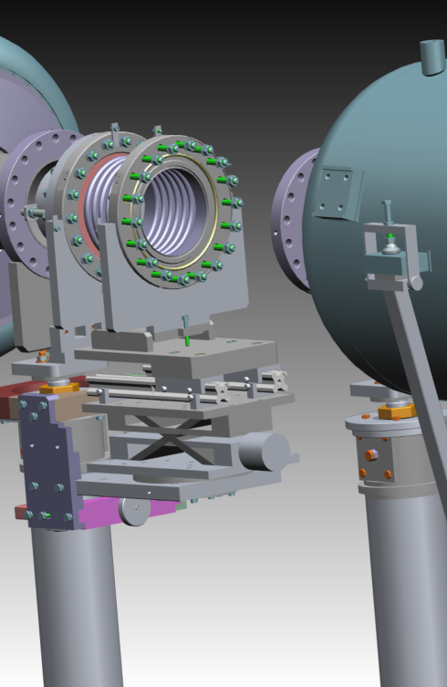
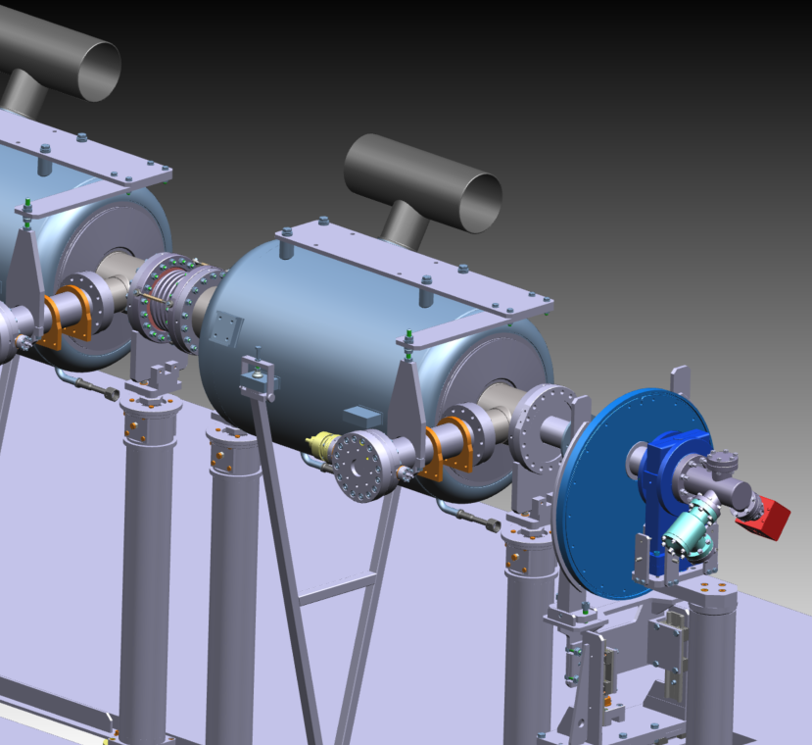
Workstation BLA
14 - BLA
19 - BLA
Cavity 4/beam pipe end connection
Coupler/coupler and coupler/transitions lengths settings
15 - BLA
20 - BLA
Cavity 3/Bellow/Cavity 4 connection
Cavity string leak check and RGA
21 - BLA
16 - BLA
Holdpoint before transferring the cavity string to ABE workstation
Cavity 2/Bellow/Cavity 3 connection
17 - BLA
Cavity 1/Bellow/Cavity 2 connection
18 - BLA
beam pipe end/Cavity 1 connection with flushing

Slide 13
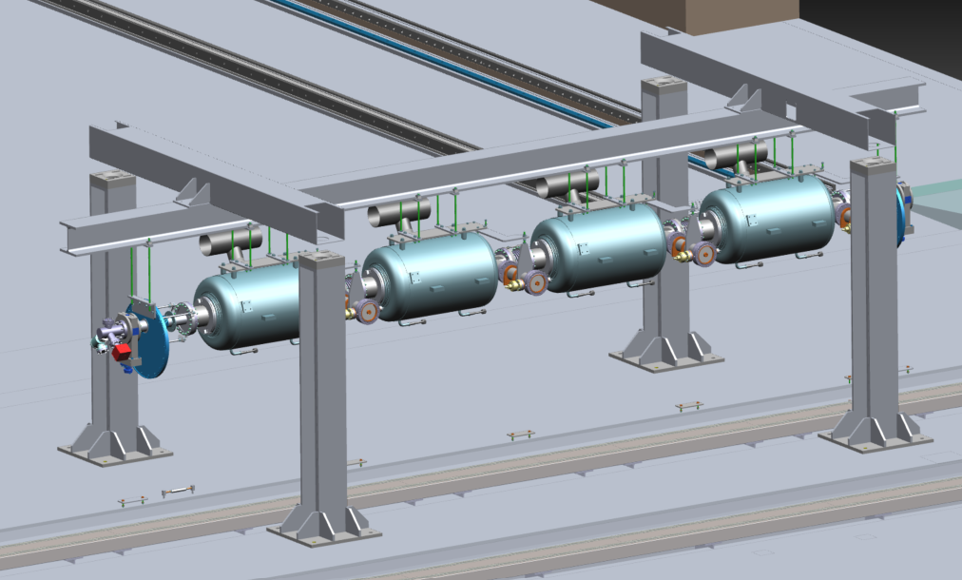
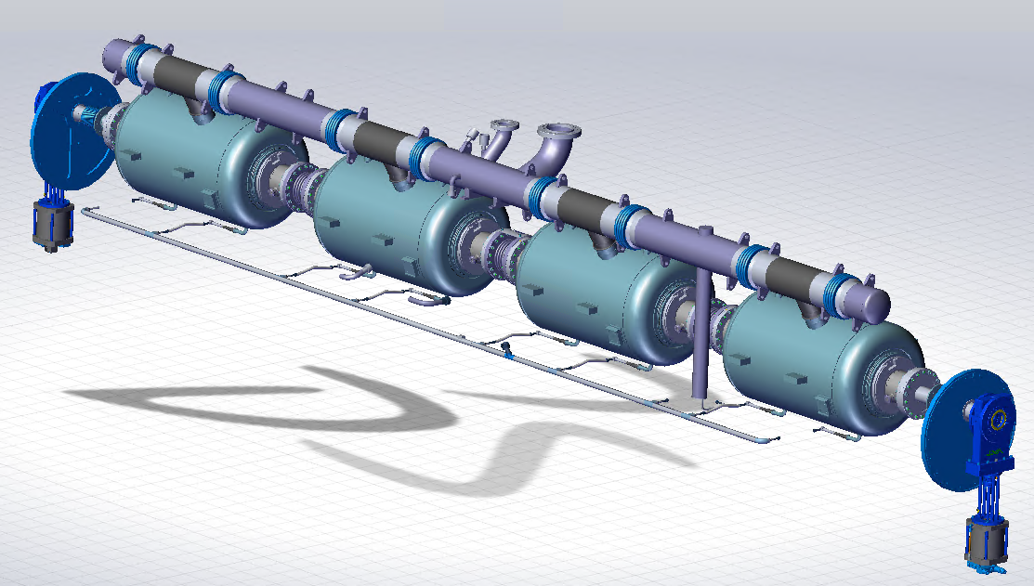
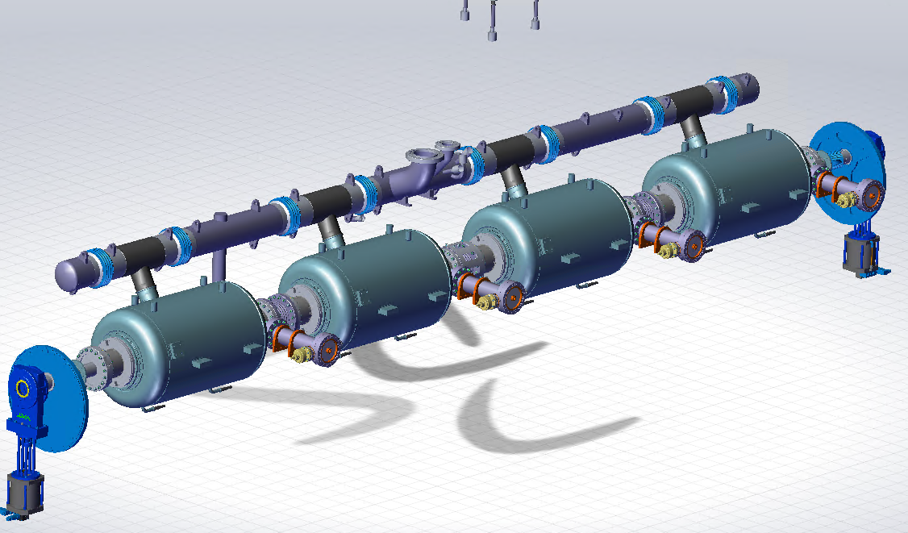
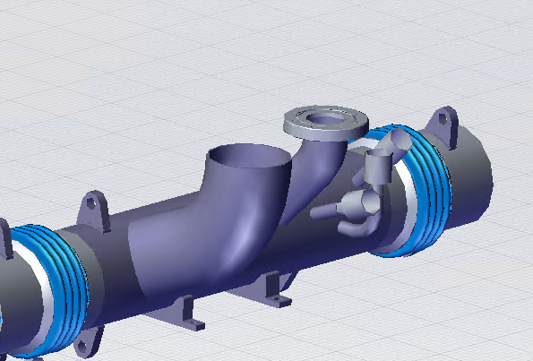
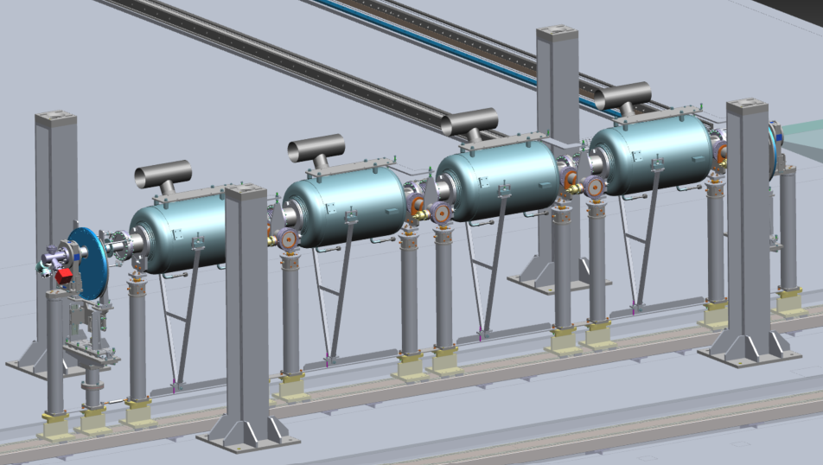
Workstation ABE
1 - ABE
6 - ABE
10 - ABE
Cavity string transfer in ABE workstation
Positioning and welding of diphasic tubes on cavity string and level tube cap + Internal and external visual inspection of the welds
Routing of cables into diphasic tubes and connection with extension cables + electrical control sensors
2 - ABE
Preparation of the cavity string (bellows protections...)
7 - ABE
Lifting of cavity string and tooling to maintaining cooling line installation
3 - ABE
Alignment of the cavity string
8 - ABE
Positioning and welding of the cooling line on cavity string + external visual inspection of the welds
4 - ABE
Preparation of the diphasic tubes sections for welding
9 - ABE
5 - ABE
Leak test of the welds of the helium circuitry welded by spraying then by overpressure of helium and sniffing
Welding of instrumentations hoses on 3rd diphasic tube section and routing of extension cables inside

Slide 14
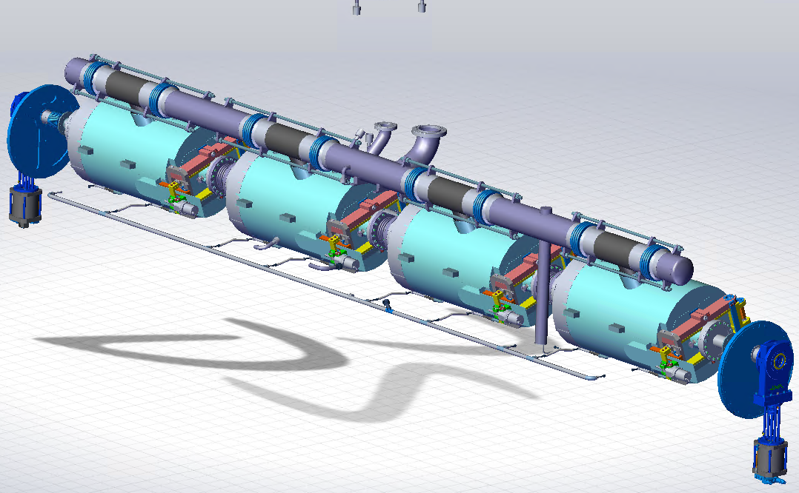
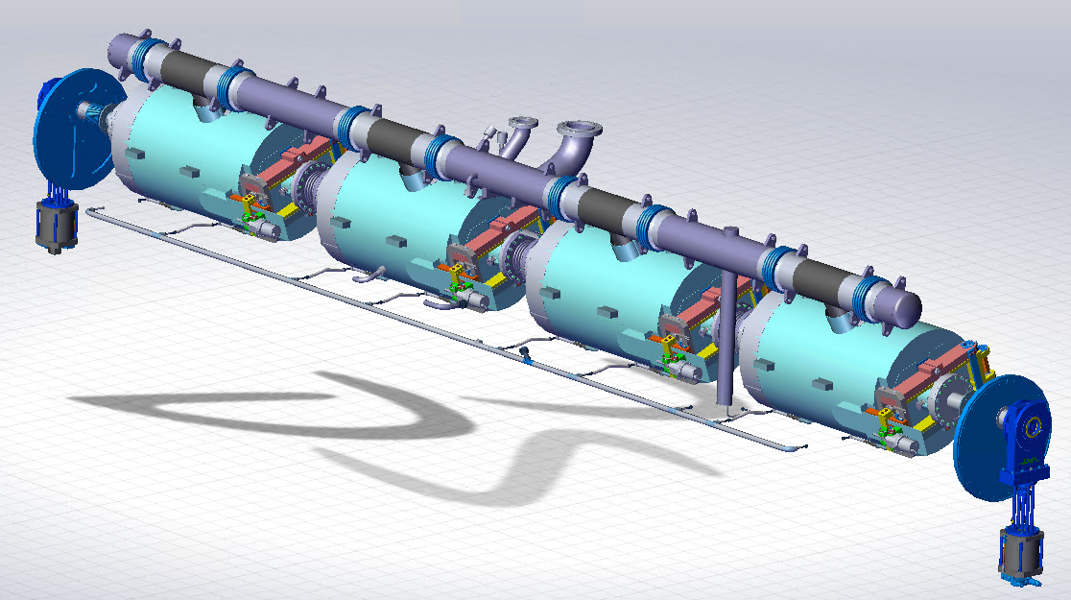
Workstation ABE
11 - ABE
15 - ABE
Tuners mechanical assembly with motors on cavity string under RF control and electrical tests on tuner operation
16 - ABE
Installation of on-helium tanks probes and electric testing of them
Installation of magnetic shields
12 - ABE
17 - ABE
Installation of the MLI on the cold mass
Assembly of thermal straps for beam pipe ends, couplers and tuner motors
13 - ABE
18 - ABE
Preparation of tuners assembly (pre-assembly of sections, assembly of piezos, limit switches,...)
Installation without settings of the invar bars on diphasic tube lugs
14 - ABE
19 - ABE
Installation of RF cables on cavities
Hold point before transfer to SPA workstation

Slide 15
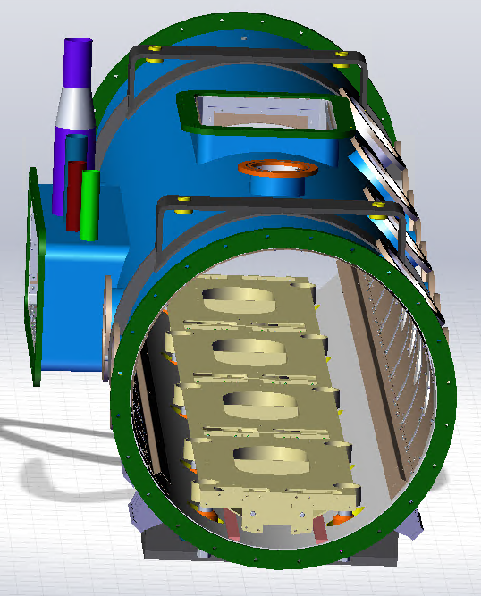
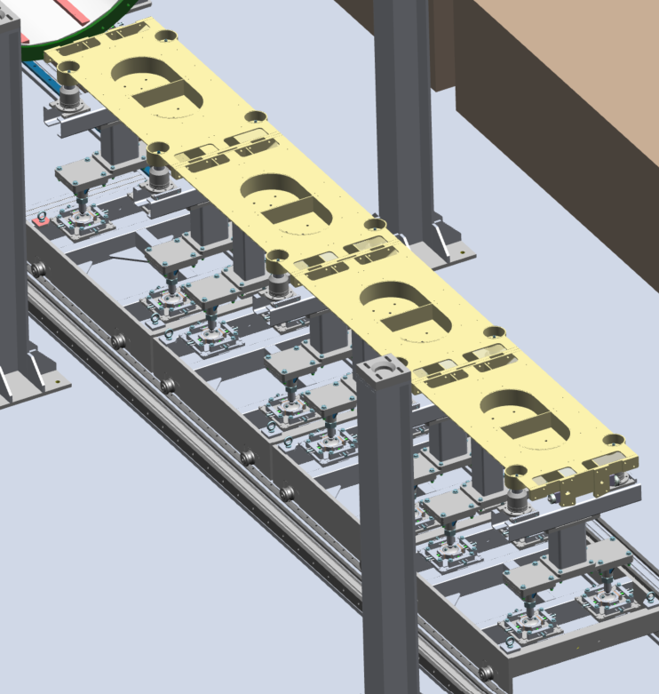
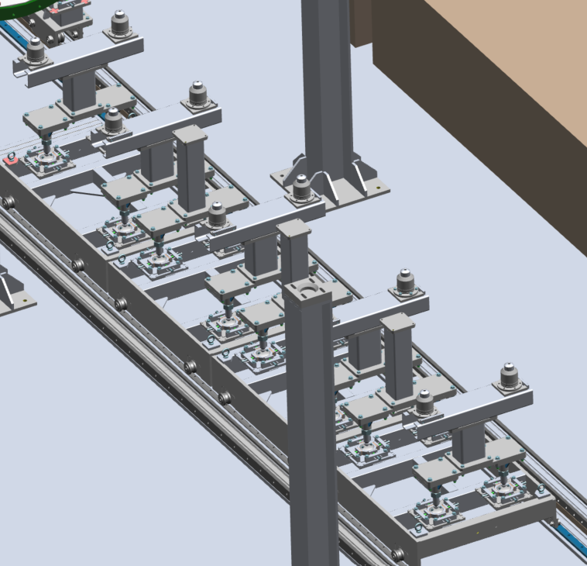
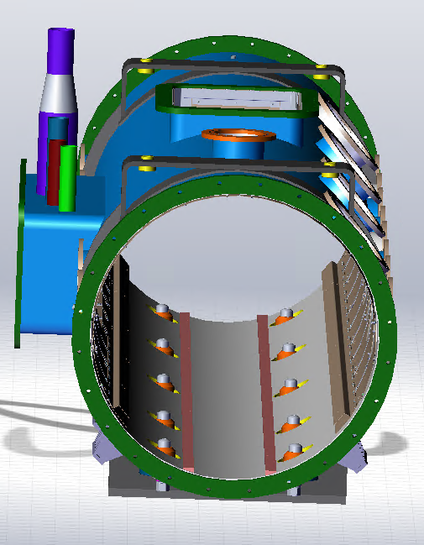
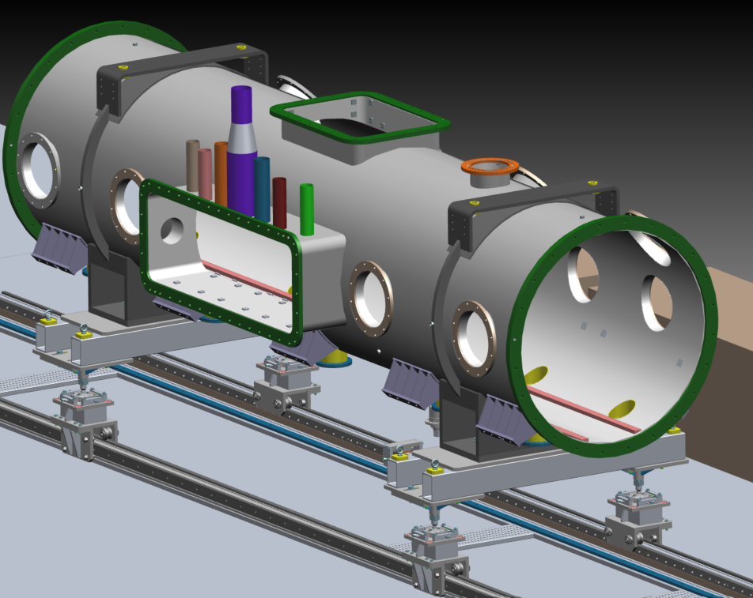
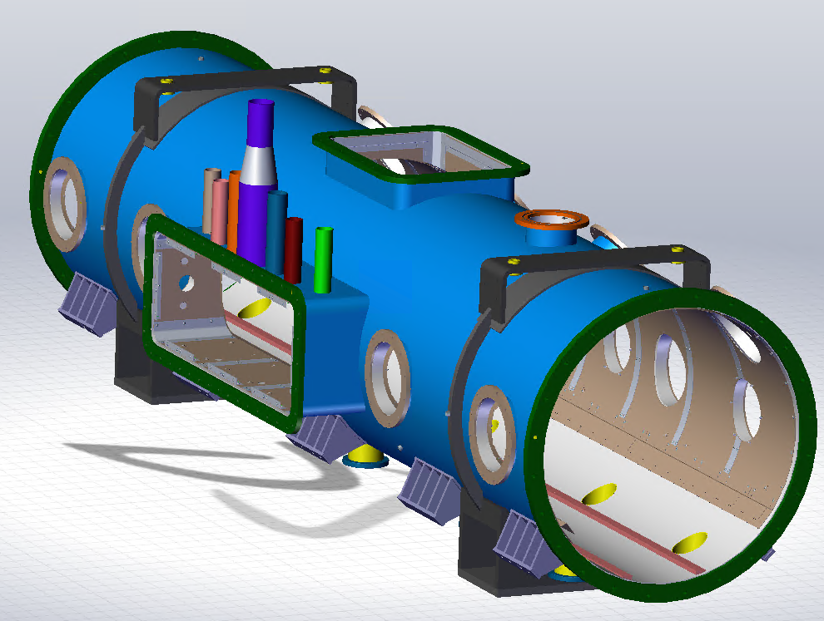
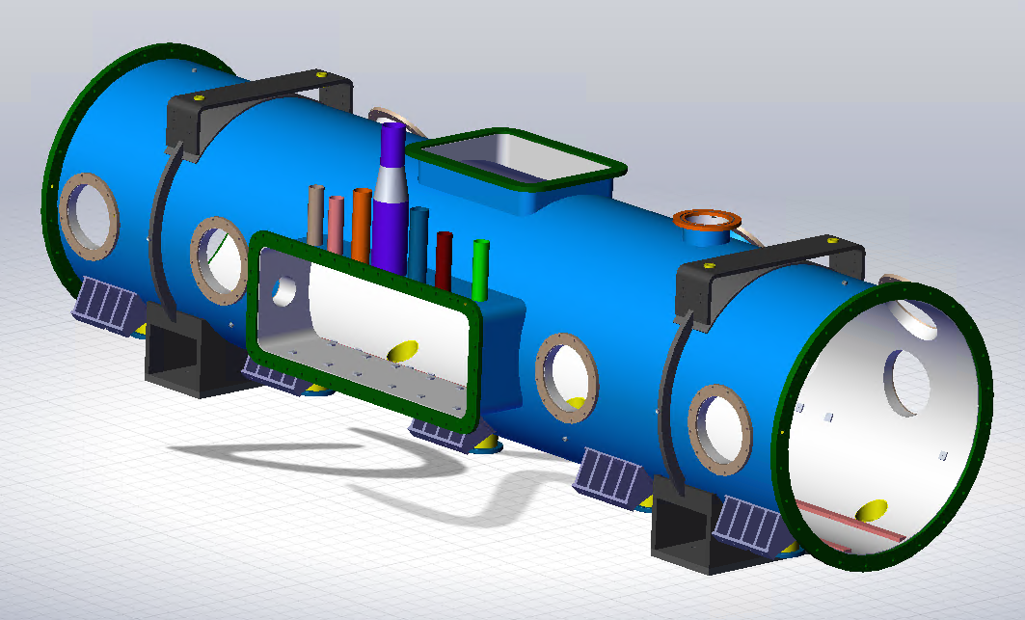
Workstation SPA
1 - SPA
6 - SPA
Transfer from vacuum vessel to SPA workstation
Assembly of studs/housings on stud/rails interface tooling
2 - SPA
7 - SPA
Mounting the magnetic shield on the vacuum vessel
Installation of the strongback sections on studs and alignment of each section
3 - SPA
Mounting the vacuum vessel on the adjustment tool on rails
8 - SPA
Assembly of the 4 sections of the strongback and beam pipe end tooling then leveling
4 - SPA
Levelling and alignment of the vacuum vessel
9 - SPA
5 - SPA
Insertion of the strongback into the vacuum vessel and placing the studs to reference height
Adjustment of the reference height of the studs

Slide 16
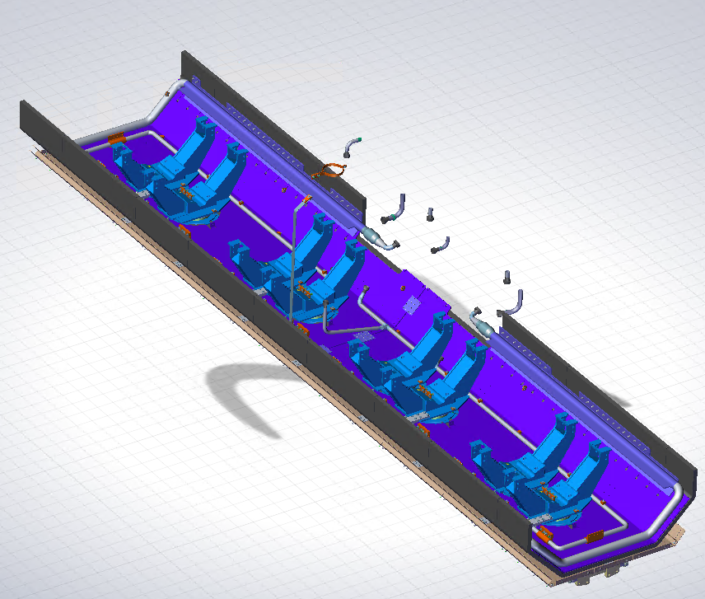
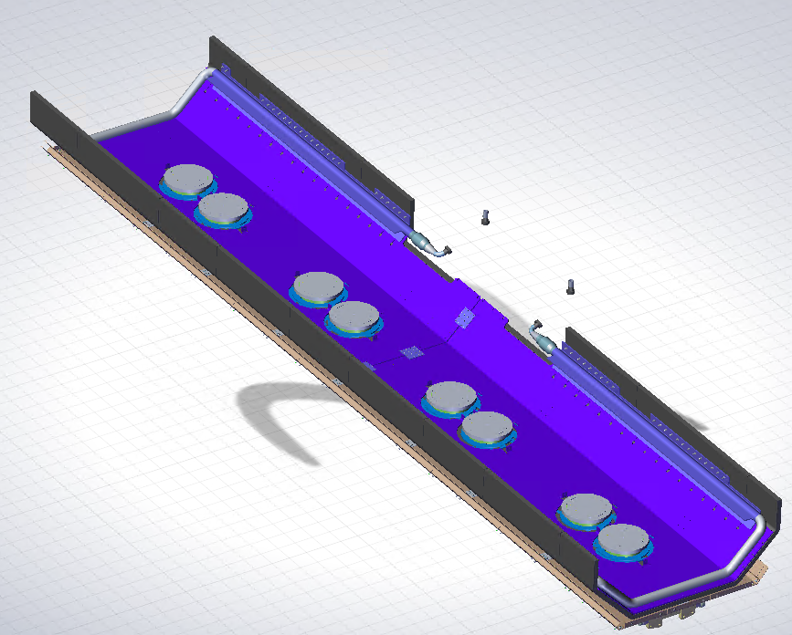
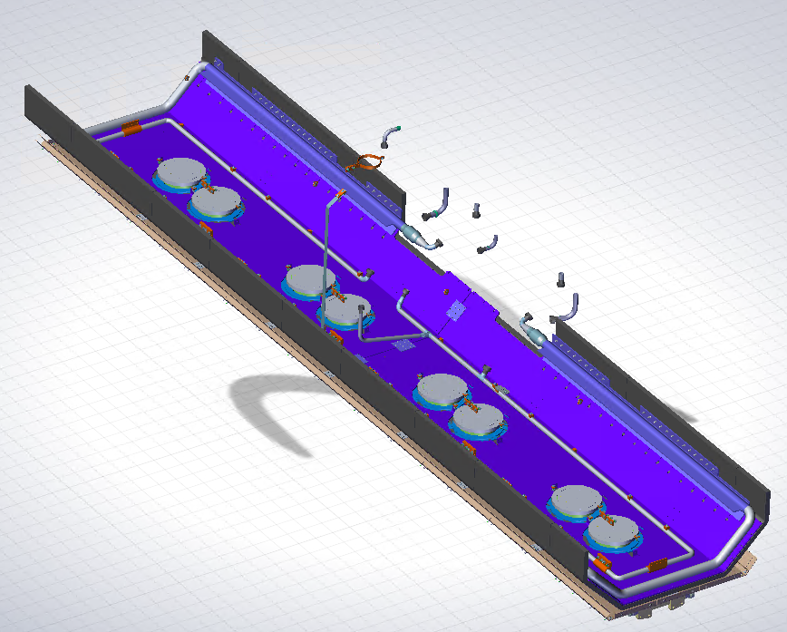
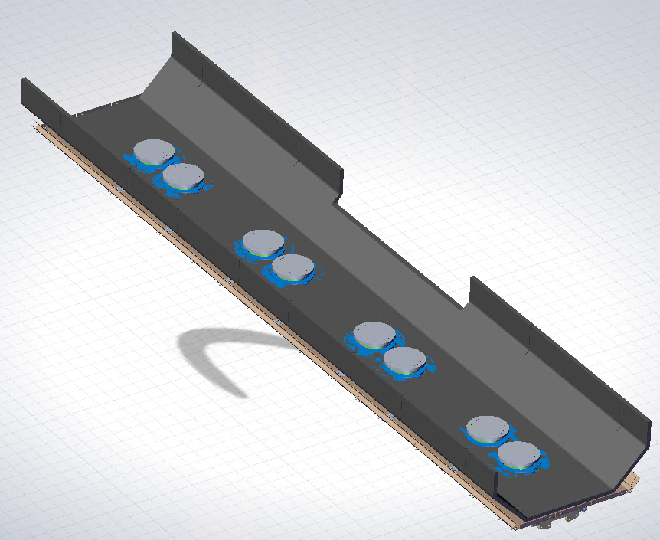
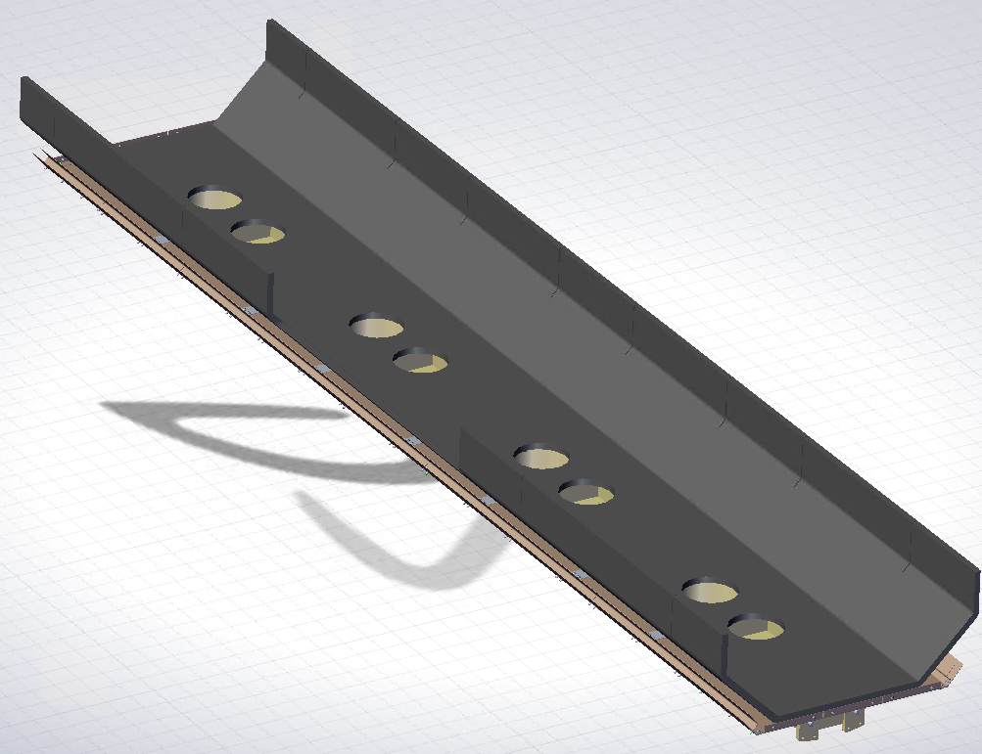
Workstation SPA
10 - SPA
14 - SPA
Final assembly of the strongback conical plates and setting of the beam pipe end tooling
Lower thermal shield assembly with 50K line
15 - SPA
11 - SPA
Installation of 5K line
Removal of the strongback from the vacuum vessel and drilling of the conical plates to receive the positioning pins
16 - SPA
Assembly of cavity posts on G11 posts and 5K line supports
12 - SPA
Assembly of the lower part of the magnetic shield and the lowest part of MLI on strongback
17 - SPA
Hold point before transfer to COS workstation
13 - SPA
Installation of G11 posts equipped with Cernox on the strongback with electrical testing

Slide 17
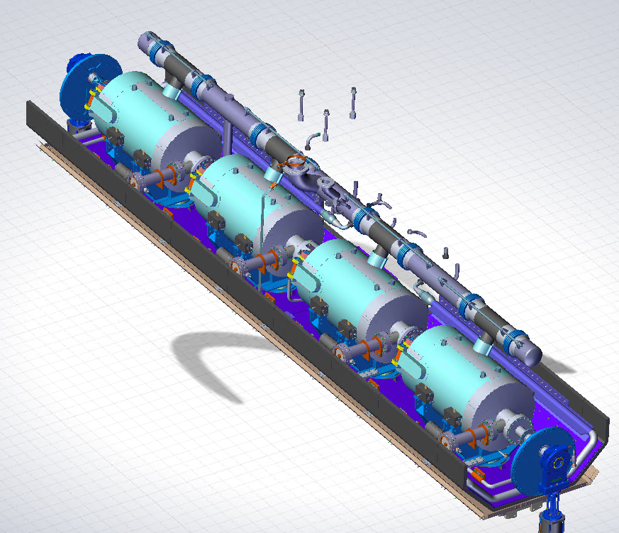
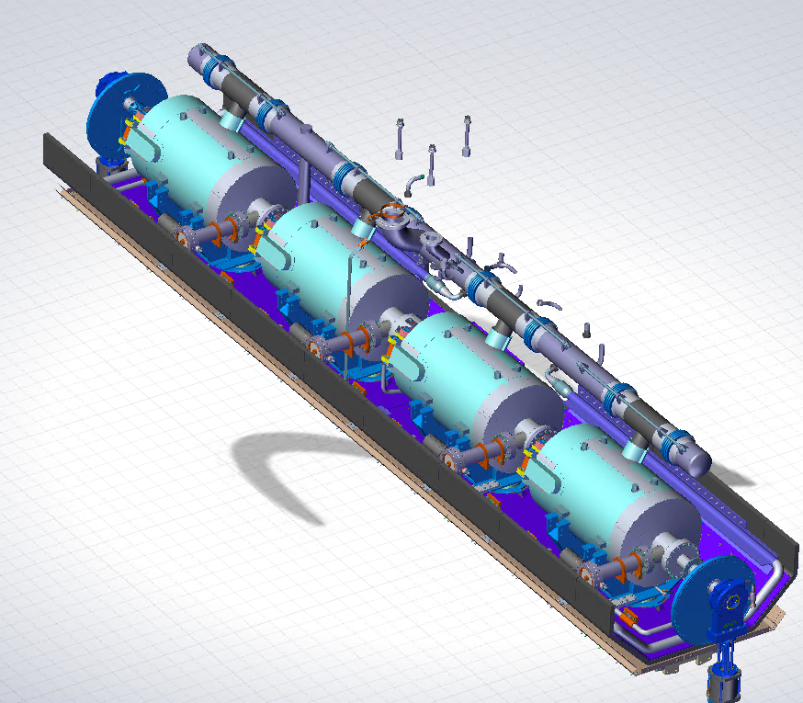
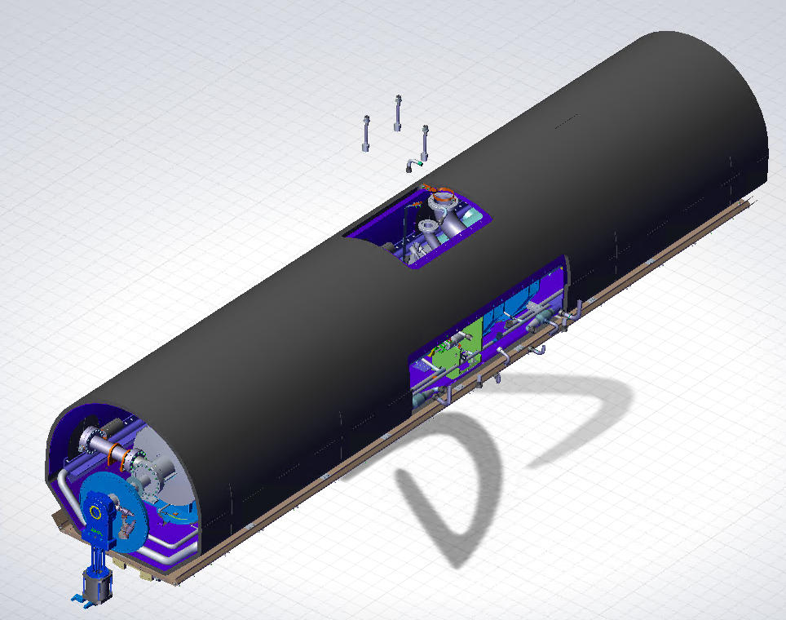


Workstation COS
1 - COS
6 - COS
10 - COS
Displacement of the cold mass above the strongback
Alignment and alignment check with C-block adjustment
Installation of HBCAM sights
11 - COS
2 - COS
7 - COS
Assembly of the upper thermal shield elements on cold mass
Complete control and alignment of the cavity train
Disassembly of bellows rigidifiers and transitions support bars then setting the Invar bars
12 - COS
Thermal sensor mounting on thermal shield and electrical test
3 - COS
8 - COS
Positioning of the cold mass on SB (height and longitudinal positioning)
Assembly of the G-10 cryo lines support and installation of JT and 2K pumping lines
13 - COS
Assembly of the 30-layer MLI on the upper thermal shield
4 - COS
9 - COS
Assembly of the C-Shape elements on the cavities
Installation of the means of thermalization of cables and parts (thermal blocs/straps connections)
14 - COS
Hold point before the CRY workstation

Slide 18





Workstation CRY
1 - CRY
5 - CRY
Insertion of strongback with cold mass in vacuum vessel
Side heat shield/MLI/magnetic shield assembly
6 - CRY
2 - CRY
Assembly of the vessel endcaps / HBCAM windows / gate valves protections
Positioning of the cold mass in the vacuum vessel (Adjustment of the studs + tightening of the locking nut)
7 - CRY
Position control of cold mass in vacuum vessel by HBCAM
3 - CRY
Pre-stressing of the strongback via studs (vacuum deformation, thermal shrinkage)
8 - CRY
Studs vacuum cover assembly
4 - CRY
9 - CRY
Couplers warm parts assembly
Hold point before transfer to CLO station

Slide 19












Workstation CRY
1 - CLO
5 - CLO
9 - CLO
Assembly/welding of the relief line (tubes/bellows) + Cernox & Platinium
Assembling the CD cryo bayonet valve kit on hoses
Lateral side port MLI and thermal shield assembly
6 - CLO
10 - CLO
2 - CLO
Assembly of the Cryo JT bayonet valve kit on hoses
Thermal shield assembly on top port + Instrumentation hoses retainer mounting
Assembly of 5K inlet & outlet bayonets valves kits on 5K hoses
7 - CLO
11 - CLO
Weldment of heat exchanger, pumping line straight tube/bellows and connection of the 2 elements
Assembly of the lateral MLI on top port
3 - CLO
Assembly of 35K-50K inlet & outlet bayonets valves kits on hoses
12 - CLO
8 - CLO
Magnetic shield assembly on top port
Leak test of the welds of the helium circuitry welded by spraying then by overpressure of helium with sniffing Radiography of CD valve welds
4 - CLO
13 - CLO
Assembly of the 2K pumping bayonet valve kit (line+valve)
Assembling the top port on the vacuum vessel

Slide 20









Workstation CRY
14 - CLO
19 - CLO
24 - CLO
Thermal shield/ MLI/magnetic shield assembly on flanges of side port and top port
Vacuuming of the vessel
Vacuuming of the cavities string
15 - CLO
20 - CLO
Top port/side port flange assembly
Vacuum vessel leak check by spraying
25 - CLO
Helium filling of vacuum vessel and leak check of the string + final RGA
16 - CLO
21 - CLO
Assembly of solid, pumping flanges and instrumentation flanges (with magnetic shield trapdoors)
Pressurization of the thermal shield 50K, 5K, 2K lines
26 - CLO
Purge of the helium from the vacuum vessel + vacuuming of the vessel
22 - CLO
17 - CLO
Leak check by surveying helium presence in insulating vacuum
Top port instrumentation flange assembly + pressure probes + relief line flange assembly
27 - CLO
Holdpoint before test phase
23 - CLO
18 - CLO
Beam line burst Disc final assembly
Assembly of the relief valve of the vacuum vessel

Slide 21

Workstation BUN
At this point in the assembly workflow, only the waveguide assembly is planned within the test site

Slide 22



Workstation EXP
5 - EXP
10 - EXP
1 - EXP
Disassembly of the heat exchanger and relief line
Filling of insulating vacuum of the vacuum vessel with nitrogen
Disassembly of the wave guides and warm part of the coupler
6 - EXP
11 - EXP
Mounting of the plugs on the relief line/pumping line/flexible
Extension of beam line pressure gauges, temperature gauges, accelerometers and shock sensors to instrumentation box
2 - EXP
Installation of bumpers to maintain the cold part of the couplers
7 - EXP
Re-assembly of the top port flange and instrumentation ports on the vacuum vessel
12 - EXP
3 - EXP
Hold final point before shipping
Removal of top port instrumentation ports, relief line flange, top port flange and the top port
8 - EXP
Assembly of spring interfaces for the transport
4 - EXP
9 - EXP
Removal of the thermal, magnetic and MLI shields from the top port
Assembly of the transport structure for shipping + installation of the vessel inside
Notes:
Adapt the assembly step workflow with design modification, HB650 REX, mockup assemblies

Slide 23
Status of LB650 CM Assembly
General workflow of workstations
Geographical location of the assembly workstations in CEA infrastructure
Overview of the main steps of each workstation
A detailed assembly step example
The use of mock-ups
The use of robot assistance for flange cleaning
Assembly tooling

Slide 24

More detailed assembly step example
Each assembly steps detailed in previous slides can be detailed in smaller steps
The objective is to create the detailed procedure for the assembly
Cavity n-1/Bellow/Cavity n connection with flushing
Removal of the centering pins
Cleaning and checking the inter-cavity bellows
Blowing with particle control of each hole of the cavity flange n and n-1
Re-installation of the bellows on its tooling without modifying the settings of the tooling
Cleaning and checking of the aluminium bellows/cavity seal
Placement of the aluminium gasket in the test flange by ovalizing it
Placement of the ovalized aluminium gasket on the open fixed flange of the bellows (critical operation: new gloves, hands at the bottom of the flange...)
Removal of the remaining screws and opening of the n-1 cavity flange by removing the remaining n nut screws while holding the flange against the cavity (2 operators)
Visual inspection of the cavity opening
Installation of n diametrically opposed screws + washers + nuts (frictionless entry)
Installation of the other screws and tightening to the star torque
Backing up of the cavity n-1
Removal of the bellows positioning tooling (checking the slight lowering of the bellows due to gravity)
Assembly of the third tie rods
Cleaning and checking of the bellows/cavity aluminium seal
Placement of the aluminium gasket in the test flange by ovalizing it
Placement of the ovalized aluminium gasket on the rotating flange of the bellows (critical operation: new gloves, hands at the bottom of the flange...)
Removal of the remaining screws and opening of the cavity n flange by removing the remaining n nut screws while maintaining the flange against the cavity (2 operators)
Visual inspection of the cavity opening
Installation of n diametrically opposed screws + washers + nuts (frictionless entry)
Installation of the other screws and tightening to the star torque
Place the bottom tie rods between the cavity posts n-1 and n
Replace the tie rods of the bellows without stress on the bellows (maintain the adjustment)
Opening of the nitrogen flushing on the cavity angle valve n-1
Connection of the flushing hose to the cavity angle valve n-1
Preparation of the cleaned and checked consumables (screws, tools)
Assembly of the bellows assembly tool on the cavity post n-1
Clean the whole flange with IPA
Unscrew the 4 yellow screws, clean and check the 4 holes
Place 4 clean screws/nuts in the 4 cleaned holes
Unscrew all the screws except the 4 yellow screws/nuts
Mounting of 2 centering devices at 180° on each of the 2 bellows flanges
Adjustment of the parallelism of the 2 bellows flanges
Rough adjustment of the bellows tie rods (to avoid too much movement when adjusting the rotating flange)
Placement of the bellows in its assembly tooling
Alignment of the bellows with the cavity flange n-1 and n
Removing the bellows from its tooling
Notes:
Continue writing the detailed workflow (adding details, images) to converge on the start of writing the procedures

Slide 25
Status of LB650 CM Assembly
General workflow of workstations
Geographical location of the assembly workstations in CEA infrastructure
Overview of the main steps of each workstation
A detailed assembly step example
The use of mock-ups
The use of robot assistance for flange cleaning
Assembly tooling

Slide 26
Use of mock-ups
To validate some critical assembly steps, the use of mock-ups objects appears useful.
  The use of mock-ups will make it possible to test the mountability and usability of tools with objects whose interfaces are representative of real objects
  This process has been used on several projects (IFMIF, ESS, …)
For the PIP-II LB650 cryomodule, some assembly tests with mock-ups have been identified :

Slide 27
Status of LB650 CM Assembly
General workflow of workstations
Geographical location of the assembly workstations in CEA infrastructure
Overview of the main steps of each workstation
A detailed assembly step example
The use of mock-ups
The use of robot assistance for flange cleaning
Assembly tooling

Slide 28


Flange Cleaning Procedure : Robot Assistance
A current R&D project aims at developing the use of robot assistance during flange cleaning phases
All flange/holes cleaning steps could be realized with a robot assistance
A pre-cleaning step is realized with lint free cloth
The robot is equipped with Ionized nitrogen blower and a particle counter
The cleaning process is carried out until the targeted cleanliness criterion is validated
Slow implantation in ESS clean room production workflow
Flange cleaning procedure can be used in LB650 clean room assembly workflow with the ESS experience

Slide 29
Status of LB650 CM Assembly
General workflow of workstations
Geographical location of the assembly workstations in CEA infrastructure
Overview of the main steps of each workstation
A detailed assembly step example
The use of mock-ups
The use of robot assistance for flange cleaning
Assembly tooling

Slide 30
Assembly tooling
Some tooling for the assembly steps are designed or in design finalization.
They are inspired by previous CEA projects (XFEL, ESS,…) and the experience from PIP-II pCM HB650
Aluminum/Polymers is favored over stainless steel for parts that will be handled regularly or on which the stresses remain low
Clean room posts leveling tooling
Aluminium

Slide 31




Assembly tooling
Some tooling for the assembly steps are designed or in design finalization.
They are inspired by previous CEA projects (XFEL, ESS,…) and the experience from PIP-II pCM HB650
Aluminum/Polymers is favored over stainless steel for parts that will be handled regularly or on which the stresses remain low
Cavity/beam pipe end/gate valve posts

Slide 32
Assembly tooling
Some tooling for the assembly steps are designed or in design finalization.
They are inspired by previous CEA projects (XFEL, ESS,…) and the experience from PIP-II pCM HB650
Aluminum/Polymers is favored over stainless steel for parts that will be handled regularly or on which the stresses remain low
Beam pipe end length adjusting tooling
PTFE

Slide 33


Assembly tooling
Some tooling for the assembly steps are designed or in design finalization.
They are inspired by previous CEA projects (XFEL, ESS,…) and the experience from PIP-II pCM HB650
Aluminum/Polymers is favored over stainless steel for parts that will be handled regularly or on which the stresses remain low
Cavity in clean room roll & pitch adjusting tooling
Aluminium

Slide 34
Assembly tooling
Some tooling for the assembly steps are designed or in design finalization.
They are inspired by previous CEA projects (XFEL, ESS,…) and the experience from PIP-II pCM HB650
Aluminum/Polymers is favored over stainless steel for parts that will be handled regularly or on which the stresses remain low
Coupler-coupler distance tooling
Aluminium

Slide 35

Assembly tooling
Some tooling for the assembly steps are designed or in design finalization.
They are inspired by previous CEA projects (XFEL, ESS,…) and the experience from PIP-II pCM HB650
Aluminum/Polymers is favored over stainless steel for parts that will be handled regularly or on which the stresses remain low
Cavity handling cart in clean room

Slide 36

Assembly tooling
Some tooling for the assembly steps are designed or in design finalization.
They are inspired by previous CEA projects (XFEL, ESS,…) and the experience from PIP-II pCM HB650
Aluminum/Polymers is favored over stainless steel for parts that will be handled regularly or on which the stresses remain low
Beam pipe end handling cart in clean room

Slide 37



Assembly tooling
Some tooling for the assembly steps are designed or in design finalization.
They are inspired by previous CEA projects (XFEL, ESS,…) and the experience from PIP-II pCM HB650
Aluminum/Polymers is favored over stainless steel for parts that will be handled regularly or on which the stresses remain low
Alignment tooling for cavity/coupler connection
Stainless steel
Aluminium
HDPE

Slide 38


Assembly tooling
Some tooling for the assembly steps are designed or in design finalization.
They are inspired by previous CEA projects (XFEL, ESS,…) and the experience from PIP-II pCM HB650
Aluminum/Polymers is favored over stainless steel for parts that will be handled regularly or on which the stresses remain low
Alignment tooling for cavity/bellow/cavity connection
HDPE
Stainless steel
Bellow/cavity alignment tooling with locating pins (like HB650 clean room process)

Slide 39

Assembly tooling
Some tooling for the assembly steps are designed or in design finalization.
They are inspired by previous CEA projects (XFEL, ESS,…) and the experience from PIP-II pCM HB650
Aluminum/Polymers is favored over stainless steel for parts that will be handled regularly or on which the stresses remain low
Support tooling for couplers
Stainless Steel
Aluminium

Slide 40


Assembly tooling
Some tooling for the assembly steps are designed or in design finalization.
They are inspired by previous CEA projects (XFEL, ESS,…) and the experience from PIP-II pCM HB650
Aluminum/Polymers is favored over stainless steel for parts that will be handled regularly or on which the stresses remain low
Support and adjustment tooling for strongback
Use of an extra set of housings+studs on tooling to limit the disassembly steps

Slide 41


Assembly tooling
Some tooling for the assembly steps are designed or in design finalization.
They are inspired by previous CEA projects (XFEL, ESS,…) and the experience from PIP-II pCM HB650
Aluminum/Polymers is favored over stainless steel for parts that will be handled regularly or on which the stresses remain low
Support and adjustment tooling for the vacuum vessel
Notes:
Continue the tooling design (lifting tooling,…)

Slide 42
Thanks for your attention

