Slide 1
HB650 Dummy Load Transportation Test Results
J. Holzbauer on behalf of the 650 Transport Team
July 14, 2022
PIP-II Technical Workshop

Slide 2
HB650 Transportation Validation Milestones
Establish Clear Specification and Scopes
Complete, Document, and Review Designs (FDR 2020-09-22)
Fabrication Prototypes (Dummy Load Delivered 2022-03-30)
Local Validation with Dummy Load (Second Road Test Completed 2022-04-29)
International Validation with Dummy Load (Aug/Sept-2022)
Local Validation with pCM (After Cold Testing)
International Validation with pCM (Ship to STFC-UKRI & Back then Repeat Cold Testing)

Slide 3
HB/LB650 Transport Documentation
Doc Name | HB650 | LB650
Transport Spec | ED0012328 | ED0013421
Transport Plan | ED0012594 | ED0013424
Transport ISD | ED0012741 | ED0013425
Transport FMEA | ED0012325 | ED0013422
Transport PtD | ED0012559 | ED0013423
Frame Design Report | ED0012560 | TBD
pCM Transport Analysis | ED0012420 | TBD
On-Site Transport Spec | TBD | TBD
CM Transport Config Drawings | TBD | TBD
Transport Frame Vendor Docs | ED0015873 | TBD

Slide 4
HB650 Transportation System Specification
Strongly collaborative approach to transport design including lessons learned from all partners
Transport spec written in close consultation with partners
Goal was a robust design flow that would systematically mitigate transport risk for both HB and LB
Other notable specifications:
-Rated, self-contained lifting fixture
-Physical stay-clear boundary
-Air freight compatible
-Instrumentation capacity
-Resonant isolation better than 80% above 10 Hz
-Internal resonances >20 Hz
Determine external inputs from standards
Design Frame to reduce input shocks to less than 1.5/2.5/3.5 g (X/Y/Z)
Design Cryomodule to survive 1.5/3.0/5.0 g (X/Y/Z)

Slide 5
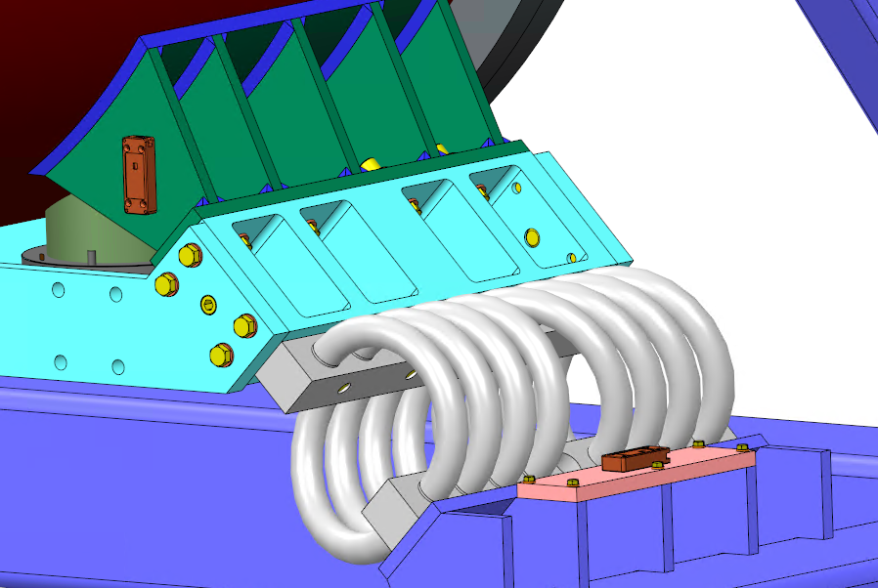
Frame Design
14 isolators, 7 cradles
28 sensor mounts
Designed to BS EN 13155:2011 and ASME B30.20, BTH-1
Dedicated instrumentation space

Slide 6
Fabrication at Caldwell Lifting Solutions
Vendor visits resulted in several modifications for assembly and ease of use (lifting points on top frame, labeling)
Frame was load tested to 200% (60,800 lb) per code prior to delivery including vendor certification

Slide 7
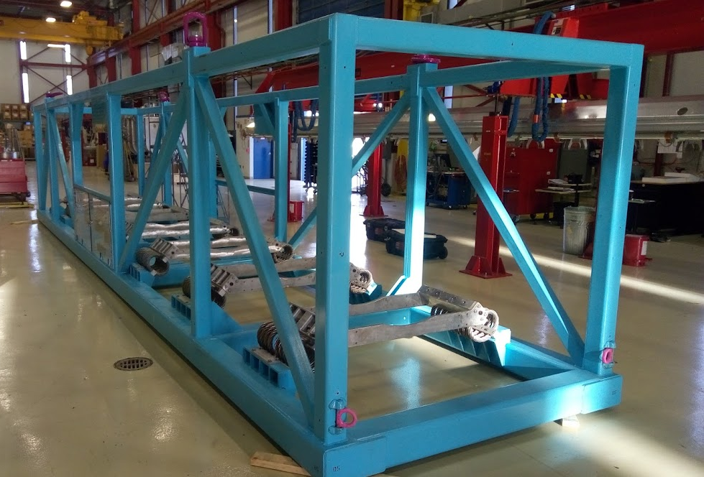
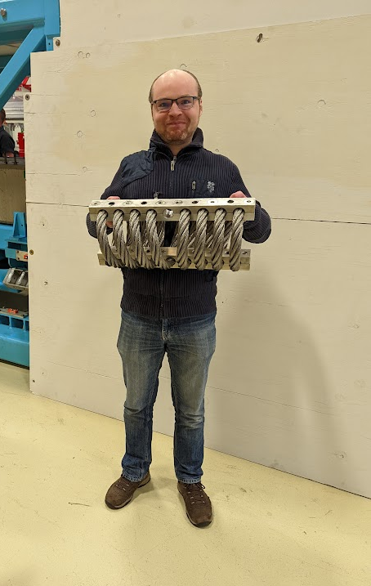
Frame Delivery

Slide 8
Dummy Load Design
Design at FNAL to mimic weight, CoM, and interfaces of HB650 Cryomodule
Strongback accepting and securing two concrete shielding blocks, designed to be stiff to protect concrete during shipping

Slide 9
First Integration (2022-04-23)
Mating of 14 interfaces (52 fasteners) was not obviously straight-forward.
Strong collaborative effort to develop tools, techniques, and procedures for assembly
Work during design and preparation paid off; partners were able to attend the first full integration which was a smooth 90 minutes, real credit to designers and assembly team

Slide 10
First Road Test (2022-04-25)
FNAL Site
Frame was installed on FNAL trailer including outer panels
Air-ride flat bed trailer, 22 tons load flattened 30 tons camber very nicely
Standard route near FNAL, ~2 hours of freeway driving on rough roads near Joliet heavy haul port (~130 miles)
No speed restrictions or other driver instructions

Slide 11
Instrumentation
Endaq tri-axial sensor packages (1 kHz sampling)
Six sensor packages, three pairs:
Driver’s Side Front
Driver’s Side Center
Passenger Side Rear
GPS Tracking

Slide 12
First Test Data Summary
Transfer Functions show standard air-ride motion at 2-3 Hz with unexpected resonances at 15 Hz in Y and 20 Hz in X (coupled to Y), both are suspected to be dummy load internal resonances
High frequency isolation is good, thus peak shocks are within expectations. However, significant excitation is present at mid-teen Hz

Slide 13
Second Road Test – Reduced Spring Count
After discussion of first road test results, it was clear that spring dominated modes must be excluded
Critical to identify if peaks seen will impact CM
Record of decision was written and released by STFC-UKRI and FNAL to remove 4 springs and retest
Pairs 2 and 6 removed, sensors move inboard 1 pair

Slide 14
14 Spring vs 10 Spring
Test 1 – 14 Springs
Test 2 – 10 Springs
Caveat: This sort of data is very noisy in road test data and the resonances are quite broad, so it’s difficult to directly drill down on a center frequency, especially given the MIMO nature of inputs
-Frequency of resonances (~15 and 21 Hz) did not change within measurement errors
-21 Hz resonance shows clear X and Y components (rolling, twisting mode)

Slide 15
Modeling Effort
The internal modes of the dummy load were not considered during design (lesson learned)
Sergey Cheban (FNAL) and Mitchell Kane (STFC-UKRI) have spent significant time modeling the dummy load and isolators to align data with models including two different spring numbers (very challenging)
Strong suspects for 15 and 21 Hz are twisting and bending modes of the dummy load
Model by: M. Kane (STFC-UKRI)

Slide 16
Non-Linear Modeling
-Enlisted Prof. Paolo Neri from University of Pisa (designed SSR transport frame) to do characterization of the chosen isolators
-Asking him to cross check Sergey and Mitchell with more advanced model for more context

Slide 17
Shock Performance – Both Road Tests
Resonant behavior is likely understood and not a concern for CM
Shock behavior is within specifications for both tests
Tightest spec is transverse, which has comfortable margin even after 4.5 hours of the worst freeways we could find with no driver restrictions
 | X (transverse) | Y (vertical) | Z (longitudinal)
Trip 1 Front | 0.93 | 0.79 | 0.30
Trip 1 Center | 1.13 | 0.85 | 0.31
Trip 1 Rear | 1.33 | 0.93 | 0.38
Trip 2 Front | 1.04 | 0.81 | 0.32
Trip 2 Center | 0.94 | 0.81 | 0.35
Trip 3 Rear | 1.21 | 0.74 | 0.32
Specification | <1.50 | <2.5 | <3.5
Peak shock in X, Rear, Trip 1 is a single event <10 ms
To be clear, the level of scrutiny of these tests is extremely high, PIP-II must be able to rely on this design and validation effort

Slide 18
Looking forward
Bids for transport vendor to UK and back are back from vendors, evaluating now
Will observe as much as possible at all stages of transport
Expect to award and set date for shipment ASAP
Award ~ 2 weeks
Set first transport date ~3 weeks
First Transport ~1 week (Final Validation Complete)
Turn around at STFC-UKRI ~2 weeks
Second Transport ~1 week
Rough estimate puts System Validated Late August, return to FNAL in Mid-September
Transportation Readiness Review for dummy load shipment scheduled for 2022-07-21
We have one (two) shot(s) at this, want to be as prepared as possible and learn as much as possible
Will have Test Report written and out for review by TRR

