Slide 1
PIP-II 2nd Technical Workshop, WG#2
Introduction and Cavity Overview
HyeKyoung Park
Fermilab
12 July, 2022

Slide 2
Welcome!!
Meeting logistics
Agenda overview
In Kind Contribution overview
Cavity design evolution
Partner milestone overview
Coming changes

Slide 3
Welcome!!
This is Working Group #2 650 MHz Cavity Processing and Testing.
As the group names indicates, the scope of our workshop will be:
650 MHz Low Beta and High Beta sections.
Focused on cavity fabrication, processing and test.
Presentations in the morning.
Ad-hoc discussions and facility visits in the afternoon.
Meeting room will be available throughout the day.
Advanced suggestion of topic is welcome and encouraged.
For example, cavity acceptance criteria list discussion.
We have about 40 primary participants.
It’s not a thesis defense, share your thoughts and experiences, enjoy the spirit of collaboration!

Slide 4
Welcome!!
This room’s capacity is 20 people. Designated overflow space is the Apex on the 2nd floor.
We do not have ‘officially’ organized after hour social.
Let’s invite each other for lunches and dinners and take advantage of the in-person meeting!

Slide 5
Workshop Topics – Today

Slide 6
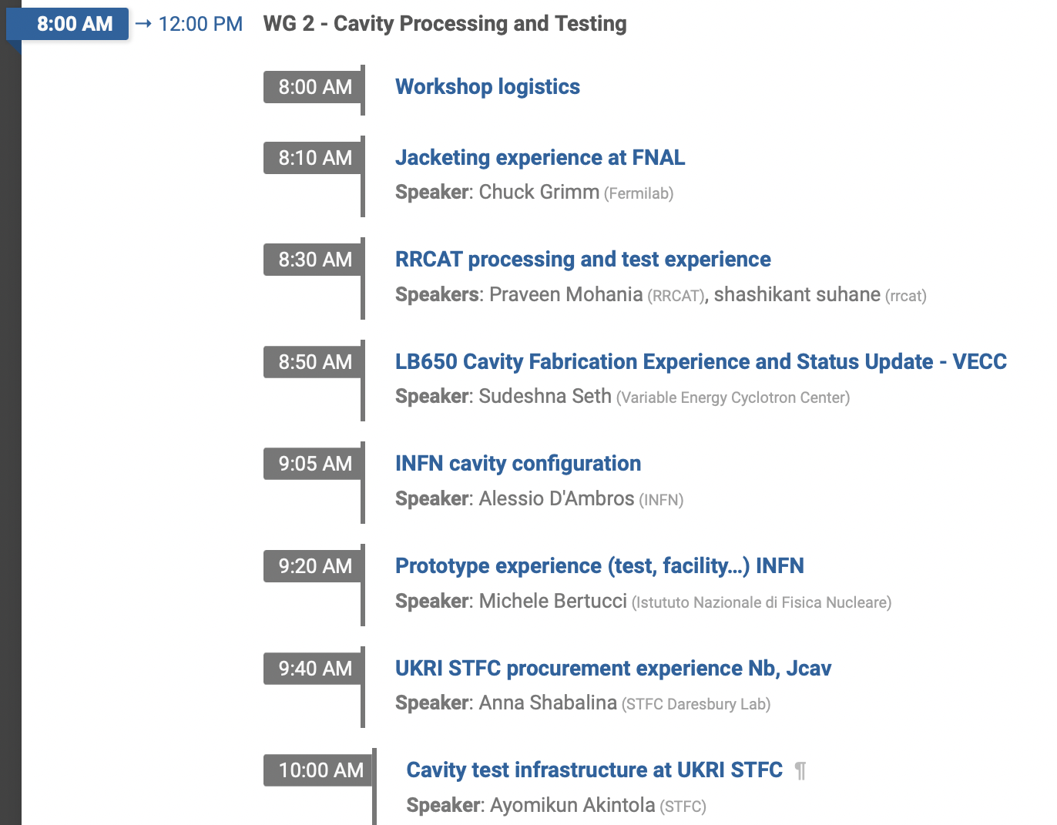
Workshop Topics – Tomorrow

Slide 7
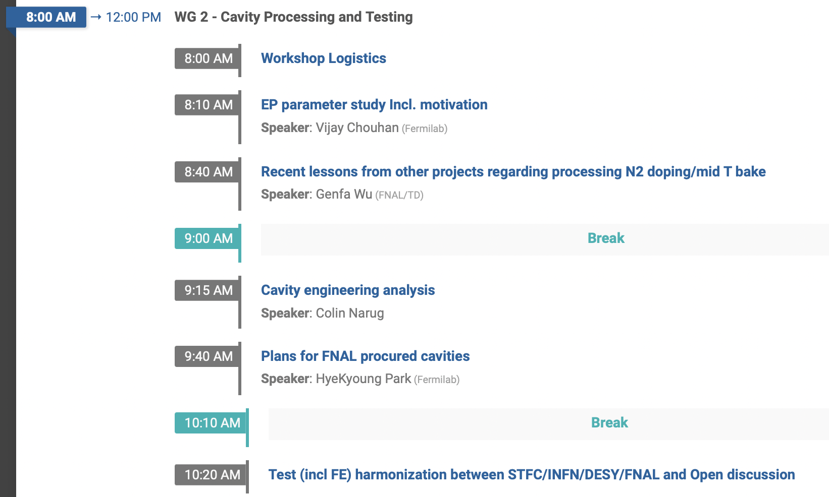
Workshop Topics – Thursday

Slide 8
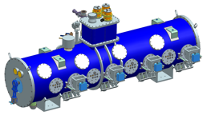
LB
9 Cryomodules in Linac
1 pre production cryomodule (ppCM) assembled by CEA
4 cavities by FNAL
9 cryomodules assembled by CEA
36+2 cavities by INFN
Additional production cavities
4 cavities by DAE VECC
R&D phase 5 cell cavities
2 cavities by INFN
2 cavities by VECC

Slide 9
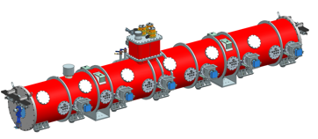
HB
4 Cryomodules in Linac
3 cryomodules by UKRI STFC
Including jacketed cavities by STFC
1 cryomodule by assembled by FNAL
6 cavities by RRCAT incl. all CM parts
14 additional production cavities by RRCAT
1 Prototype cryomodule (pCM)
3 cavities by RRCAT* and 3 FNAL legacy cavities
R&D phase 5 cell cavities
4 cavities by RRCAT*
3 cavities by FNAL
* Same cavities

Slide 10
Design Evolution LB
Bare cavity (F10128653)
B61-EZ-001,002
Beam line flange clearance holes from imperial thread to metric thread
Main coupler flange clearance holes from imperial thread to metric thread
Inner cell iris ellipse change
B61C-EZ-101,102,103,104
Fiducial features from 5 places to 8 places
B61D: Design for production CM

Slide 11
Design Evolution HB
Bare cavity (F10007331 obsolete for production)
B92D-RRCAT-502,504
No CAD change
B92E-RRCAT-506
Various dimensions change beam pipe spool parts
End cell stiffening ring location change
B92F-RI-201,202,203
Interface from imperial to metric
Beam line flange fiducial 4 places to 8 places
B92-…-…-M (F10165323)
Production cavities
STFC Jacketed cavity PRR

Slide 12
Near Term Milestones
Coupler FDR for both HB and LB – July 20th
Jacketed cavity FDR for LB – July 26th

Slide 13
Near Term Milestones with Partners – UKRI STFC
Nb PRR complete ✓
Nb procurement complete ✓
Jacketed cavity PRR complete ✓
Jacketed cavity contract award soon
Tuner PRR
Coupler PRR
Jacketed cavity MRR

Slide 14
Near Term Milestones with Partners – DAE RRCAT
Nb PRR in progress
Jacketed cavity PRR

Slide 15
Near Term Milestones with Partners – INFN LASA
Nb PRR complete ✓
Re-open Nb procurement in progress
LB Jacketed cavity FDR
Jacketed cavity PRR

Slide 16
Near Term Milestones with Partners – DAE VECC
Nb PRR
LB Jacketed cavity FDR
Jacketed cavity PRR

Slide 17
Planned Changes and Outstanding Decisions
Field Probe feedthrough connector from SMA to N type
Before UKRI jacketed cavity MRR
Heat treatment (Hydrogen degassing) temperature 800 C vs. 900 C
Related topics in this workshop

Slide 18
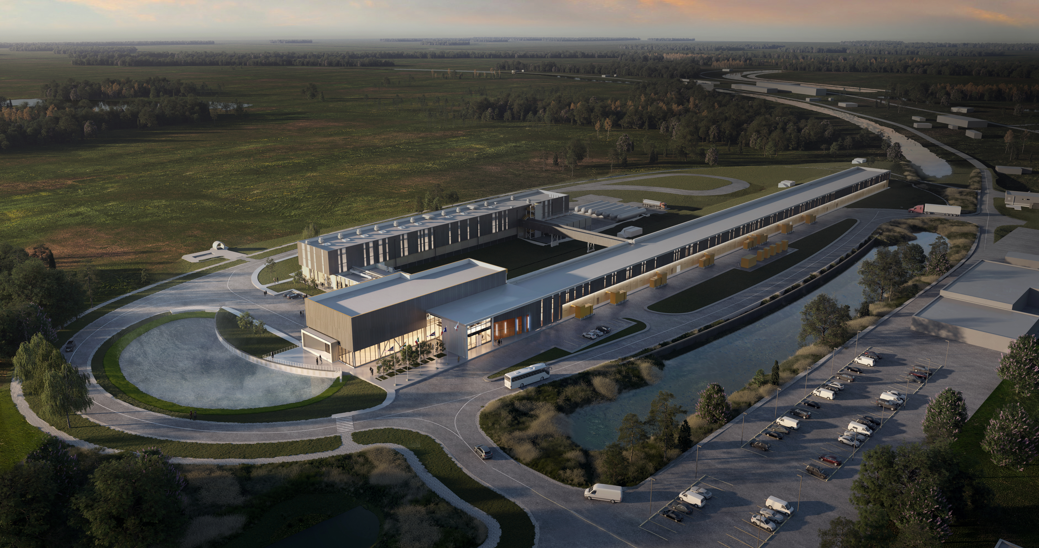
Thank You!

