Slide 1
PIP-II 2nd Technical Workshop, WG#2
FNAL cavity procurement experience RI & EZ
Grigory Eremeev
Fermilab
12-14 July, 2022

Slide 2
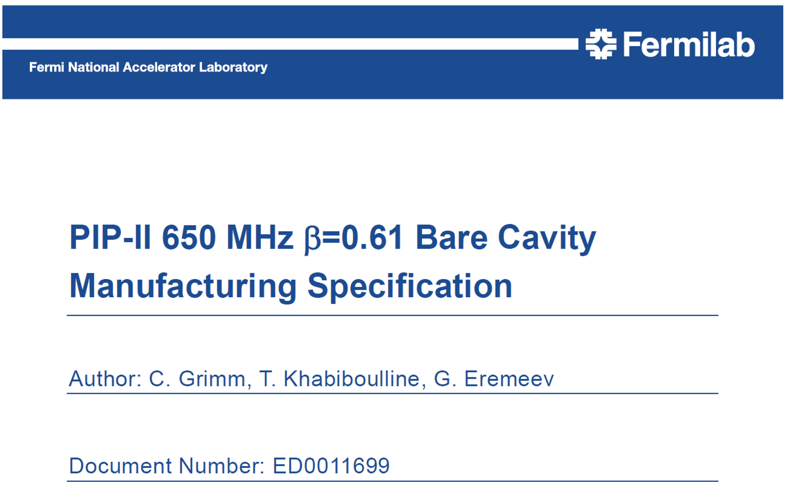
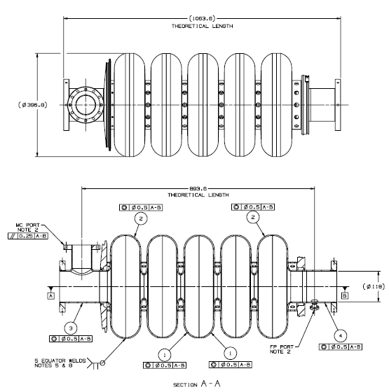
Introduction
Cavity PO for three HB650 prototype bare cavities
Cavity PO for four LB650 prototype bare cavities

Slide 3
Introduction
Cavity PO for three HB650 prototype bare cavities
Cavity PO for four LB650 prototype bare cavities
ED0008163, PIP-II Technical Review Plan

Slide 4
Introduction
A few words on procurement timelines
Req entered on 10/08/2019, PO awarded 11/24/2020, first cavity shipped 02/16/2022, contract closed
Unexpected HB650 PO delay due to BAA considerations
Req entered on 7/16/2020, PO awarded 01/26/2021, ready ship 10/21/2021, contract closed
Req entered on 6/17/2020, PO awarded 02/23/2021, ready ship 09/21/2021, contract ongoing

Slide 5
Procurement process
Kick-off meeting
MIP/fabrication drawings approval
MRR
Weekly/bi-weekly meetings and ad-hoc meetings
In-person visits
Cavity receipt and acceptance

Slide 6
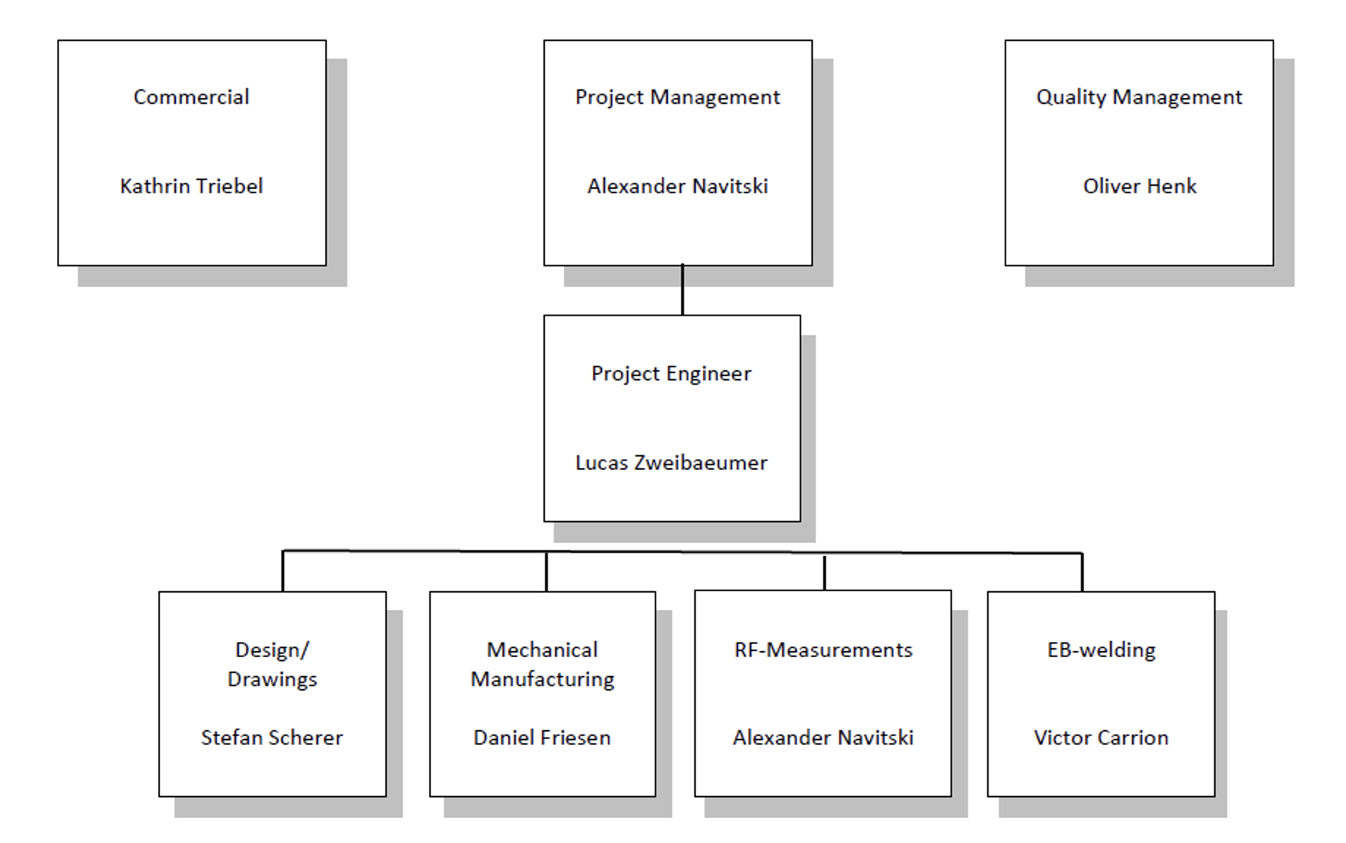
Kick-off meeting
Short meeting held over zoom to introduce roles and responsibilities of the respective parties
Introduction of the teams
Open questions
Future meetings
Information sharing media
Should be conducted in person for critical procurements to discuss the specifications in details
Notes:
Better have in person and review specifications in details

Slide 7
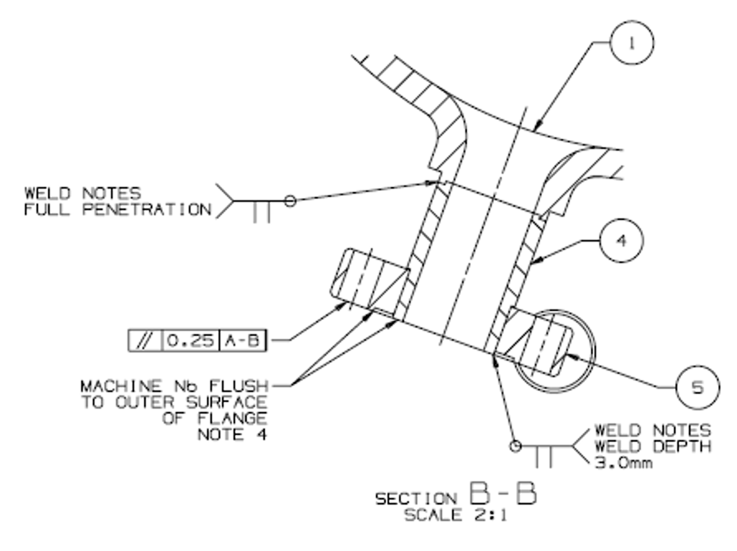
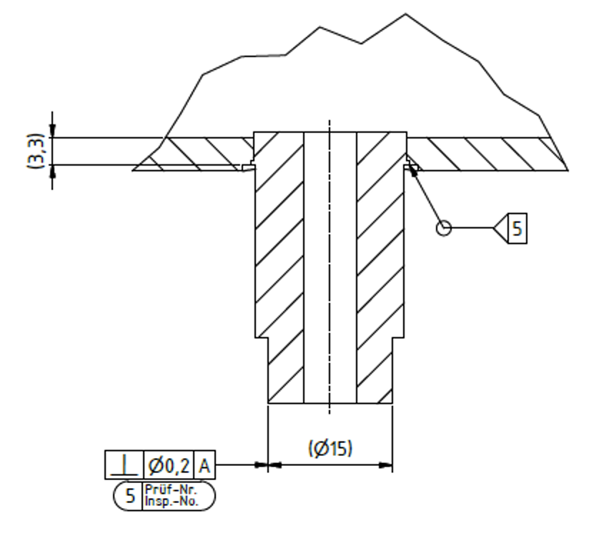
MIP/fabrication drawings approval
Reviewal and approval of fabrication flow and drawings
Fabrication drawing Design drawing

Slide 8
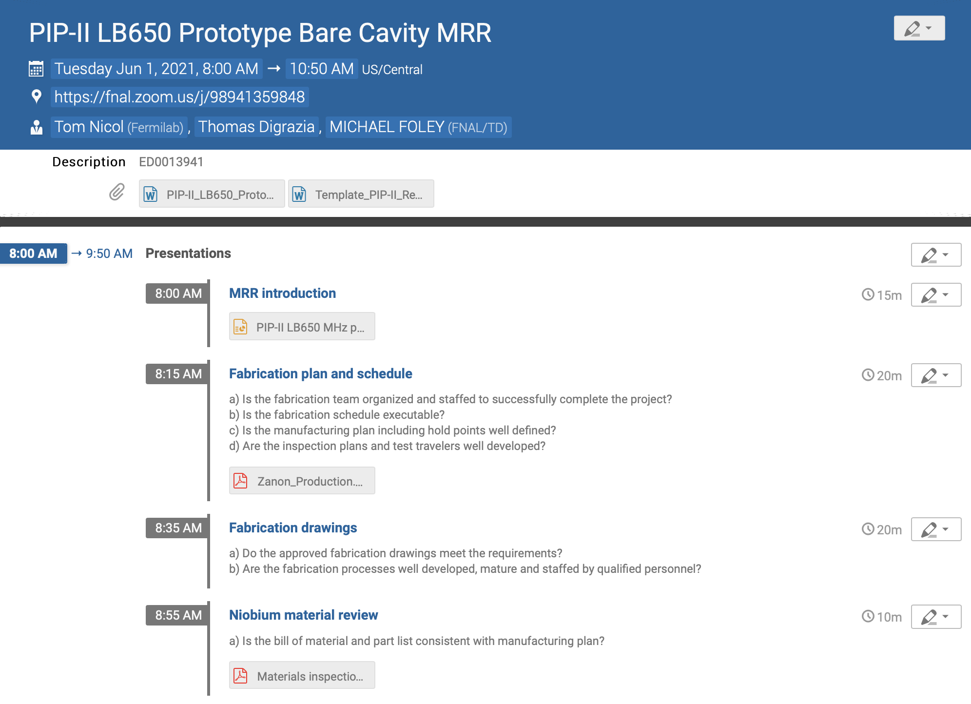
Manufacturing Readiness Review
Review of the documentation and fabrication plans prior to material cutting
Written charge to an independent panel
Half-day Zoom meeting
Should be conducted in person for critical procurements to discuss the specifications in details
Easy to miss deviations in fabrication plans vs design

Slide 9
Manufacturing Readiness Review: example of a missed item
About one month after MRR the vendor indicated an issue with one of the items that were under review

Slide 10
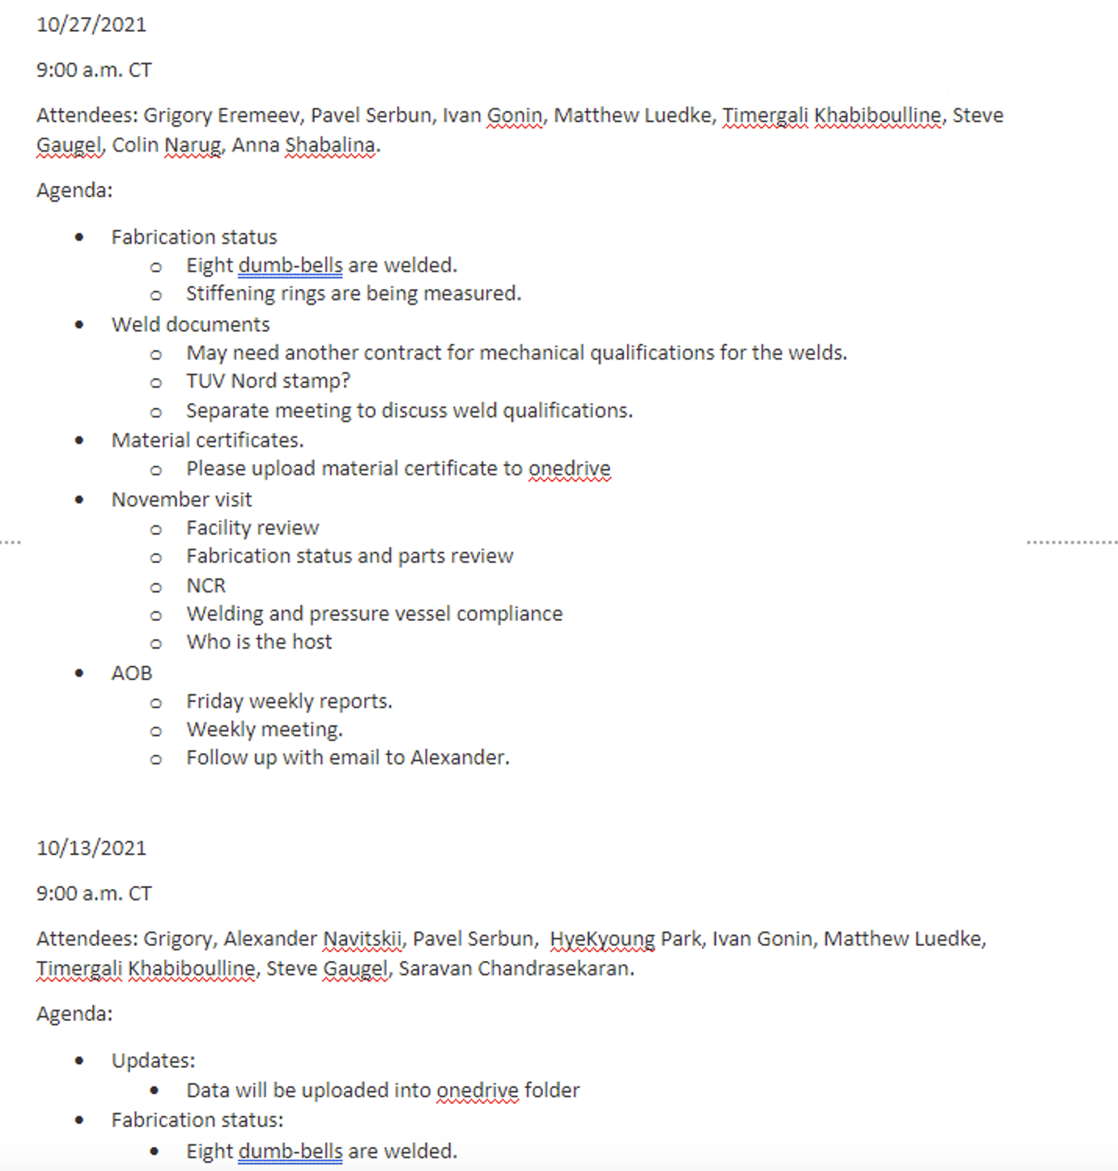
Weekly/bi-weekly meetings and ad-hoc meetings
Regular meetings with the vendor to keep track of the progress

Slide 11
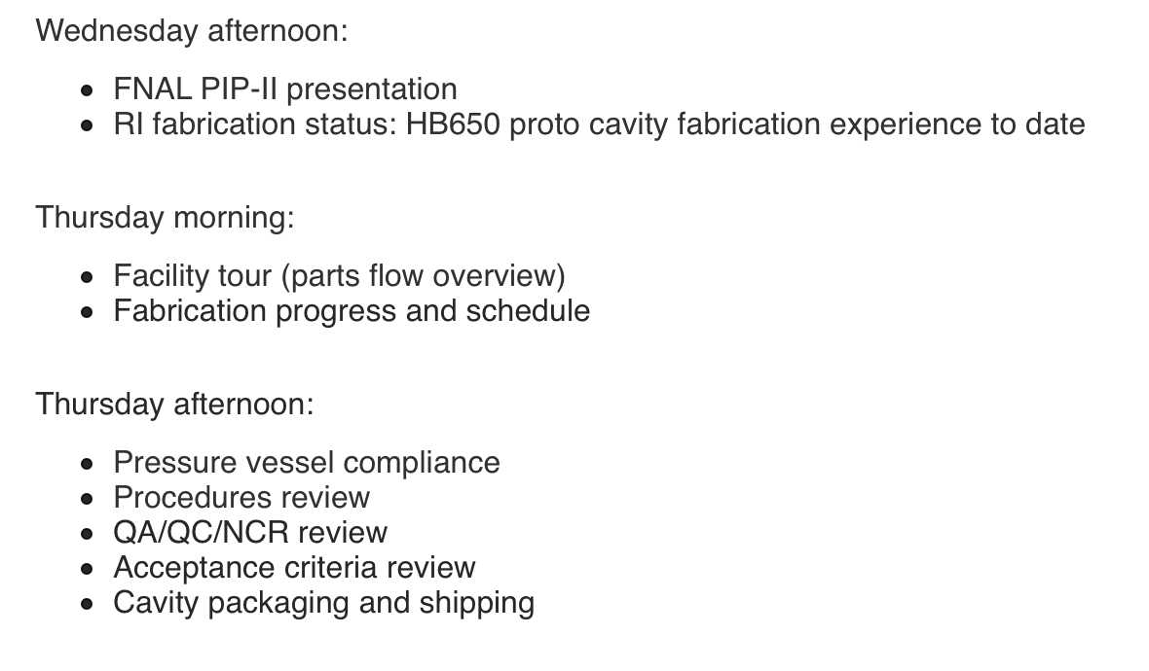
In-person visit
In-person visit to one of the vendors to discuss technical challenges and delays
Useful to see the situation on the floor, catch some deviation, and clarify some of the open questions
Not useful, in my opinion, to push the schedule (unless accompanied contract negotiations)

Slide 12
Example of information learned during in-person visit
The vendor does not consider themselves the manufacturer of these cavities for the pressure vessel certifications, since they do not own the design and mechanical calculation. This is typical for the cavities they built, so they typically do not provide ASME certification. They could provide PED or ASME certs, but they will need to be involved from the beginning, including the design.
For LCLS-II some welding documents were not shared. TUV provided certifications in conformance statement.

Slide 13
Example of information learned during in-person visit
The vendor transfers niobium parts in water after weld preparation chemistry, then places the into drying cabinet that dries the parts at 80 degrees C while supplying clean air from nearby cleanroom. (noted during in-person visit)
From FNAL specifications:

Slide 14
NCR examples: re-work approval
In a couple of case the re-work was completed before the customer was involved

Slide 15
NCR examples: grinding
From FNAL specifications:

Slide 16
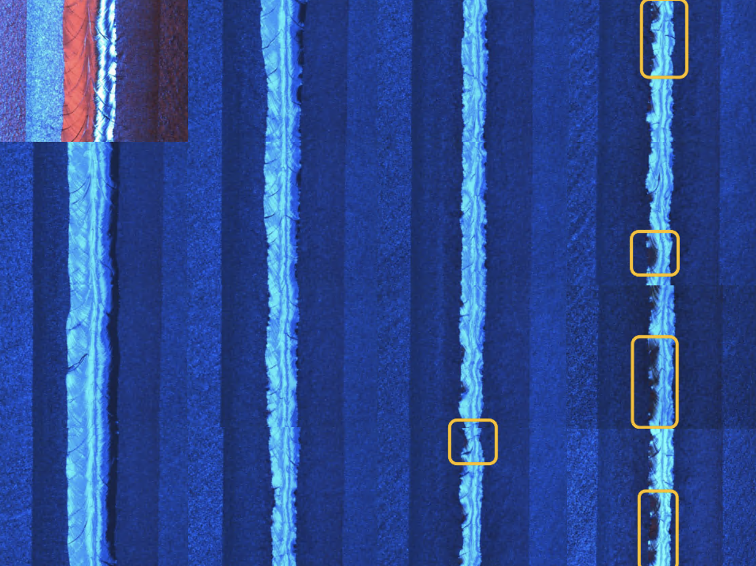
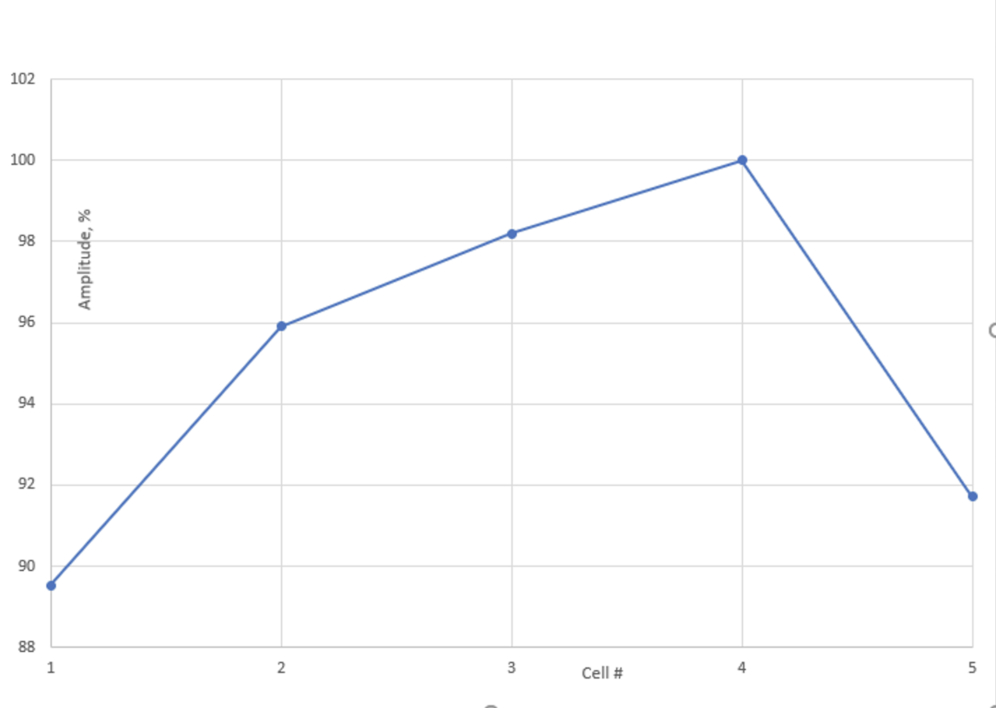
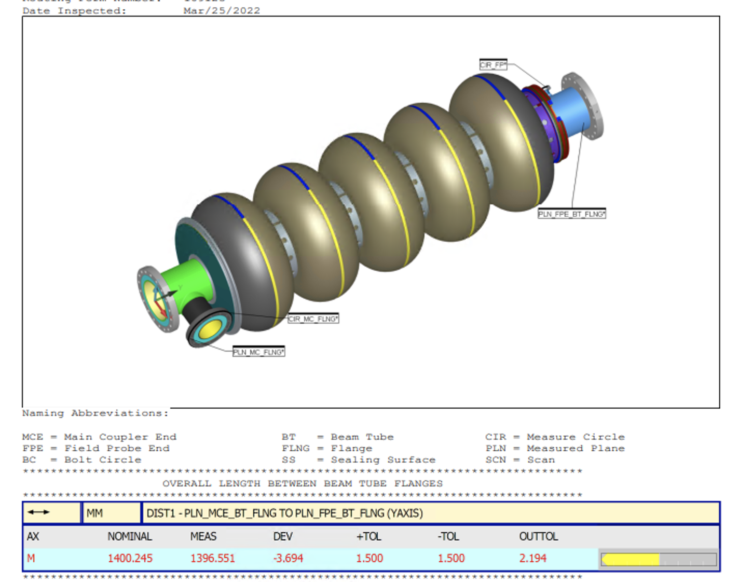
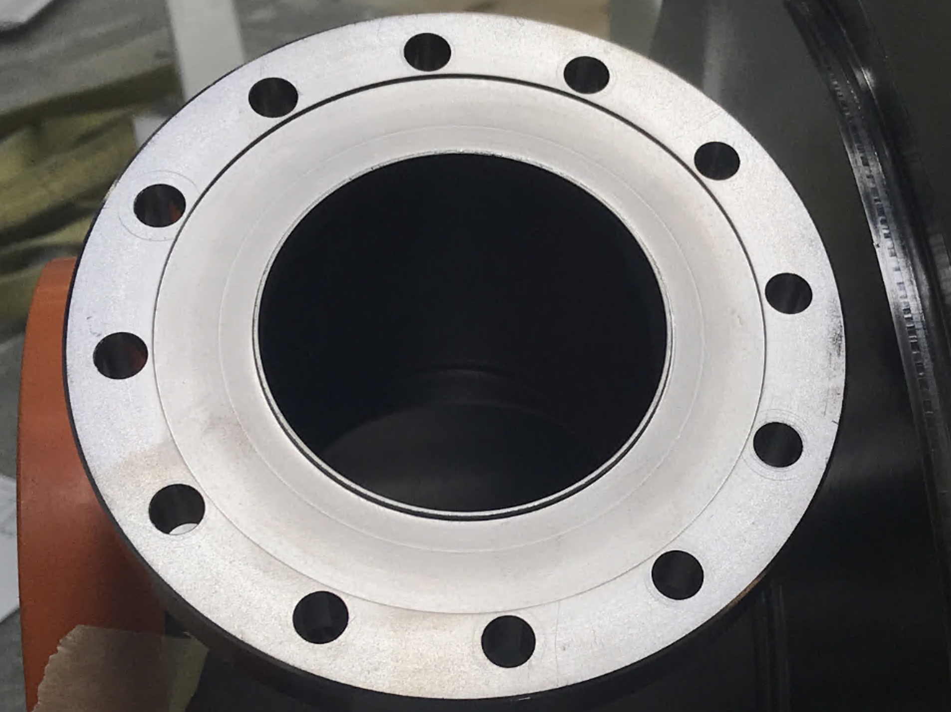
Cavity receipt and acceptance
All seven cavities are delivered, six cavities out of seven met the specifications

Slide 17
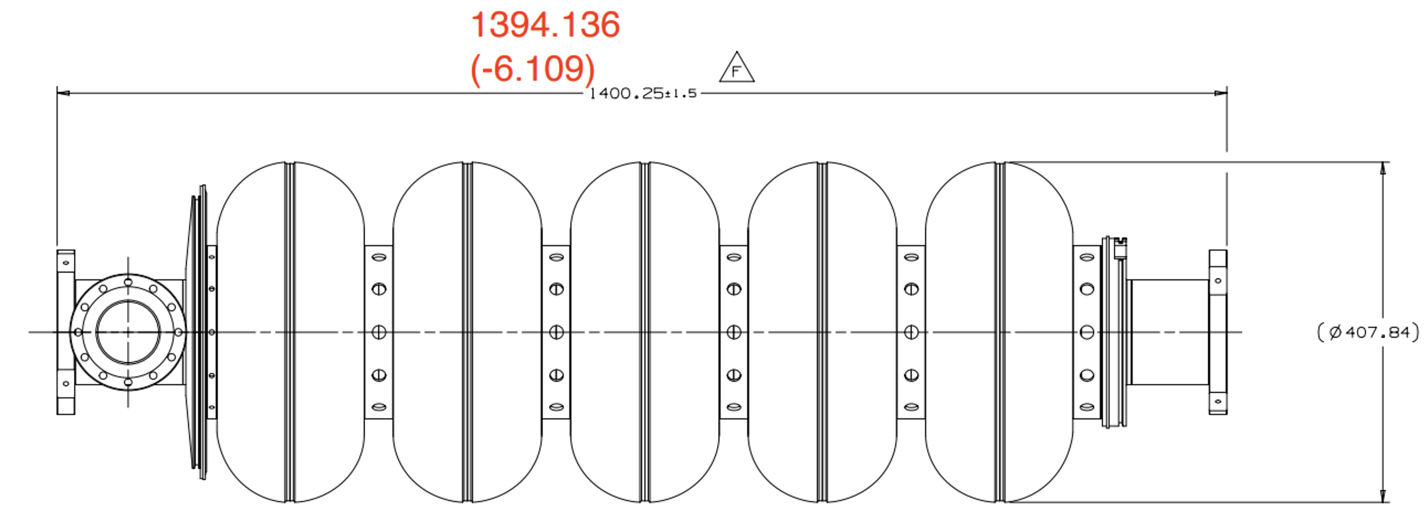
Cavity receipt and acceptance
All seven cavities are delivered, six cavities out of seven met the specifications

Slide 18
Summary
All seven cavities are delivered, six cavities out of seven met the specifications
Cavity procurement is a complex procurement
MRR is a useful gateway, but not a panacea against issues
Key meetings should be in-person with the vendor
Notes:
Delays lead to delays: need to have right teams, clear roles, and well-setup communications.

Slide 19
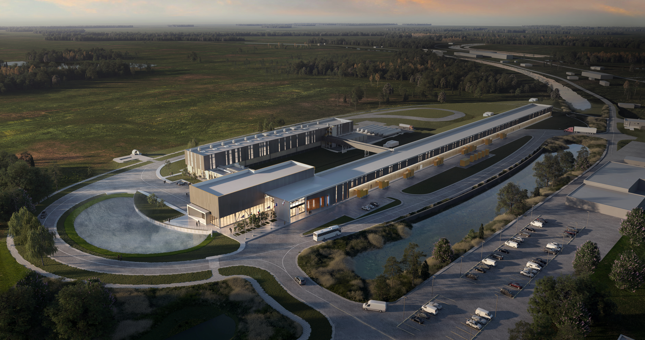
Thank You!

