Slide 1
PIP-II 2nd Technical Workshop, WG#2
Processing histories and test results HB
Fumio Furuta
FNAL
12-14 July, 2022

Slide 2
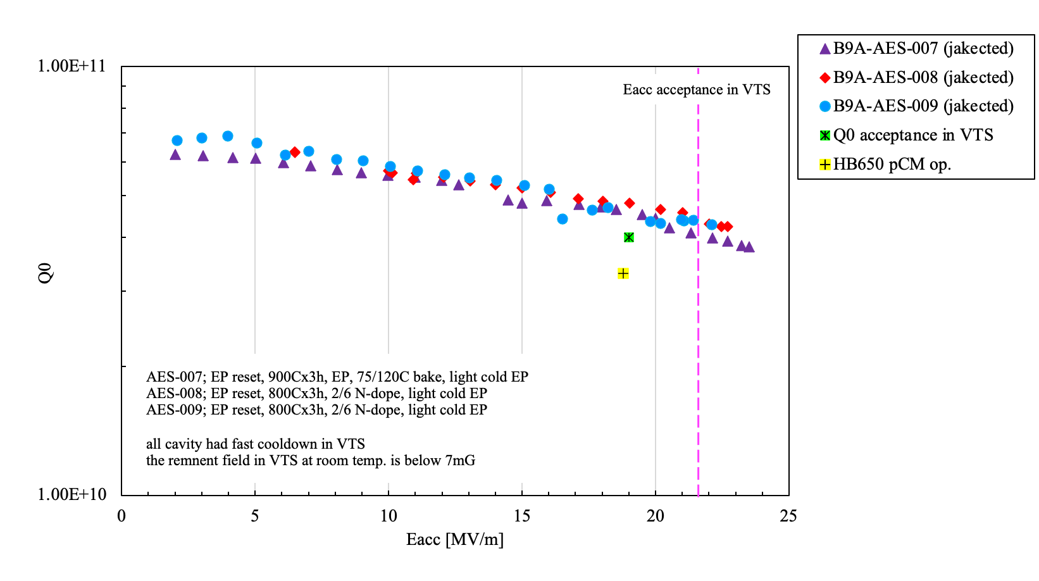
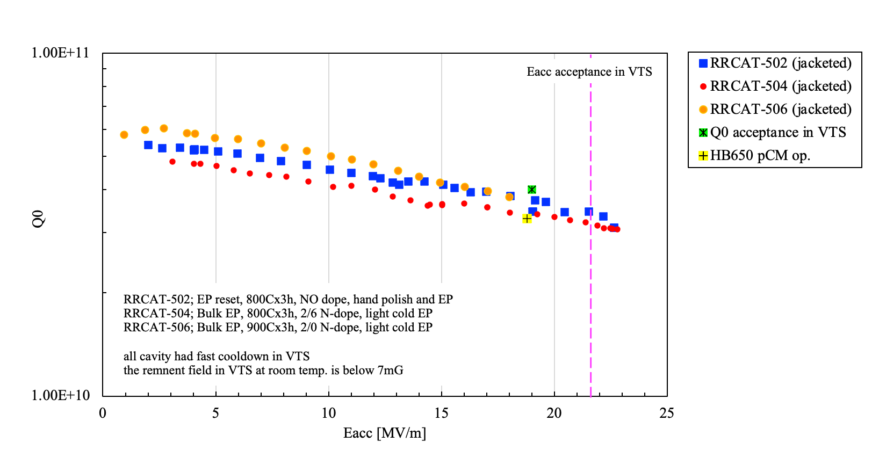
Introduction
B90
Three B90 and three B92 5-cells were qualified and installed into HB650 pCM
The plots show the final VTS results in 2K
Will present process and VTS history and some analysis of them
B92
Cavity IDs
B9A-AES-007, -008, and -009
B92D-RRCAT-502, -504, and B92E-RRCAT-506

Slide 3
# of VTS
 | Total # of VTS (bare + jacketed) | FE free | FE | failure
B9A-AES-007 | 15 (14+3) | 1 | 14 | 0
B9A-AES-008 | 17 (11+6) | 4 | 11 | 2
B9A-AES-009 | 10 (7+3) | 4 | 4 | 2
B9A-AES-010 | 2 (1+1) | 0 | 2 | 0
B90 total | 44 (31+13) | 9 | 31 | 4
 | Total # of VTS (bare + jacketed) | FE free | FE | failure
B92D-RRCAT-502 | 10 (5+5) | 2 | 7 | 1
B92D-RRCAT-504 | 11 (7+4) | 2 | 8 | 1
B92E-RRCAT-506 | 4 (2+2) | 0 | 2 | 2
B92 total | 25 (14+11) | 4 | 17 | 4
*FE free; NO detectable radiation after processing
*Failure; 2K leak, cable issue, etc.

Slide 4
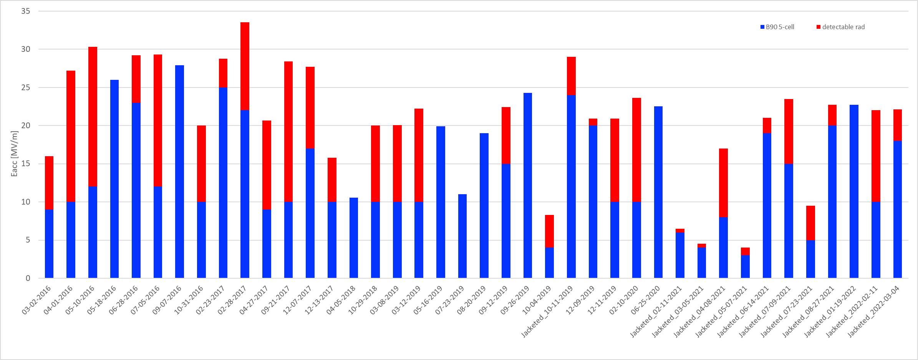
VTSs of B90 5-cells
Showing VTS date and max Eacc of B90 5-cell during 2K VTS.
Blue; NO detectable radiation, Red; there were detectable radiation.
FE onset can be seen as a boundary between blue and red bars.
2016
2017
2018
2019
2020
2021
2022
Lab2 HPR nozzle issue
cold EP applied

Slide 5
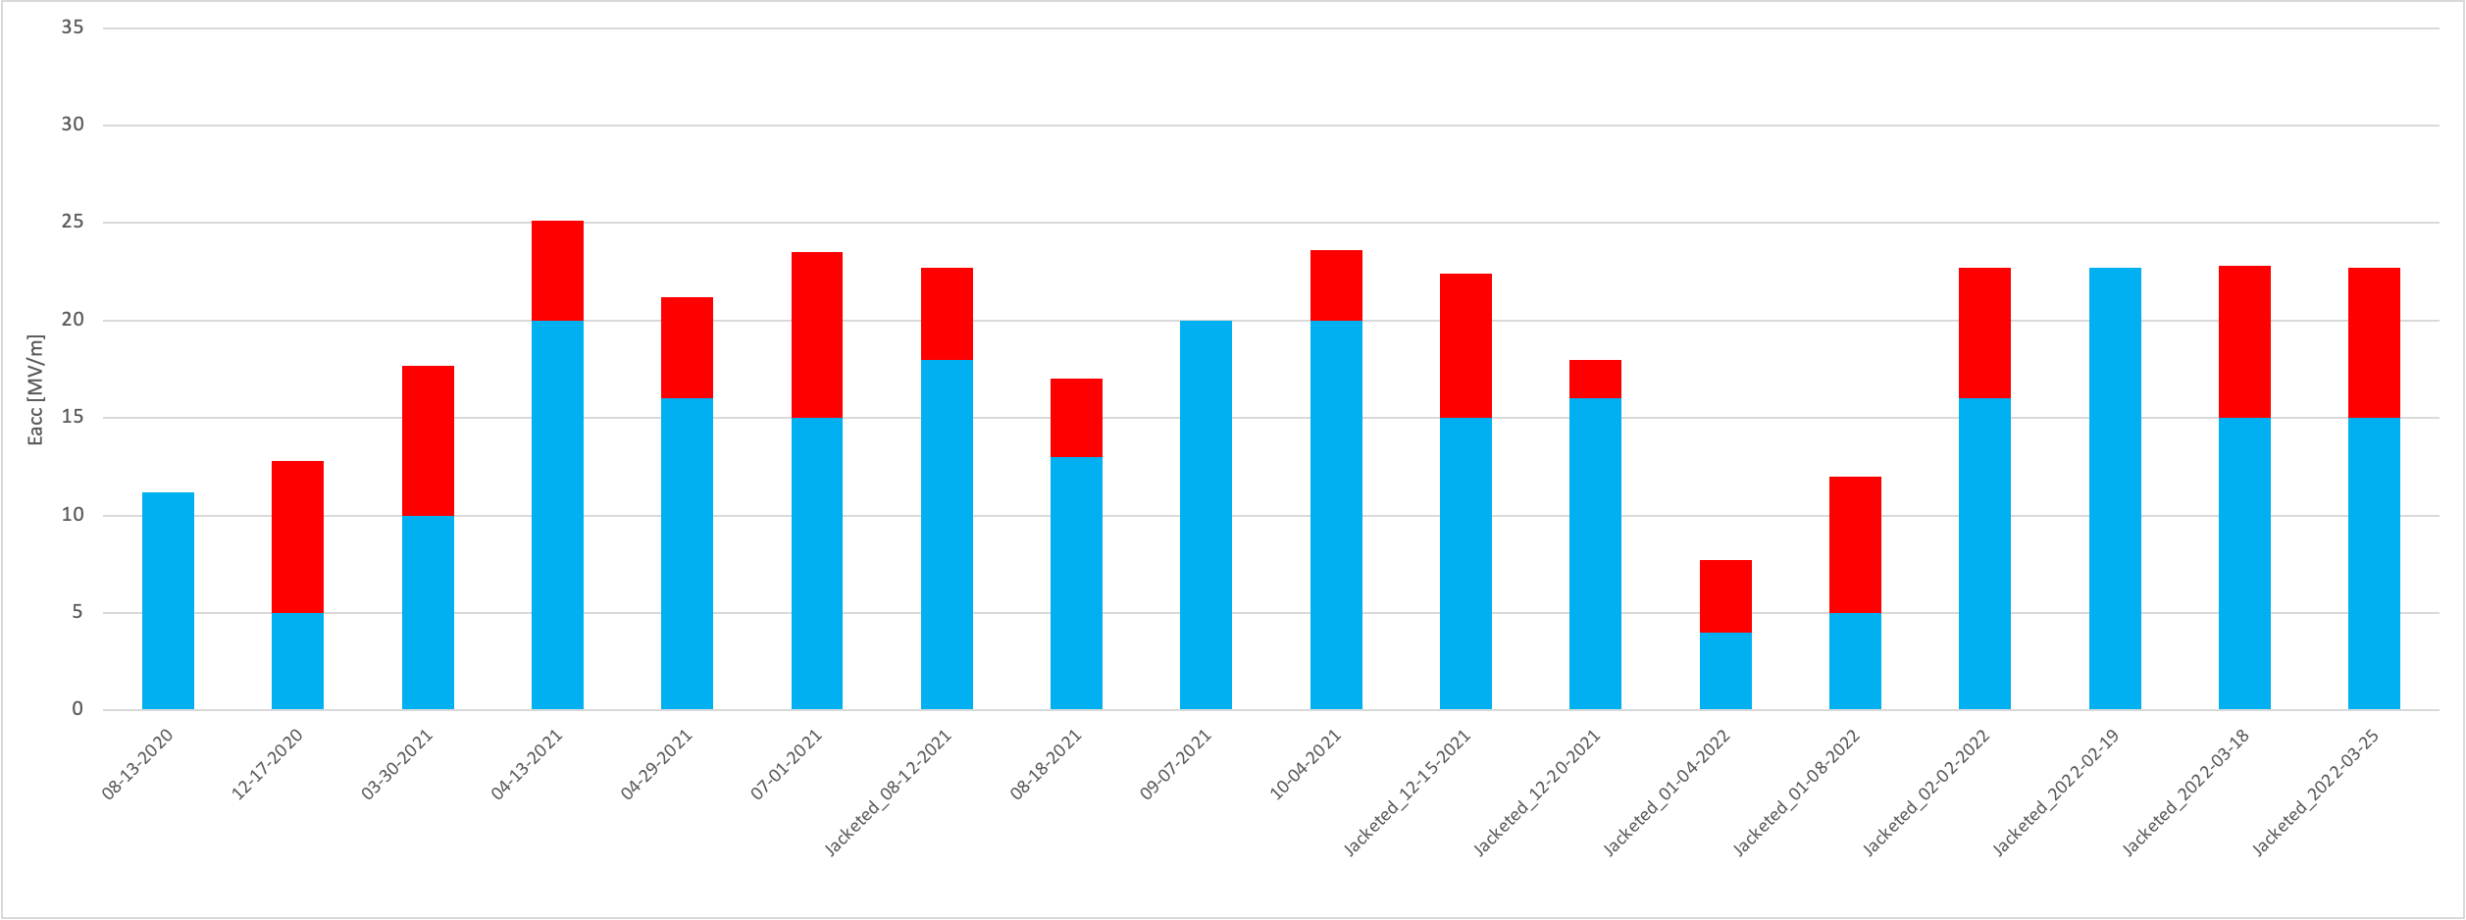
VTS on HB650 5-cells (B92)
Showing VTS date and max Eacc of B92 5-cell during 2K VTS.
Blue; NO detectable radiation, Red; there were detectable radiation.
FE onset can be seen as a boundary between blue and red bars.
2020
2021
2022
Lab2 HPR nozzle issue

Slide 6
MP behaviors during VTS
# of VTS =40
# of VTS =21
Notes
B90 had severe MP around 10~15MV/m (sometimes 10~20MV/m), and which was sometimes not able to process out or remained as FE/MP. This can be seen as FE onset peak at 10MV/m (next slide).
B92 showed MP, but much lighter than B90.

Slide 7
FE onset during VTS
# of VTS =40
# of VTS =21
Notes
B90 showed FE onset 10MV/m as the most, B92 showed 16MV/m as the most.

Slide 8
Statistic/analysis on FE and max rad level
Memo; rad limits
VTS radiation admin limit: 2 Rad/hr
Operating gradient: 50 mR/h or below
Usable gradient: 100 mR/h or below
 | # of VTS | # of NO FE | # of FE | VTS failure
HB 5-cell | 69 | 13 | 48 | 8
LB 5-cell | 19 | 12 | 6 | 1

Slide 9
FE mitigation on HB650 5-cell
Mitigation | # of applied | Improved (Lower/NO FE) | No improve (similar or worth FE)
Re-HPR | 22 | 8 | 14
EP + HPR | 12 | 5 | 7
total | 34 | 13 | 21
FE during VTS
Re-VTS
Re-HPR only
Full dis-assy and re-HPR
Partial dis-assy and re-HPR
EP +HPR
Reset(bulk EP, furnace, light EP, HPR)
Add light EP and HPR
Hand polish, EP, and HPR, etc.
Notes
success rate is about 40% so far, may need 2~3 cycles to lower/eliminate FE.

Slide 10
Summary
Four B90 and three B92 5-cells were processed and tested at FNAL so far.
Six of them were qualified and assembled as HB650 pCM string.
One (B9A-AES-010) was used for STC commissioning, and now at RRCAT to commission their horizontal test system.
B90 cavities had severe MP and more chance to trigger FE, but no more B90 in production HB.
B92 cavities showed less MP compared with B90. FE issue was also lighter than B90 cavities.
FNAL has three new B92 cavities, will have more statistics. Plans will be presented during the workshop.
HPR and EP parameter optimization will also be continued. EP study will be presented during the workshop.

Slide 11
appendix
Next page shows a copy of summary table of B90 and B92 tested at FNAL, if you are curious,,
Each VTS Traveler had more details, such as MP and/or radiation behavior, pass-band meas., OST data if taken, but just as a glance.

Slide 12
 | B9A-AES-007 | Date | Eacc max @2K [MV/m] | Q0 at Eacc max, 2K | FE onset [MV/m] | prep. |  | B92D-RRCAT-502 | Date | Eacc max @2K [MV/m] | Q0 at Eacc max, 2K | FE onset [MV/m] | prep.
 | VTS1 | 5/18/16 | 26 | 1.57E+10 | n/a | EP(120um), 2/6 N2 dope @800C dope, EP(7um) |  | VTS1 (RRCAT) | 4/4/19 | 10 | 3.00E+09 | 8 | Bulk EP(150um), 800C*3hrs, 2/6 N-dope, light EP (5um), USC, HPR (3pass)
 | VTS2 | 6/28/16 | 29.2 | 1.37E+10 | 23 | EP(7um) |  | VTS2 | 8/13/20 | 11.2 | 3.00E+10 | FE free | received from RRCAT, re-HPR at Lab2,
 | VTS3 | 7/5/16 | 29.3 | 1.38E+10 | 12 | 100K soak,Q-disease test |  | VTS3 | 12/17/20 | 12.8 | 2.00E+10 | 5 | local grinding, EP(60um), 800Cx3hrs, EP(10um, cold), HPR at Lab2
 | VTS4 | 2/23/17 | 28.76 | 1.71E+10 | 25 | EP(5um) |  | VTS4 | 3/30/21 | 17.7 | 3.91E+10 | 10 | hand polishing, EP(60um), HPR at Lab2 (9 pass in total due to r.t.leak, etc.)
 | VTS5 | 9/21/17 | 28.40 | 1.52E+10 | 10 | EP(80um) |  | VTS5 | 4/13/21 | 25.1 | 3.20E+10 | 20 | re-HPR post FE
 | VTS6 | 12/7/17 | 27.69 | 1.41E+10 | 17 | re-HPR |  | VTS6 w/v (2K leak) | 6/24/21 | n/a | n/a | n/a | re-HPR post jacketing
 | VTS7 | 10/29/18 | 20.00 | 1.63E+10 | 10 | EP(30um) |  | VTS7 w/v | 8/12/21 | 22.7 | 3.40E+10 | 18 | re-HPR w/ new nozzle
 | VTS8 | 3/12/19 | 22.20 | 1.17E+10 | 10 | 900Cx3hrs, EP(40um), 75/120 bake |  | VTS8 w/v | 1/4/22 | 7.7 | 2.60E+10 | 4 | re-HPR post STC test
 | VTS9 | 9/12/19 | 22.40 | 3.80E+10 | 15 | EP (7um, cold) |  | VTS9 w/v | 2/19/22 | 22.7 | 3.18E+10 | FE free | re-HPR
 | VTS10 | 10/4/19 | 8.30 | 1.77E+10 | 4 | re-HPR |  | VTS10 w/v | 3/25/22 | 22.7 | 3.10E+10 | 15 | re-HPR post dis-assy from string
 | VTS11 | 12/11/19 | 20.90 | 4.37E+10 | 10 | re-HPR
 | VTS12 | 2/10/20 | 23.61 | 3.69E+10 | 10 | EP (3um, cold)
 | VTS13 w/v | 4/8/21 | 17 | 2.73E+10 | 8 | re-HPR post jacketing
 | VTS14 w/v | 5/7/21 | 4 | 7.37E+09 | 3 | re-HPR w/ new nozzlle (40deg)
 | VTS15 w/v | 7/9/21 | 23.5 | 3.79E+10 | 15 | re-HPR w/ new nozzle (15deg)
 | B9A-AES-008 | Date | Eacc max @2K [MV/m] | Q0 at Eacc max, 2K | FE onset [MV/m] | prep. |  | B92D-RRCAT-504 | Date | Eacc max @2K [MV/m] | Q0 at Eacc max, 2K | FE onset [MV/m] | prep.
 | VTS1 | 3/2/16 | 16.00 | 3.30E+10 | 9 | EP (140um) |  | VTS1 (RRCAT) | 3/19/20 | 21 | 3.50E+10 | FE free | bulk EP(140um), 800C, EP(10um)
 | VTS2 | 4/1/16 | 27.2 | 1.18E+10 | 10 | re-HPR |  | VTS2 (RRCAT) | 8/26/20 | 20.2 | 3.50E+10 | 13 | re-cool down
 | VTS3 | 5/10/16 | 30.3 | 1.52E+10 | 12 | re-HPR (alternate nozzle) |  | VTS3 | 4/29/21 | 21.2 | 3.23E+10 | 16 | EP (50um + 10um cold) post receiving the cavity from RRCAT
 | VTS4 | 10/31/16 | 20.03 | 2.99E+10 | 10 | EP(3um), |  | VTS4 (2K leak) | 6/4/21 | n/a | n/a | n/a | re-HPR
 | VTS5 | 4/27/17 | 20.67 | 2.19E+10 | 9 | re-HPR post optical onspection |  | VTS5 | 7/1/21 | 23.5 | 3.00E+10 | 15 | re-HPR post 2K leak
 | VTS6 | 12/13/17 | 15.80 | 4.93E+10 | 10 | EP(60um), 900Cx3hr, 2/6 N dope@800C, EP (5um) |  | VTS6 | 9/7/21 | 20 | 3.73E+10 | FE free | 2/6 N2 dope@800C, EP10um, cold)
 | VTS7 | 4/5/18 | 10.53 | 6.52E+10 | 10 | re-HPR |  | VTS7 | 10/4/21 | 23.6 | 3.28E+10 | 20 | EP (5um, cold)
 | VTS8 | 3/8/19 | 20.05 | 4.56E+10 | 10 | EP(40um), 800c x 3 hours + 2/6 N2 dope, EP (7um) |  | VTS8 w/v | 12/15/21 | 22.4 | 2.92E+10 | 15 | re-HPR post jacketing
 | VTS9 (2K leak) | 4/11/19 | n/a | n/a | n/a | re-HPR post optical onspection |  | VTS9 w/v | 1/8/22 | 12 | 3.11E+10 | 5 | re-HPR post FE
 | VTS10 | 5/16/19 | 19.93 | 5.21E+10 | FE free | re-HPR |  | VTS10 w/v | 2/2/22 | 22.7 | 3.11E+10 | 16 | re-HPR post FE
 | VTS11 | 9/26/19 | 24.30 | 6.10E+10 | FE free | EP (5um, cold) |  | VTS11 w/v | 3/18/22 | 22.8 | 3.07E+10 | 15 | re-HPR post dis-assy from string
 | VTS12 w/v | 2/11/21 | 6.5 | 4.20E+10 | 6 | re-HPR w/tungsten carbide nozzzle post jacketing
 | VTS13 w/v | 3/5/21 | 4.5 | 4.80E+10 | 4 | re-HPR
 | VTS14 w/v | 7/23/21 | 9.5 | 5.26E+10 | 5 | EP (3um, cold), HPR w/ new nozzle (15deg)
 | VTS15 w/v | 8/27/21 | 22.7 | 4.27E+10 | 20 | re-HPR w/ new nozzle (10deg)
 | VTS16 (cable issue) | 1/15/22 | 12 | 1.10E+11 | FE free | re-HPR
 | VTS17 w/v | 1/19/22 | 22.7 | 4.24E+10 | FE free | re-cool post RF cable replacement
 | B9A-AES--009 | Date | Eacc max @2K [MV/m] | Q0 at Eacc max, 2K | FE onset [MV/m] | prep. |  | B92D-RRCAT-506 | Date | Eacc max @2K [MV/m] | Q0 at Eacc max, 2K | FE onset [MV/m] | prep.
 | VTS1 | 9/7/16 | 27.91 | 1.28E+10 | FE free | bulk EP (120um), EP(20um), Improved HPR procedure |  | VTS1 (2K leak) | 7/29/21 | n/a | n/a | n/a | bulk EP (160um), 900Cx3hrs, 2/6-dope at 900C(error), EP (10um, cold)
 | VTS2 (cable issue) | 5/30/19 | n/a | n/a | n/a | 900Cx3hrs, EP(40um), 2/6 dope@800C, EP(7um), re-HPR post r.t. leak |  | VTS2 | 8/18/21 | 17 | 4.34E+10 | 13 | re-HPR post flange polish
 | VTS3 (2K leak) | 6/13/19 | n/a | n/a | n/a | re-HPR |  | VTS3 w/v (cable issue) | 12/11/21 | n/a | n/a | n/a | re-HPR post jacketing
 | VTS4 | 7/23/19 | 11 | 7.30E+10 | FE free | re-HPR |  | VTS4 w/v | 12/20/21 | 18 | 3.30E+10 | 16 | re-cool post RF cable replacement
 | VTS5 | 8/20/19 | 19.01 | 6.37E+10 | FE free | re-HPR
 | VTS6 | 12/9/19 | 20.9 | 4.60E+10 | 20 | EP (3um, cold), HPR w/ new procedure
 | VTS7 | 6/25/20 | 22.5 | 4.00E+10 | FE free | EP (3um, cold)
 | VTS8 w/v | 6/14/21 | 21 | 3.57E+10 | 19 | re-HPR post jacketing
 | VTS9 w/v | 2/11/22 | 22 | 3.45E+10 | 10 | re-HPR
 | VTS10 w/v | 3/4/22 | 22.1 | 4.28E+10 | 18 | re-HPR
 | B9A-AES--010 | Date | Eacc max @2K [MV/m] | Q0 at Eacc max, 2K | FE onset [MV/m] | prep.
 | VTS1 | 2/28/17 | 33.53 | 1.04E+10 | 22 | bulk EP (120um), *00Cx3hrs, 2/6 N-dopw@800C, EP (20um)
 | VTS2 | 10/11/19 | 29 | 1.00E+10 | 24 | re-HPR post jacketing

Slide 13
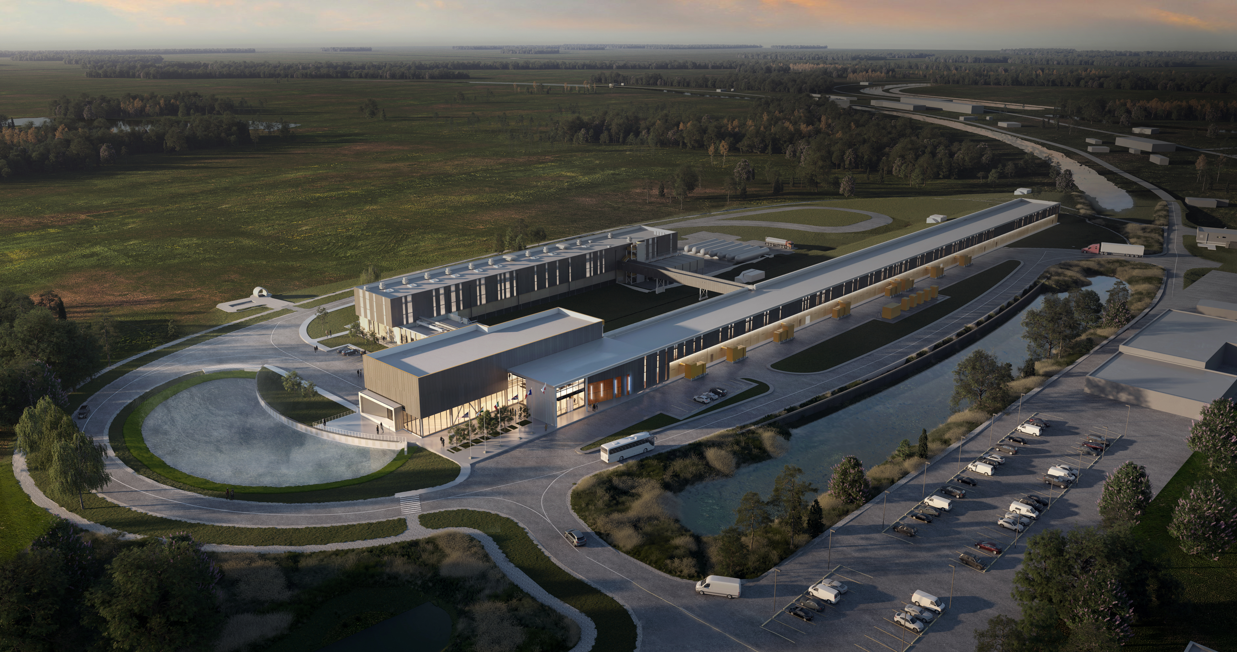
Thank You!

