Slide 1
PIP-II 2nd Technical Workshop, WG#2
Processing histories and test results LB
Fumio Furuta
FNAL
12-14 July, 2022

Slide 2
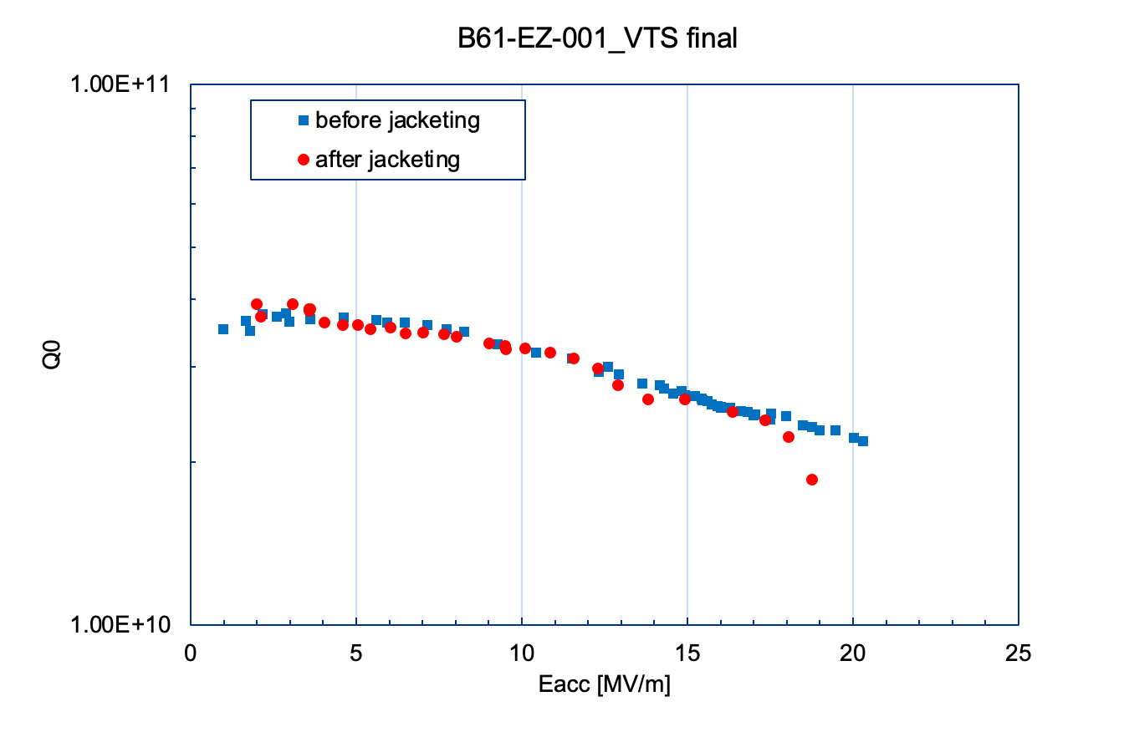
Introduction
B61-EZ-001 was processed and tested in VTS. The cavity is now at horizontal test (STC).
Process and VTS history will be presented.

Slide 3
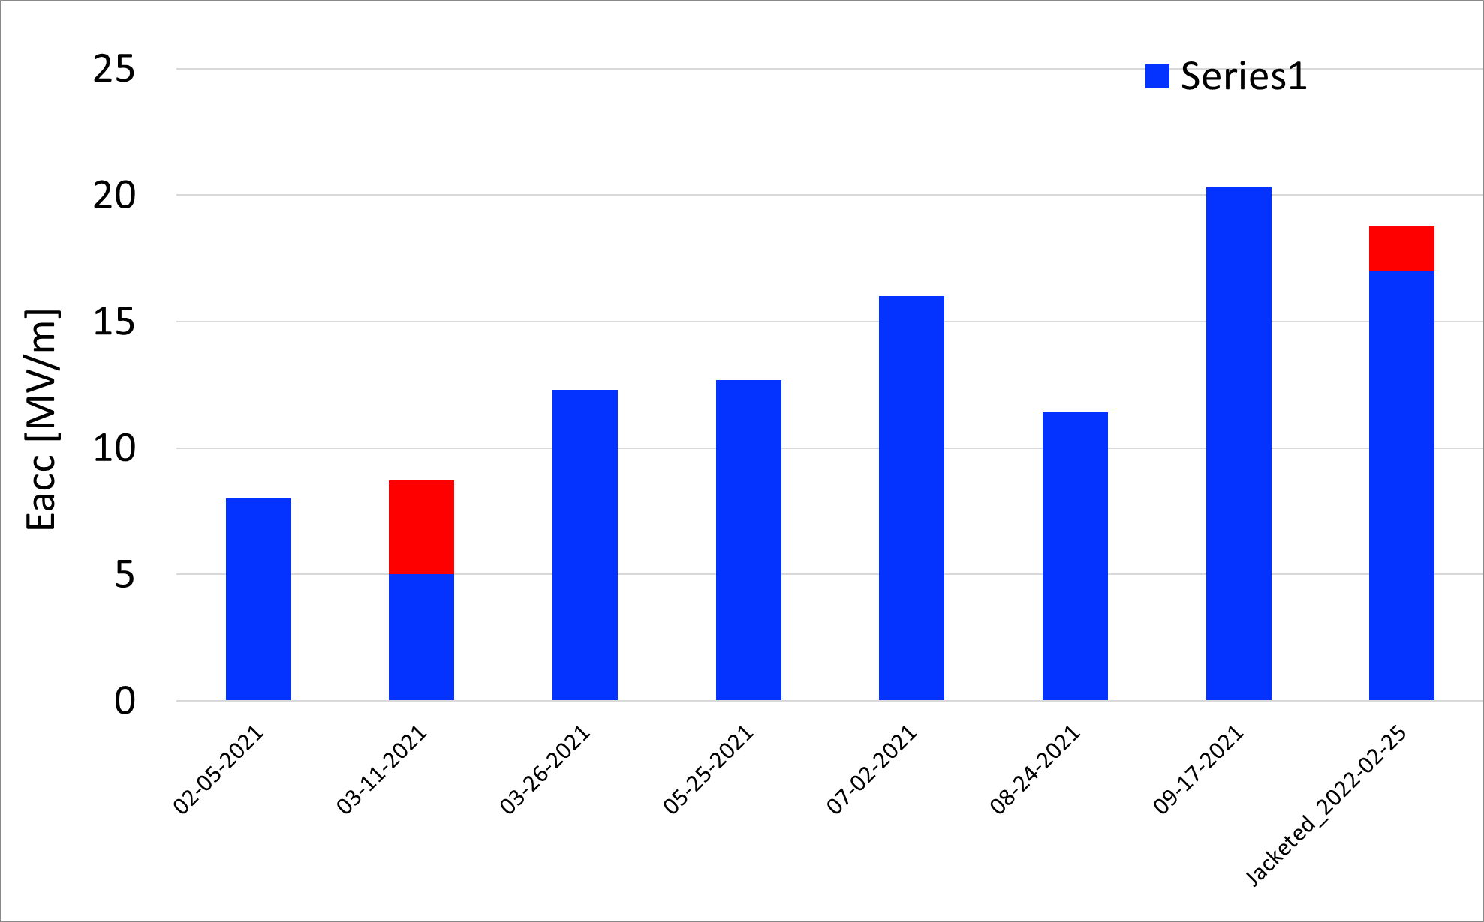
VTS of B61-EZ-001 at FNAL
VTS | date | Eacc max | Q0 | notes
VTS1 | 2/5/2021 | 8 | 1.00E+10 | EP(160um), 800Cx2hrs, EP (70um in total), tuning, USC, HPR
VTS2 | 3/11/2021 | 8.70 | 1.50E+09 | tuning, revise antenna length, full re-HPR
VTS3 | 3/26/2021 | 12.3 | 1.45E+10 | re-HPR
VTS4 | 4/19/2021 | 2K leak | n/a | re-HPR
VTS5 | 5/25/2021 | 12.7 | 2.47E+10 | full re-HPR
VTS6 | 7/2/2021 | 16 | 1.16E+10 | re-HPR, mode mixing mitigation
VTS7 | 8/24/2021 | 11.4 | 3.00E+10 | 120C bake, mode mixing mitigation
VTS8 | 9/17/2021 | 20.3 | 2.19E+10 | digital / analog PLL to mitigate mode mixing
VTS9 | 2/25/2022 | 18.8 | 1.86E+10 | jacketing, flatness=94% post jacketing
Showing VTS date and max Eacc during 2K VTS
Blue (NO FE); NO detectable radiation, Red; there were detectable radiation
Eacc at boundary of blue and red is FE onset after processing
Strugglings
VTS#1: wrong coupling, flatness degradation
VTS#2: Lab2 HPR nozzle issue
VTS#3 ~ #9: Mode mixing mitigation applied
Lab2 HPR nozzle issue

Slide 4
MP behavior during B61 5-cell VTS?
We sometime saw MP event during 2K VTS of B61-EZ-001; such as radiation spike or processing behaviors.
MP was not an issue with B61-EZ-001 VTS, we will have more test with new B61 5-cells and have more statistics.
FE behavior during B61 5-cell VTS?
FE was detected during two VTS of B61-EZ-001 VTS. one happened due to HPR nozzle issue, another one happened during VTS post jacketing.
More statistics will be collected during four new B61 5-cell VTSs.

Slide 5
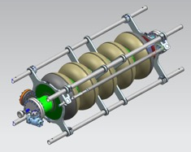
Degradation of field flatness of B61 5-cell at FNAL
Field flatness was degraded somewhere between processing post tuning and 2K VTS.
B61-EZ-001; flatness before VTS#1 ~90% -> after VTS#1 ~50%
  Stand off clamp was fabricated to ensure there is no gap between the endplates and the end-spiders.
  4-bar cage installation procedure was modified to include that.
B61C-EZ-103; flatness before VTS#1 ~97% -> after VTS#1 ~48%
  We saw degradation again, now reviewing cage installation procedures and improvement being discussed.
Ref. image
4-bar frame and standoff clamp on B92 5-cell

Slide 6
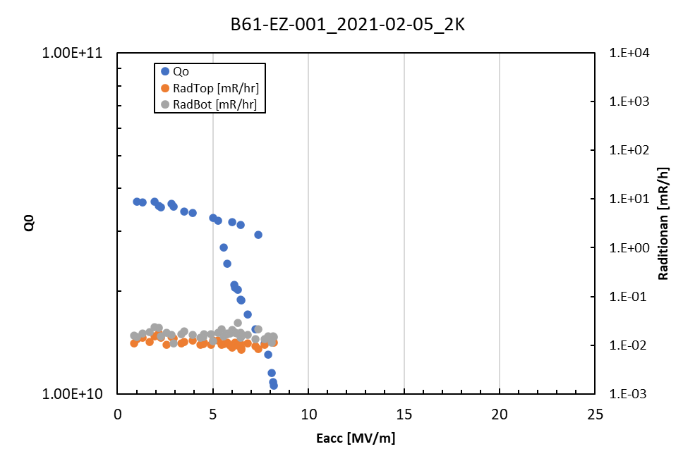
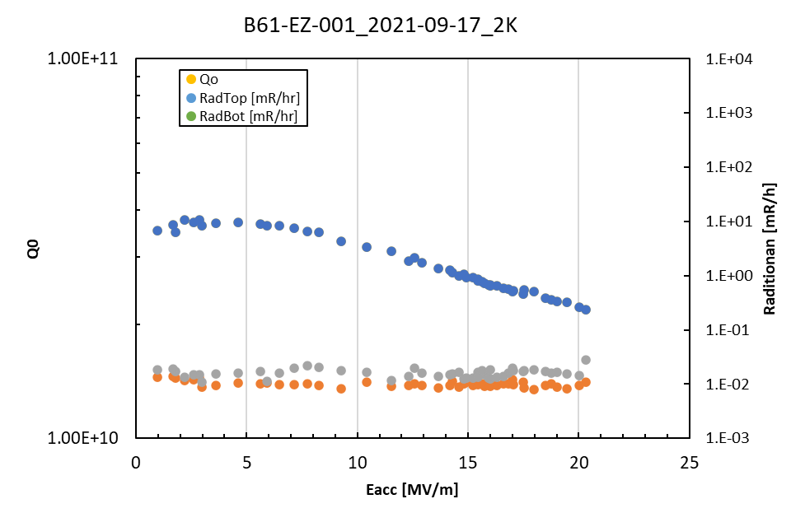
Parasitic mode suppression with modified digital PLL
4pi/5-mode was excited during pi-mode meas. of LB650 5-cell, Pi-mode meas. was interrupted
Digital PLL system is modified to suppress parasitic mode during VTS measurement
Applied and controlled RF signals via analog and digital PLL. It helped to suppress parasitic mode excitation and complete pi-mode measurement
2K, pi-mode
2K, pi-mode
Branch showed up due to 4pi/5-mode excitation

Slide 7
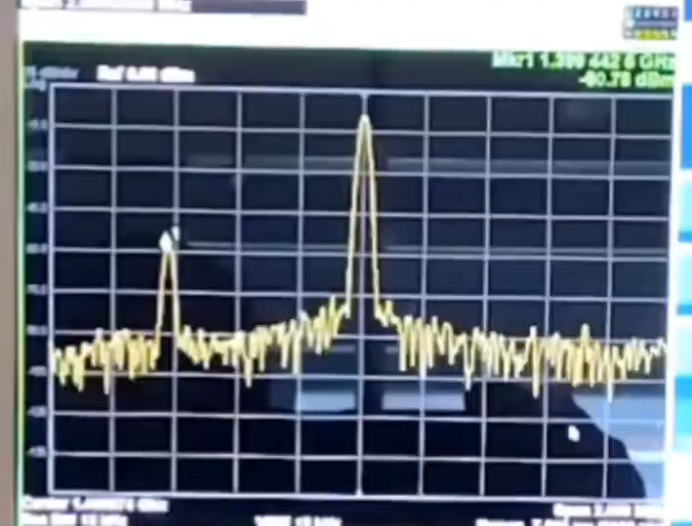
Parasitic mode suppression during VTS of B61-EZ-001
4Pi/5-mode
Pi-mode

Slide 8
Summary
B61 5-cell processing and VTS had been carried out at FNAL
Field flatness degradation was an issue with B61 5-cell. Improvement of hardware and procedures being performed.
Parasitic mode excitation was observed during VTS and limited pi-mode measurement in 2K. Modified PLL system using both digital and analog PLL was implemented, and it helped to suppress that. 2K pi-mode was successfully completed up to 22MV/m with B61-EZ-001.
We have four new B61 5-cells (B61C-EZ-101~104). One was measured but flatness degradation limited the measurement.
MP and/or FE behaviors were not yet big issue with 5-cell, will have more statistics with new LB 5-cells.
EP study on LB 5-cell will be presented, more optimization on surface processing will be done.

Slide 9
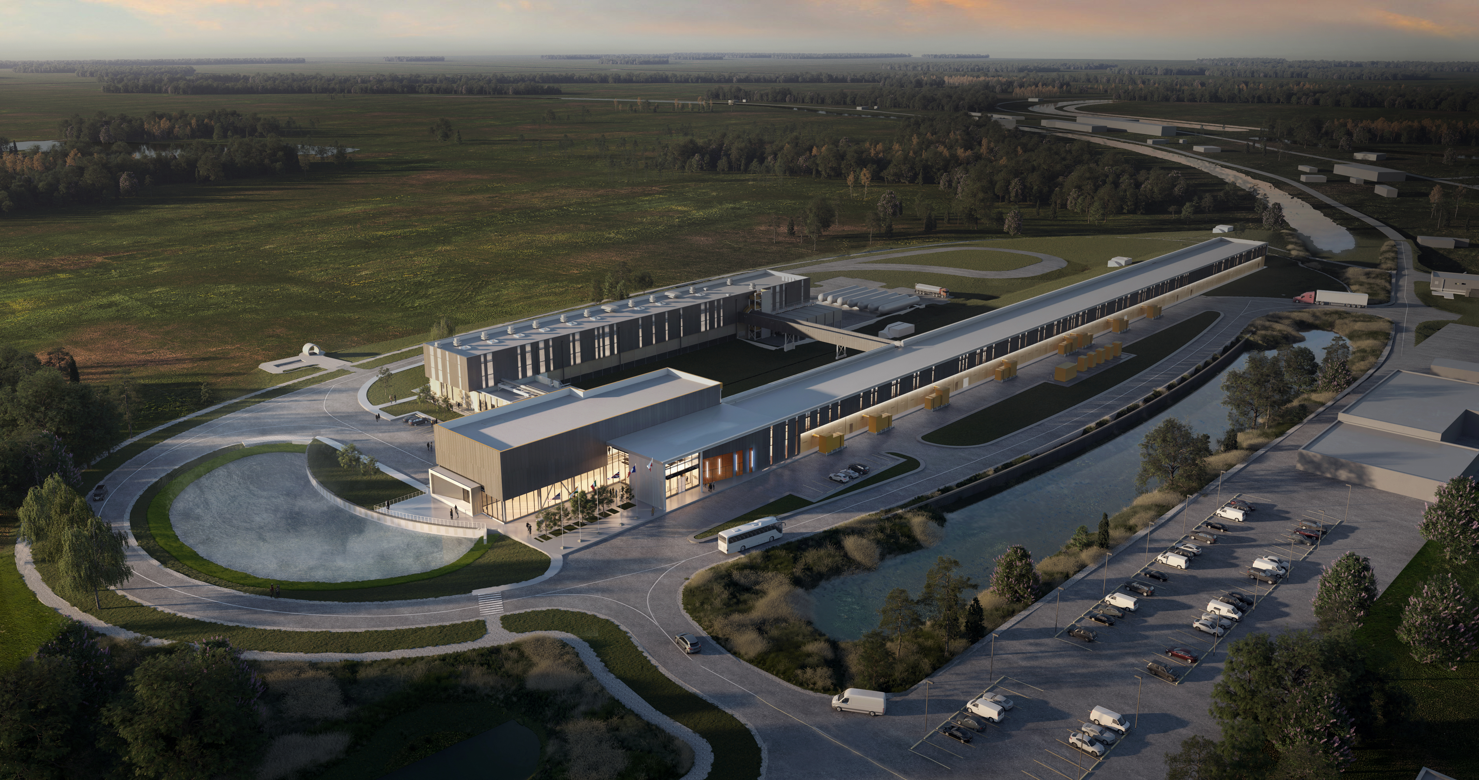
Thank You!

