Slide 1
PIP-II 2nd Technical Workshop, WG#2
STC Test Results
Alexander Sukhanov
Fermilab
12-14 July, 2022

Slide 2
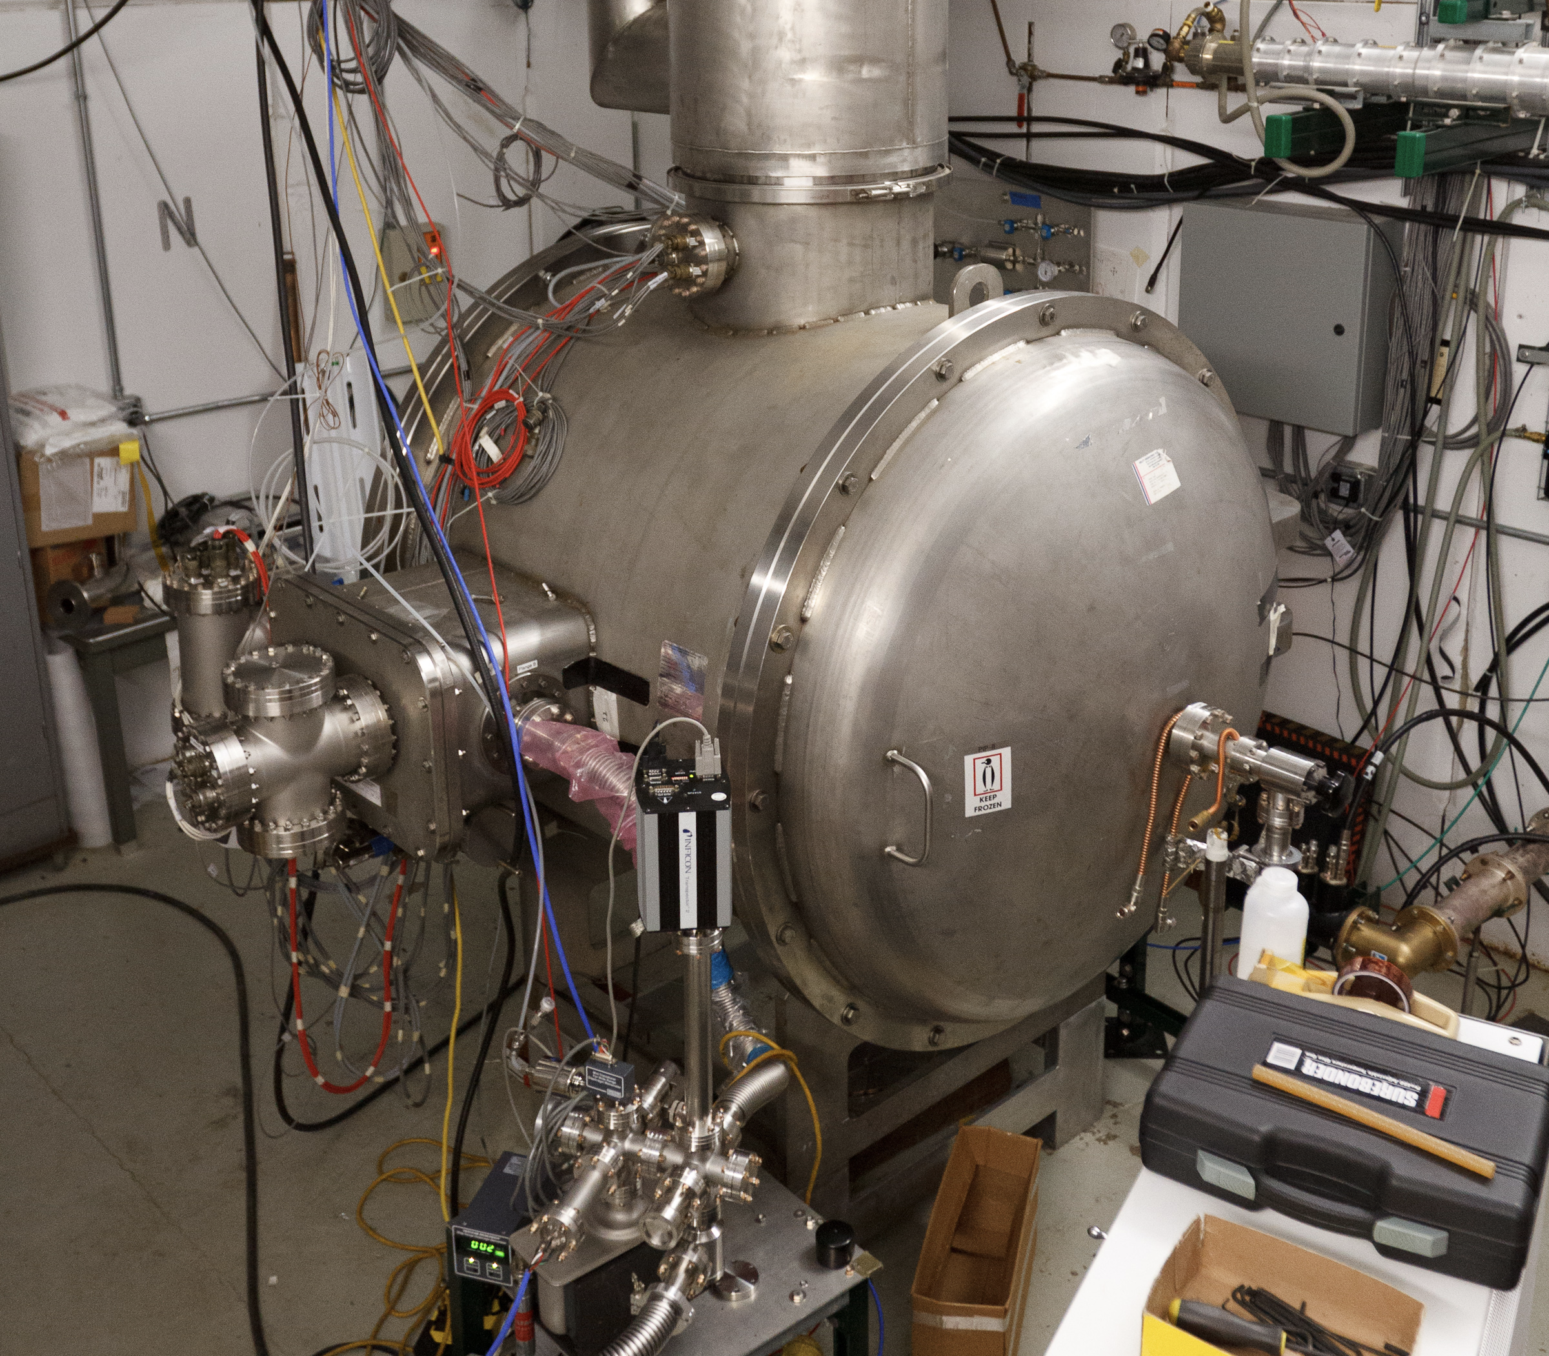
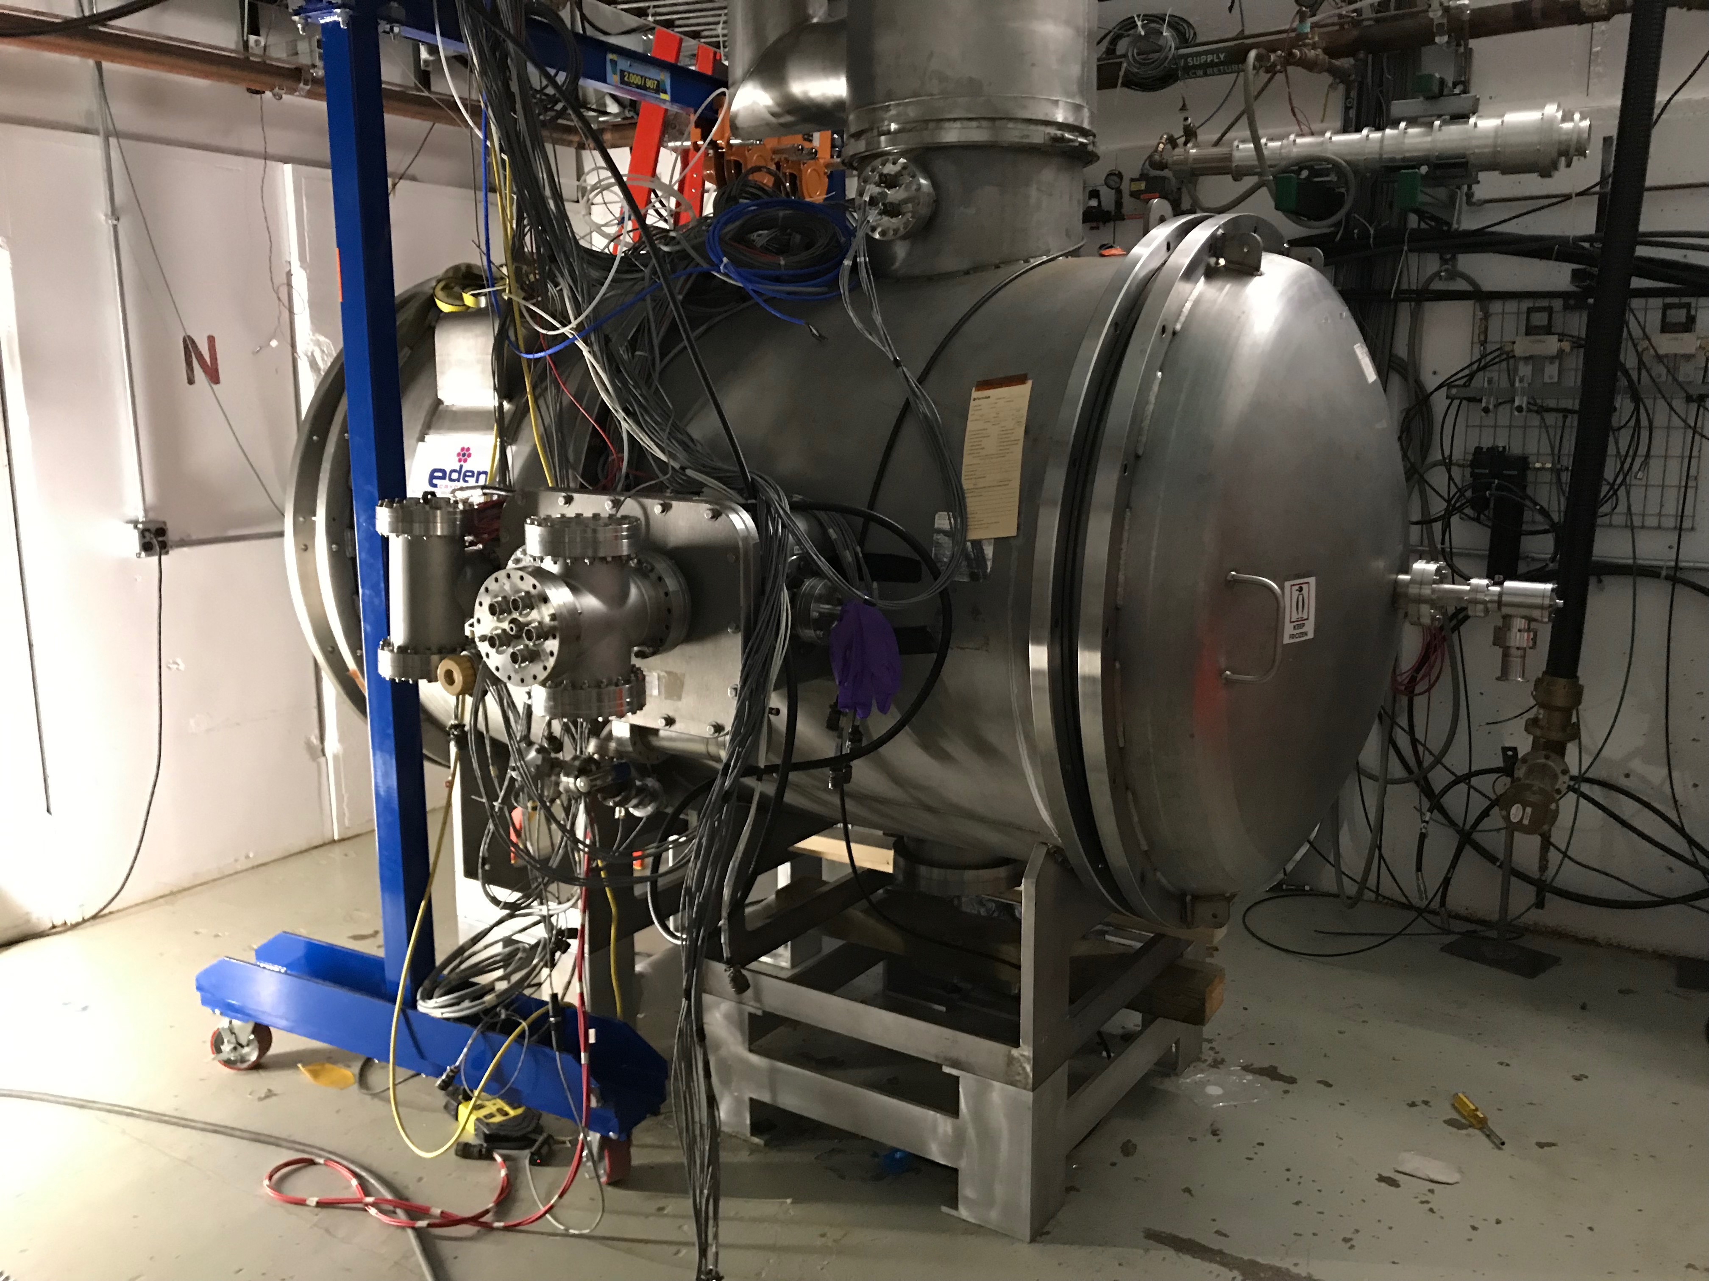
Introduction
STC – Spoke Test Cryostat - Fermilab horizontal test facility for testing jacketed SSR1 cavities
  36 cold cycles between 2013 and 2018, characterized and qualified 10 SSR1 prototype cavities and selected 8 best performers for Fermilab SSR1 prototype cryomodule
Upgraded in 2019 for testing of HB/LB650 and SSR2 cavities
Original STC
Upgraded STC

Slide 3
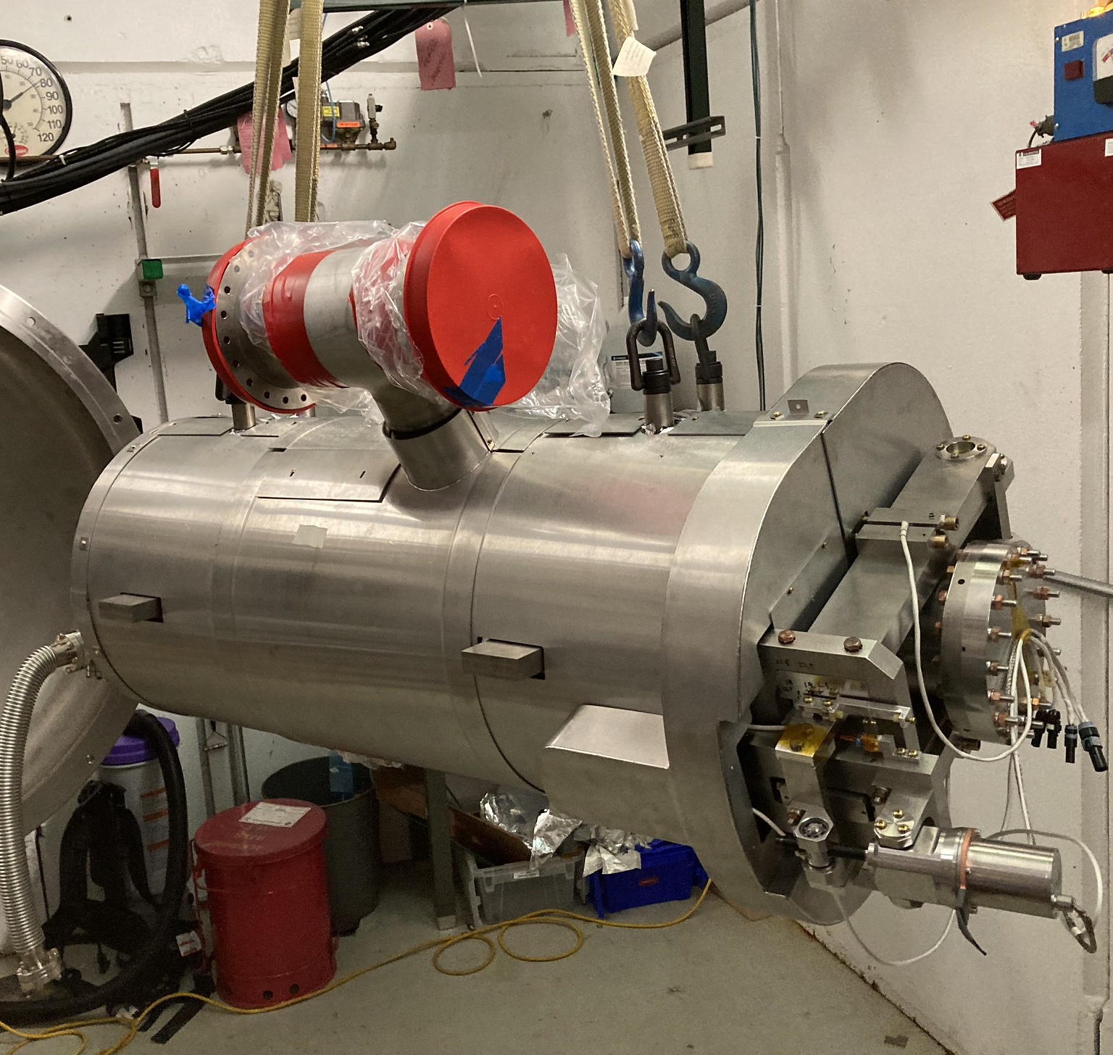
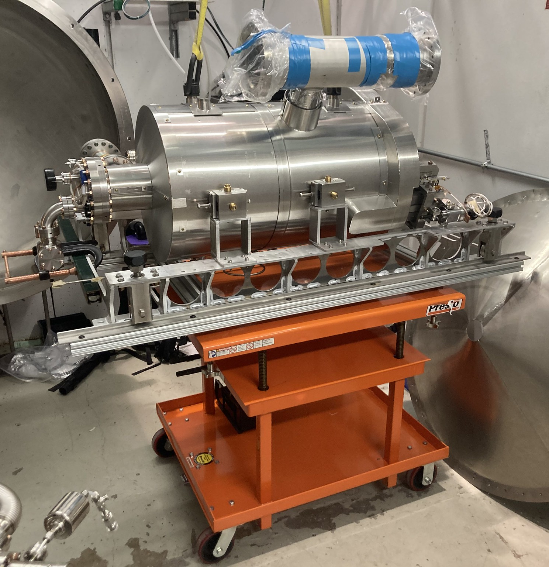
Tests of 650 MHz cavities in STC
3 tests of 650 MHz cavities (3rd one ongoing now)
HB650, beta=0.9, B9A-AES-001
January-March 2020
STC commissioning for 650 MHz operations
Prototype coupler/tuner validation/testing
Prototype cavity characterization
HB650, beta=0.92, B92D-RRCAT-502
October-November 2021
Prototype coupler/tuner validation/testing
Prototype cavity characterization, qualification for prototype HB650 cryomodule assembly
LB650, beta=0.61, B61-EZ-001
June-July 2022 (ongoing)
Preproduction coupler/tuner testing
Prototype cavity characterization
HB650 B9A-AES-010
HB650 B92D-RRCAT-502
LB650 B61-EZ-001

Slide 4
STC Test Sequence
Cavity installation
  Transportation from cavity preparation facility to STC
  Assembly of tuner, MLI, cavity magnetic shield
  Alignment w.r.t. interfaces
  Vacuum/cryogenic connections, instrumentation and thermal straps installation
Cooldown from room temperature to 2K
Tuner tests at 2K
Coupler conditioning at 2K with cavity off-resonance
Cavity on-resonance conditioning (multipactor, field emission)
Cavity characterization (max Eacc, Q0, df/dp, Lorentz force detuning)
Additional studies
  LLRF/resonance control development
  Coupler/tuner measurements
  Etc
Warmup to RT
Additional studies at RT
  Coupler conditioning w/o HV bias

Slide 5
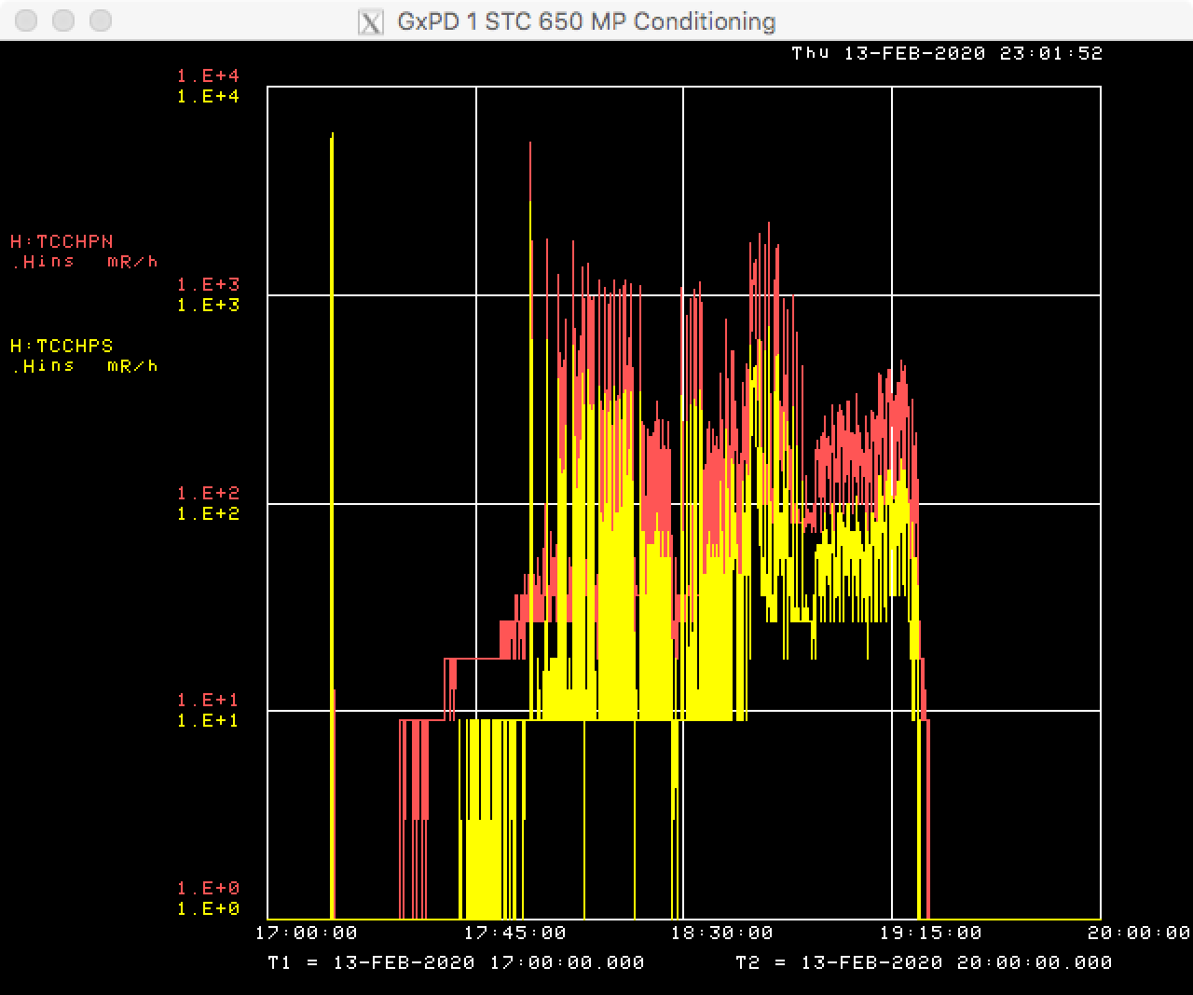
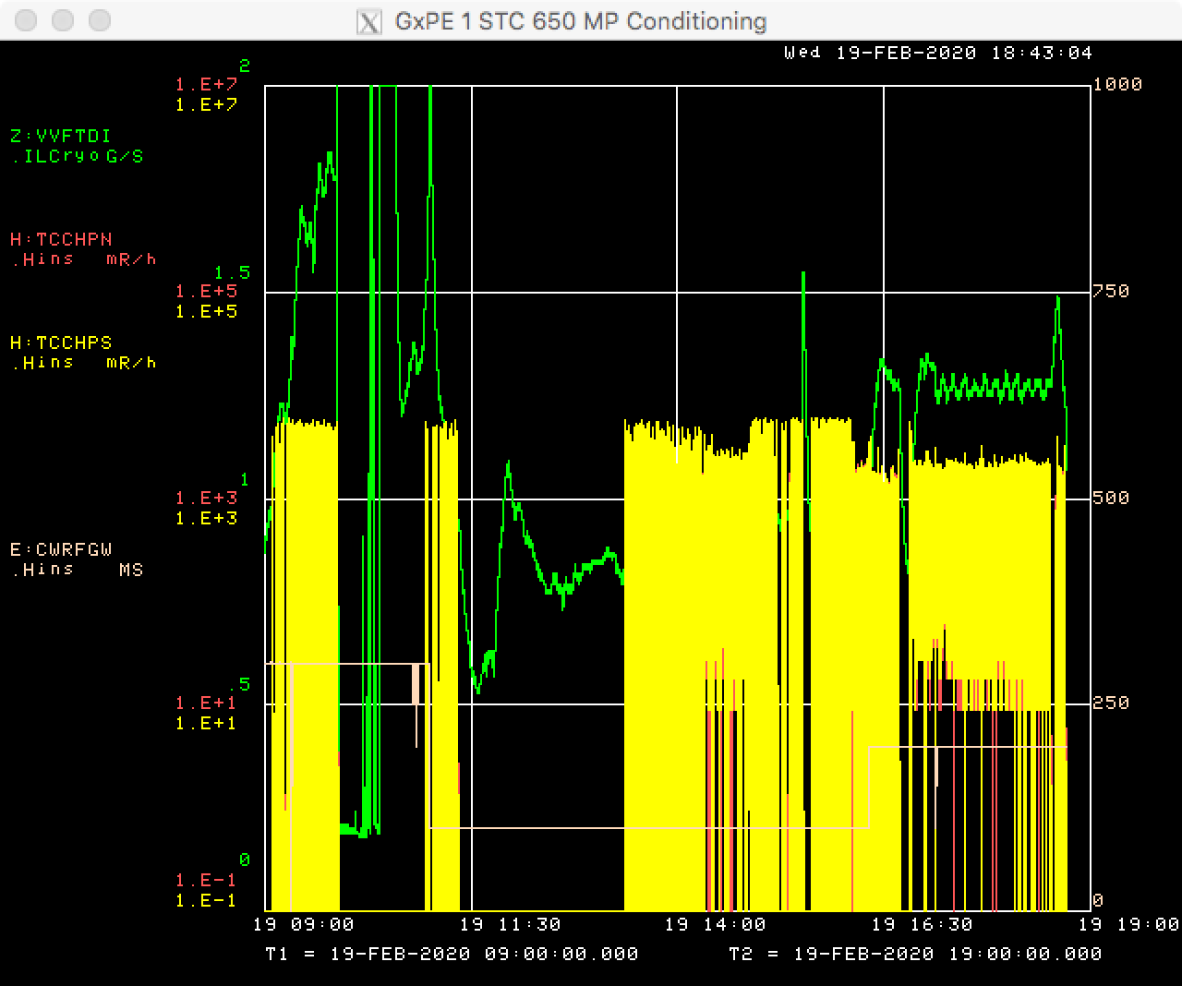
Cavity MP/FE conditioning
20-30 hours MP conditioning time
  AES-010 clean (no MP/FE) after 30 hours
  RRCAT-502 only mild FE radiation at maximum Eacc (RF power limited) after 34 hours
  EZ-001 strong FE radiation with onset at 11.5 MV/m after 20 hours
Radiation
LHe mass flow

Slide 6
Cavity quenching in STC
Quenching cavity at STC may be very violent and upsetting for cryogenic system
Magnetic field changes around cavity as result of quenching

Slide 7
Heater calibration for calorimetric Q0 measurements
Simulate dynamic heat load by heater in LHe instrumentation canister
Cavity | B9A-AES-010 | B92D-RRCAT-502 | B61-EZ-001
Sm, (g/s)/W | 0.038 | 0.040 | 0.036

Slide 8
HB650 B9A-AES-010 Q0 vs Eacc
Maximum Eacc=18 MV/m limited by available RF power (CW).
Reached 22.9 (administrative limit) MV/m in pulsed mode
Q0 = 1.9e10 at 18 MV/m
Q0 = 3.2e10 at low field

Slide 9
B92D-RRCAT-502 Q0 vs Eacc
Maximum Eacc=19.2MV/m limited by available RF power (CW).
Reached 22.9 MV/m in pulsed mode
Radiation is 36 mR/h at 19.2 MV/m, with onset at 18.5 MV/m
Initial cooldown at slow rate
2 fast cooldowns from 40 K to 4 K at 20K/minute rate
Improvement in Q0 after FCDs
Q0=3.5e10 at 19.2 MV/m
Q0=4e10 at low field

Slide 10
B61-EZ-001 Q0 vs Eacc
Maximum Eacc=16.5 MV/m limited by FE radiation
Reached 19.4 MV/m (administrative limit) in pulsed mode
Radiation is 3400 mR/h, with onset at 11.5 MV/m
Initial cooldown at slow rate
Fast cooldown 40 K to 4 K at 20K/minute rate
Improvement in Q0 after FCD
Q0=1.9e10 at 16.5 MV/m
Q0=4.2e10 at low field

Slide 11
Lorentz force detuning
LFD coefficient
Cavity | LFD coefficient, Hz/(MV/m)**2
B9A-AES-010 | 1.6
B92D-RRCAT-502 | 1.0
B61-EZ-001 | 2.4

Slide 12
Pressure sensitivity
df/dp
Cavity | df/dp, Hz/Torr
B9A-AES-010 | 6.0
B92D-RRCAT-502 | 15
B61-EZ-001 | 27

Slide 13
Summary
Cavity | B9A-AES-010 | B92D-RRCAT-502 | B61-EZ-001
MP conditioning time, h | 30 | 34 | 20
Max Eacc, (CW) MV/m | 18 | 19.2 | 16.5
Limited by | RF power | RF power | Radiation
Max Eacc (pulsed mode), MV/m | 22.9 (admin. limit) | 22.9 (admin. limit) | 19.4 (admin. limit)
Radiation at max Eacc, mR/h | n/a | 36 | 3400
Radiation onset field, MV/m | n/a | 18.5 | 11.5
Q0 at max Eacc, 1e10 | 1.9 | 3.5 | 1.9
Q0 at low field, 1e10 | 3.2 | 4.0 | 4.2
LFD coefficient, Hz/(MV/m)**2 | 1.6 | 1.0 | 2.4
df/fp, Hz/Torr | 6.0 | 15 | 27

Slide 14
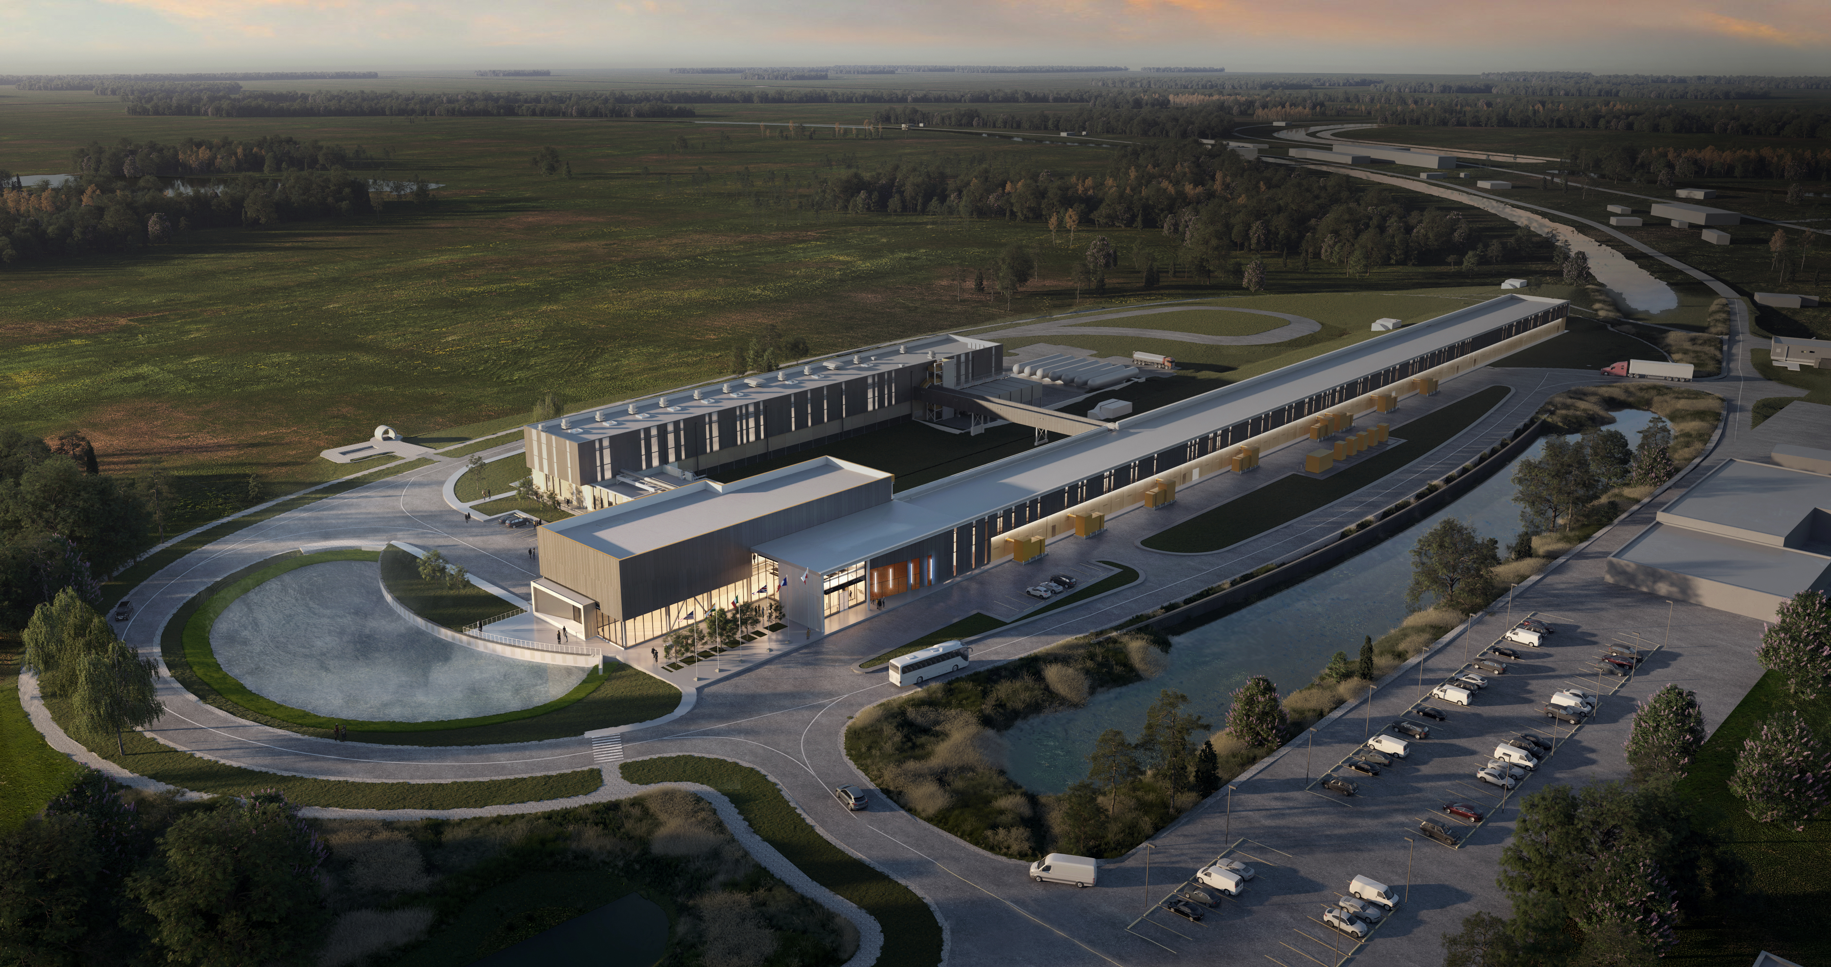
Thank You!

