Slide 1
PIP-II 2nd Technical Workshop, WG#2
Cavity Jacketing Experience at FNAL
Chuck Grimm
Fermilab
12-14 July 2022

Slide 2
Outline
Background Information
Tooling and Equipment
Cantilever and Rotation Fixtures
Glovebox – Gas Distribution System
Cavity and Helium Tank Configurations
Cavity Beam Flanges
Fundamental Power Coupler and Field Pickup Flanges
Helium Tank, Bellow, and Titanium End Caps
Assembly and Tack Welds
Assembly Setup on Cantilever Fixture
Tack Welding
Glovebox Welding
Weld Map and In-Process Weld Examination Forms
Welding Sequence
Gas Flows and Internal Cavity Purging
RF and O2 Monitoring
Final Frequency Shift and Field Flatness
Pressure Test, Leak Checks, and Traveler
Lessons Learned
Summary

Slide 3
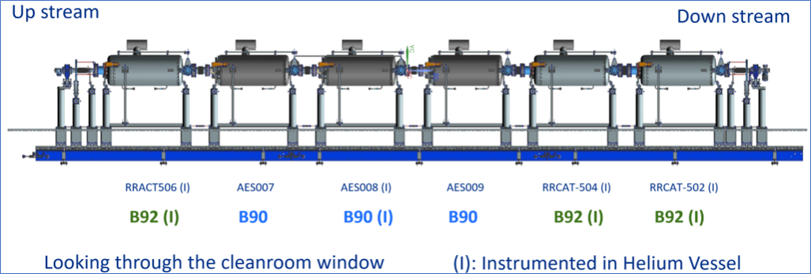
Background Information
Experienced cavity jacketing teams
Lead Engineer
RF Engineer
Welder
Support Technicians
Over 60 cavities of various frequencies and beta versions dressed to date
3.9 GHz
1.3 GHz
HB650
LB650
FNAL jacketed all 6 cavities for the prototype HB650 cryomodule

Slide 4
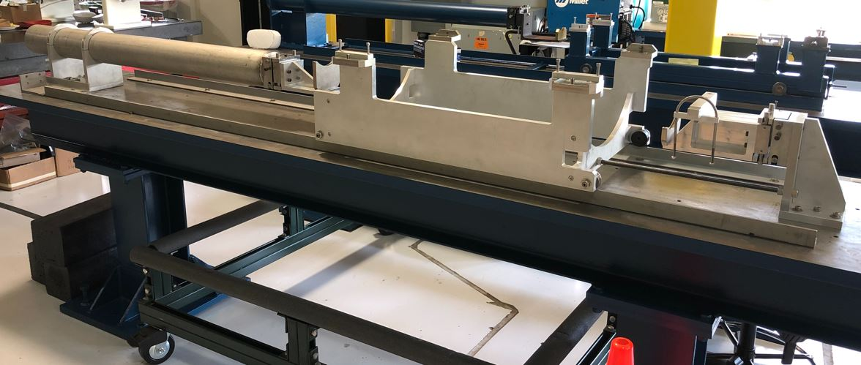
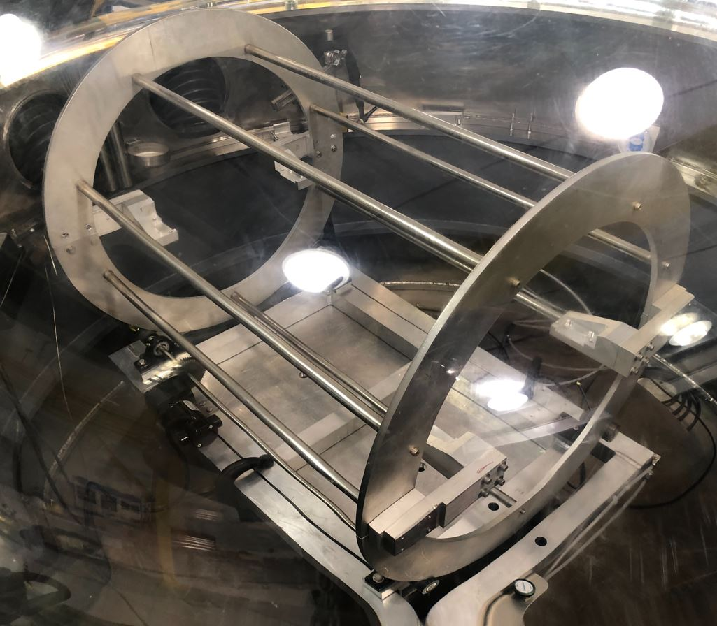
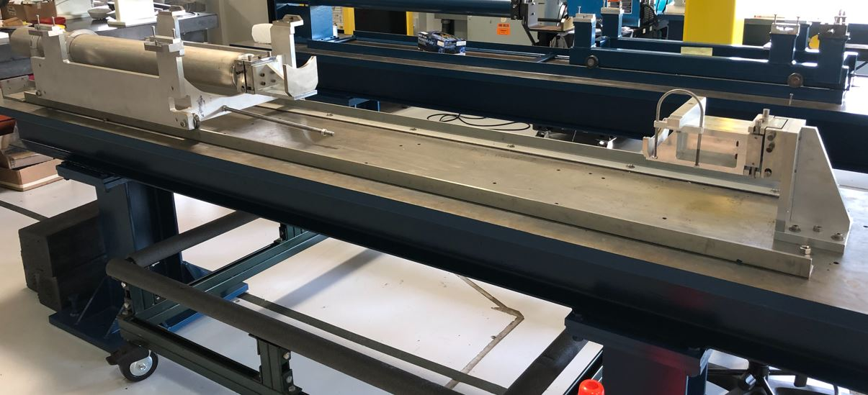
Tooling and Equipment
Main Tooling
Rotation Fixture
Cantilever Fixture

Slide 5
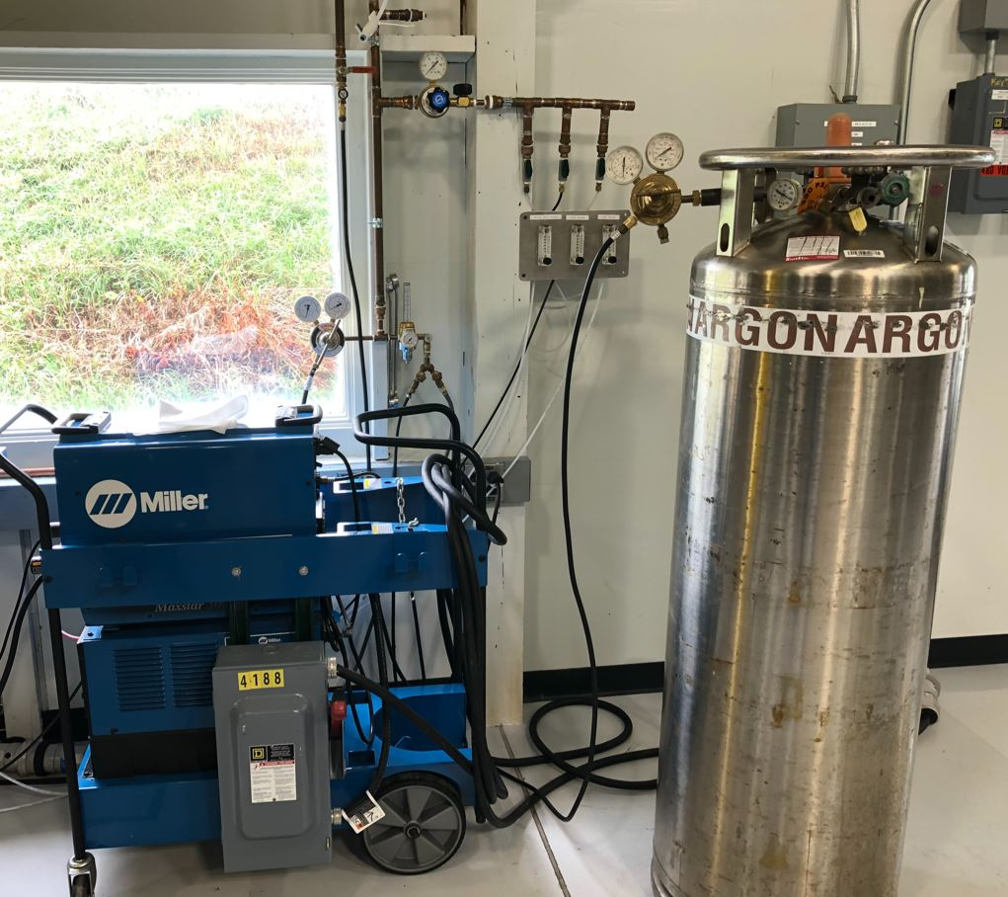
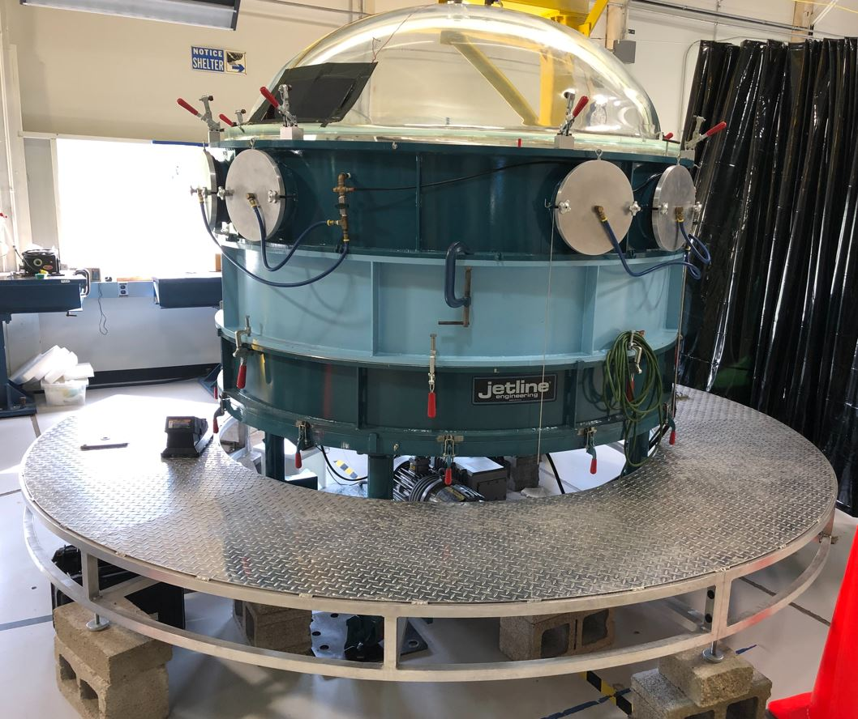
Tooling and Equipment
Glovebox
Gas Distribution System

Slide 6
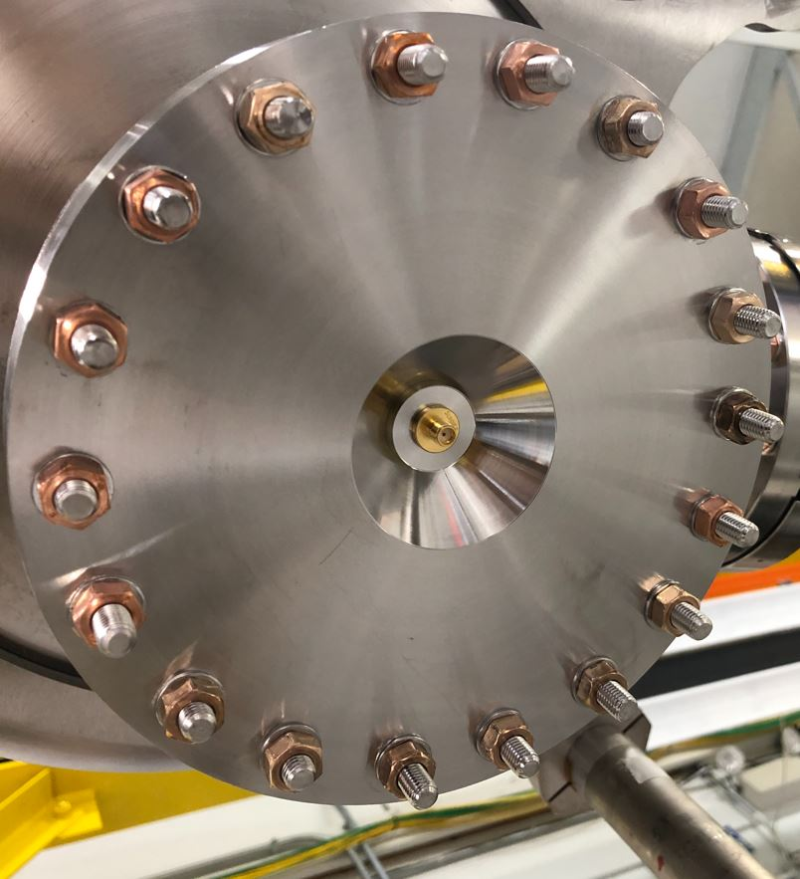
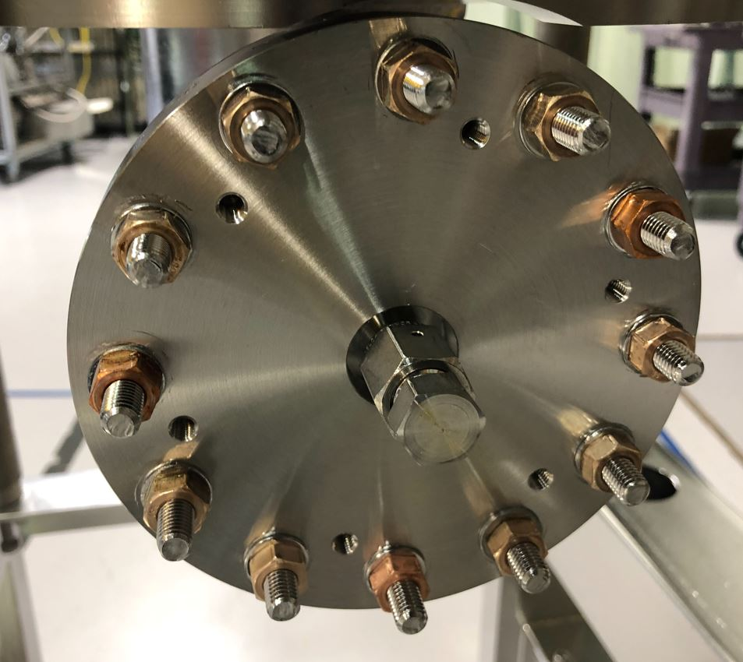
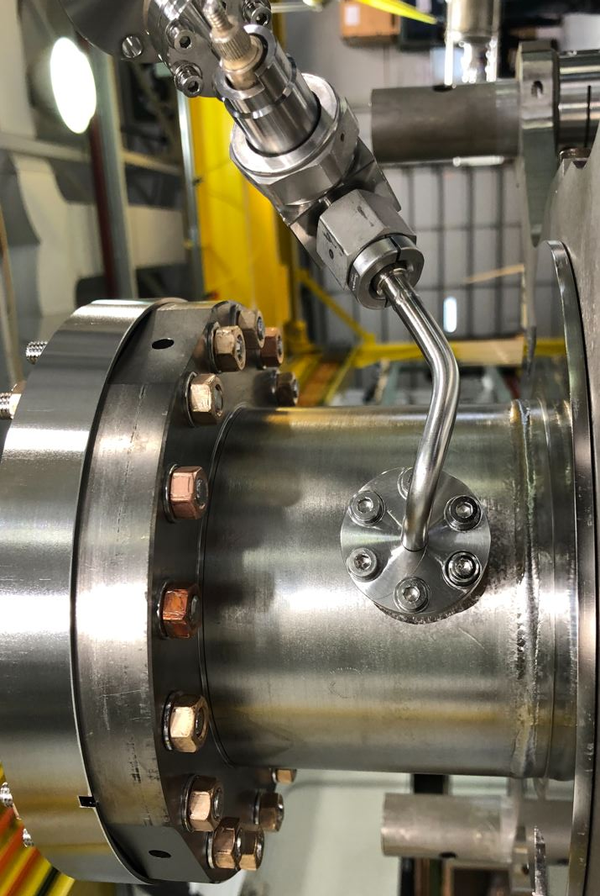
Cavity and Helium Tank Configurations
Cavity Flange Configurations
Beam Flanges with RF Feedthroughs
Coupler Flange with VCR Fitting
FP Flange with Valve

Slide 7
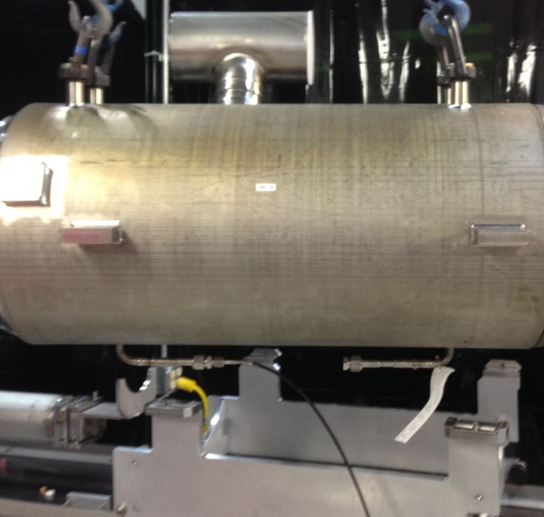
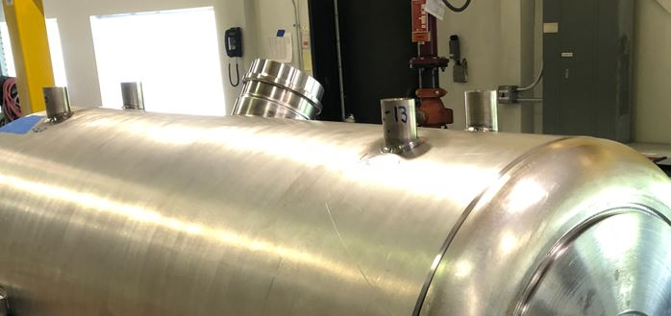
Cavity and Helium Tank Configurations
Foam Plug in Tee Ends (*)
Helium Tank Configuration
* Foam in Bi-Metal Transition
VCR Purge Line Connection
VCR Cap

Slide 8
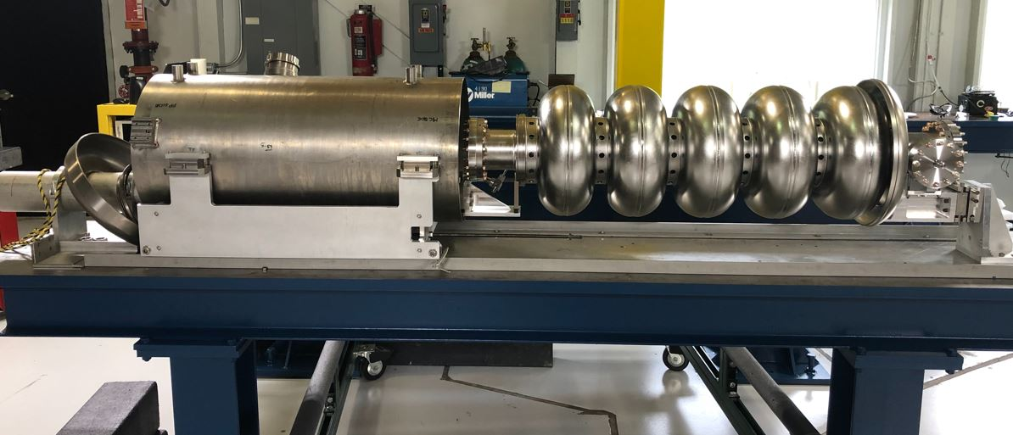
Assembly and Tack Welds
Cantilever Fixture Assembly Setup
Bellow and Ti Endcap
Helium Tank
RRCAT-502

Slide 9
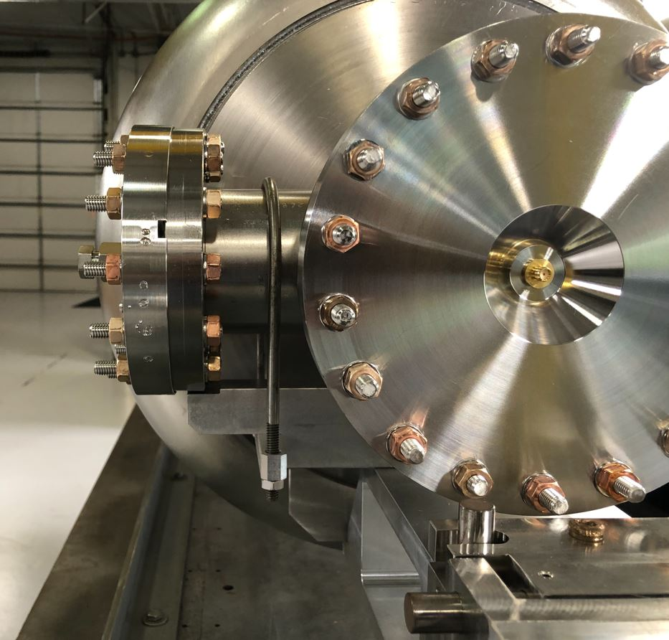
Assembly and Tack Welds
Critical FPC Flange Alignment
FPC Flange Must Rest on Machined Ledge for Proper Cavity Clocking

Slide 10
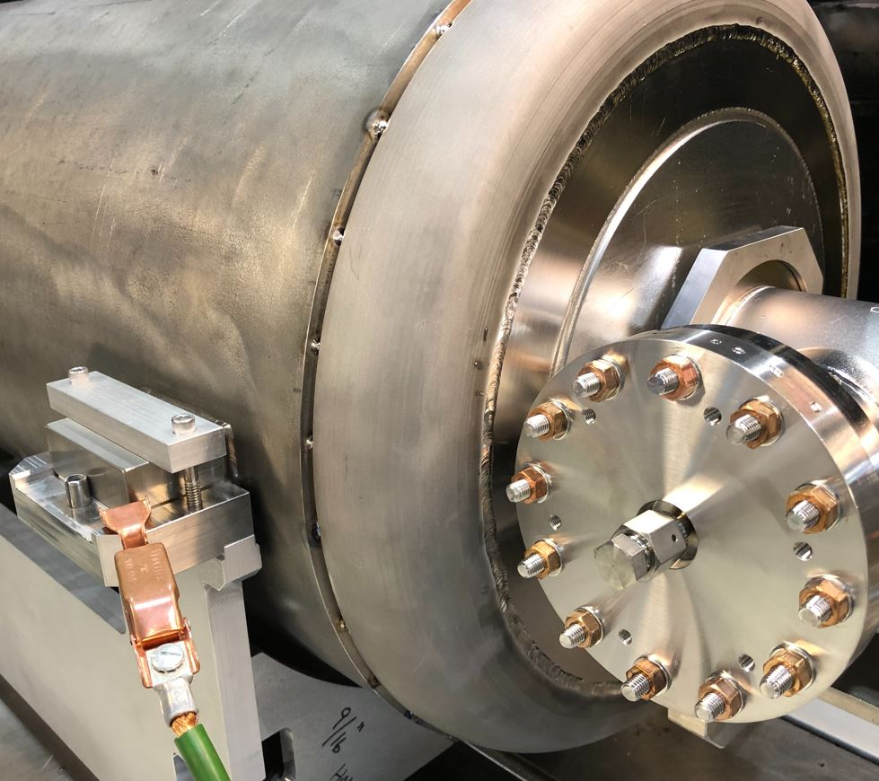
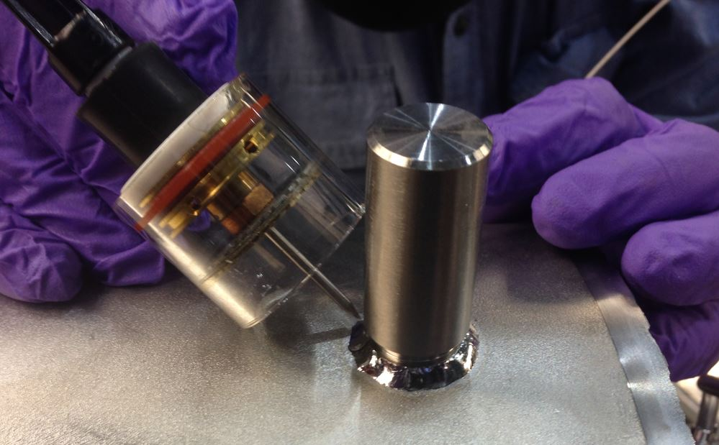
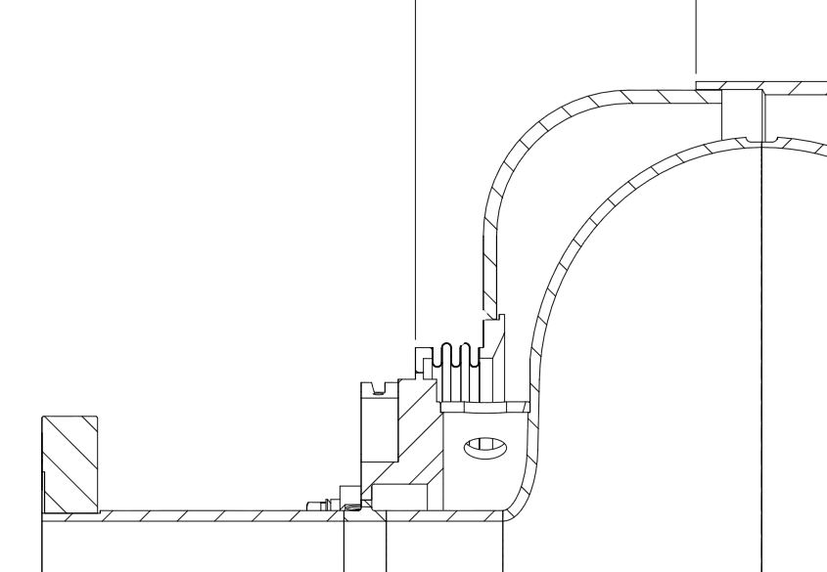
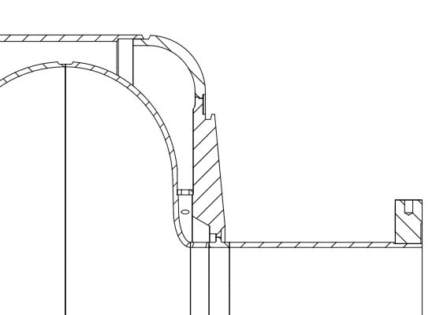
Assembly and Tack Welds
Tack Welding
Shielded Cup used for “Open Air” Tack Welding
Tack Location
FPC End Fully Tacked
No Tacks,
Float Location During Welding
Tack Location
Pickup End
FPC End

Slide 11
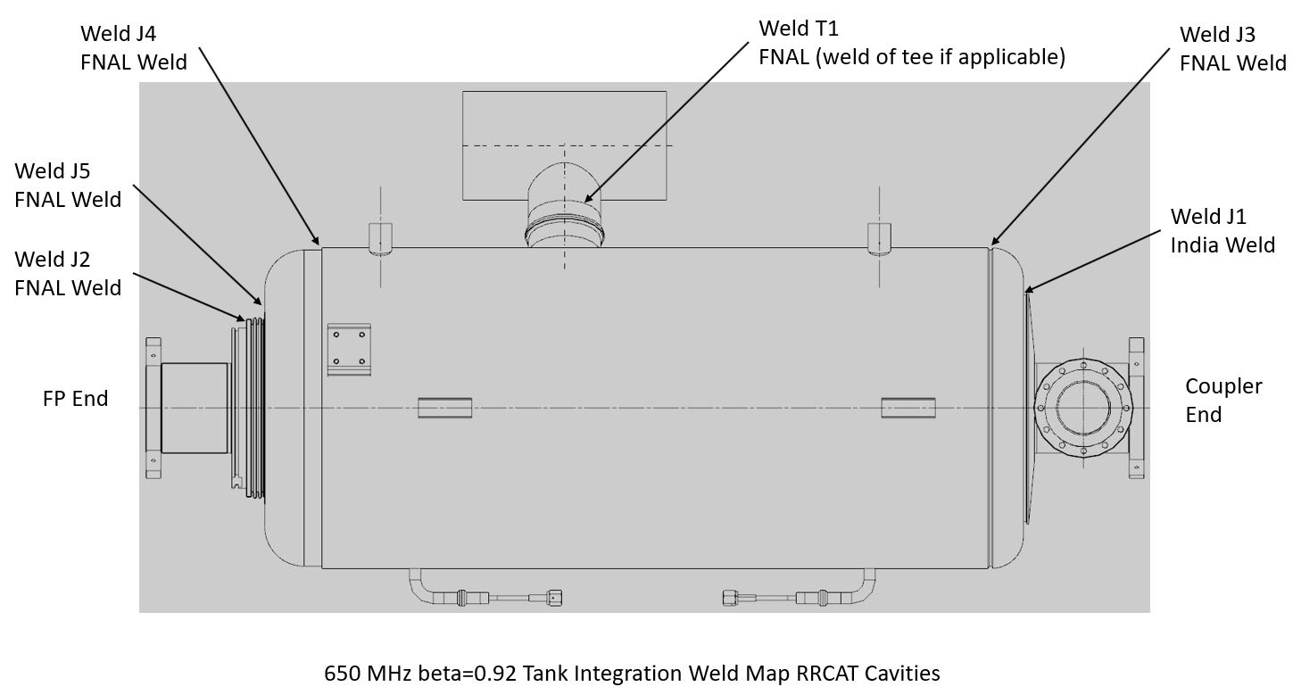
Glovebox Welding
Weld Map

Slide 12
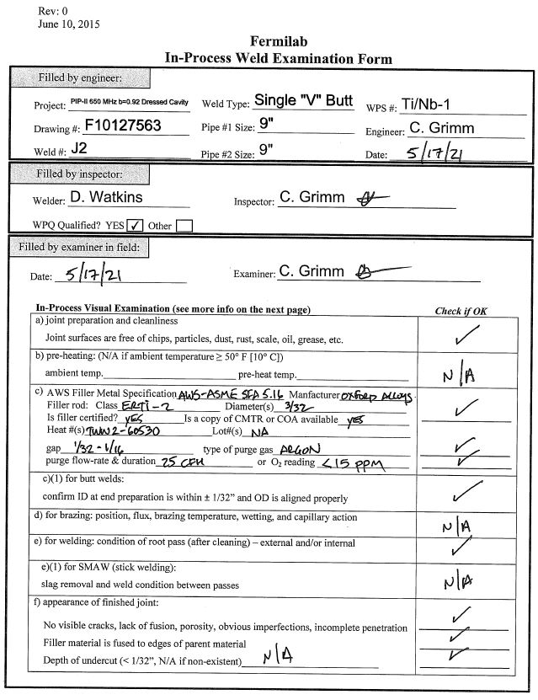
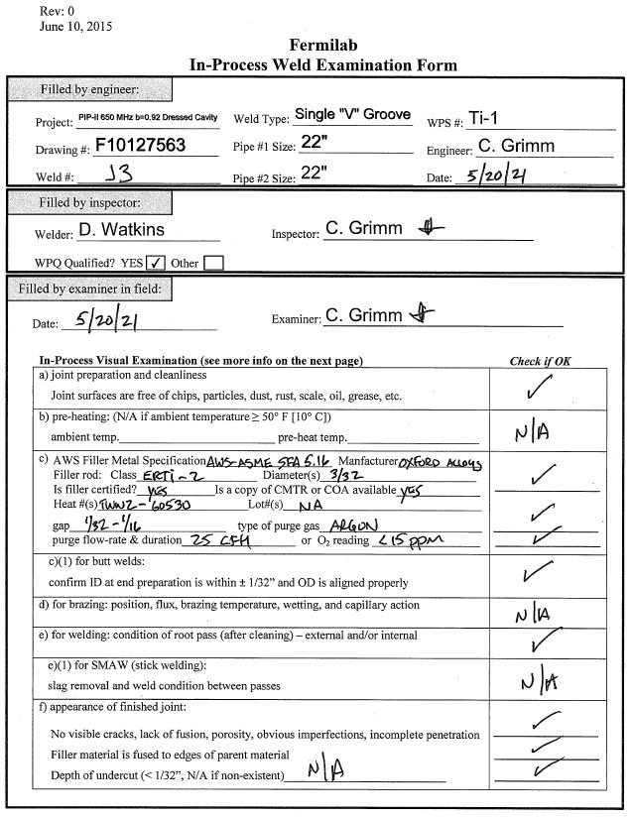
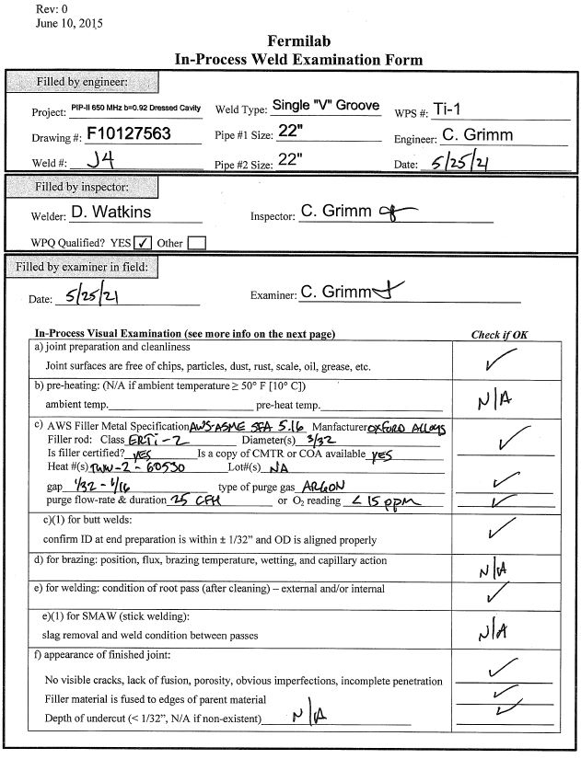
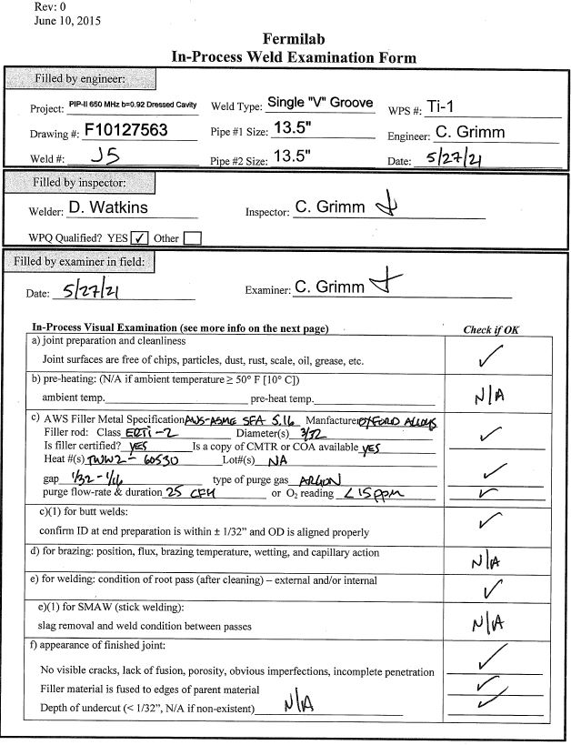
Glovebox Welding
In-Process Weld Examination Forms (J2-J5)

Slide 13
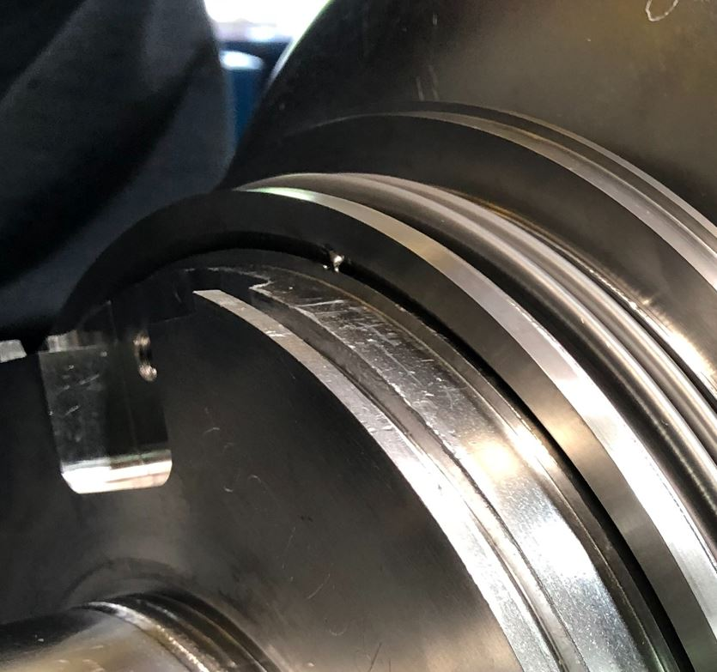
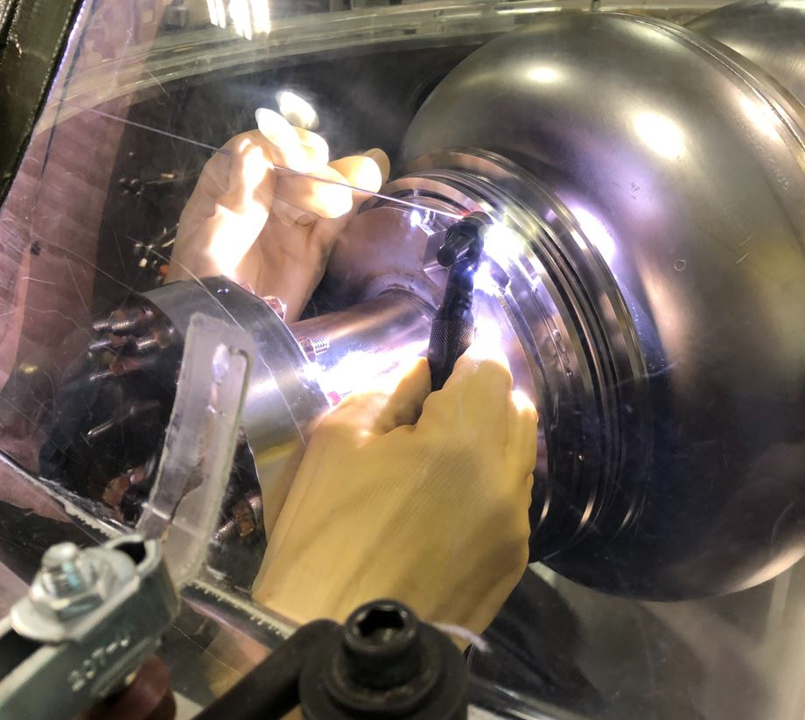
Glovebox Welding
Bellow Welding – Weld (J2)
Bellow Tack
Bellow Welding

Slide 14
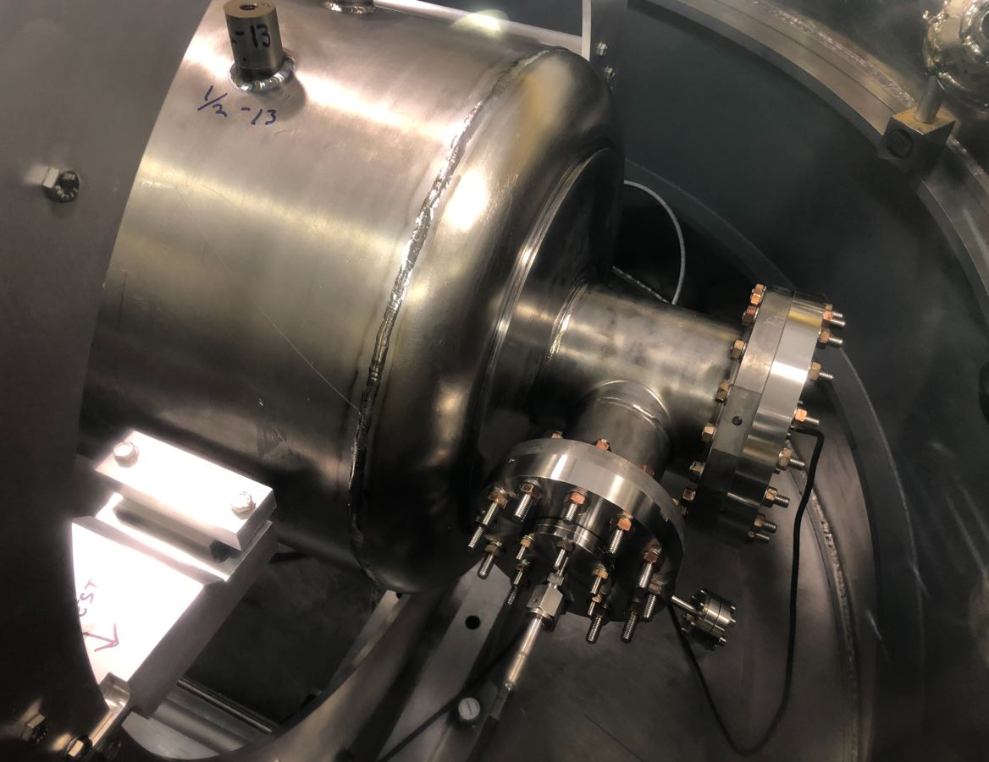
Glovebox Welding
Completed J3 Weld
Tank Integration Welding – Weld (J3)
RF Cable
Rotation Fixture
Internal Cavity Purge Line
Running 20 CFH Argon

Slide 15
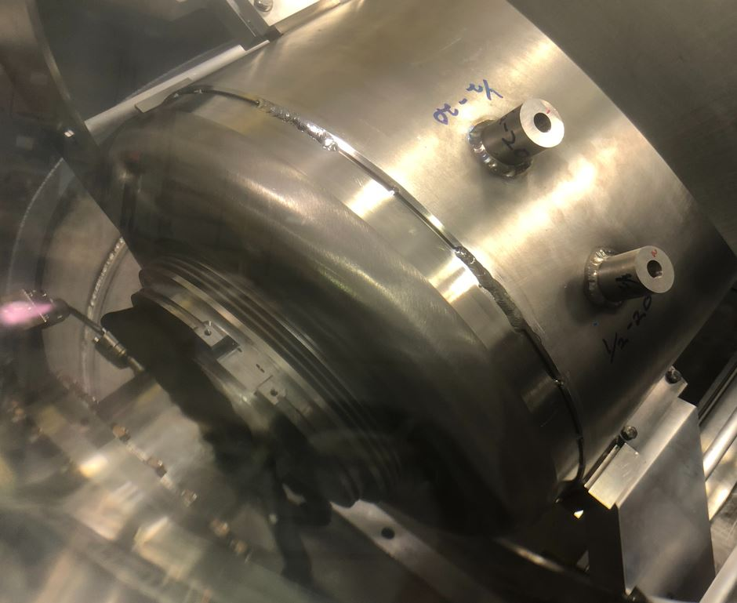
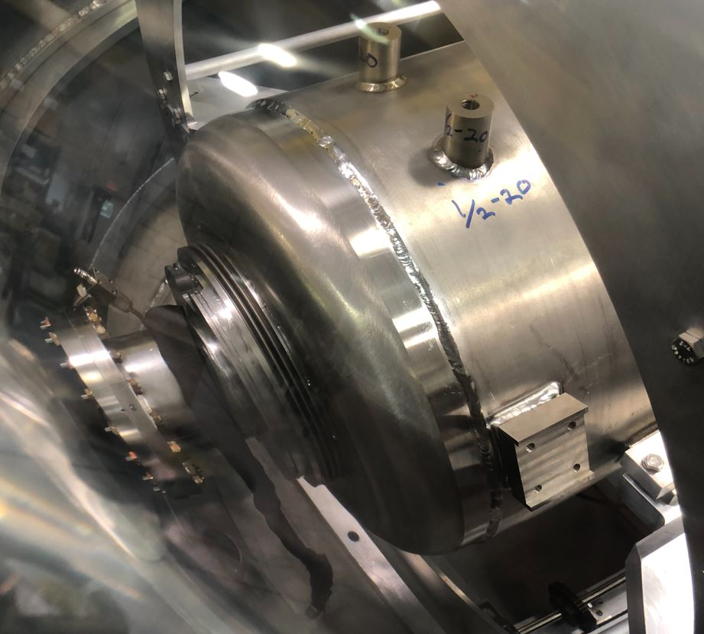
Glovebox Welding
Tank Integration Welding – Weld (J4)
Completed J4 Weld
Weld Segments
~50mm long
Cavity Internal Purge Vent

Slide 16
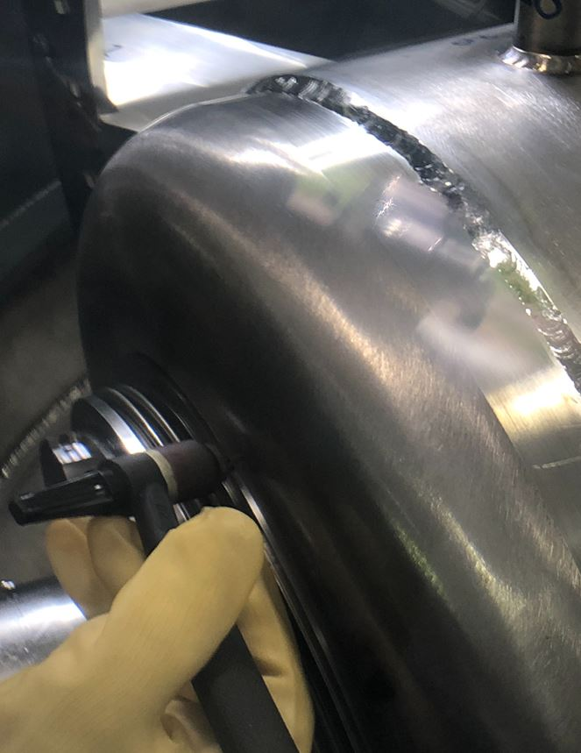
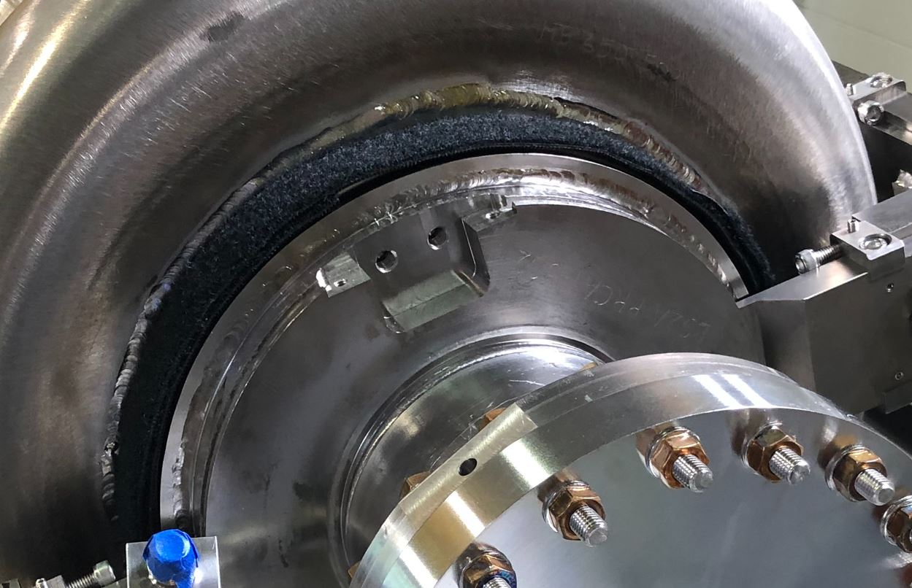
Glovebox Welding
Tank Integration Welding – Weld (J5)
Completed J5 Weld
Weld J5 Location

Slide 17
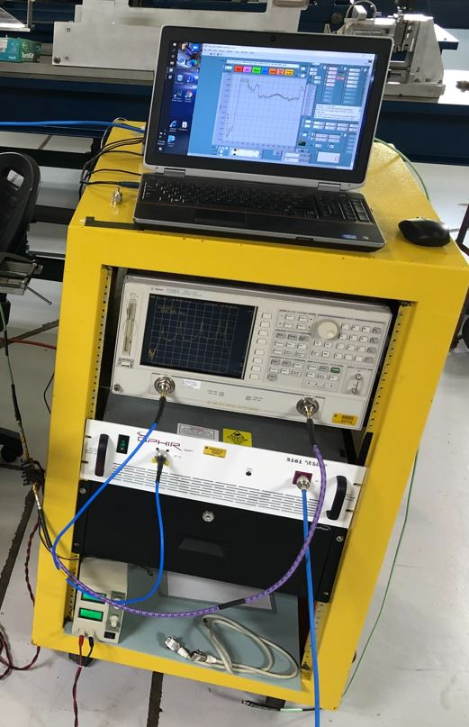
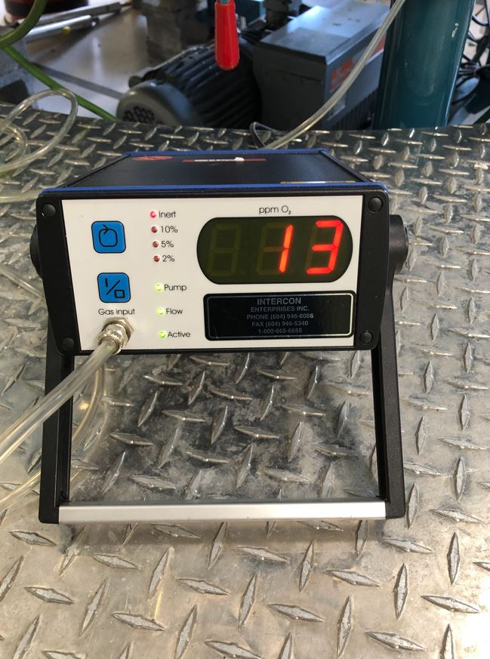
Glovebox Welding
RF and O2 Monitoring
Program set to take RF measurements every minute during welding
O2 monitor actively displays ppm of O2 during welding
Cavity RF Monitoring Station
Actual O2 Reading During RRCAT-502 Welding

Slide 18
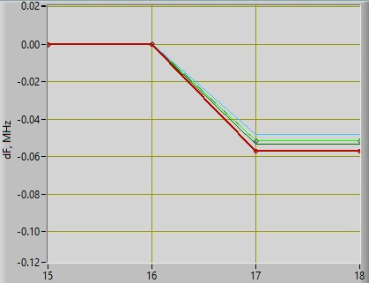
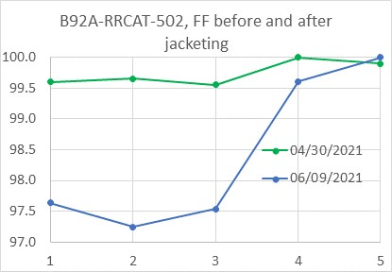
Glovebox Welding
Final Frequency Shift and Field Flatness (RRCAT-502)
All within specifications
Final RF Spectrum
Field Flatness Measurements
Beginning Measurement: 649.064 MHz
Ending Measurement: 649.013 MHz
~-50kHz Shift
Modes Separated by only 10 kHz
Beginning Average: 99.7%
Ending Average: 98.4%
Small loss of only ~1.3%
Both Graphs Courtesy of Timergali Khabiboulline

Slide 19
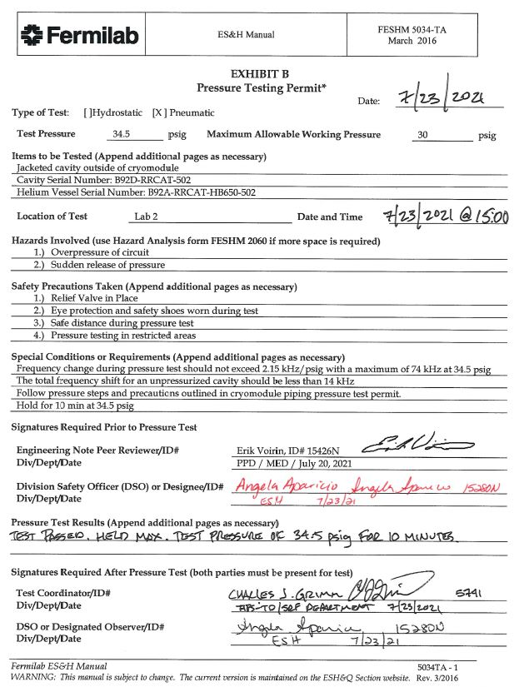
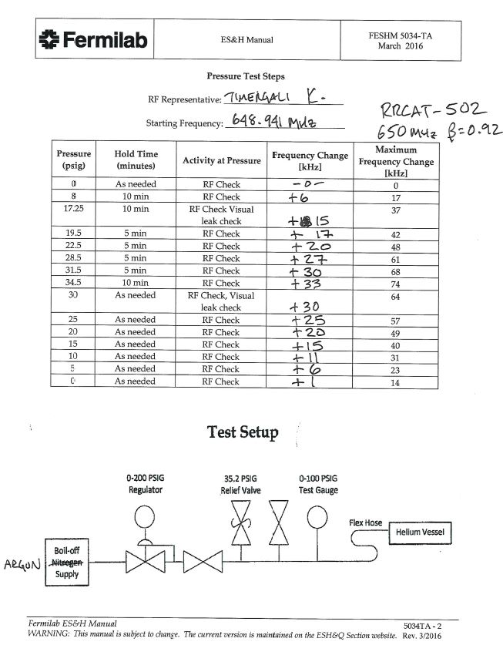
Pressure Test and Leak Checks
Helium Vacuum Leak Check Performed Before and After Pressure Test
Within specification
Performed Pressure Test Stepping up Pressure to 34.5 psig (2.3 bar)
Passed, maximum pressure held for 10 minutes without loss
Frequency shift from start to finish was +1 kHz

Slide 20
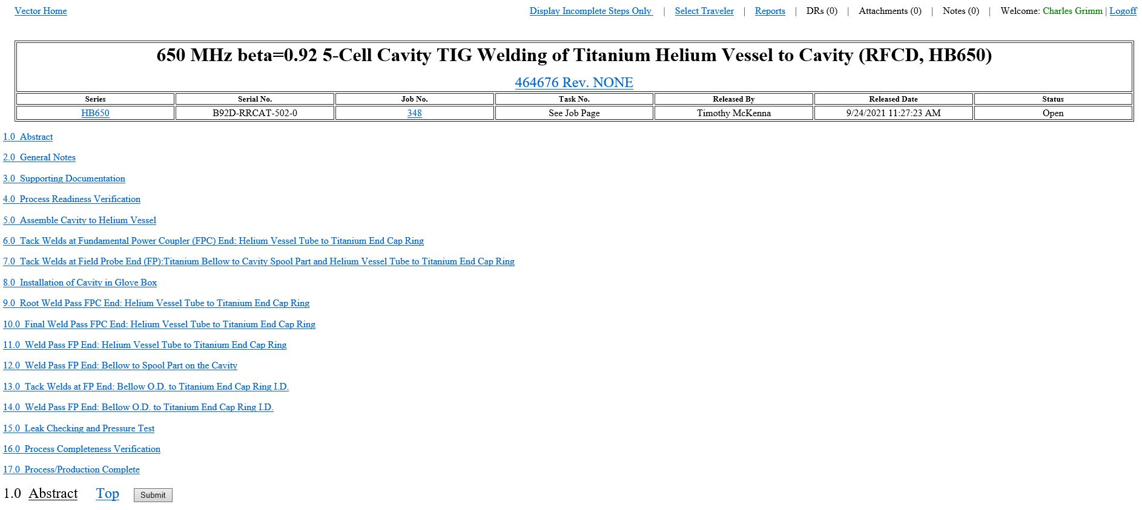
Traveler
Assembly, Welding, Leak Checks, and Pressure Test Data Included
This traveler and any other information regarding cavity jacketing can be shared with the collaboration partners/vendors -

Slide 21
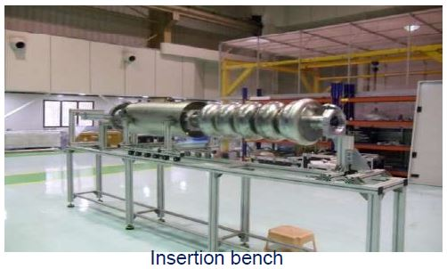
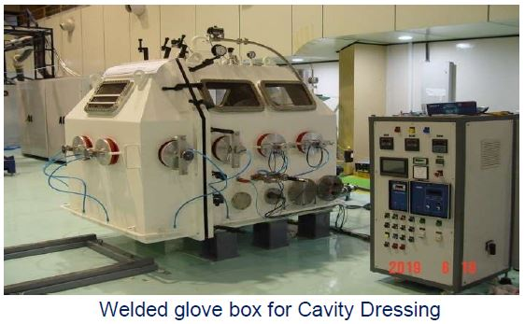
Lessons Learned
Visited RRCAT in February 2019 to help dress RRCAT-501
Needed better active cavity cooling during welding to decrease wait times between weld segments – RRCAT wait times were several hours.
Developed more efficient flow path of Argon on outside surface of cavity within the helium space of the tank.
Introduced a method to flow cool Argon gas inside of the cavity during welding.
These steps reduced wait times to 1 hour or less and helped minimize large frequency shifts, especially mode separation which influences the field flatness.
Pictures courtesy of RRCAT

Slide 22
Lessons Learned
For RRCAT-502 there was a decision to weld the bellow onto the bare cavity first so that we can have the field flatness checked to see the impact of welding so close to the end cell stiffening ring.
Bead pull measurements indicated that the weld J2 had no impact on frequency or field flatness.
Future 650 cavities will have all welds performed at the same time

Slide 23
Summary
Fermilab has a well-established team that has jacketed over 60 cavities of many frequencies and beta versions.
RRCAT-502 cavity jacketing was successful with very minimal frequency and field flatness changes from start to finish. This was true for all seven 650 cavities jacketed at FNAL.
Decision to use an Argon gas flow through the internal cavity surface helped to reduce time between weld segments and helped eliminate further RF drift changes after welding stopped.
All tooling, equipment, and infrastructure developed and validated to jacket 650 MHz cavities. Ready to transfer to industry.

Slide 24
Thank you!

Slide 25
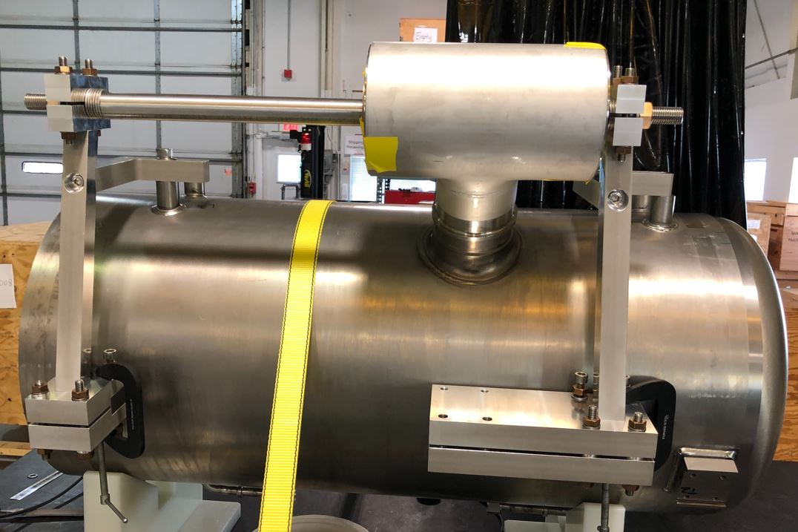
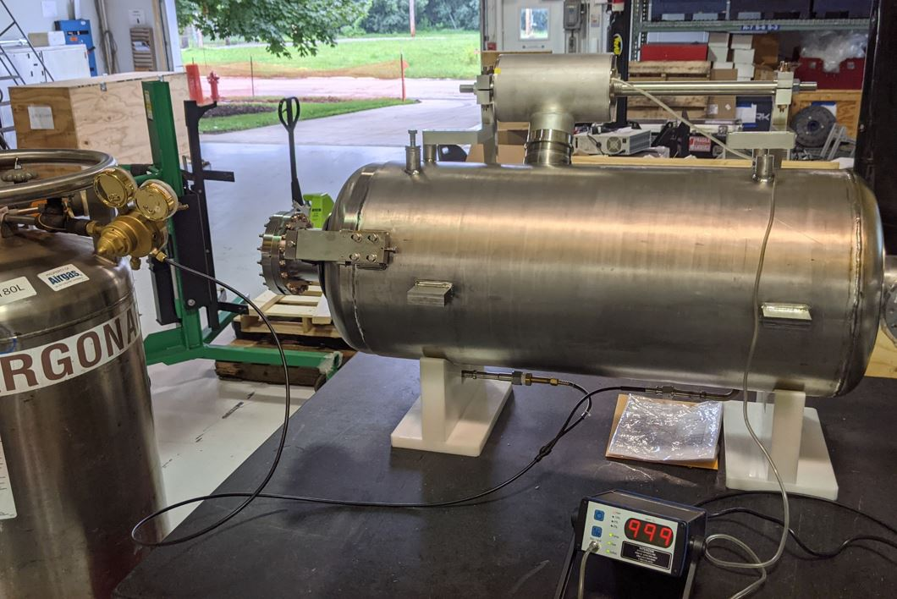
Backup Slides
Tee Welding on Helium Vessels
Some helium tanks will arrive without tee’s welded on
Tooling was designed to accurately place and weld tee’s
The precision machined tank bearing lugs are used as a reference point
The same fixture is used for both HB and LB helium vessels

