Slide 1
STFC HB650 cavity and Nb procurement
Anna Shabalina
2nd PIP-II Technical workshop
13 July, 2022

Slide 2
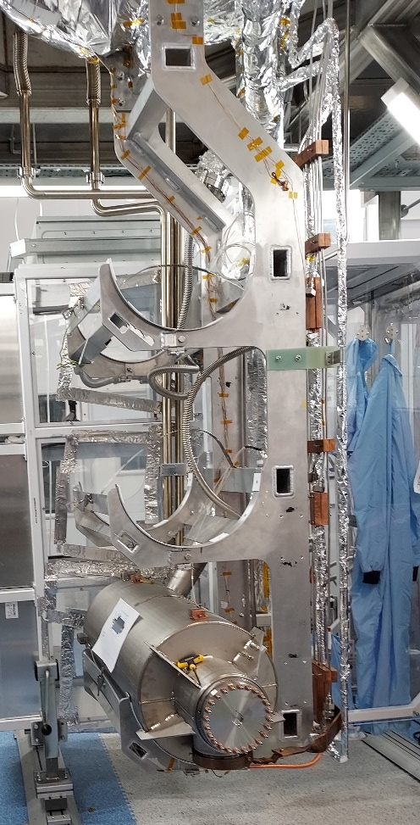
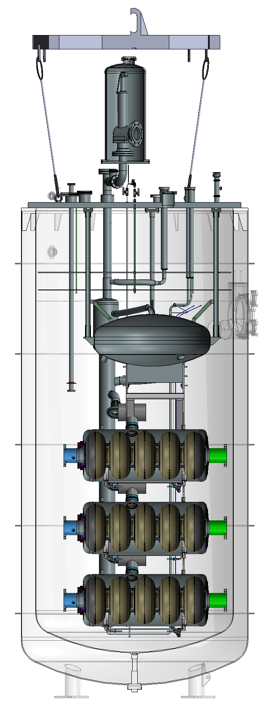
HB650 Cavity scope
Procurement of the production Niobium
2 pre-series cavities: Vendor validation
Bare cavities will be tested at FNAL
Tested at STFC after jacketing
18 series cavities
Tested jacketed at STFC one cavity at a time
Cryomodule integration at STFC
Supporting high Qo
Fast CoolDown
Enhanced magnetic hygiene
Documentation

Slide 3
Production Niobium procurement
Market survey
Tokyo Denkai (Japan) – some technical limitations
ATI Metals (USA) – at full capacity
OTIC Ningxia (China) – some technical limitations
Heraeus (Germany) – not on the market
Manufacturing specifications adjustments
Hardness
Elongation
Strain Hardening Coefficient
Tender exercise
OTIC – cheap and fast
ATI – cheap and slow
TD – expensive and very slow
3

Slide 4
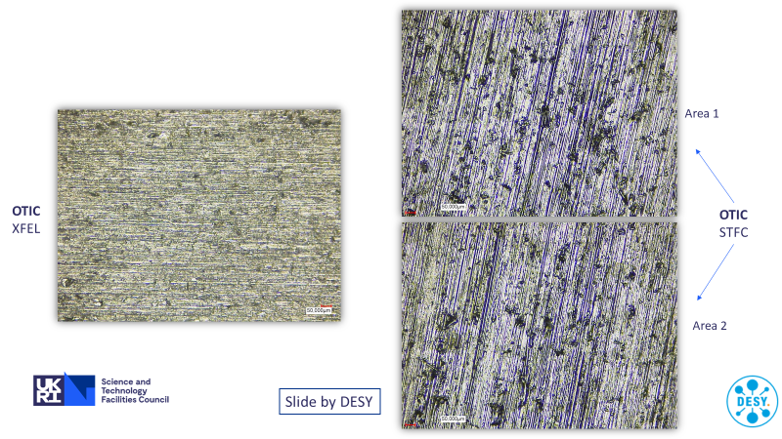
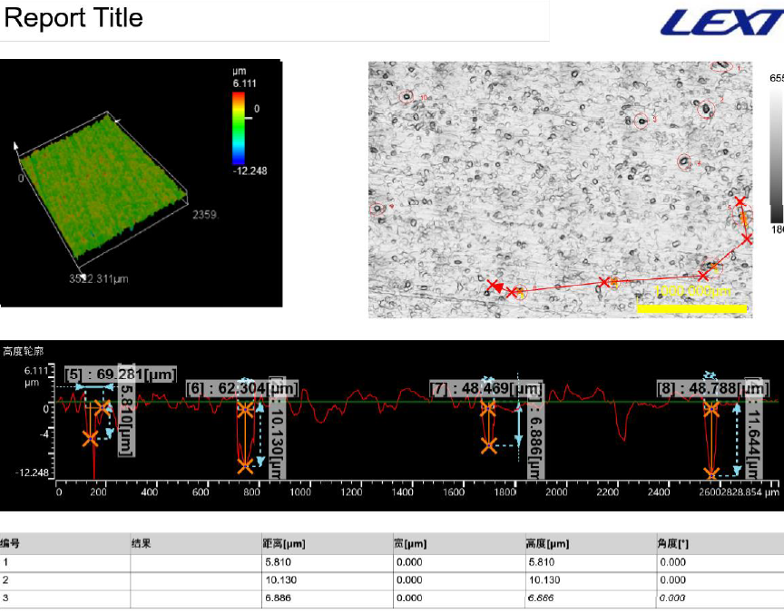
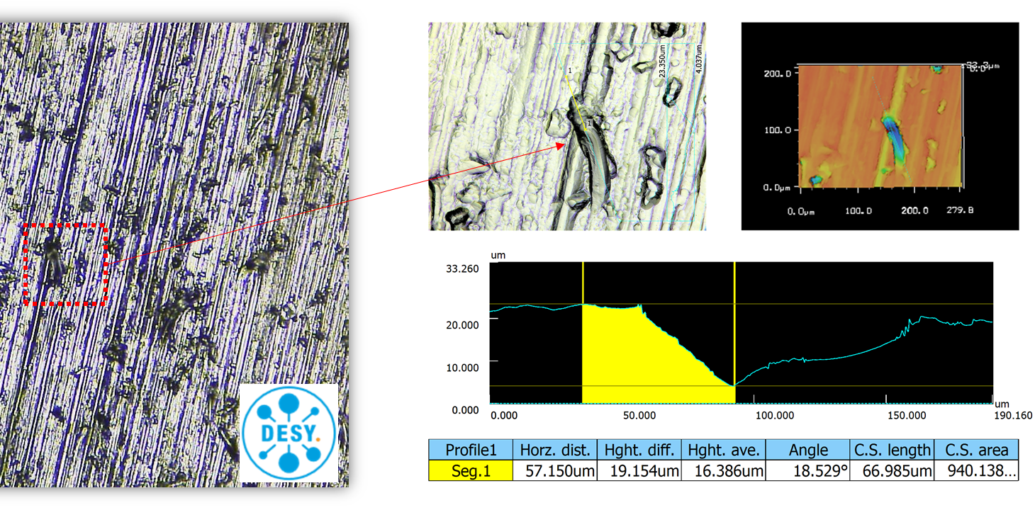
Production Niobium Procurement
Surface quality issues
Identified during Eddy Current Scanning (ECS) at DESY late September 2021
At least 10-30 μm by 40-70 μm surface defects on all sheets (225 disks)
Uniformly distributed on the entire surface
Definition of a defect caused some friction with the vendor
Widespread problem
All orders since May 2021 were affected, including PIP-II and SHINE projects
At least 500 sheets checked by November’21

Slide 5
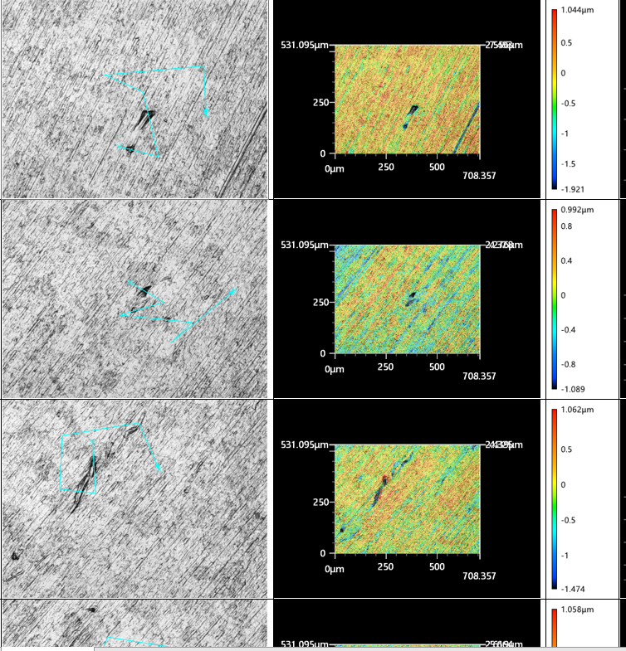
Production Niobium procurement
Resolution hindered
Miscommunication
Travel restrictions
Proprietary information
Lack of transparency
Proposed repair methods verified by ECS at DESY
Samples of PIP-II and SHINE material
Various etching and polishing combinations
Acceptable recipe found ~January 2022
Final adjustments made in May 2022

Slide 6
Production Niobium procurement
Current status: 45 disks tested, 35 accepted.
90% success rate for reworked sheets
75% success rate for the first batch of new disks
Only 3/187 of reworked sheets are expected to be unrecoverable
First batch of 88 reworked disks arrived at DESY last week
Surface investigation | 35 new disks | 10 reworked disks
Areas inspected by 3D microscopy | 91 | 3
Average | 2.6 | 0.3
Element analysis performed | 4 | -
Root cause
Excessive BCP of a dirty surface
6

Slide 7
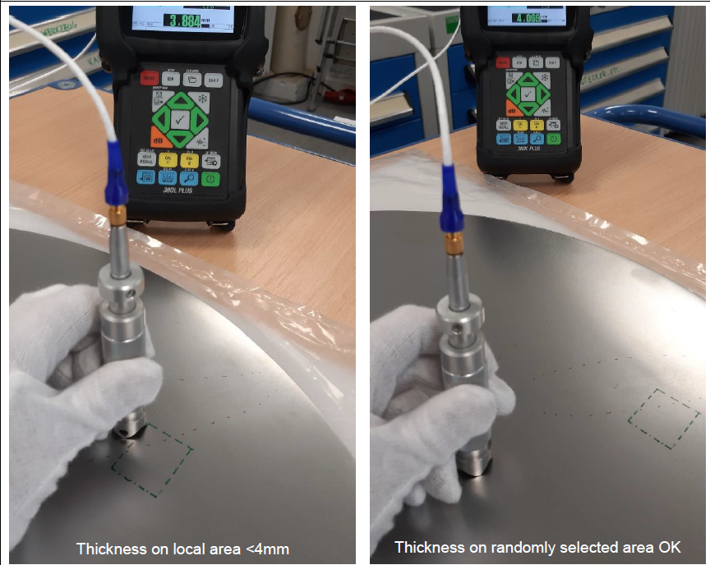
Production Niobium: QC
Extra measures
3D scans of randomly selected areas on both sides
Local thickness measurements after local grinding
Improvements at OTIC
New 3D microscope being commissioned
New ultrasonic thickness measurement device

Slide 8
Production Niobium: Final recipe
Surface treatment process | 10 reworked disks | Remaining disks
Polishing with 400 mesh abrasive belt | 15μm | 25μm
BCP | 10μm | 10μm
Surface treatment process | Process before 2021 | 35 new disks | Remaining new disks
Polishing with 180 mesh abrasive belt | 50μm | 50μm | 50μm
240 mesh | 25μm | 25μm | 25μm
320 mesh | 15μm | 15μm | 15μm
BCP | 10μm | 25μm | 10μm
400 mesh |  | 10μm | 10μm
BCP |  | 10μm | 10μm

Slide 9
Production Niobium Procurement

Slide 10
HB650 cavity procurement

Slide 11
HB650 cavity procurement
Market survey
Specifications overview
Sets expectations and “brackets”
Requests vendors input
Manufacturing specifications
Highlight Key Characteristics
Incorporated information and lessons learned from other projects (ESS, LCLS-II, SNS PPU, CEBAF upgrades)
Use the LB650, SSR1 and HB650 prototype experience
Award questionnaire designed to draw out the level of vendor’s interest in the project
Cavity manufacturing
FNAL experts will be involved with the STFC’s chosen vendor from the start
QC, MIP, and NCR processes will be developed in close collaboration with the vendor
September 29, 2021
11

Slide 12
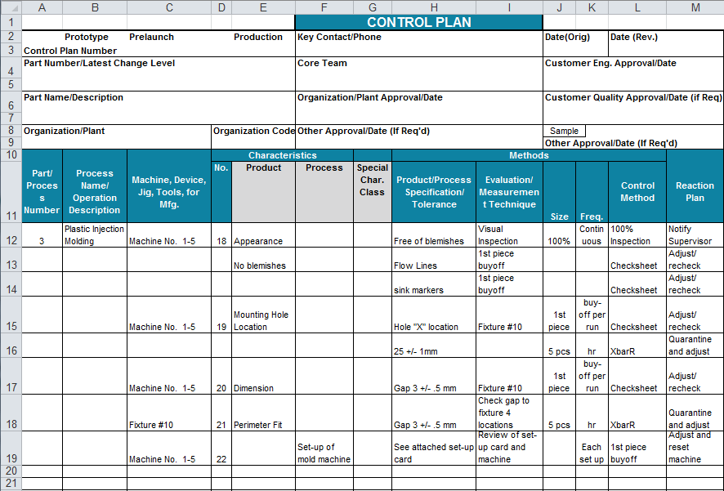
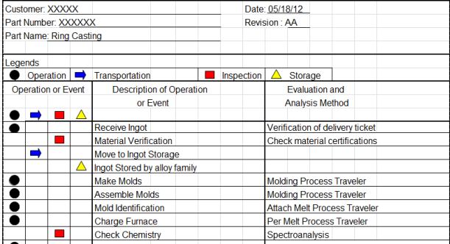
HB650 Cavity: QA/QC
APQP – Advanced Product Quality Planning
Technical Specifications and Vendor Qualification: APQP-inspired.
Early engagement: setting QC expectations
Product and process Key Characteristics
Process flow (PF) development
Control plans (CP) development
Reaction plans development
Pre-series cavities
Very detailed and involved QC
Fine-tuning PF and CP
Verifying recipes and techniques
Series cavities
Benefit from vendor qualification activities
Minimize start/stop of the production
Optimize data review
Fermilab
input
EXAMPLE
12

Slide 13
Cavity procurement strategy
Specifications development
APQP approach
Key characteristics
The “what”, not the “how”
Document readability and flow
Award questionnaire
The “how”
Strategy depends on the potential bidders
No generic boiler plate submissions – prove they’ve read my requirements.
“Show and tell”: bind them to a commitment to meet the specs with a yes/no question, ask to prove it in the next one
Page limit for answers – it is harder to summarize, vendors need to think of what’s important

Slide 14
Cavity procurement strategy
Confirm your ability to meet the specs – flexibility for the vendor to suggest changes and relax some requirements, freedom for me to reject and still be sure they can make it
Provide a statement outlining the technical challenges of this project, and opportunities for improvement – vendors need to analyze the specs and show me they know which parameters are critical
Can you meet the schedule – pre-series focuses on quality, series focuses on the delivery rate, vendors need to prove it with a schedule management plan
Capacity for performing work – do they have the machinery, how busy is the plant going to be, equipment redundancy
Necessary skillset – staff availability through the life of the project, understanding of the necessary skillset, plan for unexpected loss of expertise
Quality Assurance and Control plan example and statement – requires distilling the QA/QC manual to a couple of lines per topic from our specs, assesses vendor’s attention to details

Slide 15
Cavity procurement strategy: current status
Now
Tender is closed
Winner identified
Award letter will going out today
Next
Work out pricing schedule
Refine delivery schedule
Review proposed design changes
Work with the vendor to develop QC tools
Expecting Manufacturing Readiness Review in September

Slide 16
Thank you

Slide 17
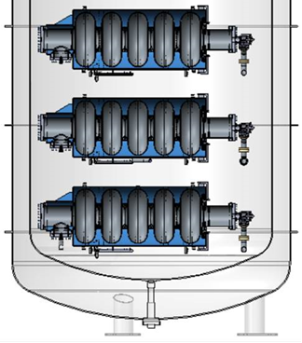
Test Facilities
STFC Test Stand
DESY Test Stand
Dose Rate & Energy Spectrum Detectors
Dose Rate Detectors
Dose Rate & Energy Spectrum Detectors
Dose Rate Detectors
Dose Rate & Energy Spectrum Detectors
Dose Rate Detectors
*Installed January 2021
Wall thickness 10-25mm
End of cavity to outer wall
Left (Coupler) 19.1cm
Right (Pick-up) 24.8cm
Coupler (left) detector ~ 25 cm
Pick-up (right) detector ~30 cm
Distance from end of cavity to Lid about 1740mm
Distance from end of cavity to radiation detector ~2m
Several cm of metal for lid, radiation baffles etc
DESY measurements from the top detector

Slide 18
VTS configuration (FNAL)
Blank flange FP side
Connector flange coupler side
Burst disk
(1619)

Slide 19
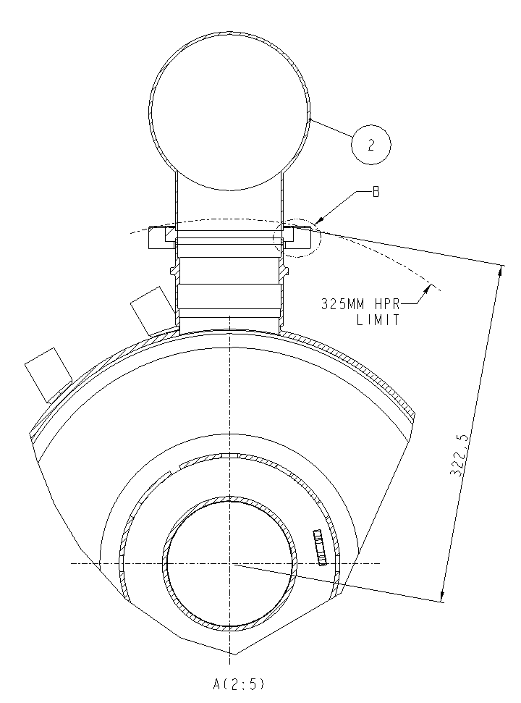
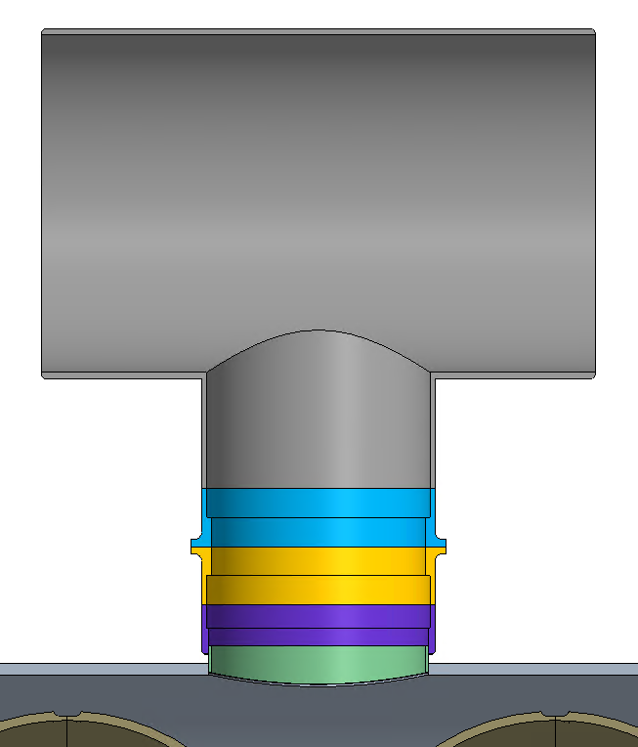
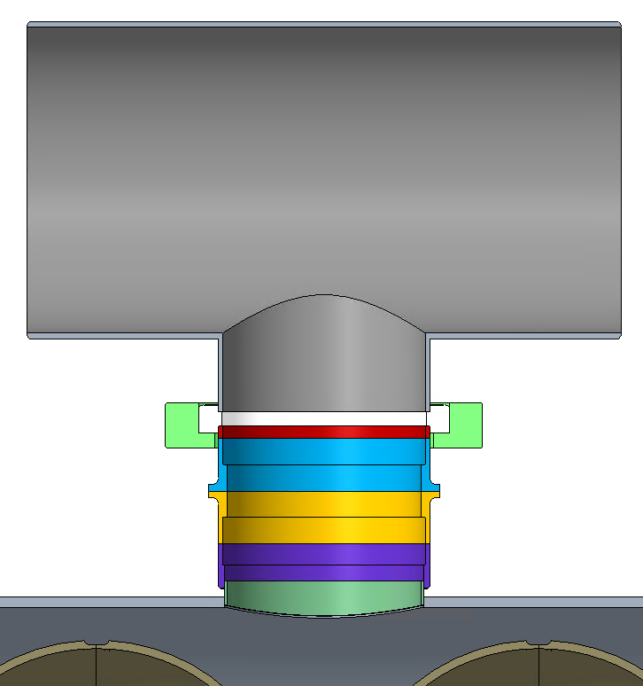
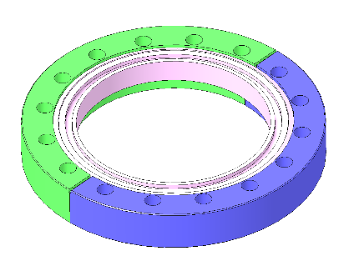
STFC Design Change: Two-phase Pipe Interface
Background
STFC’s vertical test setup requires a flanged connection to the 2-phase pipe
Max radius to the Helium Tee is 572 mm
STFC’s and leading cavity suppliers HPR can accommodate up to 325 mm radius
Design optimization
Weld the Tee after the cold test
Simplify joint
Fit into the HPR
Minimize handling after test
Split CF flange
Longer transition joint
September 29, 2021
19

