Slide 1
Flux expulsion study results
Genfa Wu
PIP-II Technical Meetings
13 July 2022

Slide 2
Outline
Introduction
Flux expulsion tests
Summary

Slide 3
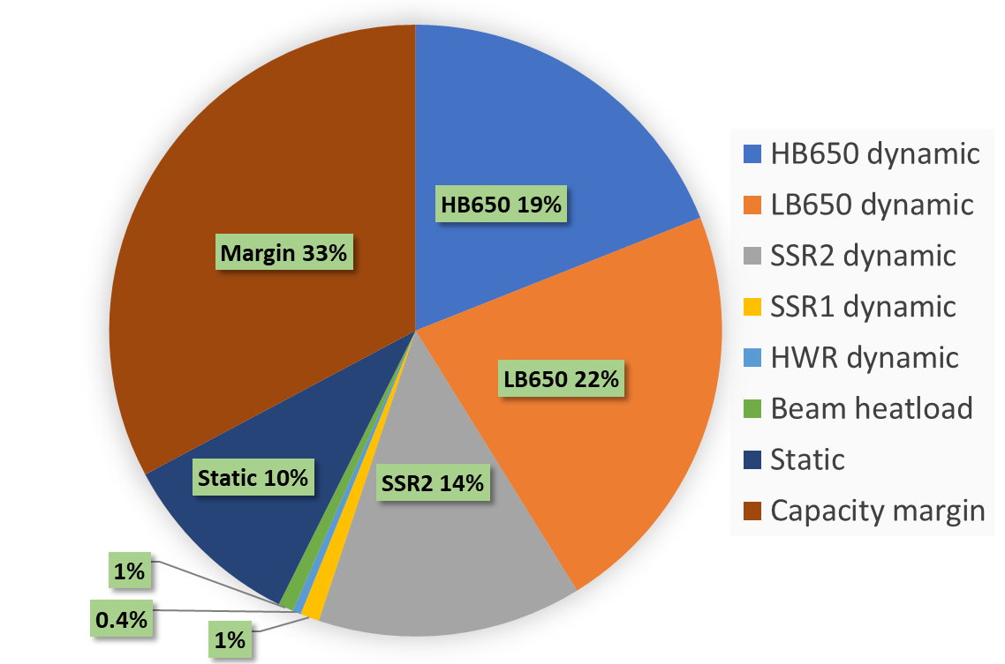
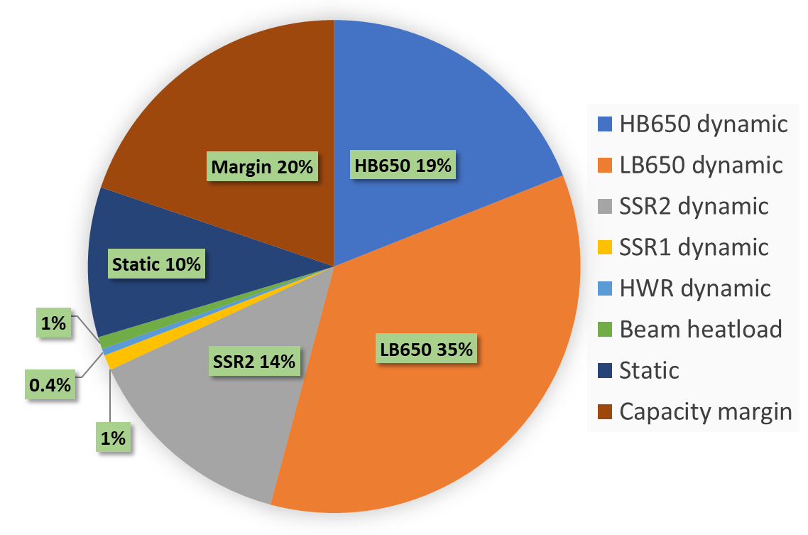
Introduction
Cryoplant capacity – 2,500 W (2K)
PIP-II 650 MHz cavities baseline processing – N-doping + flux expelled.
  HB650 3.3e10 (nominal)
  LB650 2.4e10 (nominal)
Nominal
CW
High Q
N-Doping or Mid-T baking
Magnetic Hygiene and Flux Expulsion
High Rs sensitivity of trapped magnetic field
Flux trapped LB650 at 1.5e10

Slide 4
Minimize the Magnetic Field Trapping
<=3 mG trapped satisfies Q₀ spec, 8 nΩ total R_{s} .
Magnetic shield and hygiene
  Magnetic field at room temperature for 650 MHz <=5 mG.
Fast cool down
  Thermo-electric current of 8 mG on average.
Niobium capable of flux expulsion with required mechanical strength
  Niobium for 650 MHz requires flux expulsion capability >= 75%

Slide 5
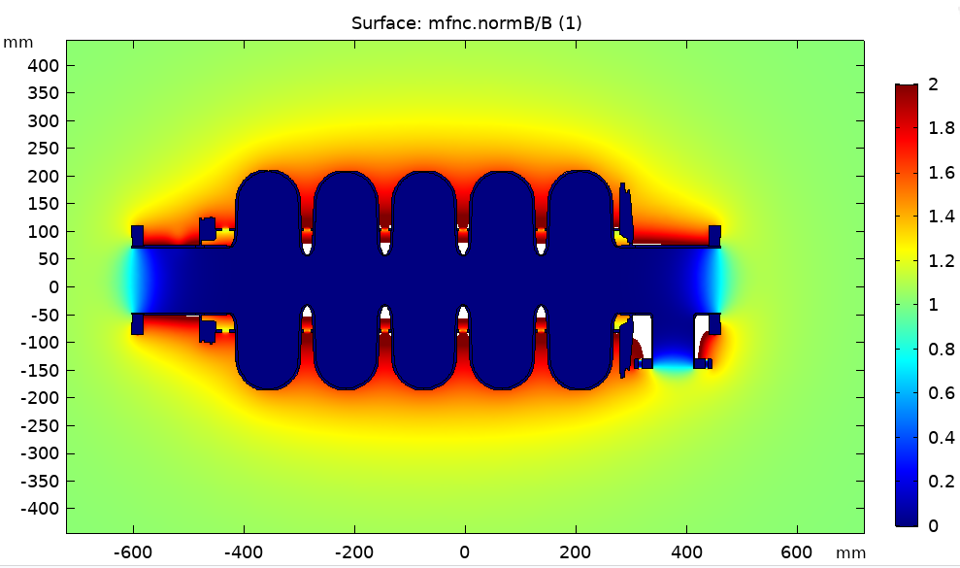
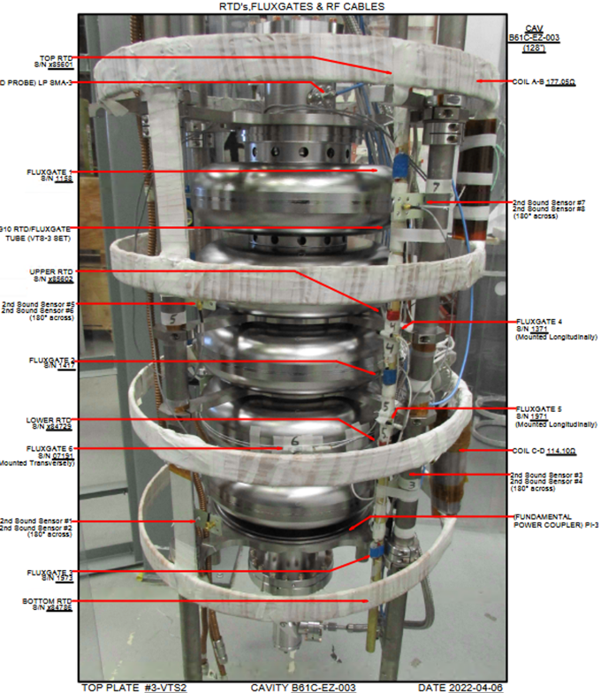
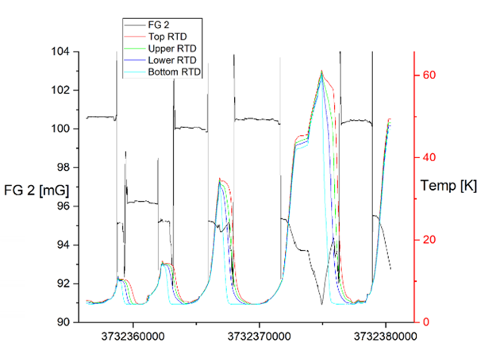
Flux expulsion measurement
Courtesy of Yi Xie
Flux sensors
Courtesy of K. McGee

Slide 6
NX niobium
NX (OTIC) Niobium | Note
NX 1.0 | Original batch supplied to LCLS-II, requires 950C or 975C
NX 2.0 | INFN 1-cell and 5-cell prototype cavities
NX 3.0 | Further increased grain size to ASTM 5 average (4-6)
NX 3.5 | Further 800C annealing of the NX3.0 to remove ASTM 7 grains. More grains in between 4-5.

Slide 7
Cavity and Niobium Materials
ΔT ~ 4K
Cavity | Niobium material | 800 C HT (Bsc/Bnc) | 900 C HT (Bsc/Bnc)
B61S-EZ-001 | NX2.0 | Trapped (1.08) | Expelled (1.7)
B61S-VECC-002 | Heraeus | Trapped (1.35)
B61-EZ-001 | NX2.0 | Trapped
B61C-EZ-101 | NX3.0 and NX3.5 | To be tested
B61C-EZ-102 | NX3.0 and NX3.5 |  | To be tested
B61C-EZ-103 | NX3.0 and NX3.5 |  | Expelled*, re-test
B61C-EZ-104 | NX3.0 and NX3.5 | To be tested
Notes:
* Sensor not attached well (1.1 full expulsion, reached 1.07), to be re-tested.

