Slide 1
Roadmap to determine 800C vs 900C HT
Genfa Wu
PIP-II Technical Meetings
13 July 2022

Slide 2
Outline
Introduction
Road maps
Current status

Slide 3
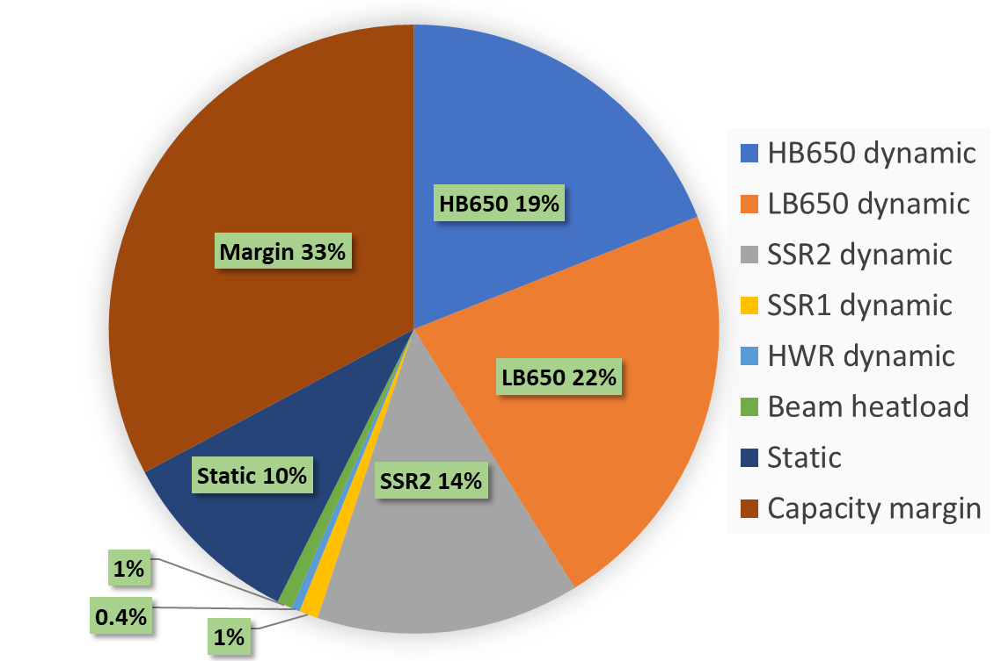
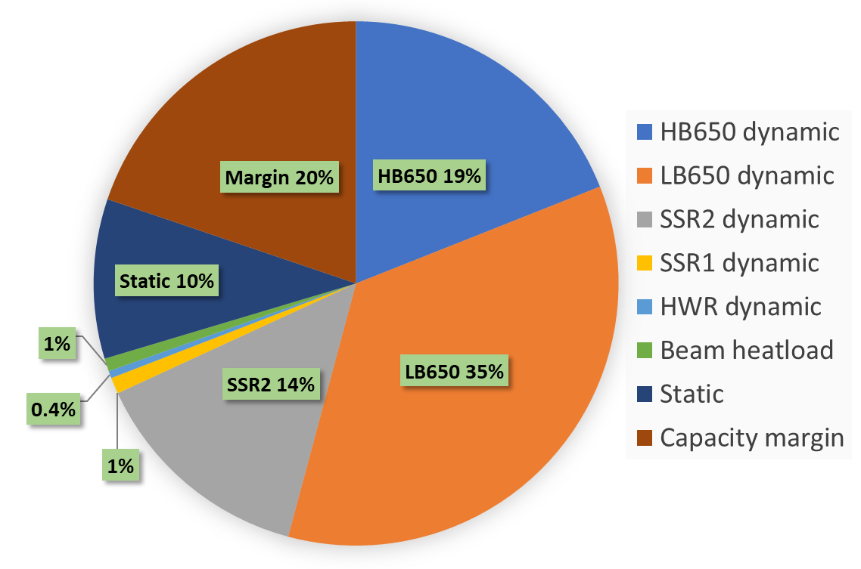
Introduction
Cryoplant capacity – 2,500 W (2K)
PIP-II 650 MHz cavities baseline processing – N-doping + flux expelled.
HB650 3.3e10 (nominal)
LB650 2.4e10 (nominal)
Nominal
CW
High Q
N-Doping or Mid-T baking
Magnetic Hygiene and Flux Expulsion
High Rs sensitivity of trapped magnetic field
Flux trapped LB650 at 1.5e10

Slide 4
Minimize the Magnetic Field Trapping
<=3 mG trapped satisfies Q₀ spec, 8 nΩ total R_{s} .
Magnetic shield and hygiene
Magnetic field at room temperature for 650 MHz <=5 mG.
Fast cool down
Thermo-electric current of 8 mG on average.
Niobium capable of flux expulsion with required mechanical strength
Niobium for 650 MHz requires flux expulsion capability >= 70%

Slide 5
Road maps
Two parallel paths
Sample studies
Cavity studies
Bare cavity road test with two end supports of the support cage
Jacketed cavity pressure test and road test

Slide 6
Road maps – sample studies
Measure YS of PIP-II material after 800C vs 900C
Tasks #13, 14
Is YS 900C sample ~ YS 800C sample in both cases?
Is YS at 900C < max stress on cavity, considering de-rating(20 Mpa)??
No
Measure YS of half-cell samples w 800C vs 900C
Tasks #2,4
Yes, in both cases
Yes but only in flat samples
Yes but only in half-cell samples
No, in both cases
Yes
Good confidence that 900C is feasible in LB650s – to be confirmed with test on cavity
Proceed with YS measured on bended material
900C most likely not feasible in LB650s – to be confirmed with test on cavity since simulations may be affected by large errors
Tasks #6
Courtesy of M. Martinello

Slide 7
Re-HPR
Road maps – cavity studies
If rad. issues
160um EP + 900C 3h + 2/0 N-doping + 7um EP
B61C-EZ-103
VTS test
Successful ?
No
If performance issues
Yes
Re-processing
Task #11
Proceed with 900C on B61C-EZ-102
Transportation test
Yes
Successful ?
No
VTS test
Jacketing
Pressure Test
Yes
Successful ?
Recommend to not proceed with 900C
No
Recommend to proceed with B61C-EZ-102 jacketing

Slide 8
Re-HPR + re-test
Road maps – cavity studies
If rad. issues
120um EP + 900C 3h +
40 um EP +
2/0 N-doping + 7um EP
VTS test
Successful ?
No
B61C-EZ-102
If performance issues
Yes
Re-processing + re-test
Task #11
Transportation test
B61C-EZ-103
Pressure test OK
Jacketing
Pressure Test
Recommend to proceed with 900C on production bare cavities
Recommend to not proceed with 900C
Yes
Successful ?
No
Contact partner labs to make sure the contract w cavity vendor is modified accordingly

Slide 9
Current Status
B61-EZ-103 road test successful (See Jeremiah presentation)
Additional road tests planned
B61-EZ-102 900C H-bake in progress
B61-EZ-101 and B61-EZ-104 are scheduled to be 800C H-baked tentatively

Slide 10
Summary
The roadmap was defined
One bare cavity road test is in progress
Result was promising
Need more data to determine the H-degas temperature.

Slide 11
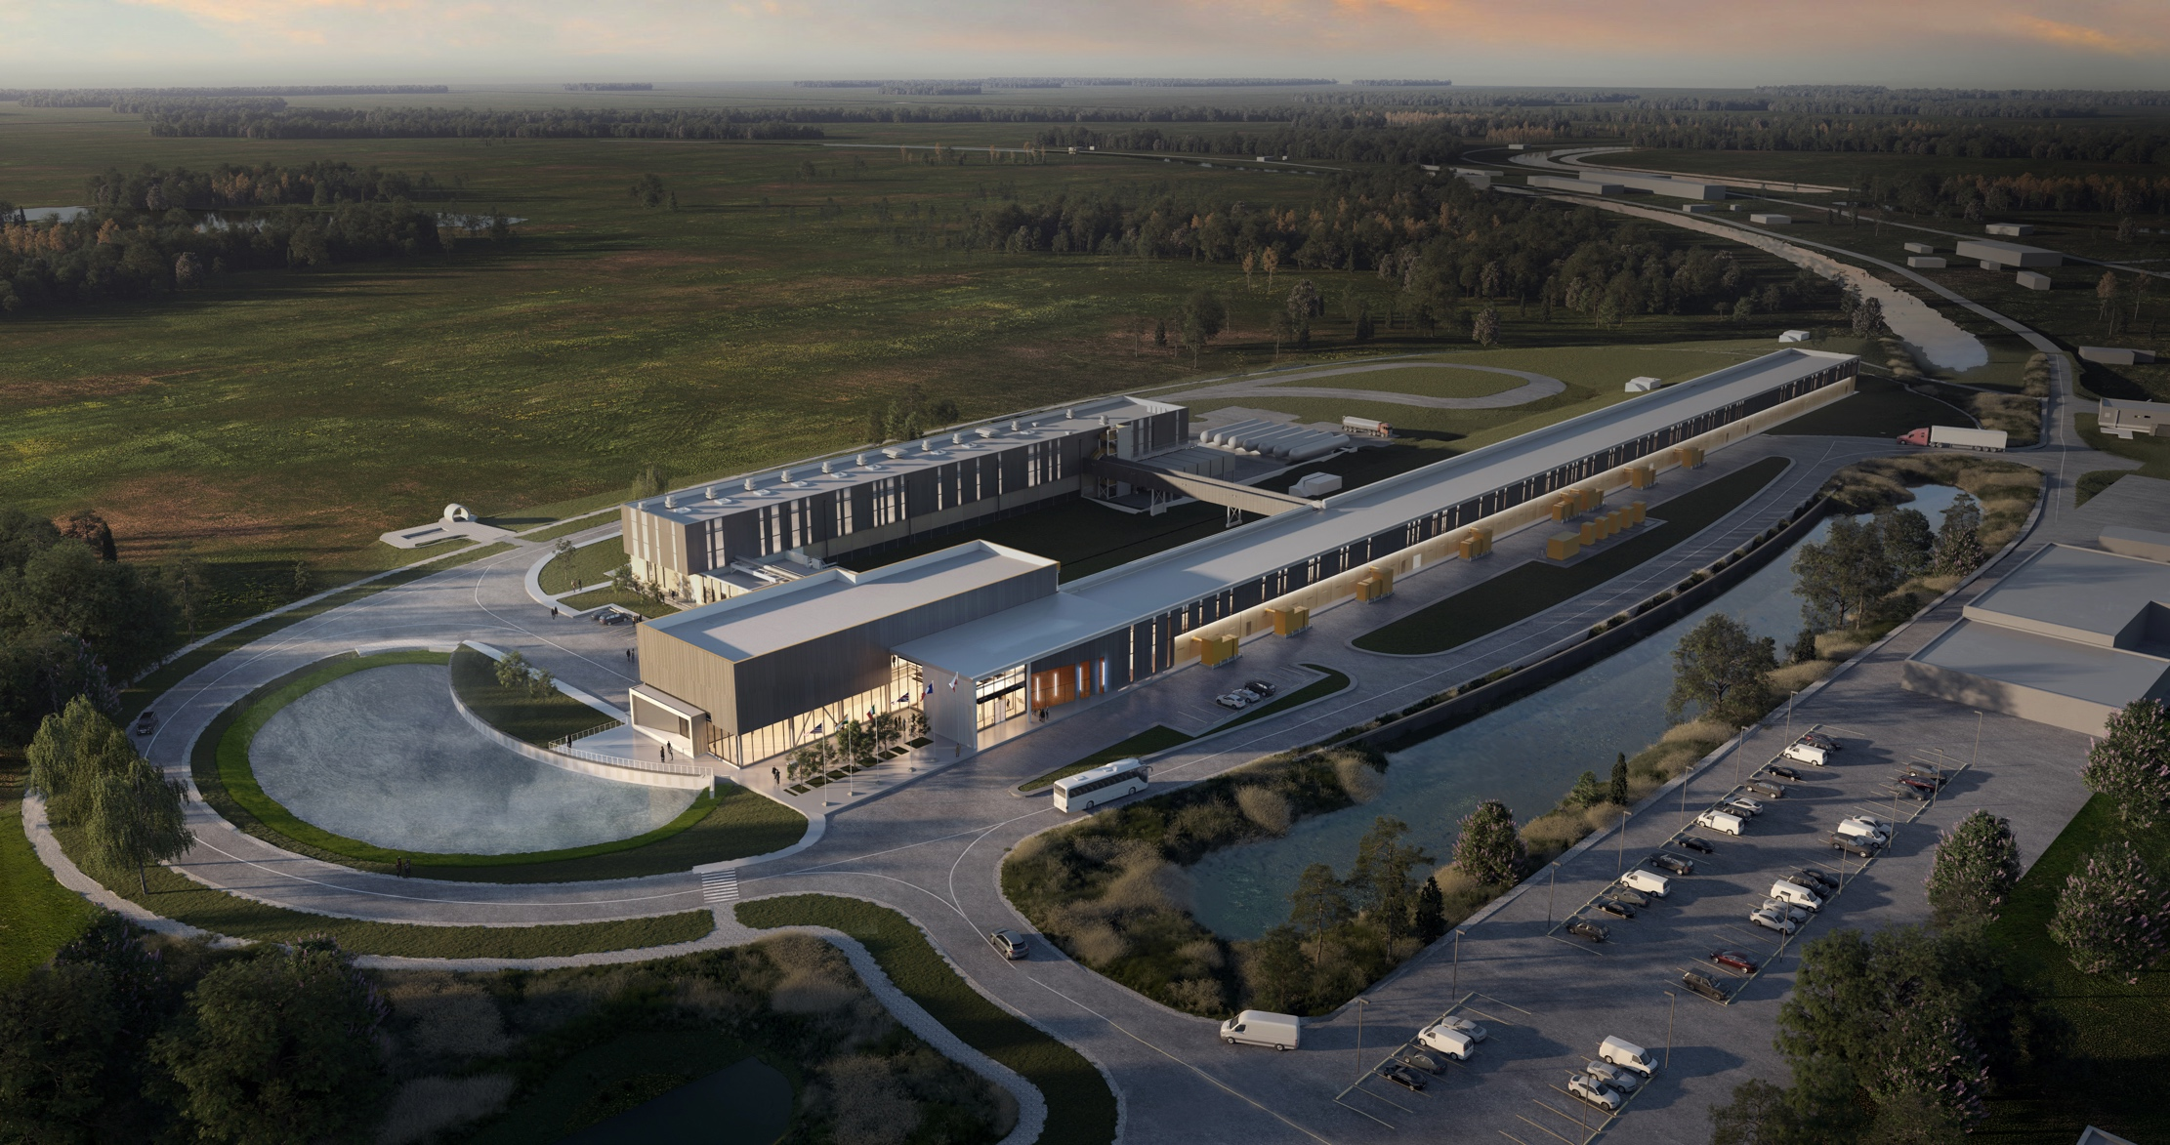
Thank You!

