Slide 1
Shipping Tests for LB650 Cavities
J. Holzbauer on behalf of the 650 team
Technical Workshop
Wednesday, July 13, 2022

Slide 2
Testing Goals
Shipping of cavities includes several categories of risk:
  Damage to sealing surfaces
  Contamination of RF surfaces
  Gross mechanical damage
  Minor plastic mechanical ‘damage’: RF Detuning
For LB650, especially 800/900 C baked, we wanted to do road testing to verify that all, but especially the last risks, are mitigated
Transport of the bare LB650 cavity has proceeded well with no damage or changes, but the cavity is held in a cage with spiders that grab the beam pipes and center cells
The goal of this test is to mimic a dressed cavity with a bare cavity and cage with only the end spiders

Slide 3
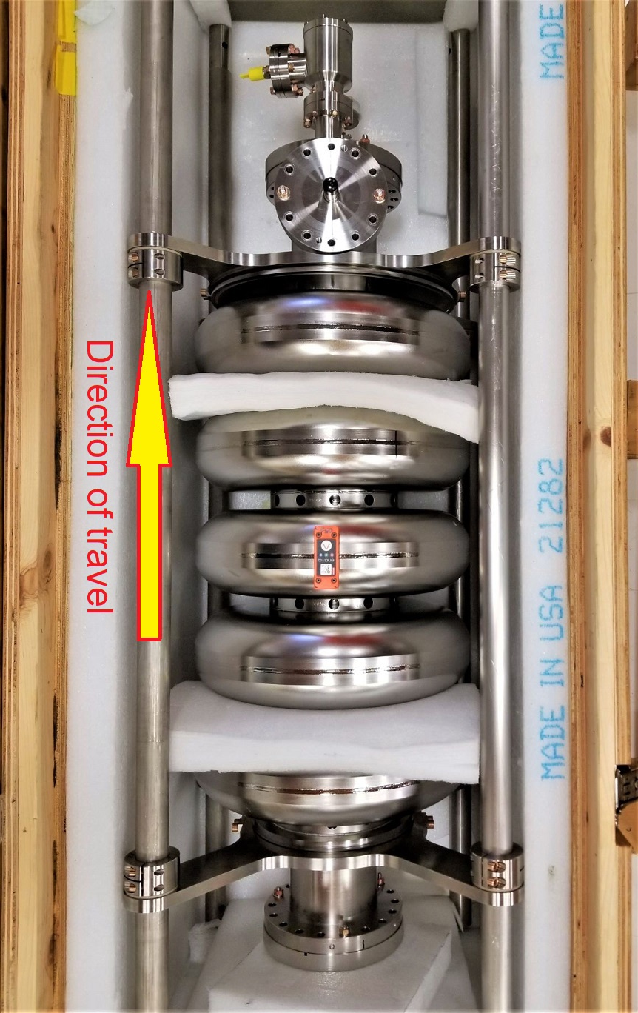
Test Procedure/Configuration
Using bare cavity crate and cage, remove center spiders so cavity is suspended by beam pipes (similar to JCav configuration)
3-D accelerometers on center cell equator and beam pipe
Load into transport truck and spend 2-3 hours on freeway
RF QC before and after as well as external visual inspection
Route selected is known to be quite rough for freeway (worst case scenario)

Slide 4
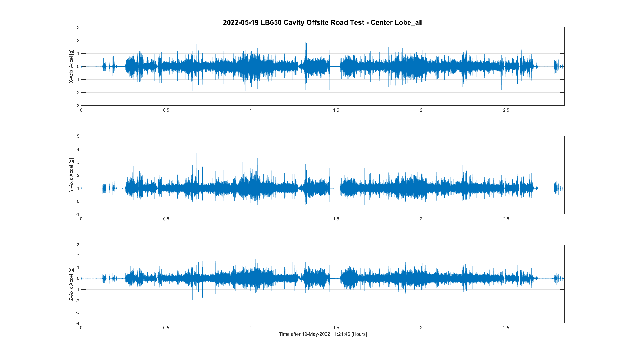
Initial Results and Simulations

Slide 5
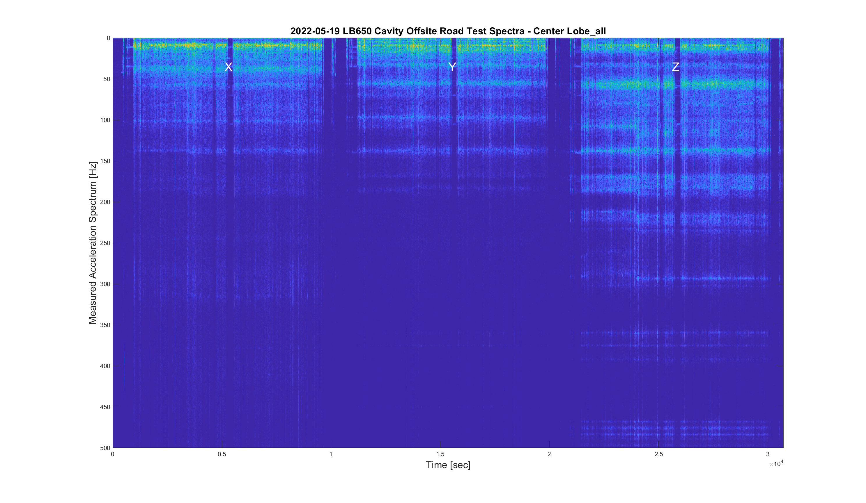
Initial Results and Simulations

Slide 6
Results Summary
Two cavities used, two routes, two trucks
B61-EZ-103 (with heat treatment), roughest road, air-ride trailer: Field Flatness shifted
B61-EZ-103 (with heat treatment), roughest road, ‘improved padding’, spring trailer: Field Flatness shifted again
B61-EZ-101 (not heat treated), roughest road, air ride trailer: Field Flatness did not shift
B61-EZ-103 (heat treated), standard road, air ride trailer, Field Flatness did not shift
  Colin N. is working on detailed cavity simulations, and his transport studies align with field flatness shift seen by RF group

Slide 7
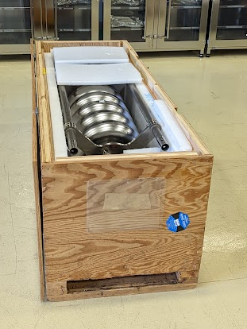
Conclusions and Path Forward
Air ride trailers are essential
Heat treated cavities are more vulnerable to transport shocks
Despite this, they can survive standard handling on normal roads with the existing crate
To do:
Modify JCav crate with shock isolation pads
Learn lessons from other cavity shipments and delicate equipment transport to include in LB650 JCav shipping spec

