Slide 1
Recent lessons from other projects regarding processing N2 doping/mid-T bake
Genfa Wu
PIP-II Technical Meetings
13 July 2022

Slide 2
Outline
Introduction
Data from other projects
Summary

Slide 3
LCLS-II and LCLS-II HE N-doping
140-200 µm Bulk EP warm (200um later)
High-temperature heat treatment for flux expulsion (typically 800 C, later 900-975C) for 3 hours
  Temperature determined per niobium material lot by single cell flux expulsion testing
Still in Furnace, 800ºC + 2N6 doping
Final EP (5-7 µm)
150 µm Bulk EP warm
High-temperature heat treatment for flux expulsion (typically 900-975ºC) for 3 hours
  Temperature determined per niobium material lot by single cell flux expulsion testing
50 µm EP (30 µm warm + 20 µm cold)
800ºC for 3 hours + 2N0 doping
Final EP (7 µm cold)
LCLS-II
LCLS-II HE
Notes:
Two furnace cycles and 2N0

Slide 4
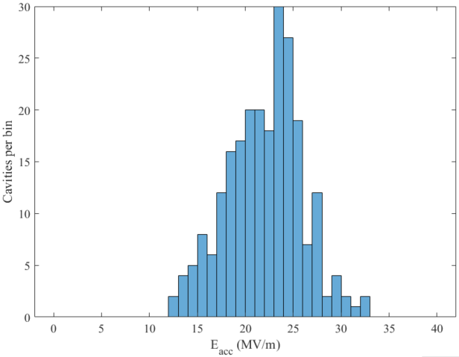
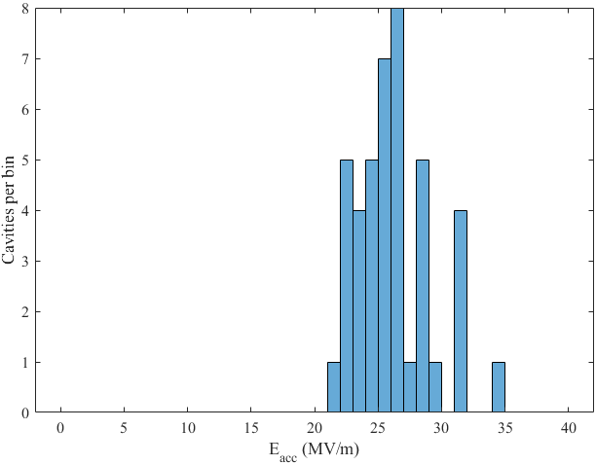
LCLS-II HE Cavity Data Summary (1.3 GHz 9-cell Cavties)
LCLS-II
HE vCM + production
Average quench gradient: 22.0±3.9 MV/m
Average quench gradient: 26.3±2.9 MV/m
Average Q:
3.18±0.44×10¹⁰
Average Q:
3.19±0.45×10¹⁰
>4 MV/m improvement
Separate heat treatment and N-doping improved the performance
Data from J. Maniscalco, SLAC
Notes:
Data up to May 2022

Slide 5
Possible PIP-II 650 MHz Cavity Processing Recipe
120 µm Bulk EP warm
High-temperature heat treatment for flux expulsion (900C) for 3 hours
40 µm EP (20 µm warm + 20 µm cold)
800ºC for 3 hours + 2N0 doping
Final EP (10 µm cold)
150 µm Bulk EP warm
High-temperature heat treatment for flux expulsion (typically 900-975ºC) for 3 hours
  Temperature determined per niobium material lot by single cell flux expulsion testing
50 µm EP (30 µm warm + 20 µm cold)
800ºC for 3 hours + 2N0 doping
Final EP (7 µm cold)
PIP-II LB650 initially.
HB650 to be evaluated
LCLS-II HE
Notes:
Two furnace cycles and 2N0

Slide 6
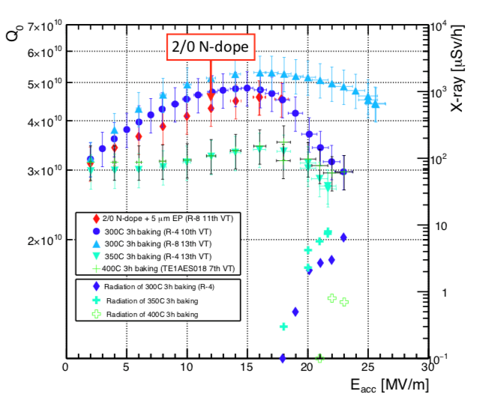
Mid-T baking of 1.3 GHz cavity
Data from S. Posen
1-cell cavity Mid-T baking and N-doping comparison
Mid-T baking achieved similar performance compared to N-doping

Slide 7
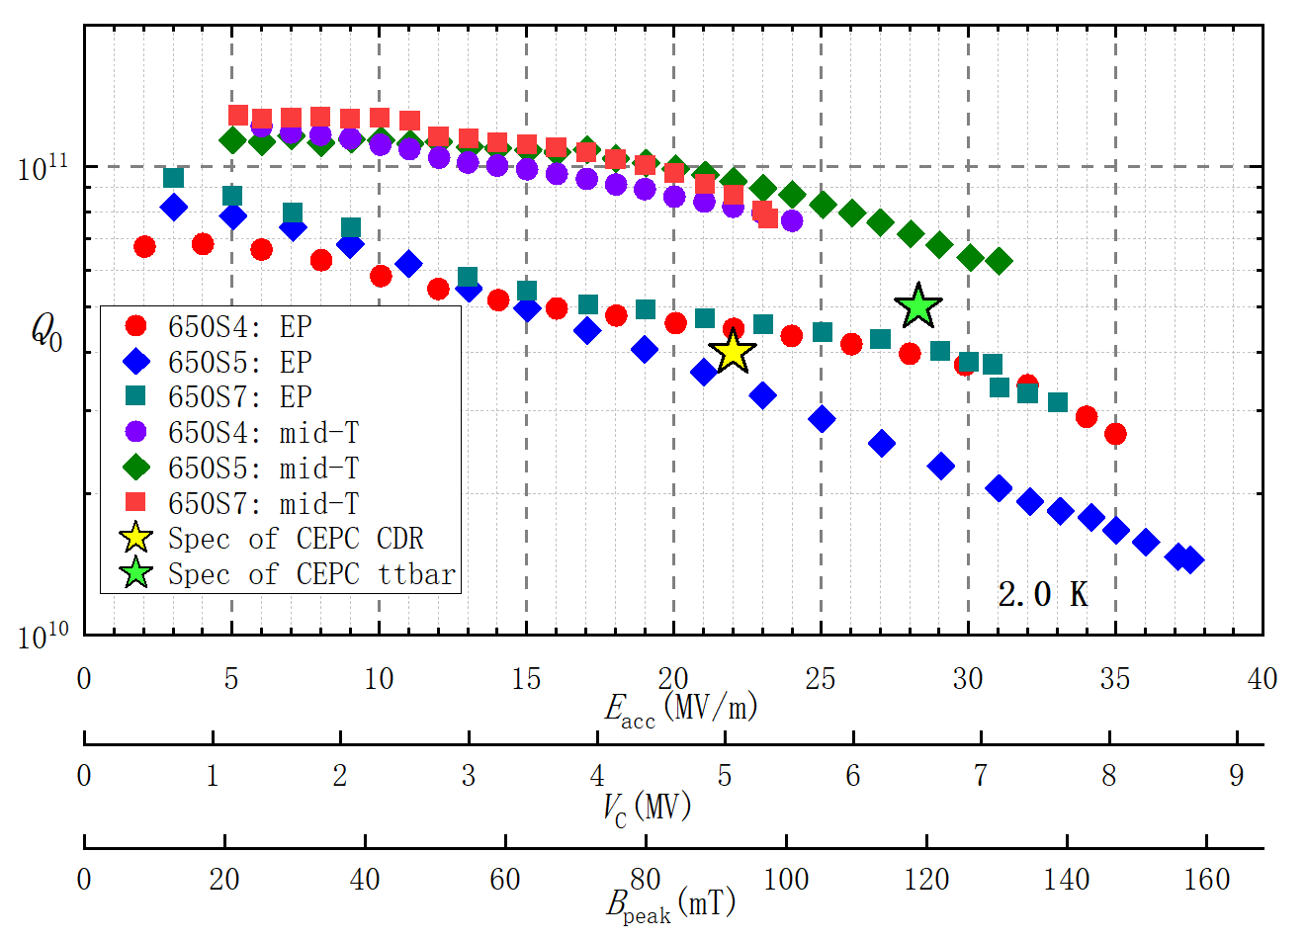
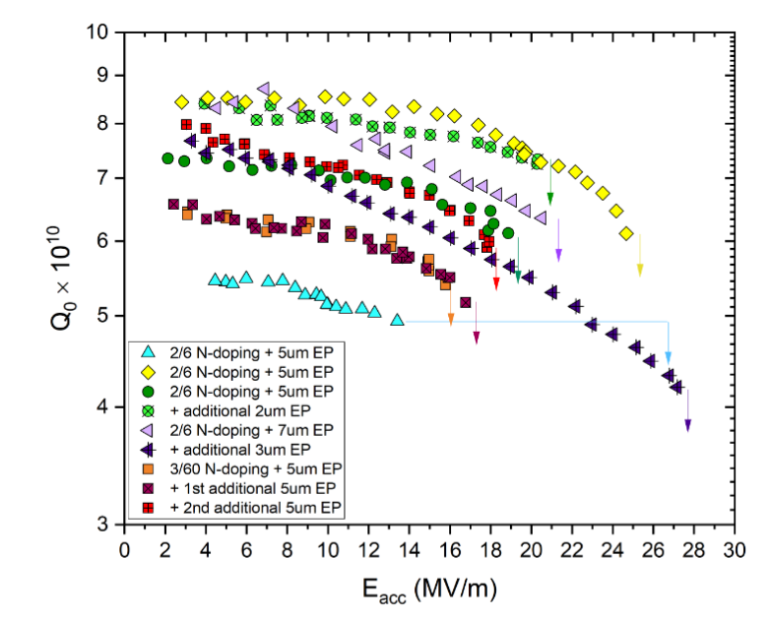
Mid-T baking CEPC project (650 MHz 1-cell cavities)
N-doping of a LB650 1-cell cavity
Mid-T baking of a HB650 1-cell cavity
M. Martinello, Journal of Applied Physics 130, 174501 (2021)
Data from S. Peng, IHEP
Mid-T baking achieved similar performance compared to N-doping
Notes:
10% Bpeak difference between INFN-1-cell and BEPC 1-cell (lower Bpeak, likely high-beta)

Slide 8
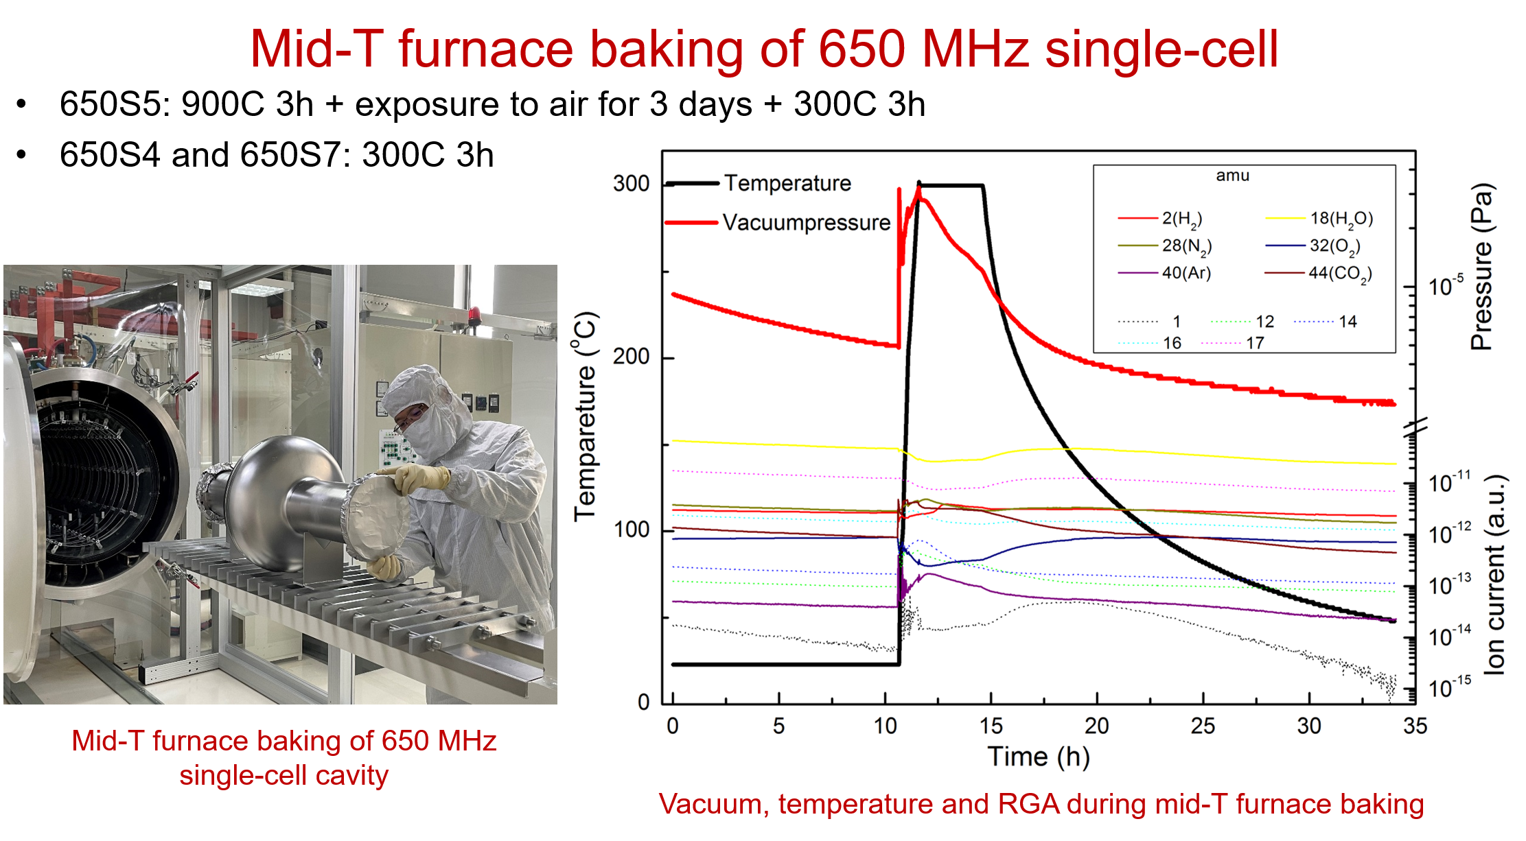
Mid-T baking of CEPC project (650 MHz 1-cell cavities)
Slide from S. Peng, TTC HG HQ working group

Slide 9
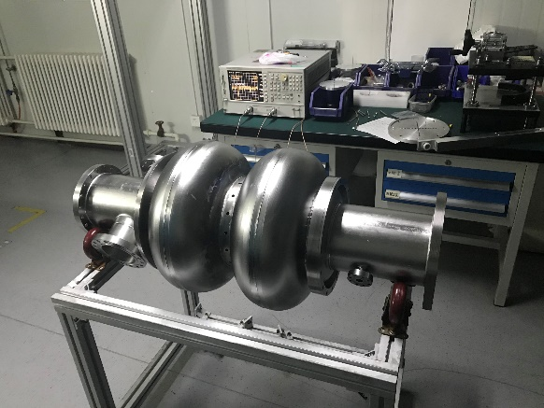
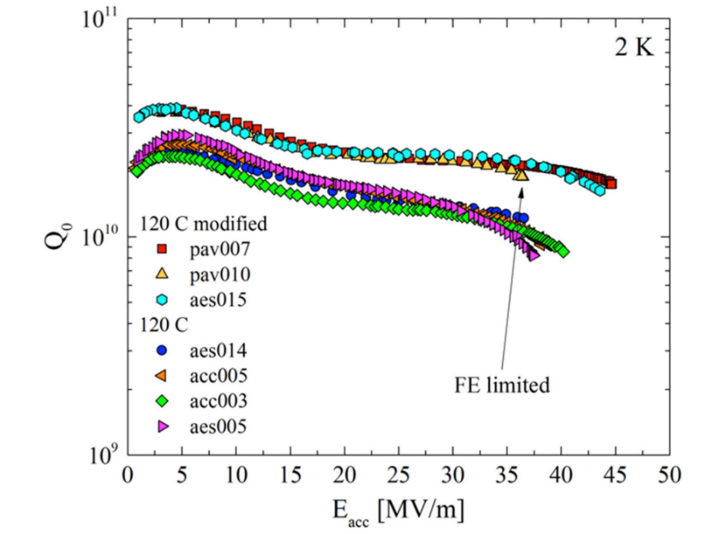
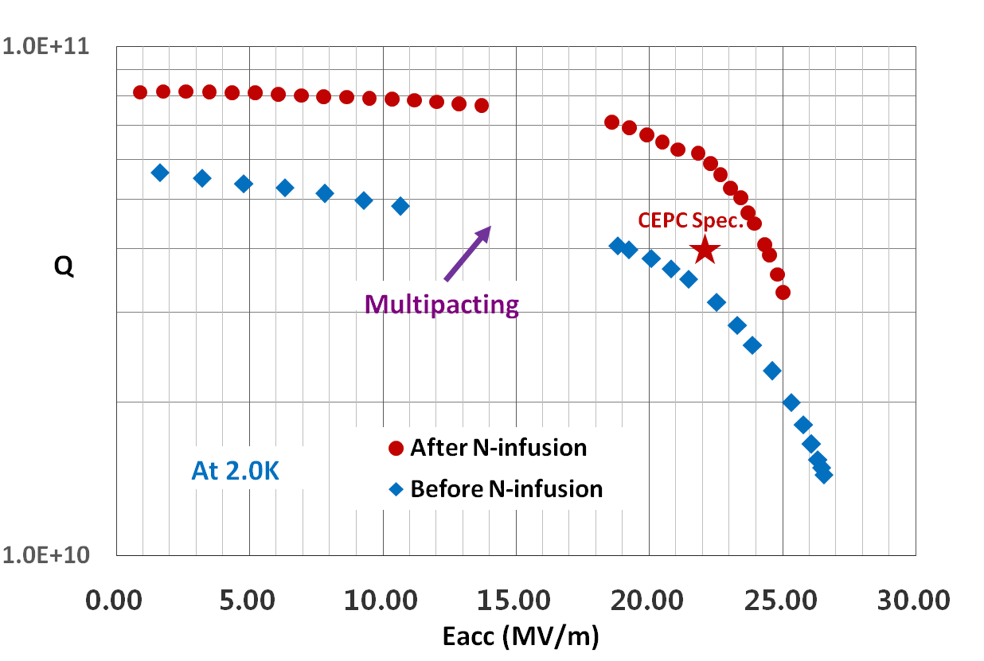
N-infusion
HB650 2-cell cavity
N-infusion vs. standard baking for EP cavities
A Grassellino et al 2017 Supercond. Sci. Technol. 30 094004
Data from IHEP

Slide 10
Summary
The PIP-II 650 MHz baseline is N-doping. Processing change requires more processing data to demonstrate the alternative processing.
Separation of N-doping and heat treatment showed improvement in LCLS-II HE production.
High Q at the medium field has several options.
  N-doping
  N-infusion
  Mid-T baking
Mid-T baking has the potential to be the simplest processing recipe.

Slide 11

Thank You!

