Slide 1
PIP-II 2nd Technical Workshop, WG#2
Cavity Engineering Analysis
Colin Narug
Fermilab
12-14 July 2022

Slide 2
Introduction
To ensure the safety of workers and equipment, detailed analysis of each cavities.
Analysis Process
Example Analysis
  Segments of analysis from various cavities taken to show process
Backup Slides
  Containing some finer details about analysis constraints
  Initial Shipping Results of 0.61 Cavity

Slide 3
Engineering Documents
This presentation can only contain brief summaries, for more details see the following documents:
β = 0.92
  Mechanical Analysis: ED0005527
β = 0.90
  Mechanical Analysis: EN03855
β = 0.61
  Mechanical Analysis: EN03694

Slide 4
Design Requirements
Cavities must meet requirements of FESHM 5031.6
Requires cavities to be designed to TD-09-005
  TD-09-005 provides guidance on how to perform analysis of cavities according to ASME Boiler and Pressure Vessel Code (BPVC) Section VIII Div. 1
    Material, weld, inspection requirements
  Mechanical analysis requirements also provided
    Manual Calculations as per Div. 1
      Design margin of 3.5
    FEA performed as per Div. 2, Part 5
      Allowed as per u-2(g)
      From discussions with pressure vessel committee, Div. 2 Class 2 margin can be used
        (2.4+Weld Efficiency)/0.8 (FESHM derating)

Slide 5
Analysis Process
SRF Cavity
Protection Against Plastic Collapse
Protection Against Local Failure
Weld Joints
Design by Rule
Design by Analysis
ASME BPVC VIII, Div. 2
Protection Against Buckling
ASME BPVC IX
ASME BPVC VIII, UW
Classical equations
Engineering Standards
Protection Against Cyclic Loading
EJMA
ASME BPVC VIII, Div. 2 Part 4
ASME BPVC VIII, Div. 1

Slide 6
Design By Analysis Requirements
For a brief overview of the Design by Analysis Requirements using Elastic-Plastic Methods
Protection Against Plastic Collapse: Model convergence with scaled load
Protection Against Local Failure: Local Failure Factor ≤ 1
Protection Against Buckling: Exaggerated defects do not cause plastic collapse
Protection Against Cyclic Failure: Cycling loads do not cause excessive plastic deformation.

Slide 7
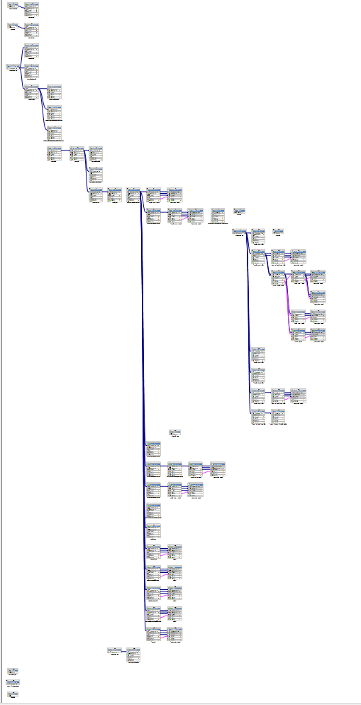
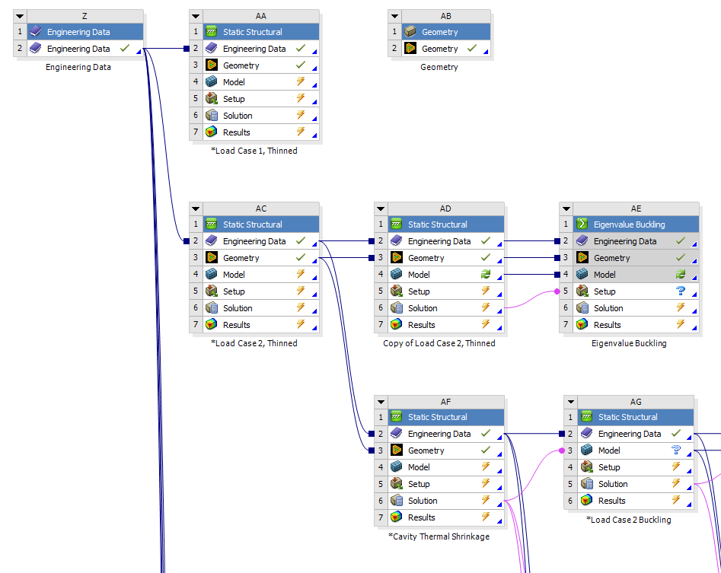
Analysis Setup
8 load cases have been identified to address the various loads that the cavity can see during its lifetime
Each load step requires multiple simulation modules to resolve
Ratcheting requires setting up unified model to examine
Load Case | Loads | Condition Simulated | Applicable Temperature
1 | 1. Gravity | Warm Pressurization | 293 K
 | 2. P1 = 0.205 MPa
 | 3. P2 = P3 = 0
2 | 1. Gravity | Cold operation, full Liquid Helium, maximum pressure – no thermal contraction | 2 K
 | 2. Liquid Helium Head
 | 3. P1 = 0.41 MPa
 | 4. P2 = P3 = 0
3 | 1. Cool down to 2 K | Cool down and tuner extension, no primary loads | 2 K
 | 2. Tuner extension of 2 mm (Cavity compressed by 2 mm)
4 | 1. Gravity | Cold operation, full Liquid Helium inventory, maximum pressure–primary and secondary loads | 2 K
 | 2. Liquid Helium Head
 | 3. Cool down to 2 K
 | 4. Tuner extension of 2 mm
 | 5. P1 = 0.41 MPa
 | 6. P2 = P3 = 0
5 | 1. Gravity | Insulating and beam vacuum upset, helium volume evacuated | 293 K
 | 2. P1 = 0
 | 3. P2 = P3 = 0.1 MPa
6 | 1. Gravity (3.5G,2.5G,1.5G) | Shipping Loads | 293 K
7 | 1. Gravity (3g) | Shipping Loads , Lifting Lug Supported | 293 K
8 | 1. Gravity | Beam Tube Venting, Tuner Extension | 293 K
 | 2. P1 =P2= 0 MPa
 | 3. P3= 0.205 MPa
 | 4. Tuner Extension of 2 mm

Slide 8
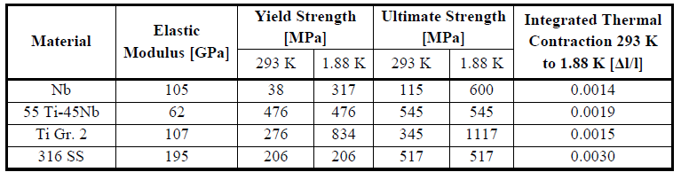
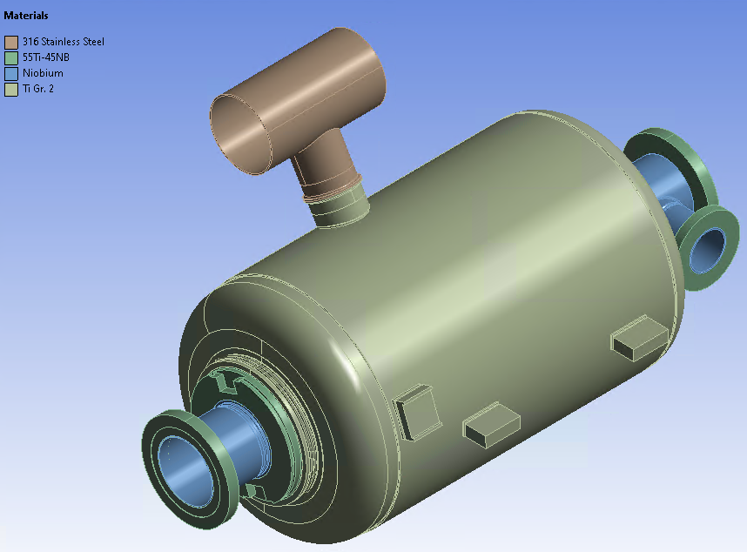
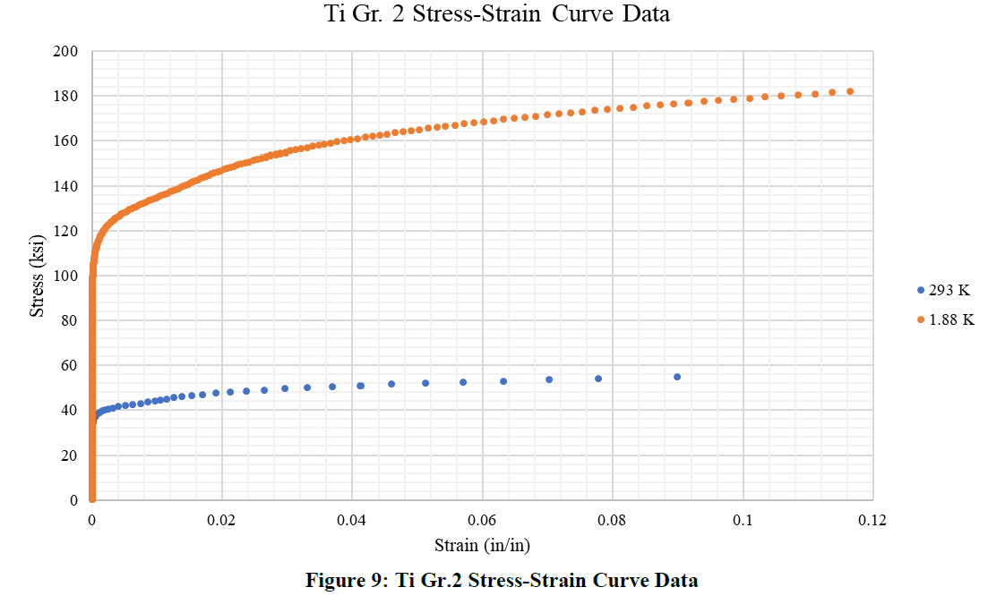
Material Properties
Material properties for analysis are provided by TD-09-005
Elastic-plastic curve generated using equations provided by ASME BPVC Div. 2 Annex 3-D

Slide 9
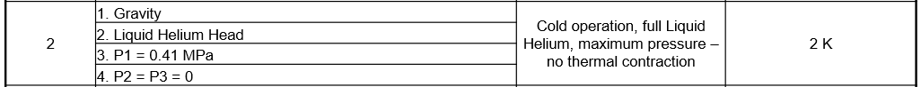
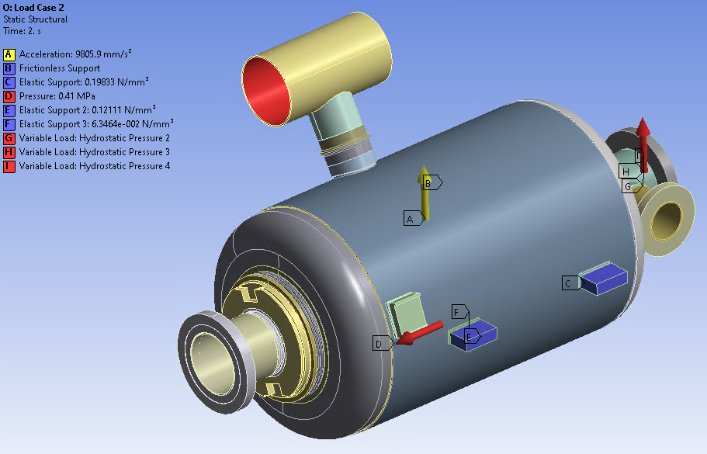

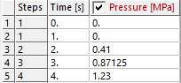
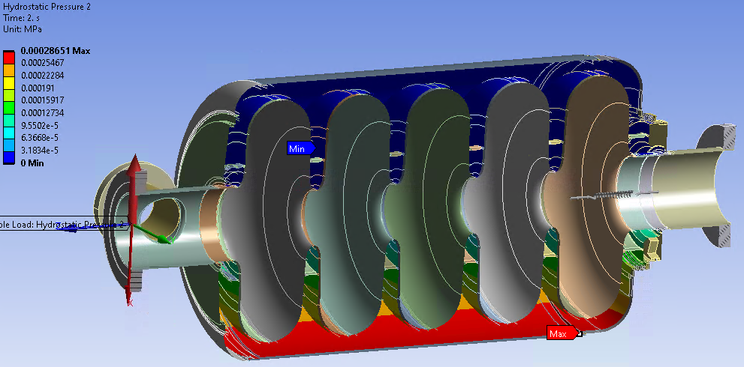
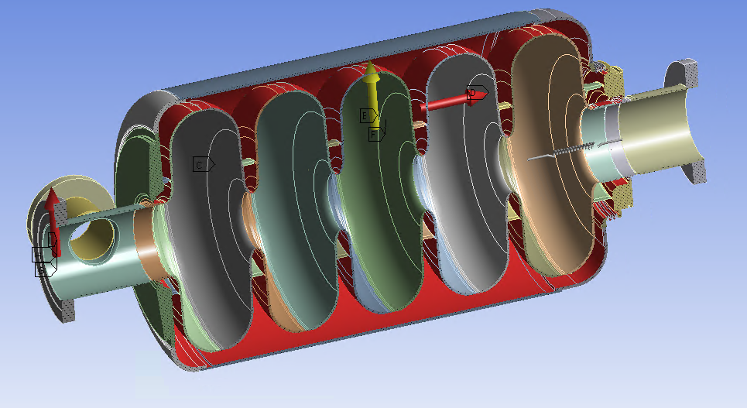
Example: Load Case 2, β= 0.61 Cavity

Slide 10
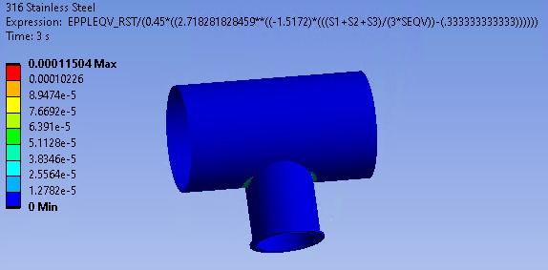
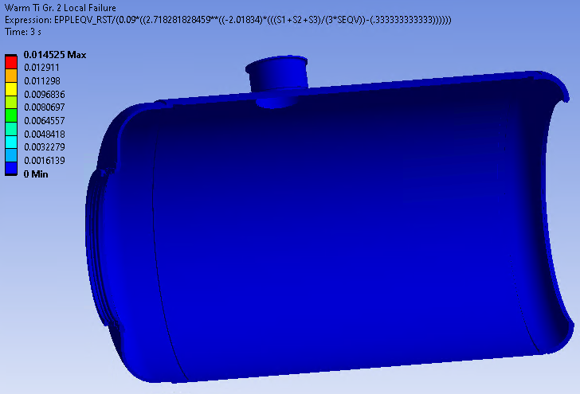
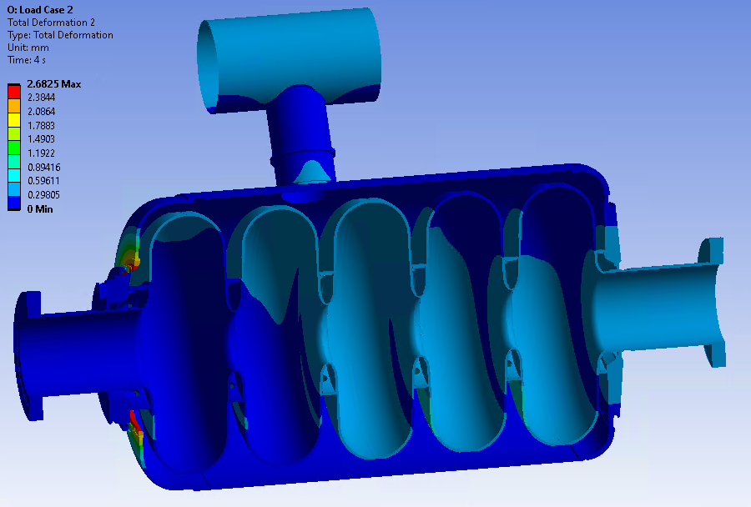
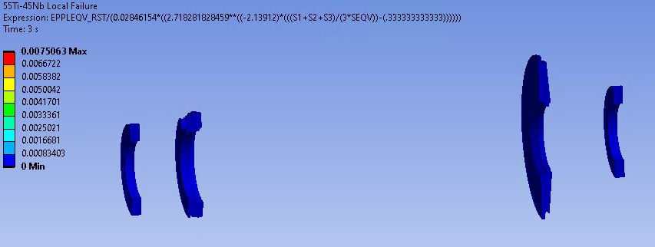
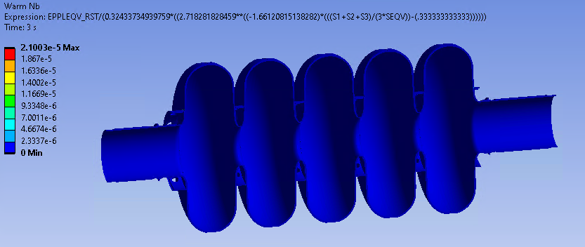
Example: Load Case 2, β= 0.61 Cavity Results

Slide 11
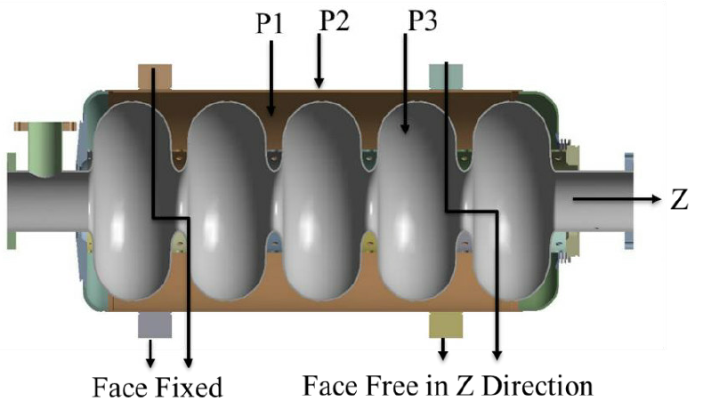
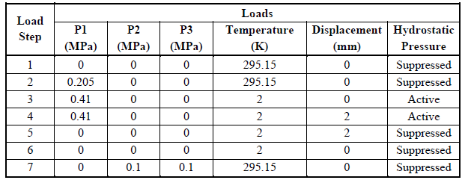
Example: β= 0.92 Cavity Ratcheting
Model is considered to meet requirements if, after cycling load steps at least 5 times, one of the requirements are met:
No Plastic action incurred in the component
An elastic core is present in the primary-Load Bearing Boundary of the component
There is no permanent change in the overall dimensions of the component

Slide 12
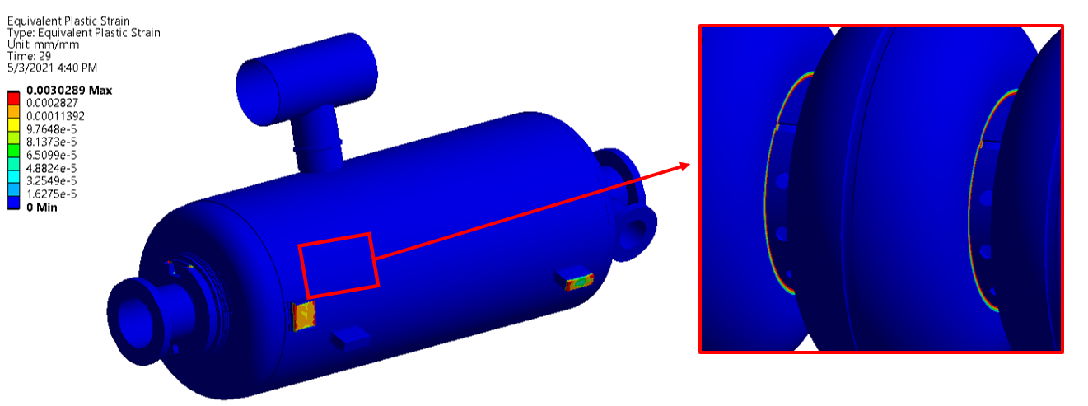


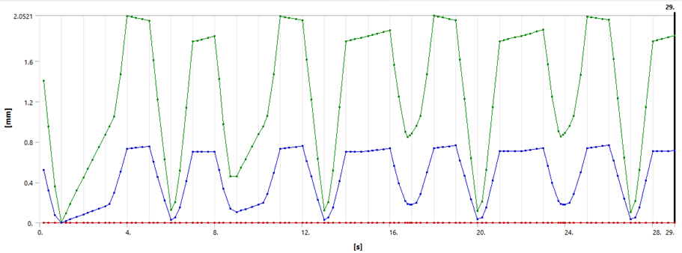
Example: β= 0.92 Cavity Ratcheting
No Plastic action incurred in the component
An elastic core is present in the primary-Load Bearing Boundary of the component
There is no permanent change in the overall dimensions of the component

Slide 13
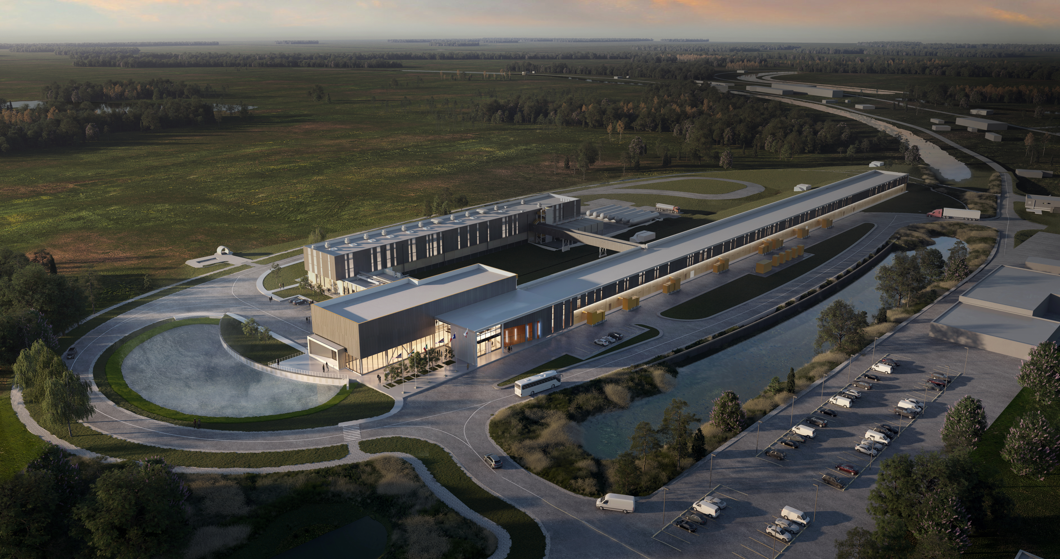
Thank You!

Slide 14
Backup Slides

Slide 15
Material Properties
Gathering data from multiple sources…
Title of Document: | Source | Elastic Modulus (psi) |  | Yield Strength (psi) |  | Tensile Strength (psi)
 |  | 293 K | 2 K | 293 K | 2 K | 293 K | 2 K
SRF Guidelines | TD-09-005 | 1.52E+07 | N/A | 5500 | 46000 | 16600 | 87000
RRR Niobium Properties | ED0371037 | N/A | N/A | 7200 | N/A | 14000 | N/A
Default Values | ED0371110 | 1.52E+07 | 1.71E+07 | 10152.6 | 101381.4 | 26686.9 | 107618.0
Conservative Values |  | N/A | N/A | 5511.4 | 45977.0 | 16534.3 | 87022.6
SSR2 Cavity Note | EN03693 | 1.52E+07 | 1.71E+07 | 9428 | 46000 | 21756 | 87000

Slide 16
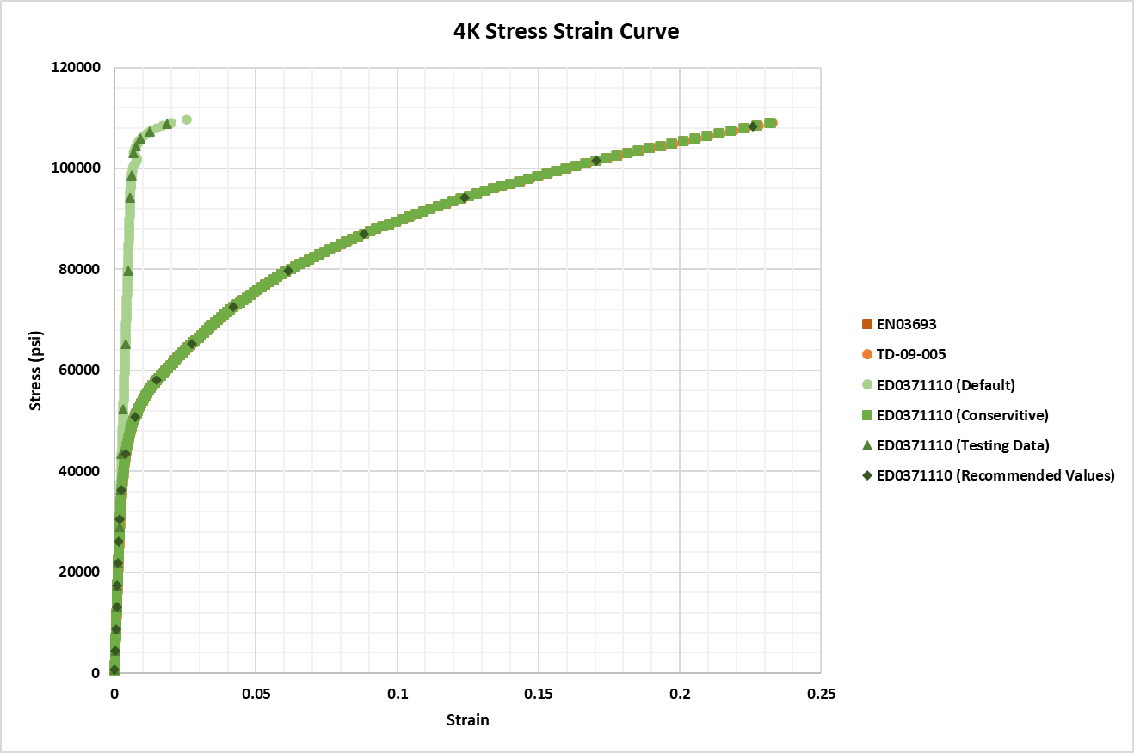
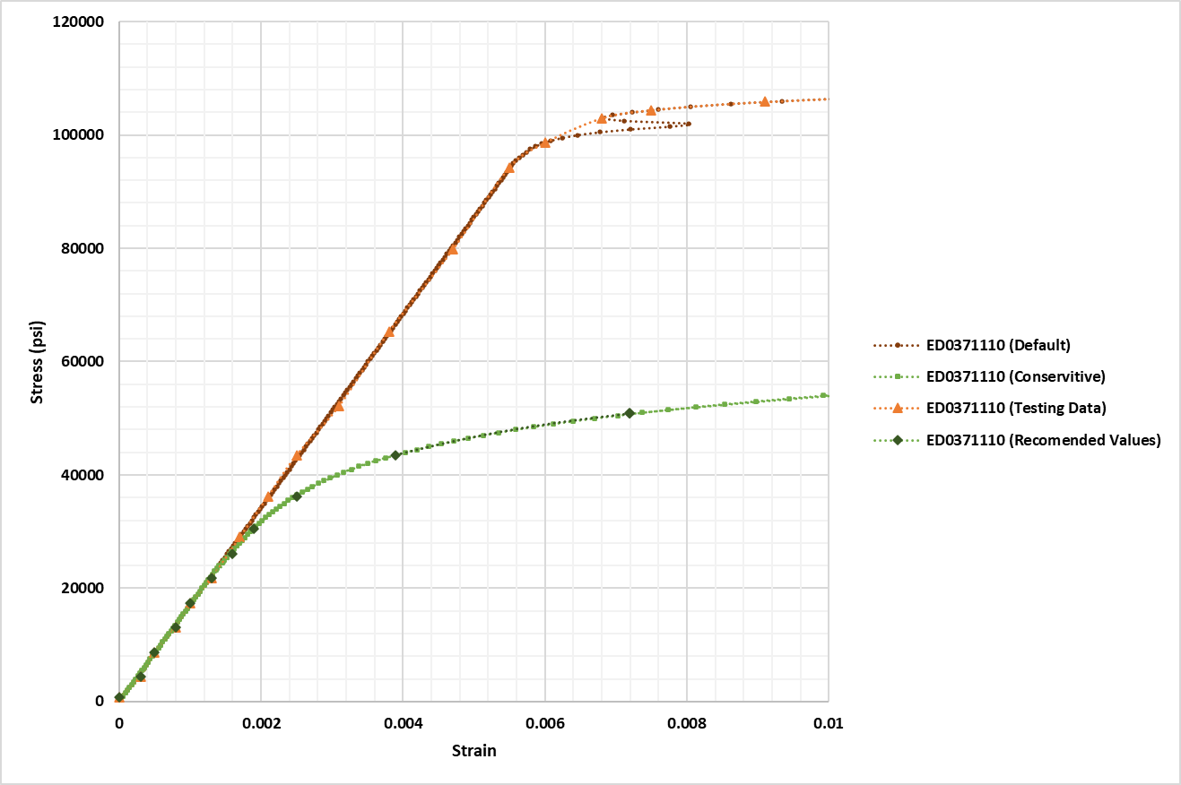
Material Properties - Room Temperature
Provided curves

Slide 17
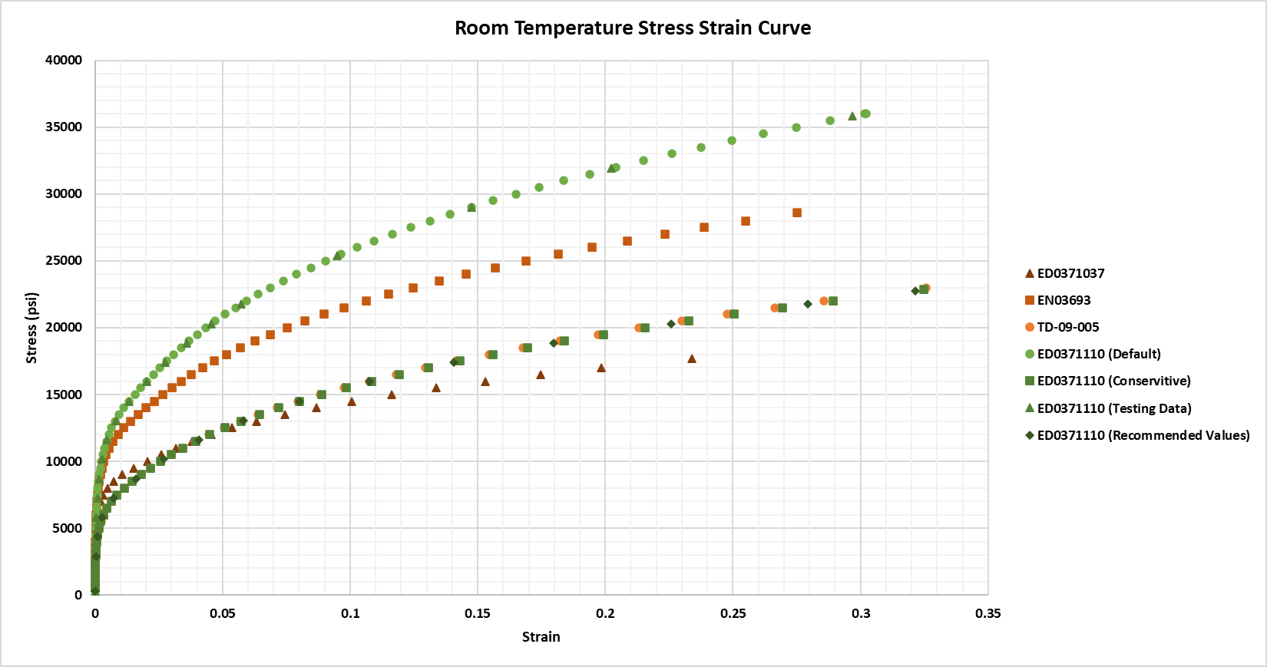
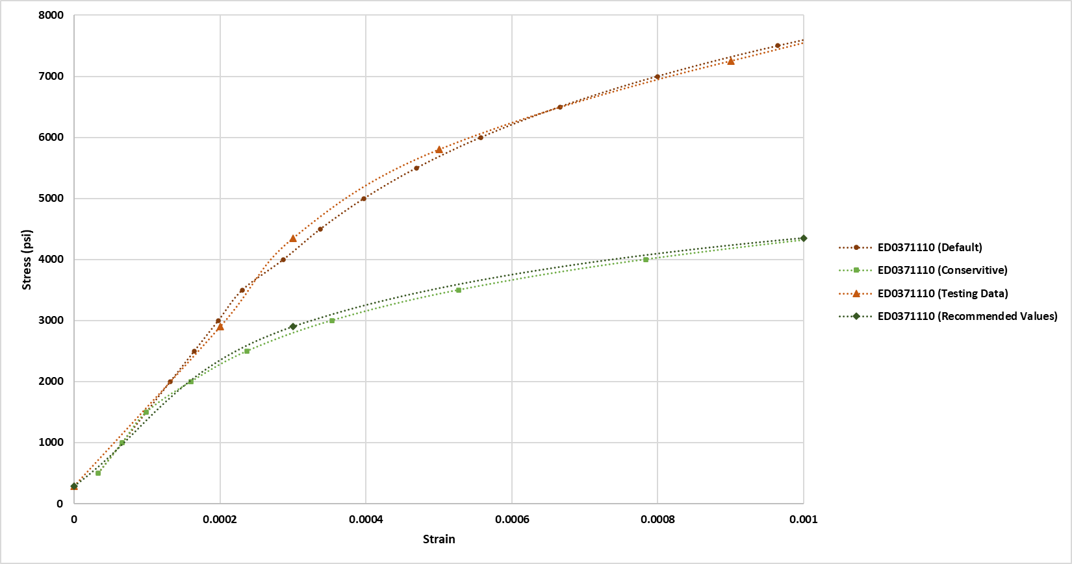
Material Properties – Cryogenic Temperatures
Provided curves

Slide 18
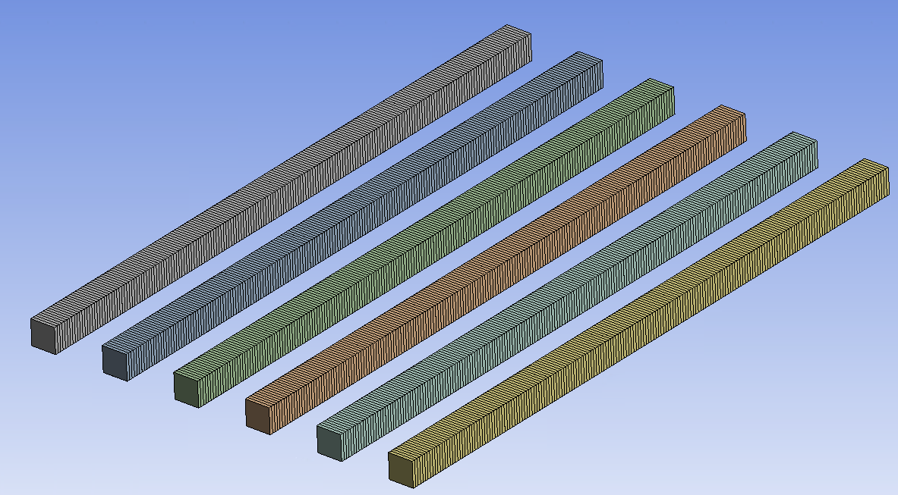
Practical Behavior
To show the behavior of each material, a simple FEA assessment was setup.
2’ long cantilever beam with 1”x1” rectangular cross section
Multiple bars setup with different material properties
Elastic
SRF Guideline
RRR Niobium Properties
SRF Analysis Properties
SRF Analysis Conservative Properties
SSR2 Properties

Slide 19
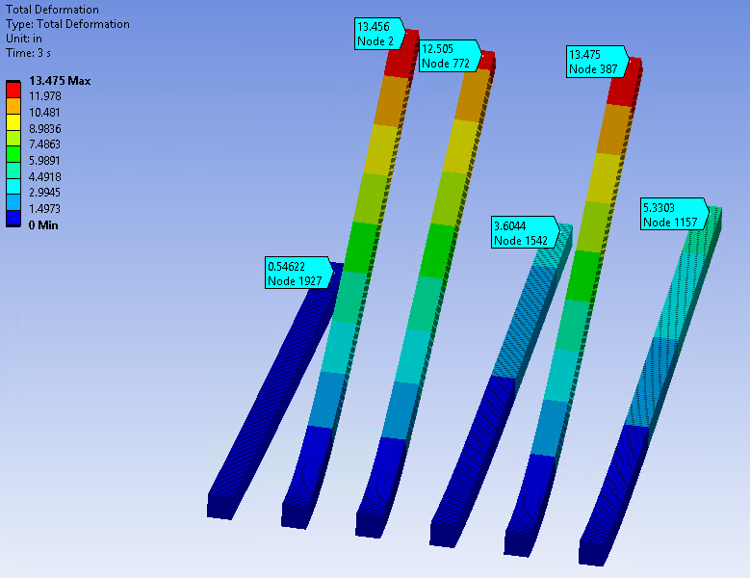
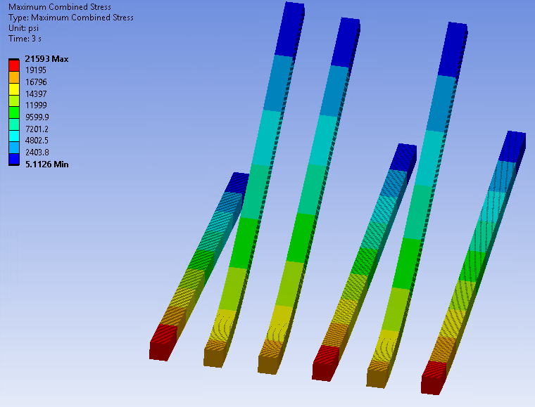
Cantilever Results – Room Temperatures

Slide 20
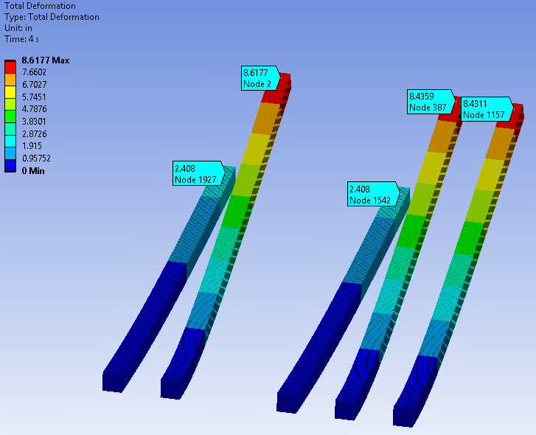
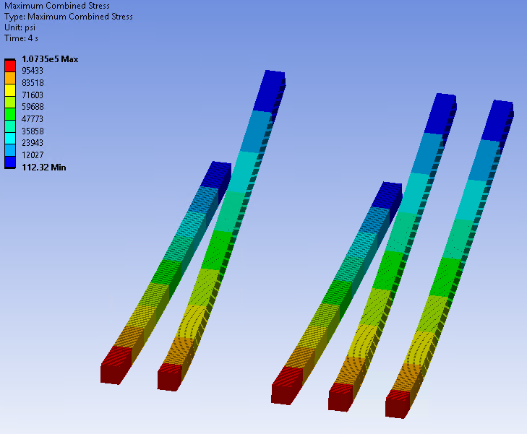
Cantilever Results – Cryogenic Temperatures

Slide 21
Cavity Thickness Reduction
As a result of changes in processing:
Previous processing resulted in a thickness reduction of 250 μm
Changes resulted in current reset being 390 μm
  80 (Fab)+160 (Bulk) +10 (Post N-dope) + 60 (EP reset 1) + 10 (post dope) + 60 (EP reset 2) + 10 (post dope) = 390 total.
  Reduces thickness by ~5-10% for β = 0.61 cavities compared to previous processing.

Slide 22
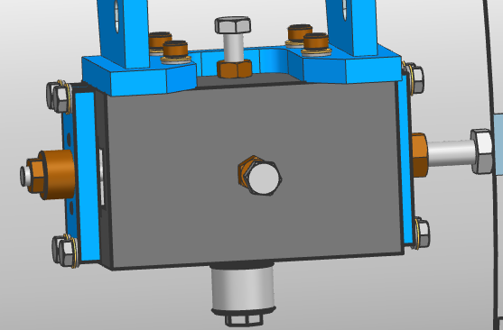
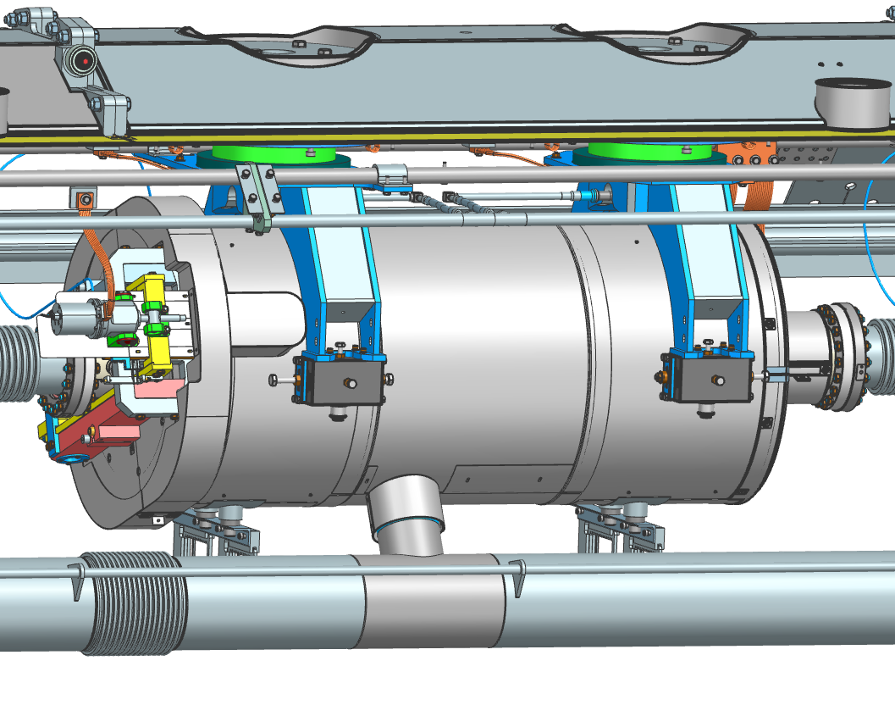
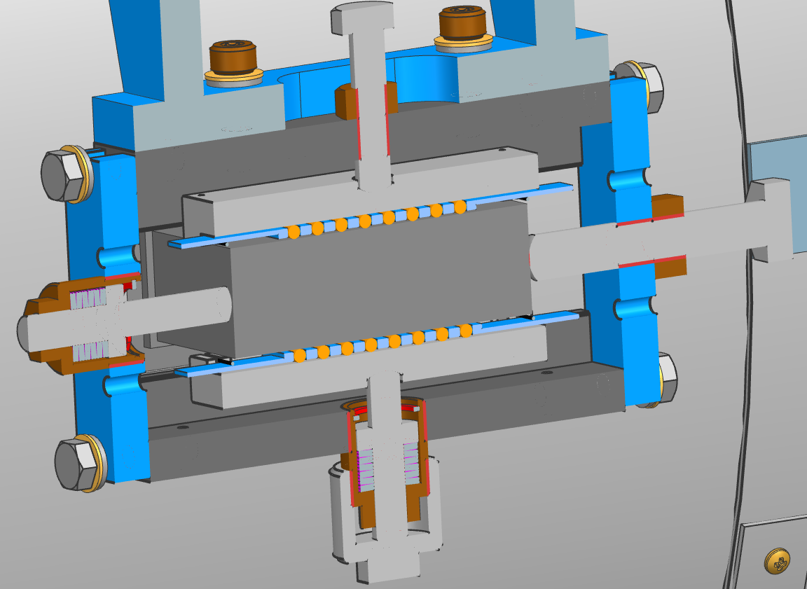
Cavity Support

Slide 23
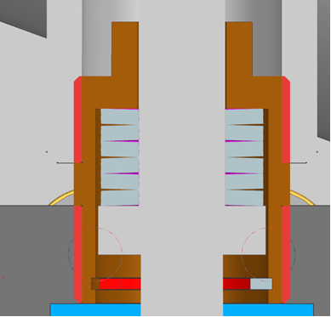
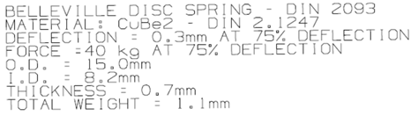
Cavity Support
The cavity is supported in the cryomodule using Bellville Washer springs.
Washer Stiffness of apx. 392.4 [N]/0.3 [mm]
  1,308 [N/mm]
Spring stiffness of 1,308[N/m] / 6 => 218 [N/mm]
  Over range of 1.8 mm
Cavity mass of ~105.81 [kg] => 1,038 [N]
  ~259.5 [N] per lug =>~1.19 [mm] of deflection

Slide 24
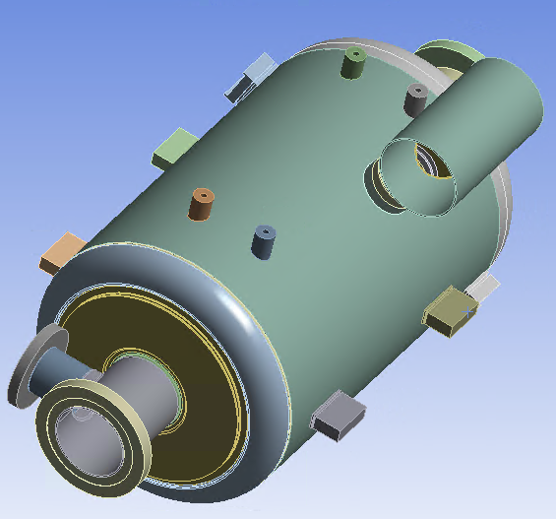
Cavity
Spring
Fixed

Slide 25
Shipping Boundary Requirements
As per ED0013421 (LB650 Transportation Spec)
As per 7.2, shipping will see the following peak accelerations applied to the cavity:
  3.5G (longitudinal), 2.5G (vertical), 1.5G (Transverse)
As per 7.1, cavity should not have a resonant frequency above 30 Hz
  Due to computational size of problem, multiple separate models needed to be solved
Simulations are still a work in progress
  More results for 0.61 Cavity will be available by FDR

Slide 26
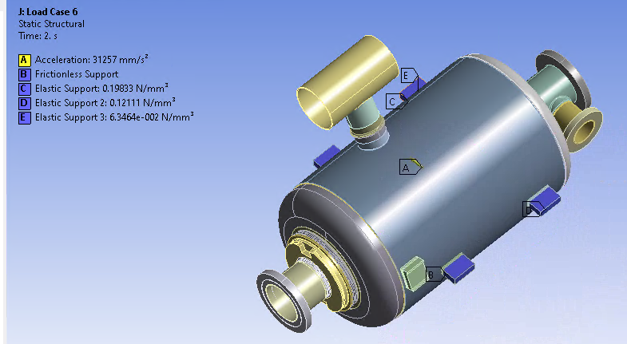
Shipping Boundary Conditions
Boundary conditions below are shown
Refinement needed (supports are fixed not spring supported), tuner seems to need to be more rigid, etc.)
More load cases needed
Load Step | Acceleration (G)
 | X | Y | Z
1 | 0 | 1.5 | 0
2 | 0 | 3.188 | 0
3 | 0 | 4.5 | 0
4 | -3 | 0 | 0
5 | -6.375 | 0 | 0
6 | -9 | 0 | 0
7 | 0 | 0 | 3
8 | 0 | 0 | 6.37497
9 | 0 | 0 | 9

Slide 27
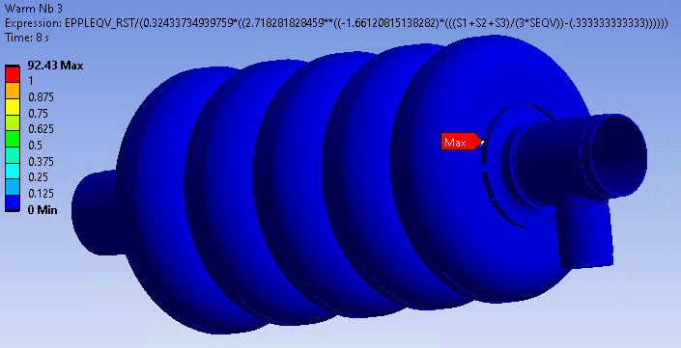
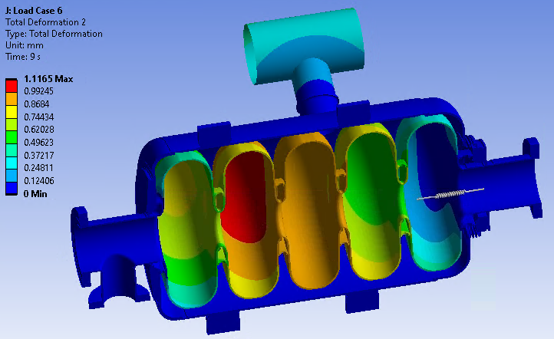
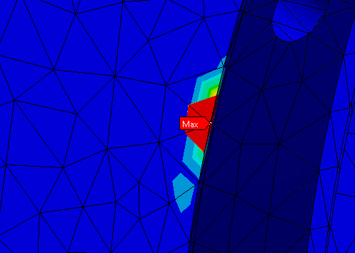
Shipping – Initial Results
Time | Titanium Gr. 2 |  | 55Ti-45Nb |  | Nb
 | Average | Mean | Average | Mean | Average | Mean
2 | 0.00 | 0.00 | 0.02 | 0.00 | 0.00 | 0.00
5 | 0.00 | 0.00 | 0.04 | 0.00 | 0.02 | 0.06
8 | 0.00 | 0.00 | 0.09 | 0.00 | 92.43 | 14.94
Model solved => Plastic against plastic collapse shown
Isolating local failure results show Niobium is above limit
  Is a singularity generated as a result in the transition between acceleration vectors
  Isolating the load step…

Slide 28
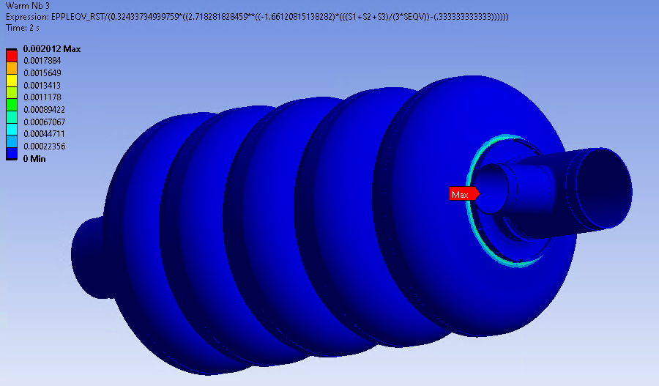
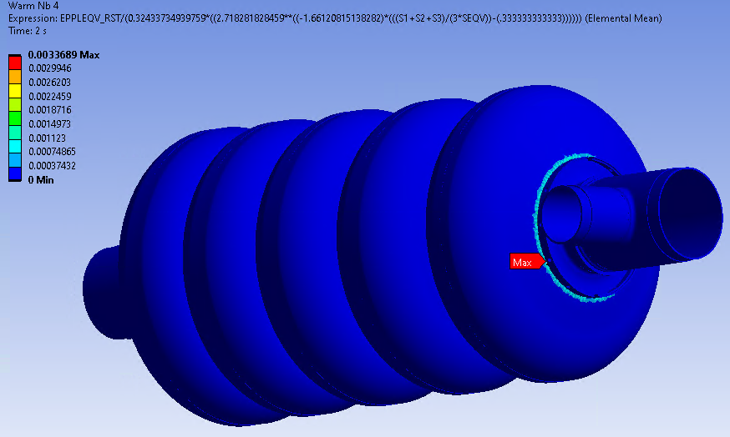
Shipping – Initial Results cont.
Isolating the third load combination, the singularity vanished

Slide 29
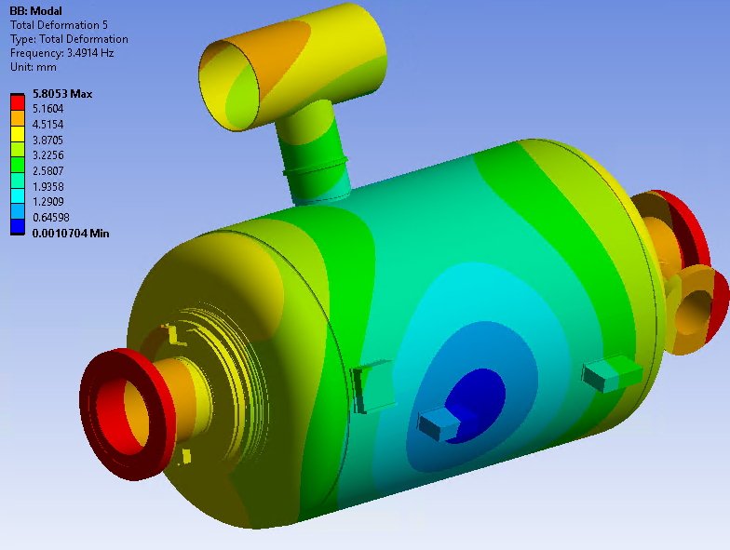
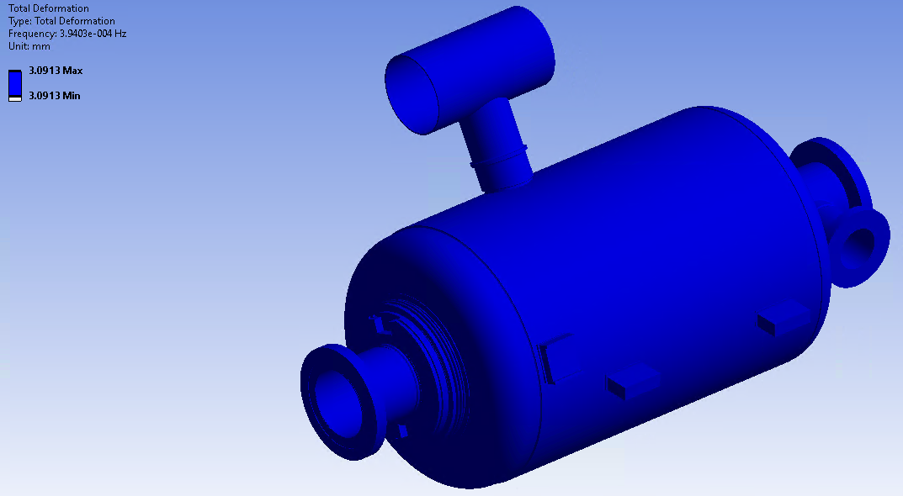
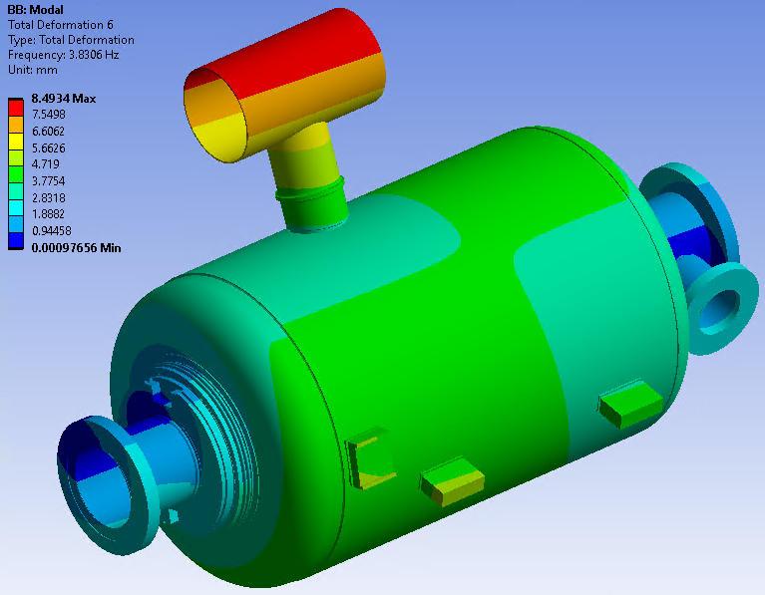
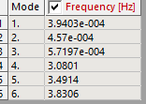
Low Frequency Range
Between 0-3 Hz some natural frequencies did appear, however they seem to be critical.
Lower frequencies are structure moving, not necessarily a natural frequency
Still investigating results

Slide 30
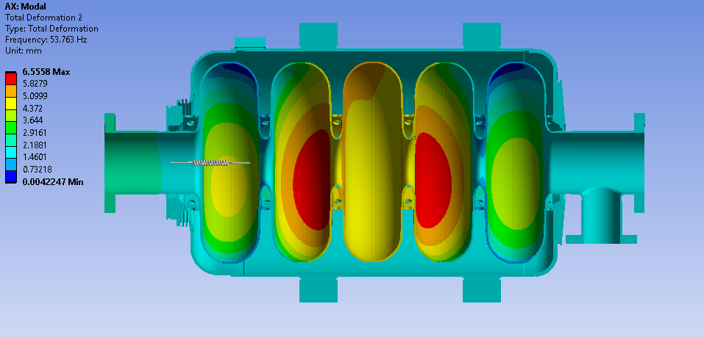
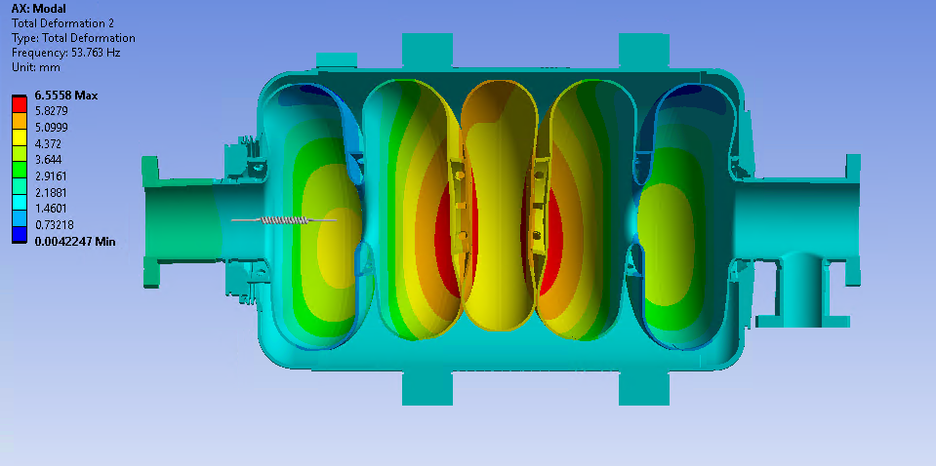
Mid-Range frequency
After low frequency, next frequency that occurs is at 53 Hz.
Cavity begins resonating
Scaled Deformation
Unscaled Deformation

