Slide 1
WG4 Cryogenic Distribution System (CDS)
Ram Dhuley, PhD
PIP-II Technical Meeting
July 12-14, 2022

Slide 2
Welcome and introductions
CDS WG Chair:
  Ram Dhuley rdhuley@fnal.gov (attending remotely)
CDS WG Co-chairs:
  William Soyars soyars@fnal.gov and Alexander Martinez martinez@fnal.gov
  William Soyars is your main point of in-person contact

Slide 3
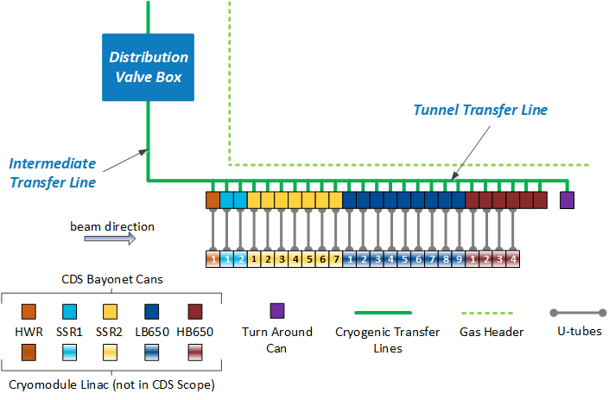
CDS Technical Scope
Design and deliver a cryogenic system to
  Distribute refrigeration between Cryogenic Plant and Cryomodule Linac
  Provide flexibility and control across all Linac operating modes

Slide 4
CDS Technical Deliverables
Fermilab procurements:
Deliverable | Quantity | Description, features, and scope
Intermediate Transfer Line | 1 | Connect Distribution Valve Box (CP Building) to TTL Bayonet Cans (Linac Tunnel) CDS Installation scope
Cryomodule (CM) U-tubes | 125 | Interface TTL to each Cryomodule within Linac Tunnel Positive isolation between CDS and CM One U-tube per circuit per Bayonet Can; Five per BC
Cryogenic Control System | 1 | Hardware and software for all CDS and CM cryogenic control devices Assembly and programming
Ancillary Components | 25 6 | CM 2 K Return rupture discs and reclosable relief valves Helium, LCW, compressed air, and nitrogen piping assemblies
In-Kind by Wroclaw Univ. Science and Technology (WUST), Poland:
Deliverable | Quantity | Description, features, and scope
Distribution Valve Box | 1 DVB | Process isolation between CP and CM Linac Design, fabrication, QA/QC, and delivery of 1 DVB PIP-II CDS owns Installation scope
Tunnel Transfer Line | 25 BC 1 TC | Segmented TL with individual bayonet/turnaround cans (25+1) Design, fabrication, QA/QC, and delivery of 26 TL modules PIP-II Linac Installation L3 owns Installation scope

Slide 5
CDS Contributors
  WUST
    Management – Maciej Chorowski, Pawel Wojcik
    Engineering – Pawel Duda, Michal Stanclik, Tomasz Banaszkiewicz, Grzegorz Michalski
  FNAL
    Management – Alexander Martinez (acting CAM)
    Design engineering – Ram Dhuley (acting L3 Manager), Justin Tillman, Greg Langlois, Ruben Noceda
    Analyses – William Soyars, Erik Voirin, Ang Lee
    Guest engineers (2018-2021) – Ashish Shukla (RRCAT, India), Jitendra Kumar (BARC, India)

Slide 6
CDS Working Group
  Goals
    Share progress on design and analyses with collaborators and stakeholders
    Brainstorm on outstanding design/engineering issues
  Agenda: Details available at https://indico.fnal.gov/event/54738/
    Day 1: Learn about challenges and risks in designing, building, and operating large-scale CDS
    Day 2: Discussion on PIP-II CDS 3D models, interfaces, installation plan, and more
    Day 3: Discussion on EN and ASME design codes; thermal-fluid analyses of CDS components

Slide 7
Welcome again, and we hope you have fun at the meeting!

