Slide 1
Challenges in design, construction, and exploitation of Big Science Cryogenic Distribution Systems
Maciej Chorowski / Wroclaw Univ. of Science and Technology
PIP-II Technical Workshop
07/13/2022

Slide 2
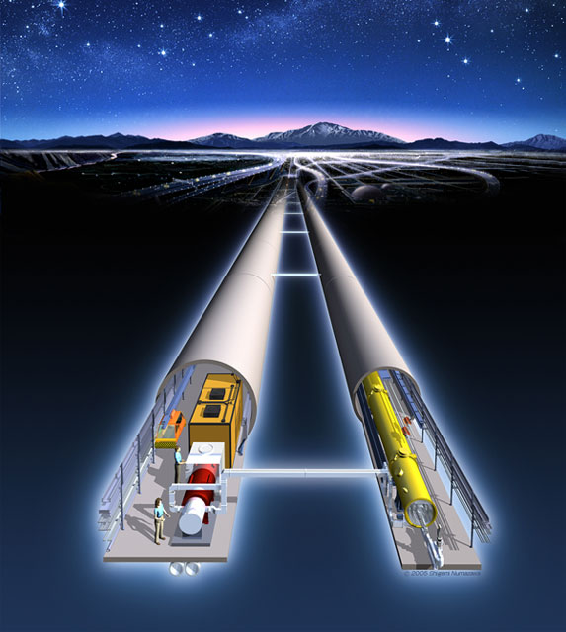
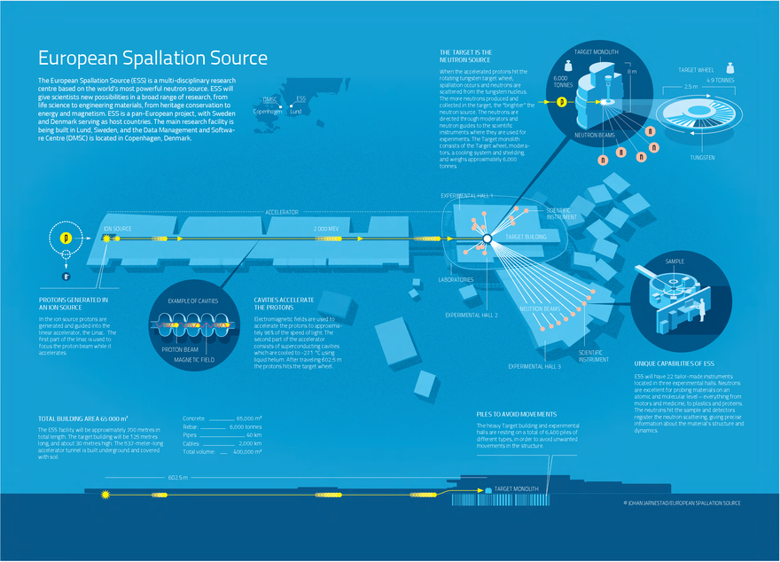
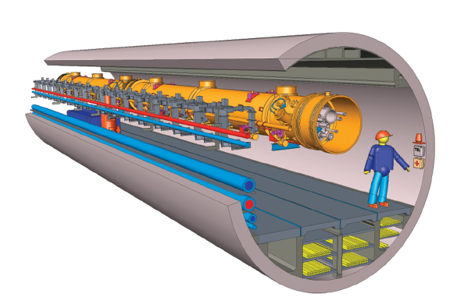
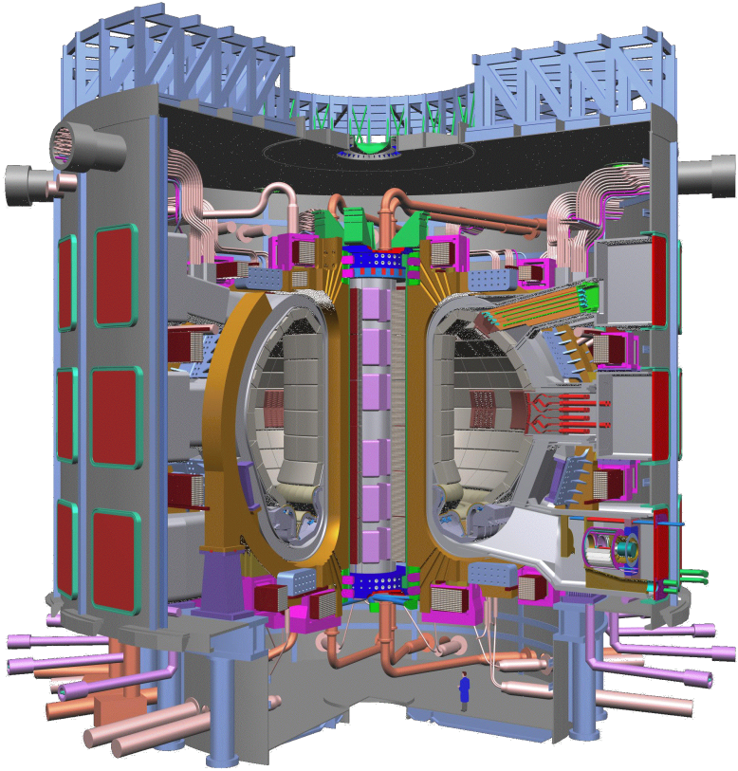
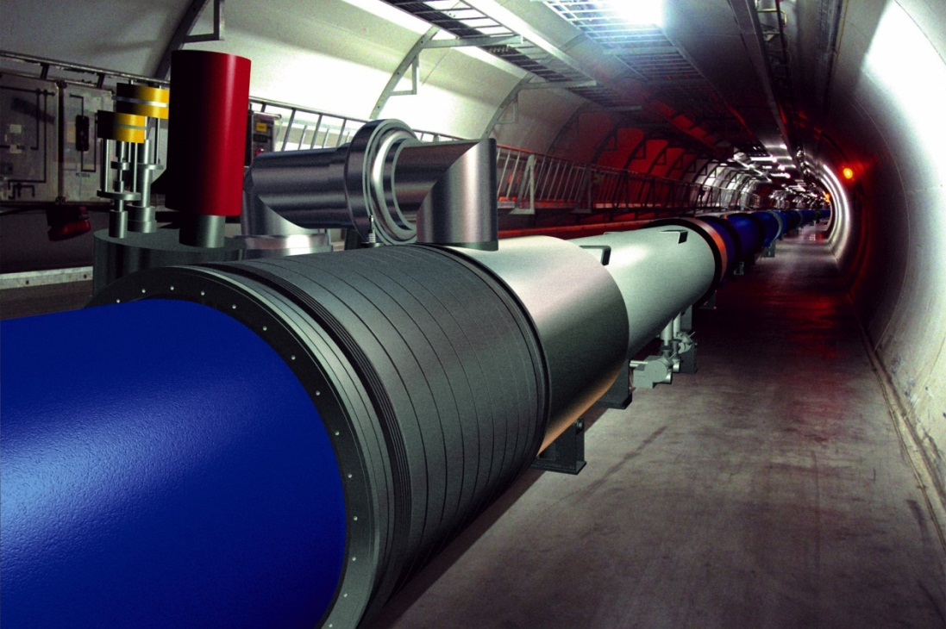

Helium cryogenics is a must in „Big Science”
ILC
ESS
FAIR
XFEL
LHC
PIP II
ITER

Slide 3
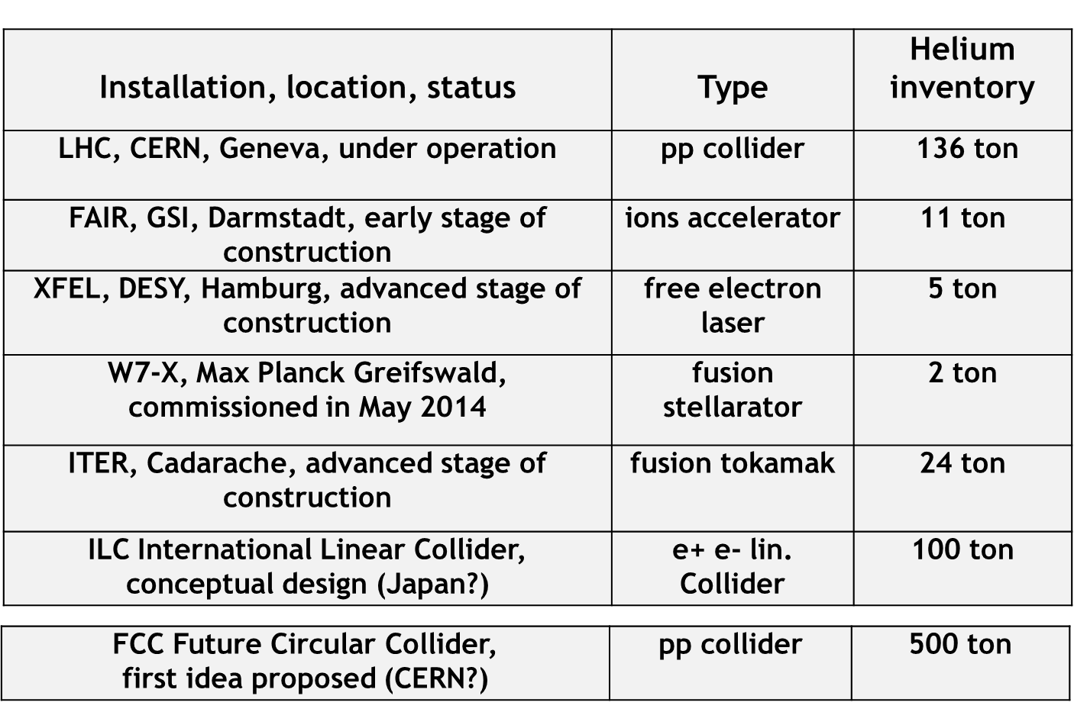
Helium cryogenics and inventory in chosen projects

Slide 4
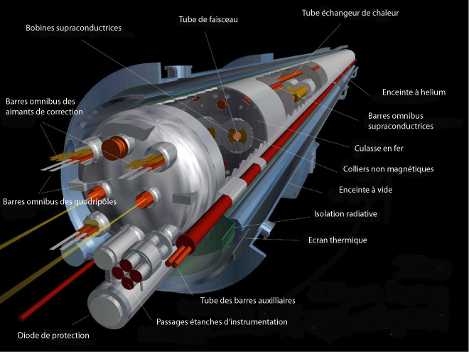
Why Cryogenics ? - Critical current density of superconductors
LHC magnets ary cryostated with pressurized IIHe

Slide 5
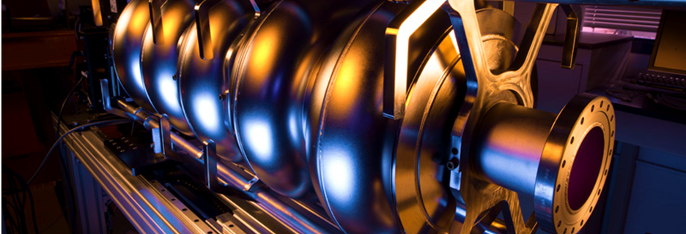
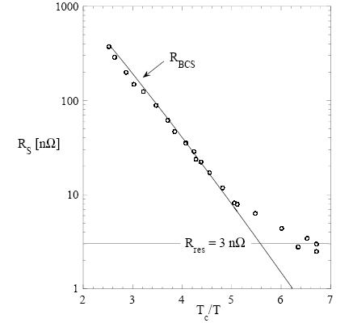
Why Cryogenics ? Optimization of operating temperature for superconducting RF cavity
BCS theory R_{BCS} = (A ω² /T) exp (-B T_{c}/T)
For practical materials R_{S} = R_{BCS} + R₀
Refrigeration (Carnot) P_{a} = P (T_{a}/T - 1)
⇒ depending upon ω and R₀, optimum operating temperature for superconducting cavities
Niobium
Optimal operation temperaturę for Nb suepercondicting RF cavity is below 2 K.
RF Cavities are cryostated with saturated II He

Slide 6
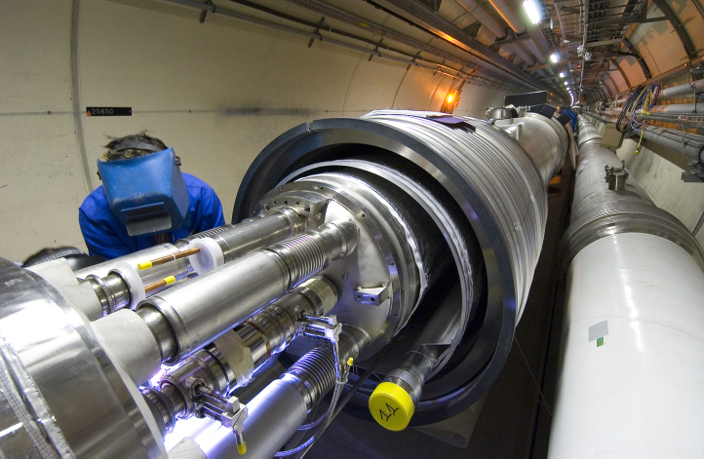
Why Supercritical Helium? Transport of refrigeration in large distributed cryogenic systems
To avoid two-phase flow helium is transported in supercritical state at the distance up to 3.3 km (LHC sector length)

Slide 7
Phase diagram of helium
„Big Science” cryogenic systems make extensive use of practically all thermodynamic states of cold helium:
Supercritical
Saturated He I
Saturated He II
Pressurized He II
Low pressure vapour
λ line

Slide 8
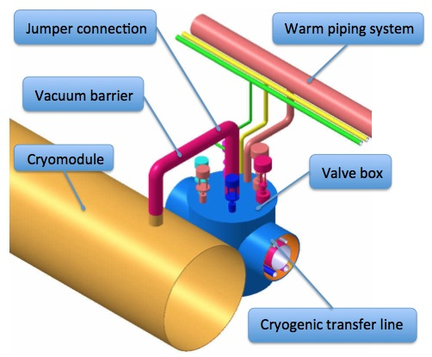

Cryogenic Distribution System CDS
Connects a cryoplant with cryomodules, magnets, helium innventory tanks
Transfers helium in both directions
Allows cool down, cryostating, warm up a machine
Guarantees safe operation in all operating modes (including failure modes)
Main components of CDS are: transfer lines, valve boxes, jumper connections, warm piping systems

Slide 9
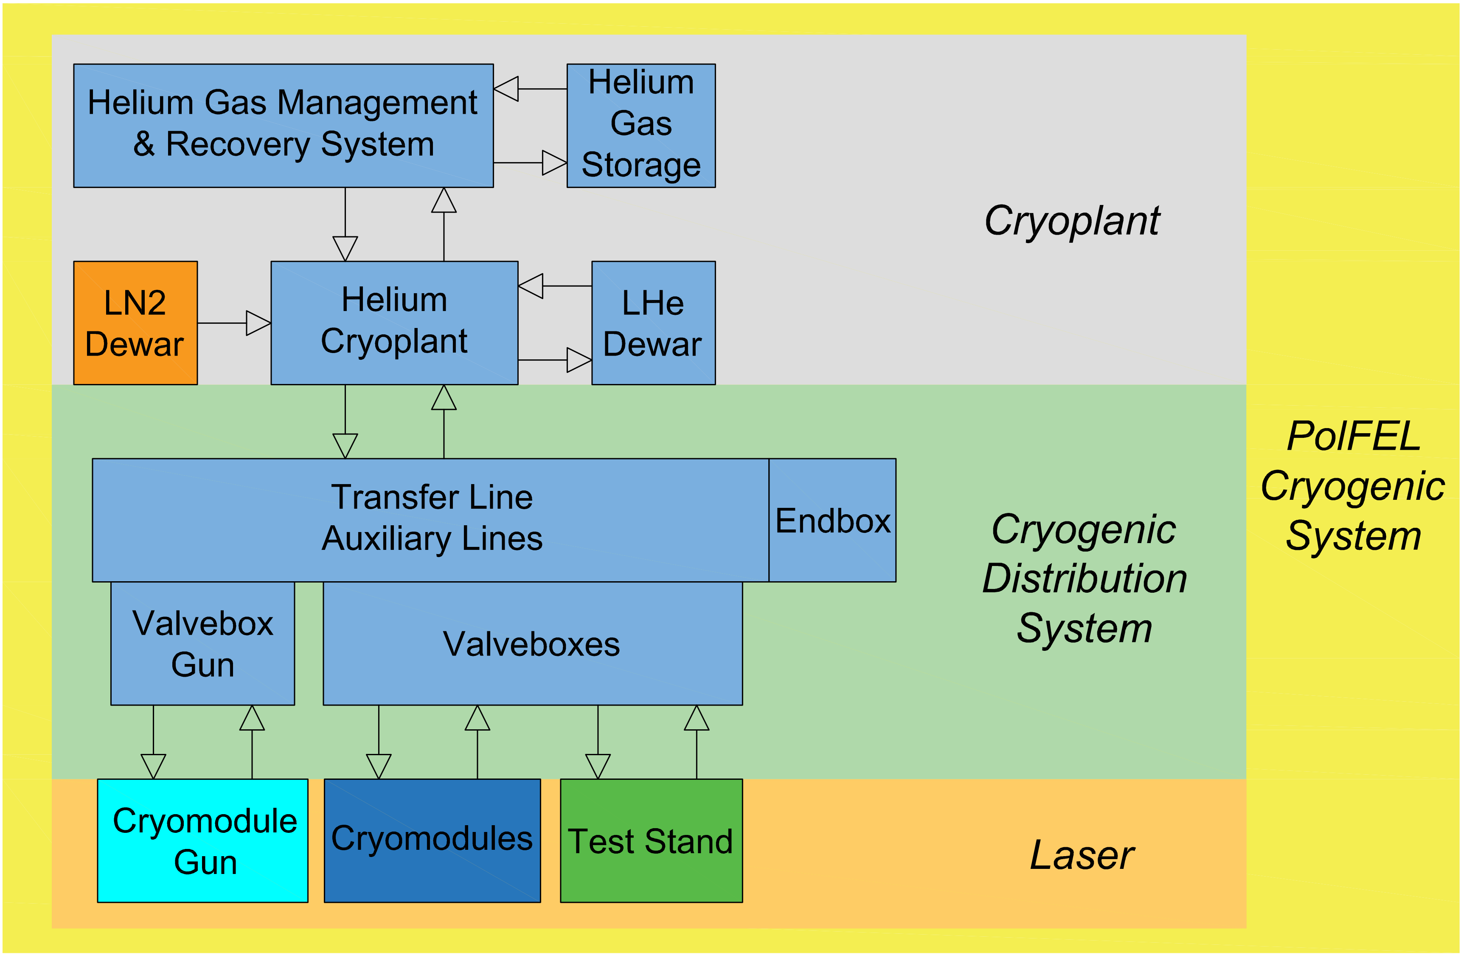
Exemplary Cryogenic Distribution System – POLFEL
PolFEL (Polish Free Electron Laser) will be the first Free Electron Laser (FEL) facility operating in Poland and Eastern Europe.

Slide 10
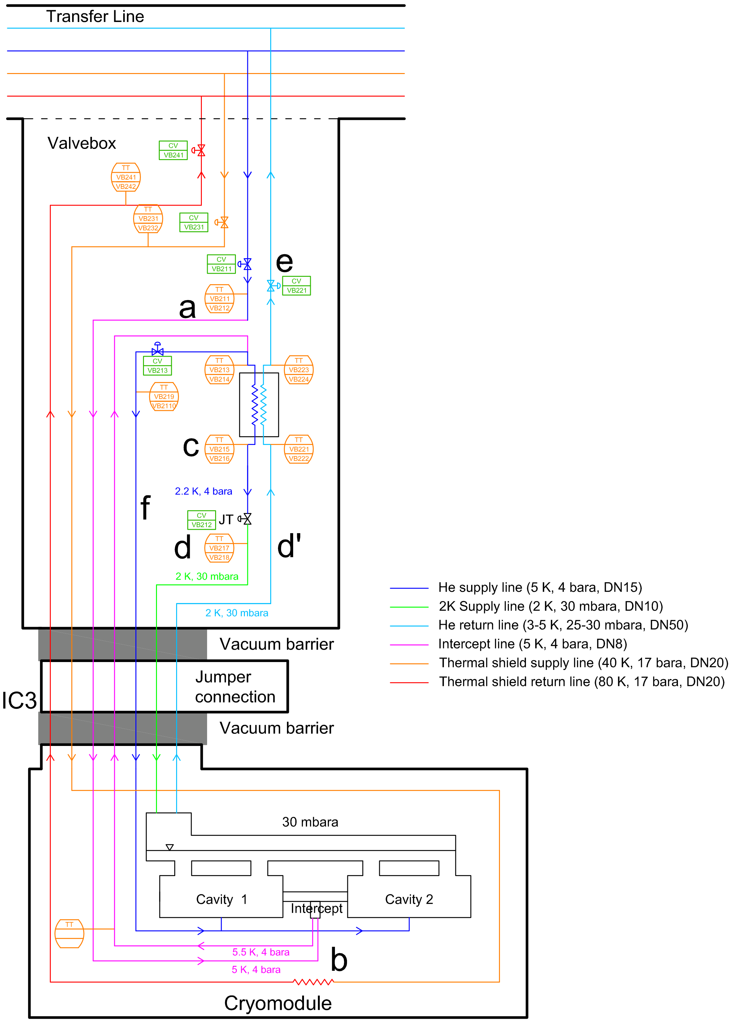
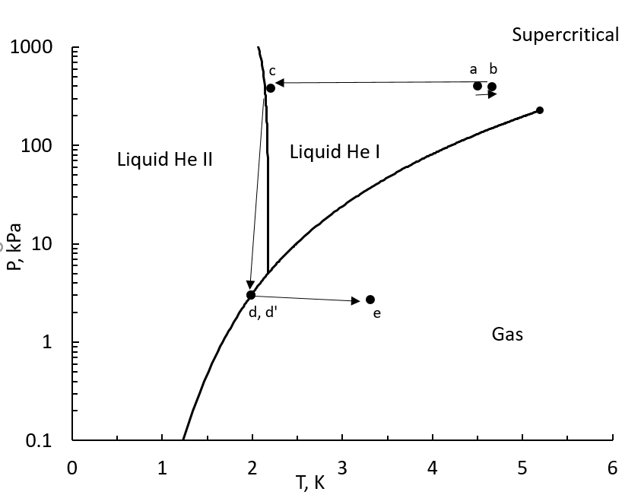
Simplified flow scheme of POLFEL Valve Box with corresponding T-s diagram Take notice of thermodynamic processes occuring in Valve Box/Cryomodule

Slide 11
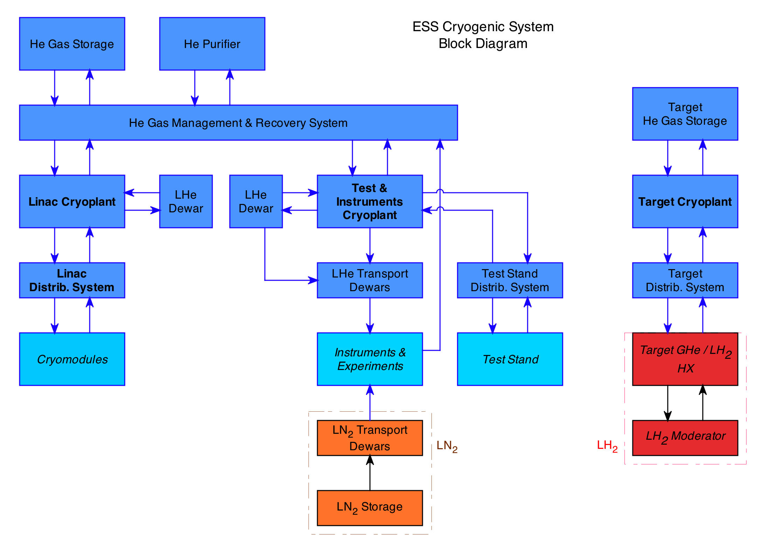
ESS Cryogenics System

Slide 12
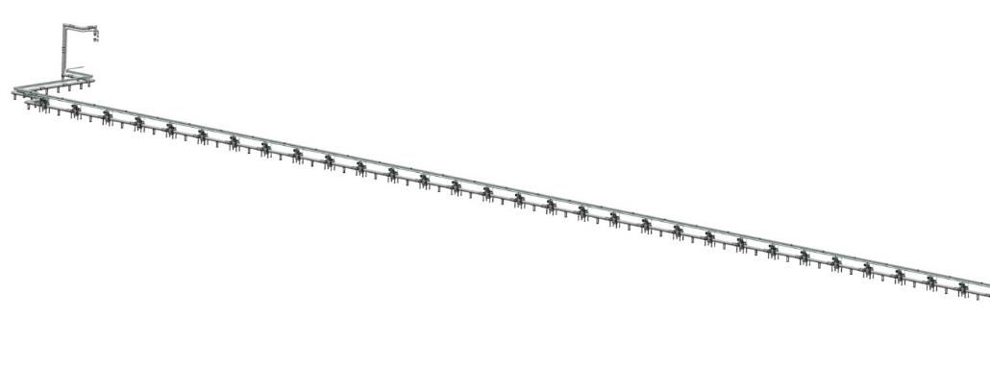
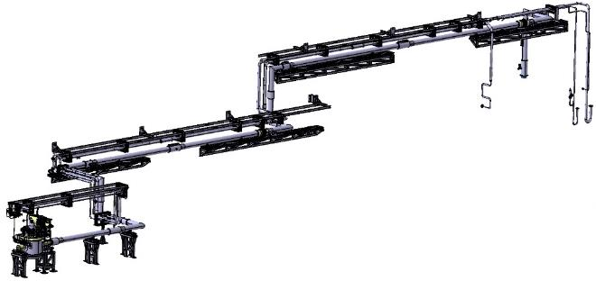
ESS Cryogenic Distribution System - WUST contribution to ESS
AIK 11.1 – Cryogenic Distribution for Elliptical Linac (CDS-EL)
4-channel Cryogenic
Transfer Line (65m)
Cryogenic Distribution Line
with 30 valve boxes and 4 Aux lines
AIK 11.3 – Cryogenic Distribution for Lund Test Stand2 (CDS-LTS2)
Auxiliary Lines
LTS2 Valve Box
4-channel Cryogenic
Transfer Line (65m)

Slide 13
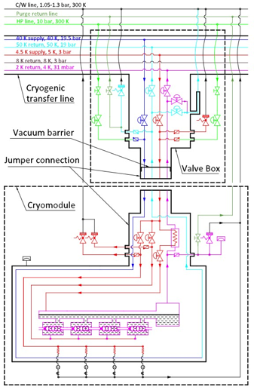
Accelerator Cryogenics
Distribution system delivers single
phase supercritical Helium at 4.5 K & 40 K
2 K helium produced at
each cryomodule
Sub atmospheric vapor pumped off
to cryoplant
4.5 K – 300 K cooling of couplers

Slide 14
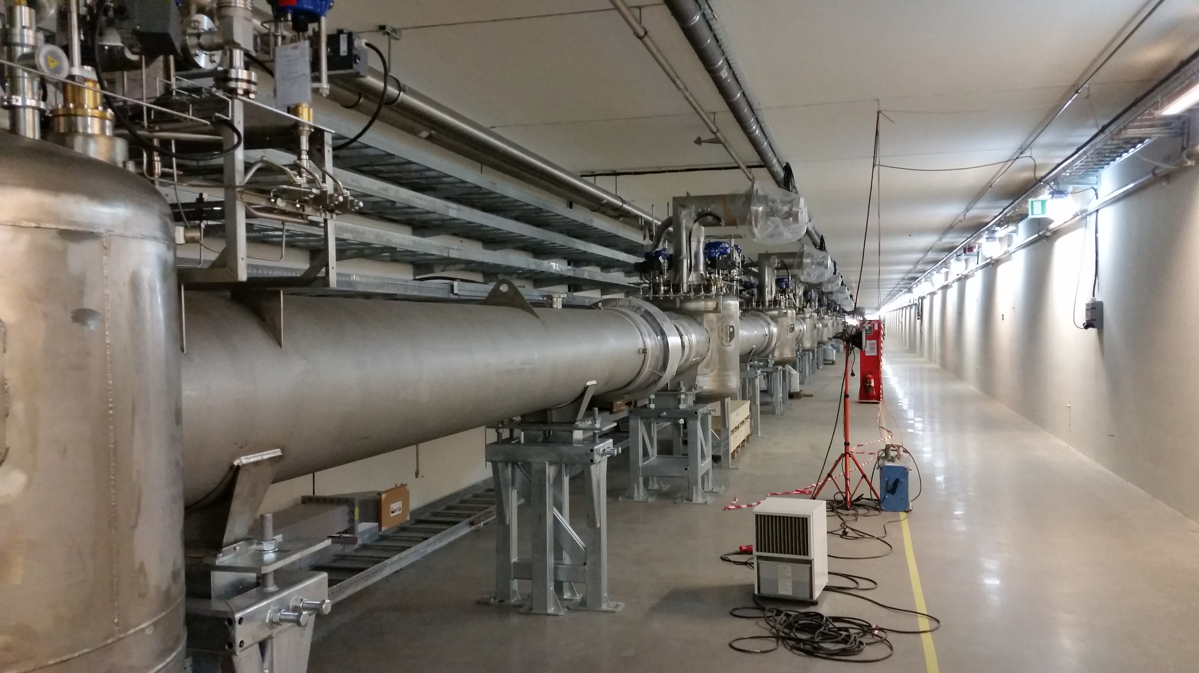
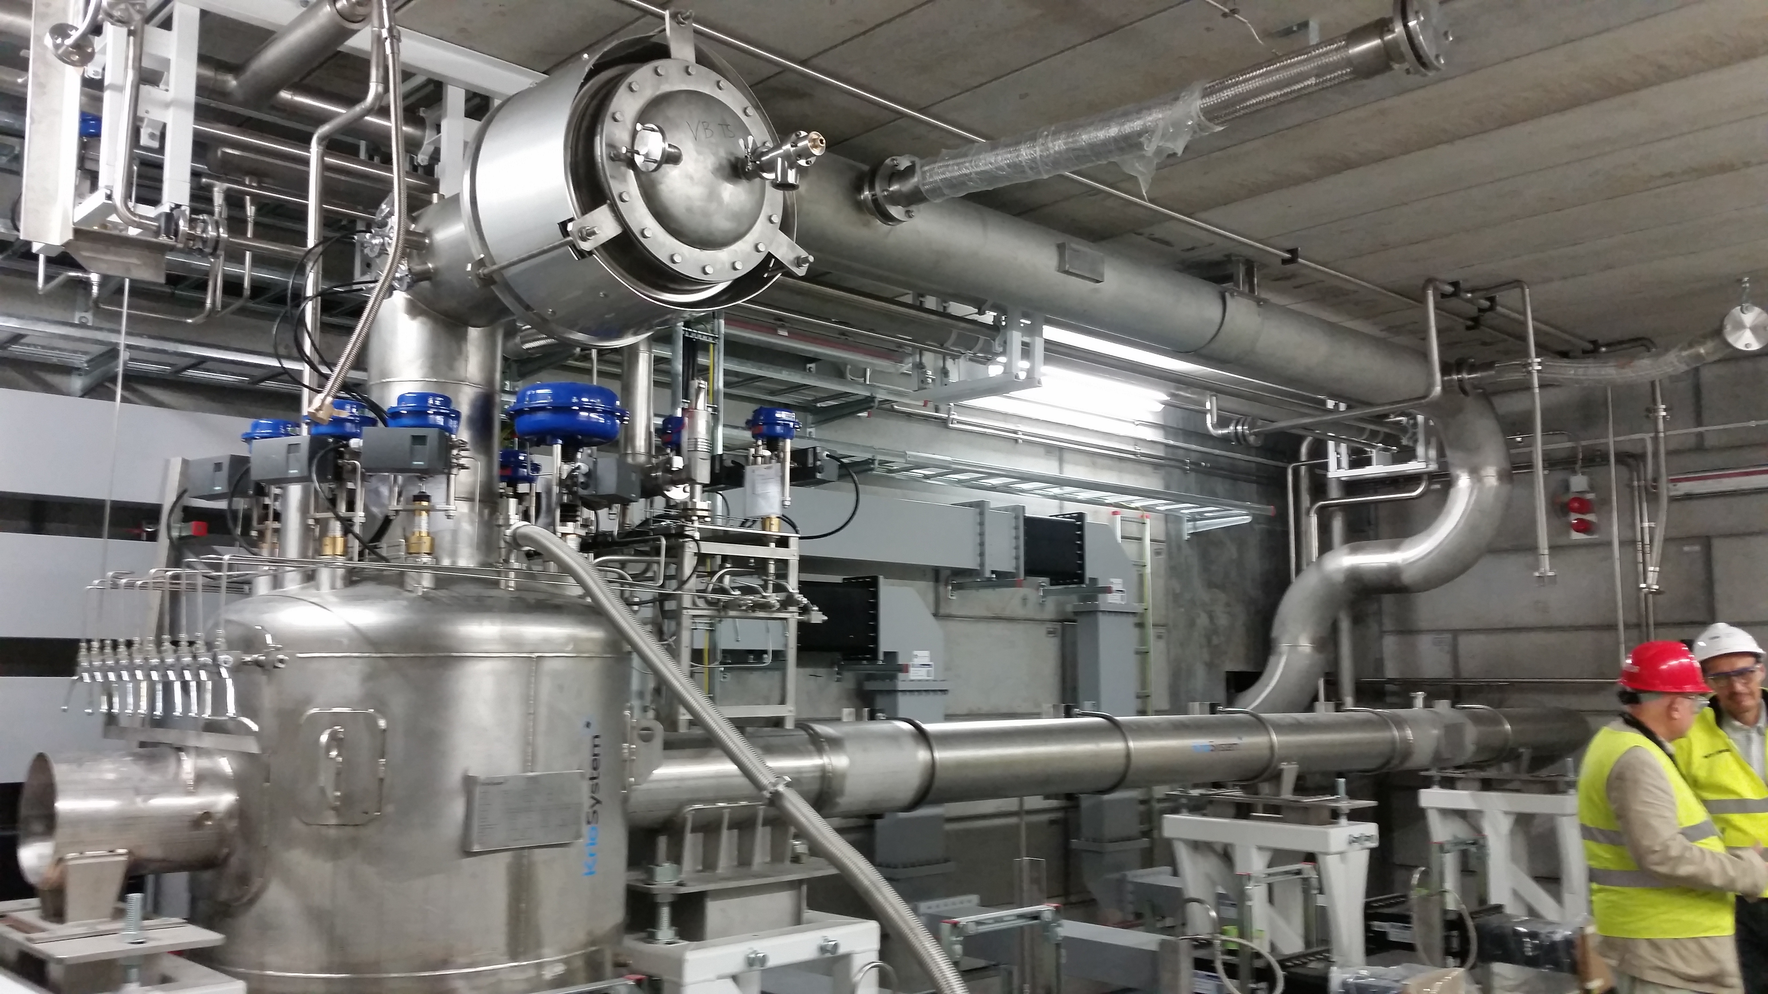
ESS Distribution Cryogenics System installed in the tunnel
Test stand allowing optimization of the main system

Slide 15
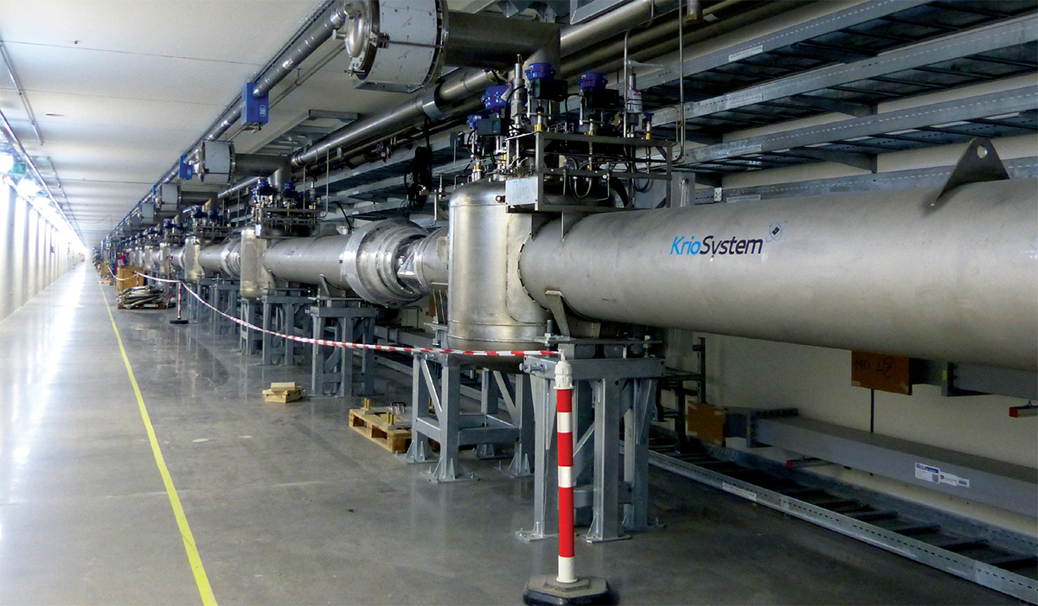
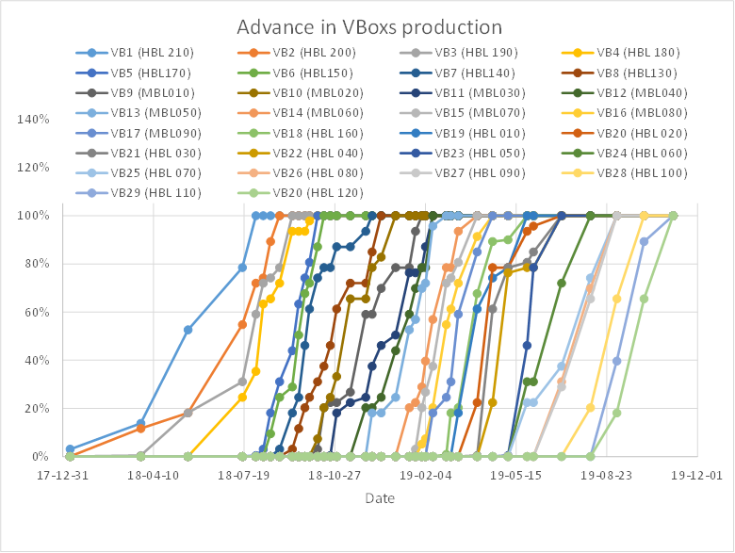
Industrialization of the CDS valboxes production
The production rate accelerated from 6 monthes (first valve box) to three weeks (average)

Slide 16
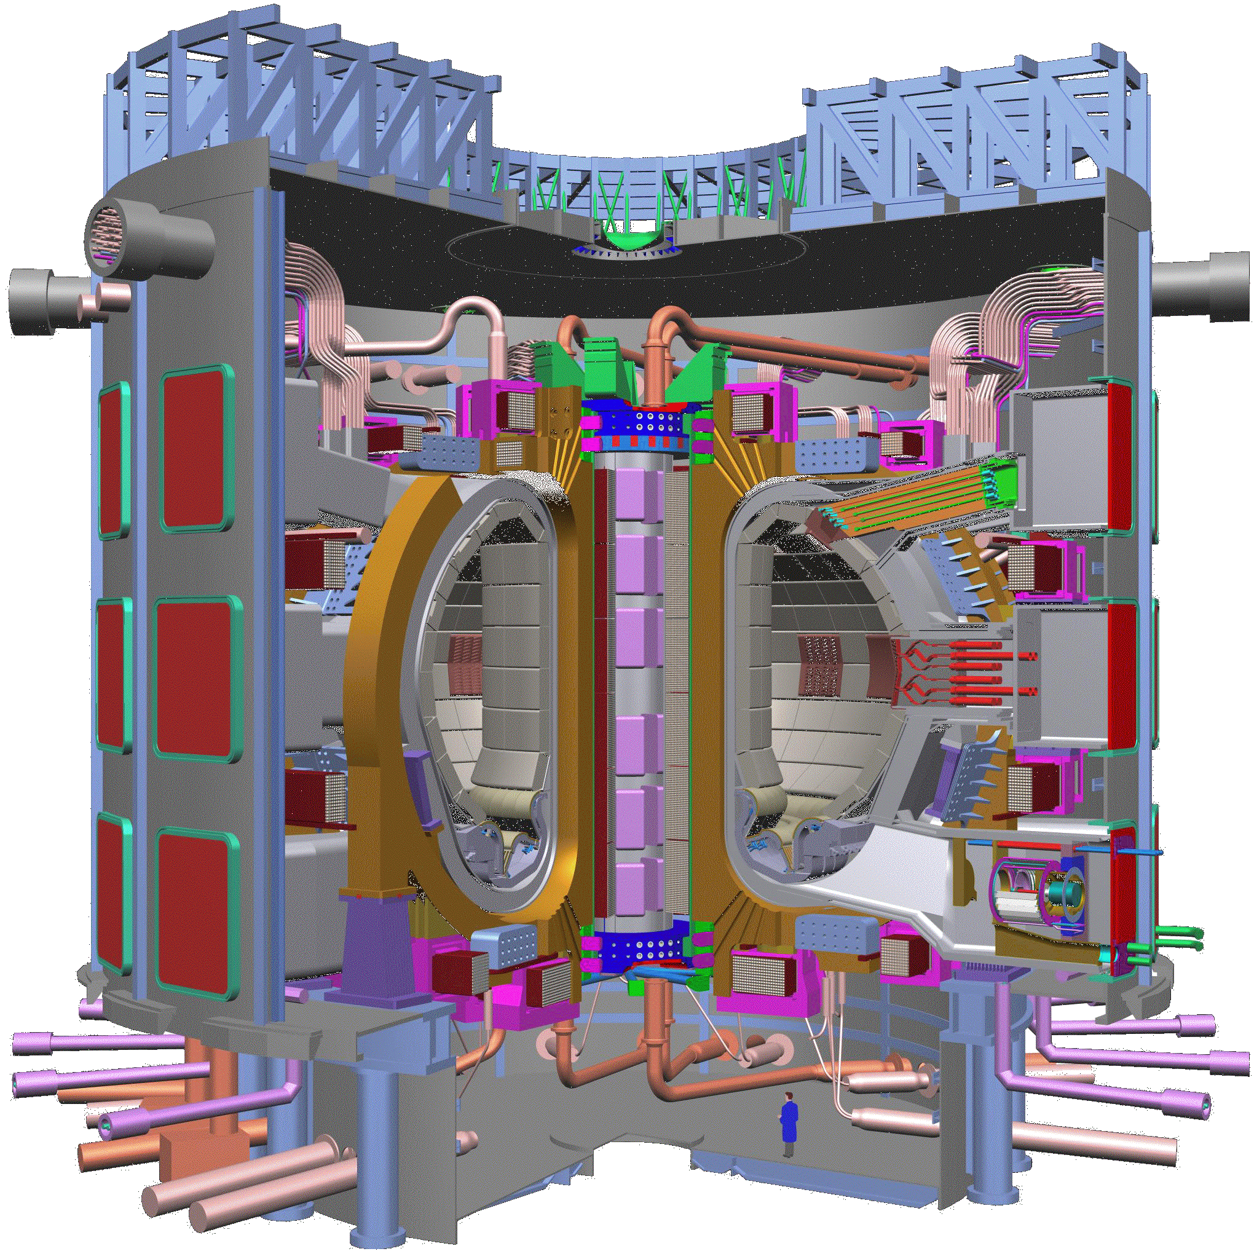
ITER cryogenic system – two temperature extremities meet
Central
Solenoid, Nb₃Sn
10⁸ K
4,2 K
Blanket Module
Outer Intercoil Structure
Vacuum
Vessel
Toroidal Field
Coil, Nb₃Sn, 18
Cryostat
Poloidal Field
Coil, NbTi
Port Plug
(IC Heating)
Divertor
Machine Gravity
Supports
Torus
Cryopump
Cryolines
Cryodistribution
Cryolines
Cryodistribution

Slide 17
ITER Cryogenic Distribution System - cooling loop of cable in conduit coils
Circulation of supercritical helium in CIC cables of ITER magnet coils

Slide 18
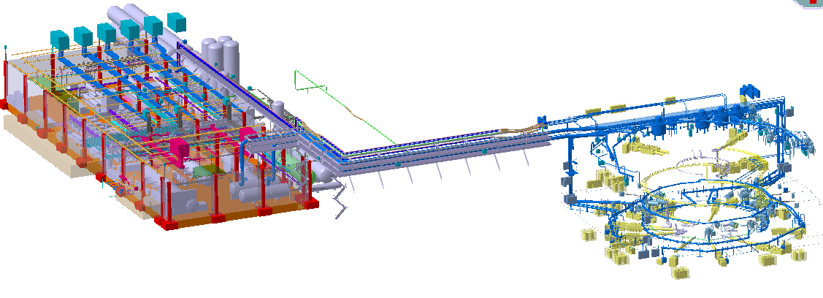
ITER Cryogenic System
Cryodystribution
lines and boxes in
the tokamak building
Main cryogenic
transfer lines
Helium and nitrogen liquefiers
in the cryoplant buildings

Slide 19
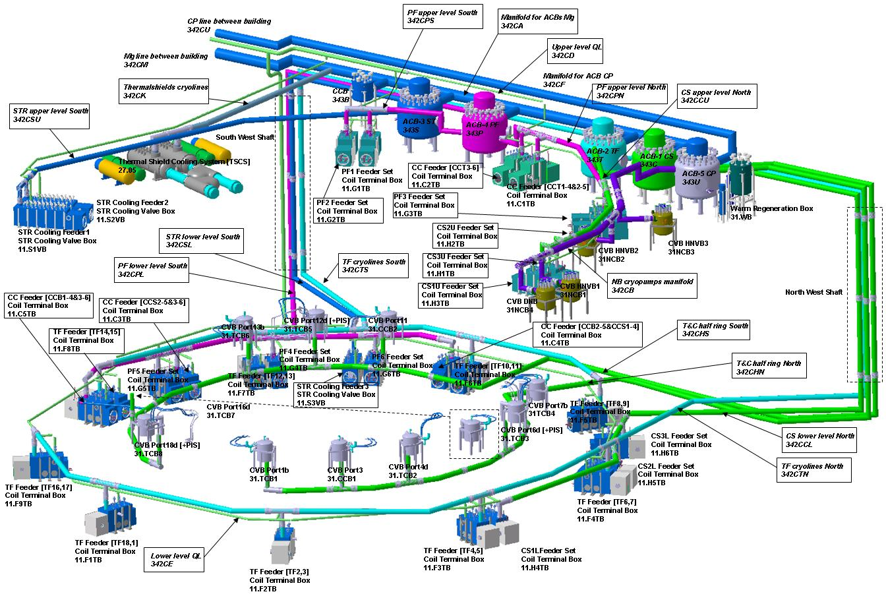
ITER Cryogenic Distribution System in the tokamak building

Slide 20
Challenges in design, construction and operation of CDS
Mechanical design compromising allowable heat balance with mechanical stability
Risk analysis and coping with failure modes
Industrialization of the production, CDS is the first system installed in the tunel
Vacuum sectorization
Control systems
And many others
Cryogenic Distribution System – definitely not „Just Piping”

