Slide 1
Risk Analysis of Cryogenic Distribution Systems
Maciej Chorowski / Wroclaw Univ. of Science and Technology
PIP-II Technical Workshop
07/13/2022

Slide 2

Outline
Why the Risk Analysis of Cryogenic Distribution System is recommended.
Metodology proposed by WUST
Risk analysis examples – LHC, ESS distribution systems
Conclusions

Slide 3
Outline
Why the Risk Analysis of Cryogenic Distribution System is recommended.
Metodology proposed by WUST
RAMI approach
Risk analysis examples – LHC, ESS distribution systems
Conclusions

Slide 4
Properties of cryogenic liquids
Cryog-en | M [g] | T_{N} [K] | ρ₁ [kg/m³] | ρ₂ [kg/m³] | ρ₃ [kg/m³] | T_{C} [K] | P_{C} [MPa] | ΔH_{V} [kJ/kg] | V₂ / V₁ ---- | V₃ / V₁ ----
He | 4,003 | 4,2 | 124,9 | 16,91 | 0,178 | 5,2 | 0,229 | 20,3 | 7,4 | 701
H₂ | 2,01 | 20,3 | 70,81 | 1,34 | 0,089 | 33,04 | 1,29 | 446,0 | 52,8 | 788
Ne | 20,18 | 27,17 | 1207 | 9,58 | 0,90 | 44,5 | 2,73 | 85,8 | 126,0 | 1341
N₂ | 28,01 | 77,3 | 808 | 4,62 | 1,25 | 126,2 | 3,39 | 199,0 | 175,0 | 646
O₂ | 32,00 | 90,2 | 1140 | 4,47 | 1,43 | 154,6 | 5,04 | 213,0 | 255,0 | 797
CH₄ | 32,00 | 111,6 | 423 | 1,82 | 0,717 | 190,5 | 4,60 | 510,0 | 232,0 | 590

Slide 5
Energy release potential of liquid cryogens
Consider vessel containing volume V of liquid cryogen at saturation (T_{sat}) and atmospheric pressure, environment at T_{a}
  What is the energy release potential of that liquid?
  How much damage can be done by releasing it to the environment?
Technical answer depends upon the details of the process, but… thermodynamics can set upper boundaries to answer these questions
  Cooling of equipment (thermal energy): first principle
  Mechanical damage (mechanical energy): second principle
T_{a}
Environment
Heat
Mechanical
T_{sat}
V
Courteasy Ph. Lebrun

Slide 6
Cooling of equipment: thermal energy
Heat needed to vaporize mass m of liquid and warm resulting vapour up to temperature T
Q(T) = m L_{v} + m C_{p} (T-T_{sat})
  Case 1: 1000 liter (125.2 kg) liquid helium at 4.2 K, 1 bar Lv = 20.8 kJ/kg Cp ≈ 5.2 kJ/kg.K
  Case 2: 1000 liter (806.6 kg) liquid nitrogen at 77.2 K, 1 bar Lv = 199.3 kJ/kg Cp ≈ 1.05 kJ/kg.K
First principle of thermodynamics (energy conservation): Q is drawn from the environment of the fluid, where it will cool mass M of equipment from T_{a} down to temperature T Q(T) = M [h(T_{a})-h(T)] h(T) enthalpy of material
  Applications: 1 ton of iron 10 tons of iron
Courteasy Ph. Lebrun

Slide 8
Mechanical energy release
Upper bound set by 2nd principle of thermodynamics (Carnot)
Mechanical energy W
  extracted from heat Q at T
  by Carnot engine rejecting at Ta
  W = Q (T_{a}/T – 1)
Consider only heat of vaporization at T_{sat} W = m L_{v} (T_{a}/T_{sat} – 1)
  Case 1: 1000 liter liquid He at 4.2 K (T_{a}/T_{sat} – 1) ≈ 68 W ≈ 177 MJ (~ 65 kg TNT)
  Case 2: 1000 liter liquid N2 at 77.2 K (T_{a}/T_{sat} – 1) ≈ 2.76 W ≈ 443 MJ (~ 163 kg TNT)
Real process
  efficiency < Carnot
  also include specific heat of vapour
  see examples later
T_{a}= 290 K
Environment
Heat Q+W
Mechanical W
Carnot engine
Heat Q
T_{sat}
V
Courteasy Ph. Lebrun

Slide 9
Outline
Why the Risk Analysis of Cryogenic Distribution System is recommended.
Metodology proposed by WUST
RAMI approach
Risk analysis examples – LHC, ESS distribution systems
Conclusions

Slide 10
Risk Analysis – aim and scope of the task
Identification of all risks for personnel, equipment and environement caused by the failure of Cryogenic Distribution System and that can not be avoided by design.
Classification of all failures to determine worst case scenario – based on RAMI approach
Risk analysis gives possible causes and consequences, event scenarios and repair schedules of all recognized system failure modes.

Slide 11
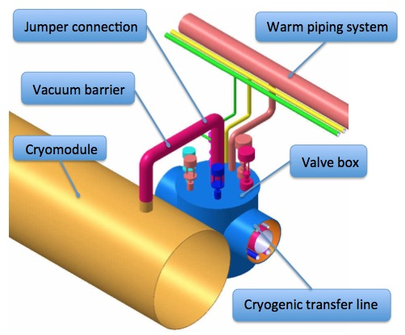
Risk analysis of Cryogenic Distribution Systems
Cryogenic node – a single element of the cryogenic system
Each cryogenic node - component of the machine like transfer line, pipe, vessel, heat exchanger, cryostat can be treated as a separate helium enclosure, characterized by the amount and thermodynamic parameters of enclosed helium.

Slide 12
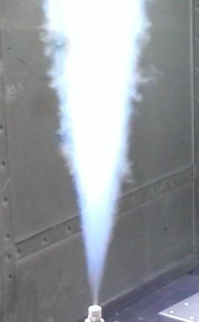


Possible failures of cryogenic node followed by the cryogen discharge
q_{m}
q_{m}
p
Mechanical break of cold vessel
Fast degradation of vacuum insulation with cryogen
Intensive heat flow to the cryogen
Magnet quench (optionally)
Pressure increase of the cryogen and in the vacuum space
Opening of the rupture disk and/or safety valve
Cryogen discharges through the rupture disk and/or safety valve
Mechanical break of warm vacuum vessel
Fast degradation of vacuum insulation with air
Intensive heat flow to the cryogen
Magnet quench (optionally)
Pressure increase of the cryogen
Opening of the safety valve
Cryogen discharge through the safety valve

Slide 13
Categorization of the failures
The failures are categorized according to the criticality rate of the failure:
failure occurence rate
(based on probability data)
severity rate to the personnel
(based on oxygen deficiency hazard)
severity rate to the machine
(based on the helium flow and the failure location)
M. Chorowski, J. Fydrych, M. Grabowski, Risk Analysis of the ITER cryodistribution system, Technical Report WUT-IO_TR_015-1010

Slide 14
Risk assessment – RAMI approach
Criticality rate of the failure
failure occurence rate
(based on probability data)
severity rate to the personnel
(based on oxygen deficiency hazard)
severity rate to the machine
(based on estimated time to restart experiment)

Slide 15
Failure criticality rate

Slide 16
Failure criticality rate
Cumulative failure rate, CFR |  |  | OCC
 | CFR | < 0.0005 | 1
0.0005 ≤ | CFR | < 0.005 | 2
0.005 ≤ | CFR | < 0.05 | 3
0.05 ≤ | CFR | < 0.5 | 4
0.5 ≤ | CFR | < 5 | 5
5 ≤ | CFR |  | 6

Slide 17
Occurance rate OCC
Probabilities of defect occurrence (failure rates) of the most common defects:
Defect | Failure rate
Cold weld ruture | 5.26⋅10⁻⁵ m⁻¹⋅year ⁻¹
Cold pipe leakage | 5.26⋅10⁻⁶ m⁻¹⋅year ⁻¹
Cold pipe rupture | 4.38⋅10⁻⁵ m⁻¹⋅year ⁻¹
Cold bellows rupture | 8.76⋅10⁻⁵ year ⁻¹
Vacuum jacket rupture | 8.77⋅10⁻³ year ⁻¹
Electrical joint failure | 1.2⋅10⁻¹ year ⁻¹
Capilary break | 2.0⋅10⁻⁸ year ⁻¹
Warm line leakage | 8.8⋅10⁻⁷ year ⁻¹
T. Peterson, Helium and nitrogen ODH analysis for ICB Engineering Laboratory, Fermilab, 1991
M. Chorowski, J. Fydrych, M. Grabowski, Risk Analysis of the ITER cryodistribution system, Technical Report WUT-IO_TR_015-1010

Slide 18
Failure criticality rate
Cumulative failure rate, CFR |  |  | OCC
 | CFR | < 0.0005 | 1
0.0005 ≤ | CFR | < 0.005 | 2
0.005 ≤ | CFR | < 0.05 | 3
0.05 ≤ | CFR | < 0.5 | 4
0.5 ≤ | CFR | < 5 | 5
5 ≤ | CFR |  | 6
 | Helium at ambient temperature | Helium at low temperature
 | HRL, WRL, quench line | Auxiliary system (DFB, QRL) | LHC
Maximum mass flow rate, kg/s | SEV_{M} | SEV_{M} | SEV_{M}
Leakage | 1 | 1 | 1
1 – 15 | 1 | 2 | 2
15.1 – 20 | 3 | 4 | 4
more than 20 | 4 | 5 | 6

Slide 19
Failure criticality rate
Cumulative failure rate, CFR |  |  | OCC
 | CFR | < 0.0005 | 1
0.0005 ≤ | CFR | < 0.005 | 2
0.005 ≤ | CFR | < 0.05 | 3
0.05 ≤ | CFR | < 0.5 | 4
0.5 ≤ | CFR | < 5 | 5
5 ≤ | CFR |  | 6
Oxygen concentration, % | SEV_{P}
21 – 18 | 1
18 – 15 | 2
15 – 12 | 3
12 – 10 | 4
10 – 6 | 5
6 – 0 | 6
 | Helium at ambient temperature | Helium at low temperature
 | HRL, WRL, quench line | Auxiliary system (DFB, QRL) | LHC
Maximum mass flow rate, kg/s | SEV_{M} | SEV_{M} | SEV_{M}
Leakage | 1 | 1 | 1
1 – 15 | 1 | 2 | 2
15.1 – 20 | 3 | 4 | 4
more than 20 | 4 | 5 | 6

Slide 20
The criticality matrix – basis for decisions mitigating the risk
System in design phase
System under operation
A – The personnel access restrictions
B1/B2 – The changes possible in the machine design phase
C1/C2 – The changes possible in the machine consolidation phase

Slide 21
Outline
Why the Risk Analysis of Cryogenic Distribution System is recommended.
Metodology proposed by WUST
Risk analysis examples – ESS distribution system
Conclusions

Slide 22
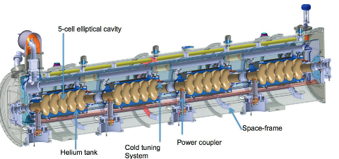
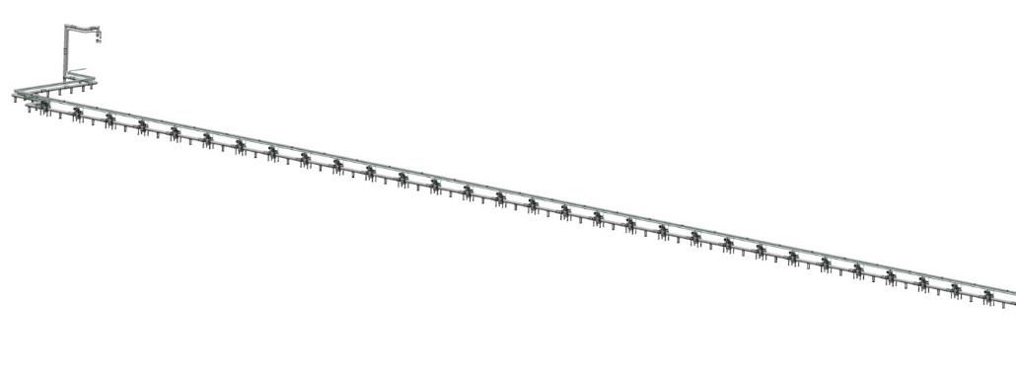
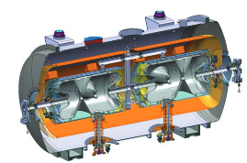
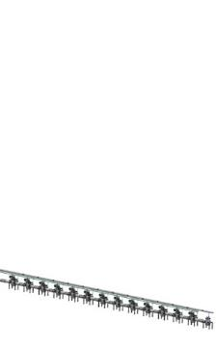
ESS Linac CDS – function and layout
Linac Cryogenic Distribution System
CDS for the spoke linac
(French in-kind, CNRS)
CDS for the elliptical linac
(Polish in-kind, WUST)
Cryogenic
Transfer
Line (65 m)
Cryogenic Distribution Line
(255 m, 30 valve boxes)
Cryogenic Distribution Line
(55 m, 13 valve boxes)
Auxiliary process lines
Endbox
Splitting
box
30 branch cryolines
13 branch cryolines
Cryogenic
Transfer Line
Cryogenic Distribution Line
with 13 valve boxes
Cryogenic Distribution Line
with 30 valve boxes

Slide 23
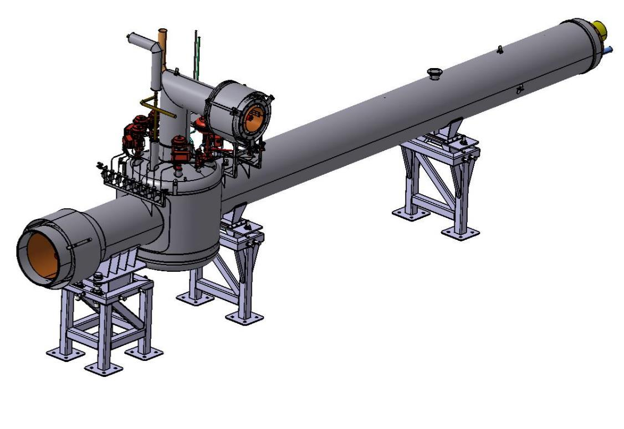
3D model of the Valve Box for CDS-EL

Slide 24
Identification of the CDS’s nodes

Slide 25
Identification of the CDS’s nodes
Cryogenic Transfer Line incl. Splitting Box – F1

Slide 26
Identification of the CDS’s nodes
Cryogenic Distribution Line incl. End Box – F2

Slide 27
Identification of the CDS’s nodes
Valve Box – F3

Slide 28
Identification of the CDS’s nodes
Auxiliary Lines – F4

Slide 29
Cryogenic failure modes identification
No. | Cryogenic failure mode
1. | Air flow to insulation vacuum
2. | Helium flow to insulation vacuum
3. | Air flow to sub-atmospheric helium
4. | Pressurized He flow to sub-atmospheric helium
5. | Helium flow to environment
6. | Air flow to sub-atmospheric line
7. | He flow to sub-atmospheric line

Slide 30
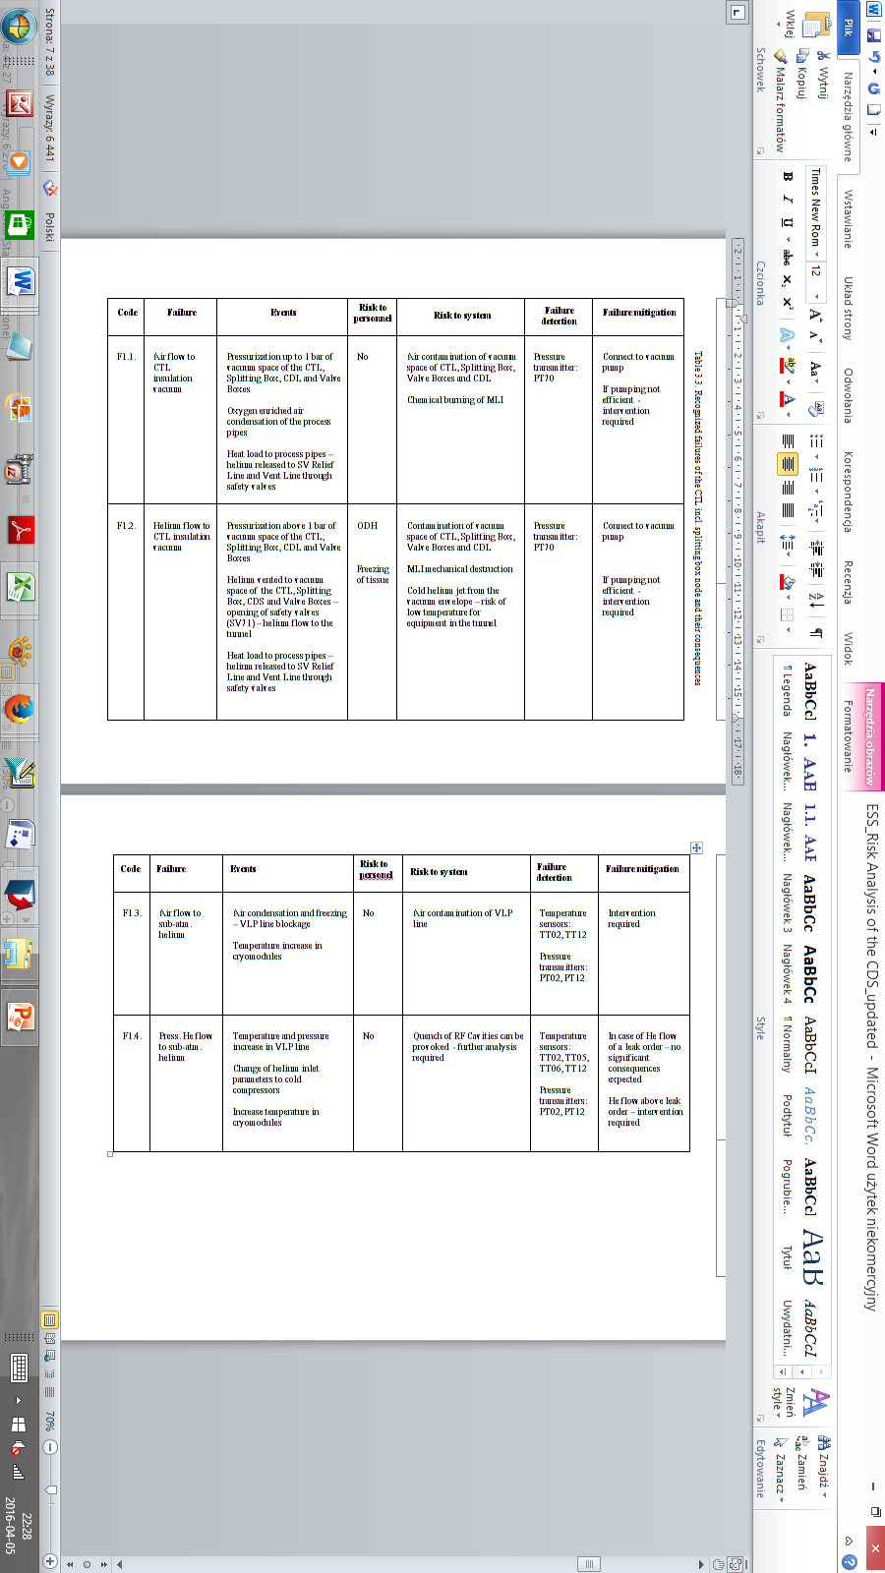
Recognized failures of the CTL

Slide 31
Conclusions of the ESS cryogenic distribution system risk analysis
17 different failure modes of the CDS have been recognized, analyzed and classified
Based on RAMI approach worst case scenarios have been identified for both operation and cool down modes.

Slide 32
Outline
Why the Risk Analysis of Cryogenic Distribution System is recommended.
Metodology proposed by WUST
Risk analysis examples – LHC cryogenic system
Conclusions

Slide 33
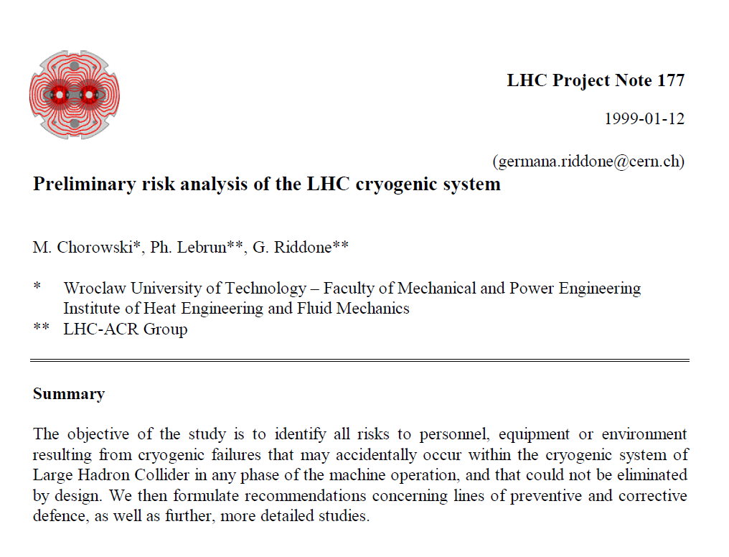

Slide 34
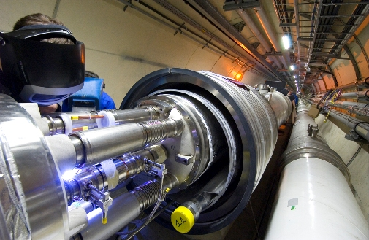
Cryogenic node – simplest element of the cryogenic system – basis for the risk analysis
Each component of the machine like pipe, vessel, heat exchanger, and cryostat can been treated as separate helium enclosure, characterized by the amount and thermodynamic parameters of helium.

Slide 35
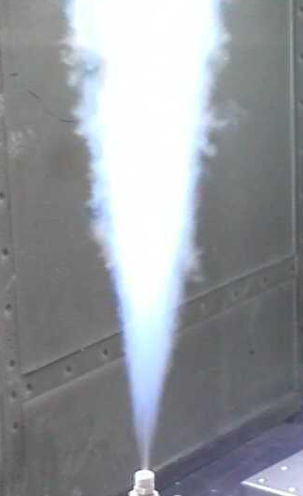
Possible failures of cryogenic node followed by the cryogen discharge
In LHC – to header D
In LHC – to header D
q_{m}
q_{m}
p
Mechanical break of warm vacuum vessel
Fast degradation of vacuum insulation with air
Intensive heat flow to the cryogen
Magnet quench (optionally)
Pressure increase of the cryogen
Opening of the safety valve
Cryogen discharge through the safety valve
Mechanical break of cold vessel
Fast degradation of vacuum insulation with cryogen
Intensive heat flow to the cryogen
Magnet quench (optionally)
Pressure increase of the cryogen and in the vacuum space
Opening of the rupture disk and/or safety valve
Cryogen discharges through the rupture disk and/or safety valve

Slide 36
Possible failure modes of the LHC cryogenic system
1 Air flow to insulation vacuum
2 Helium flow to the insulation vacuum
3 Air flow to the sub-atmospheric helium
4 Helium flow to environment
5 Air flow to beam vacuum
6 Helium flow to beam vacuum
7 Pressurised helium flow to sub-atmospheric helium
8 Energy release to cold mass helium due to magnet quench
9 Energy release to cold mass helium due to electrical arc
LHC Project Note 177

Slide 37
(resulting from
5 cm² hole)
LHC Project Note 177

Slide 38
Risk analysis – worst case scenario analysed – full break of jumper connection

Slide 39

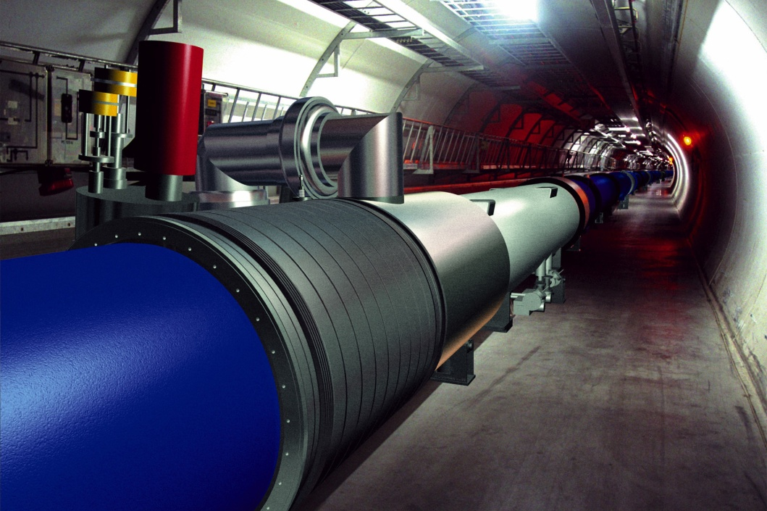
Can the helium discharge be avoided?
Geneva, 19 September 2008:
„Investigations at CERN following a large helium leak into sector 3-4 of the Large Hadron Collider (LHC) tunnel have indicated that the most likely cause of the incident was a faulty electrical connection between two of the accelerator’s magnets. Before a full understanding of the incident can be established, however, the sector has to be brought to room temperature and the magnets involved opened up for inspection. This will take three to four weeks. Full details of this investigation will be made available once it is complete”.

Slide 40
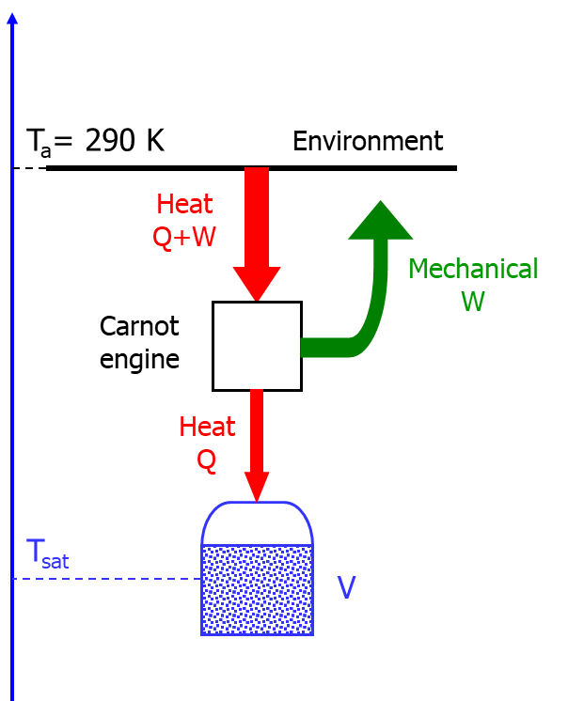
Not foreseen in PRA: pressurization of the vacuum space

Slide 41
Damage caused by the pressurization of the vacuum space

Slide 42
Preliminary Risk Analysis update
Redefinition of Maximum Credible Incident
with respect to He flow to cryostat insulation vacuum – full cut of interconnecting pipes
Development of mathematical model
Modeling of the 19. Sept. 08 incident
Modeling of the MCI (Maximum Credible Event)
  original SV scheme
  temporary SV scheme
  final SV scheme
Analysis of the pressure rise in the LHC tunnel following the helium significant discharge
Conclusions

Slide 43
Preliminary Risk Analysis update: STEP 1:
Redefinition of Maximum Credible Incident with respect to He flow to cryostat insulation vacuum – full cut of interconnecting pipes
Interconnection pipe | PRA (LHC PN 177) cm² | 19. Sept. 08 , cm² | MCI, cm²
Bus-bar piping | 5 | 2 x 32 | 6 x 32
Line E | 0 | 2 x 50 | 2 x 50
Line C via Line C’ | 0 | 1.8 | 2 x 1.8
A limiting factor which has to be taken into account is the available free cross-section for
longitudinal flow in the magnet cold-mass lamination, limited to about 60 cm2. Therefore,
even in the case when breaches appearing in the interconnection are larger than 2 x 60 cm2,
the magnet laminations will limit the total effective opening to 120 cm2.
080919 incident

Slide 44
Preliminary Risk Analysis update: STEP 2 –Development of mathematical model
3xQV
p_{set}=17bar
2xSV
p_{set}=1.07bar
Vacuum vessel
Thermal shield
Cold mass
Holes 2x32cm² @ t=0s
Holes 2x30cm² @ t=22s
Thermodynamic model input:
qRate_{Quecnch} – heat transfer to Cold Mass helium from quenched magnets
qRate_{Arc} – heat transfer to helium from electrical arc
qRate₀₁ – heat transfer to Vacuum helium form Vacuum Vessel
qRate₂₁ – heat transfer to Vacuum helium form Aluminum Shield
qRate₁₃ – heat transfer to Cold Mass helium from Vacuum helium

Slide 45
Magnet quench heat transfer to cold mass helium – data from String experiments
Data have been scaled according to the equation
M. Chorowski, P. Lebrun, L. Serio, R. van Weelderen - Thermohydraulics of Quenches and Helium Recovery in the LHC Magnet Strings - LHC Project Report 154

Slide 46
Electrical arc heat transfer to helium – data from 19. Sept. 08 incident
Data for I_{arc}=8.7kA:
Conservative scaling with the current:
A Perin - “LHC Project Report 1168 - Annex F: Estimation of the mass flow of helium out of the cold masses and of the pressure evolution in the cryostat of sub-sector 23-25 „

Slide 47
Gas helium heat transfer - convection heat transfer
Heat transfer from Vacuum Vessel to Vacuum helium – Q_{Rate01}
Tv
Heat transfer from Aluminum Shield to Vacuum helium – Q_{Rate21}
QRate13
T_{Al}
Tc
T_{vv=}300K
QRate21
Heat transfer from Vacuum helium to Cold Mass helium – Q_{Rate13}
QRate01
Cold Mass
T_{c}, T_{v} – helium temperature in Cold Mass, Vacuum
T_{Al}, T_{vv} –temperature of Vacuum Vessel, Aluminum Shield
A_{c}, A_{Al}, A_{vv} – area of Cold Mass, Aluminum Shield, Vacuum Vessel
Al.. Shield
Vacuum Vessel

Slide 48
Model tuning – the only parameter to tune the model was the natural convection heat transfer coefficient
p_{CM}=16bar
Measured and calculated data for 080919 LHC failure
Evolution of the helium temperature and pressure in Cold Mass

Slide 49
Modelling of 19. Sept. 08 incident
Sequence of events
19. Sept. 08 Incident
Time | Event
t=0 | M3 pipe break, hole area: 2x32 cm² caused by Electrical arc at I=8.7kA
t=5s | Quench of 4 magnets for I=8.7kA
t=22s | pipe break, hole area: 2x30 cm²

Slide 50
Maximum Credible Incident analysis
Sequence of events – comparison with 19. Sept. inc.
19 Sept. 08 incident
Time | Event
t=0 | M3 pipe break, hole area: 2x32 cm² caused by Electrical arc at I=8.7kA
t=5s | Quench of 4 magnets for I=8.7kA
t=22s | pipe break, hole area: 2x30 cm²
MCI
Time | Event
t=0 | Pipe break with total area of the holes: 6x32 cm² = 192 cm² but Cold Mass free flow area is 60cm² and Quench of all (16) magnets at I=13.1kA caused by Electrical arc at I=13.1kA

Slide 51
Model validation: 19. Sept. 08 incident modeling results vs. measured data
CERN data
WUT calculations
Measured and calculated data for the 19. Sept. 08 incident (LHC Project Report 1168 )
Modeling results

Slide 52
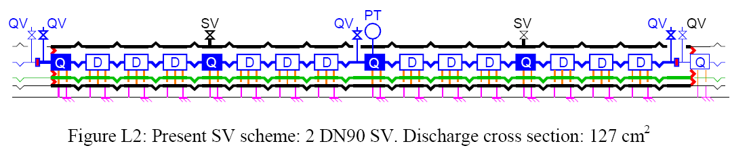
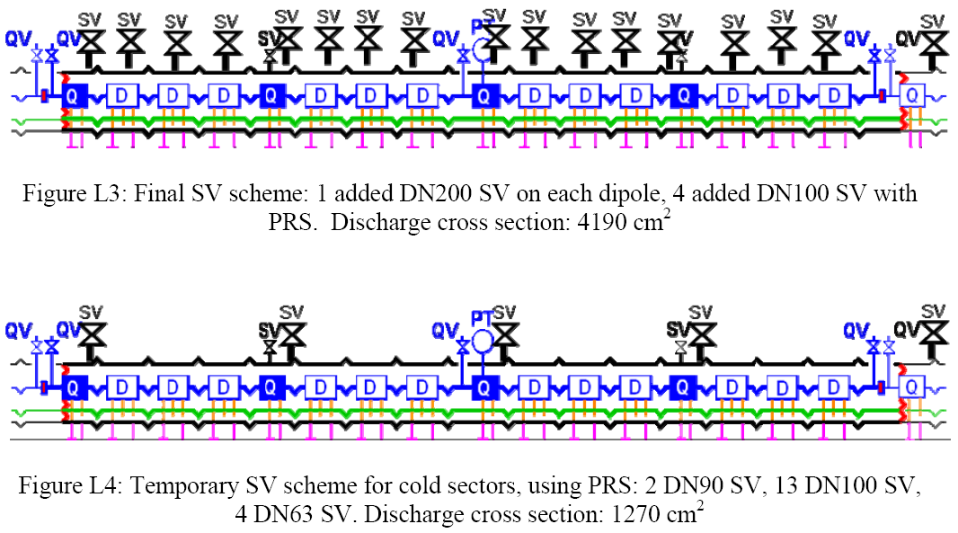
Vacuum vessel safety valves (SV) schemes
Prior to
19.Sept. 08 incident SV scheme
Final SV scheme
Temporary SV scheme

Slide 53
Modeling results for redefinedMCI with temporary SV scheme
Helium mass flow thought holes, SV and QV valves

Slide 54
Modeling results for redefined MCI with final SV scheme
Helium mass flow thought holes, SV and QV valves

Slide 55
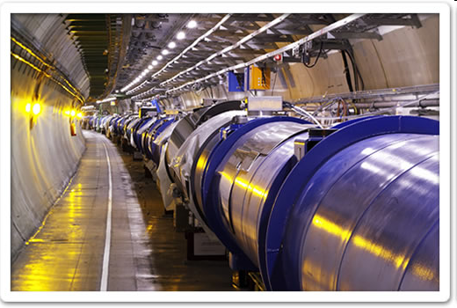


Helium propagation, tunnel pressurization and ODH
During the incident the amount of about 6 ton of helium has been released into the LHC tunnel in the way that can be classified as a physical phenomenon with a high rate volume production.

Slide 56
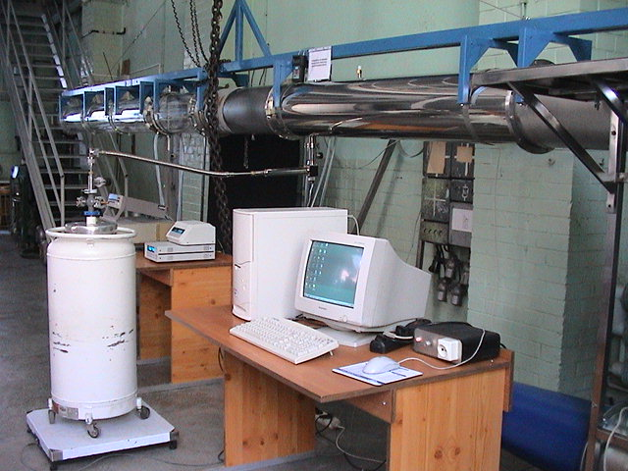
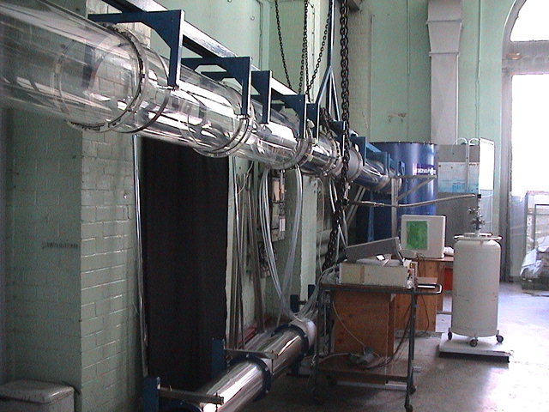
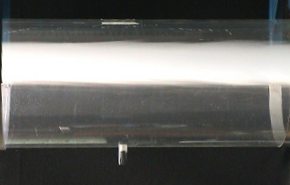
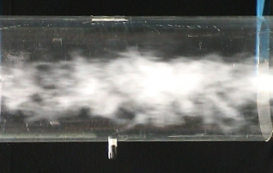
The observed oxygen concentration decrease was in good agreement with a small scale modelling of the helium discharge to the LHC tunnel mock-up
Test set-up
build and operated at WUT
Visualisation results
LHe
Air
LHe
Measurement results
1
1
0.8
0.8
h / D
h / D
0.6
0.6
0.4
0.4
0.2
0.2
0
0
5
10
15
20
0
180
200
220
240
260
280
300
O
2
concentration, %
Temperature, K

Slide 57
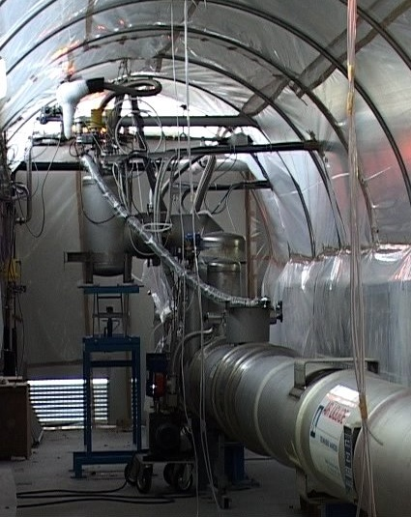
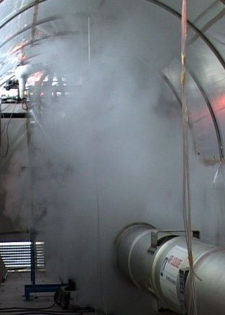
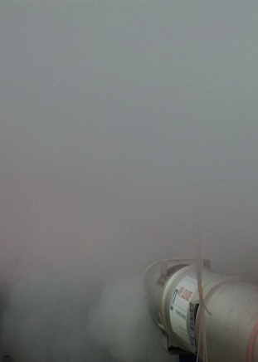
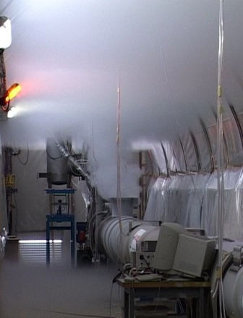
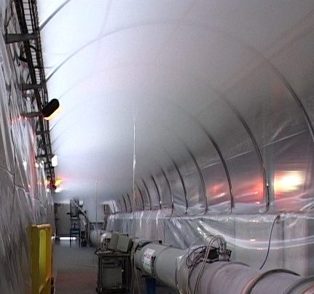
As well as with a full scale modelling of the helium discharge to the LHC tunnel mock-up
Cold helium propagation
in the LHC tunnel
Large scale
experiment at CERN

Slide 58
Conclusions
Risk analysis for PIP II Cryogenic Distribution System is recommended
The analysis should be based on WUST experience with other similar systems (ESS, XFEL, LHC, ITER), the metodology takes into account both physics and RAMI approach
The cheapest intervention is during the design phase

