Slide 1
PIP-II CDS - cold interfaces installation method
Tomasz Banaszkiewicz / Wroclaw Univ. of Science and Technology
PIP-II Technical Workshop
July 13th, 2022

Slide 2
PIP-II CDS
The Cryogenic Distribution System is divided into three individual deliverables:
Distribution Valve Box (DVB)
Intermediate Transfer Line (ITL)
Tunnel Transfer Line (TTL)

Slide 3
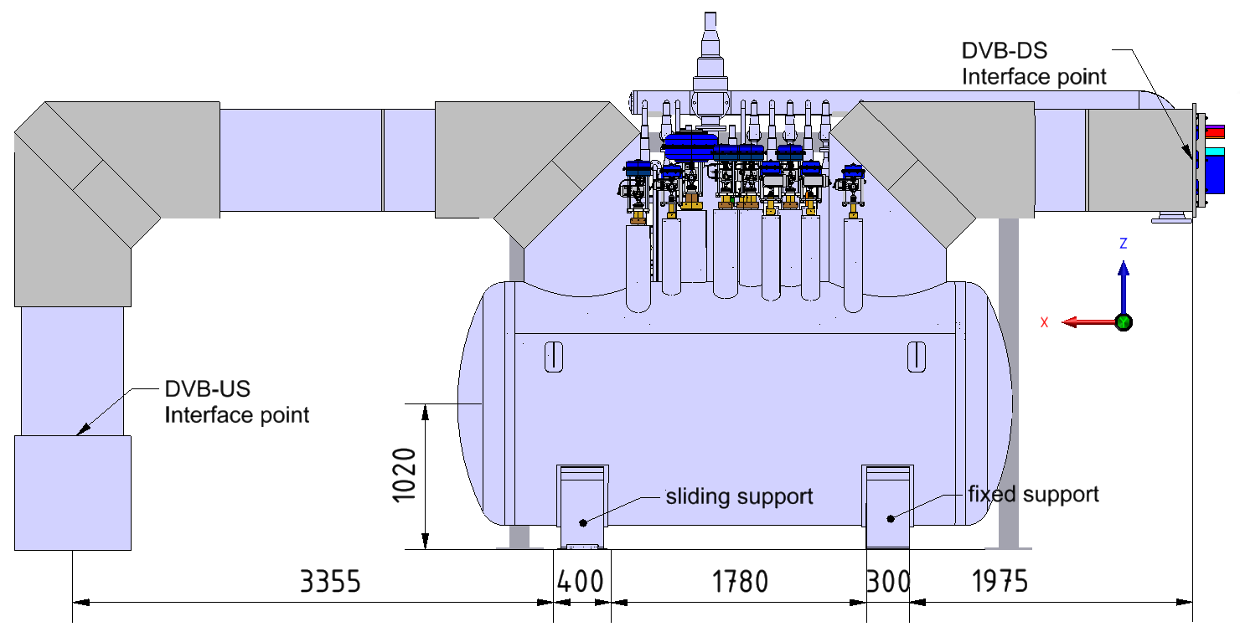
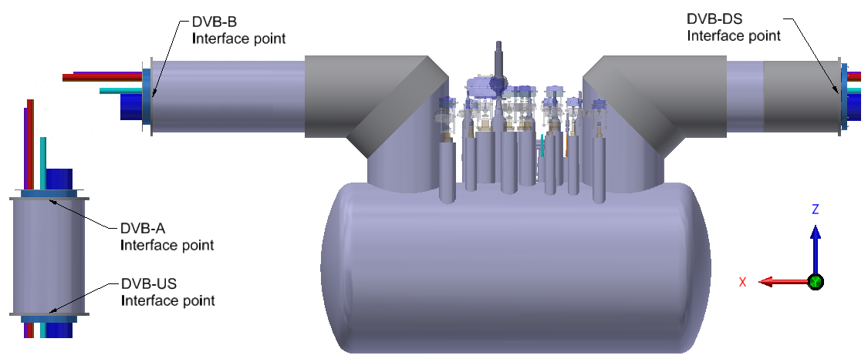
Cryogenic interfaces of the DVB
Distribution Valve Box has four Cryogenic interface points:
DVB-US – upstream interface point connecting to the Cryoplant
DVB-DS – downstream upstream interface point connecting to the ITL
DVB-A, DVB-B – internal interfaces connecting elements od the DVB shipped sepparately

Slide 4
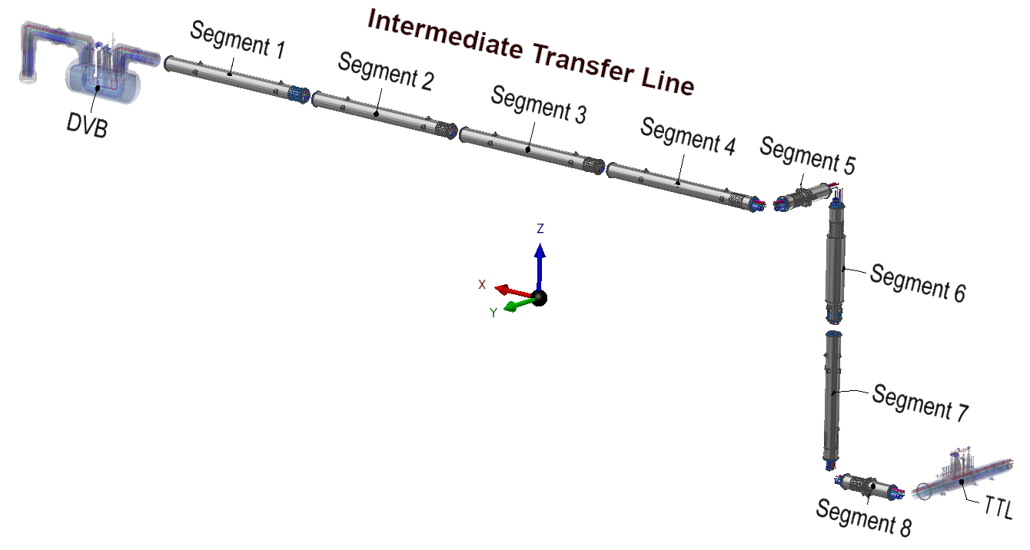
Cryogenic interfaces of the ITL
S-US
S-DS
Intermediate Transfer Line consists of eight segments.
Each segment has two cryogenic interface points:
S-US – upstream interface point
S-DS – downstream interface point

Slide 5
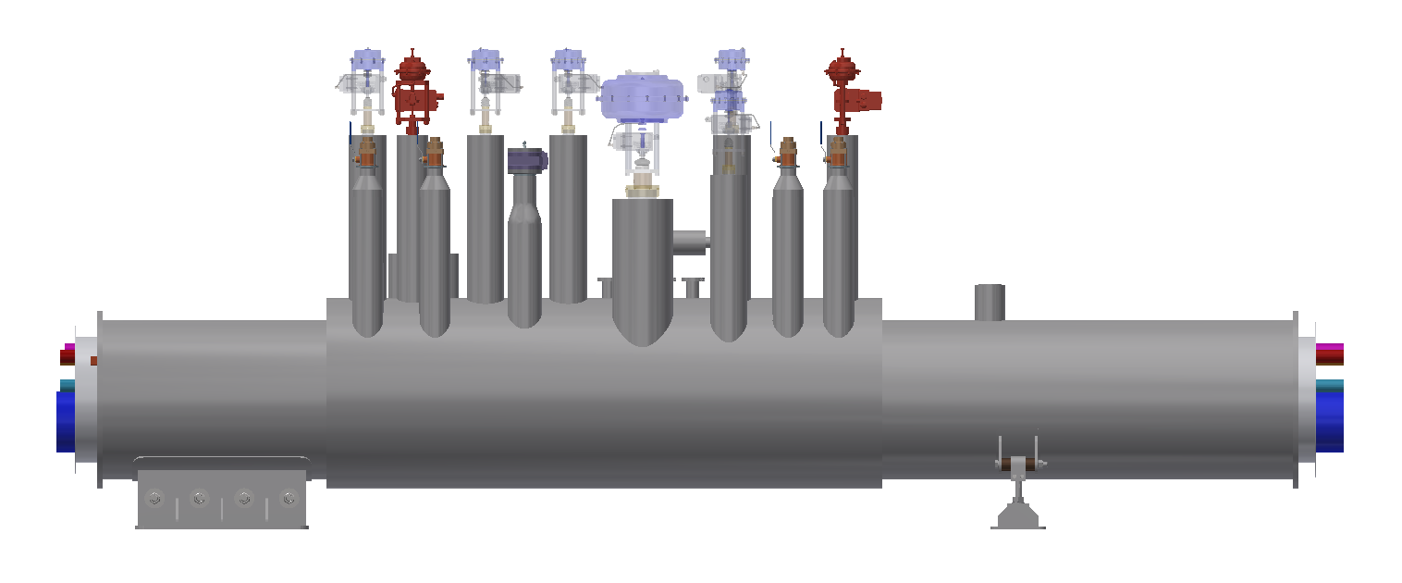
Cryogenic interfaces of the TTL
Tunel Transfer Line consists of 25 Bayonet Cans (BC) and Turnaround Can (TC).
Each Bayonet Can has two interface points:
BC-US – upstream interface point
BC-DS – downstream interface point
Turnaround Can has only one interface point:
TC-US – upstream interface point
BC-DS
BC-US

Slide 6
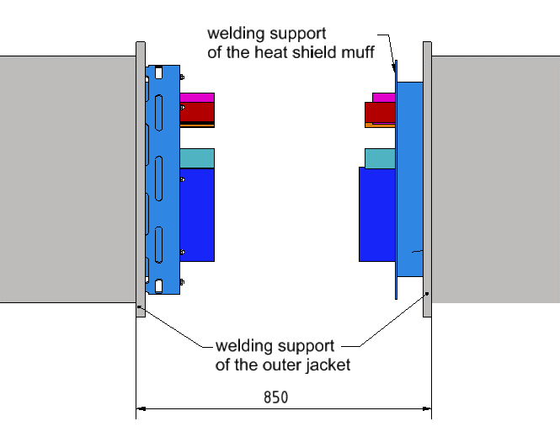
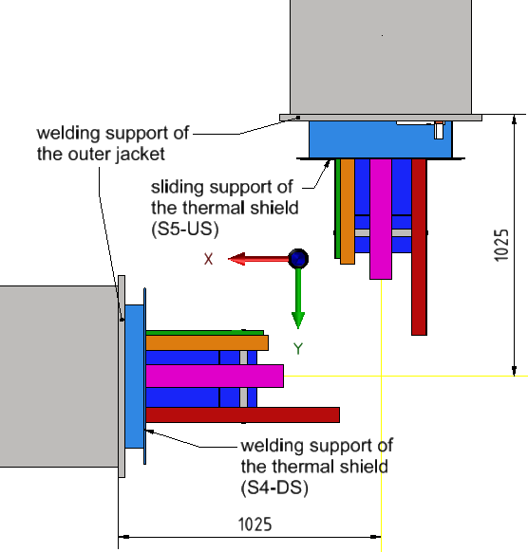
Interface types
Straight connection
Corner connection

Slide 7
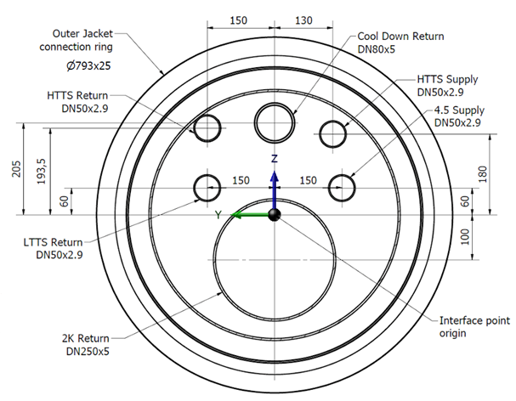
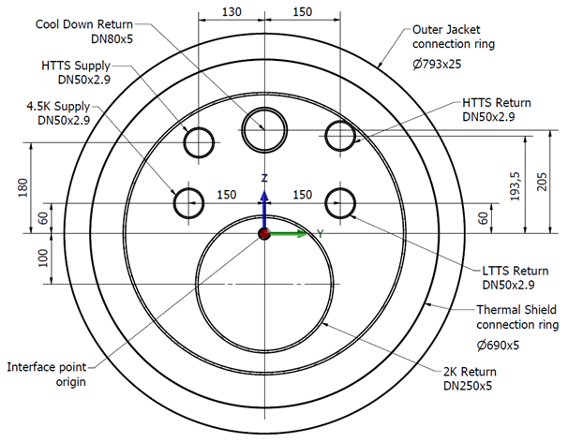
Straight interface

Slide 8
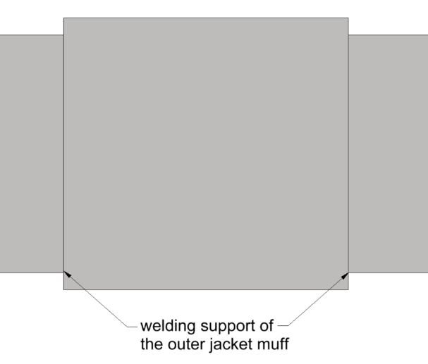
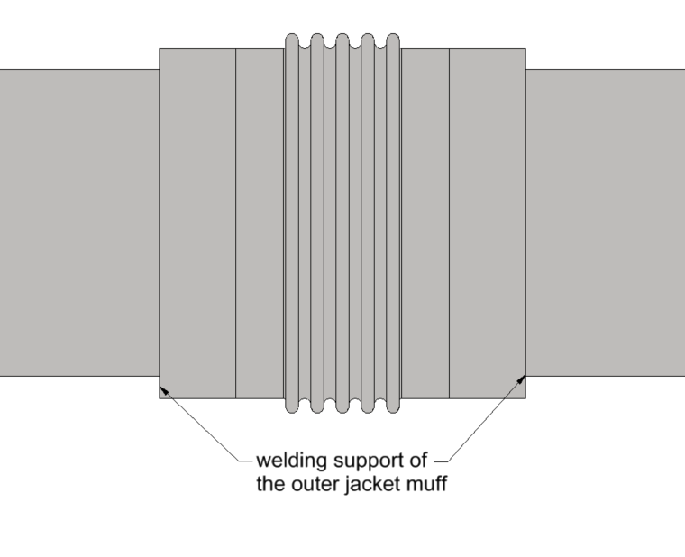
Straight interface
Mounting of the connection should be done according to the following algorithm:
1. The outer jacket muff should be placed on the outer jacket of one of the segments taking part in the connection.
slide
slide
outer jacket muff with no bellows
outer jacket muff with bellows

Slide 9
Straight interface
Mounting of the connection should be done according to the following algorithm:
1. The outer jacket muff should be placed on the outer jacket of one of the segments taking part in the connection.
The horizontal space between two interface point origins (the farthest edges of the adjacent outer jacket welding rings) should be set to 850 mm
3. The actual length of the space between each cold line should be measured.

Slide 10
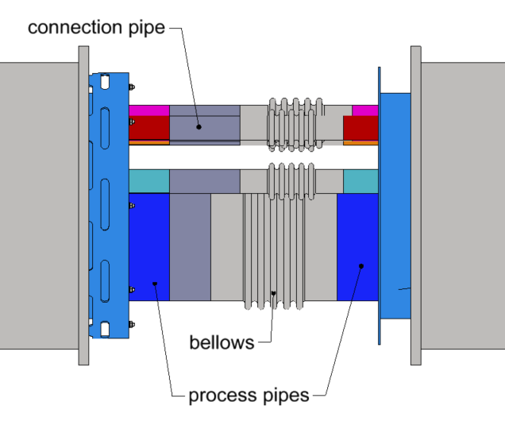
Straight interface
Mounting of the connection should be done according to the following algorithm:
The connection between two adjacent cold lines should be made of two elements: compensation bellows in the pre-contracted state and the connection pipe. The length of the connection pipe should be such to complete the connection between the cold line and the bellows. Bellows and the connection pipes should be welded to the cold lines, and the connection should be helium tight.

Slide 11
Straight interface
Exeplary pre-stress table for bellows
Process line name | DN | Material | Type | Pre-stress value, mm | Design
2K Return | 250 | 1.4541 | ARN06.0250.048.0 double welded with inner sleeve | 10 | From catalogue
CD Return | 80 | 1.4541 | ARN25.0080.042.0 double welded with inner sleeve | 10 | From catalogue
4.5K Supply | 50 | 1.4541 | ARN25.0050.032.0 double welded with inner sleeve | 12 | From catalogue
LTTS Return | 50 | 1.4541 | ARN25.0050.032.0 double welded with inner sleeve | 12 | From catalogue
HTTS Supply | 50 | 1.4541 | ARN25.0050.032.0 double welded with inner sleeve | 12 | From catalogue
HTTS Return | 50 | 1.4541 | ARN25.0050.032.0 double welded with inner sleeve | 12 | From catalogue

Slide 12
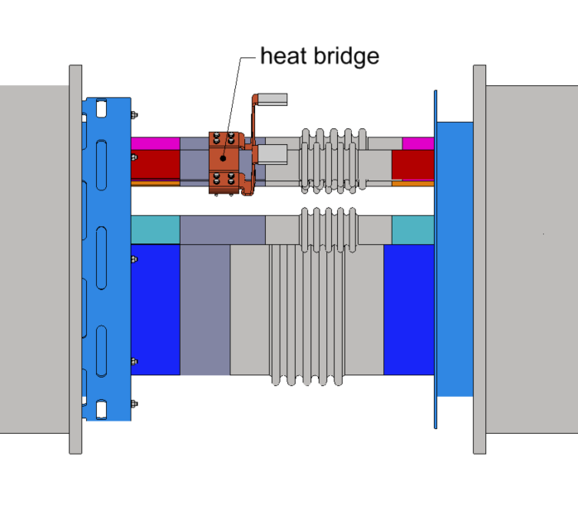
Straight interface
Mounting of the connection should be done according to the following algorithm:
Install 10 layers of MLI on process pipes with the density of 20 layers /cm
No MLI on the HTTS Return Line
6. Install one end of the heat bridge on the HTTS Return line.

Slide 13
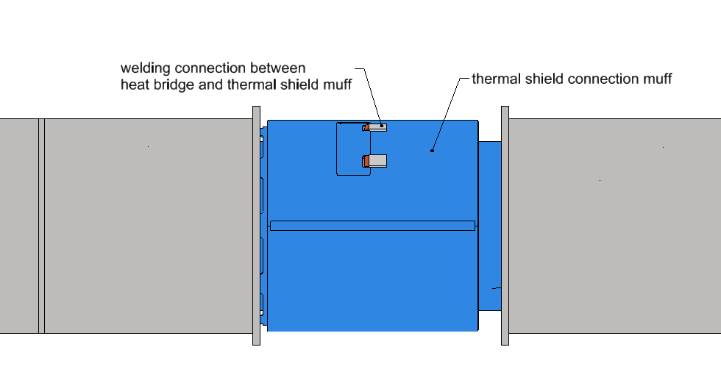
Straight interface
Mounting of the connection should be done according to the following algorithm:
Install the thermal shield muff. The connection muff is made of two halves that need to be welded together and to the fixed support on the UPSTREAM interface side
8. Connect the second end of the heat bridge to the Thermal shield connection muff.
9. The thermal shield muff should be covered with 30 layers of MLI with the density of 20 layers /cm

Slide 14
Straight interface
Mounting of the connection should be done according to the following algorithm:
10. The outer jacket muff should be shifted back to the connection. The muff should be placed on both supports.
11. The outer jacket muff should be welded to both supports. The weld connection should be helium tight. If the outer jacket muff consists of the bellows, it should be pre-compressed.
slide
slide
outer jacket muff with no bellows
outer jacket muff with bellows

Slide 15
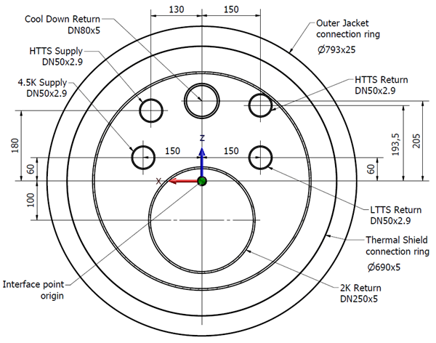
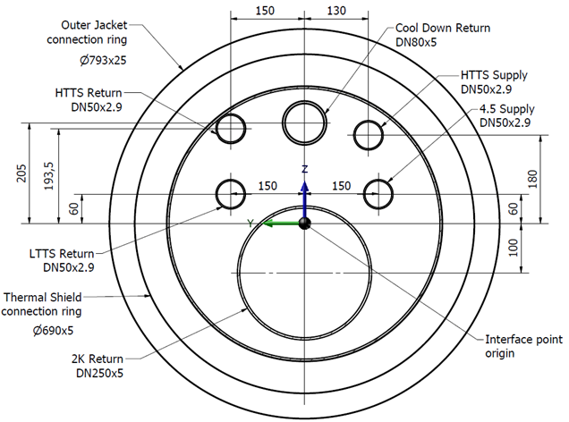
Corner interface

Slide 16
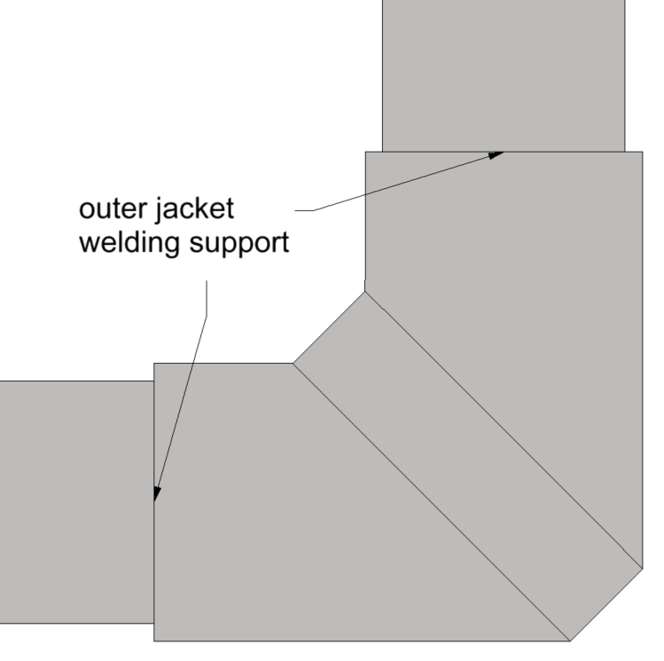
Corner interface
Mounting of the connection should be done according to the following algorithm:
1. The outer jacket corner-connection cover is made of 4 pieces: 2 pipe pieces cut on the one end at a 45° angle and two semi-circular pieces to connect them. The pipe pieces should be placed on the outer jacket of the segments taking part in the connection.
slide
pipe pieces
slide

Slide 17
Corner interface
Mounting of the connection should be done according to the following algorithm:
The space between two interface point origins should be set to 1025 mm both in the x and y direction
The actual length of the space between each cold line should be measured.

Slide 18
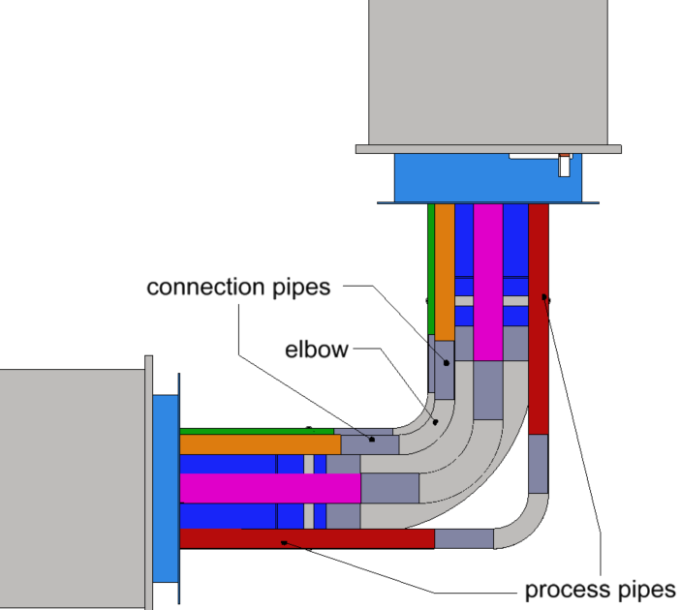
Corner interface
Mounting of the connection should be done according to the following algorithm:
The connection between two adjacent cold lines should be made of three elements: the 90° elbow or metal hose and straight connection pipes. The connection pipes should be welded to the cold lines on each side of the interconnection and the elbow should be welded to the free ends of the connection pipes. All the welds should be helium tight.

Slide 19
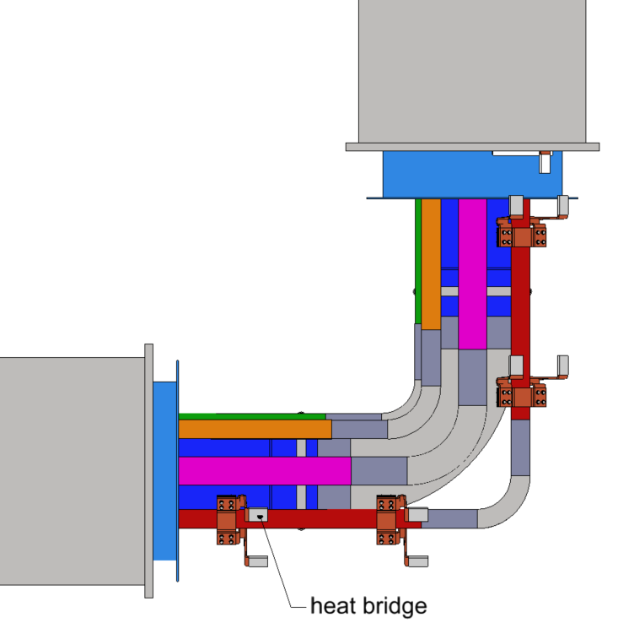
Corner interface
Mounting of the connection should be done according to the following algorithm:
Install 10 layers of MLI on process pipes with the density of 20 layers /cm
No MLI on the HTTS Return Line
6. Install one end of each heat bridge on the HTTS Return line.

Slide 20
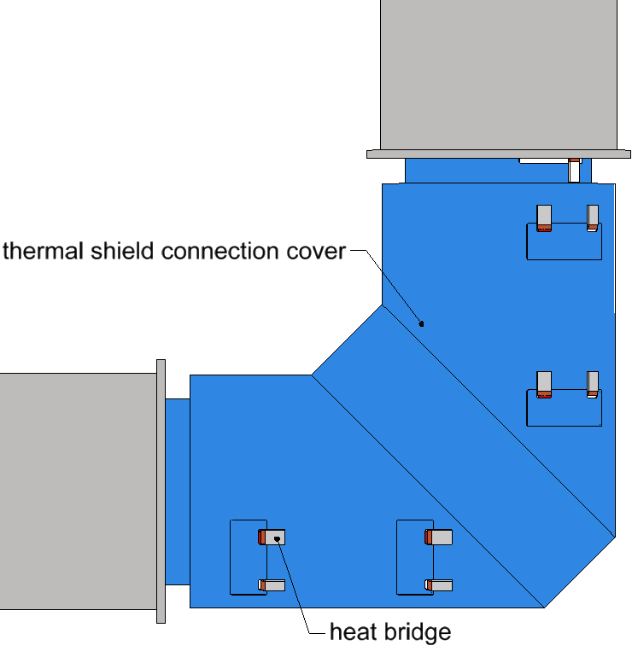
Corner interface
Mounting of the connection should be done according to the following algorithm:
Install the thermal shield corner-connection cover. The corner-connection cover is made of four parts that need to be welded together and to the fixed support on the DOWNSTREAM interface side
8. Connect the second end of the heat bridges to the Thermal shield corner-connection cover.
9. The thermal shield cover should be covered with 30 layers of MLI with the density of 20 layers /cm

Slide 21
Corner interface
Mounting of the connection should be done according to the following algorithm:
10. The straight elements of the outer jacket corner-connection cover should be shifted back to the connection and the corner-connection cover should be assembled.
11. The outer jacket corner-connection cover should be welded to the welding supports on both sides of the interconnection. The weld connection should be helium tight
slide
pipe pieces
slide

Slide 22
Thank You

