Slide 1
DVB design
Pawel Duda / Wroclaw University of Science and Technolog
PIP-II Technical Workshop
13/07/2022

Slide 2

Outline
CDS overview
DVB overview
  PID diagram
  process pipes design
  thermal shield design
  vacuum vessel and external supports design

Slide 3
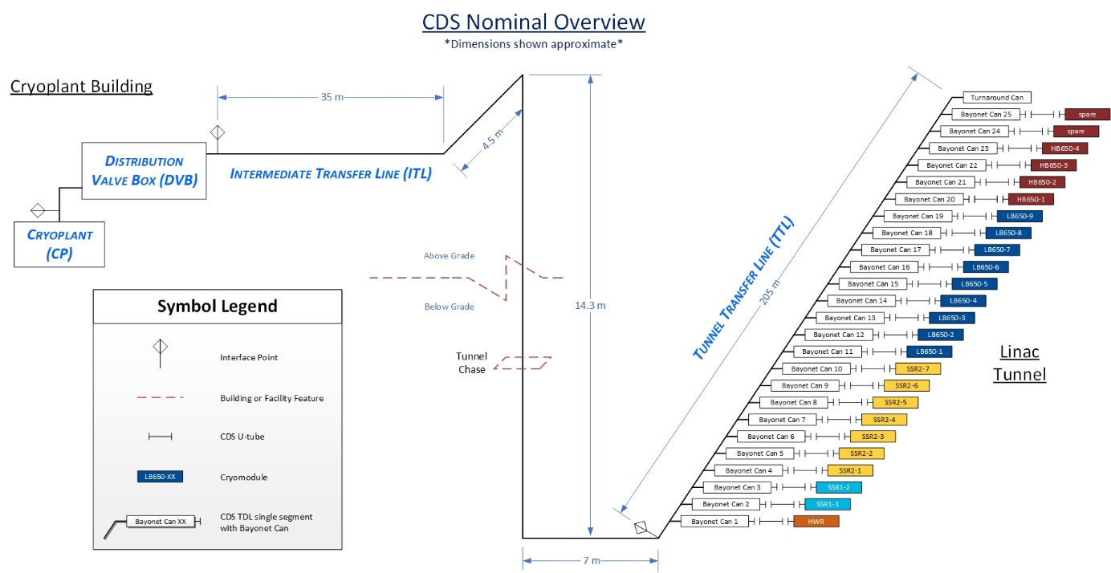
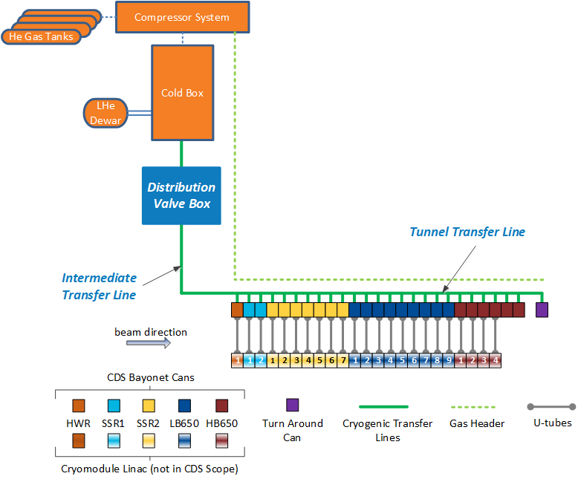
CDS overview
Cryogenic distribution system

Slide 4
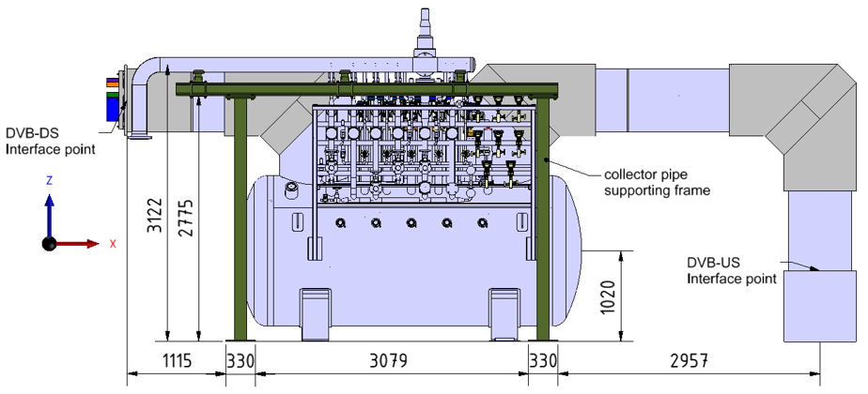
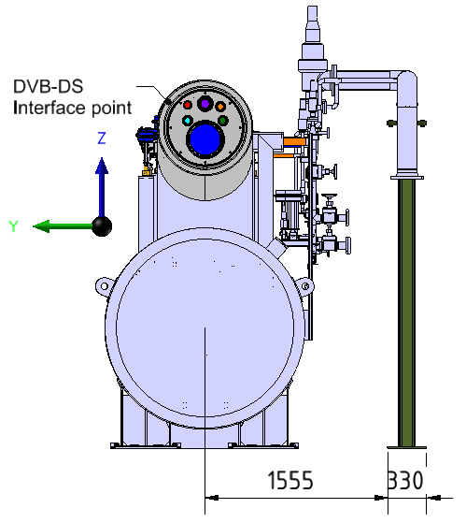
DVB overview
ITL Connection
3m high
7.8m long with a Cold Box connection
5m without a CB connection
1.5m in diameter
Cold Box
Connection

Slide 5
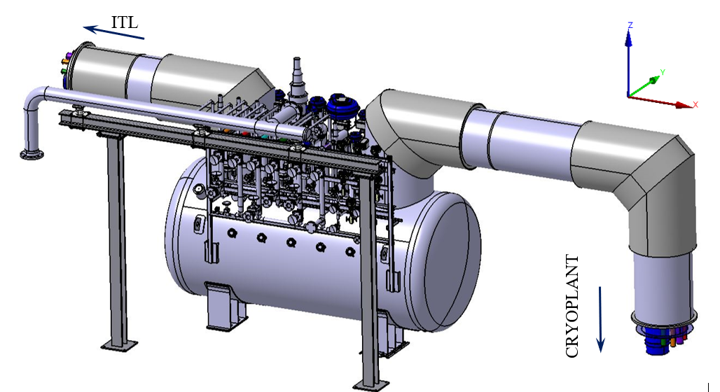
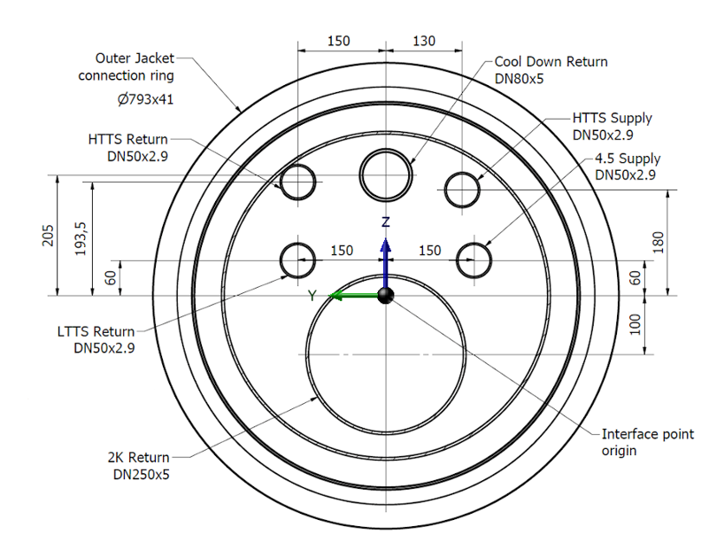
DVB overview
Main process lines
HTTS Return (80K; 20 bara)
HTTS Supply (40K; 20 bara)
LTTS Return (9K; 20 bara)
4.5 K Supply (4.5K; 20 bara)
2 K Return (3.8K; 4.1 bara)
Cooldown Return (80K; 20 bara)
Warm Manifold
Fixed Support
Sliding Support

Slide 6
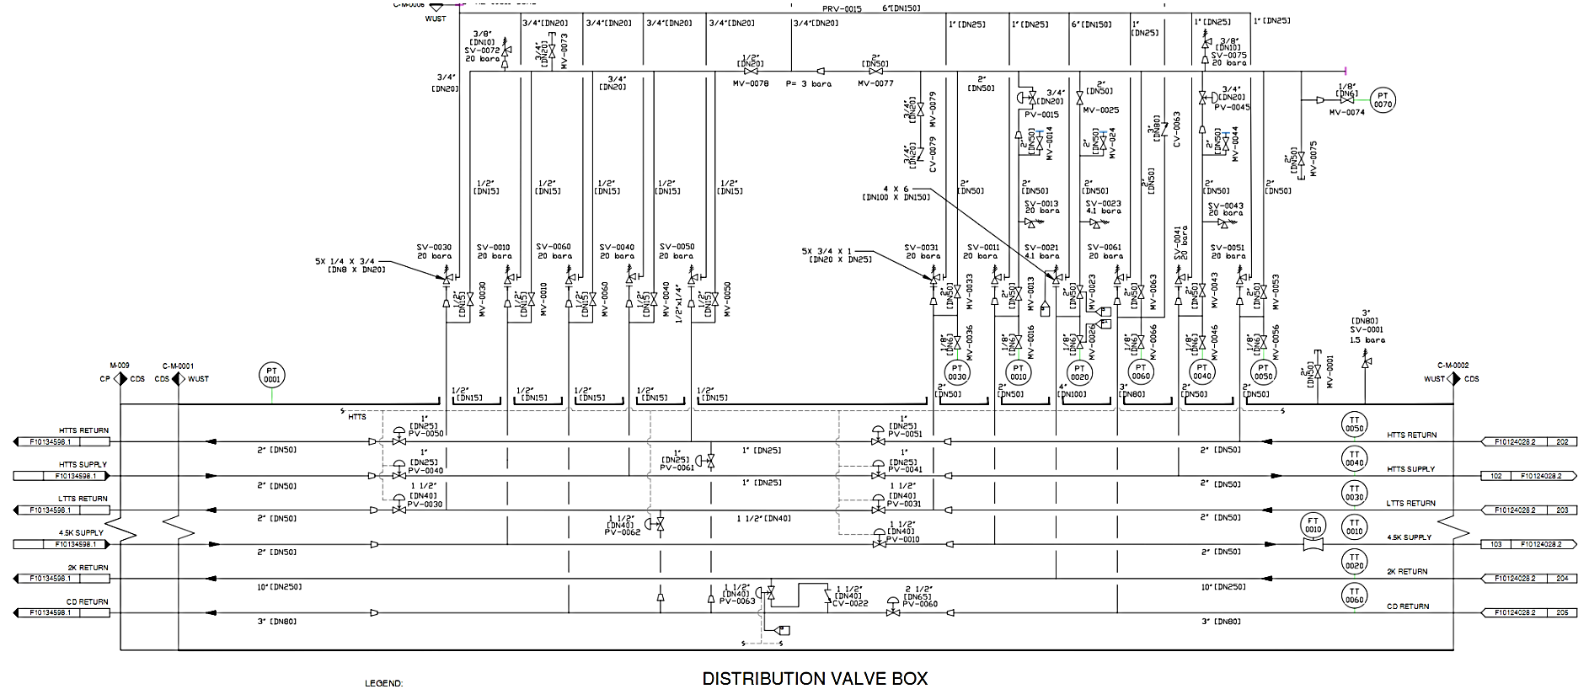
DVB PID diagram
Warm He supply
to CDS
Main process lines
HTTS Return (80K; 20 bara)
HTTS Supply (40K; 20 bara)
LTTS Return (9K; 20 bara)
4.5 K Supply (4.5K; 20 bara)
2 K Return (3.8K; 4.1 bara)
Cooldown Return (80K; 20 bara)
Flow meter
Process
valves
Cooldown valves

Slide 7
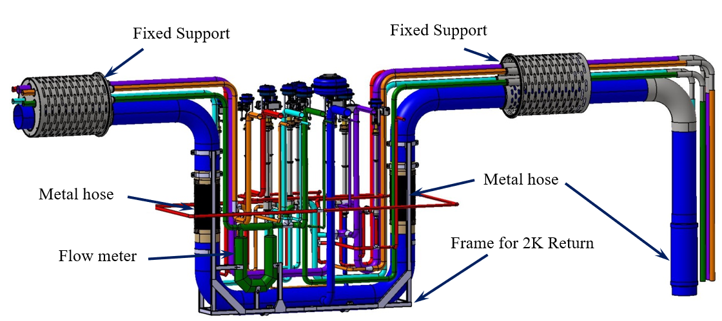
Process pipes design
Main process lines
HTTS Return (80K; 20 bara)
HTTS Supply (40K; 20 bara)
LTTS Return (9K; 20 bara)
4.5 K Supply (4.5K; 20 bara)
2 K Return (3.8K; 4.1 bara)
Cooldown Return (80K; 20 bara)
Process pipes are covered with 10 layers of MLI at layer density of ≤ 20/cm

Slide 8
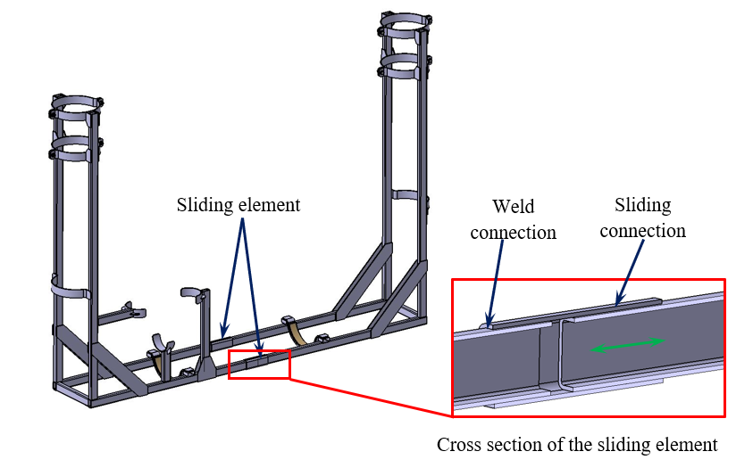
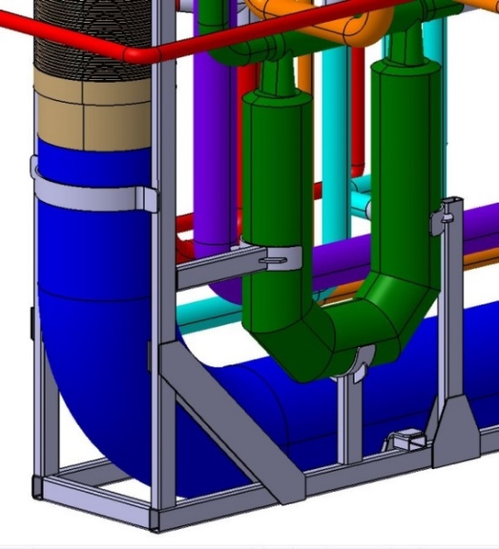
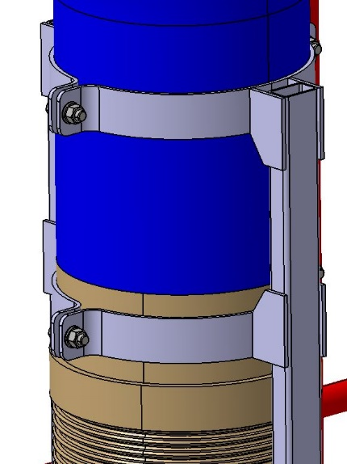
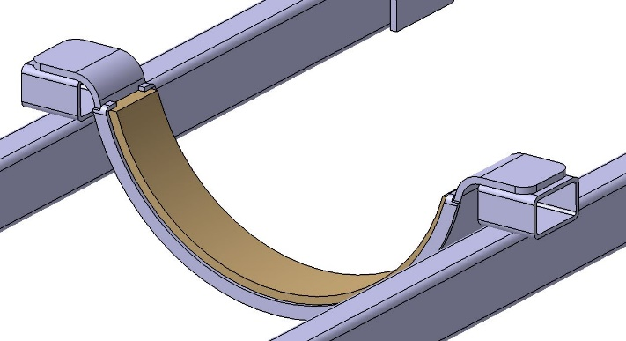
Process pipes design – 2K Return frame
Teflon plate on horizontal surfaces
Fixed connection between frame and 2K Return
Support for the flow meter

Slide 9
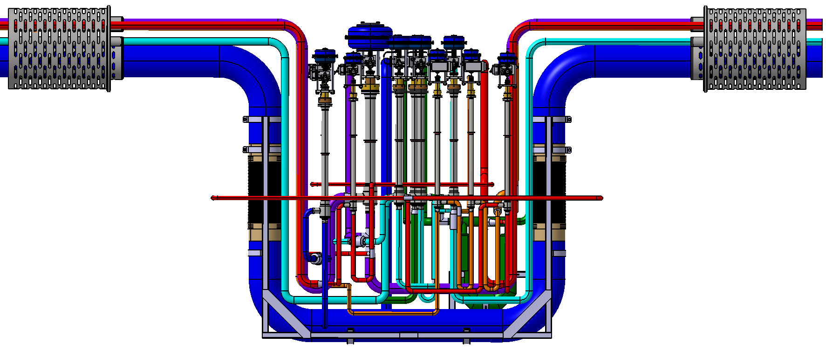
Process pipes design - shape compensation
Fixed Support
Fixed Support
Movement
Fixed Support
Fixed Support
Compensation
arm
„0” point

Slide 10
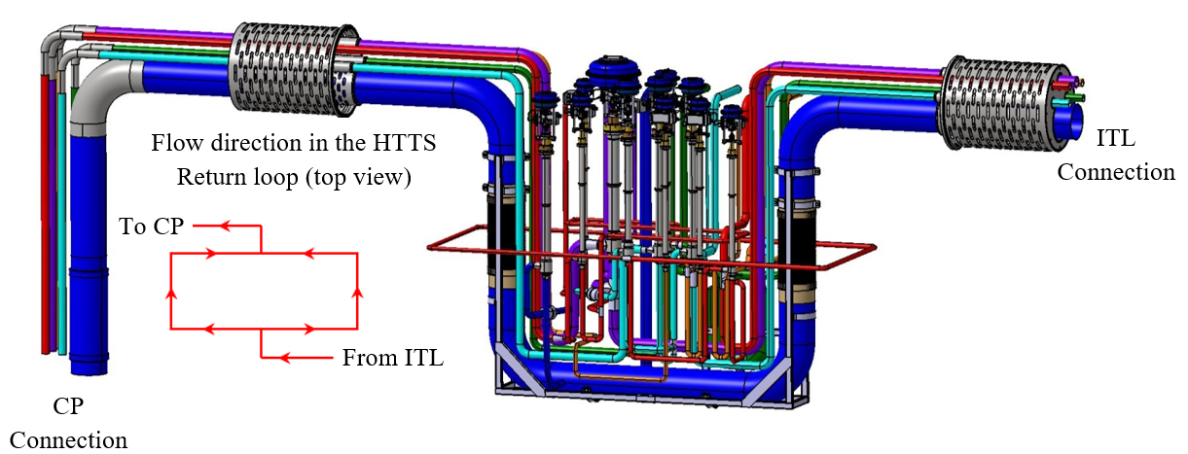
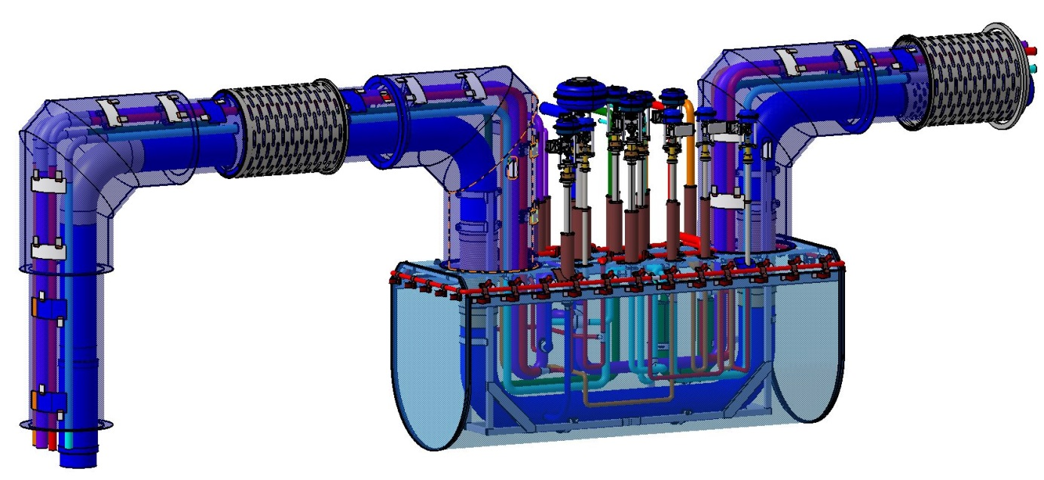
Process pipes design – TS cooling loop
Main process lines
HTTS Return (80K; 20 bara)
HTTS Supply (40K; 20 bara)
LTTS Return (9K; 20 bara)
4.5 K Supply (4.5K; 20 bara)
2 K Return (3.8K; 4.1 bara)
Cooldown Return (80K; 20 bara)

Slide 11
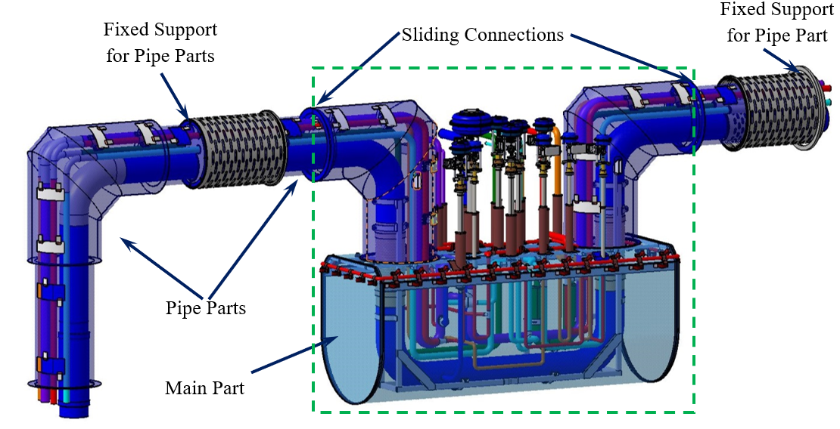
Thermal shield design
Main Part:
aluminium 1050 sheet
wall thickness of 10 mm
Pipe Parts:
aluminium 1050 pipe segments
diameter of 700 mm and 560 mm
wall thickness of 5 mm
The shield is covered with 40 layers of MLI at layer density of ≤ 20/cm

Slide 12
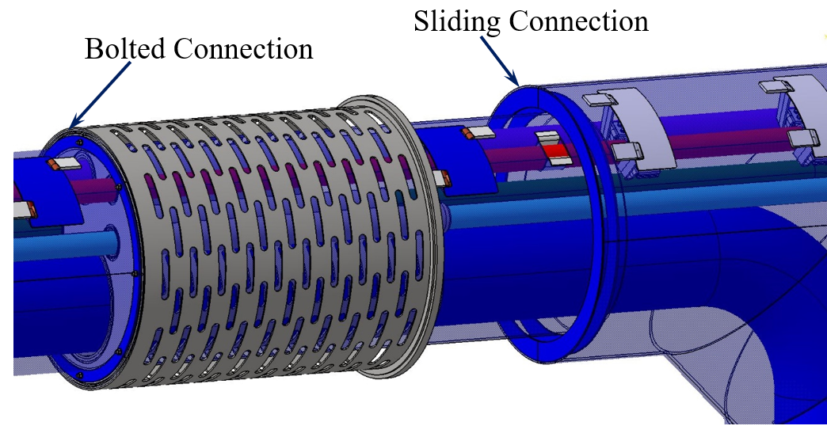
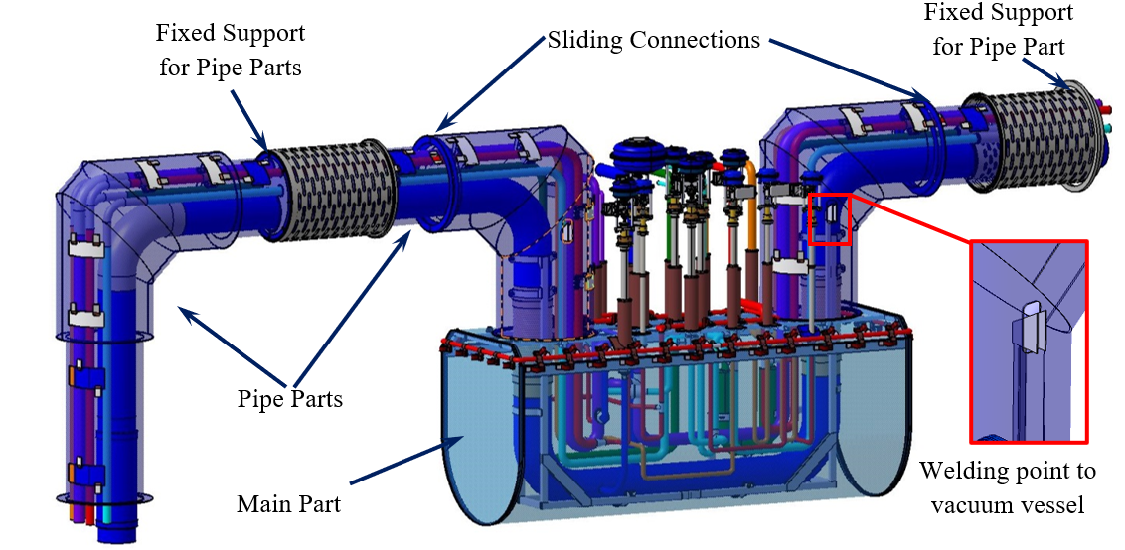
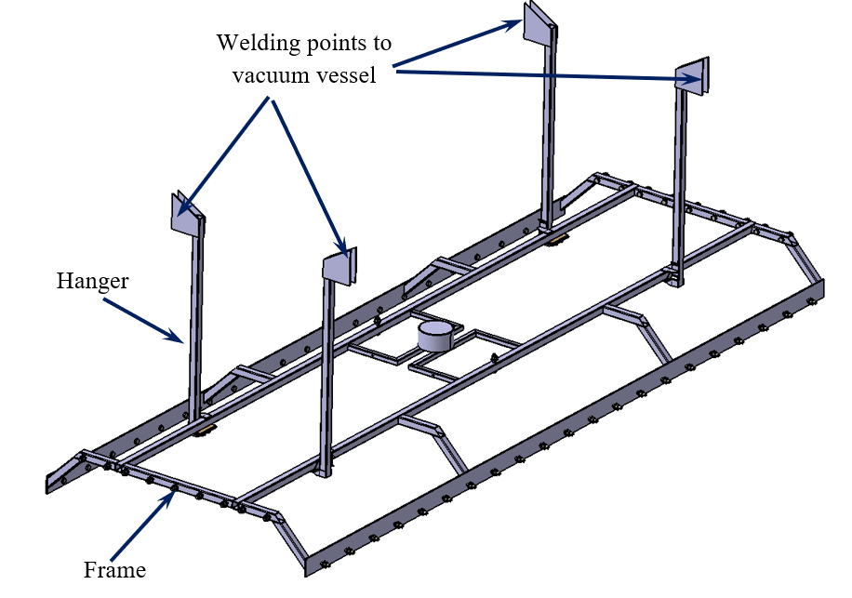
Thermal shield design

Slide 13
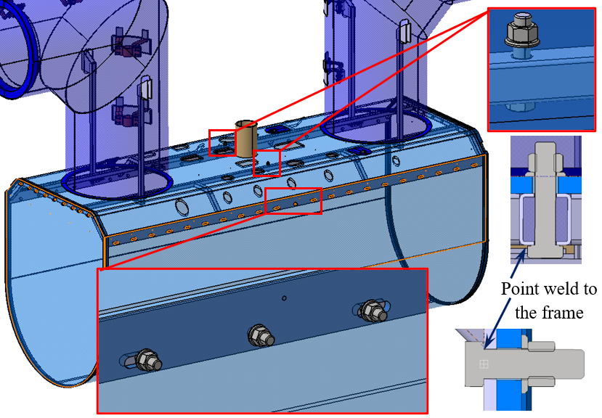
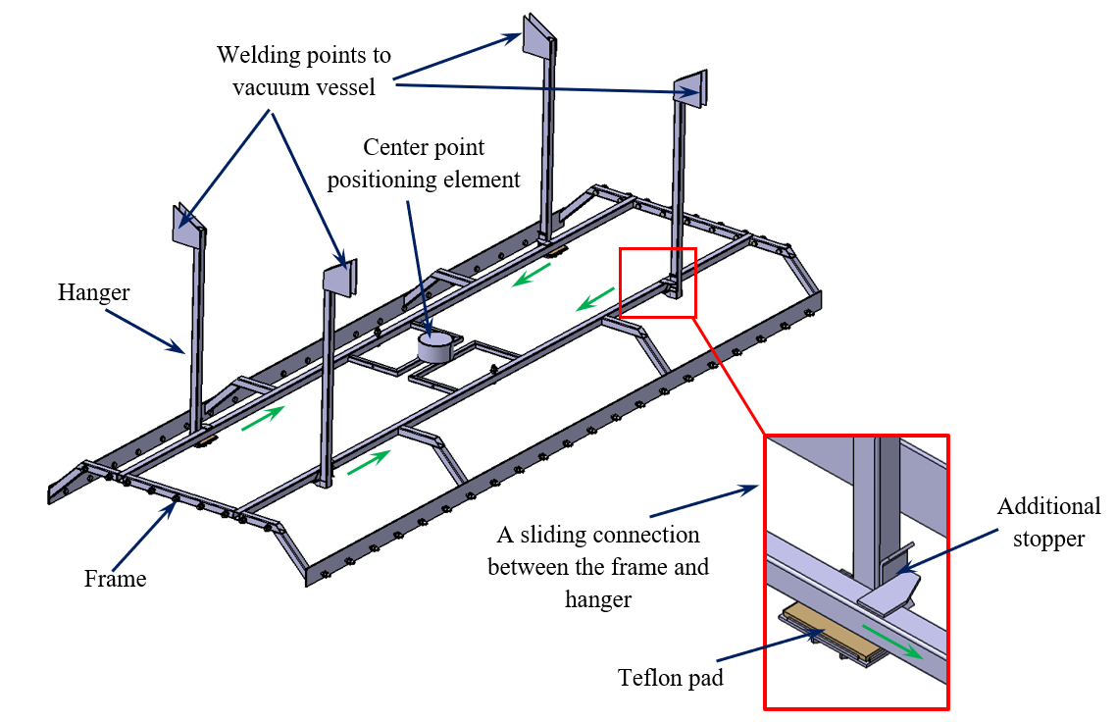
Thermal shield design
Possibility of movement -

Slide 14
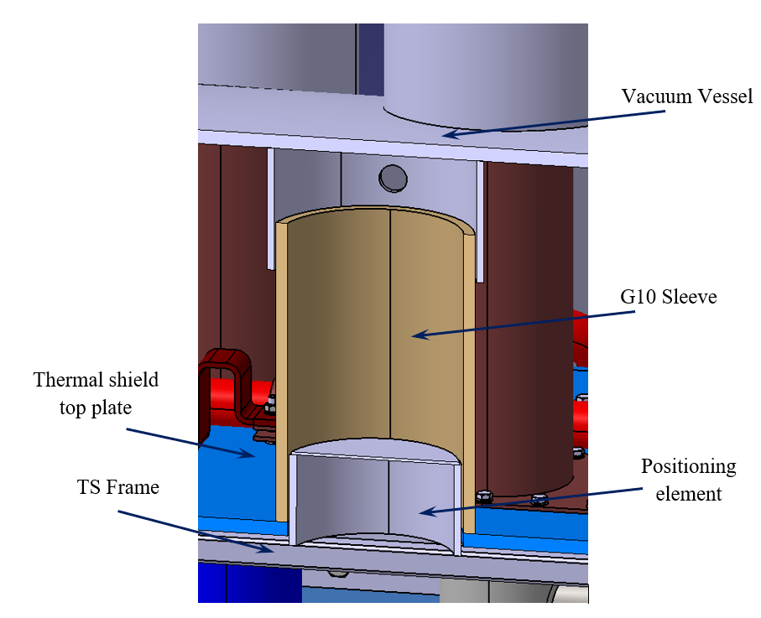
Thermal shield design

Slide 15
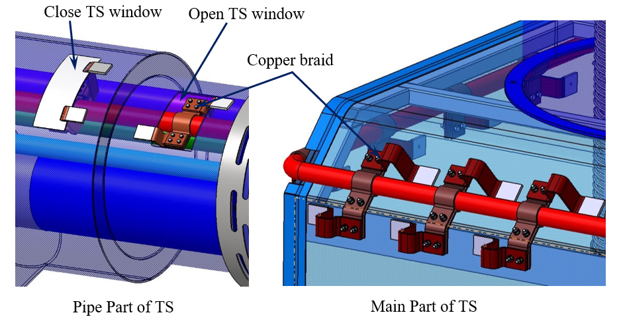
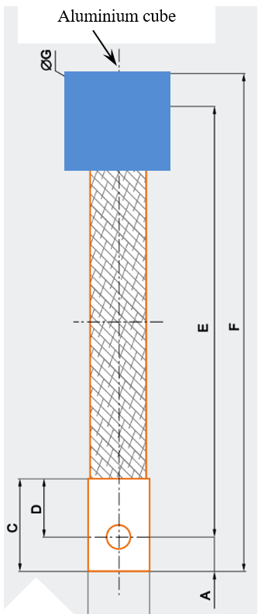
Thermal shield design – thermalization method

Slide 16
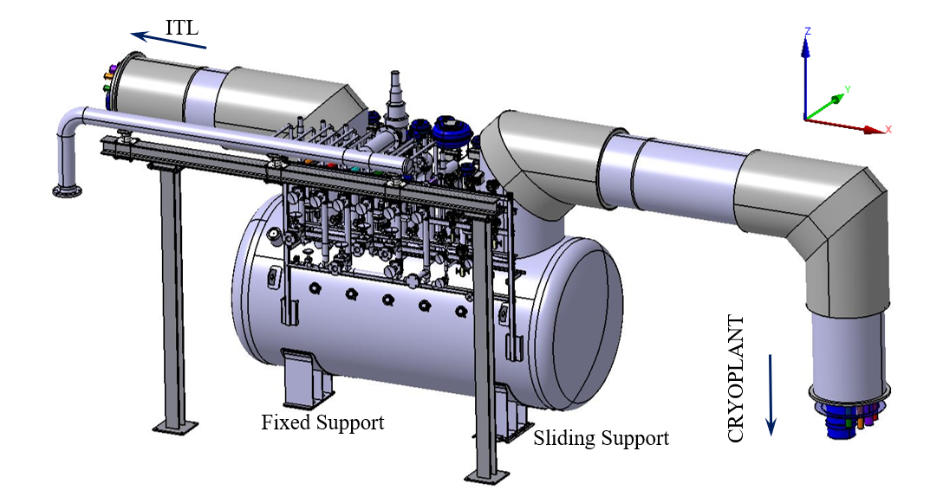
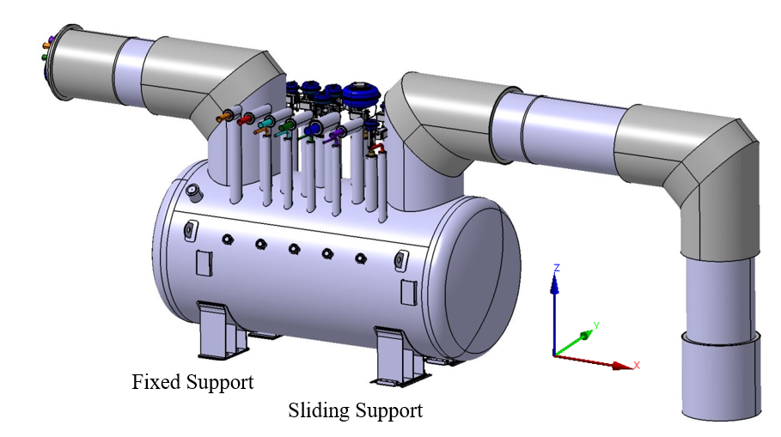
  Vacuum vessel and external supports design
Welding point for warm manifolds frame

Slide 17
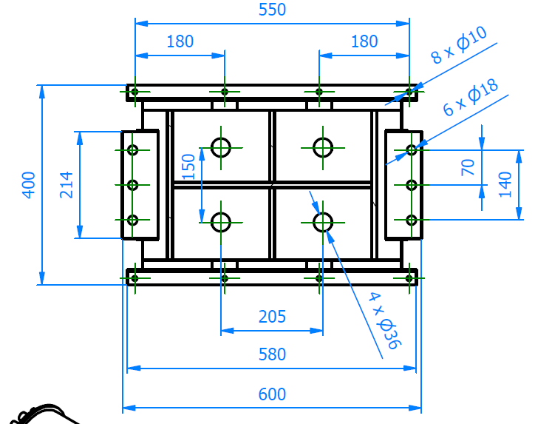
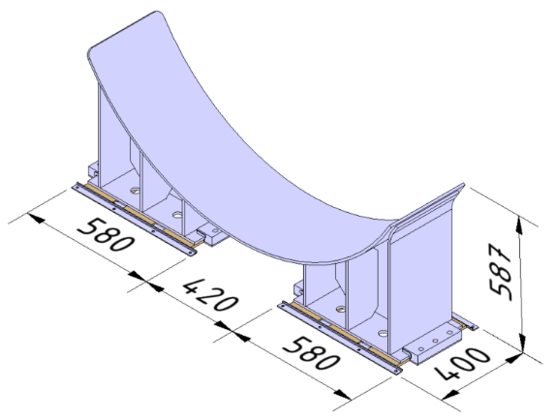
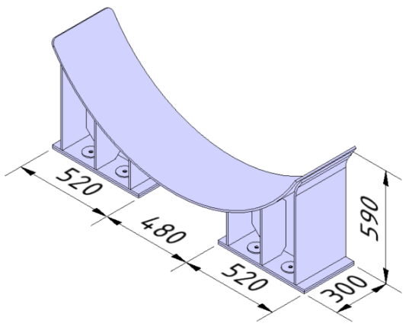
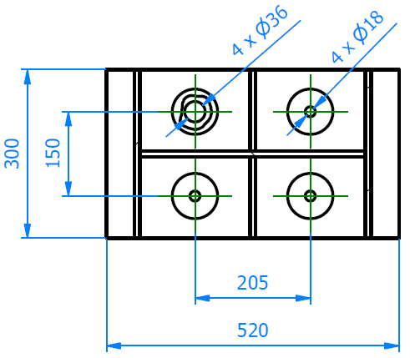
  Vacuum vessel and external supports design
The adjustability of the external supports for mounting will be not less than ± 10 mm in
all planes.

Slide 18
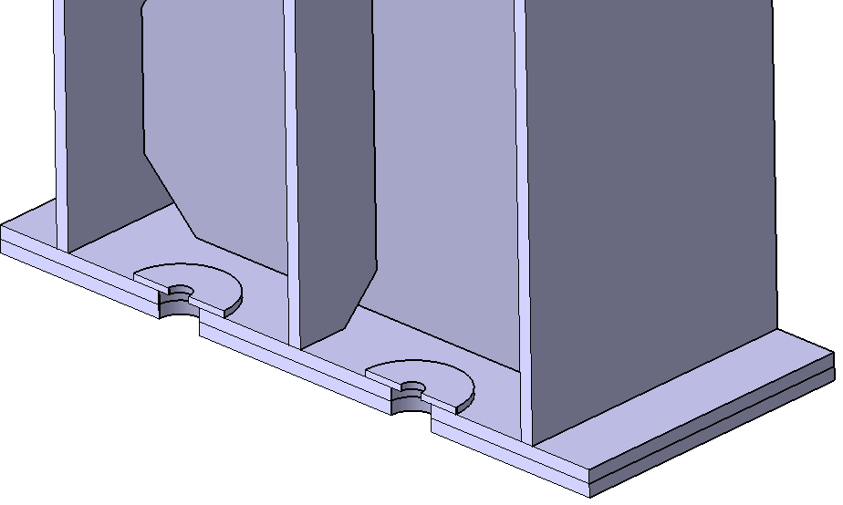
  Vacuum vessel and external supports design
The fixed support need to be anchored to the platform using 4 anchor bolts per leg with the size of M16

Slide 19
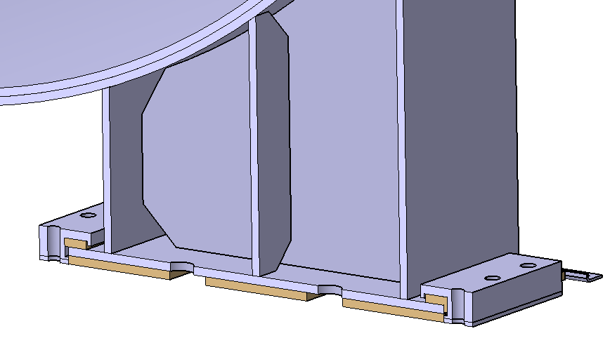
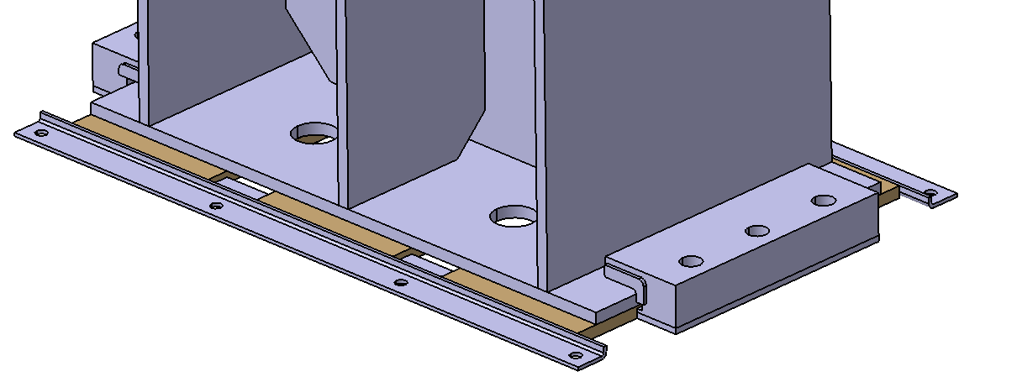
  Vacuum vessel and external supports design
slide in the x-y plane
each bracket should be anchored to the platform using 4 bolts in size of M8 to fix its z-position
Bracket for support
Teflon plates
Bracket for support
+/- 20mm
Bracket for teflon plates
5mm

