Slide 1
WG 4 - Cryogenic Distribution System
Thermal design of CDS components
Jaroslaw Polinski
WUST, Wrocław, Poland
jaroslaw.polinski@pwr.edu.pl
PIP II Technical Workshop, FNAL/Remotely, 12-14 of July 2022

Slide 2
Content
Importance of the thermal insulations in cryogenic devices and systems
Cryogenic thermal insulation materials and systems
Multilayer Insulation (MLI) performance
Thermal Shields design review
#2
J. Polinski, Thermal design of CDS components, PIP II Technical Workshop, FNAL/Remotely, 12-14 of July 2022

Slide 3
Compensation of the heat flux to insulated cold space
Minimum work of the refrigerator:
Scheme of the ideal refrigerator
#3
J. Polinski, Thermal design of CDS components, PIP II Technical Workshop, FNAL/Remotely, 12-14 of July 2022

Slide 4
Minimum work of ideal refrigerator
For T₀ = 4K -> W/Q₀ ≈ 75 W/W
For T₀ = 2K -> W/Q₀ ≈ 150 W/W !!!
Minimal work W to compensation of the heat flux Q₀ in function of the cold temperature, environment temperature T=300K
#4
J. Polinski, Thermal design of CDS components, PIP II Technical Workshop, FNAL/Remotely, 12-14 of July 2022

Slide 5
Real efficiency of cryogenics refrigerators
% of Carnot cycle
Cooling capacity, (W)
Based on: Strobridge, T.R.: Cryogenic Refrigerators – an Updated Survey, NBS Tech Note 655, 1974.
#5
J. Polinski, Thermal design of CDS components, PIP II Technical Workshop, FNAL/Remotely, 12-14 of July 2022

Slide 6
Cryogens evaporation losses due heat input
Volumetric cryogen losses due 1 W heat input
#6
J. Polinski, Thermal design of CDS components, PIP II Technical Workshop, FNAL/Remotely, 12-14 of July 2022

Slide 7
Content
Importance of the thermal insulations in cryogenic devices and systems
Cryogenic thermal insulation materials and systems
Multilayer Insulation (MLI) performance
Thermal Shields design review
#7
J. Polinski, Thermal design of CDS components, PIP II Technical Workshop, FNAL/Remotely, 12-14 of July 2022

Slide 8
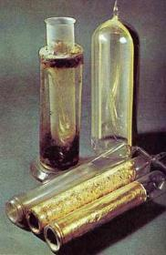
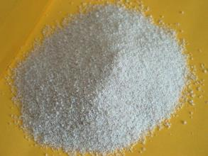
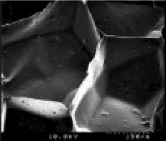
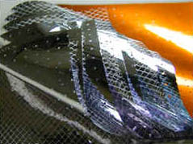
Cryogenic thermal insultions
Thermal conductivity, W/m/K
Close-cells foam
#8
J. Polinski, Thermal design of CDS components, PIP II Technical Workshop, FNAL/Remotely, 12-14 of July 2022

Slide 9


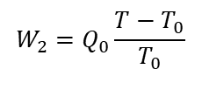

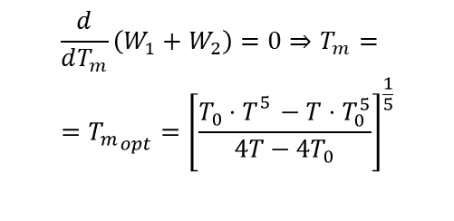
Thermal Shield concept
$$W_{1}=\left(Q_{m}−Q_{0}\right)\frac{T−T_{m}}{T_{m}}$$
$$W_{2}=Q_{0}\frac{T−T_{0}}{T_{0}}$$
$$Q_{m}=Q_{r}\left(T,T_{m}\right)=σ⋅ε\left(T_{}^{4}−T_{m}^{4}\right)$$
$$Q_{0}=Q_{r}\left(T_{m},T_{0}\right)=σ⋅ε\left(T_{m}^{4}−T_{0}^{4}\right)$$
$$\frac{d}{dT_{m}}\left(W_{1}+W_{2}\right)=0⇒T_{m}= \\ ={T_{m}}_{opt}={\left[\frac{T_{0}⋅T_{}^{5}−T⋅T_{0}^{5}}{4T−4T_{0}}\right]}^{\frac{1}{5}}$$
#9
J. Polinski, Thermal design of CDS components, PIP II Technical Workshop, FNAL/Remotely, 12-14 of July 2022

Slide 10
TS optimal temperature (300 – 4K)
T_{m_opt}= 97K
T_{m}= 80K
T_{m}= 116K
W_{tot} / W_{min}= 1.1
#10
J. Polinski, Thermal design of CDS components, PIP II Technical Workshop, FNAL/Remotely, 12-14 of July 2022

Slide 11
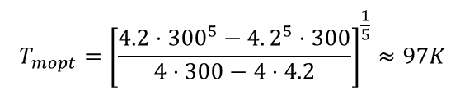
Thermal Shield concept
$$W_{1}=\left(Q_{m}−Q_{0}\right)\frac{T−T_{m}}{T_{m}}$$
$$W_{2}=Q_{0}\frac{T−T_{0}}{T_{0}}$$
$$Q_{m}=Q_{r}\left(T,T_{m}\right)=σ⋅ε\left(T_{}^{4}−T_{m}^{4}\right)$$
$$Q_{0}=Q_{r}\left(T_{m},T_{0}\right)=σ⋅ε\left(T_{m}^{4}−T_{0}^{4}\right)$$
$$\frac{d}{dT_{m}}\left(W_{1}+W_{2}\right)=0⇒T_{m}= \\ ={T_{m}}_{opt}={\left[\frac{T_{0}⋅T_{}^{5}−T⋅T_{0}^{5}}{4T−4T_{0}}\right]}^{\frac{1}{5}}$$
$$T_{mopt}={\left[\frac{4.2⋅300^{5}−4.2^{5}⋅300}{4⋅300−4⋅4.2}\right]}^{\frac{1}{5}}≈97K$$
#11
J. Polinski, Thermal design of CDS components, PIP II Technical Workshop, FNAL/Remotely, 12-14 of July 2022

Slide 12
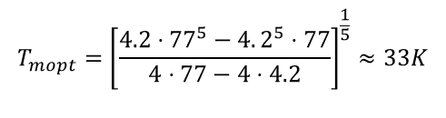
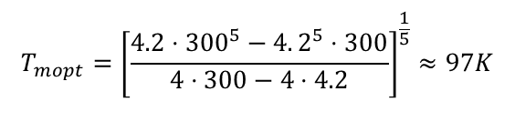
Thermal Shield concept
$$W_{1}=\left(Q_{m}−Q_{0}\right)\frac{T−T_{m}}{T_{m}}$$
$$W_{2}=Q_{0}\frac{T−T_{0}}{T_{0}}$$
$$Q_{m}=Q_{r}\left(T,T_{m}\right)=σ⋅ε\left(T_{}^{4}−T_{m}^{4}\right)$$
$$Q_{0}=Q_{r}\left(T_{m},T_{0}\right)=σ⋅ε\left(T_{m}^{4}−T_{0}^{4}\right)$$
$$\frac{d}{dT_{m}}\left(W_{1}+W_{2}\right)=0⇒T_{m}= \\ ={T_{m}}_{opt}={\left[\frac{T_{0}⋅T_{}^{5}−T⋅T_{0}^{5}}{4T−4T_{0}}\right]}^{\frac{1}{5}}$$
2nd Thernal Shield (between 77 – 4.2 K)
$$T_{mopt}={\left[\frac{4.2⋅300^{5}−4.2^{5}⋅300}{4⋅300−4⋅4.2}\right]}^{\frac{1}{5}}≈97K$$
$$T_{mopt}={\left[\frac{4.2⋅77^{5}−4.2^{5}⋅77}{4⋅77−4⋅4.2}\right]}^{\frac{1}{5}}≈33K$$
#12
J. Polinski, Thermal design of CDS components, PIP II Technical Workshop, FNAL/Remotely, 12-14 of July 2022

Slide 13
Content
Importance of the thermal insulations in cryogenic devices and systems
Cryogenic thermal insulation materials and systems
Multilayer Insulation (MLI) performance
Thermal Shields design review
#13
J. Polinski, Thermal design of CDS components, PIP II Technical Workshop, FNAL/Remotely, 12-14 of July 2022

Slide 14
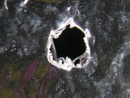
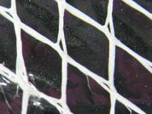
Multilayer Insulation MLI
Environment – warm boundary
2 mm
VACUUM
Insulated space – cold boundary
Shield perforation hole
1.8 mm
Shield perforation
1.6 mm
0.18 mm
Radiation shield
Spacer
Spacer
#14
J. Polinski, Thermal design of CDS components, PIP II Technical Workshop, FNAL/Remotely, 12-14 of July 2022

Slide 15
Multilayer Insulation MLI
Radiation shields:
Shield material: single or double side metal plated Mylar, Kapton, Dracon, material thickness: 5 – 75 μm
Pleating metals: Al, Ag, Cu, Au – layer thickness 0.05 do 0.1 μm (500 – 1000 Å)
Perforation: holes 1 – 3 mm diameter, perforation area: 0.1 – 0.3% of total area
Spacer material:
single/ double silky net
single/ double nylon net
glass fibres mats
Special cases:
Radiation shields are crinkled or dimpled and no spacer material is used
One shield side is metalized – no metalized side is concerned as low conductivity spacer and no additional spacer is used
#15
J. Polinski, Thermal design of CDS components, PIP II Technical Workshop, FNAL/Remotely, 12-14 of July 2022

Slide 16
Multilayer Insulation MLI
Radiation
Environment – warm boundary
Insulated space – cold boundary
Gas conduction
Solid conduction
#16
J. Polinski, Thermal design of CDS components, PIP II Technical Workshop, FNAL/Remotely, 12-14 of July 2022

Slide 17
Multilayer Insulation MLI
Main MLI insulation parameters:
Numbers of the shields
Shield reflecting metal layer material
Spacer material and structure
Vacuum level
Layers density
Methods of installation, (layer-by-layer, blankets/sub-blankets, seaming, butt-joining, spiral wrapping ect.)
#17
J. Polinski, Thermal design of CDS components, PIP II Technical Workshop, FNAL/Remotely, 12-14 of July 2022

Slide 18
Compilation of the MLI experimental results
MLI config # | MLI description | Reference
1 | Lydall CRS – Aluminum foil 1145 - 0,7μm thickness + Cryotherm 1303 (microfiber glass non-woven binder free thermal spacer) | Senthil Kumar, A., Krishna Murthy, M.V., Jacob, S., Kasthurirengan, S. (2000). Thermal Performance of Multilayer Insulation Down to 4.2 K. Advances in Cryogenic Engineering. https://doi.org/10.1007/978-1-4615-4215-5_92
2 | Jehier IR 305 – Double aluminised Mylar (DAM) 6 μm thickness , 400Aº coating thickness on each side, perforation diameter 2mm at a pitch of 56mm + polyester tulle with weight of 5x10³ kg/m²
3 | NRC2 – Crinkled single side aluminized Mylar with thickness 6 μm
4 | IHI – 12μm dimpled, double aluminised Mylar, dimple diameter 2mm at a pitch of 6mm, dimple height 200μm
5 | DAM 12 μm, perforation 0.4%, 1.5 mm holes/nylon net 80 μm thickness | S. Jacob, S. Kasthurirengan, R. Karunanithi, Investigations into the thermal performance of multilayer insulation (300-77 K) Part 1: Calorimetric studies, Cryogenics,Volume 32, Issue 12, https://doi.org/10.1016/0011-2275(92)90328-8
6.1 | DAM 12μm/ glass fibres 76.2 mm – 63.28 layers/cm | S.L. Bapat, at all, Experimental investigations of multilayer, Insulation, August 1990 Cryogenics 30(8):711-719, DOI: 10.1016/0011-2275(90)90235-5
6.2 | DAM 12μm/ glass fibres 76.2 mm – 50 layers/cm
6.3 | DAM 12μm/ glass fibres 76.2 mm – 30 layers/cm
6.4 | DAM 12μm/ glass fibres 76.2 mm – 24.2 layers/cm
7 | NRC2 | Q.S. Shu, R.W. Fast, H.L. Hart, Heat flux from 277 to 77 K through a few layers of multilayer insulation, Cryogenics, Volume 26, Issue 12, https://doi.org/10.1016/0011-2275(86)90167-0
8 | Jehier IR 305 | Fesmire J.E,. Augustynowicz S.D, Darve C., Performance characterization of perforated multilayer insulation blankets, Proceedings of the 19h ICEC
9 | Single layer of DAM 25μm, 250A Al layer thickness | P. Lebrun et al., Investigation and qualification of thermal insulation systems between 80 K and 4.2 K. Cryogenics 32(ICMC Supplement), 44–47 (1992) 12
10 | DAM 25 mm, 250A/net 30 μm, 4x5 mm x mm
11 | DAM 6 mm, 400A /net 6 μm
12 | DAM 8 mm, 230A/CRYOTHERM 2330 60 μm | Benda V e al., Qualification of multilayer insulation systems between 80 K and 4.2 K, Proc. Cryogenics 2000, International Institute of Refrigeration
13 | DAM 8 mm, 230A/SYNTRA 5507 90 μm
14 | Al 11 mm, 230A/CRYOTHERM 2330 60 μm
#18
J. Polinski, Thermal design of CDS components, PIP II Technical Workshop, FNAL/Remotely, 12-14 of July 2022

Slide 19
Compilation of the MLI experimental results
MLI conf #5
MLI conf #12
MLI conf #8
Temperature range: 300 – 77K, vacuum condition: vary, residual gas: N₂
#19
J. Polinski, Thermal design of CDS components, PIP II Technical Workshop, FNAL/Remotely, 12-14 of July 2022

Slide 20
Compilation of the MLI experimental results
#3
#4
#2
#1
#5
#6.3
#7
Temperature range: 300 – 77K, vacuum condition: very good
#20
J. Polinski, Thermal design of CDS components, PIP II Technical Workshop, FNAL/Remotely, 12-14 of July 2022

Slide 21
MLI performance for 300-80K temperature range
J.E. Fesmire, W.L. Johnson, Cylindrical cryogenic calorimeter testing of six types of multilayer insulation systems, Cryogenics 89 (2018) 58–75
https://doi.org/10.1016/j.cryogenics.2017.11.004
#21
J. Polinski, Thermal design of CDS components, PIP II Technical Workshop, FNAL/Remotely, 12-14 of July 2022

Slide 22
Self compression of MLI at horizontal cylinders
T.Ohmori, Thermal performance of multilayer insulation around a horizontal cylinder, Cryogenics 45 (2005) 725-732
https://doi.org/10.1016/j.cryogenics.2005.06.009
#22
J. Polinski, Thermal design of CDS components, PIP II Technical Workshop, FNAL/Remotely, 12-14 of July 2022

Slide 23
Compilation of the MLI experimental results
#6.4
#6.3
#6.2
#6.1
Temperature range: 300 – 77K, vacuum condition: very good
#23
J. Polinski, Thermal design of CDS components, PIP II Technical Workshop, FNAL/Remotely, 12-14 of July 2022

Slide 24
Compilation of the MLI experimental results
B. Deng et al., Study of the thermal performance of multilayer insulation used in cryogenic transfer lines, Cryogenics 100 (2019) 114–122
115, https://doi.org/10.1016/j.cryogenics.2019.01.005
#24
J. Polinski, Thermal design of CDS components, PIP II Technical Workshop, FNAL/Remotely, 12-14 of July 2022

Slide 25
Compilation of the MLI experimental results
#9
#10
#11
#12
#13
#14
Temperature range: 77 – 4.2 K, vacuum condition: vary, residual gas: He

Slide 26
Compilation of the MLI experimental results
#14
#4
#10
#13
#1
#3
#11
#12
#2
Temperature range: 77 – 4.2 K, vacuum condition: very good
#26
J. Polinski, Thermal design of CDS components, PIP II Technical Workshop, FNAL/Remotely, 12-14 of July 2022

Slide 27
Compilation of the MLI experimental results
T cold = 4.2 K, T hot : vary, vacuum condition: very good
V. Venturi, Thermodynamic and technological optimization of complex cryogenic insulation systems, PhD Thesis at WUST and CERN
#27
J. Polinski, Thermal design of CDS components, PIP II Technical Workshop, FNAL/Remotely, 12-14 of July 2022

Slide 28
MLI durng vacuum ventilation with atmospheric air (failure event)
Heat transfer to the helium vessel in case of vacuum vessel sudden ventilation with atmospheric air
W. Lehman and G. Zahn, Safety aspects for LHe cryostats and LHe transport containers, Kernforschungzentrum Karlsruhe, Institut fur Technische Physik, 7500 Karlsruhe, Germany.
#28
J. Polinski, Thermal design of CDS components, PIP II Technical Workshop, FNAL/Remotely, 12-14 of July 2022

Slide 29
MLI Summary
60 – 80K temperature surfaces against 300K are usually covered with 30 – 50 layers of MLI
  Heat transfer is low enough
  Higher number of MLI layers does not significantly reduce the heat flux, but increases the production costs (material, pumping time, outgassing)
  Large number of MLI layers on a horizontal surface can lead to MLI self-compression and degradation of insulation performance
4K temperature surfaces against 80K are usually covered with 10 layers of MLI (LHC case)
  Heat transfer is low enough
  Higher number of MLI layers can increase the heat flux
  Heat loads are relatively low in case of the sudden vacuum lost case
The MLI density shall be not larger than 30 layers/cm.
Vacuum pressure shall be lower than 10⁻³ Pa for 300 – 80K case and lower than 10⁻⁴ Pa for 4 – 80 K case
#29
J. Polinski, Thermal design of CDS components, PIP II Technical Workshop, FNAL/Remotely, 12-14 of July 2022

Slide 30
Content
Importance of the thermal insulations in cryogenic devices and systems
Cryogenic thermal insulation materials and systems
Multilayer Insulation (MLI) performance
Thermal Shields design review
#30
J. Polinski, Thermal design of CDS components, PIP II Technical Workshop, FNAL/Remotely, 12-14 of July 2022

Slide 31
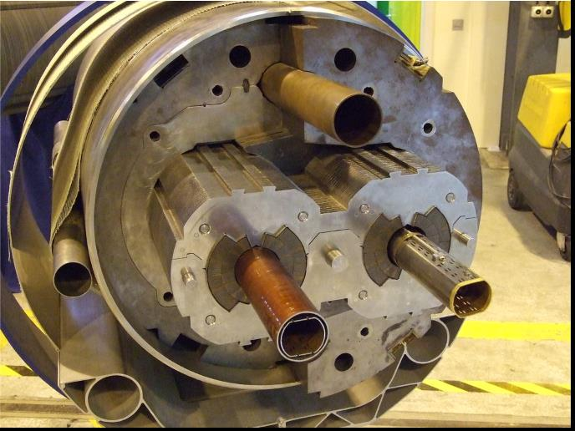
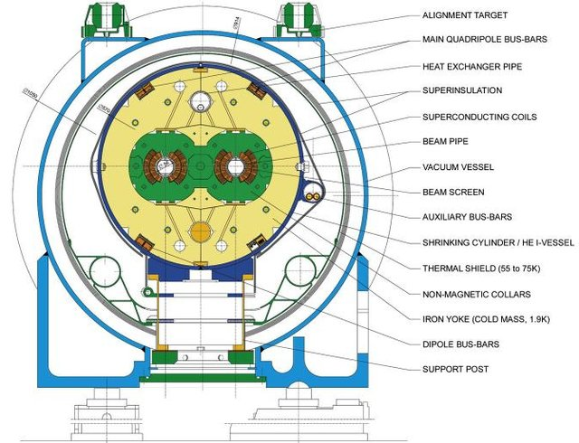
LHC Thermal Shield design
Cross-section of the LHC
#31
J. Polinski, Thermal design of CDS components, PIP II Technical Workshop, FNAL/Remotely, 12-14 of July 2022

Slide 32
XFEL Cryo system scheme

Slide 33
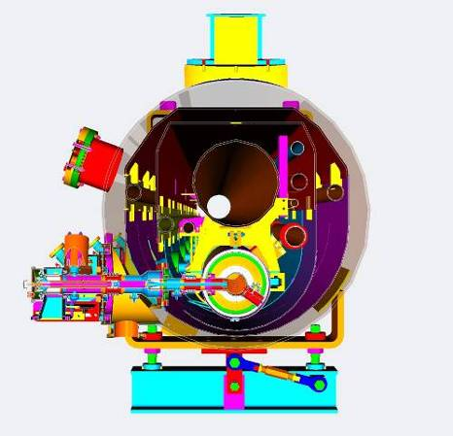
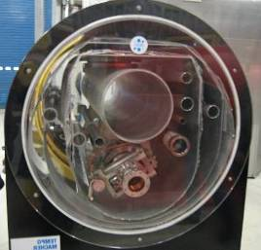
XFEL cryomodule cross section
70 K shield
2 K return DN300
magnet current feedthrough
2.2 K forward DN40
5 K forward DN65
80 K return DN65
40 K forward
8 K return DN65
5 K shield
RF main coupler
2 K 2-phase 76 mm
cavity
2K Bypass DN32
#33
J. Polinski, Thermal design of CDS components, PIP II Technical Workshop, FNAL/Remotely, 12-14 of July 2022

Slide 34
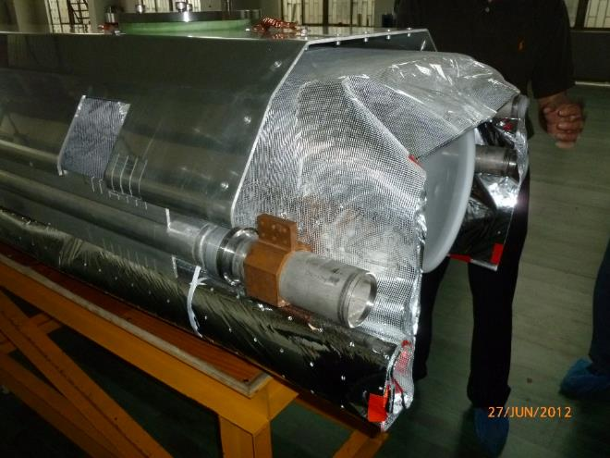
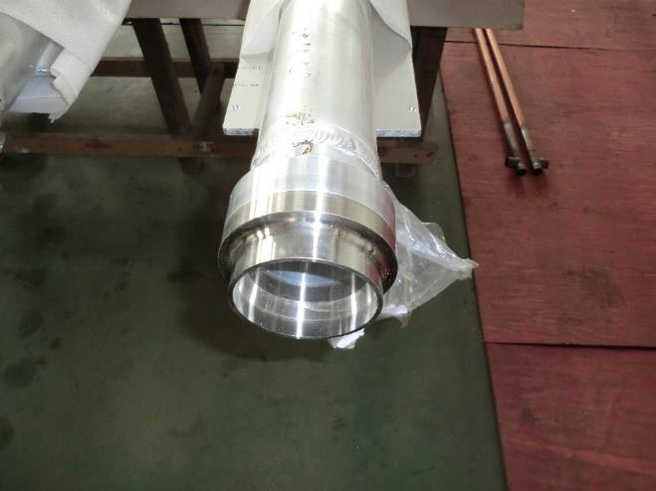
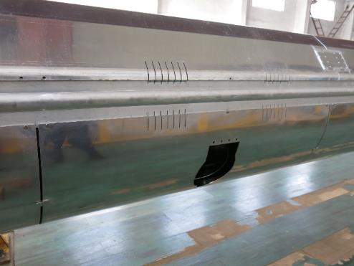
XFEL cryomodule Thermal Shield

Slide 35
4.5K Thermal Shield for 2K surfaces?
In the ILC CM the upper TS parts are retained to cool the intercepts of input couplers, current leads, HOM couplers, HOM absorber and RF cables, and to provide mechanical support to the intercepts.
In an addition, ILC cooling scheme is slightly modified to cool intercepts at lower temperature levels (46K and 66K instead of 54K and 74K, respectively)
XFEL
Cryomodule
ILC
Cryomodule
#35
J. Polinski, Thermal design of CDS components, PIP II Technical Workshop, FNAL/Remotely, 12-14 of July 2022

Slide 36
4.5K Thermal Shield for 2K surfaces?
P. Lebruna et al., Does one need a 4.5 K screen in cryostats of superconducting accelerator devices operating in superfluid helium?, AIP Conference Proceedings 1573, 245 (2014); https://doi.org/10.1063/1.4860708
#36
J. Polinski, Thermal design of CDS components, PIP II Technical Workshop, FNAL/Remotely, 12-14 of July 2022

Slide 37
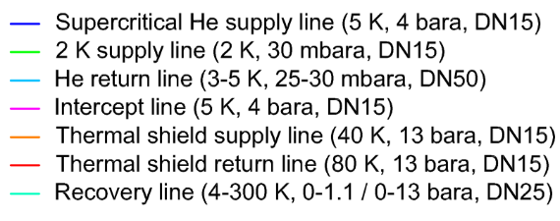
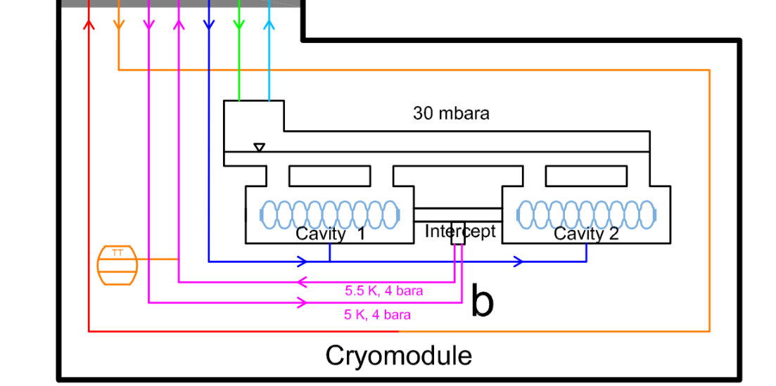
4.5K Thermal Shield for 2K surfaces?
PolFEL
Cryomodule
#37
J. Polinski, Thermal design of CDS components, PIP II Technical Workshop, FNAL/Remotely, 12-14 of July 2022

Slide 38
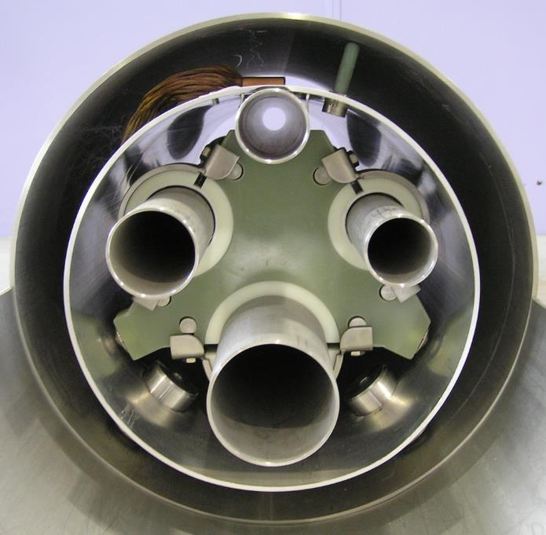
XATL1 Transfer Line (XFEL AMTF)
Thermal bridge
between radiation
shield and
80 K process pipe
(Copper)
Vacuum vessel
(Austenitic Stainless
steel 304, 1.4301)
Process pipes
(Austenitic Stainless
steel 304L, 1.4306)
Radiation shield
(Aluminium alloy
Al6060)
Sliding support
(Epoxy G-10)
Spacer
(Glassboard)
#38
J. Polinski, Thermal design of CDS components, PIP II Technical Workshop, FNAL/Remotely, 12-14 of July 2022

Slide 39
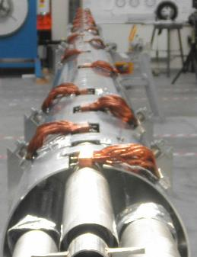
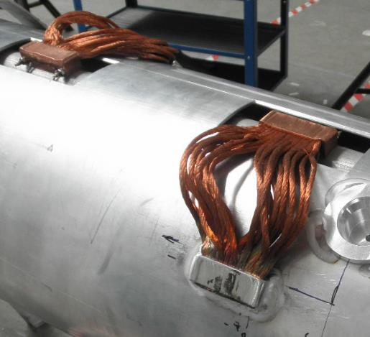
XATL1 Transfer Line (XFEL AMTF)
Aluminium thermal shield, ø300x4 mm
Copper block tied to the stainless steel pipe
Thermal bridge 24 pcs.
Copper wires knead from both sides by press
Stainless steel cooling pipe, ø48.3x2 mm
Aluminium block welded to the aluminium pipe
#39
J. Polinski, Thermal design of CDS components, PIP II Technical Workshop, FNAL/Remotely, 12-14 of July 2022

Slide 40
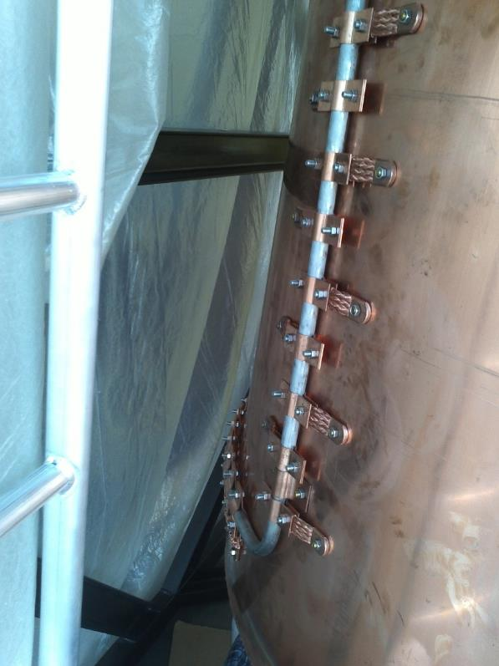
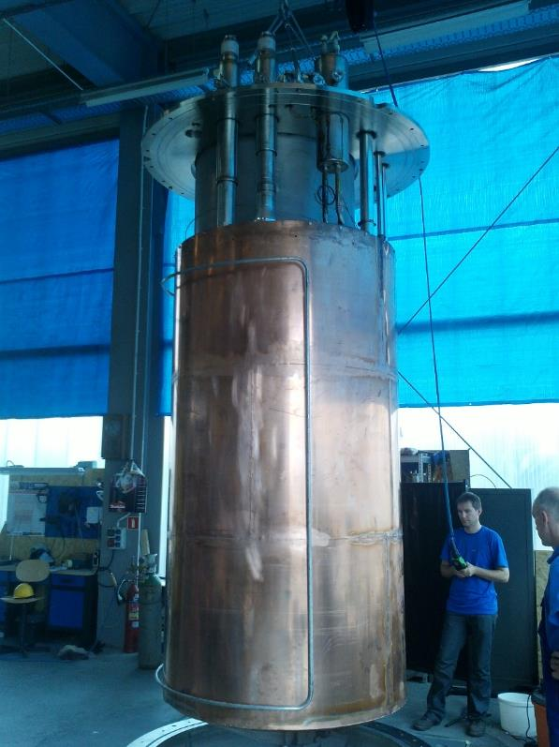
XATC Test Cryosat (XFEL AMTF)
#40
J. Polinski, Thermal design of CDS components, PIP II Technical Workshop, FNAL/Remotely, 12-14 of July 2022

Slide 41
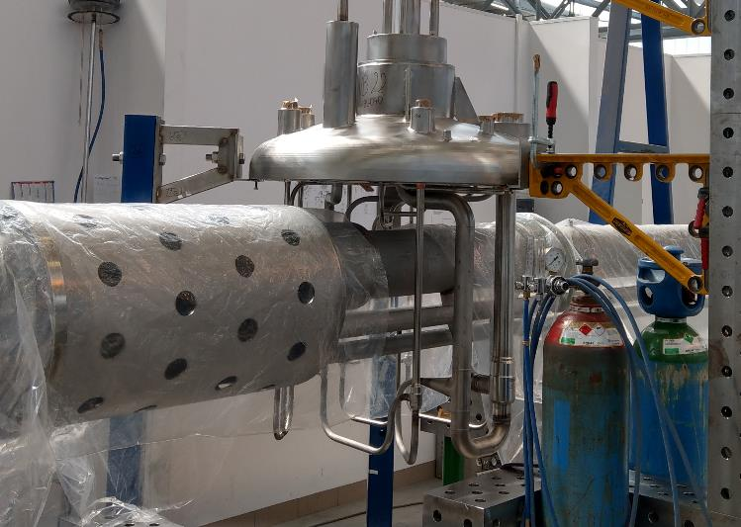
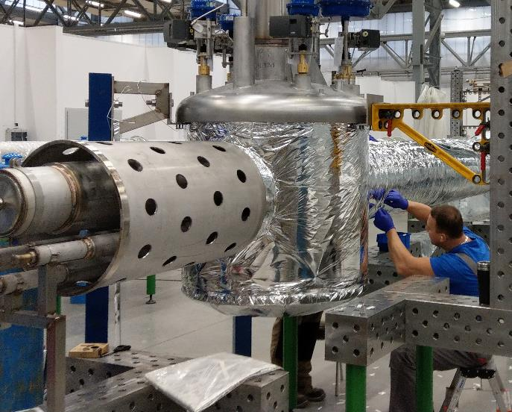
ESS CDS-EL Valve Box
#41
J. Polinski, Thermal design of CDS components, PIP II Technical Workshop, FNAL/Remotely, 12-14 of July 2022

Slide 42
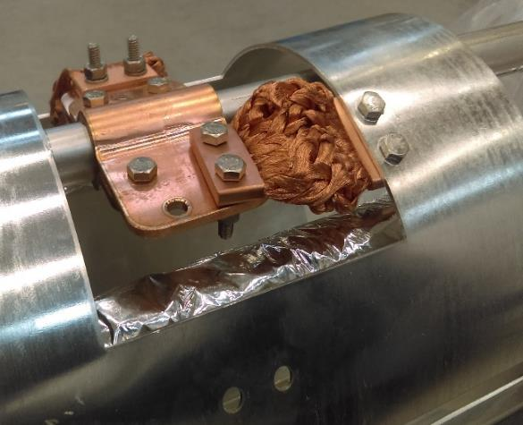
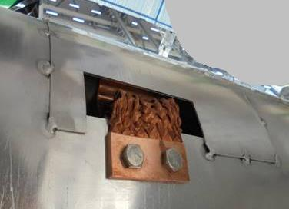
ESS CDS-EL (ESS, Lund, Sweden)
Copper clamps bolted to the cooling pipe
Copper flexible connector bolted to aluminium pipe
Aluminium cover
Aluminium TS
#42
J. Polinski, Thermal design of CDS components, PIP II Technical Workshop, FNAL/Remotely, 12-14 of July 2022

Slide 43
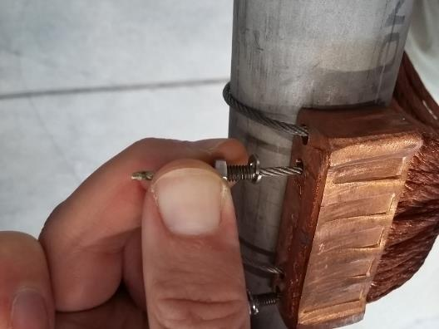
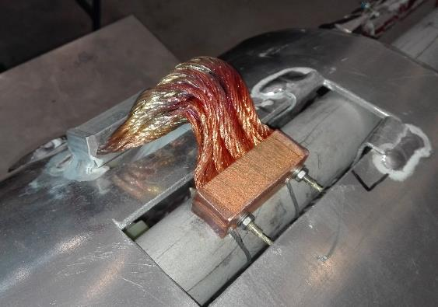
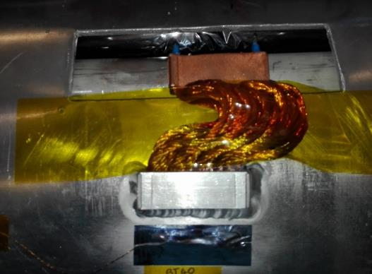
FAIR SIS100 BPL - prototype module
Copper block with the flexible strands is bolted to stainless steel tube
Aluminum block with the flexible strands is welded to Al thermal shield
#43
J. Polinski, Thermal design of CDS components, PIP II Technical Workshop, FNAL/Remotely, 12-14 of July 2022

Slide 44
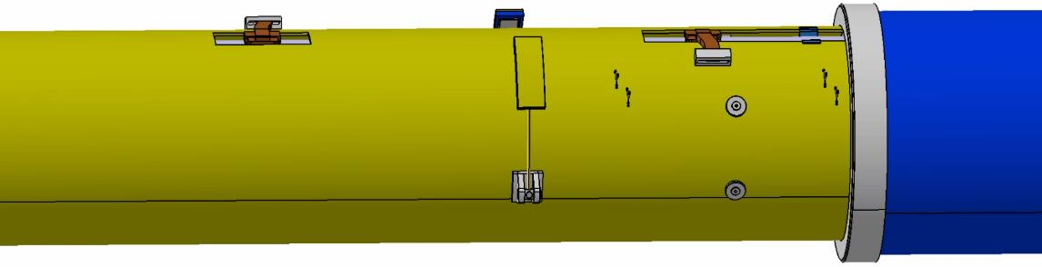

FAIR SIS100 BPL - prototype module commissioning tests results
80K
TS_Return – 60.4K
81K
Broken
81K
Measurement results Curtesy GSI
Theoretical thermal conductivity
Real thermal conductivity:
TS return line T=60.4K
TS temp T=80K
Measured heat flux to TS – 49.2W
No of thermal connections – 6
q_{real}= 0.425 W/K
$q_{teor}=A\frac{L}{k}$ = 1.07 W/K
A – total cross section of the Cu strands – 12 x 16 mm²
L – strand length – 90 mm
k – thermal cond. of Cu – 500 W/mK
#44
J. Polinski, Thermal design of CDS components, PIP II Technical Workshop, FNAL/Remotely, 12-14 of July 2022

Slide 45
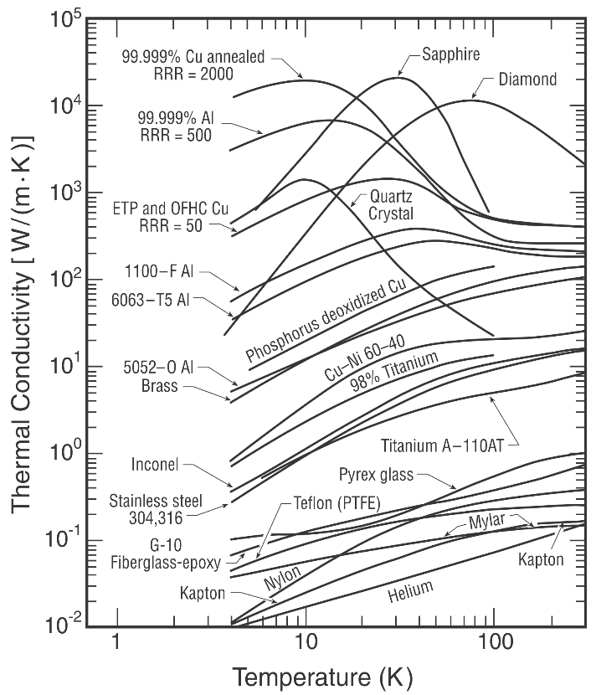
Which copper for TS and thermal couplers? OFE or ETP?
For radiation shield and nitrogen purposes
thermal conductivity OFE ≈ ETP
For helium purposes
thermal conductivity OFE >> ETP
4K
70K
#45
J. Polinski, Thermal design of CDS components, PIP II Technical Workshop, FNAL/Remotely, 12-14 of July 2022

Slide 46
Thermal shield design summary
Extruded Thermal Shield
  Excellent thermal conduction,
  For cryogenic systems with length above of several hundred meters,
  Potential problem with production certification
  Potential problems with bi-metalic joints
  Dedicated design that cannot be easily used in different projects
„Tailored” Thermal Shields
  More complex in assembly (thermal coupling) – no issue in unit production,
  Difference in thermal contraction between the process pipe and thermal shield materials need to be accounted in the design,
  Components readily available in the market,
  Sophisticated shapes are possible.
#46
J. Polinski, Thermal design of CDS components, PIP II Technical Workshop, FNAL/Remotely, 12-14 of July 2022

Slide 47
Thank you for your attention
#47
J. Polinski, Thermal design of CDS components, PIP II Technical Workshop, FNAL/Remotely, 12-14 of July 2022

