Slide 1
Thermal shields design for CDS components
Pawel Duda / Wroclaw University of Science and Technolog
PIP-II Technical Workshop
14/07/2022

Slide 2
Outline
Thermal shields in CDS overview
TS in DVB
TS in ITL and TTL
Thermal coupling between the TS and cooling pipe
Determination of the number of thermal bridges

Slide 3
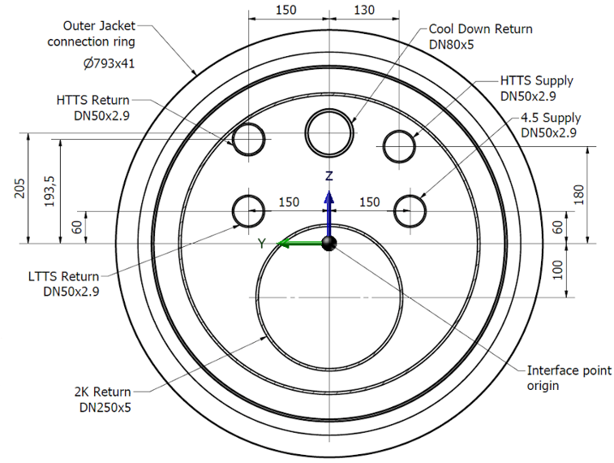
Thermal shields in CDS overview
Main process lines
HTTS Return (80K; 20 bara)
HTTS Supply (40K; 20 bara)
LTTS Return (9K; 20 bara)
4.5 K Supply (4.5K; 20 bara)
2 K Return (3.8K; 4.1 bara)
Cooldown Return (80K; 20 bara)
Cross section of Intermedite Transfer Tine and Tunnel Transfer Line

Slide 4
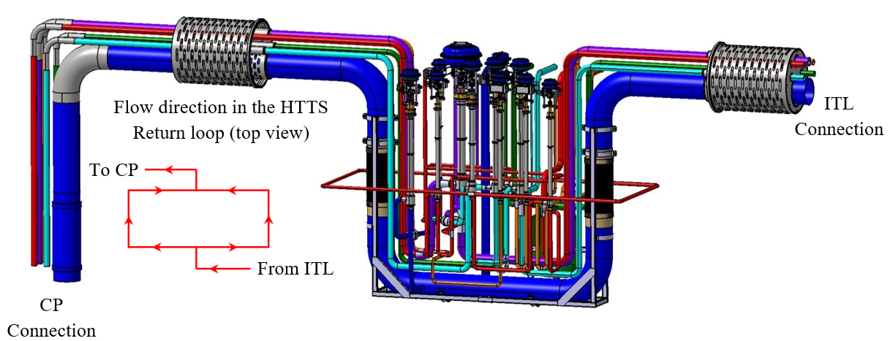
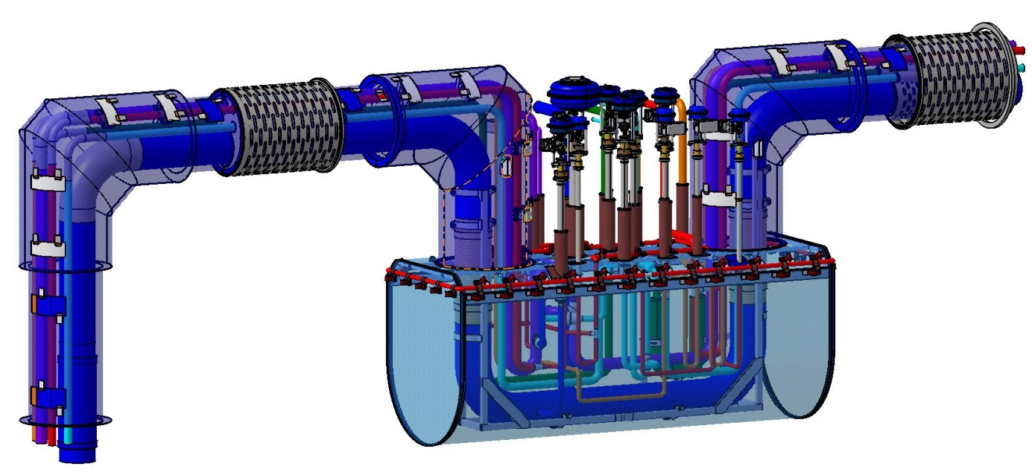
Process pipes design – TS cooling loop
Main process lines
HTTS Return (80K; 20 bara)
HTTS Supply (40K; 20 bara)
LTTS Return (9K; 20 bara)
4.5 K Supply (4.5K; 20 bara)
2 K Return (3.8K; 4.1 bara)
Cooldown Return (80K; 20 bara)

Slide 5
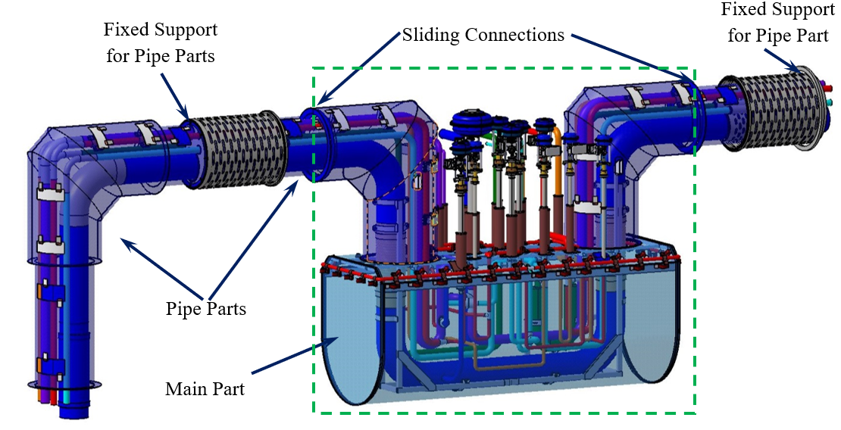
Thermal shield in DVB
Main Part:
aluminium 1050 sheet
wall thickness of 10 mm
Pipe Parts:
aluminium 1050 pipe segments
diameter of 700 mm and 560 mm
wall thickness of 5 mm
The shield is covered with 40 layers of MLI at layer density of ≤ 20/cm

Slide 6
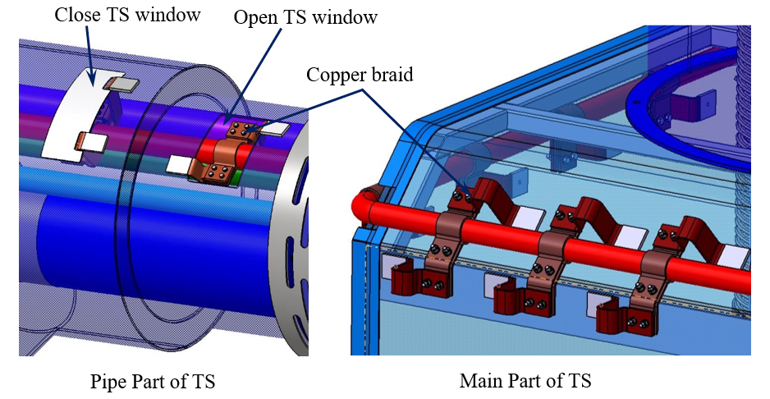
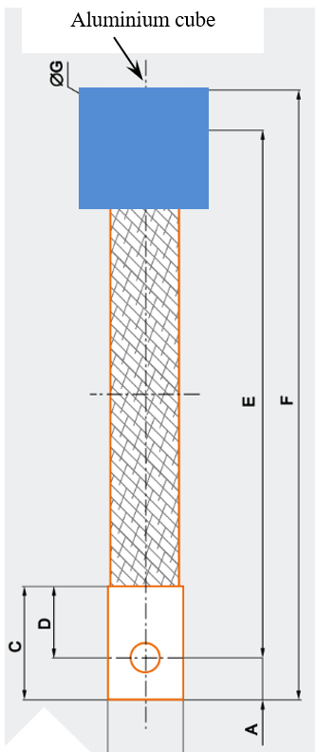
Thermal shield in DVB – thermalization method

Slide 7
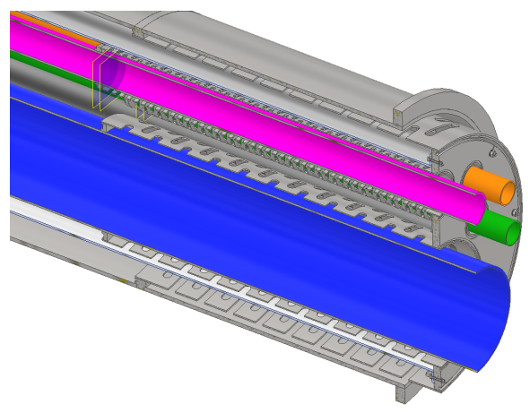
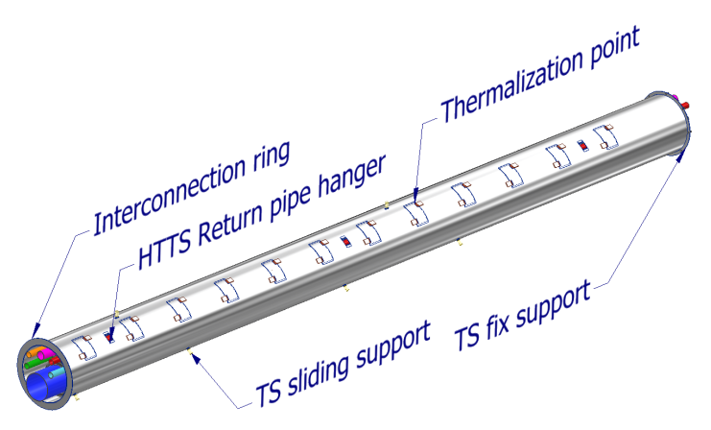
ITL thermal shield – supports
Thermal shield fixed support
One end of the thermal shield is bolted to the back plate of the process piping fixed support
Vacuum jacket
Bolted connections
Thermal shield
Process pipe fixed support
Thermal shield sliding support
Same as the process piping sliding support

Slide 8
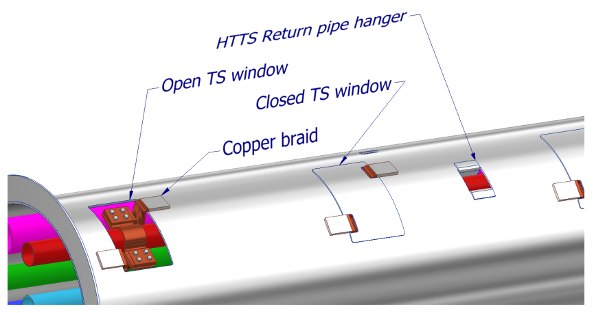
Thermal shield in ITL
Made of aluminum alloy 1050
Conductively connected to HTTS Return using flexible thermal braid/strap
Wrapped with 40 layers of MLI (20/cm) after assembly

Slide 9
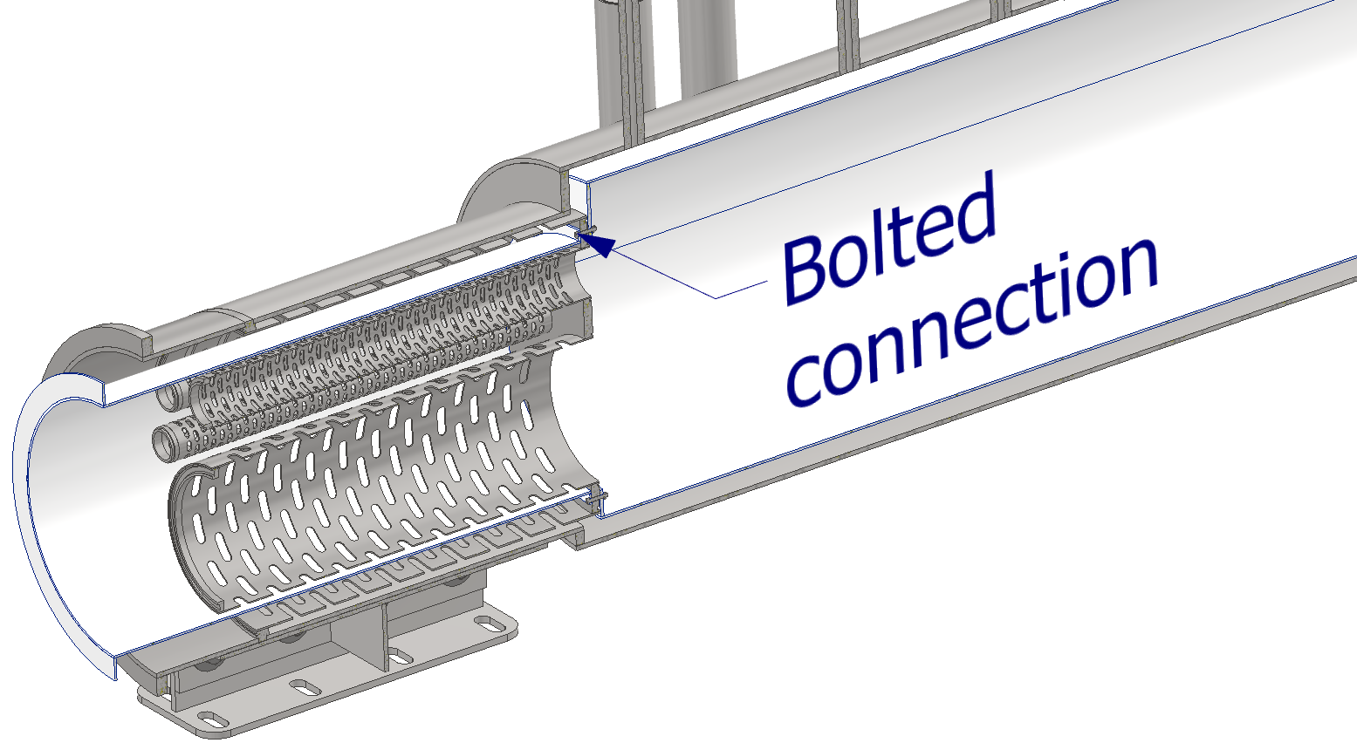
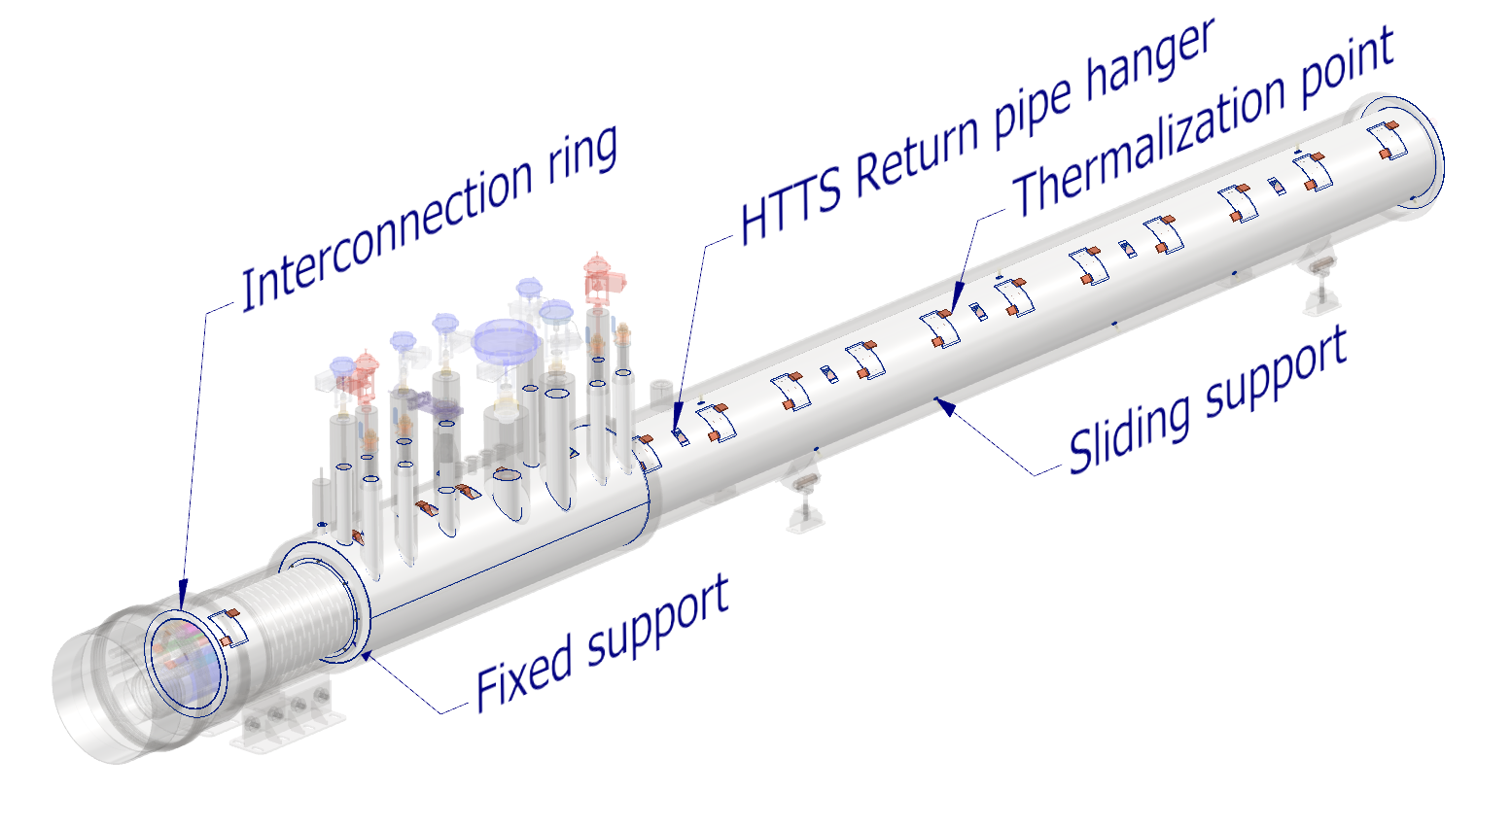
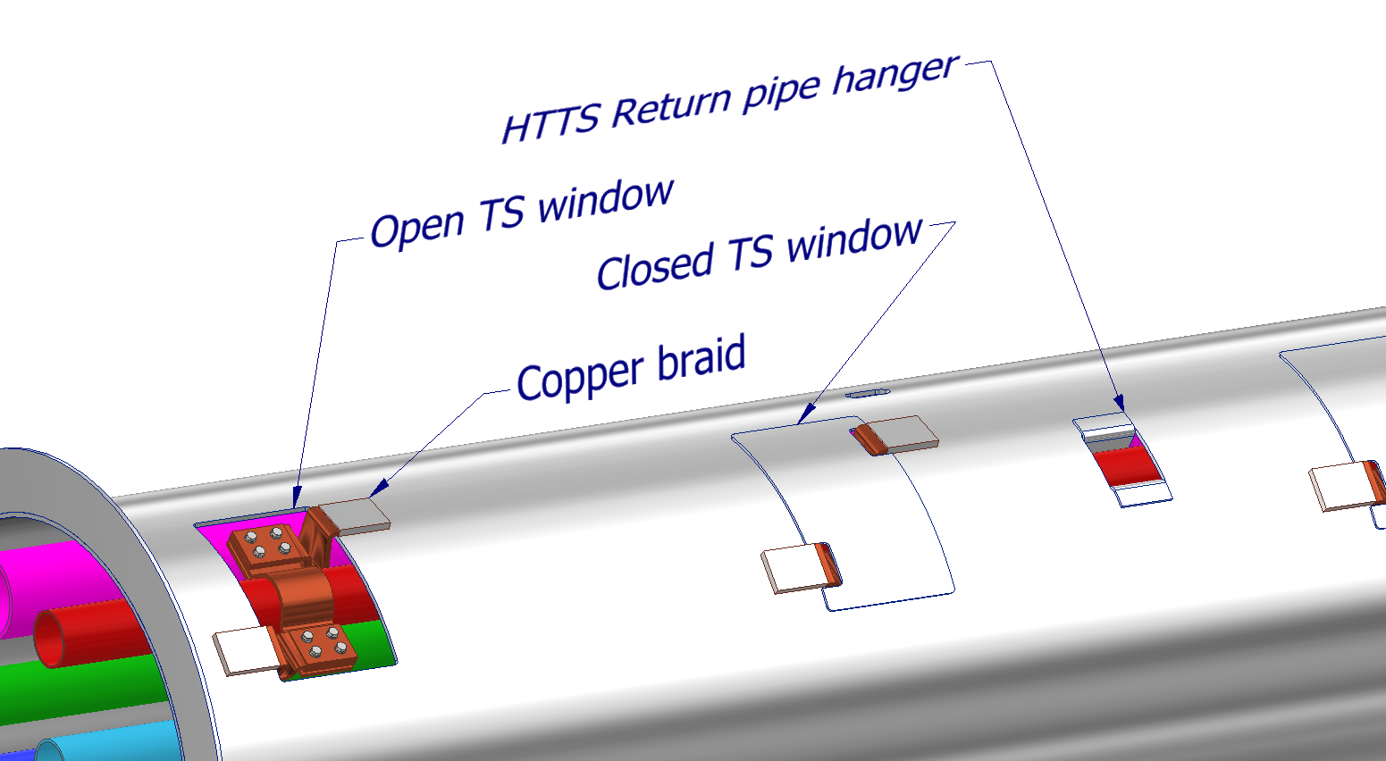
Thermal shield in TTL
Made of aluminum alloy 1050
Conductively connected to HTTS Return using flexible thermal braid/strap
Wrapped with 40 layers of MLI (20/cm) after assembly

Slide 10
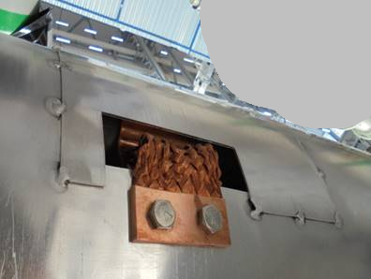
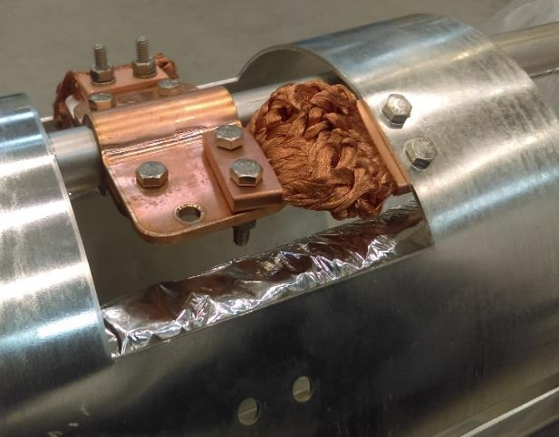
ESS and PIPII solutions
Production and assembly experiences:
Fast production – main components are from market except claws which should be tailored to pipe’s diameter
Easy access to raw materials
High repeatability
No problems during installation – simple operations as drilling
To reduce thermal gap additional radiation cover needed
ESS CDS–EL (ESS, Lund – Sweden)
Aluminium cover
Copper clamps bolted to the cooling pipe
Copper flexible connector bolted to aluminium pipe
Aluminium pipe - TS
DVB, ITL and TTL solution
Differences in design for PIPII:
aluminum cube clamped at one end of the thermal bridge
welding the aluminum cube to the thermal screen will allow for better heat conduction
Weld connection betwen aluminium cube and shield
Weld connection betwen aluminium cube and shield

Slide 11
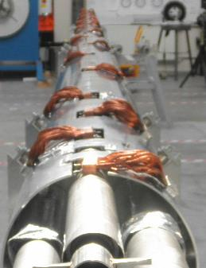
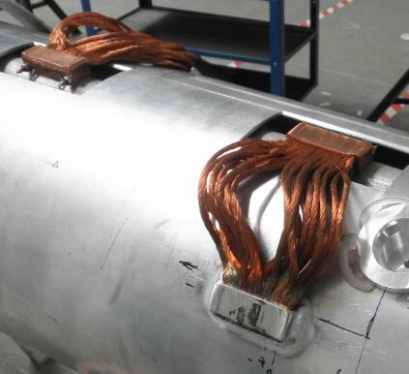
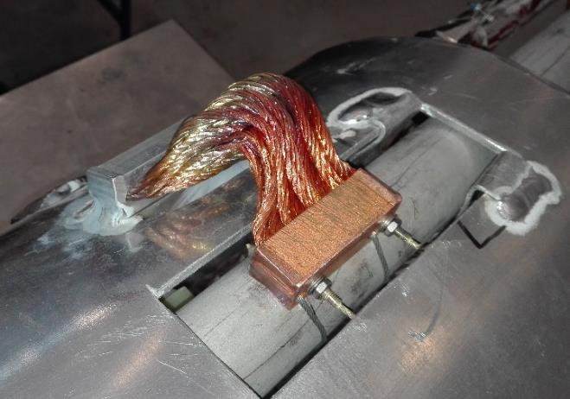
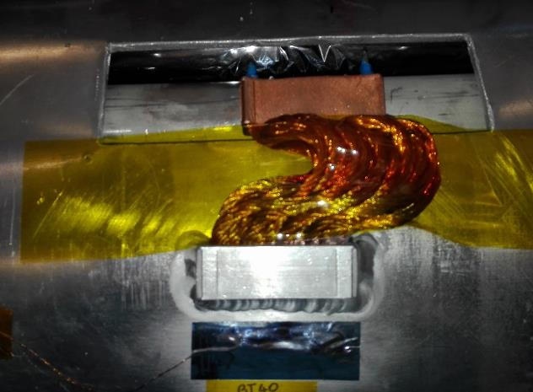
Experience in the production of welded thermal bridges
XATL1 – 165 m transfer line for XFEL project (DESY, Hamburg)
BPL – bypass line for FAIR project – prototype module (GSI, Darmstadt)
Copper block tied to the stainless steel pipe
Copper wires knead from both sides by press
Aluminium block welded to the aluminium pipe
Aluminium block with the flexible strands is welded to Al thermal shield
Advantages
Good thermal conduction – tailored Surface of Al/Cu blocks
Flexibility and wide range of connected elements movement
Possibility to install in narrow places
Easy aluminium welding process

Slide 12
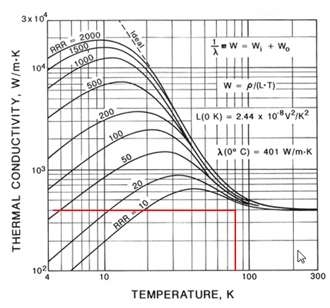
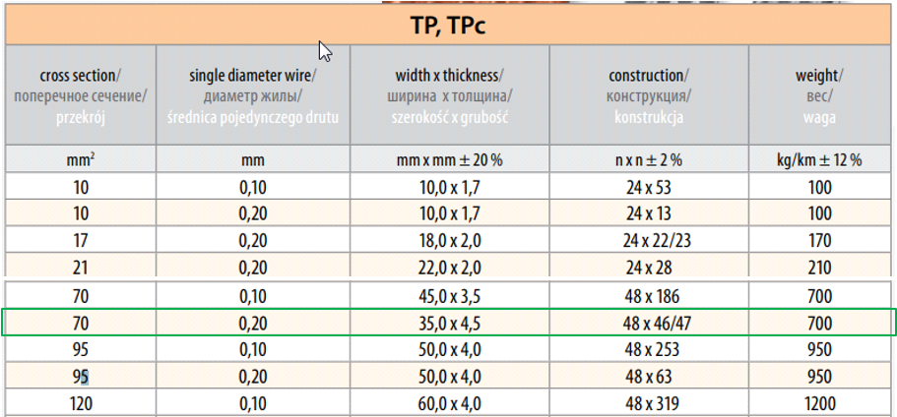
Determining the minimum number of thermal bridges
The copper braids selected for the DVB have a minimum total cross section area of A=70 mm² and their maximum length is assumed as L=130 mm.
The thermal conductivity of the copper is assumed as λ=400 W/mK (conservative assumption) for 80 K, for temperature range of 77 – 300 K, therefore the thermal conduction of each copper braid can be found as k = 0.22 W/K, for further calculations it was assumed k = 0.2 W/K

Slide 13
Determining the minimum number of thermal bridges
The copper braids selected for the DVB have a minimum total cross section area of A=70 mm² and their maximum length is assumed as L=130 mm.
The thermal conductivity of the copper is assumed as λ=400 W/mK (conservative assumption) for 80 K, for temperature range of 77 – 300 K, therefore the thermal conduction of each copper braid can be found as k = 0.215 W/K, for further calculations it was assumed k = 0.2 W/K
For thermal conductivity k=0.2 W/K and a maximum temperature difference between the ends of a single thermal bridge ΔT=7 K, the maximum heat flux transmitted through one thermal bridge is Q=1.4 W

Slide 14
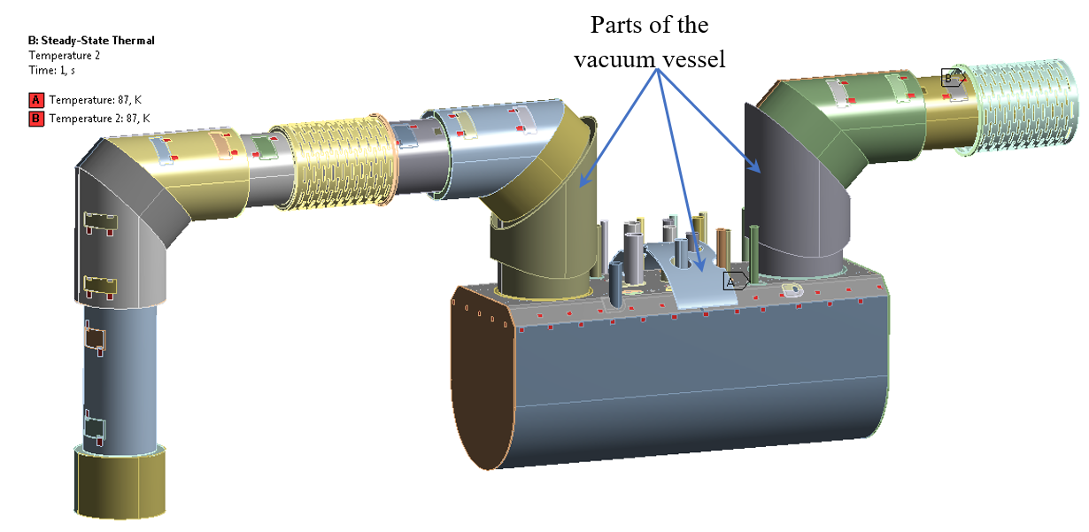
Determining the minimum number of thermal bridges
Thermal shield FEM analisys - checking the number of thermal bridges
thermal shield is loaded by radiation heat flux of 1.5 W/m2
the main part of thermal shield is suspended from the vacuum jacket by 4 steel hangers and and its position is determined by the central support made of G10
temperature of 87K was assumed in the places where thermal bridges are welded(assumed a 7 K temperature difference across the thermal bridge)

Slide 15
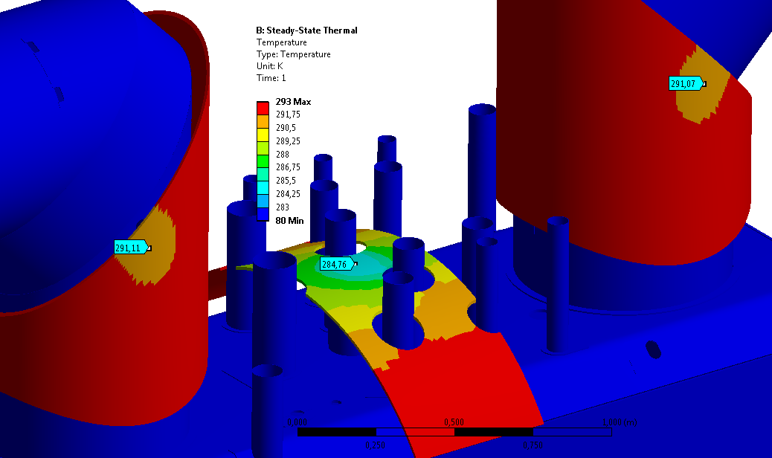
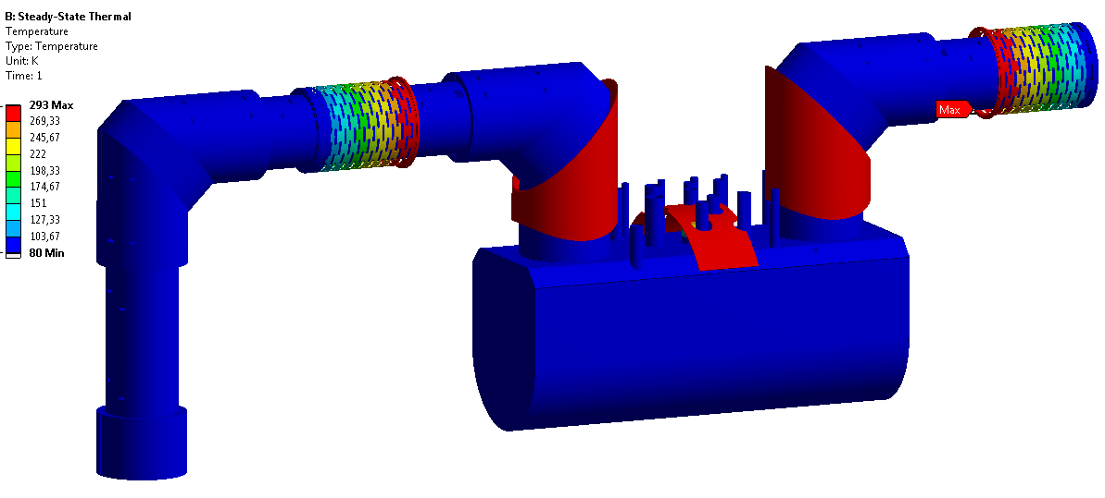
Determining the minimum number of thermal bridges
The lowest temperature on the vacuum vessel is 284.7 K. The lowest temperature occurs in the place of installation central support made of G10.
This is the temperature near the dew point for 55% humidity (284 K). However, the model does not consider the total area of the vacuum jacket, so in fact the indicated temperature will be higher. Additionally, the model assumes full contact between the G10 sleeve and the thermal shield and the vacuum jacket, in fact the contact surfaces will be much smaller, there will also be contact resistance.

Slide 16
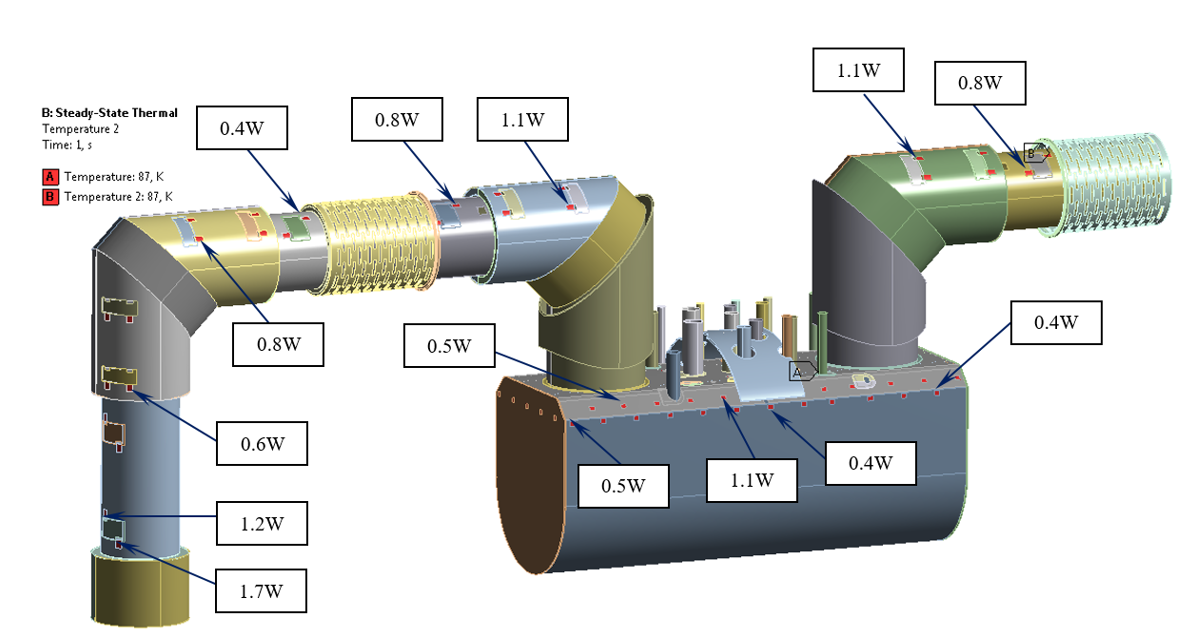
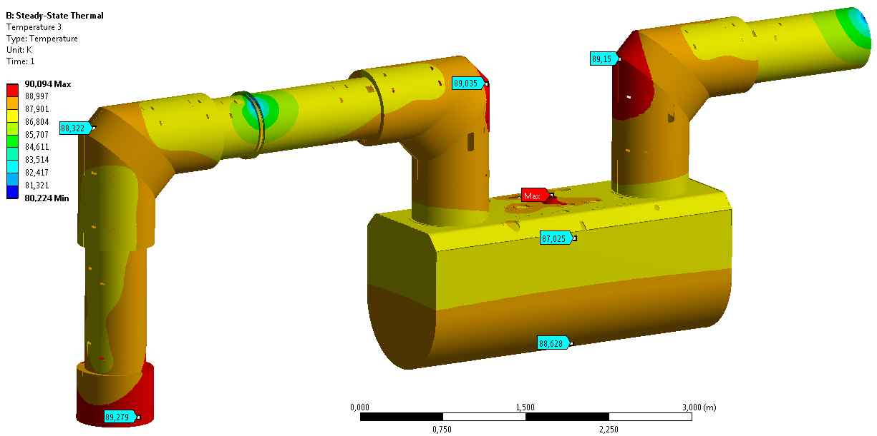
Determining the minimum number of thermal bridges
The highest heat flux must be transferred by the thermal braid closest to the CP interconnection, it results from the lack of a thermal connection with the CP thermal shield. This can be mitigated by installing additional thermal straps in this region.

