Slide 1
Safety valves calculations for PIP-II CDS
Tomasz Banaszkiewicz / Wroclaw Univ. of Science and Technology
PIP-II Technical Workshop
July 14th, 2022

Slide 2
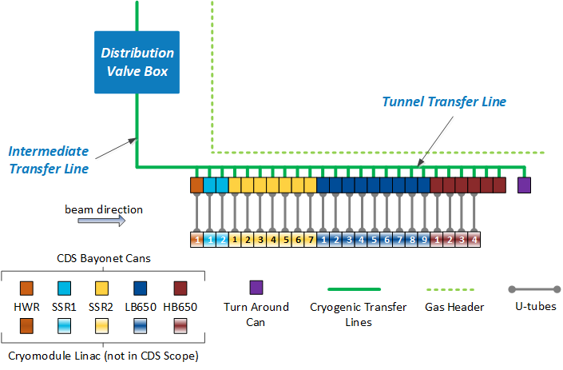
Safety valve sizing methodology
Operational scenarios
Nominal
Commitioning
Cooldown / Warmup
Failure scenarios
Unwanted valve closure
Vacuum jacket damage
Process pipe damage
Safety valve sizing
Primary reliefs
Trapped volume reliefs
Vacuum reliefs

Slide 3
Safety valve sizing methodology
Operational scenarios
Nominal
Commitioning
Cooldown / Warmup
Failure scenarios
Unwanted valve closure
Vacuum jacket damage
Process pipe damage
Safety valve sizing
Primary reliefs
Trapped volume reliefs
Vacuum reliefs

Slide 4
Primary reliefs
Primary reliefs are the reliefs guarding the main process lines. Every main proces line is guarded by two primary reliefs – one in the Distribution Valve Box (DVB) and one in the Turn Around Can (TC)
TC
DVB

Slide 5
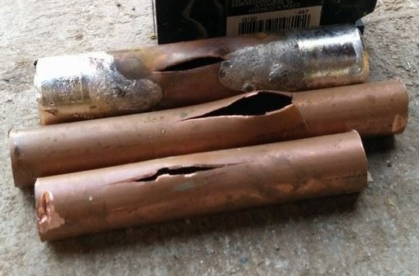
Trapped volume reliefs
Every cold line that potentially can be separated with valves from the ColdBox or the atmosphere needs to be guarded using the relief valve.

Slide 6
Primary reliefs and trapped volumes
Steps to calculate the safety valve minimal size:
Calculation of the relief temperature in the case of the vacuum insulation damage (for every operational conditions)
Calculation of the worst case scenario in therms of the heat intake
Calculation of the minimal orifice size

Slide 7
Relief temperature calculation
In the event of the vacuum insulation being damaged it is assumed that all the cold lines in the CDS are separated from the Cryoplant. Helium in the main lines is trapped in the constant volume.
For the trapped volume, the density of helium does not change until the relief equipment opens.

Slide 8
Relief temperature calculation
In the event of the vacuum insulation being damaged it is assumed that all the cold lines in the CDS are separated from the Cryoplant. Helium in the main lines is trapped in the constant volume.
For the trapped volume, the density of helium does not change until the relief equipment opens.
Initial conditions
T = 5 K
P = 4 bara
ρ = 124.5 kg/m³

Slide 9
Relief temperature calculation
In the event of the vacuum insulation being damaged it is assumed that all the cold lines in the CDS are separated from the Cryoplant. Helium in the main lines is trapped in the constant volume.
For the trapped volume, the density of helium does not change until the relief equipment opens.
Initial conditions
T = 5 K
P = 4 bara
ρ = 124.5 kg/m³
Heat input

Slide 10
Relief temperature calculation
In the event of the vacuum insulation being damaged it is assumed that all the cold lines in the CDS are separated from the Cryoplant. Helium in the main lines is trapped in the constant volume.
For the trapped volume, the density of helium does not change until the relief equipment opens.
Initial conditions
T = 5 K
P = 4 bara
ρ = 124.5 kg/m³
Relief conditions
T = 8.74 K
P_{SET} = 20 bara
ρ = 124.5 kg/m³
Heat input

Slide 11
Relief temperature calculation – 2 K return line
Initial conditions
T = 3.8 K
P = 27 mbara
ρ = 0.349 kg/m³
Relief conditions
T = 572 K
P_{SET} = 4.1 bara
ρ = 0.349 kg/m³
nominal operational conditions
Heat input
Initial conditions
T = 5.2 K
P = 2 bara
ρ = 33.1 kg/m³
Relief conditions
T = 7.9 K
P_{SET} = 4.1 bara
ρ = 33.1 kg/m³
cool down conditions
Heat input

Slide 12
Relief temperature calculation – 2 K return line
Initial conditions
T = 3.8 K
P = 27 mbara
ρ = 0.349 kg/m³
Relief conditions
T = 572 K
P_{SET} = 4.1 bara
ρ = 0.349 kg/m³
nominal operational conditions
Heat input
Initial conditions
T = 5.2 K
P = 2 bara
ρ = 33.1 kg/m³
Relief conditions
T = 7.9 K
P_{SET} = 4.1 bara
ρ = 33.1 kg/m³
cool down conditions
Heat input

Slide 13
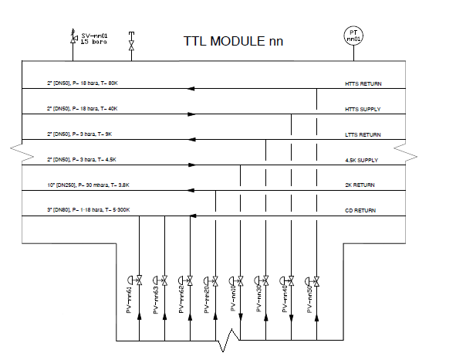
Heat Intake
The calculation can be done concerning one of three scenarios:
The sudden disappearance of the vacuum in the vacuum vessel – the most conservative approach. Heat intake to the cold line is limited only by the MLI to 6 kW/m²

Slide 14
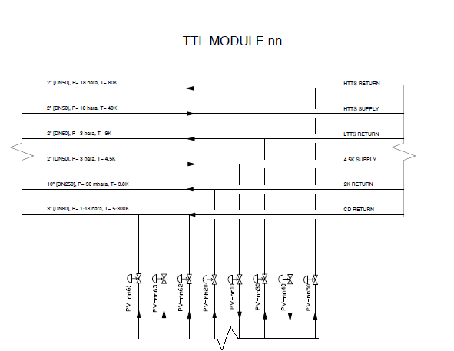
Heat Intake
The calculation can be done concerning one of three scenarios:
The sudden disappearance of the vacuum in the vacuum vessel – the most conservative approach. Heat intake to the cold line is limited only by the MLI to 6 kW/m²
air
air

Slide 15
Heat Intake
The calculation can be done concerning one of three scenarios:
Air inflows into the vacuum vessel through an orifice with the area of 5000 mm². For a conservative approach, the calculation assumes that every line gets 100% heat introduced by the inflowing air (limited by MLI). – This scenario was used for the calculation of the trapped volume reliefs
5000 mm² is the area of the largest safety valve allowed to be installed on the vacuum vessel
(EN 13458-2)

Slide 16
Heat Intake
The calculation can be done concerning one of three scenarios:
Air inflows into the vacuum vessel through an orifice with the area of 5000 mm². For a conservative approach, the calculation assumes that every line gets 100% heat introduced by the inflowing air (limited by MLI). – This scenario was used for the calculation of the trapped volume reliefs
5000 mm² is the area of the largest safety valve allowed to be installed on the vacuum vessel
(EN 13458-2)

Slide 17
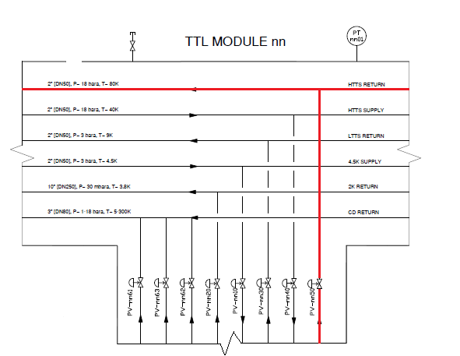
Heat Intake
The calculation can be done concerning one of three scenarios:
Air inflows into the vacuum vessel through an orifice with the area of 5000 mm². For a conservative approach, the calculation assumes that every line gets 100% heat introduced by the inflowing air (limited by MLI). – This scenario was used for the calculation of the trapped volume reliefs
air
5000 mm² is the area of the largest safety valve allowed to be installed on the vacuum vessel
(EN 13458-2)

Slide 18
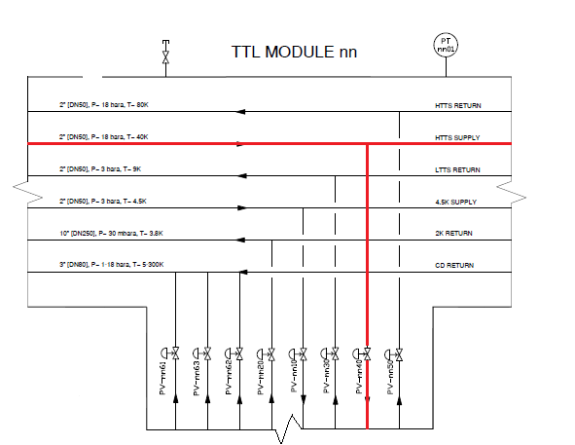
Heat Intake
The calculation can be done concerning one of three scenarios:
Air inflows into the vacuum vessel through an orifice with the area of 5000 mm². For a conservative approach, the calculation assumes that every line gets 100% heat introduced by the inflowing air (limited by MLI). – This scenario was used for the calculation of the trapped volume reliefs
air
5000 mm² is the area of the largest safety valve allowed to be installed on the vacuum vessel
(EN 13458-2)

Slide 19
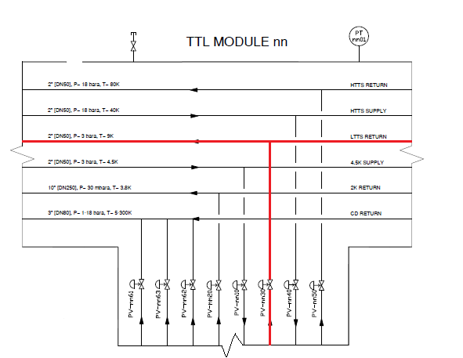
Heat Intake
The calculation can be done concerning one of three scenarios:
Air inflows into the vacuum vessel through an orifice with the area of 5000 mm². For a conservative approach, the calculation assumes that every line gets 100% heat introduced by the inflowing air (limited by MLI). – This scenario was used for the calculation of the trapped volume reliefs
air
5000 mm² is the area of the largest safety valve allowed to be installed on the vacuum vessel
(EN 13458-2)

Slide 20
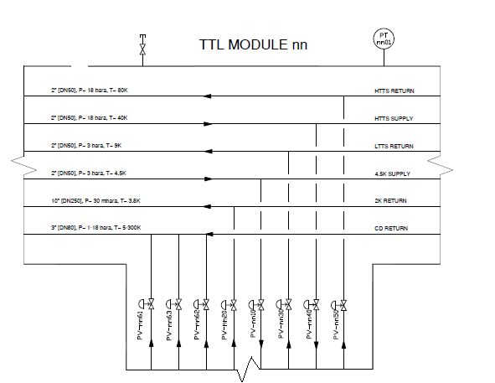
Heat Intake
The calculation can be done concerning one of three scenarios:
Air inflow through the orifice with the area of 5000 mm² – the most realistic approach. Every line gets heat intake respectively to its surface area as a percentage of the total cold surface area (limited by MLI). – This scenario was used for the calculation of the primary reliefs
air
5000 mm² is the area of the largest safety valve allowed to be installed on the vacuum vessel
(EN 13458-2)

Slide 21
Determination of the required SV capacity (EN 13648-3)
Calculation of the mass flow Q_{m} to be relieved by the pressure-relief devices:
$Q_{m}=3,6\frac{W}{L^{′}}$ kg/h
where:
L’ is specific heat input - $ν{\left[\frac{∂h}{∂ν}\right]}_{p}$at the relieving pressure and at the temperature, where $\frac{\sqrt{ν}}{ν{\left[\frac{∂h}{∂ν}\right]}_{p}}$ has a maximum value;
$ν$ is the specific volume of critical or supercritical fluid at the relieving pressure and any temperature within the operating range
h is the enthalpy of the fluid at the same conditions as above

Slide 22
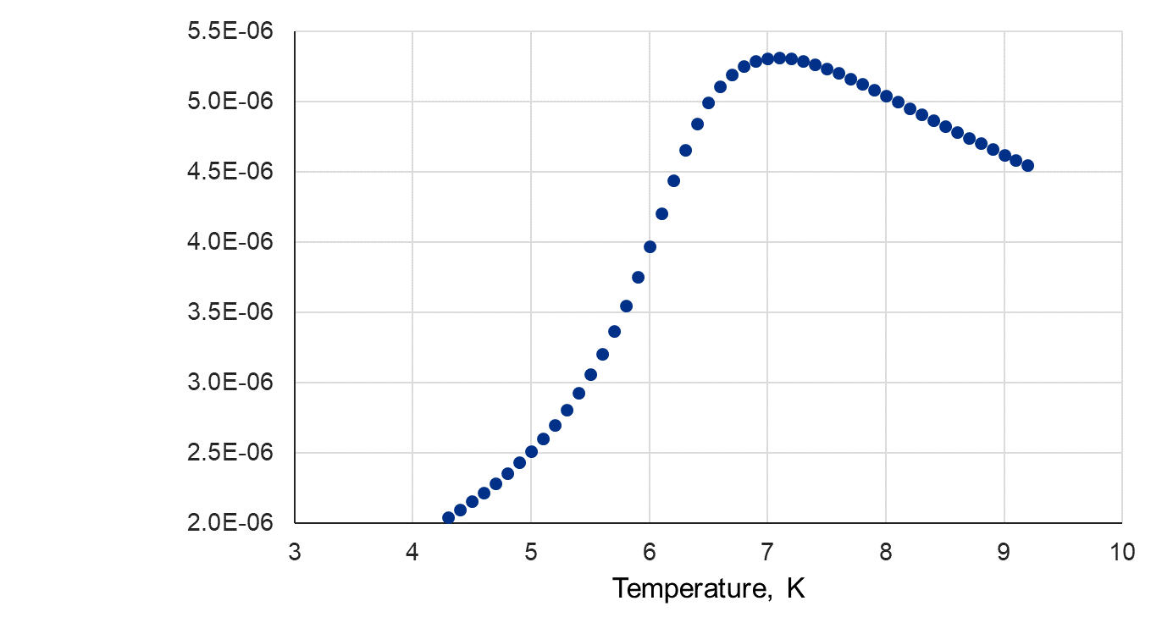
Determination of the required SV capacity (EN 13648-3)
Calculation point chosen for the 2K return line with the maximum allowable working pressure: 4.1 bara
If the calculated relief temperature is lower than the temperature with the maximum value of $\frac{\sqrt{ν}}{ν{\left[\frac{∂h}{∂ν}\right]}_{p}}$, the point taken into calculation is the point with the maximum value of $\frac{\sqrt{ν}}{ν{\left[\frac{∂h}{∂ν}\right]}_{p}}$as the temperature of the helium inside the proces pipe will rise over time
$$\frac{\sqrt{ν}}{ν{\left[\frac{∂h}{∂ν}\right]}_{p}}$$
T_{relief_calc}

Slide 23
Determination of the required SV capacity (EN 13648-3)
Calculation point chosen for the 2K return line with the maximum allowable working pressure: 4.1 bara
Point taken into the calculation
If the calculated relief temperature is lower than the temperature with the maximum value of $\frac{\sqrt{ν}}{ν{\left[\frac{∂h}{∂ν}\right]}_{p}}$, the point taken into calculation is the point with the maximum value of $\frac{\sqrt{ν}}{ν{\left[\frac{∂h}{∂ν}\right]}_{p}}$as the temperature of the helium inside the proces pipe will rise over time
$$\frac{\sqrt{ν}}{ν{\left[\frac{∂h}{∂ν}\right]}_{p}}$$
T_{relief}

Slide 24
Determination of the required SV capacity (EN 13648-3)
Calculation point chosen for the 2K return line with the maximum allowable working pressure: 4.1 bara
If the calculated relief temperature is higher than the temperature with the maximum value of $\frac{\sqrt{ν}}{ν{\left[\frac{∂h}{∂ν}\right]}_{p}}$, but the two temperatures are close together, the point taken into calculation is the point with the maximum value of $\frac{\sqrt{ν}}{ν{\left[\frac{∂h}{∂ν}\right]}_{p}}$ - for conservative approach.
$$\frac{\sqrt{ν}}{ν{\left[\frac{∂h}{∂ν}\right]}_{p}}$$
T_{relief_calc}

Slide 25
Determination of the required SV capacity (EN 13648-3)
Calculation point chosen for the 2K return line with the maximum allowable working pressure: 4.1 bara
Point taken into the calculation
If the calculated relief temperature is higher than the temperature with the maximum value of $\frac{\sqrt{ν}}{ν{\left[\frac{∂h}{∂ν}\right]}_{p}}$, but the two temperatures are close together, the point taken into calculation is the point with the maximum value of $\frac{\sqrt{ν}}{ν{\left[\frac{∂h}{∂ν}\right]}_{p}}$ - for conservative approach.
$$\frac{\sqrt{ν}}{ν{\left[\frac{∂h}{∂ν}\right]}_{p}}$$
T_{relief}

Slide 26
Determination of the required SV capacity (EN 13648-3)
Mass flow Q_{m} to be relieved by the pressure-relief devices:
$Q_{m}=3,6\frac{W}{L^{′}}$ kg/h
Table of the parameters for the primary relief calculation
Circuit | nominal pressure, bar | nominal temperature, K | density, kg/m3 | MAWP, bar(a) | T_{relief}, K | L’, J/kg | Q_{m}, kg/h
2K Return | 0.0313 | 3.8 | 0.406 | 4.1 | 7.1 | 24876 | 21719
4.5K Supply | 2.9 | 4.5 | 125.65 | 20 | 12.8 | 75205 | 1588
LTTS Return | 2.9 | 9 | 13.00 | 20 | 12.8 | 75205 | 1588
HTTS Supply | 18 | 40 | 20.92 | 20 | 40 | 222671 | 533
HTTS Return | 18 | 80 | 10.63 | 20 | 80 | 435308 | 846
CD Return | 18 | 80 | 167.6 | 20 | 12.8 | 75205 | 2340

Slide 27
The minimal orifice size (EN ISO 4126-1)
Critical flow occurs when:
Subritical flow occurs when:
$$\frac{p_{b}}{p_{o}}≤{\left(\frac{2}{k+1}\right)}^{\left(\frac{k}{k−1}\right)}$$
$$\frac{p_{b}}{p_{o}}>{\left(\frac{2}{k+1}\right)}^{\left(\frac{k}{k−1}\right)}$$
Capacity for gaseous fluid at critical flow
Capacity for gaseous fluid at subcritical flow
$$Q_{m}=0.2883 C A{ K}_{dr}\sqrt{\frac{p_{o}}{ν}}$$
$$Q_{m}=0.2883 C A{ K}_{dr}{ K}_{b}\sqrt{\frac{p_{o}}{ν}}$$
where:
p_{o} – relieving pressure (p_{set}), [bar]
p_{b} – back pressure, [bar]
k – isentropic exponent, [-]
Q_{m} – mass flow rate, [kg/h]
C – function of the isentropic exponent, [-]
A – flow area of a safety valve – orifice cross-section area, [mm²]
K_{dr} – certified derated coefficient of discharge, [-]
K_{b} – theoretical capacity correction factor for subcritical flow, [-]
$$K_{b}=\sqrt{\frac{\frac{2k}{k−1}\left[{\left(\frac{p_{b}}{p_{o}}\right)}^{\frac{2}{k}}−{\left(\frac{p_{b}}{p_{o}}\right)}^{\frac{k+1}{k}}\right]}{k{\left(\frac{2}{k+1}\right)}^{\frac{k+1}{k−1}}}}$$
$$C=3.948 \sqrt{k{\left(\frac{2}{k+1}\right)}^{\frac{k+1}{k−1}}}$$

Slide 28
CDS relief valve sizes
Minimal orifice sizes of the primary reliefs
Line Name | T_{relief}, K | MAWP, bar(a) | L’, J/kg | Total venting required, g/s | Required vent rate for each relief, g/s | Min orifice size, for required vent rate, mm | Relief ID SV__
2K Return | 7.1 | 4.1 | 24876 | 12067 | 6033 | 70.2 | 0021 / 2720
4.5 Supply | 12.8 | 20 | 75205 | 881 | 441 | 8.2 | 0011 / 2710
LTTS Return | 12.8 | 20 | 75205 | 881 | 441 | 8.2 | 0031 / 2730
HTTS Supply | 40 | 20 | 222671 | 298 | 148 | 6.7 | 0041 / 2740
HTTS Return | 80 | 20 | 435308 | 469 | 235 | 10.2 | 0051 / 2750
Cool Down | 12.8 | 20 | 75205 | 1229 | 650 | 9.9 | 0061 / 2760

Slide 29
CDS relief valve sizes
Minimal relief valve sizes for the cold circuits for trapped volume - DVB
Line Name | Pipe size | Pipe length, m | MAWP, bar(a) | Minimal Safety Valve orifice diameter, mm | Relief ID SV__
4.5 K Supply | DN50 | 10 | 20 | 4.9 | 0010
LTTS Return | DN65 | 5 | 20 | 3.1 | 0030
HTTS Supply | DN25 | 5 | 20 | 2.1 | 0040
HTTS Return + Heat Shield* | DN25 | 15 | 20 | 8.6 | 0050
Cool Down Return | DN80 | 15 | 20 | 7.4 | 0060
Minimal relief valve sizes for the cold circuits for trapped volume - TTL
Line Name | Pipe size | Pipe length, m | MAWP, bar(a) | Minimal Safety Valve orifice diameter, mm | Relief ID SV__
4.5 K Supply | DN15 | 10 | 20 | 4.9 | nn10
2 K Return | DN65 | 10 | 4.1 | 16.5 | nn20
LTTS Return | DN20 | 10 | 20 | 3.1 | nn30
HTTS Supply | DN20 | 10 | 20 | 2.6 | nn40
HTTS Return + Heat Shield* | DN20 | 15 | 20 | 8.6 | nn50

Slide 30
Vacuum reliefs
The Cryogenic Distribution System contains vacuum breaks that divide the vacuum insulation into three individual volumes.
Vacuum break
Imput data name | DVB + ITL | TTL volume 1 | TTL volume 2
Inner diameter, m | 0.691/1.7* | 0.691 | 0.691
Outer diameter, m | 0.711/1.68* | 0.711 | 0.711
Length, m | 71 | 104 | 106
Area of air contact, m² | 172 | 232 | 240
Vacuum volume, m³ | 32.3 | 31.7 | 31.7

Slide 31
Vacuum reliefs
In case of cold process pipe damage, helium is inflowing to the vacuum jacket.
The vacuum jacket is considered the new trapped volume of helium with the volume of damaged cold process pipe.
General equation for convective heat transfer Q to the Outer jacket (no MLI)
$$Q=π∙D_{Vout}∙L∙α\left(T_{air}−T_{He}\right)$$
where:
D_{Vout}- outer diameter of the vacuum jacket, m²
L – length of the vacuum jacket, m
$α$ – heat transfer coefficient W/m²K,
T_{air}/T_{He} – air/helium temperature, K

Slide 32
Vacuum reliefs
For this calculation, after the rupture the main 4.5 K supply line was assumed as it has the highest helium flux.
Vacuum break
Output data | DVB+ITL | TTL volume 1 | TTL volume 2
Pnominal, bar | 0 | 0 | 0
Prelief, bar | 1.5 | 1.5 | 1.5
Trelief, K | 4.5 | 4.5 | 4.5
helium mass flow in cold ruptured line, g/s | 178 | 178 | 178
Heat transfer (Q), kW | 545 | 737.5 | 762
Relief mass flow rate, kg/h | 139438 | 188653 | 194906
Minimal Relief Area, mm² | 38444 | 52012 | 53736
Minimal number of safety valves (DN80) | 8 | 11 | 11

Slide 33
Thank You

