Slide 1






PIP2 Managing Obsolescence
Gregory Vogel
AD/Controls
12 July 2022

Slide 2
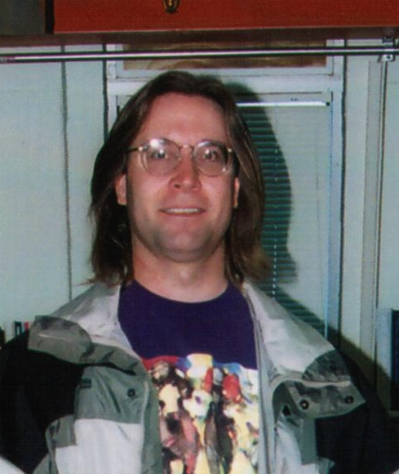

Managing Obsolescence
Obsolescence
Things go obsolete. It’s a fact of life.
Hardware, Software, Skill Sets…
Circa 2000 Circa 2022
Reasonably up to date On the verge…

Slide 3
Managing Obsolescence
Issue of Obsolescence
The PIP-II Linac is to be integrated into an accelerator complex that is over 50 years old and is planned to continue to operate for another 20+ years delivering particle beams to assorted physics experiments.
As such, PIP-II will need to remain a functional, operational machine for at least this amount of time.
PIP-II systems will need to be capable of being updated to remain compatible to the evolving network communication and security standards over its operational lifetime.
To accomplish this PIP-II will need to be a reliable, operable, maintainable, upgradeable and flexible machine.

Slide 4
Managing Obsolescence
Some Drivers of Obsolescence
Standards Evolutions
  IPv4, IPv6, etc.
  Ethernet, Fast Ethernet, Gigabit Ethernet
  10BASE-T, 100BASE-T, 1000BASE-T
  3G, 4G, 5G, etc.
  Computer/Network Security
Technology Evolutions
  Copper cable, Multi-mode fiber, Single-mode fiber…
  PLDs, PROMs, EPROMs, ASICs, FPGAs, SoC FPGAs
  uProcessors, Multi-Core uProcessors, Process size reductions (um=>nm)
  pMOS, nMOS, CMOS
  8 bit, 16 bit, 32 bit, 64 bit databus
Changing operational requirements
  Increased accelerator intensity requirements by experiments
  Overlapping operating schemes
Regulatory Changes
Manufacturer Closure

Slide 5
Managing Obsolescence
Obsolescence
Some examples
  Personal Computers
    Apple II series
    IBM PC (original, XT, AT, 386, 486, Pentium,…)
    Commodore 64
    Coleco Adam
    Apple Macintosh (Motorola 68000 series, PowerPC based series, …)
  Associated peripheral busses
    ISA & EISA
    SCSI
    Parallel Port (Centronics port)
    GPIB/IEEE-488
    RS-232

Slide 6
Managing Obsolescence
Obsolescence
More Examples
  Field Busses/Module Standards
    CAMAC
    Multibus
    FASTBUS
    NIM
    VME?
  Communication/Networking
    ARCNET
    AppleTalk
    NBF
    IPX/SPX
    Token Ring
  Personal Computer Operating Systems
    DOS
    MAC OS
    OS/2

Slide 7
Managing Obsolescence
Obsolescence
Even More Examples
  Programming Languages
    Autocode
    FORTAN
    BASIC
    COBOL
    Pascal
    Assembly Language
  Technologies
    Wire Wrap Backplanes
    PLDs (PLS153, PLS173, etc.)
    Discrete Logic (5400 series, 7400 series)

Slide 8
Managing Obsolescence
Obsolescence
3-5 year life cycles are common in both hardware & software products
Intel processor timeline
  8086 – introduced 1976
  8088 – introduced 1979
  80286 – introduced 1982
  80386 – introduced 1985
  80486 – introduced 1989
  Pentium (P5) – introduced 1993, discontinued 2000
  Pentium Pro (P6) – introduced 1995, discontinued 1998
  Pentium II - introduced 1997, discontinued 2003
  Pentium III - introduced 1999, discontinued 2004
  Pentium 4 - introduced 2000, discontinued 2008
  Pentium M - introduced 2003, discontinued 2009
  Pentium D - introduced 2005, discontinued 2010
  Core i series 1st generation (i3, i5 & i7) – introduced 2008, discontinued 2011
  Core i series 2nd generation (i3, i5 & i7) – introduced 2010, discontinued 2013
  Core i series 3rd generation (i3, i5 & i7) – introduced 2012, discontinued 2015
  Continued Core i series updates approximately annually

Slide 9
Managing Obsolescence
Obsolescence
Windows NT version history
  NT 3.1 – 1993
  NT 4.0 – 1996
  Windows 2000 – 2000 (supported thru 2005/extended support 2010)
  Windows XP – 2001 (supported thru 2009/extended support 2014)
  Windows Vista – 2006 (supported thru 2012/extended support 2017)
  Windows 7 – 2009 (supported thru 2015/extended support 2020)
  Windows 8/8.1 – 2012 (announced extended support to 2023)
  Windows 10 – 2015 (announced support to 2025)
  Windows 11 – 2021
  Note: OS updates often require related application/development tool updates

Slide 10
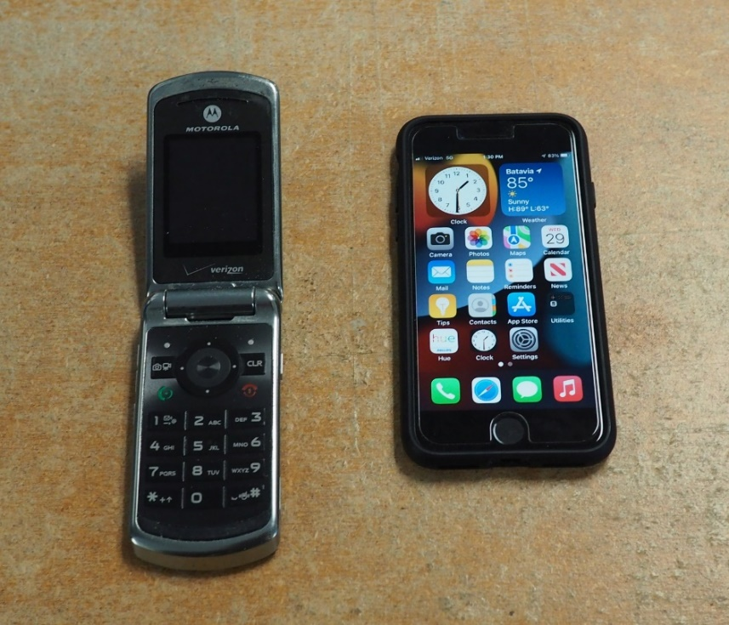
Managing Obsolescence
Obsolescence
Equipment selection should be based on recent standards
  Cell Phone example
    3G 2002-2022, 4G 2010-present, 5G 2019-present
2009-3G 2022-5G

Slide 11
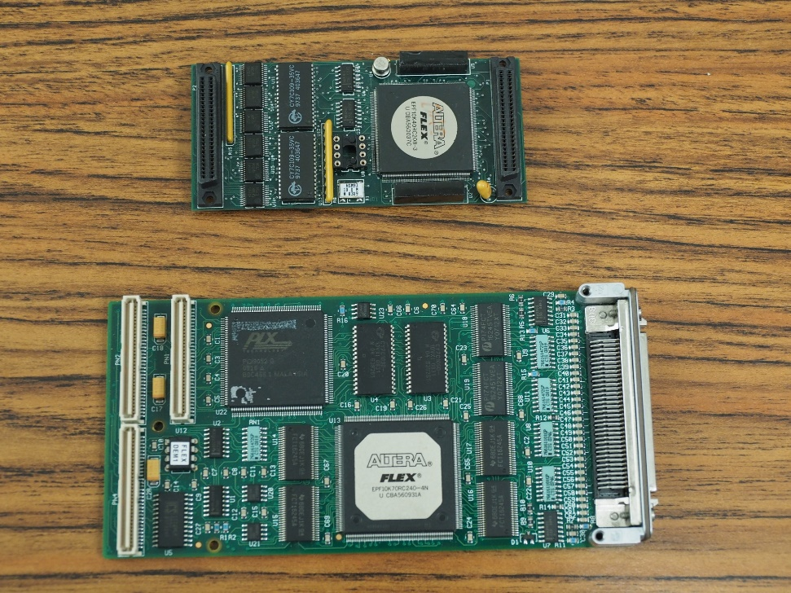
Managing Obsolescence
Dealing with/Delaying Obsolescence
In general
  In house design & support capability
  Modular designs to allow for easier maintenance & upgrades
    Both Hardware & Software

Slide 12
Managing Obsolescence
Dealing with/Delaying Obsolescence
In general
  Use newest well supported, available technology in Final Designs
    Standards based designs
    Verify with vendors that equipment selected for use will be available and supported in future
    Newest tools & commercial products (Design S/W, FPGA’s, networking, etc.)
    Commercial Off the Shelf hardware/components where possible
  Plan support for continuous update cycle for commercial hardware and software
    Operating Systems
    Networking & Network Hardware
    Databases
    Applications
    Front End S/W

Slide 13
Managing Obsolescence
Dealing with Obsolescence
Hardware
  Continuous upgrade cycle
    Replacing aging hardware on regular/planned basis
      Replacing 1GB network switches with 10GB/100GB network switches
      Replacing existing Front Ends with newer units
      Routine replacement of commercial equipment (Oscilloscopes, etc.)
      Technology Insertions
    Perform routine equipment redesigns prior to actual End of Life (EOL)
      Extend system lifespans
      Allow for regular system updates
        Firmware
        Hardware (FPGAs, etc.)

Slide 14
Managing Obsolescence
Dealing with Obsolescence
Hardware
  Stockpiling obsolete parts while still available
    Potential Storage issues
    Aging of stored parts
    Need to maintain potentially obsolete tools for use with parts (H/W, F/W & S/W)
    Use of last of stored parts prior to system retirement will still require End of Life (EOL) redesign

Slide 15
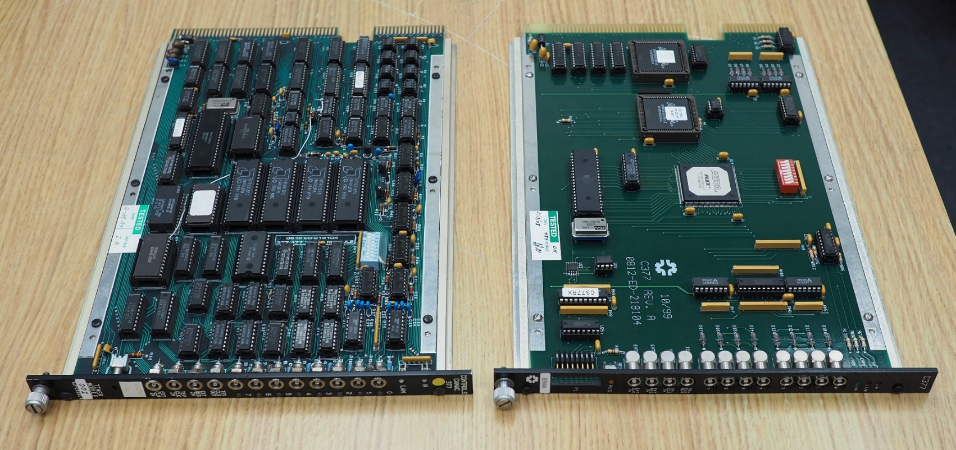
Managing Obsolescence
Dealing with Obsolescence
Hardware
Simple End of Life redesign of replacement.
  Replacement of existing system/module with functionally identical, interchangeable unit

Slide 16
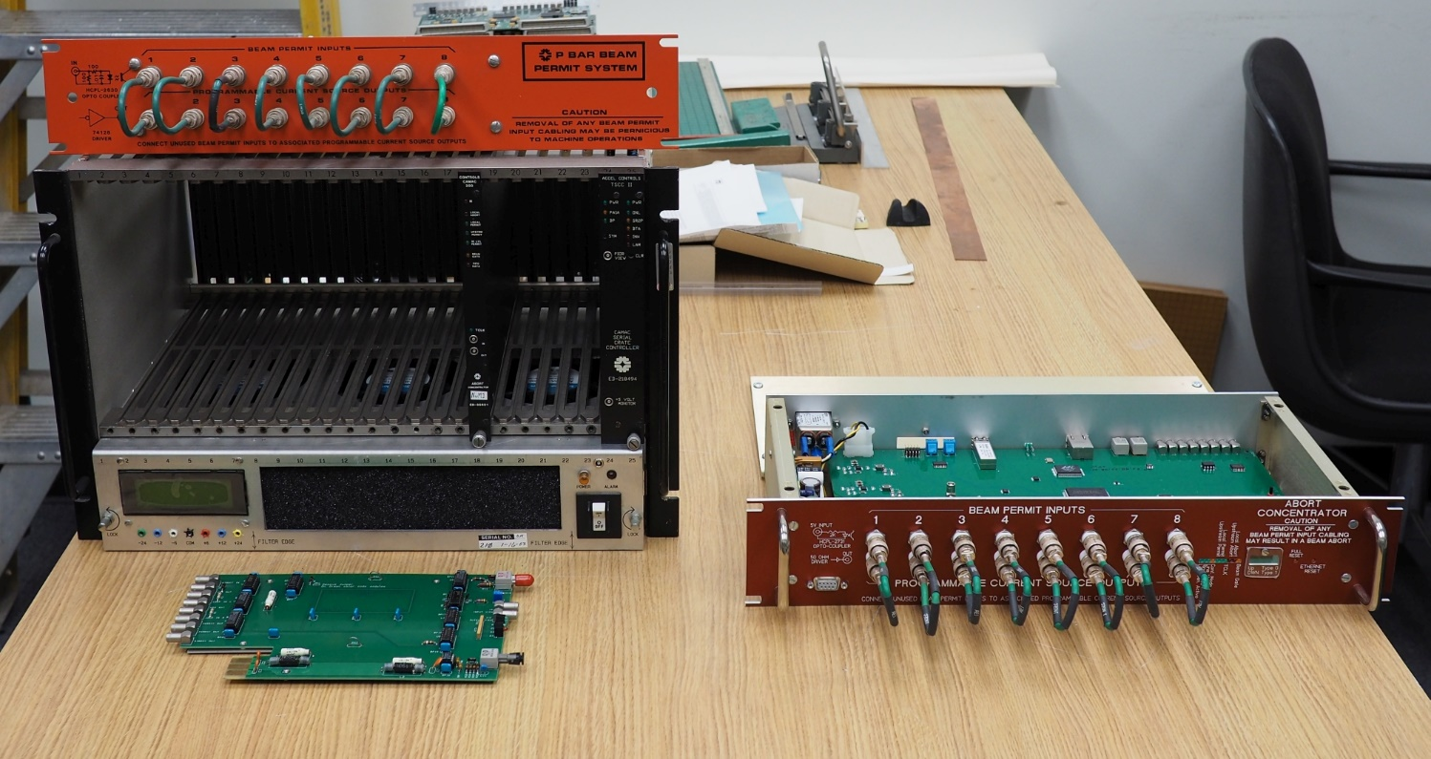
Managing Obsolescence
Dealing with Obsolescence
Hardware
Major End of Life redesign of replacement.
  Replacement of existing system/module with more capable, modern system/unit

Slide 17
Managing Obsolescence
Dealing with Obsolescence
Documentation
PDF’s of all design documents should be available in easily accessible location (web, shared network drives, document databases, etc.)
  Schematics
  Board Layouts
  Parts Lists
  Specifications
  Functional Descriptions
  System Block Diagrams

Slide 18
Managing Obsolescence
Dealing with Obsolescence
Personnel
  Keep skills up to date via training
    Tools
    Equipment
    Technologies
    Standards
  Succession planning
    Continuous influx of new people to help prevent everyone retiring at once
    Bring new replacement personnel in ahead of retirement of key personnel
      To support information transfer
    Cross training of group personnel

Slide 19
Managing Obsolescence
Manage Obsolescence
In the design/development stage
FPGA selection to ensure plenty of capability for expansion via firmware updates…
Use Common Field Bus architecture as much as possible
  uTCA?
Commercial Off the Shelf where possible
Common 19” Rack Mountable Hardware where possible
  Allows for easier replacement
Common Control System for entire complex
Networking needs to support IPv6 or later
Modular, Modular, Modular!
  Both hardware & software
Design to most recent standards

Slide 20
Managing Obsolescence
Manage Obsolescence
In the operational stage
Scheduled Maintenance
Scheduled Updates
Plans to support updates to stay current with Standards
  Commercial Software Products
  Communications
  Networking
  Commercial Instrumentation
  Security Updates

Slide 21
Managing Obsolescence
Questions?

