Slide 1
PIP-II Workshop on Managing Technology Obsolescence – Operational Conditions
Darren Crawford
PIP-II Operations Coordinator
12-Jul-22

Slide 2
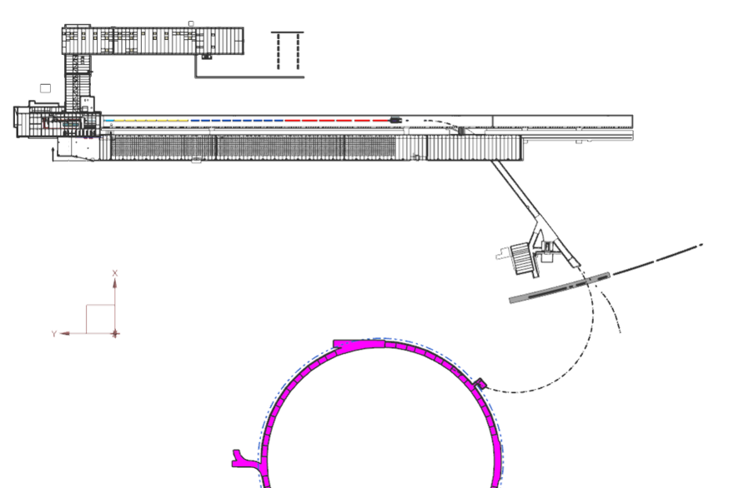
PIP-II Era
Warm FE and SC Linac replace existing Linac (RIL, Alvarez DTL, Side-coupled cavities)
Regular operation: beam to Booster
Tuning: SAD and BAL
Parameters
Energy up to 800 MeV
Nominal 0.55 ms x 20 Hz x 2 mA (pulsed), capable of CW operation
WFE: capable of 10 mA, current is chopped and scraped in the MEBT to inject 2 mA into SC Linac
Warming up and cooling down cryomodules will likely change performance of the PIP-II SC Linac, will introduce uncertainty, require significantly longer commissioning time, increases risk of cryo system failures
Requirement:
Keep SC Linac cold, preferably at 2-4 K but not exceeding ~20 K during maintenance periods
Maintain feeder redundancy for Cryo Plant power

Slide 3

Accelerator Operations
Operators log downtimes and attribute them to machines and causes
Downtimes can hide behind others, e.g. “We accessed to fix a water leak in the Main Injector, and while we were down, we did RF repairs in the Booster.”
The statistics shown in the following slides are from periods of stable running (startup periods excluded)
Accelerator Division Operations Department
Maximize beam intensity while minimizing beam loss in the accelerator chain
Investigate equipment issues and relay information to system experts
Document accelerator conditions in electronic logbook and downtime logger
Maintain training credentials (Safety, Division, Department, equipment specific)
Average time as an operator is ~2 yrs

Slide 4
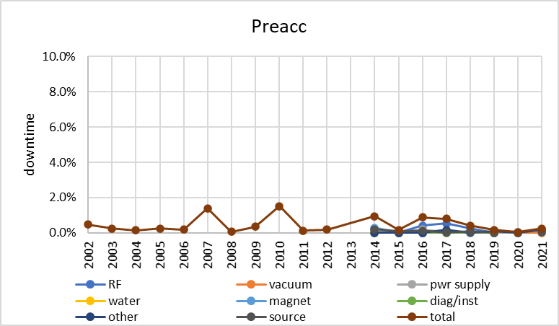
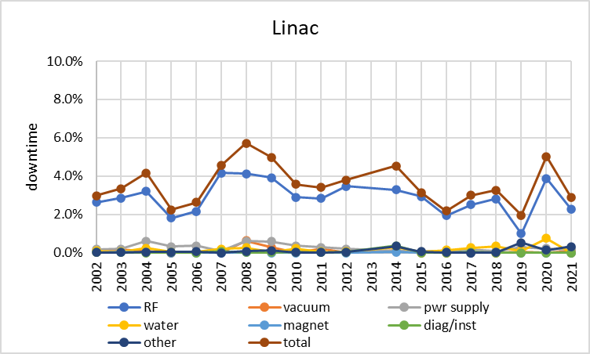
Existing Linac
Preacc contributes essentially no downtime
Linac downtime ~2-5% driven by RF

Slide 5
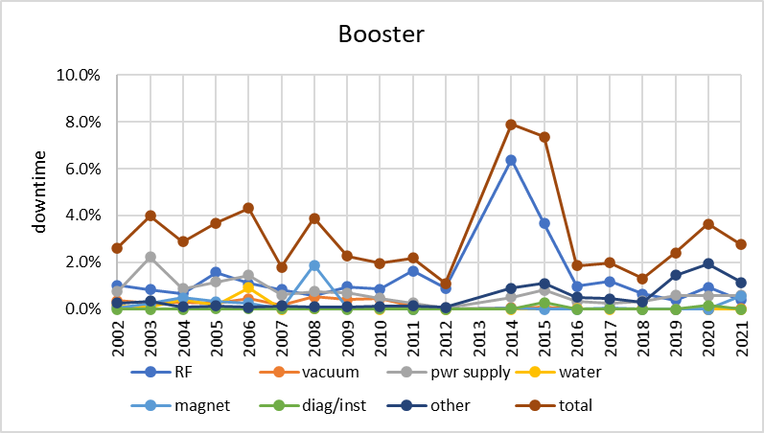
Booster
PIP RF cavity refurb
beam studies
Recent downtime ~2-4% including 1-2 shifts of scheduled beam studies per month
Downtime due to RF was reduced by PIP adding cavities

Slide 6
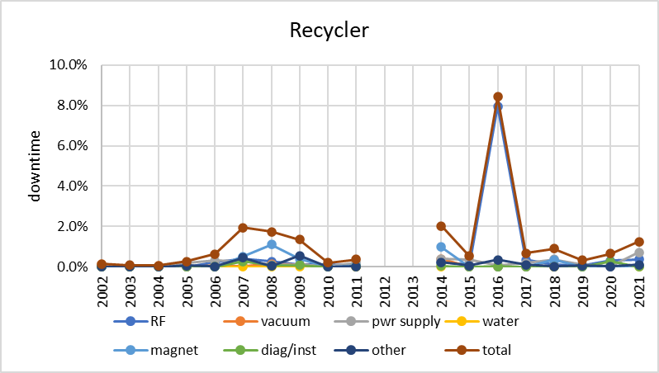
Recycler
anode power supply transformer fire
Converted from pbar storage to proton slipstacking in 2013
Downtime typically <2%

Slide 7
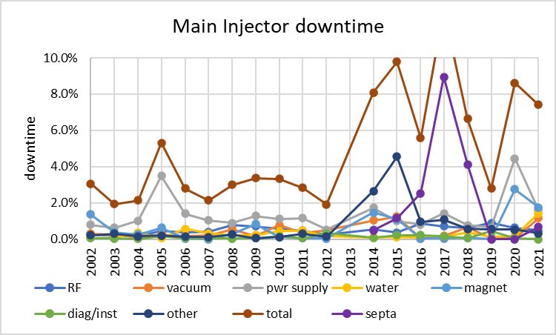
Main Injector
During the Tevatron era (–2011), tunnel accesses were strictly limited; following the accelerator and NuMI upgrade in 2013, accesses and studies were more common (“other”)
No single dominant source of downtime, though power supplies are common issue

Slide 8
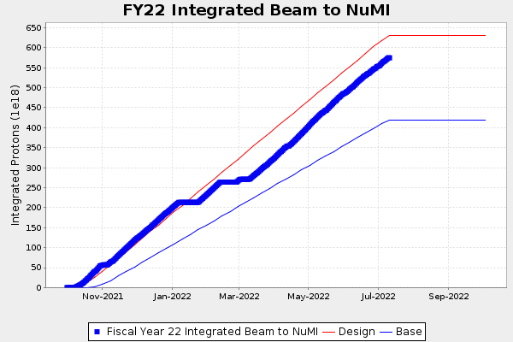
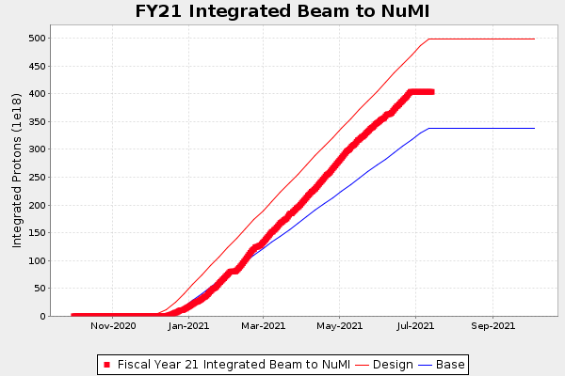
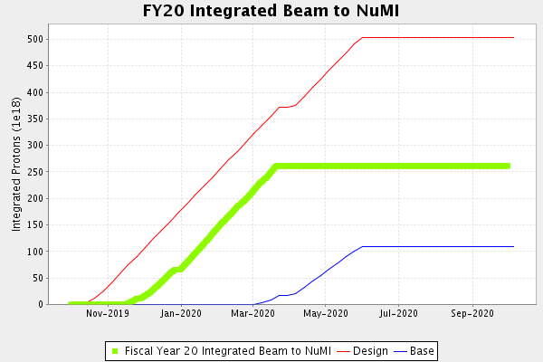
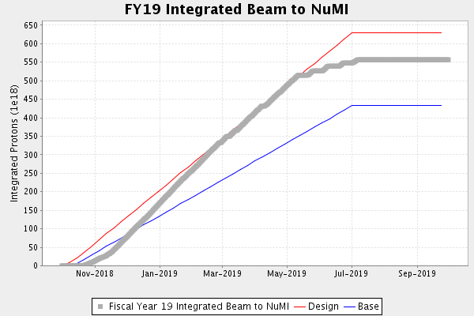
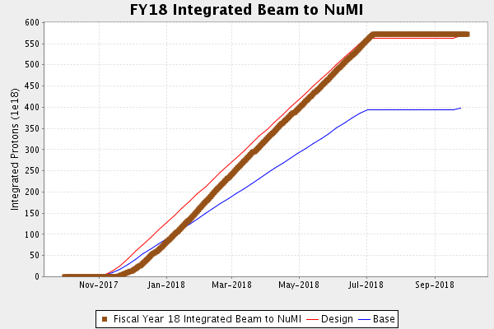
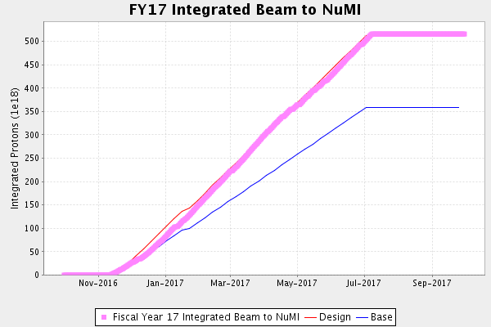
Beam to NOvA in the 700-kW era
Red line assumes 85% uptime from Proton Source, 95% uptime from MI/Recycler (~81% from Complex)
893 kW
budget
COVID
budget

Slide 9
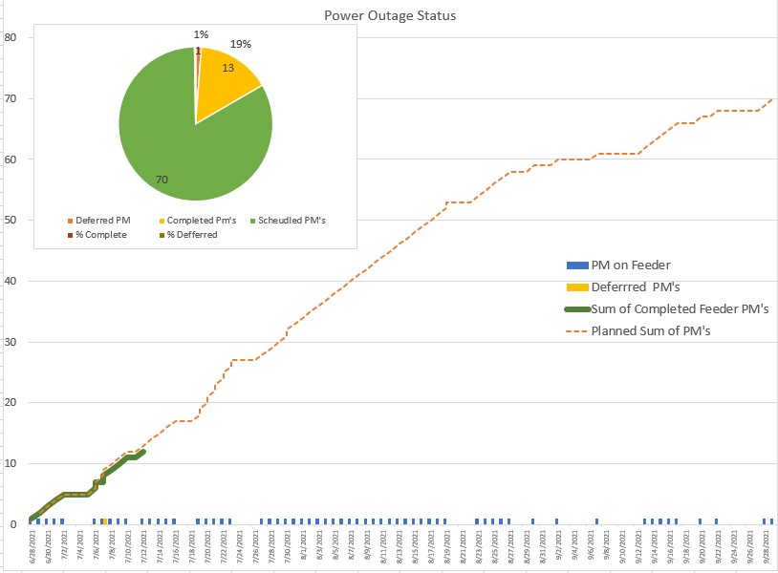
Typical shutdown start / end
Turn off in July when MI operation would be limited by cooling-pond temperatures
ComEd will not do their maintenance during the summer, so startup not before mid September
MSS
KRS

Slide 10
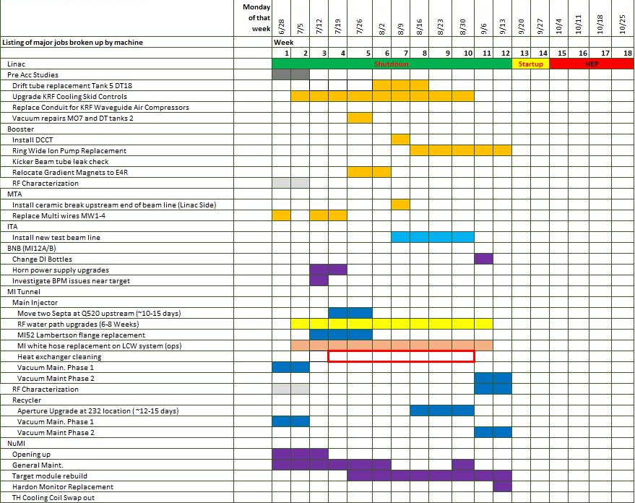
Typical shutdown drivers
Water maintenance across the complex currently takes ~12 weeks; could be reduced with more technicians
Work is structured to turn on Linac first, then Booster, then MI/Recycler for efficient beam commissioning

Slide 11
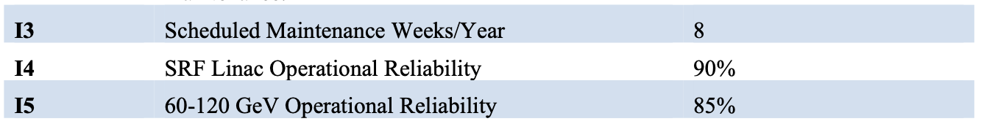
Maintenance model during PIP-II era
PIP-II Global Requirements Document (GRD, ED0001222) defines requirements for beam maintenance and linac and AC availability
  Availability – ratio of time when beam is available for experiments to scheduled time
Will still need ~2 weeks for ComEd substation maintenance as well as annual feeder maintenance
Will want to reestablish Linac beam ~2 weeks before MI
  Can also do Linac / Booster studies during this period
availability
availability

Slide 12
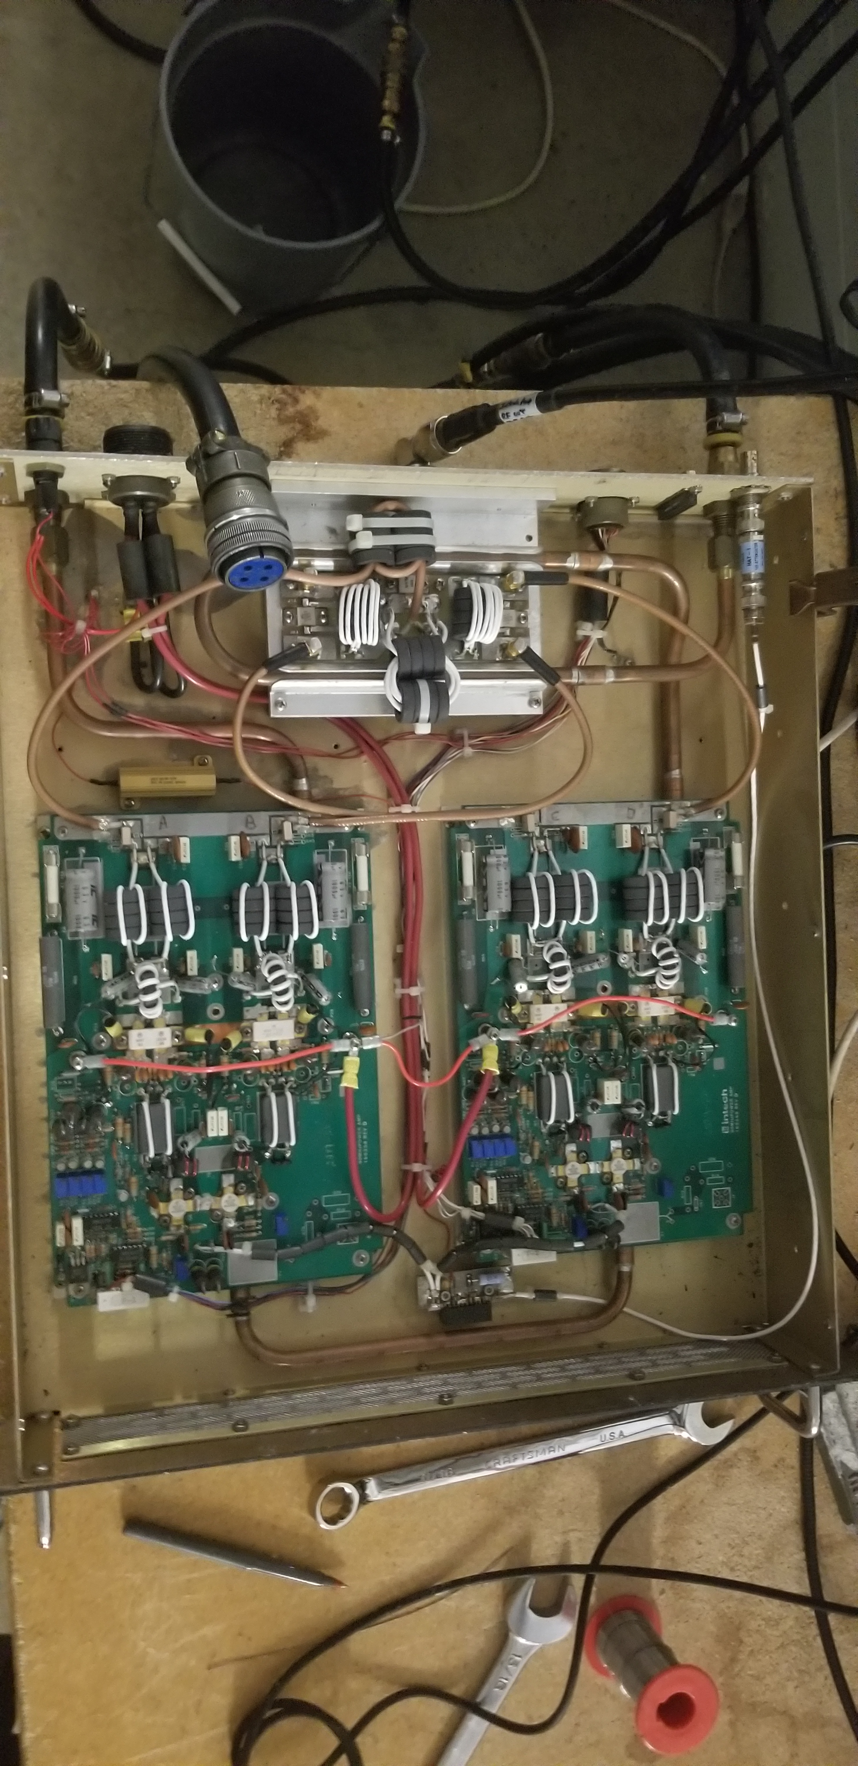
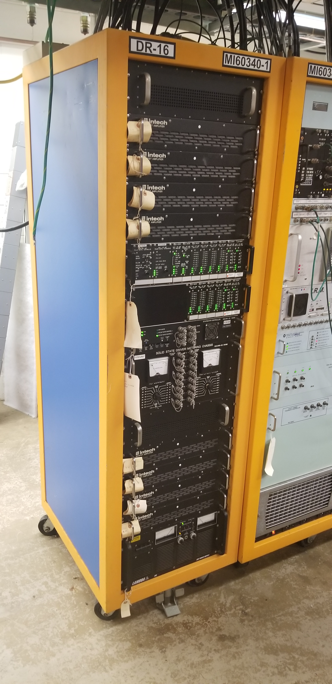
MIRF/Booster/RR
Fermilab standard for electronics racks is 19” rackmount hardware
Operators can replace problematic equipment with available spares
  Requires limited system knowledge
  This reduces downtime!
12
D. Crawford, Technology Obsolescence - Operational Conditions

Slide 13
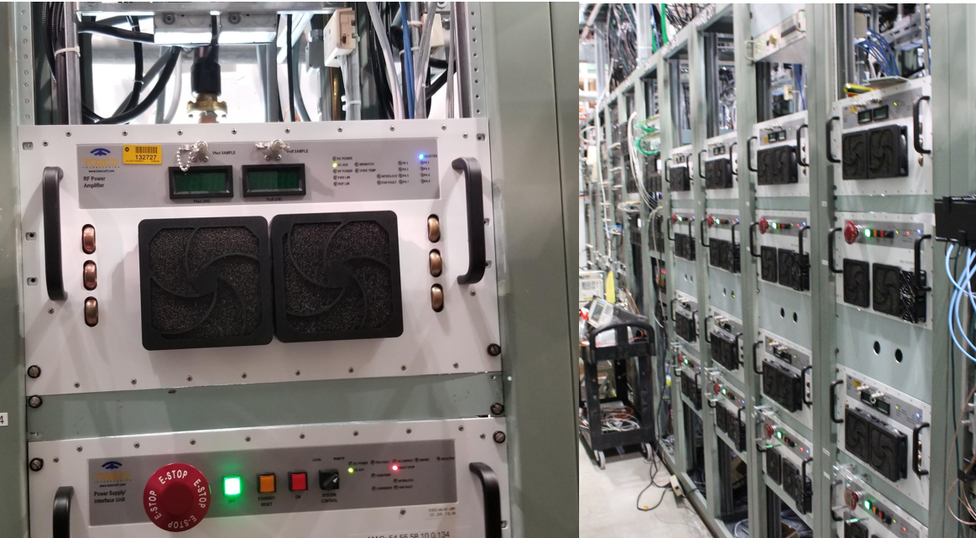
TOMCO HWR amplifier at PIP2IT
Rackmount
Standard design for 19” Rackmount Systems
Front panel
  On/Off/Remote/Local control
  Status indicators
  Emergency off
  Realtime Current/Voltage values
  Analog test points for troubleshooting
Back panel
  Power connections
  Water connections
  Communication port
  Interlocks interface
  Fuse holder
Needs to support
  Scheduled maintenance
  Scheduled updates
  Industry standards for
    Firmware/software
    Communications protocols
    Networking
Custom parts, non-standard designs can contribute to longer downtimes, increase in training procedures for a “unique” design.
D. Crawford, Technology Obsolescence - Operational Conditions
13

Slide 14
Summary
Plan on at least 85% Accelerator Complex uptime during operational period in PIP-II era
Expect 8 week annual shutdowns for maintenance including 1 week Master Substation/KRSS power outage plus feeder maintenance
Will want to reestablish Linac beam ~2 weeks before MI
Standardized equipment that can be easily swapped out reduces downtime
Operators are the first line of investigation to equipment issues for all accelerators

Slide 15
Sample Current Linac Maintenance Plan

