Slide 1
Software Obsolescence and Sustainability
John Diamond
AD/Controls
July 12th, 2022

Slide 2
What is the agenda?
Motivation: How do we effectively maintain the mountain of in-house software written over the last 4 decades and still have time to write new software? How do we ensure that the software written this afternoon will be maintainable 10-20 years from now?
Vocabulary
What is “tech debt”? What is legacy software? What is obsolete software?
What is sustainable software? What is code stewardship?
Maintenance
What are effective strategies for managing our tech debt and legacy software (often written decades ago)?
Avoidance
How do we avoid creating a mountain of tech debt for ourselves and future generations?

Slide 3
What is the scale of this problem?
AD has a massive legacy software investment
Console applications, scripts, user libraries, system services, middleware, front ends, embedded systems, etc.
C, C++, Erlang, PERL, Java, FORTRAN, … even Pascal!
~8.5 million LoC in MECCA, ~1.8 million Java = > 10 Million LoC
Many FTEs will be spent on developing software for PIP-II era controls
If we spend all our effort maintaining the existing infrastructure, who will do this work?
And how fast will the software we build for PIP-II become technical debt?

Slide 4
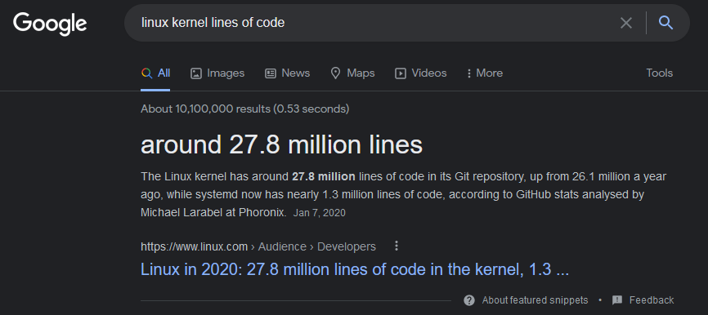
Wait, how many lines of code?
Baseless claim: ACNET comparable to Linux in complexity…
The Linux kernel contains ~ 3x as much code but v5.11 had 1912 developers contributing
Our GitHub Enterprise has slightly more than 50 seats…
Only 3x the size yet supported by 40x the developers

Slide 5
What is Tech Debt?
Maintenance load is the resources you need to dedicate just to maintain the existing feature set of the system
Tech Debt = Additional maintenance load that comes from a loss of context
Context is what you know about how the software works, where things are and what needs to change.
Context Loss occurs when a developer forgets, leaves or switches roles
Along with Tech Debt, you start to fear changing code that you lack sufficient context of
Code Stewardship reduces the maintenance load of tech debt
The only way to eliminate tech debt is to delete code

Slide 6
What is Legacy Software?
Legacy Software = Software that we fear to change
Legacy Software != old software
It could be “new”! (e.g. how many times have you struggled with code you wrote “only” 2 years ago??)
If we fear changing software because we didn’t write it, or we don’t have the proper “context” anymore then this prevents us from making improvements (e.g. new features, bug fixes, refactoring).

Slide 7
What is Obsolete Software?
Obsolete Software = Software that is not used
We can identify it!
Users don’t launch it
Other software does not depend on it
Systems don’t load it
Some risks we take by keeping obsolete software around:
We waste time maintaining software that no one will use
e.g. make it work with PostgreSQL
We expose ourselves to security holes
We put off important changes because we fear breaking useless code
But how do we identify software that is becoming obsolete?

Slide 8
What is Sustainable Software?
Sustainable Software = Software that you don’t fear changing
If it’s not used, get rid of it!
ACNET has some analytics for analyzing use – we need this from EPICS!
Don’t duplicate functions/features/services, reuse!
Plan for context loss events – these will happen!
Software developers will leave / move on to other roles, leaving code without context to other developers
Software developers will move on to other projects, or different technology stacks and lose important context (forget) that is not documented
What software developers can do (from least to most effective):
Document code
Don’t re-invent the wheel! Use standard libraries and open source software to get the job done. (i.e. Circular Buffers???)
Write clean code and constantly refactor to clean code (if you don’t know Uncle Bob or Martin Fowler – find out)
Write modular code
Use automated testing and continuous delivery
Practice Test Driven Development
90%+ test coverage, modular code by design, easy to refactor and self documenting (WIN, WIN, WIN, WIN!)

Slide 9
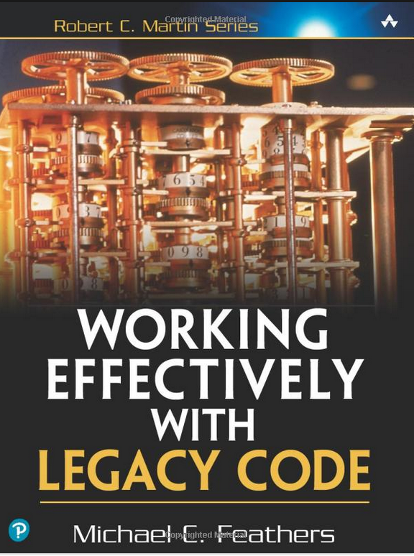
What do we do about legacy software?
Is it obsolete? If yes, let’s get rid of it
Legacy code can made to be maintainable
Automated testing helps lower the fear to making changes
Put tests in place before making changes to existing code & use it to verify that things that are supposed to work don’t break (characterization tests)
When writing new software, automated unit tests and acceptance tests will help you and others make future changes without fear

Slide 10
How should we manage tech debt going forward?
The software we write today will need to be maintained for decades
From: Technical Debt First Steps, presented by Chelsea Troy (O’Reilly Media)
Priorities:
Remove obsolete features/software ← cheap & easy wins!
Address documented “hot spots” that make implementing new features difficult ← big morale booster!
Address “abandoned houses” at the point change is needed.
Look for spots where code flexibility does not match the rate of change
Don’t get in the way of software developers maintaining the code – they know best!

Slide 11
What is AD/Controls doing?
Forming a Controls Software Stewardship Committee that will address the challenge of sustaining in-house software
Decide which code is obsolete and should be retired
Identify the software which changes frequently, assign resources to address known issues
EPICS (Open Source Software)
Spreading the maintenance burden into the OSS community

Slide 12
Are we done yet?
Thank you!
Any questions??

