Slide 1


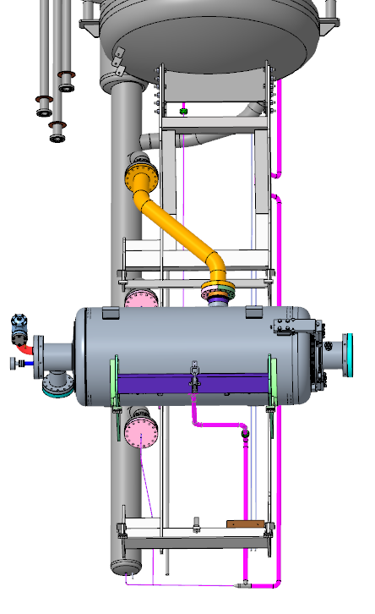
Modifications to STFC-DL cavity test infrastructure for PIP-II
2nd PIP-II Technical Workshop
Ayomikun Akintola

Slide 2
Introduction
For PIP-II cavity testing, a number of PIP-II specification requirements have necessitated modifications to the existing VTF currently being used for ESS cavity testing here at Daresbury. These requirements are:
  The total magnetic field within in the test environment must be <0.5 µT throughout the entirety of the test duration.
  The ability to measure, record, and control the magnetic field within the test environment.
  The cavities must be thermally cycled to 35 K [-/+ 10 K] and then a fast cooldown through the superconductor’s critical temperature for the expulsion of trapped magnetic fields in the cavity.
  The minimum helium mass flow through the cavity jacket during the fast cooldown must be at least 8 g/s.
These requirements result in the need for:
  Mechanical changes to CSI cradle frame and cradle position.
  Process changes to the existing helium circuit and cryoplant.
  Installation of a magnetic field measurement system and read-out.
  Installation of additional magnetic field attenuation.
I will only be discussing changes to the cryogenic system in this presentation but slides are available for the magnetic field modifications.

Slide 3
Fast cooldown (FCD)

Slide 4
Objectives
To evaluate the maximum rate of cooling the cavity from 45 K to 5 K.
Target Rate to be achieved is 20 K/minute
The LHe flow rate required to achieve this rate for the PIP-II HB650 cavity is > 12 g/s per Cavity
(As per simulations results by the FNAL SRF team)
We believes that we can achieve 8 g/s in the current ESS configuration with a single cavity.

Slide 5
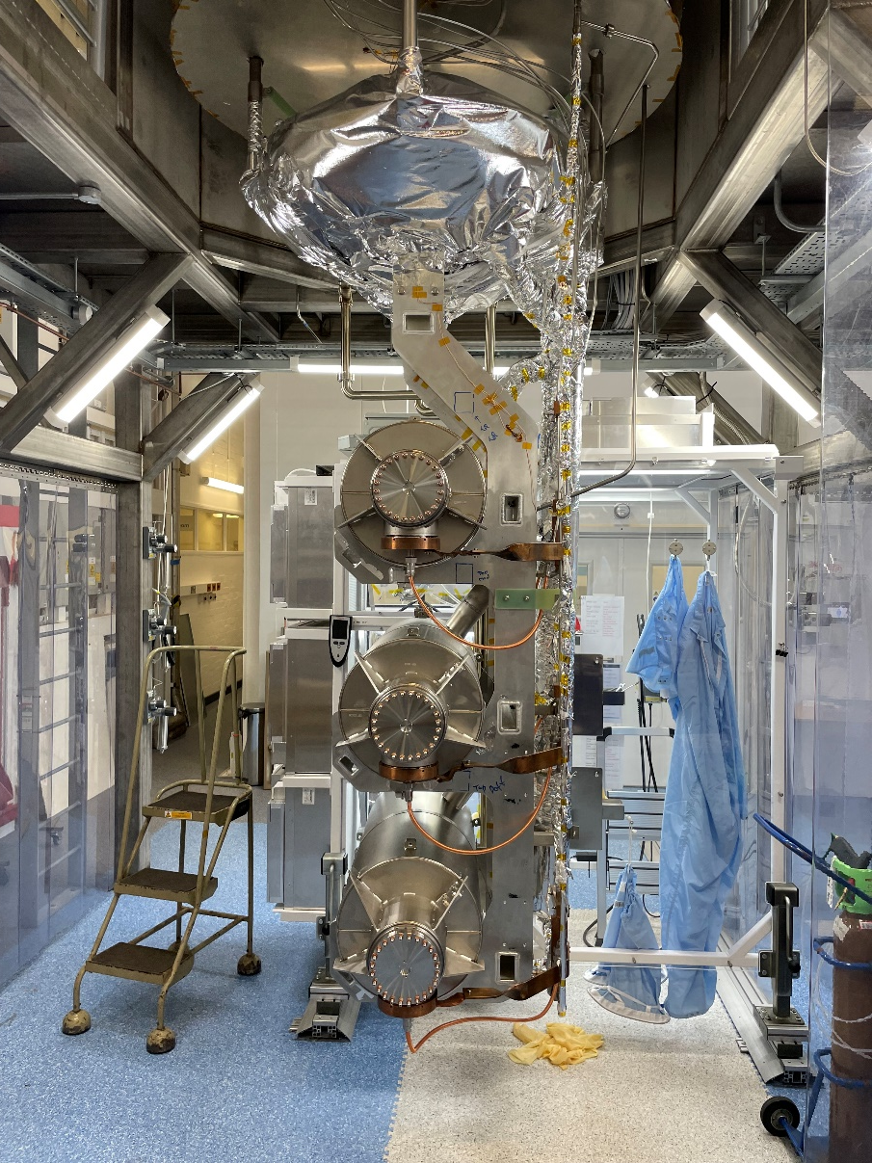
Existing CSI configuration
a)
b)
Helium Reservoir
The maximum flow rate that can be achieved in the current configuration is 15 g/s.
However, this is distributed equally across 5 different branches with a maximum achievable flow of 3 g/s in each branch.
Therefore in order to achieve a flowrate exceeding 8 g/s, we must minimise the number of branches.
This can be achieved by testing only one cavity at a time.
A
C4
~ 3 g/S
C3
~ 3 g/S
C2
15g/S
~ 3 g/S
C1
C
~ 3 g/S
~ 3 g/S
B
D
Figure 1a and b: Configuration for ESS HB704

Slide 6
Proposed CSI modifications
1. Remove elbow to bottom of helium reservoir
Helium Reservoir
Helium Reservoir
A
2. Unchanged pipe -> 10mm mini CF connection
A
C4
~ 3 g/S
C5
3. 3mm coiled ID pipe
C3
15g/S
~ 3 g/S
15g/S
C2
~ 3 g/S
C1
12g/S
4. Remove tees to top and middle bottom fill lines
C
C1
5. Reducer
-> 3 mm
~ 3 g/S
6. 3mm ID pipe
C
~ 3 g/S
3g/S
B
D
B
D
Figure 2: Configuration for ESS HB704
Figure 3: Proposed configuration for PIP-II HB650

Slide 7
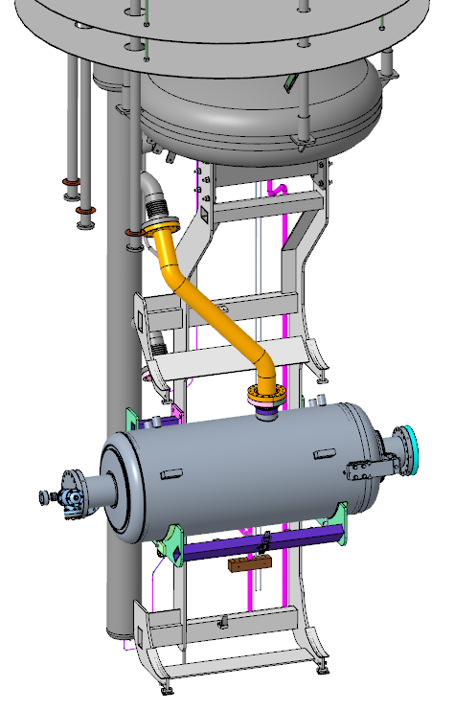
a)
b)
Figure 4a and b : Modified CSI CAD for HB650 cavity testing

Slide 8
Process and procedural changes
In addition to the changes in the configuration of the CSI, we will also need to make modification to the process and operating procedures.
During the cooldown process the temperature gradient across the cavity can exceed 100 K, thus in order to minimise the gradient is to cooldown slowly from 300 K to 4 K.
The fast cooldown is only required below 45 K.
Once the cavity is cooled to 4 K, it will be thermalised so that the temperature gradient across the cavity is > 20 K. once this is done, then the temperature of the cavity is raised to about 45 K followed by a fast cooldown back to 4 K

Slide 9
Proposed modes of operation [for normal HB650 testing]
Mode 1: Cavity assembly
Mode 2: Mode 2 Checks & CSI loading into bunker
Mode 3: Mode 3 Checks & Shield cooldown to 80-90 K using GHe and LHe
Mode 4: Cavity cooldown with LHe to 4 K then RF testing [Set up and Cable Calibration – 2 hrs ]
Mode 5: LHe is boiled off using heaters to thermally cycle cavity to 35 K [+/- 10 K]
Mode 6: Fast cooldown of cavity to 4 K with helium flowrate of 15 g/s; Once at 4 K, CSI is filled at 4 g/s until full.
Mode 7: Cavity cooldown to 2 K , LP measurement - 2 hrs , if cavity fails conditioning maybe required [2 hrs - 2 days]
Mode 8: Temperature stability at 2 K and RF operations
Mode 9: Warmup to 300 K
Mode 10: CSI removal from bunker
Mode 11: Cavity disassembly on CSI stand (then return to mode-1)

Slide 10
Operating Modes
Weekend
Shield
Cooling
AM
PM
Overnight
AM
PM
Mode 4
Mode 5
Mode 6
Cavity Cooldown
Mode 7
200K
Thermal
Cycling
35K [+/- 10K]
Mode 8
Fast
Cooldown [15g/s]
100 K
Cooldown to 2k
RF tests at 2K
RF tests at 4K
4 K
@
300L LHe
2 K
Figure 5: Newly Proposed Mode of Operations Plot

Slide 12
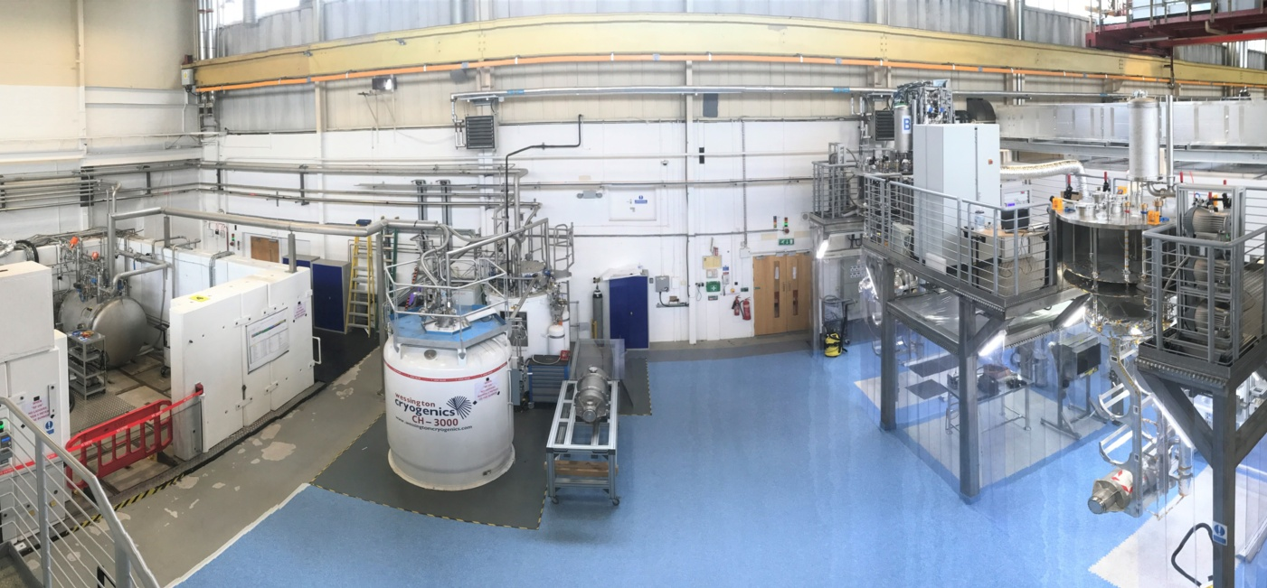
SuRF Lab
CSI-A
Purifier
2K Cold Box
Helium Dewar
CSI-B
Image © STFC John Dawson

Slide 13
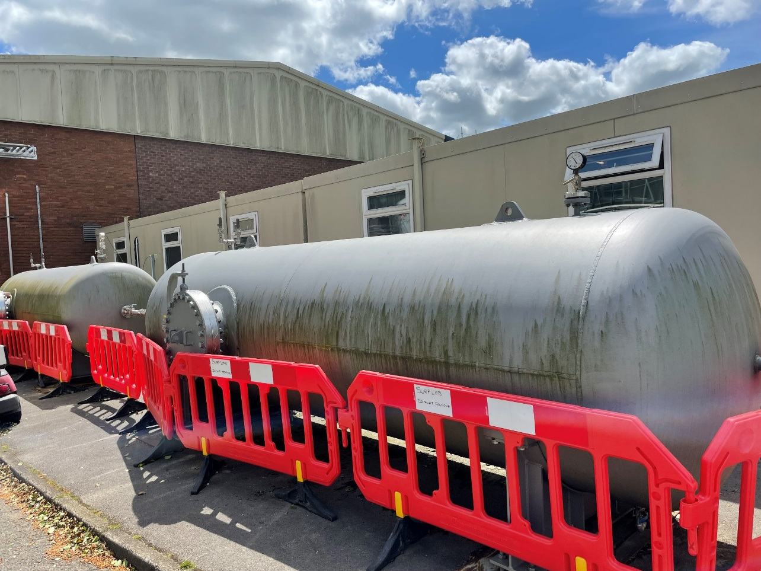
Cryoplant modifications
In order to implement this process, modifications to the existing cryogenic system will be required.
Insert image of Warm gas storage and/or SuRF lab
Figure 6: Warm gas storage tanks

Slide 14
Existing warm gas storage capacity
Existing system
Max storage pressure (bar) | 40 (in actuality Relief valve set to 35 bar)
Safe operation storage pressure | 30 Bar
Each warm gas tank in liquid litre equivalent of helium (L) | 528.40
Each warm gas tank (m3) | 10.00
Total available storage vessel volume (m3) | 20.00
Number of 10m3 storage vessels | 2.00
Total liquid litre equivalent of helium (L) | 1056.80
Table 1 – Existing system

Slide 15
Potential Limitations, issues, new-situations to be managed
The duration of maximum flow rate is expected to be between 10 and 30 minutes but we should be ready to be in this situation at least for 1 hour.
Mass Flow LHe consumed in 1 hour Pressure rise in warm gas buffer
LT607 PT120 (maximum capacity 35 bar)
______________________________________________________________________
10 g/S 267 litres 10 bar (5 bar in ½ hr)
20 g/S 404 liters 20 bar (10)
30 g/S 810 liters 30 bar (15)
40 g/S 1080 liters 40 bar (20)
This necessitates a fast cool-down start up condition to be PT120 < 10 bar
Note: that the PT120 will continue to rise normally due shield cooling and other ongoing operations
.

Slide 16
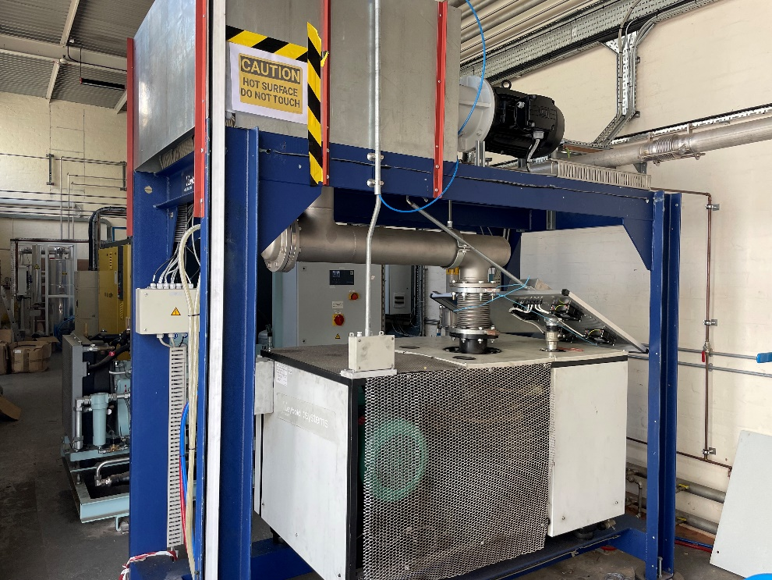
Potential Limitations, issues/ new-situations to be managed
The maximum flow rate of the system could be limited by
1) Pumping speed of the P6020 at 600 < P < 1000 mbar : Specified at ~ 40 g/S
2) Maximum Speed of the recovery compressor to empty the gas bag : (16g/S)
3) HazOp to be reviewed after modifications and before commissioning
Figure 7 : 2 K pump

Slide 17
Liquid Inventory requirement for FCD and fill
For a fast cooldown to 4 K at 15 g/s for 1hr and a normal fill at 4 g/s for 2hrs afterwards:
Fast cooldown procedure (fast cooldown [15g/s] + fill [4g/s])
Total duration of fast cooldown Run (hrs) | 3.00
Total liquid litre equivalent of helium (L) | 618.90
Required number of 10m3 storage vessels | 1.24
Integer required number of storage | 2.00
Additional 10m3 storage required | 0.00
Table 2 - Fast Cooldown Parameters (Fast Cooldown + Fill)
This would require a warm gas buffer pressure below 10 bar when the fast cooldown begins as a start condition, which operationally is not realistic. Therefore to operate safely within the plants normal operating conditions additional warm gas storage is required.

Slide 18
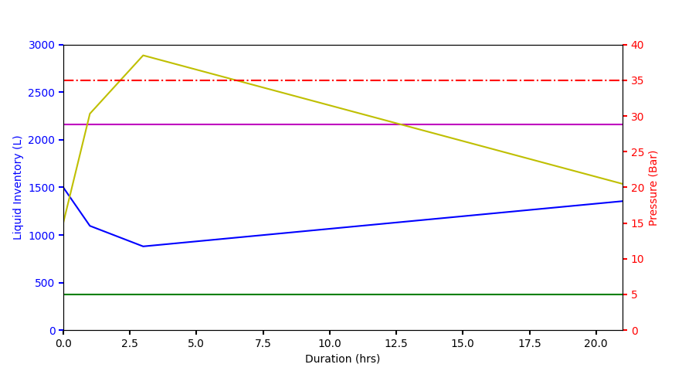
Existing storage
Pressure Overshoots due to FCD
Fill – 2 hrs
Recovery – 18 hrs
FCD – 1 hr
Warm gas storage maximum pressure
Legend
Magenta – Total helium inventory (L)
Yellow – Warm gas buffer pressure (Bar)
Blue – Liquid helium in dewar inventory (L)
Green – Clean gas pressure (Bar)
Red – Maximum operating pressure (Bar)
Start of FCD
Figure 8: PIP-II fast cooldown cycle plot (current storage capacity)

Slide 19
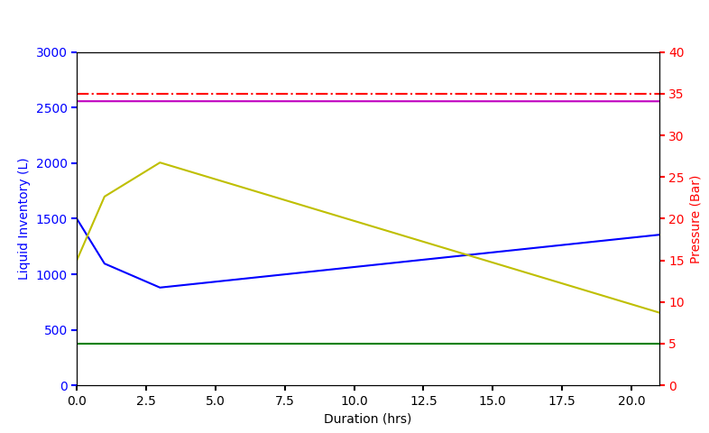
Warm gas pressure < Maximum operating pressure
≈
9 Bar of operating margin post-FCD and CSI fill i.e. L/GHe cooling of thermal shield
With additional storage
FCD – 1 hr
Fill – 2 hrs
Recovery – 18 hrs
Legend
Magenta – Total helium inventory (L)
Yellow – Warm gas buffer pressure (Bar)
Blue – Liquid helium in dewar inventory (L)
Green – Clean gas pressure (Bar)
Red – Maximum operating pressure (Bar)
Expected maximum pressure is reduced to 25 bar from 38 bar
Start of FCD
Figure 9: PIP-II fast cooldown cycle plot (with additional storage capacity)

Slide 20
FCD validation process
The cryo team will require a 2-week slot from the ESS testing schedule to carry out FCD validation with 1 placeholder ESS high-beta cavity to be tested. The FCD process for PIP-II can’t be fully validated during ESS testing as permanent modifications need to be made to the CSI’s helium circuit, however we will be able to answer a number of key questions related to plant performance.
The cavity cooling rate will be varied by varying the amount of liquid introduced into the CSI by adjusting the position of the CSIs bottom fill valve and the associated mass flow monitored and recorded from FM2230 – Mass flow meter on the outlet of the 2 K pumps. The pressure in the CSI and the helium flow rate can then be plotted as a function of the bottom fill valve position.
The FCD process will operate using the same procedure for normal bottom fills with a few modifications (it will have the same interlock parameters):
  Position of bottom fill valve will be varied
  All inlet valves on 2 K pump manifold to be opened
  Mass flow meter maxes out at 10g/s -> Equation to be implemented in EPICS to measure mass flow.

Slide 21
Proposal and Procedure for FCD validation
Conduct test with only one cavity on the bottom cradle
Proceed with normal cool-down up-to mode 4 till CSI reaches ~ 4 K
Thermalise Cavity @ 4 K to minimise temperature gradient across cavity to less than 20K
Raise cavity temperature to T > 35 K (+/- 10K)
Conduct fast cool-down cycle below 45 K with maximum helium flow rate (exceeding 8 g/s)
Hold the maximum flow till all the parts of the cavity reach below 5K. This duration is expected to between 10 minutes and 30 minutes.
Proceed with normal RF tests after FCD

Slide 22
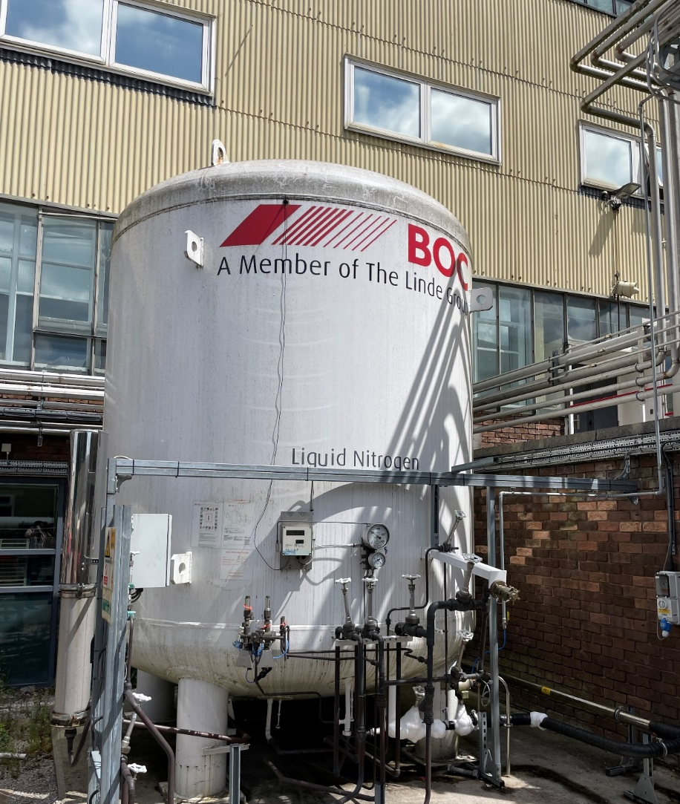
Potential additional improvements to cryogenic operations
Improved shield cooling rate using LN2:
  Insert a tap into the existing LN2 supply line
  Switch shield GHe supply line to LN2 supply line
  Isolate shield circuit from LHe circuit inside 2 K box
  Make appropriate arrangements for GN2 exhaust
Figure 10 : LN2 Dewar

Slide 23
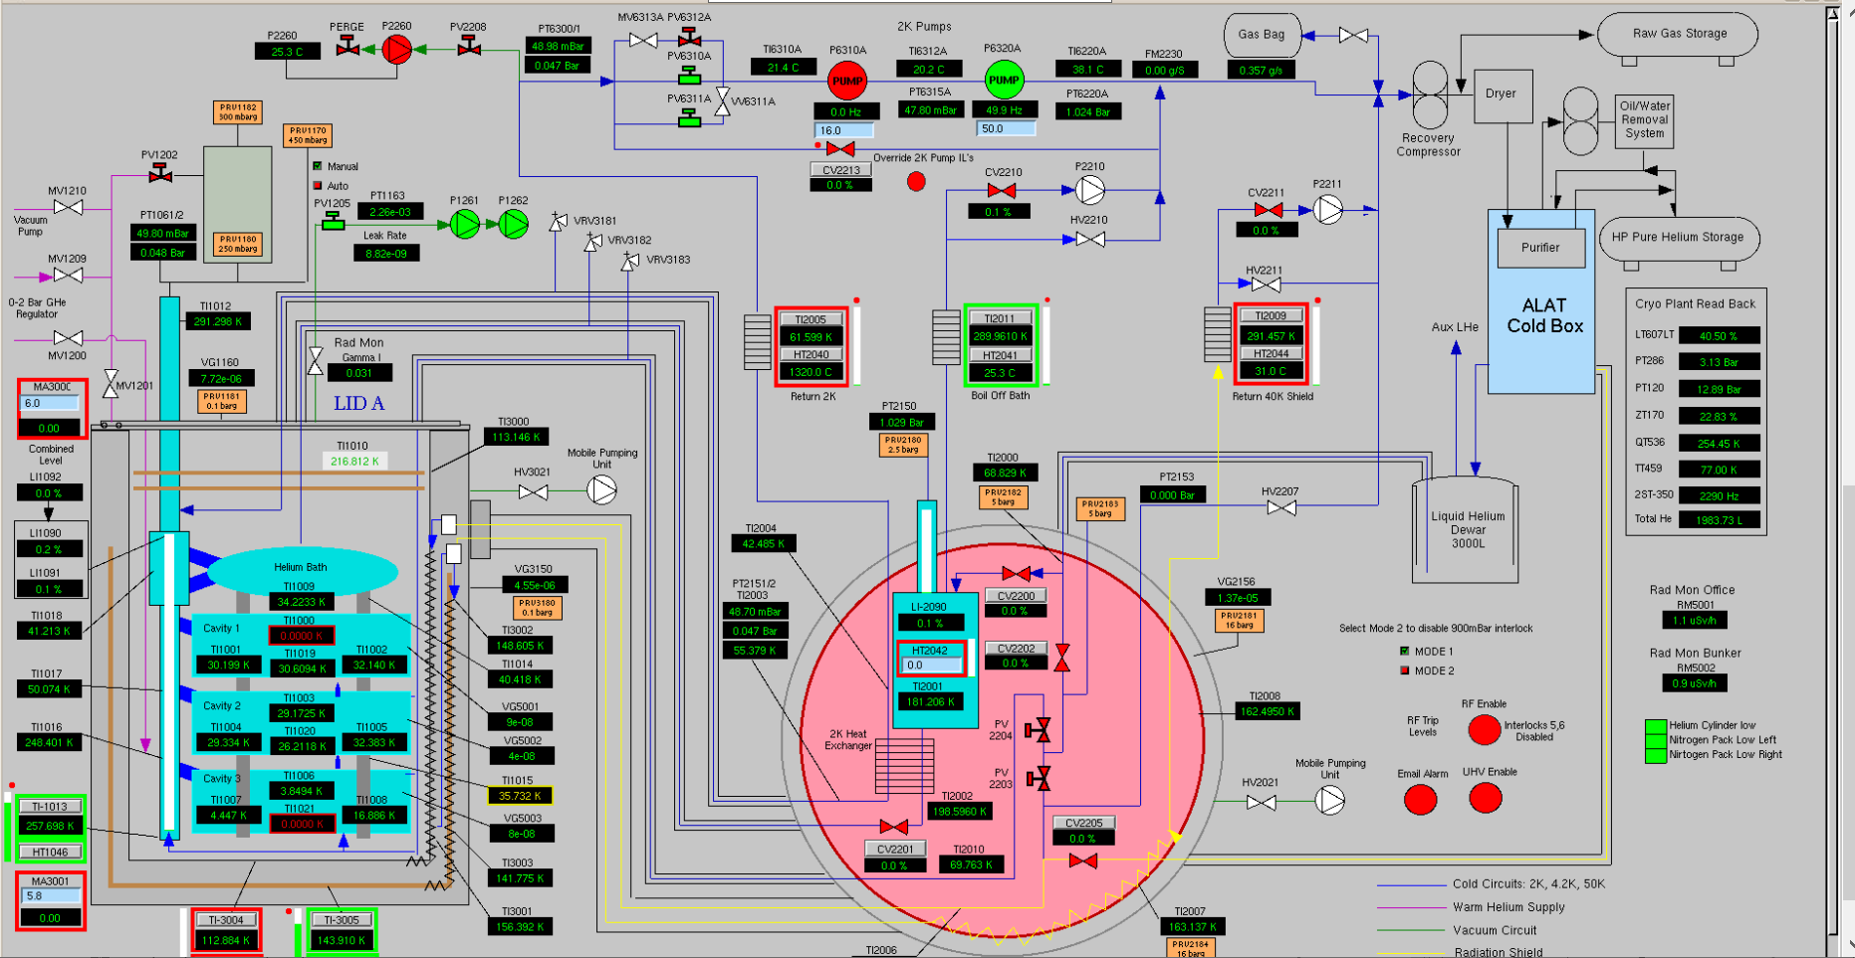
VTF
Controls

Slide 24
Summary
CSI and cryoplant modifications are required to meet PIP-II cavity testing requirements.
Only one PIP-II cavity is to be tested on a CSI per run.
STFC’s current cryoplant configuration can deliver 15 g/s helium mass flow through PIP-II dressed cavities (Well above PIP-II 8 g/s requirement) –> still to be demonstrated in a run.
Additional warm gas storage is required to provide the necessary dirty GHe storage for FCD and subsequent fill with sufficient storage capacity afterward to continue normal RF and cryo operations.

Slide 25
Additional modifications to CSI and VTF

Slide 26
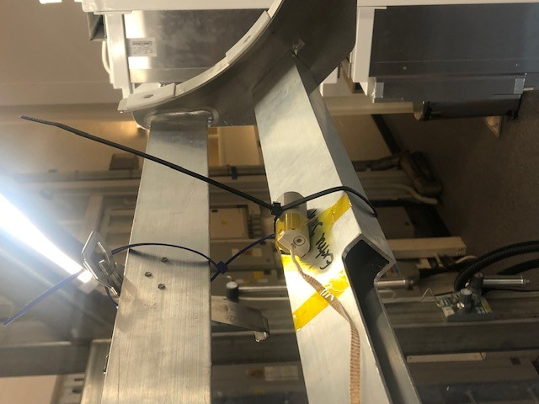
Current state of VTF – ESS Cavity testing
ESS requirement = 1 µT
Figure 11: CryoMag field probe mounted onto middle cradle
Figure 12: Top coil at 6 A measurements
Methodology:
3 x Bartington magnetics CryoMag fluxgates were mounted on all 3 cradle positions on CSI
Measurements were made at room temperature under atmospheric pressure.
The top and bottom Coil currents were increased incrementally by 1 A with the Top coil increasing an amp once the bottom coil had been cycled from 0A – 10 .A
For Normal Operating, Our Coil Configuration -> Top Coil = 6 A and Bottom Coil = 5.8 A :
Top Cradle Position – 0.399 µT < 1 µT
Middle Cradle Position – 0.457 µT < 1 µT
Bottom Cradle Positon – 0.650 µT < 1 µT
Summary:
The VTF operates well within ESS magnetic field requirement of < 1 µT.
Additional magnetic field attenuation maybe required to meet PIP-II magnetic field requirements.

Slide 27
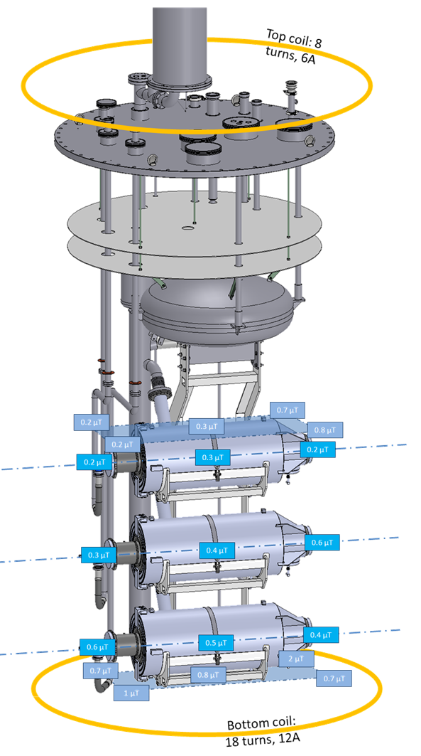
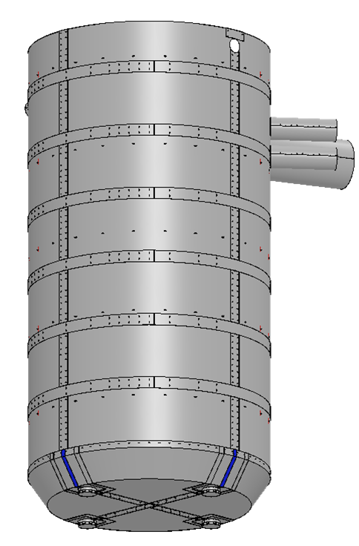
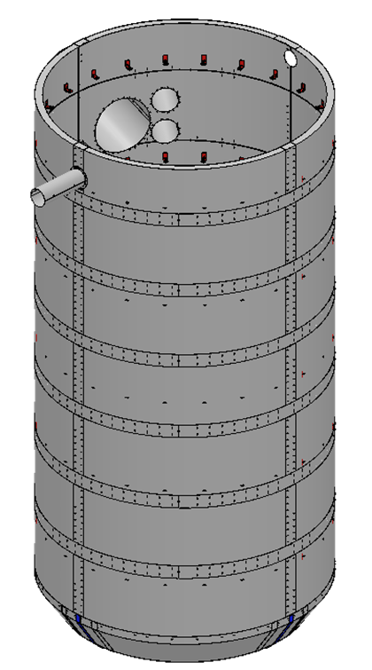
Active and Passive magnetic shield
Figure 13 : top and bottom active magnetic shield coils
Figure 14: Passive Mu-metal shielding

Slide 28
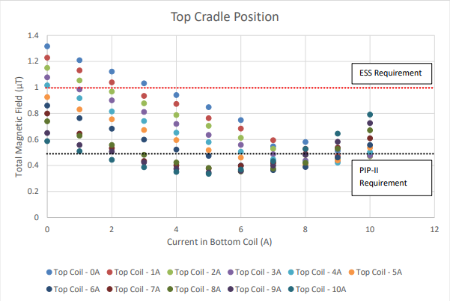
Top Cradle Position
Minimum Measured Field: 0.336 µT @ Top Coil - 10 A , Bottom Coil – 5 A
Figure 15: Magnetic Field Measurements in the Top Cradle Position (with Active and Passive Shielding)

Slide 29
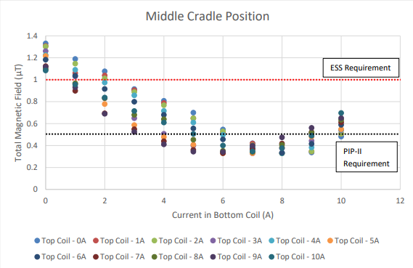
Middle Cradle Position
Minimum Measured Field: 0.328 µT @ Top Coil - 2 A , Bottom Coil – 8 A
Figure 16: Magnetic Field Measurements in the Middle Cradle Position (with Active and Passive Shielding)

Slide 30
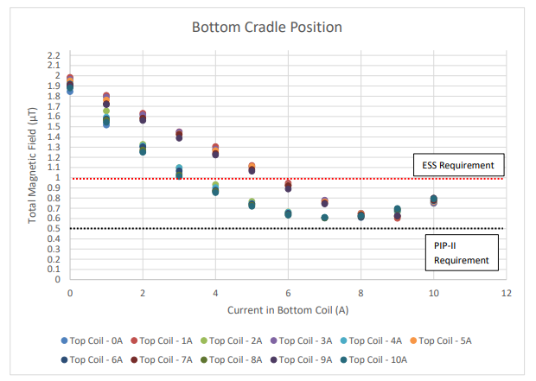
Bottom Cradle Position
Minimum Measured Field: 0.602 µT @ Top Coil - 1 A , Bottom Coil – 9 A
Figure 17: Magnetic Field Measurements in the Bottom Cradle Position (with Active and Passive Shielding)

Slide 31
Summary
The results of the magnetic field measurements show that in the top and middle position – under a number of top and bottom coil configurations – the ambient magnetic field within the VTF is within PIP-II. As the middle position exhibits the lowest ambient field measurements, this cradle position was chosen as the testing cradle of the HB650 cavities.

Slide 32
Thank You

