Slide 1
Main Injector/Recycler Machine Report
Marty Murphy
AD 0900 Scheduling Meeting
Friday, 27 May 2022

Slide 2
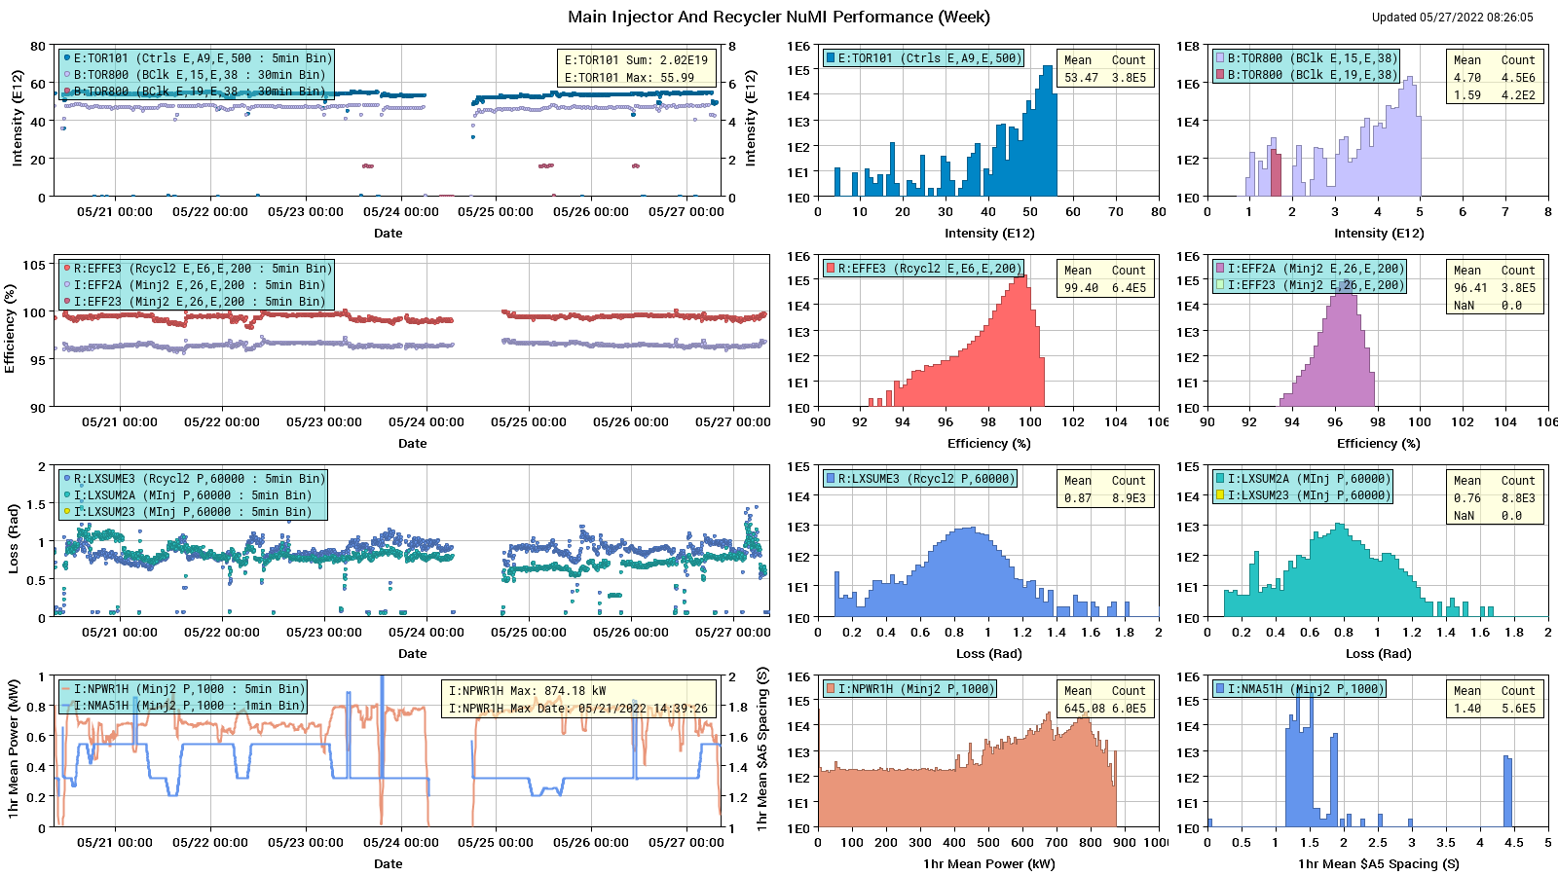
HEP Beam to NuMI

Slide 3
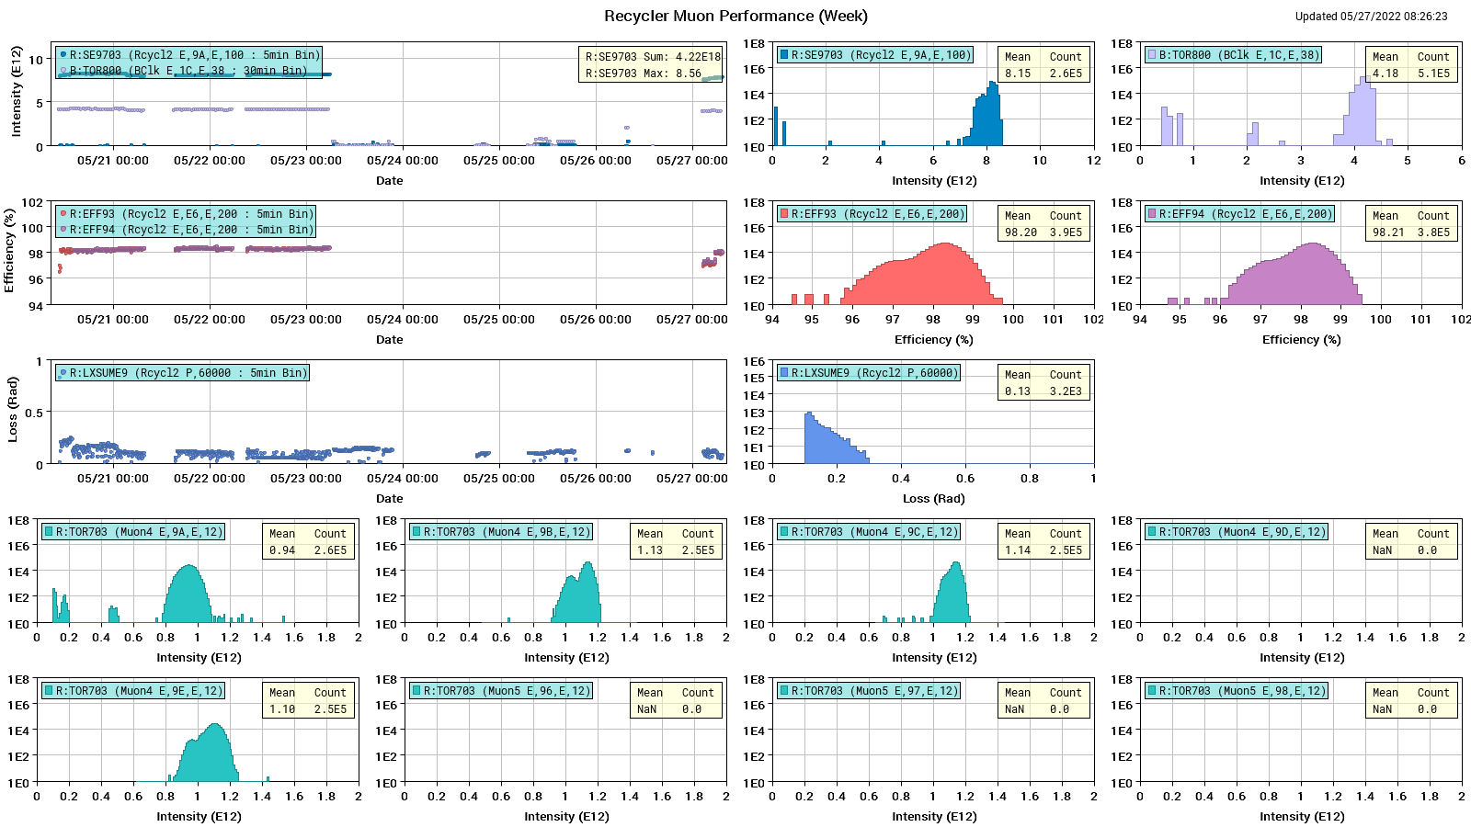
Protons to g-2

Slide 4
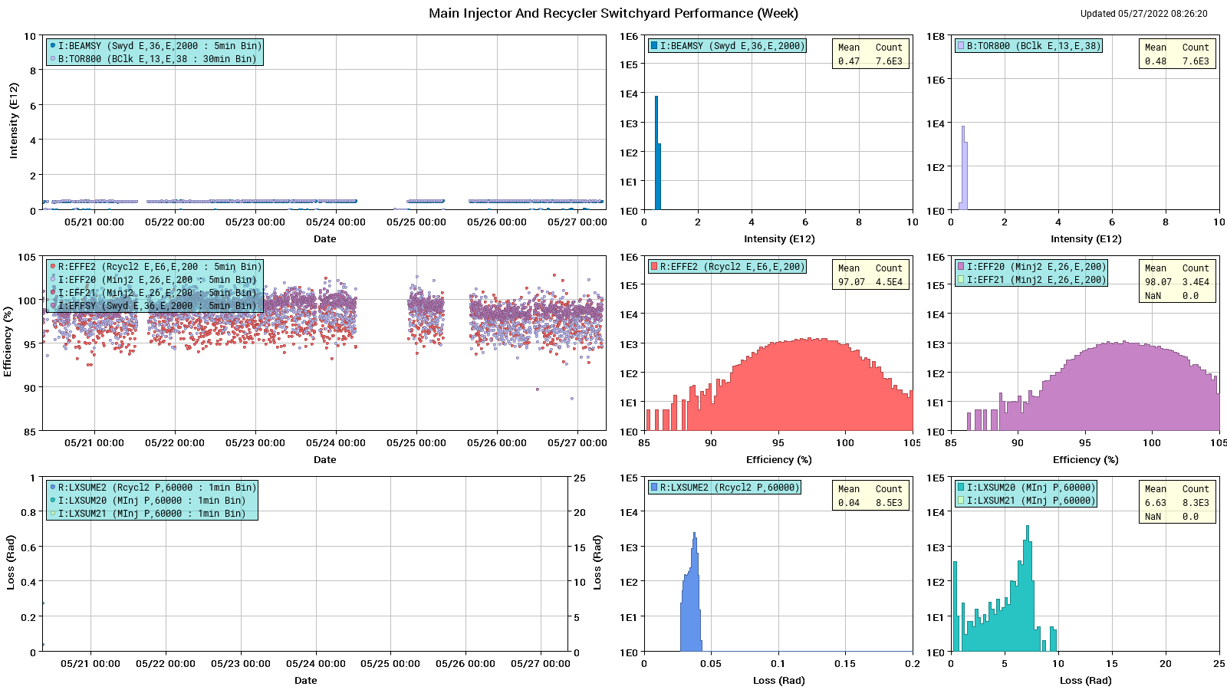
Protons: MI to SY

Slide 5
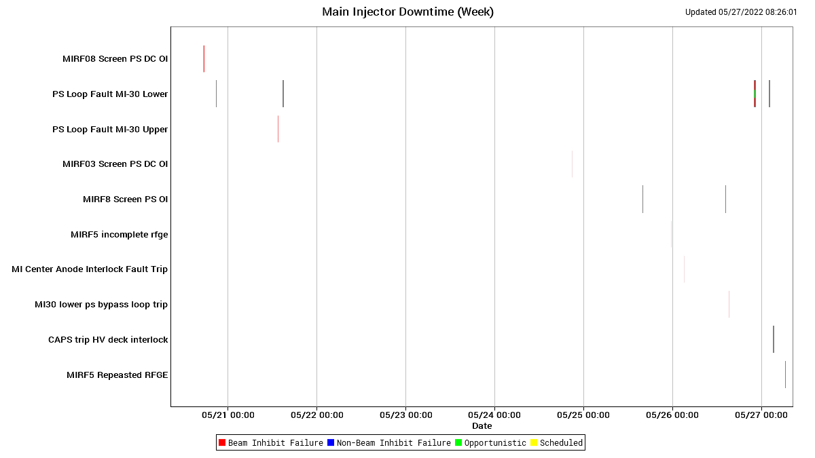
MI Down Time

Slide 6
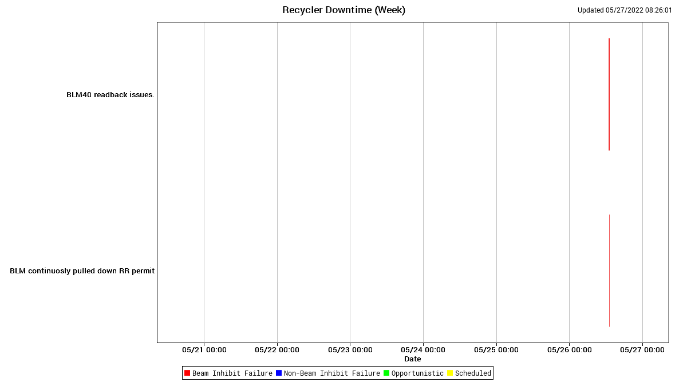
RR Down Time

Slide 7
This Week
A good week of running with a couple significant periods of down time.
  Beam to NuMI, g-2, mu2e studies, & SY as requested.
  Thanks to Proton Source for continued high intensity & Ops for vigilant tuning efforts.
  Access on Tuesday for various jobs:
    RF PA changes,
    leaky magnet inspections,
    worked on MI30 Upper & Lower PS issues. Upper PS fixed. Lower VCB tripped overnight today.
Current Conditions:
  Beam off for Booster work
Ongoing studies:
  RR: $E0/$E1 studies under SY event
  RR: Tune scans measuring affect of MI bend/quad ramps on beam in RR.
Next week:
  Continue same beam studies and longitudinal instability investigation.

