Slide 1
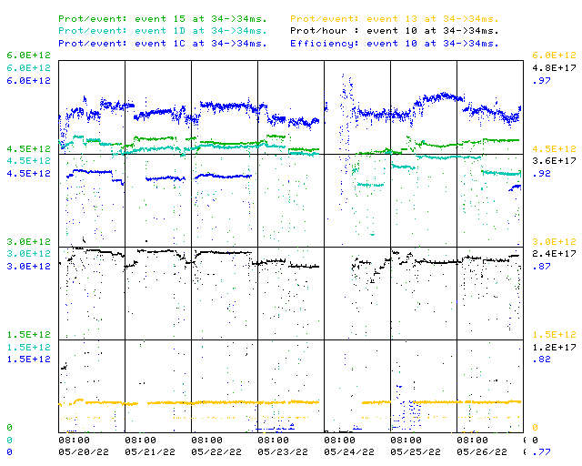
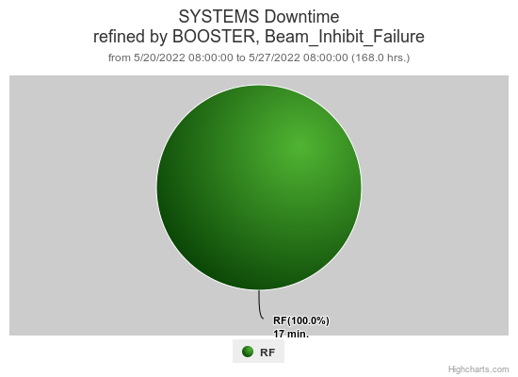
Booster Operations 05/20/22 – 05/27/22
F
F
F
Sa
Su
M
Tu
W
Th
Downtime:
~ 17 minutes beam inhibit for the week
Several Minor RF trips
BRF16 Bias Supply
Also:
Very productive studies day on Tuesday, progress made with new digital LLRF system
Damper Beam Studies Performed
Having times of Debuncher Phase wandering, sometimes affecting beam
Having higher extraction losses on cogged cycles
This morning BRF2 rmodulator change & BRF16 bias supply diagnosis.
Thanks to Ops for diligence & tuning on the off shifts
Requesting 2ea $17’s per supercycle for 2 - 3 hours for studies as needed.
This week:
Booster running ok, down from best running so far this run but still delivering lots of beam
Max protons/hr 2.47E17, total protons delivered 3.58E19
Beam to Numi $15 ~4.7E12 with ~ 54E12 on target
Beam to BNB $1D ~4.5E12 –> about 6.5E16P/Hr
Beam to Muon $1C ~4.0E12+ for ~1E12 POT
Beam to SY $13 @2T

