Slide 1
Lab 6 PMT (R669) Stability Study
By: Brian Leung

Slide 2
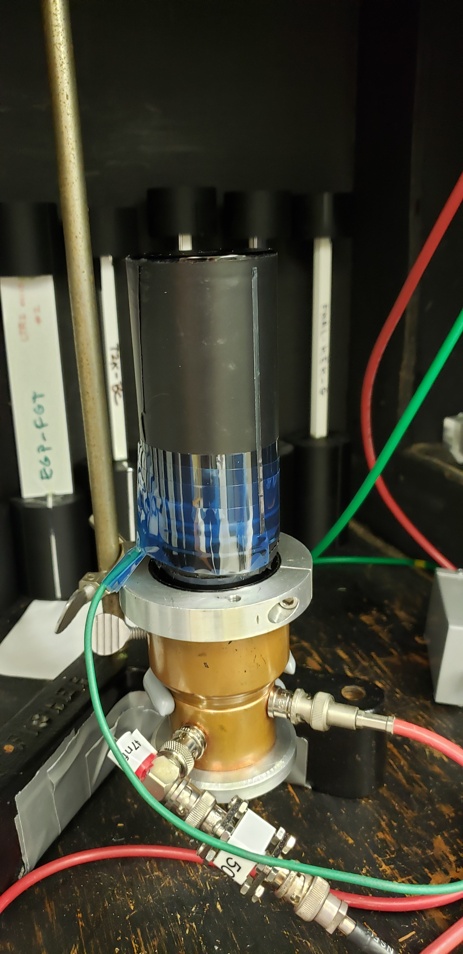
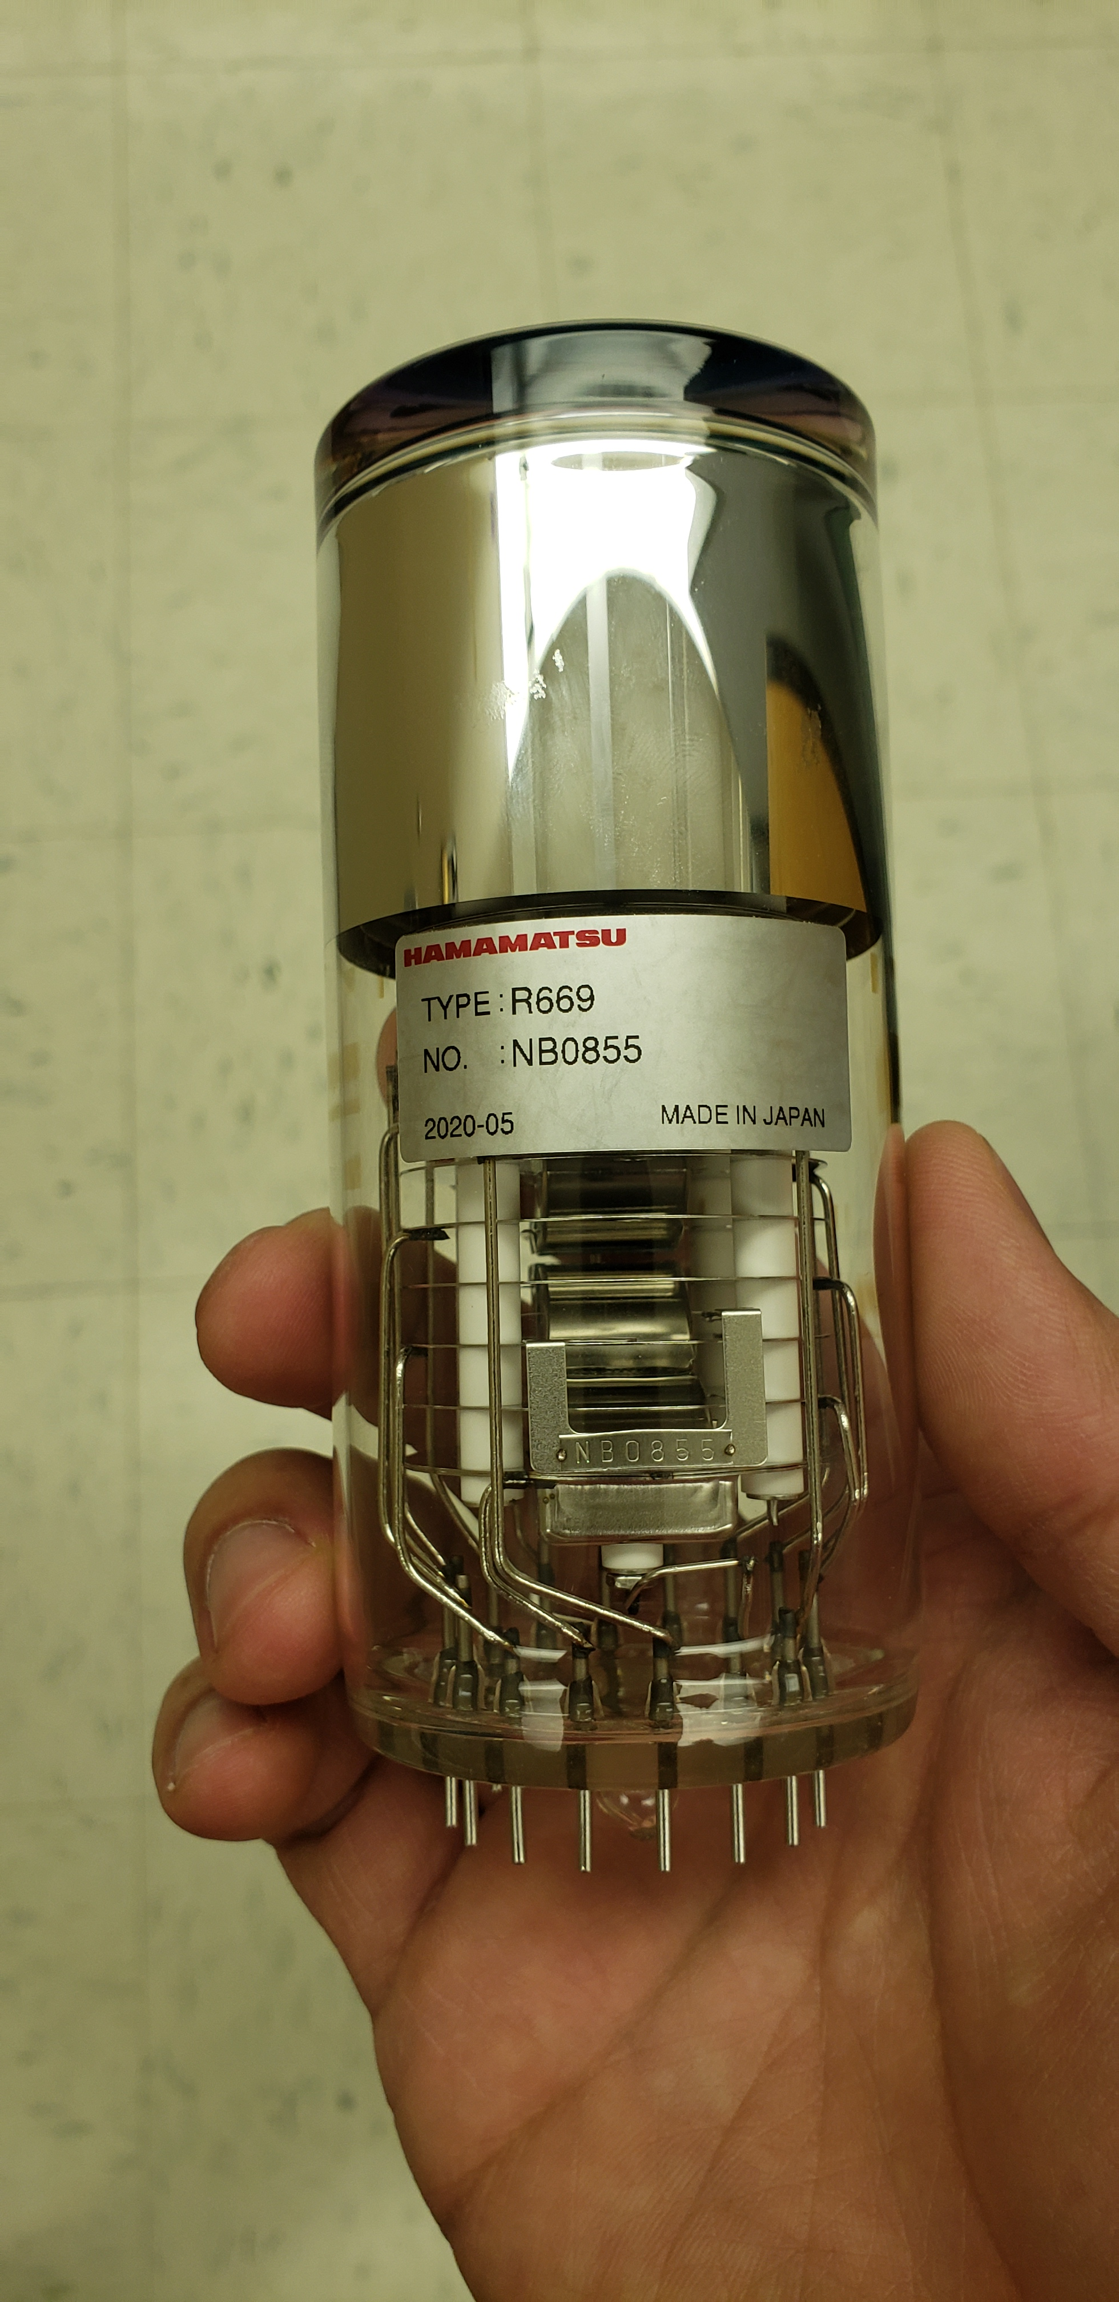
Lab 6 Photomultiplier Tubes
Hamamatsu R669s
Testing stability and reproducibility of measurements
Carlos PMT – Wrapped, Issues with Sensitivity on boundary of PMT surface
Anna PMT – Newer PMT, Sensitivity is LOW, Issues with Gain

Slide 3
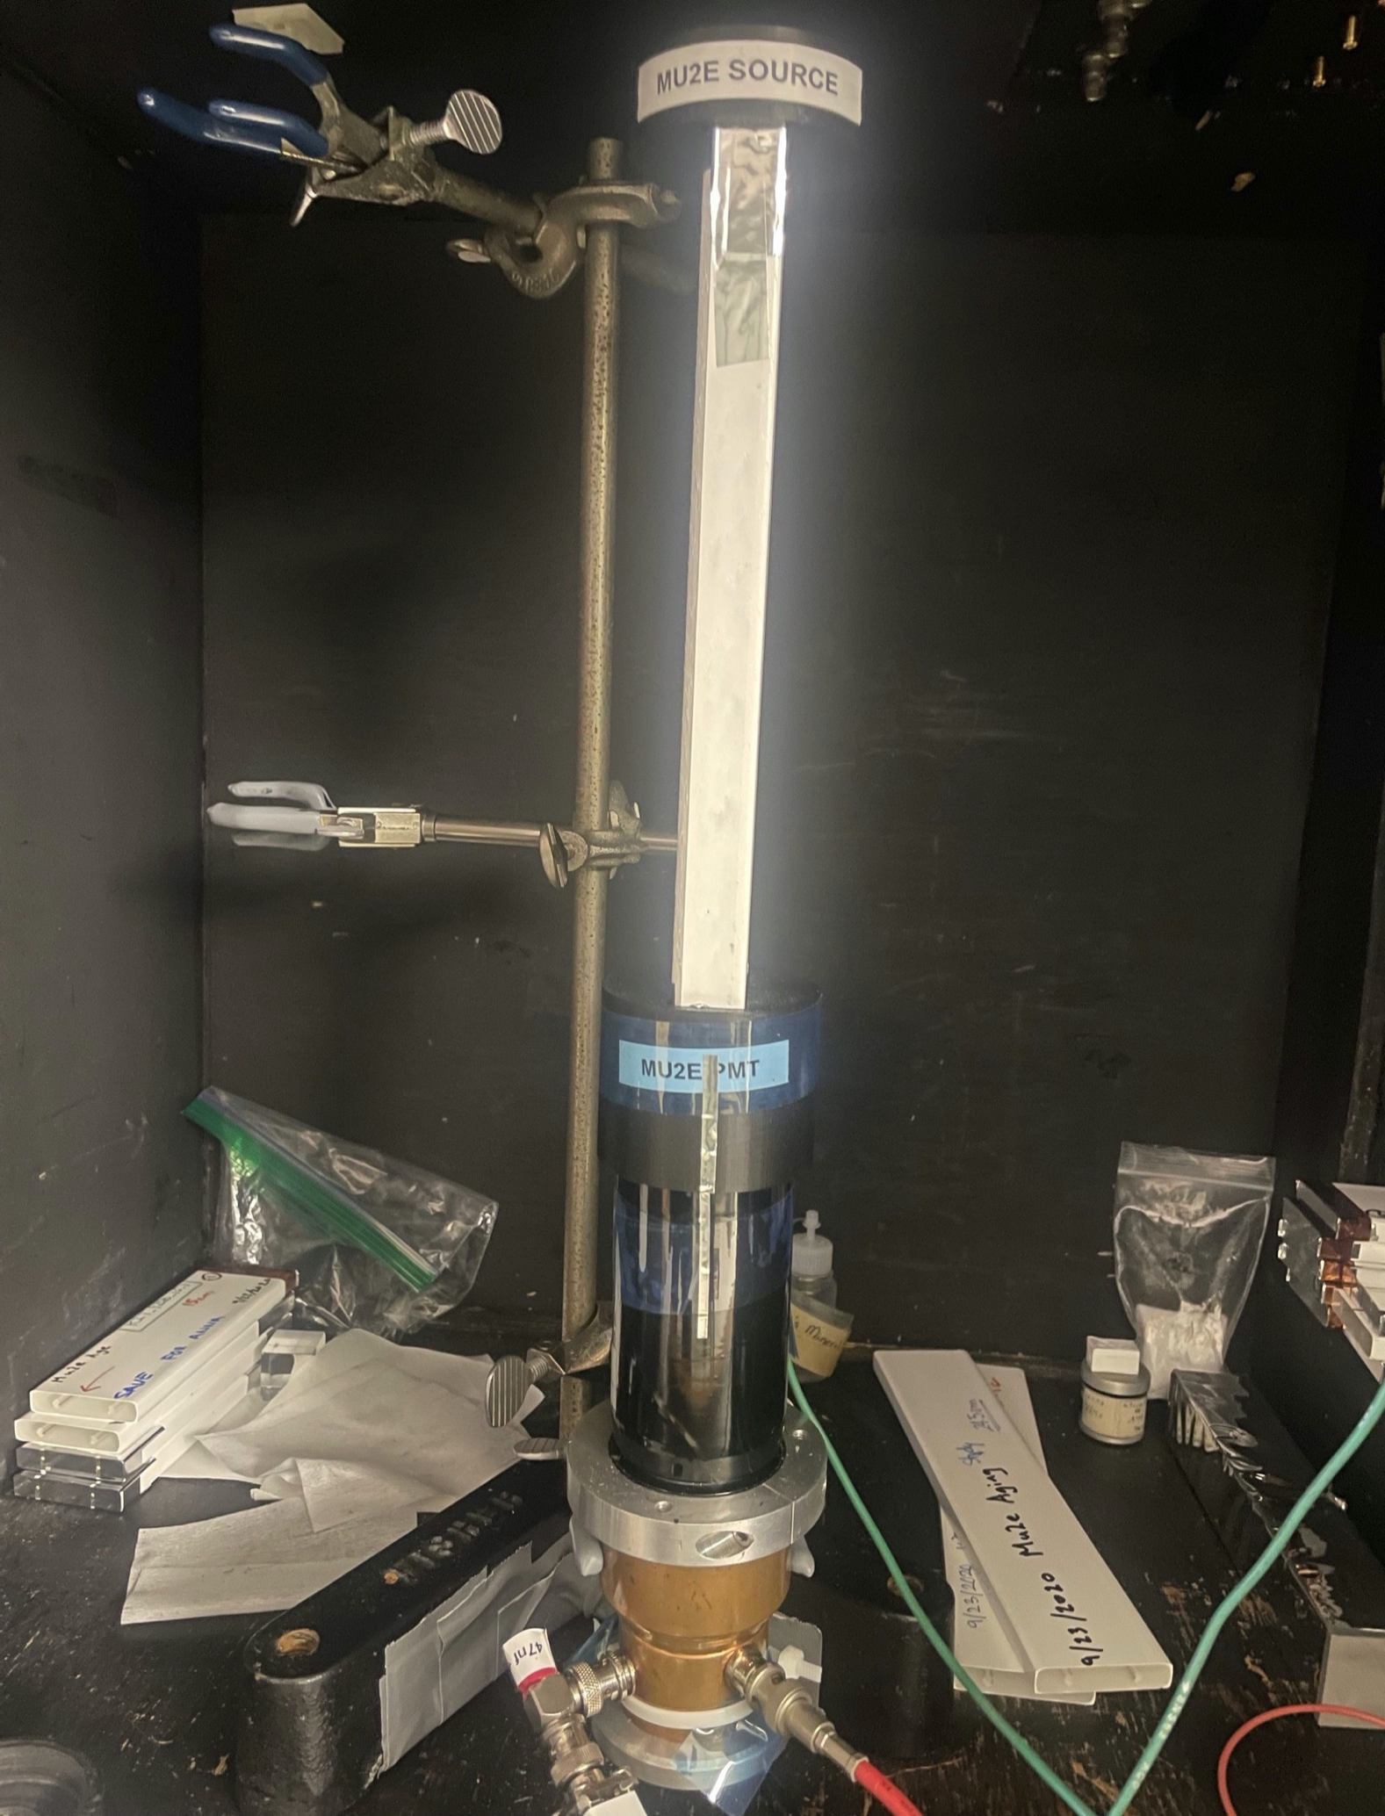
Lab 6 Test Setup
Measurements done in Lab 6 Dark Box following specific procedure (Voltages, Gain Settings, MAESTRO Settings, etc.)
Source = ²⁰⁷Bi
Samples and Source secured using 3D-printed fixtures

Slide 4
Ongoing Results
CARLOS | BLUE | GREEN | Mu2e | No. of Days Since Start |  | BLUE Ref 5/11/22 | 217,239,352
5/11/2022 | 1 | 1 | 1 | 0 |  | GREEN Ref 5/11/22 | 230,570,465
5/12/2022 | 1.001114 | 0.996231 | 0.978739 | 1 |  | Mu2e Ref 5/11/22 | 10,336,977
5/16/2022 | 1.012817 | 1.006617 | 1.01322 | 5 |  | BLUE StdDev | 0.964%
5/17/2022 | 1.01372 | 1.011004 | 1.052723 | 6 |  | GREEN StdDev | 0.683%
5/25/2022 | 0.994287 | 0.991987 | 0.965901 | 14 |  | Mu2e StdDev | 3.102%
5/26/2022 | 0.99297 | 0.999246 | 0.983496 | 15
5/31/2022 | 0.988873 | 0.994009 | 0.965935 | 20
Each Sample measured 3 times
Results are Averages of data
Compared to Reference Measurement from 5/11/22
Anna PMT had issues with Mu2e measurement (signal very low)
ANNA | BLUE | GREEN | Mu2e | No. of Days Since Start |  | BLUE Ref 5/11/22 | 45,390,956
5/11/2022 | 1 | 1 | 1 | 0 |  | GREEN Ref 5/11/22 | 55,658,616
5/12/2022 | 0.986374 | 0.990095 | 1.115432 | 1 |  | Mu2e Ref 5/11/22 | 49,640
5/16/2022 | 0.99746 | 1.001711 | 1.153943 | 5 |  | BLUE StdDev | 1.651%
5/17/2022 | 1.032511 | 1.020114 | 0.989941 | 6 |  | GREEN StdDev | 1.121%
5/25/2022 | 0.98059 | 0.985793 | 1.079177 | 14 |  | Mu2e StdDev | 8.030%
5/26/2022 | 0.999213 | 0.995015 | 1.194643 | 15
5/31/2022 | 0.99578 | 0.992871 | 1.014149 | 20

Slide 8
Lab 6 Polystyrene Polymer Studies (Update)
Blue Light Testing (Optic Sphere)
INEOS and LG Chemicals Pellets look promising
Oven Casting Runs for various PS Pellet Samples
Testing:
AmSty 665, INEOS 1200, INEOS 153F (German), LG Chemicals 25SPI (Korean)
More PS Pellet Samples in the future (Kumho & Hyundai)

Slide 9
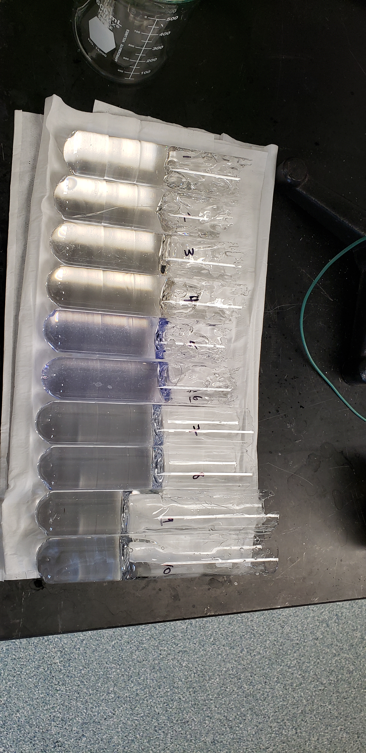
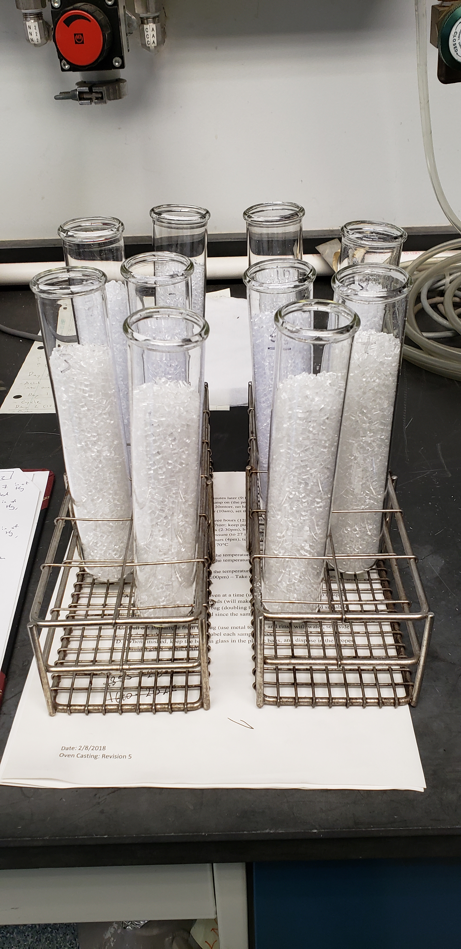
AmSty 665 (2021) | Samples 1/2
AmSty 665 (2022) | Samples 3/4
INEOS 1200 | Samples 5/6
INEOS 153F | Samples 7/8
LG Chemicals 25SPI | Samples 9/10

